Slide 1
PORTABLE
DYNAMOMETRY
NICK ROCHE, SPT

Slide 2
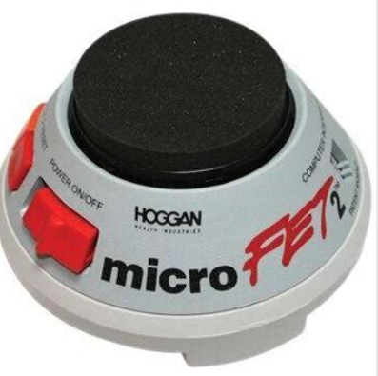
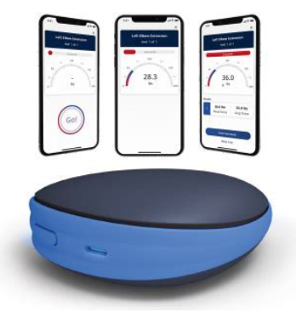
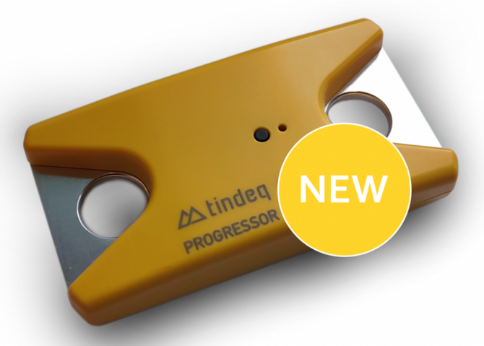



Hand-Held Dynamometers (HHD)
Tension / Traction / Inline Dynamometers

Slide 3
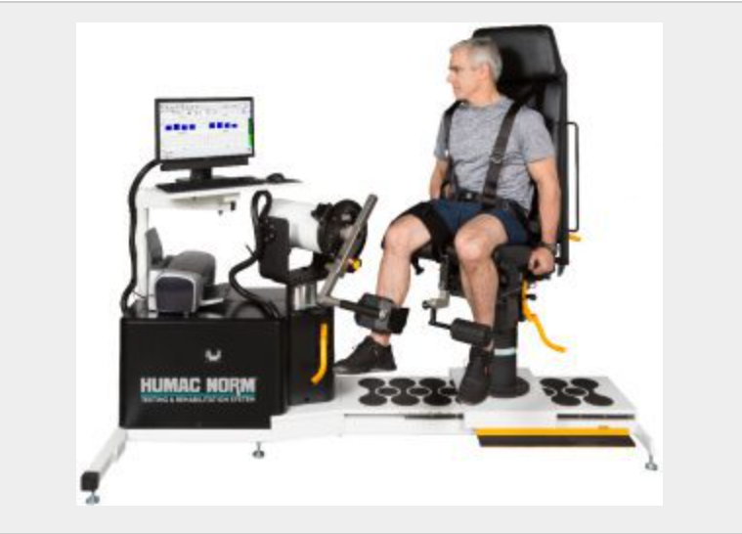

The Gold Standard:
Isokinetic Dynamometry (ID)

Slide 4
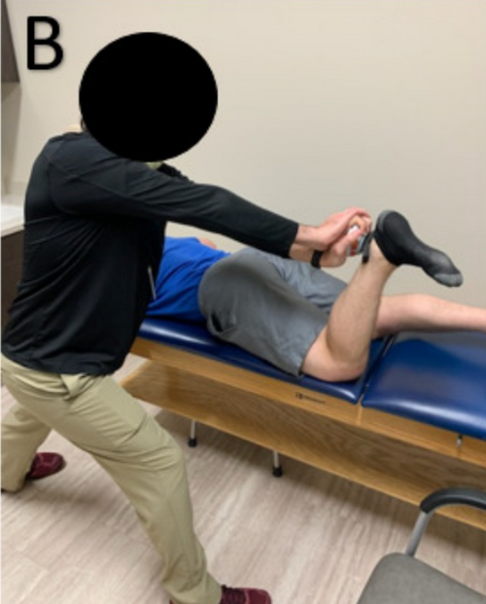
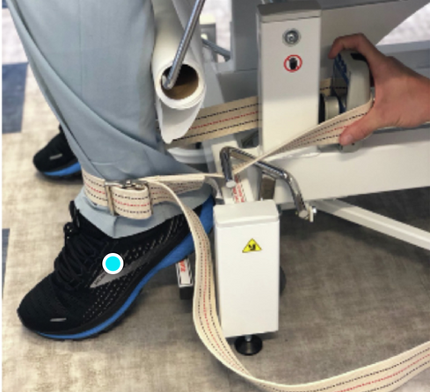
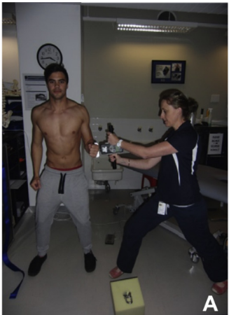
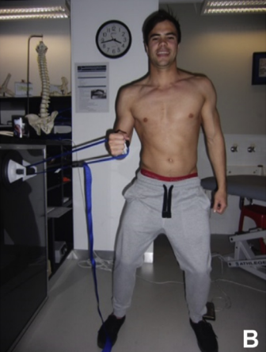
Fixation
Manual
External

Slide 5
Importance?

Slide 6

  Quantifies patient strength
    Helps prescribe and progress an appropriate training program
  Affordable
  Accessible
  Time efficient

Slide 7

  Assess readiness for return to activity/sport
    Limb asymmetry < 5-15%
  Targeted strength training can improve clinical and functional performance
Notes:
In 2021 CPGs for HS strain and stroke, dynamometry has strong evidence for assessing strength in the evaluation
Particularly useful:
Athletic populations
When you’re stumped

Slide 8

Positioning
Reliability
Validity

Slide 9

  Caution
  UE research lacking
  Lack of consensus for patient and practitioner positioning
  Hip data = JOSPT systematic review
  Knee + shoulder data = personal review

Slide 10
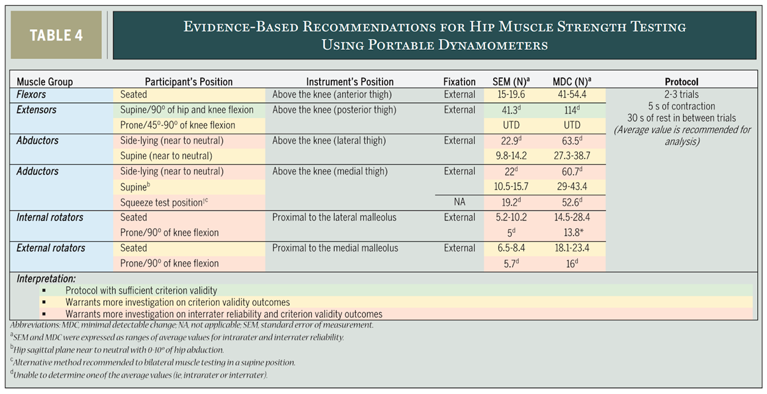
HIP
Notes:
Notes:
2023, 107 studies, 103 reliability, 14 validity. Injury free and pelvic/lower limb MSK disorders (OA, THA, PFPS, TKA, pelvic pain).
Intra- and Inter-rater reliability across positions and fixation methods is sufficient (ICC = 0.78-0.96) with low-high quality evidence = reliable.
Criterion validity less investigated, less consistent (r = 0.40-0.93) with very low to moderate quality evidence = Validity needs more research (HHD not interchangeable with isokinetic dynamometry
Let's not lose the forest for the trees though. Still provides a reliable, objective measure to incorporate into clinical picture.
Fixation: higher quality evidence for external fixation (belt) vs. manual, though sufficient reliability for both. External fixation recommended to combat difficulties with stronger participants and assessor bias.
Positions:
Flexion: seated (higher quality evidence, smaller SEM)
Extension: Supine (best validity, more toqrue) vs. prone (more glute max targeted vs. whole thigh in supine; smaller SEM)
Abduction: Sidelying (best at isolating the motion, but inconsistent validity and low-high quality evidence)
Adduction: Sidelying or supine (both low-high quality reliability evidence, inconsistent validity)
IR/ER: Prone isolate ship rotators best (less adduction compared to seated)
Generally: Use position that most easily isolates the motion (being prone/supine/sidelying often does this by blocking the torso)
Overall:
Intra-rater reliability for HHD is well established. More research needed on criterion validity in standardized positions (HHD not synonymous with isokinetic dynamometry at this time) --> As long as same person measuring, can reliably give you an objective number to guide treatment, especially useful if utilizing established SEM and MDC values.

Slide 11
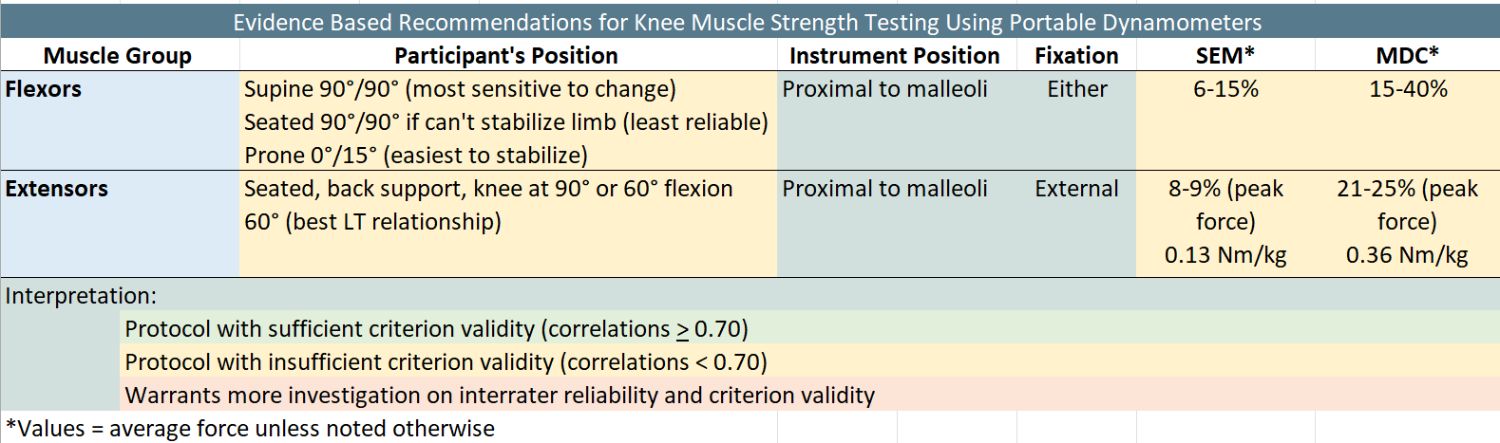
KNEE
Notes:
Knee Additional Info:
External fixation + stabilization of trunk, pelvis, and thigh = highest validity
Combined knee extension strength threshold necessary for patient to rise from a chair without hands = 40% BW

Slide 12
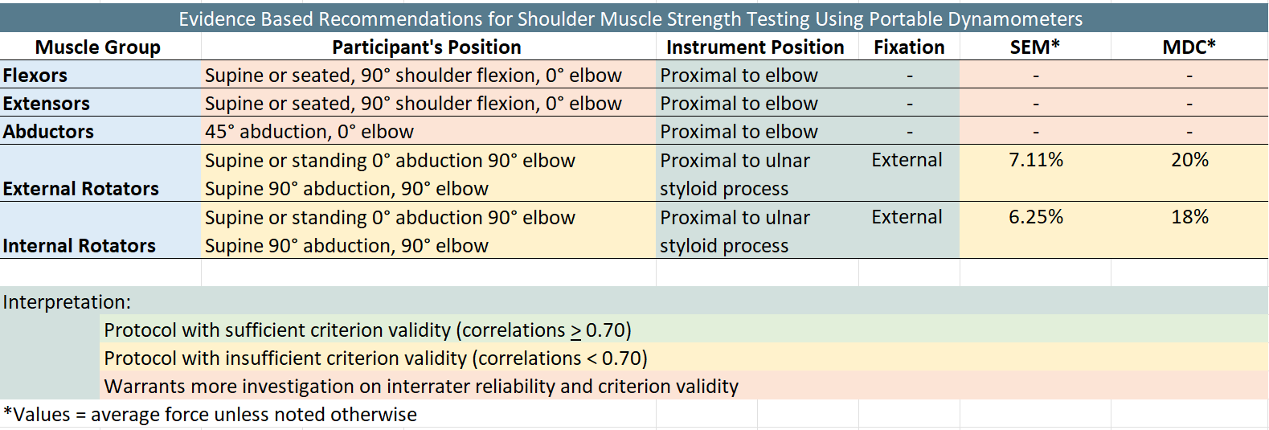
SHOULDER
Notes:
Shoulder Additional info:
No statistically significant difference b/w supine and seated testing
Minimal data on shoulder flexion, extension, and abduction
External fixation doesn’t significantly affect reliability. Easy to combat smaller forces produced at UE’s compared to LE’s. May be more convenient to do HHD with manual stabilization in UE**
IR/ER positioning
Best reliability in standing
Best isolation of motion in supine
Poor quality studies
Small sample sizes, 20-30 people
90° shoulder abduction = less activation of
Coracobrachialis
Biceps
Brachialis
Pec major
Subscapularis

Slide 13
  Normative Values

Slide 14
“1000 Norms Project”
Who
  1,000 healthy participants aged 3-101 years
Testing Set Up
  Fixed dynamometry for knee extension, HHD for all other muscle groups.

Slide 15
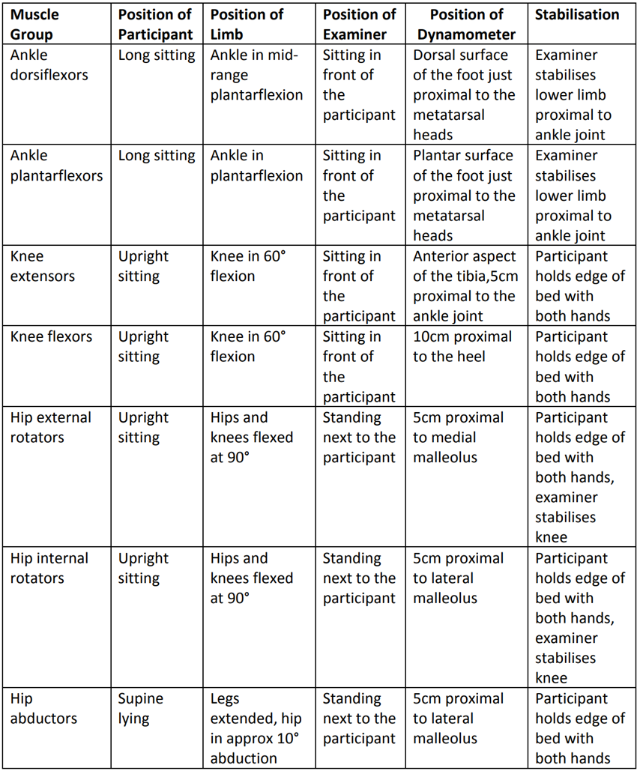
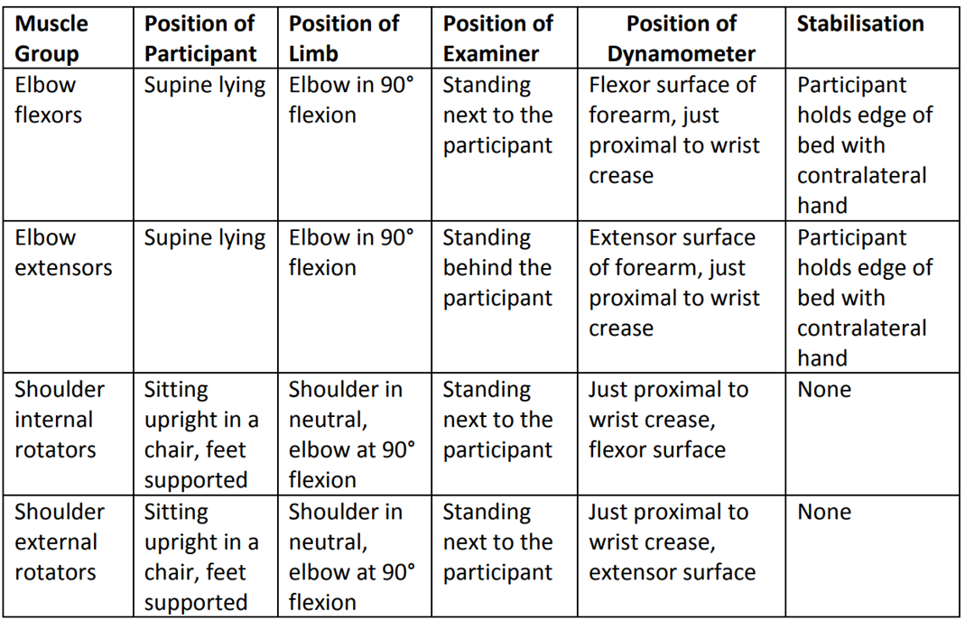
1000 Norms Project Testing Positions

Slide 16
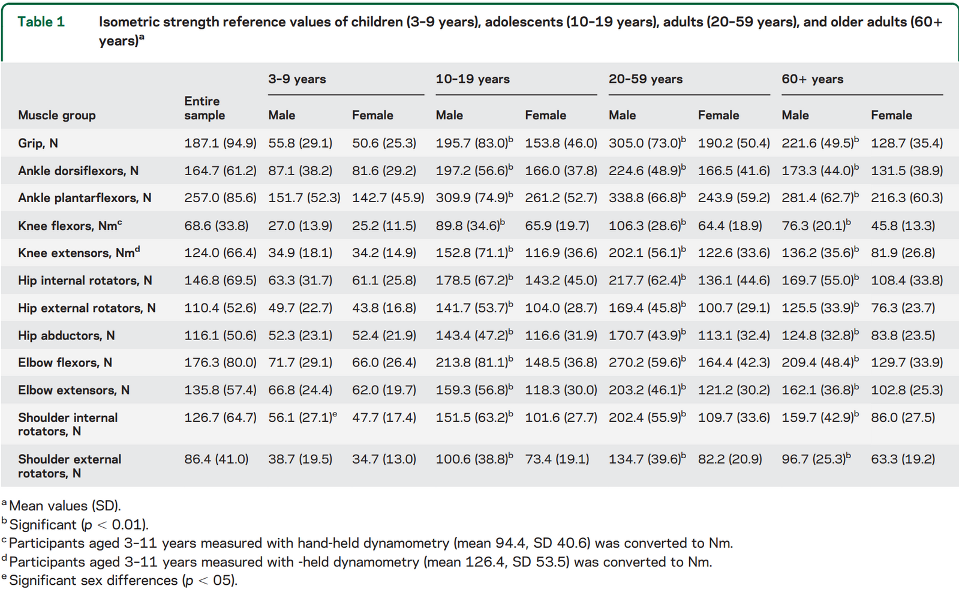
Notes:
1 N = .22 lb. force
Test positions would need to be the same as in the study/previous slide!

Slide 17
Who
  125 ACLR patients, 18 yr mean age
Definitions
  Q-RPKT: quadriceps avg. peak torque normalized to body mass
  Q-LSI: quadriceps limb symmetry index
  BPTB: bone patellar tendon bone graft
  HT: hamstring tendon graft
  QT: quadriceps tendon graft
Info Nuggets
  Only ~65% of ACLR athletes return to pre-injury level of sport participation
  HT graft = better
    Q-LSI at 3, 6, and 9 months
ACLR Study
Notes:
Testing set up
Similar to what we show later in PP

Slide 18
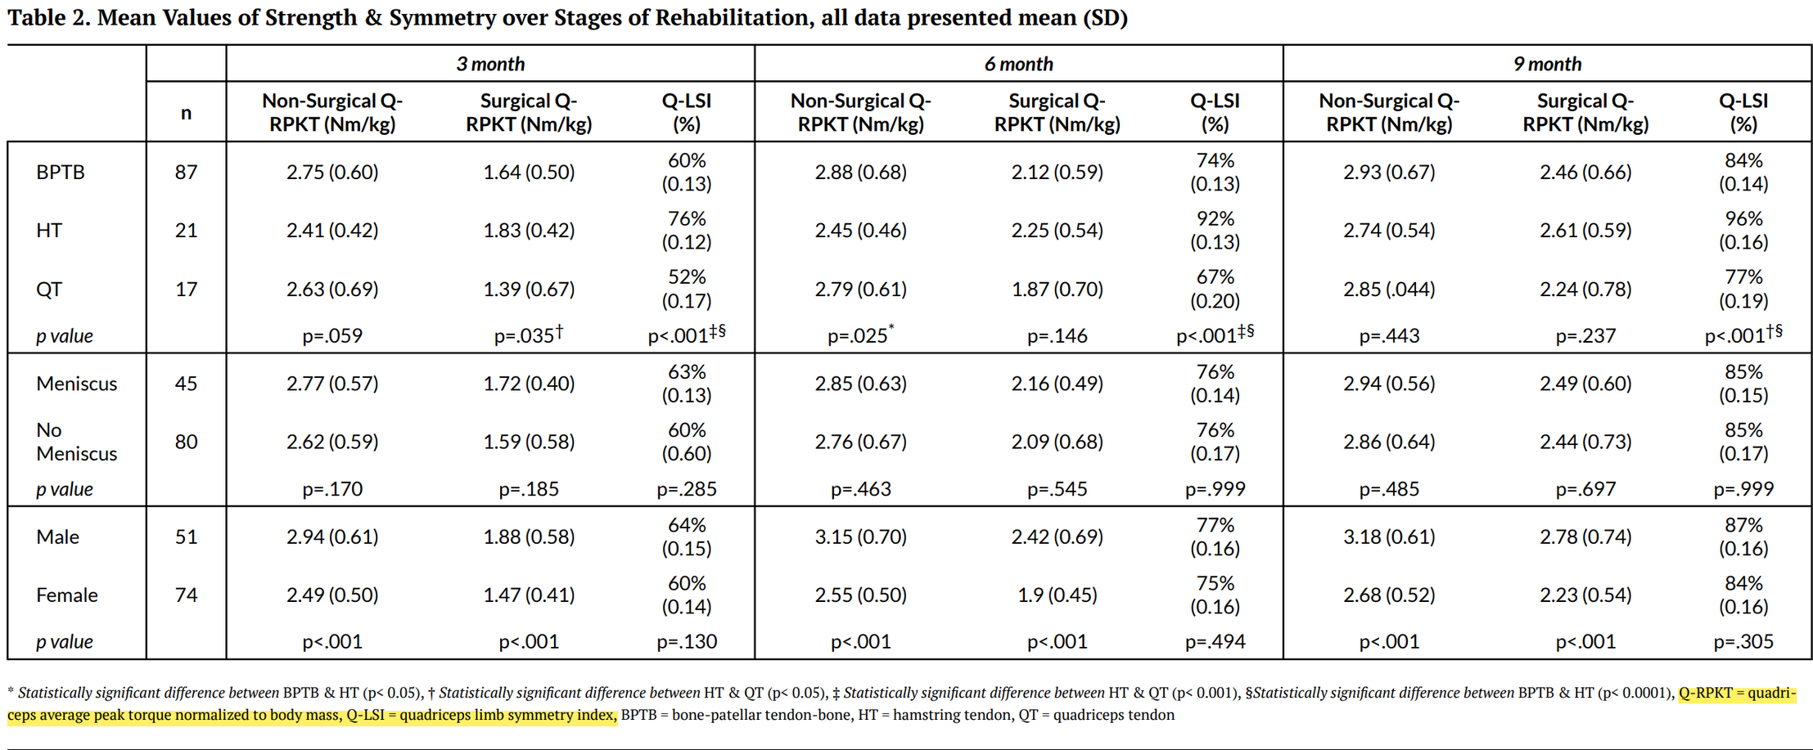
Notes:
Q-LSI significantly greater in HT compared to BPTB and QT graft at all three points in time. Q-RPKT for QT was significantly lower than HT at 3 months post-op. At all time points, males show greater Q-RPKT than females, but sex didn’t significantly impact Q-LSI. Receiving a concomitant meniscal procedure at the time of ACLR did not statistically impact Q-RPKT or Q-LSI (concise – quad may be stronger with HT grafts compared to BPTB and QT grafts in ACLR patients)
Good resource if you have an ACLR patient. Ideal peak torque normalized to body mass is 2.99, very difficult to achieve though.

Slide 19
No Normative Data?
Limb Symmetry Index (LSI)
  Involved limb strength / uninvolved
Goal?
  Deficit between limbs < 5-15% according to most research
    Less risk of injury
Notes:
Won’t want to use normalized data anyway if not doing exact testing set up as these studies

Slide 20

  Research Takeaways

Slide 21
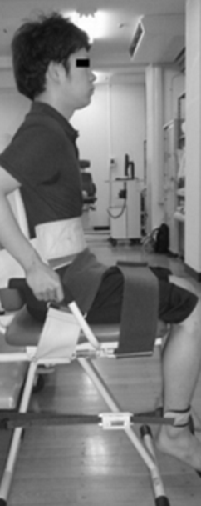
  UE dynamometry research = Lacking
  ↑ Reliability by:
    Stabilize surrounding joints
      Prone/supine/sidelying
  Besides knee extension, there is no best set up --> be consistent
  Ankle PF strength with HHD = poorest validity --> calf raises

Slide 22

  Reliability
    HHD
      Intra-rater → Well established
      Inter-rater → Not as good
    Does experience affect reliability?
      Not for traction dynamometry
  External fixation use associated with higher quality evidence
  Multiple papers suggest calibrating dynamometer monthly with weights
  Research most lacking where?
    Criterion validity in standardized positions
Notes:
No standardized testing positions. Pick a set up, stabilize as much as possible, traction dynamometry, belt/external stabilization, be consistent with set up

Slide 23
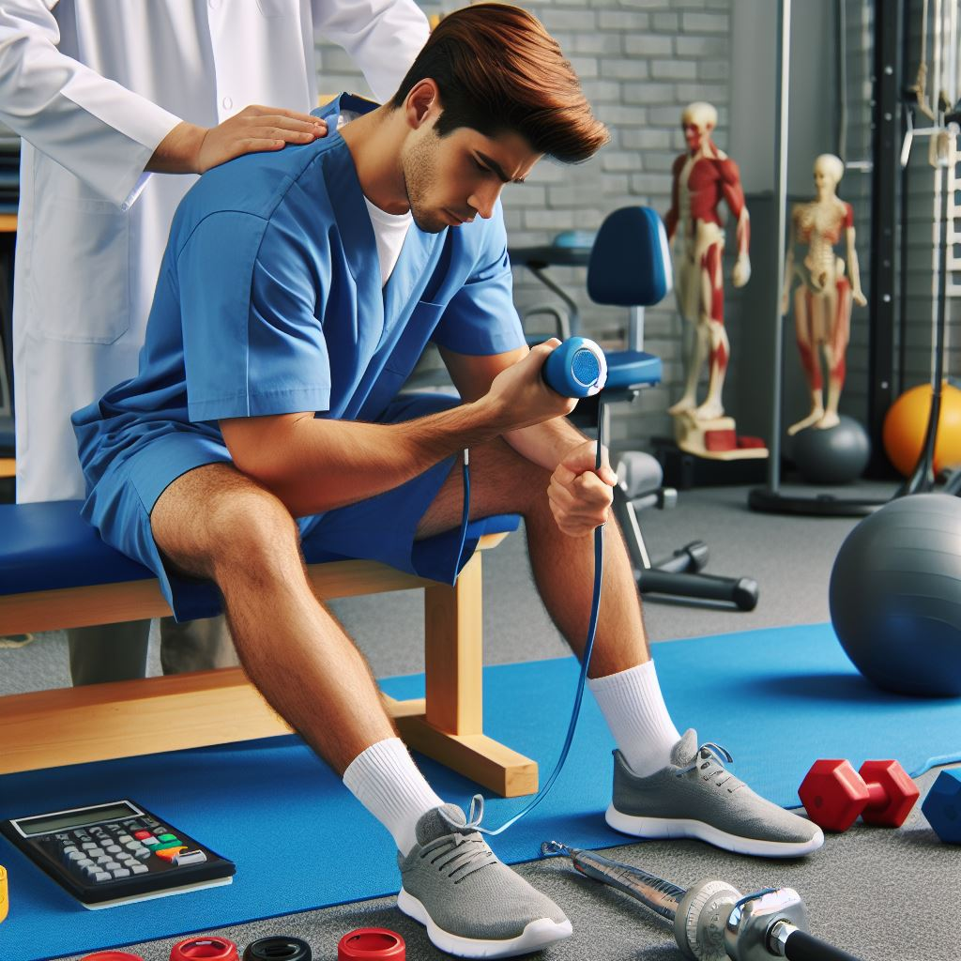
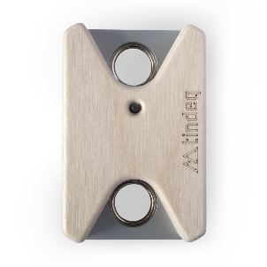
What does all this mean?
  Clinical Applications

Slide 24
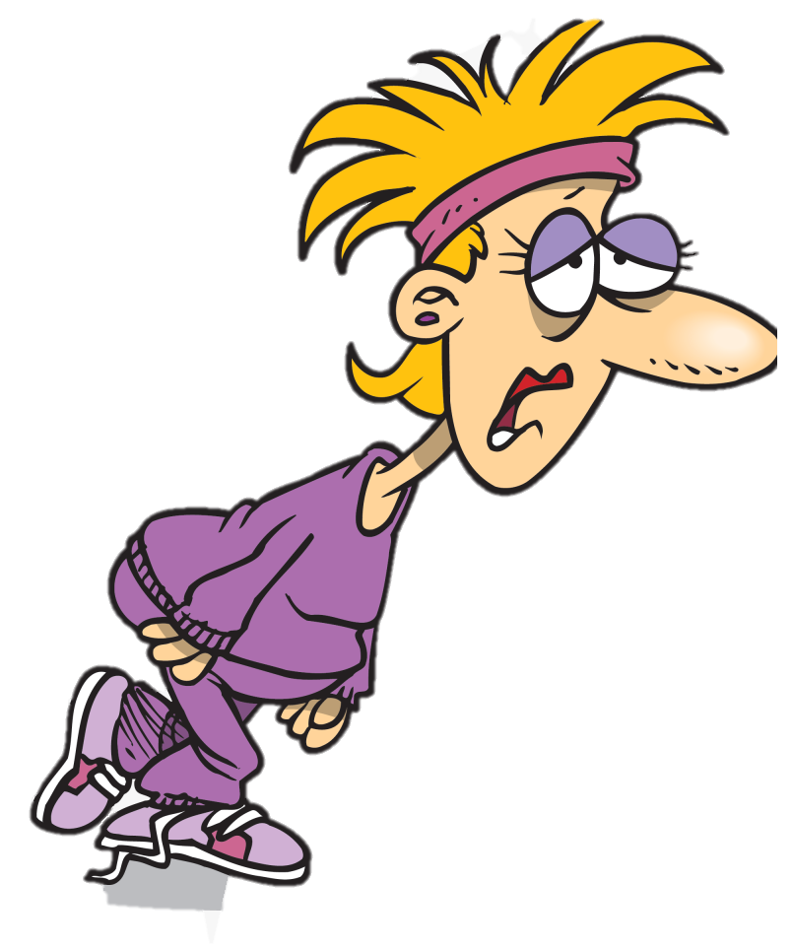
  Manual vs External Fixation
Patient strength > PT
Can’t nullify patient movement
Use external fixation

Slide 25
  External fixation + traction dynamometry
  Most practical when?
    Large muscle groups, LE → Quadriceps
    UE?
      HHD often just as good, need more research
  Best Reliability and Validity

Slide 26

Verbal Standardization
Have consistent phrasing
  “on go, slowly ramp up to max force over 5 seconds”
Constant encouragement
  “Push push push push push push!!!!”
Notes:
-Other instructions to consider
-Most research: 5 second max effort test
-Patient holding plinth or not? Be consistent
-if cuing “hard and fast as possible,” take up slack first

Slide 27
  Patient/Practitioner Positioning
Pick a set up, be consistent
1
Stabilize other joints as possible
2
Ensure device is perpendicular to landmark
3
Notes:
Fixation belt perpendicular to limb
Fixation belt lined up with line of force being tested

Slide 28
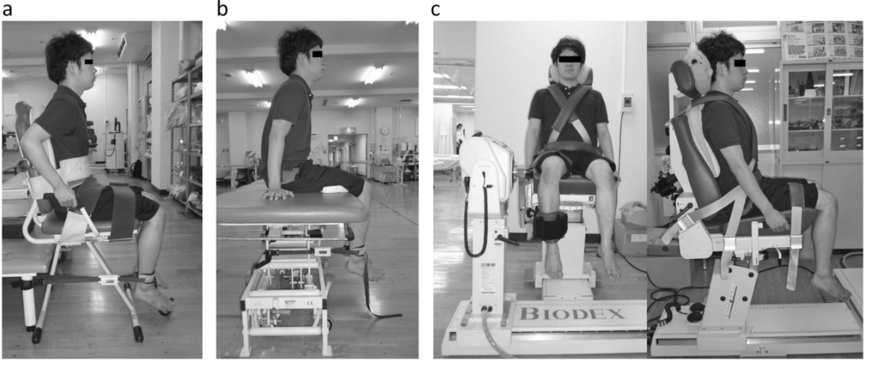
Testing Set Up
Notes:
Keys Reminder
Ensure belt is perpendicular to limb attachment
Standardized verbal cuing and test re-test set up

Slide 29
The Knee

Slide 30
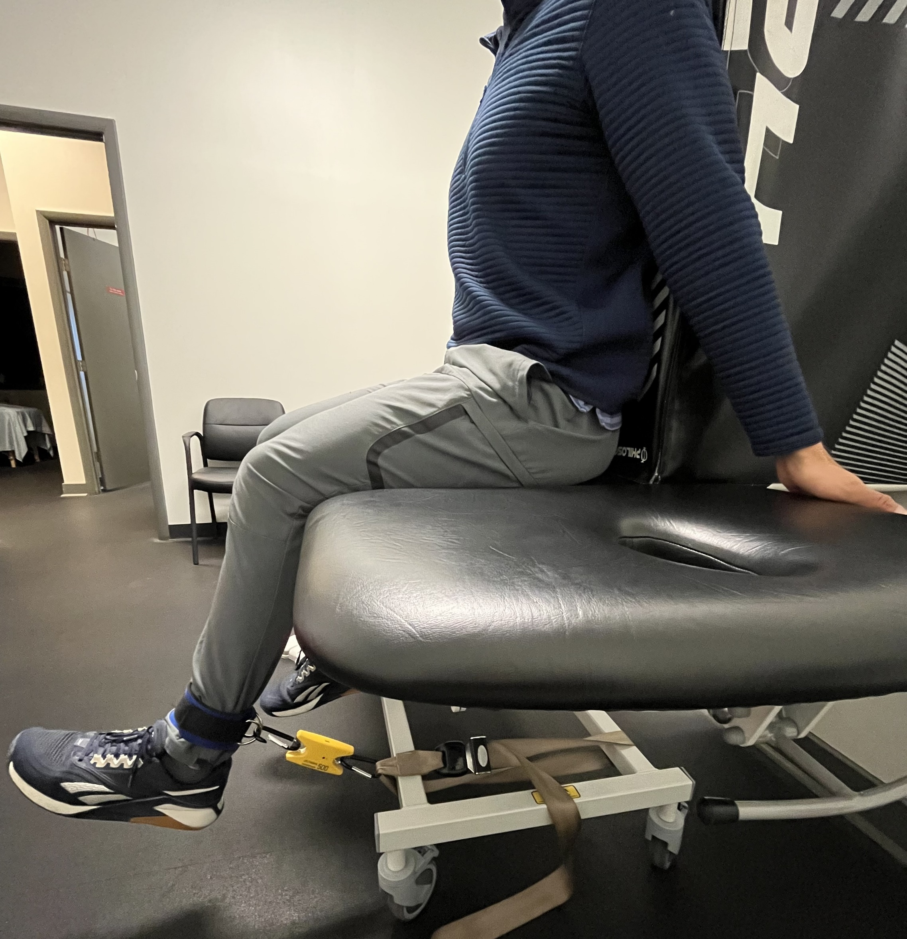
Extension
Notes:
Optimal LT: 60 deg knee flexion
Evidence:
seated with back support
knee at 60 deg with band taught
stabilize as much as possible (hold onto table, strap around waist ideally)
From experience
Greatest stabilization with alternating hand grasp (front and back of table)
Specific Paper:
Back rest
1.5-2 inch pad under thigh
Strap above medial malleolus
Device anchored to plinth
At angle of 100° to the shin
Knee angle under tension = 70°
Measure moment arm
Lateral epicondyle to middle strap
Passively take up slack in strap
Patient grips table
Test

Slide 31
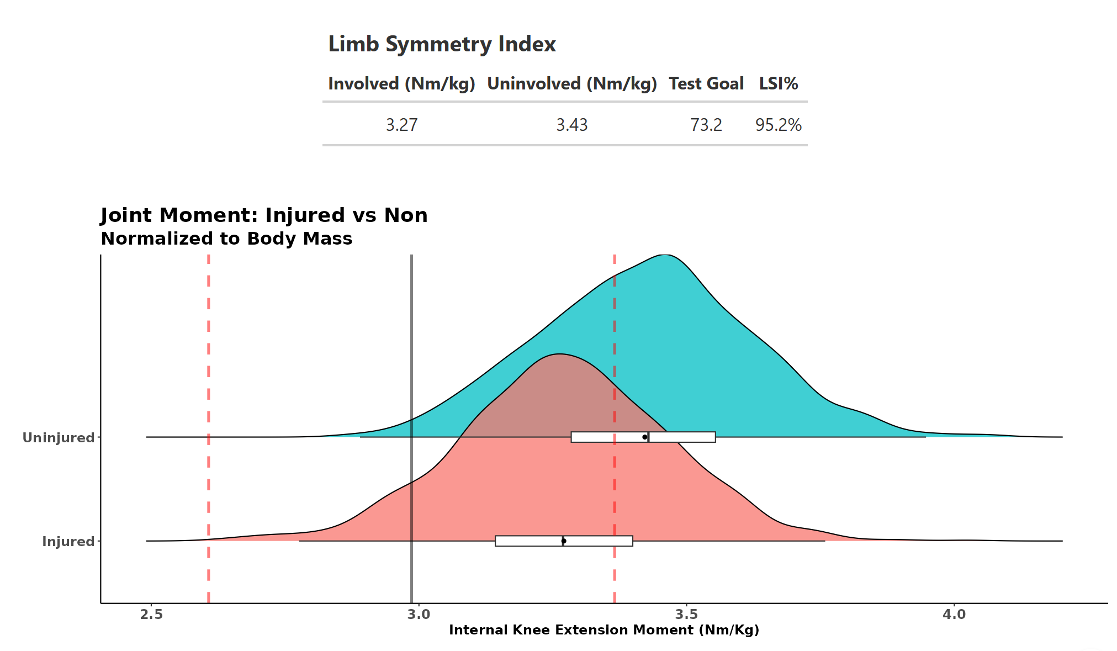
  Knee Extension Torque Calculator
  Required Data (keep units consistent)
    Force (lb. or kg)
    Moment arm (m)
    Body weight (lb. or kg)
  Gold standard
    2.99 Nm/kg
  Knee Ext Torque Normalized to BW
Notes:
2.99 = gold standard knee ext torque normalized to BW value that some research indicates is ideal to see to minimize injury risk for return to sport

Slide 32
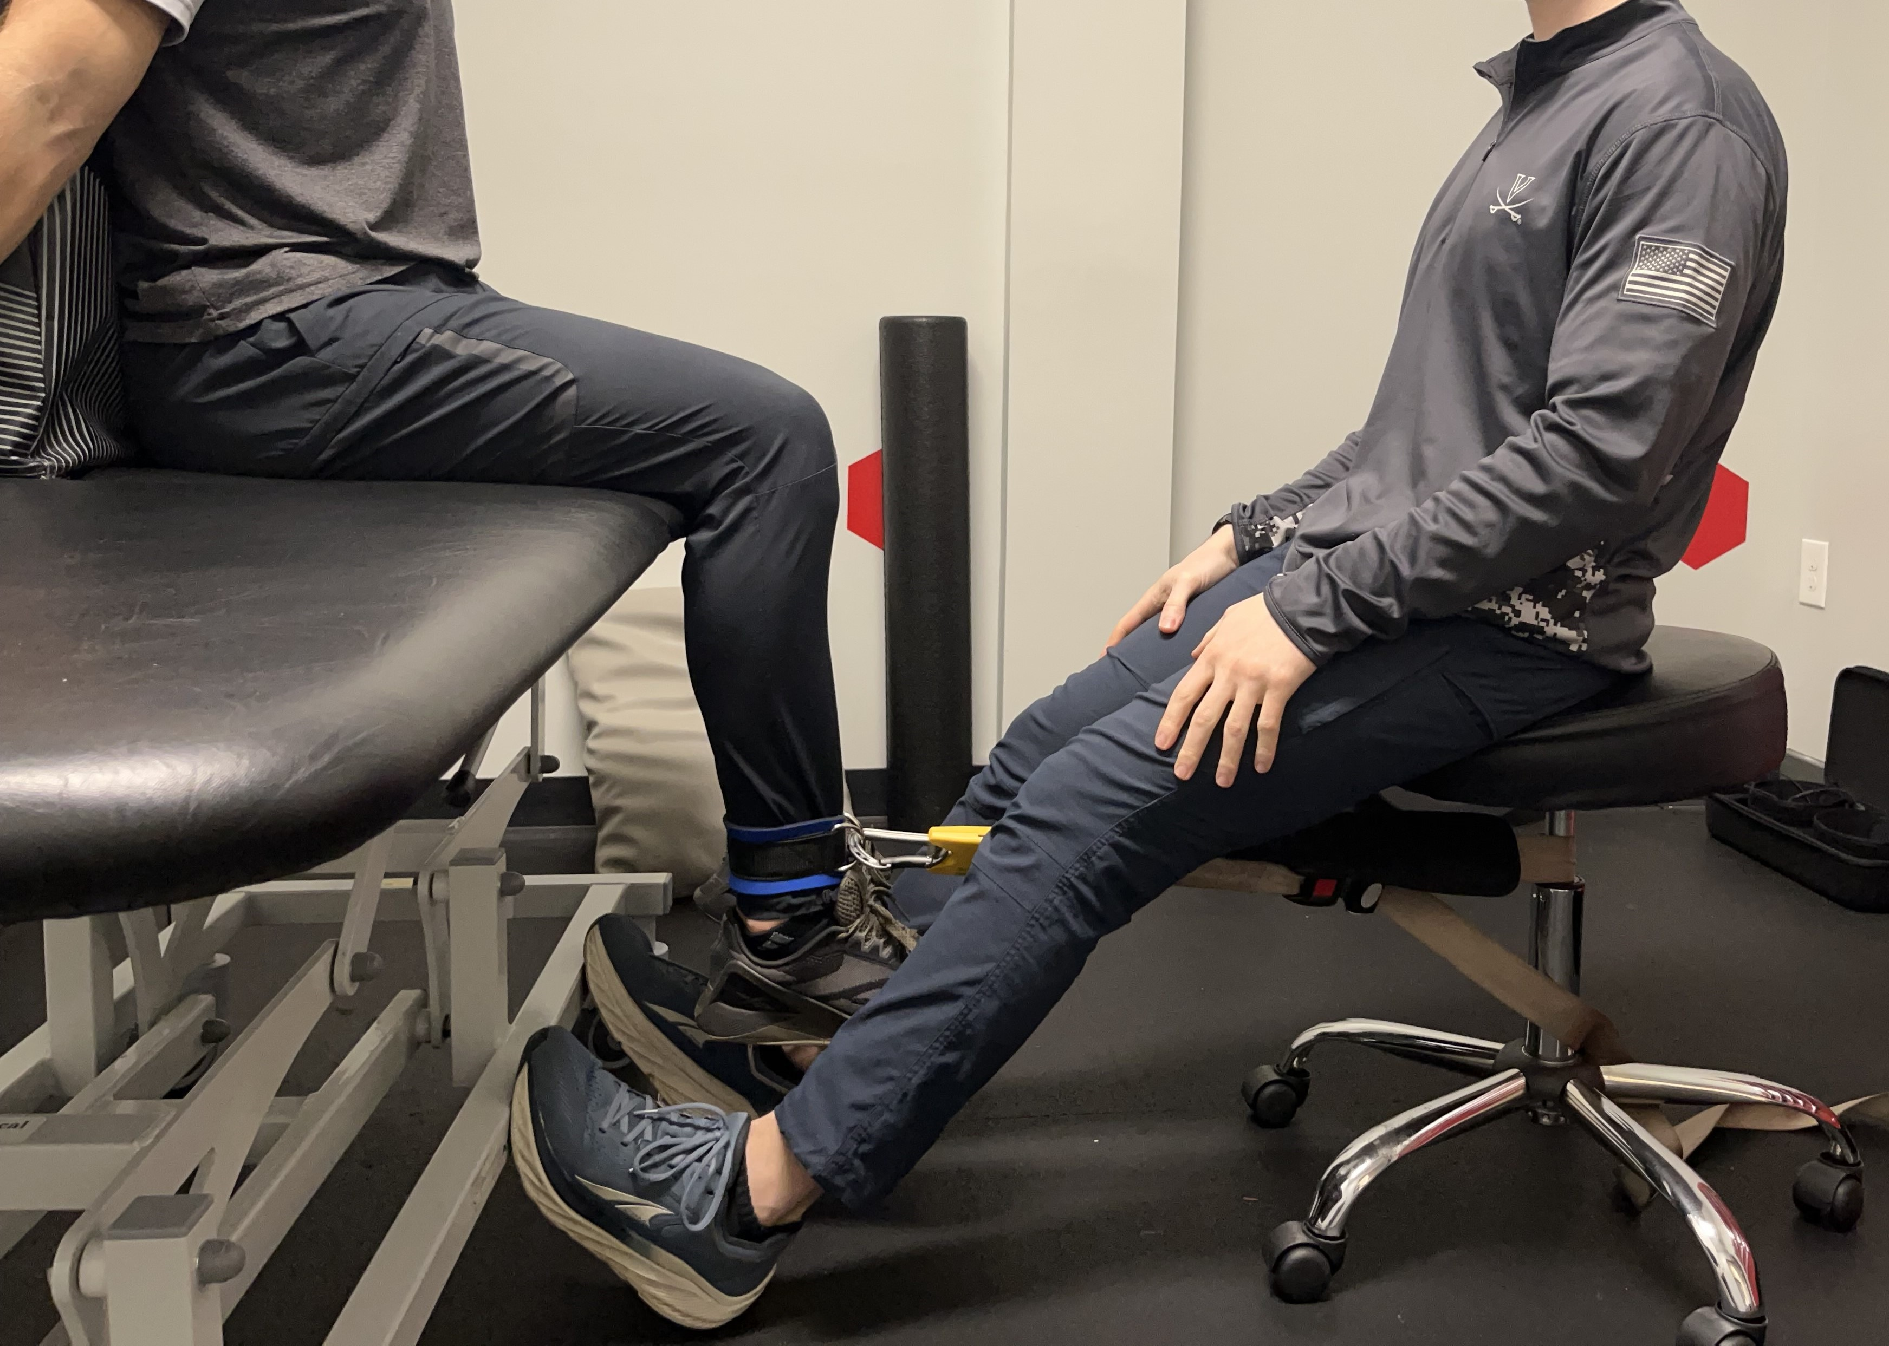
Flexion
Seated
Notes:
Optimal LT relationship: 45-90 deg hip flexion
Evidence: supine or seated 90/90 or prone 0/15
Here
90 deg knee flexion, alternating hand grip, box behind back

Slide 33
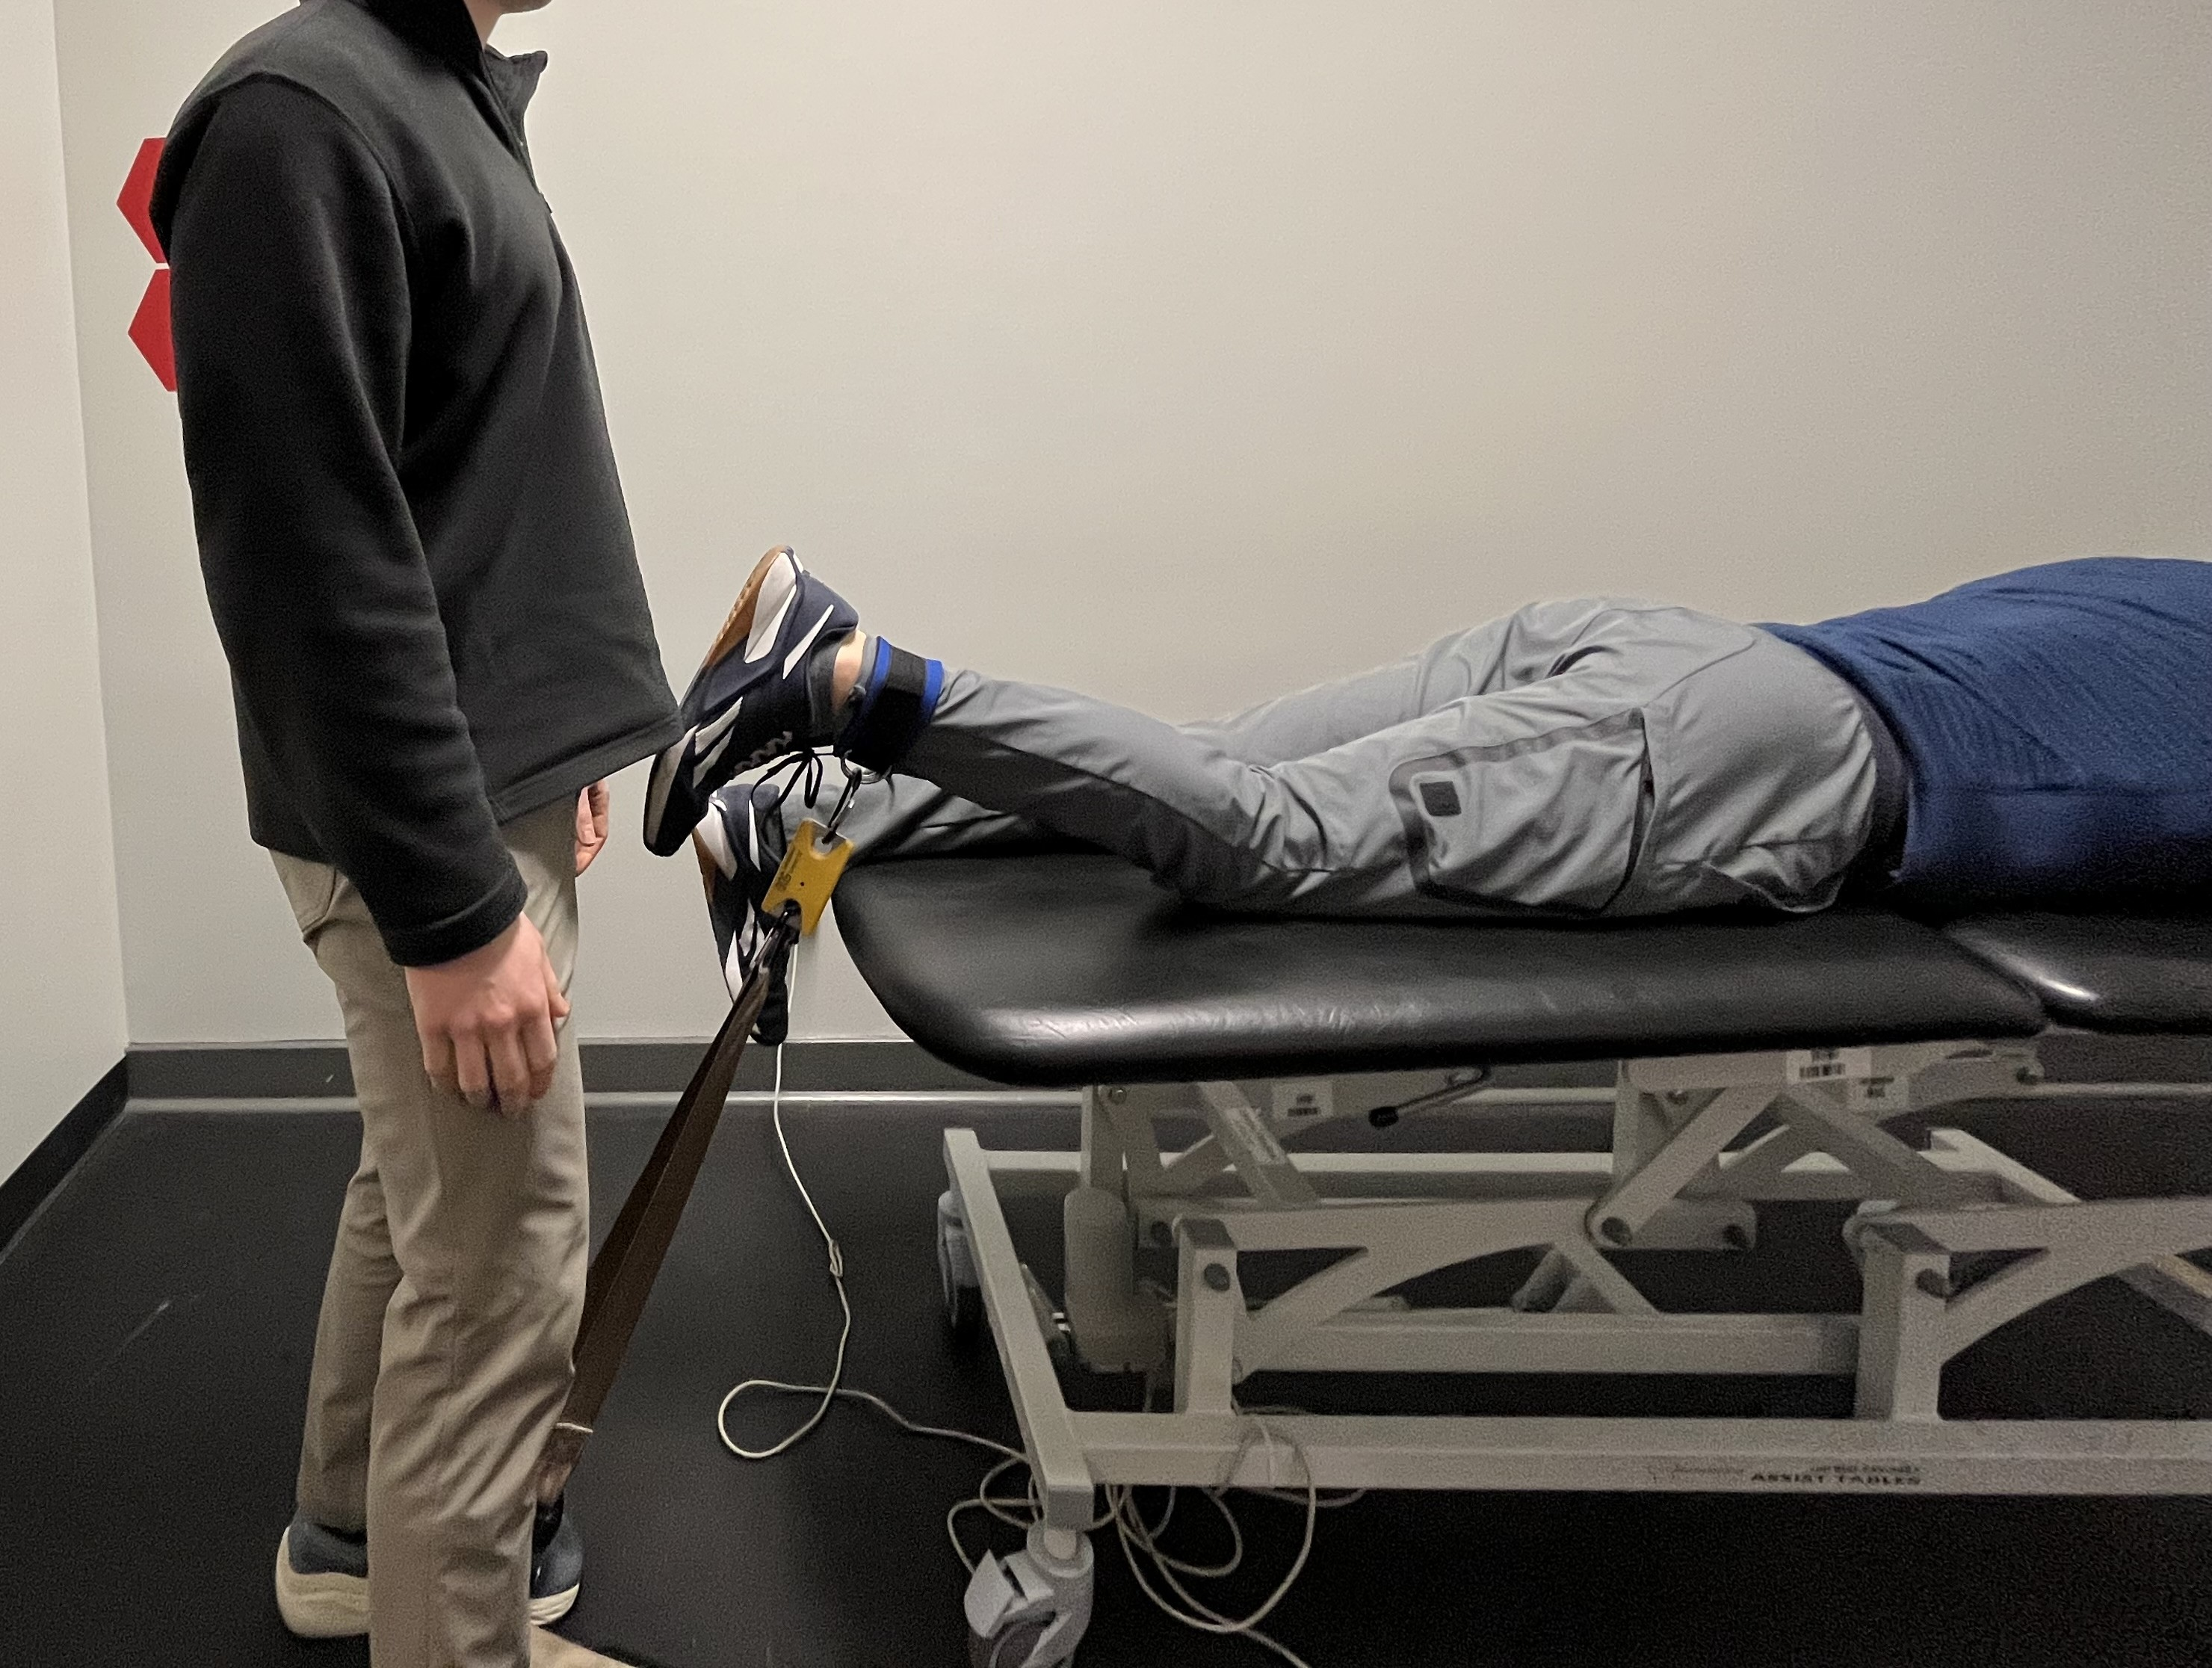
Flexion
Prone
Notes:
15-30 deg knee flexion, patient grabbing table. Can stabilize pelvis if desired to combat hip flexion

Slide 34
The Hip

Slide 35
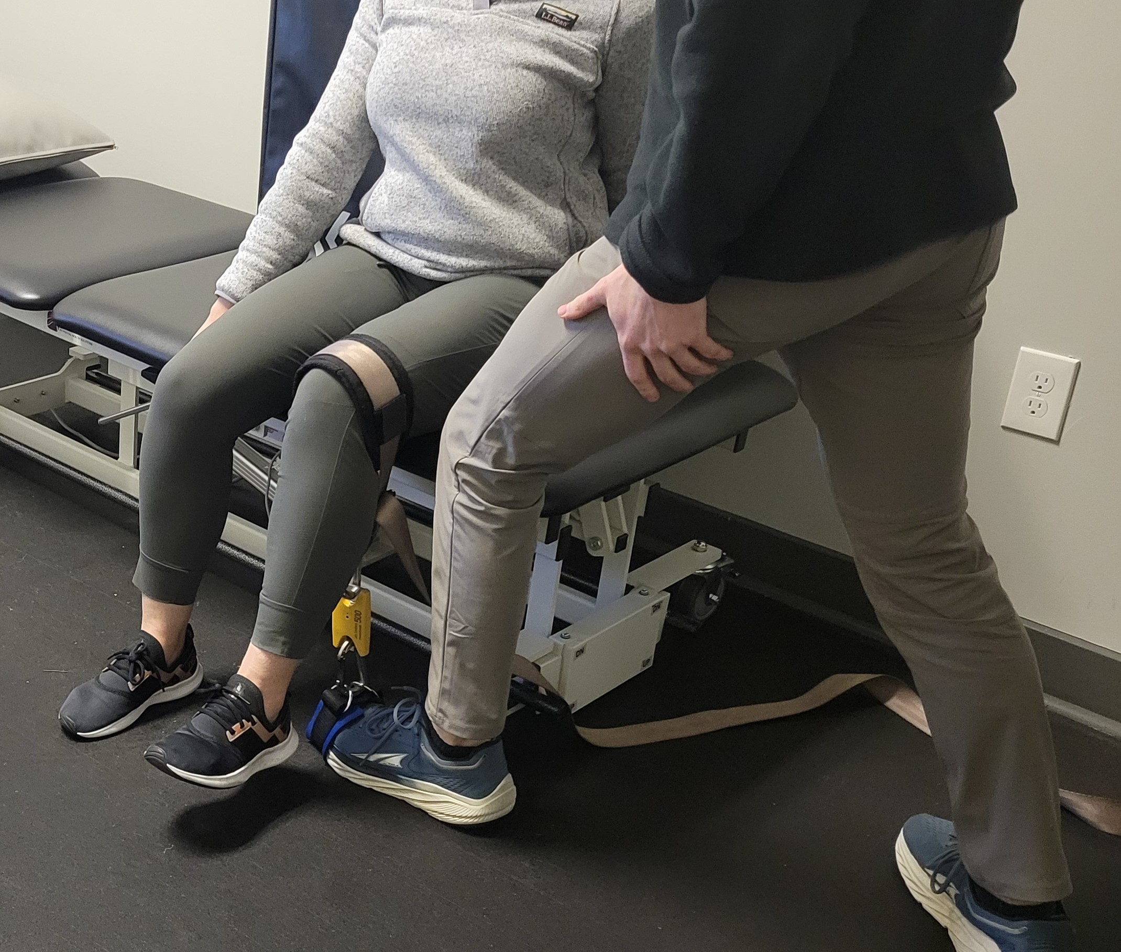
Flexion - Seated
Notes:
Optimal LT: no best angle. Consider resting length is around 0 deg hip flexion
Evidence
Seated 90/90
Supine 0 deg at hip
Set up
Similar to knee extension

Slide 36
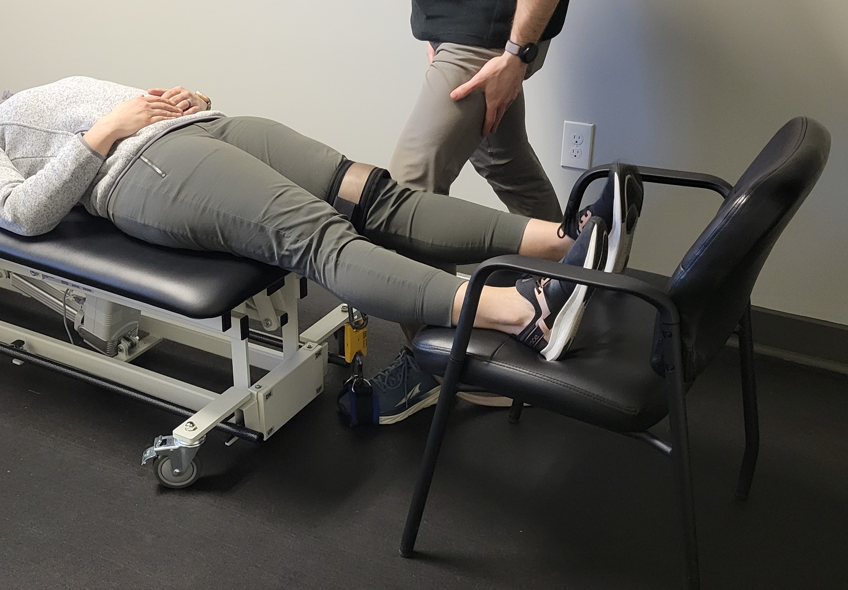
Flexion – Supine
Notes:
Hold onto table! We were rushing this photo. These types of set ups when stepping on one end, can hold onto table as PT to help stabilize yourself

Slide 37
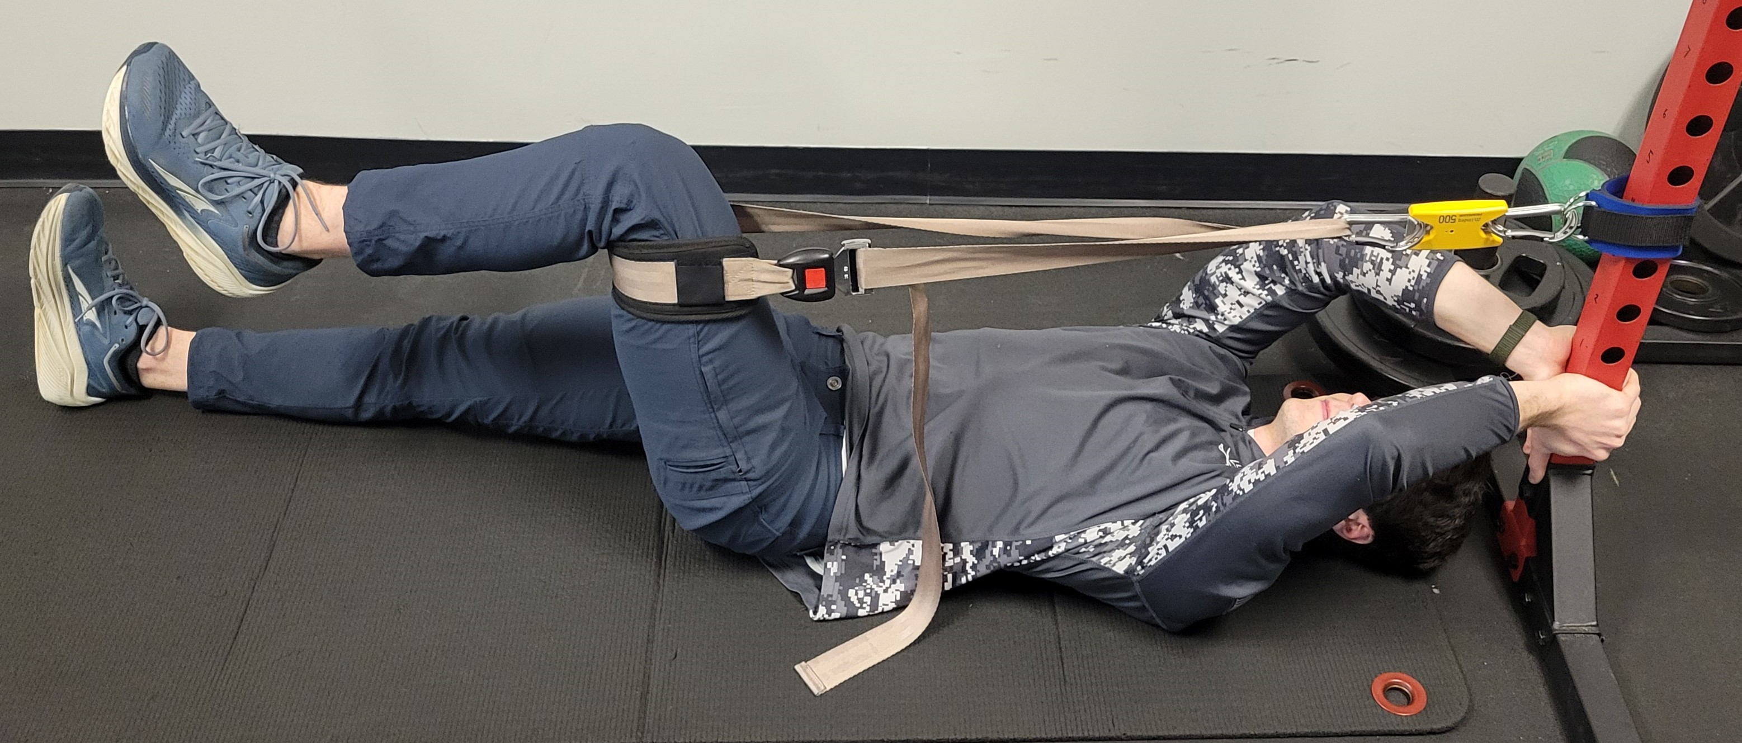
Extension – Short Lever
Notes:
Optimal LT: 40 deg hip flexion
Evidence
Supine 90 deg hip/knee flexion
Here
90/90 hip/knee
*Note, may need to keep hip angle at 90 deg exactly or greater (knee closer to body), to avoid hips rising up off ground. Can also stabilize patient’s hips

Slide 38
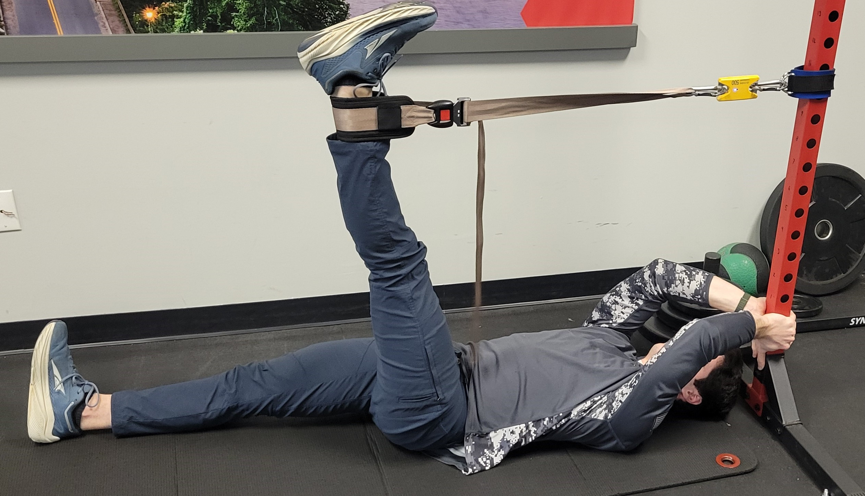
Extension – Long Lever
Notes:
Consideration
Proximal HS mechanism of injury
Ball sports, sprinting/cutting
Here
Close to 90 deg hip flexion, really patient’s available end range.

Slide 39
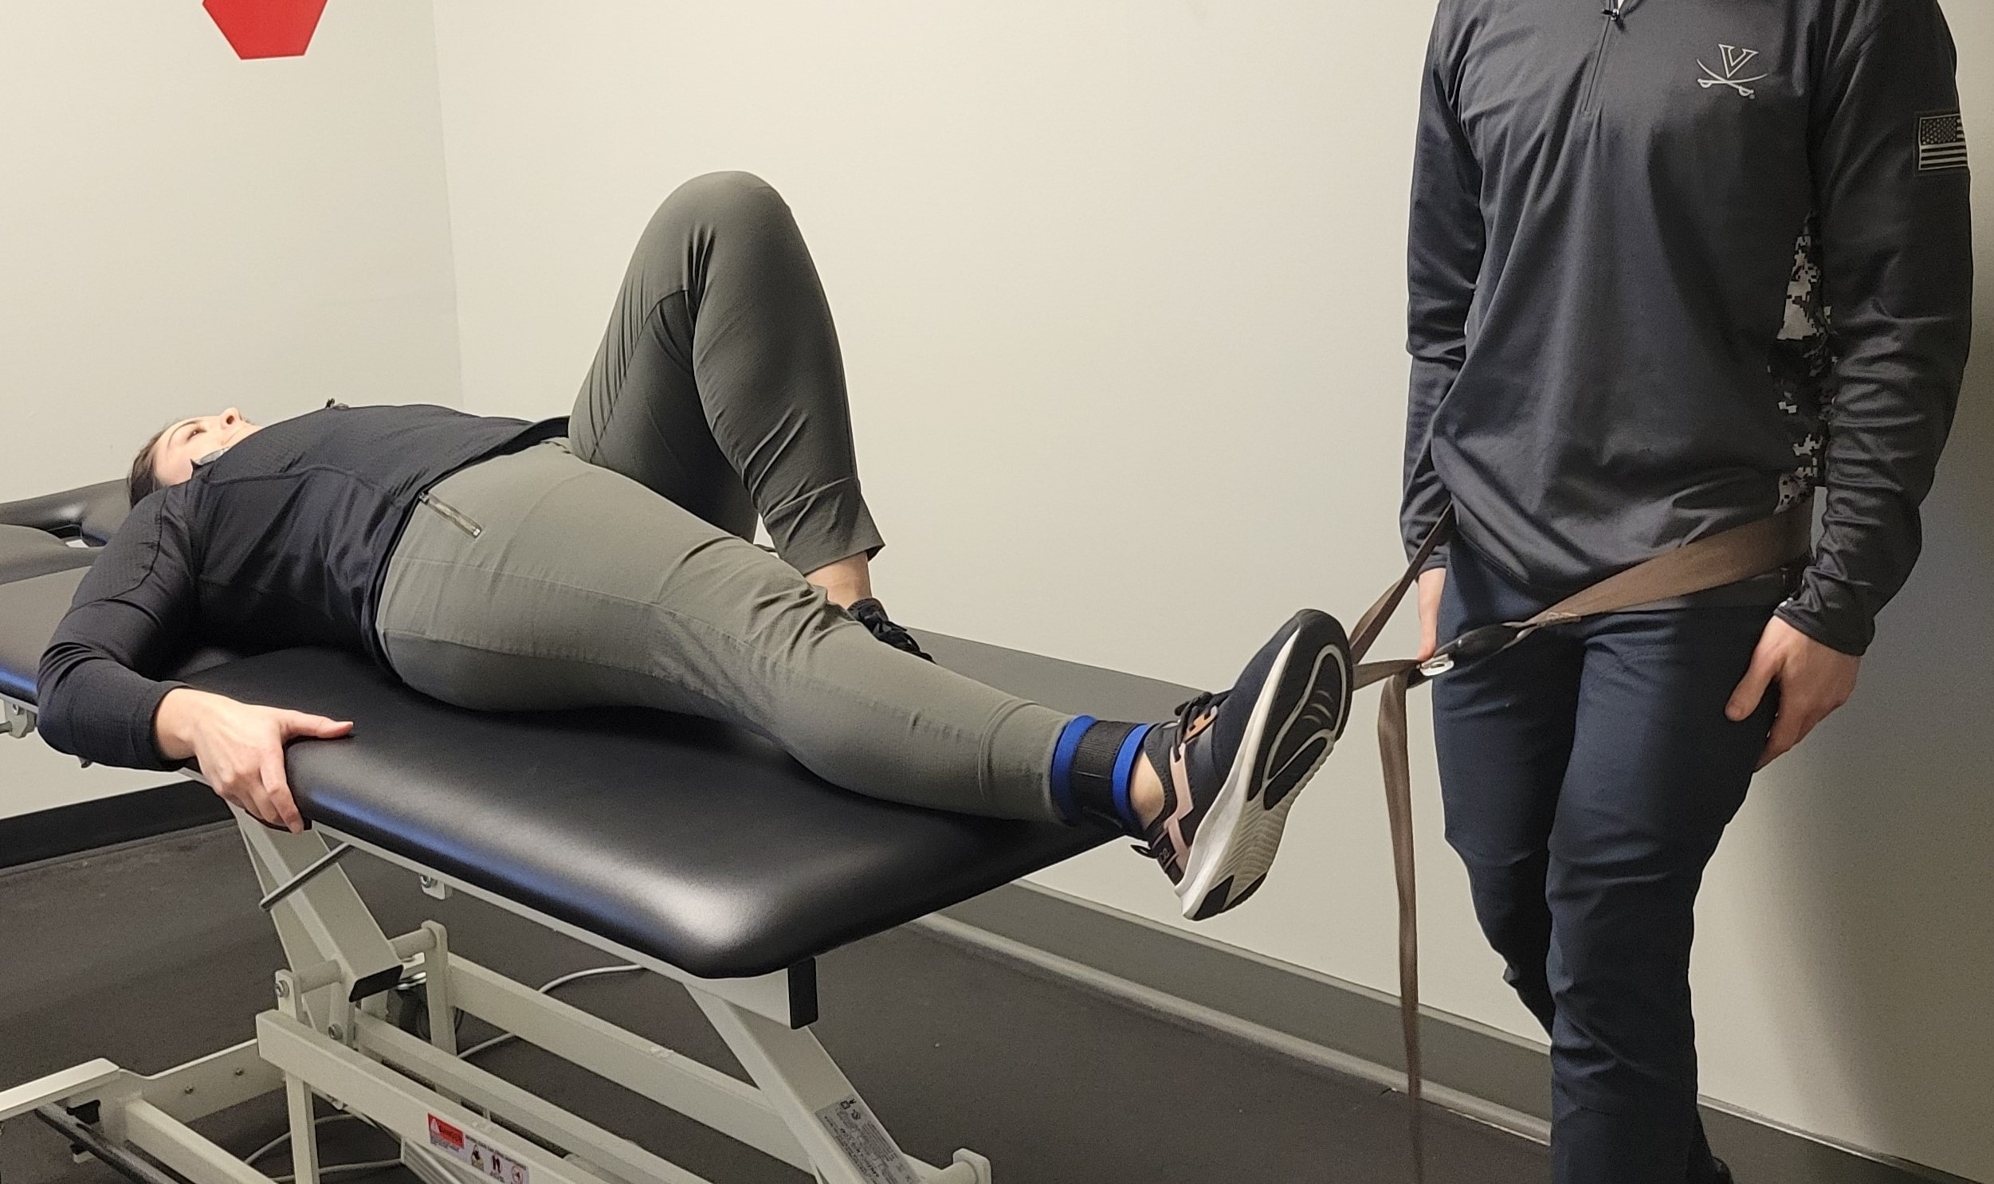
Abduction – Supine
Notes:
Optimal LT: -10 deg hip abduction
Evidence
Supine validity > sidelying (though sidelying easier to isolate muscle)

Slide 40
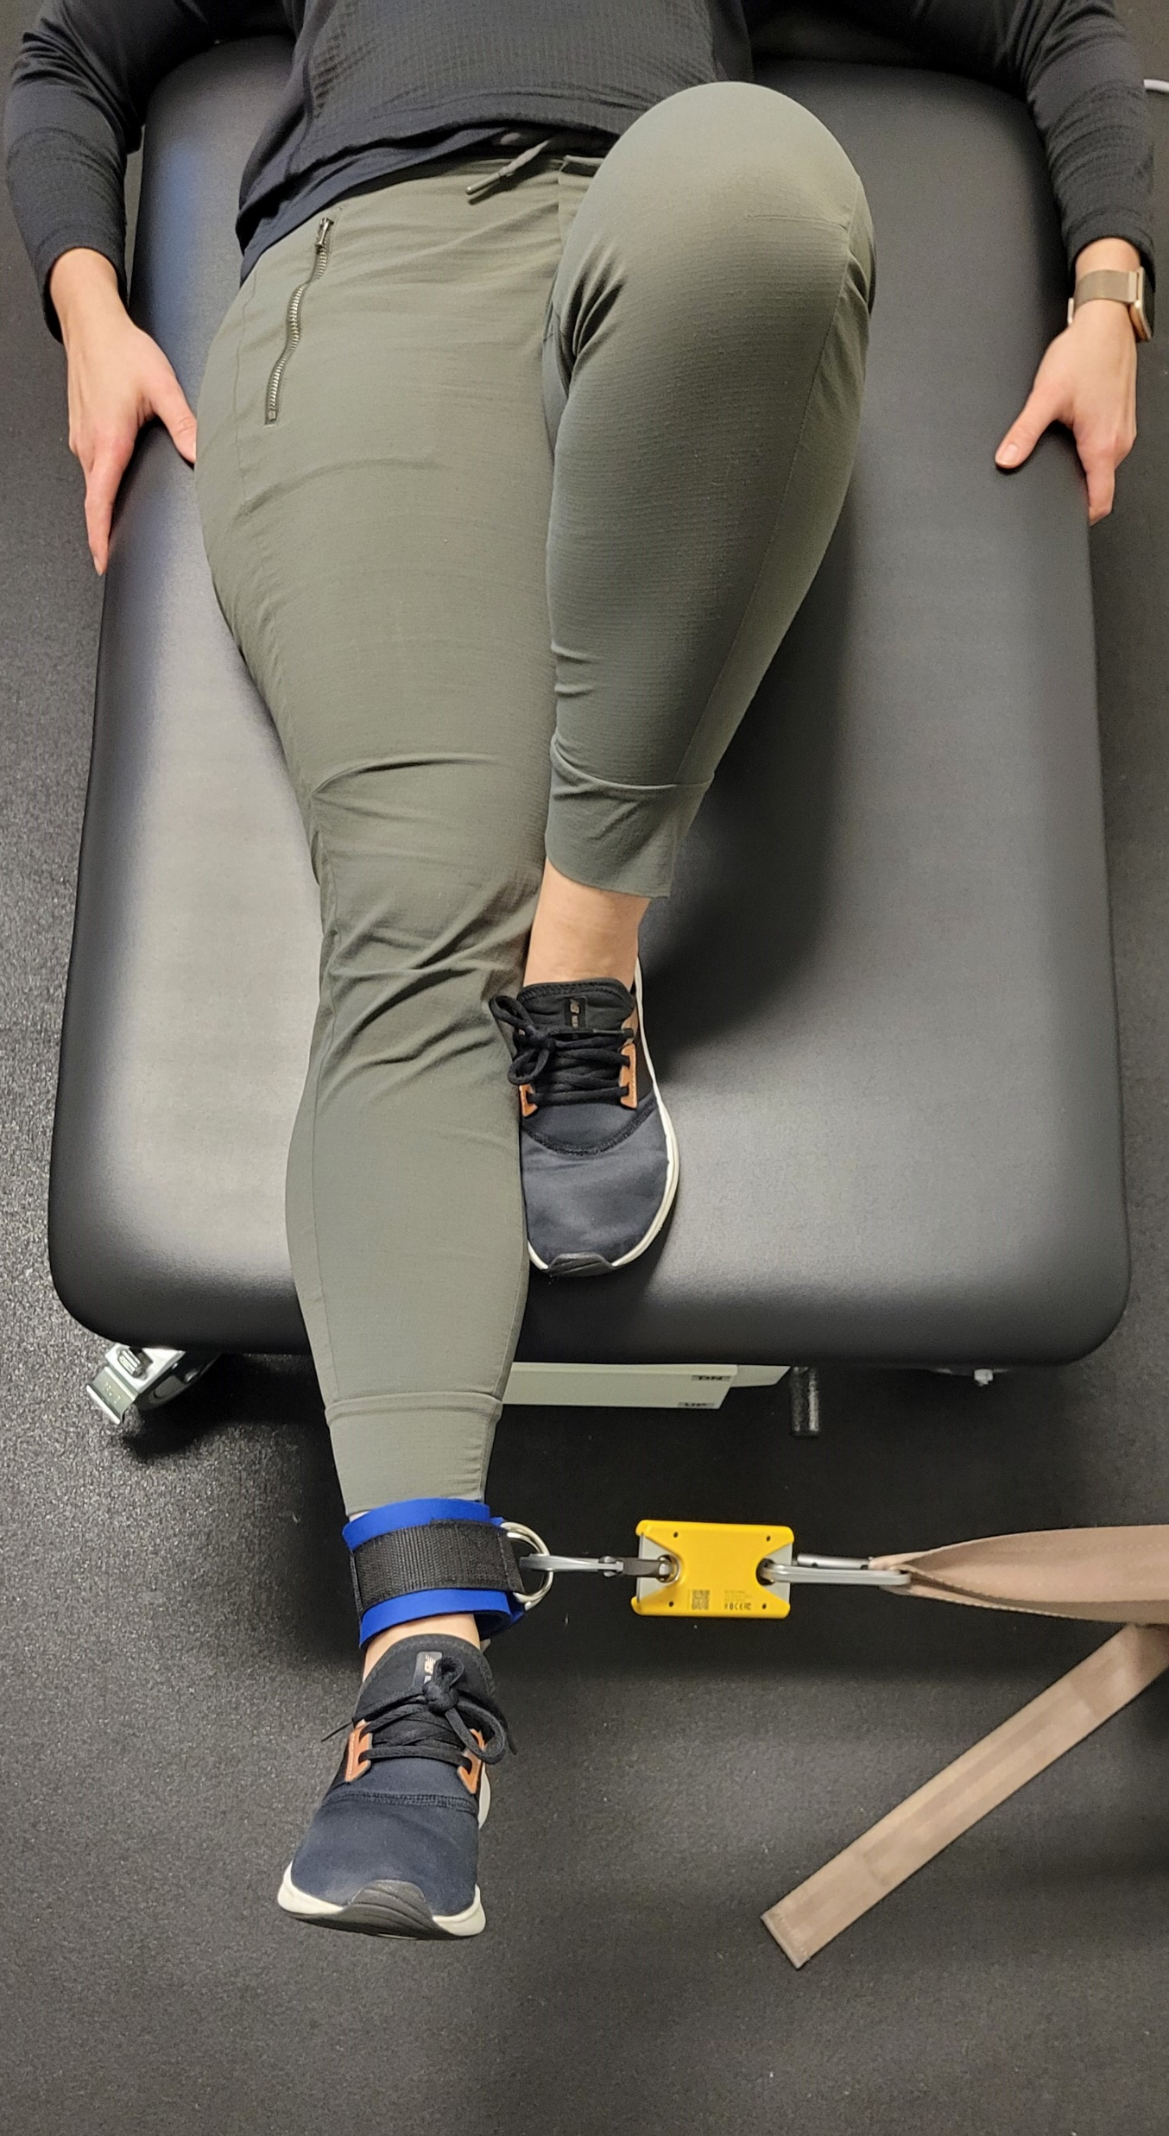
Abduction Supine
Notes:
n

Slide 41
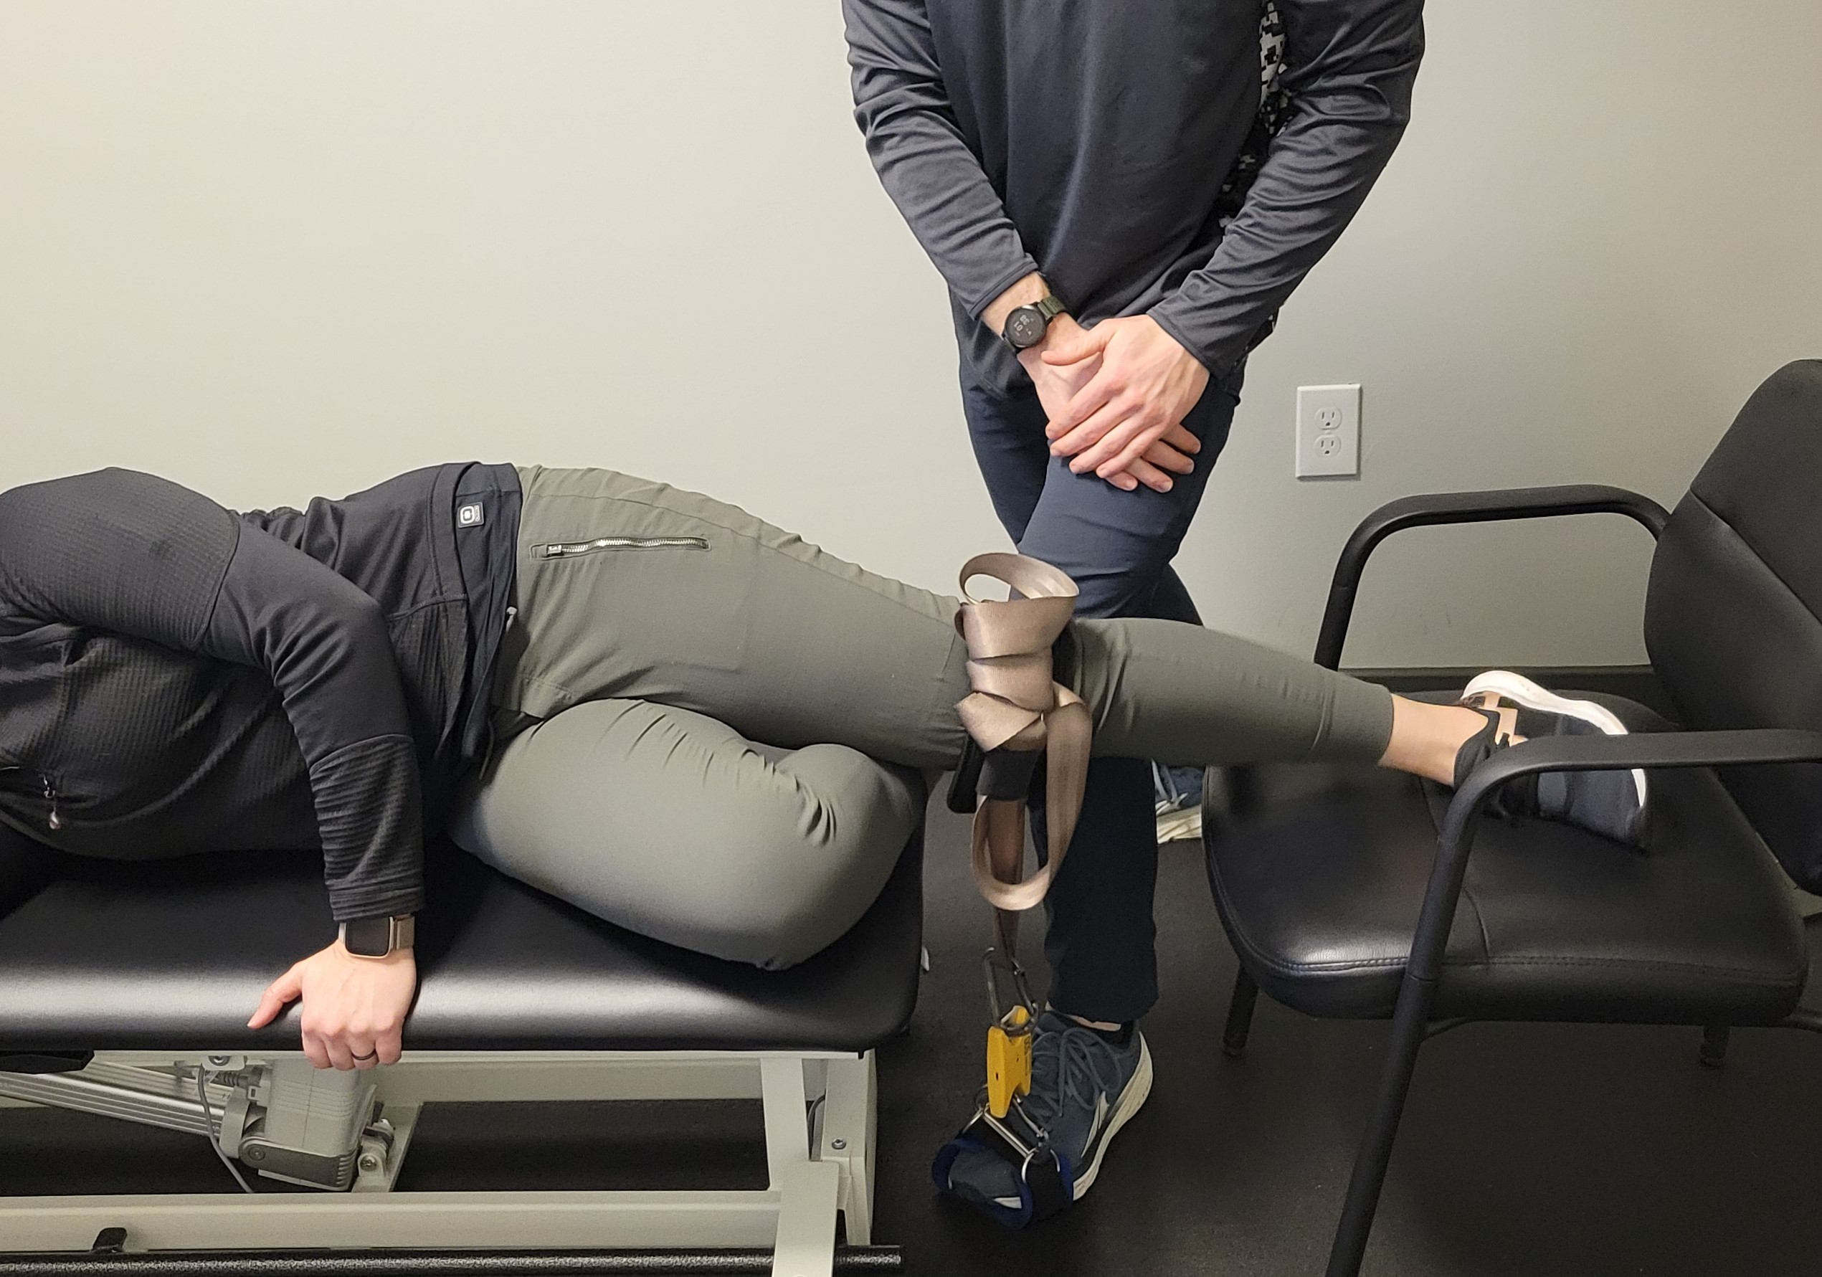
Abduction – Sidelying
Notes:
Consider
S/L hip ABD testing: number doesn’t account for force required to pick up weight of limb → values underestimate force production

Slide 42
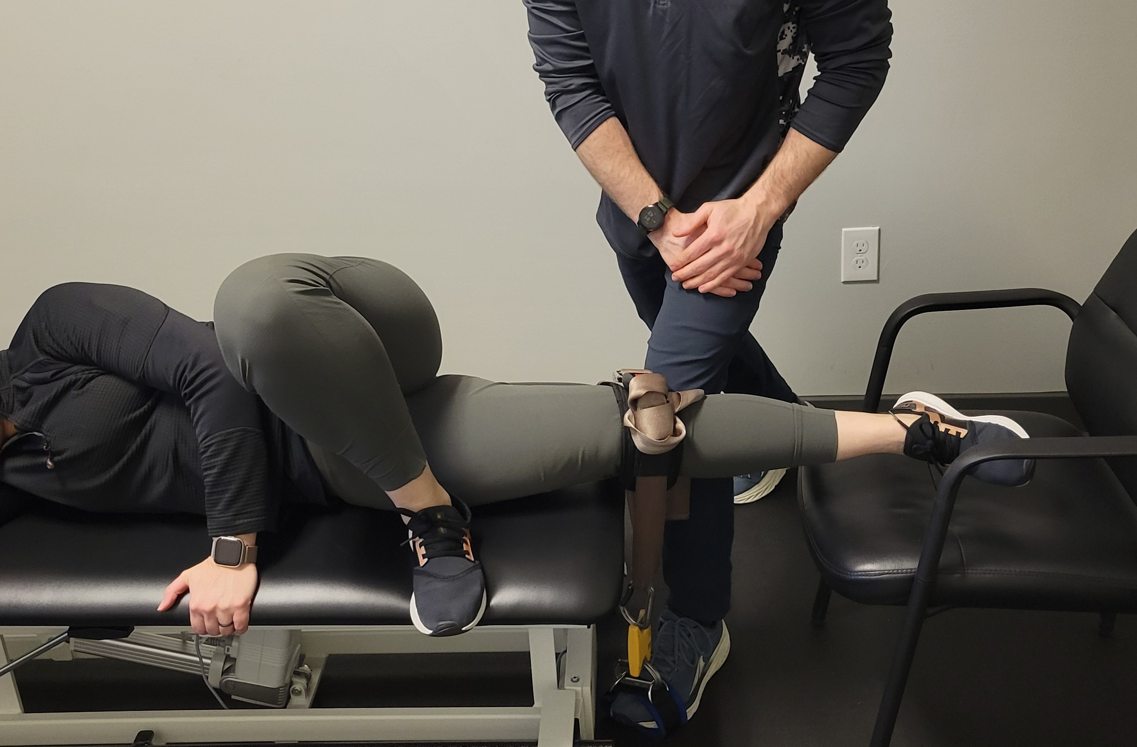
Adduction – Sidelying
Notes:
Optimal LT: not available
Evidence
Supine validity > sidelying
Consider
Adductor/groin strains mainly happen with sprinting. Main action functionally is to extend the hip when flexed and flex the hip when extended. Pure adduction just isolates the muscle better

Slide 43
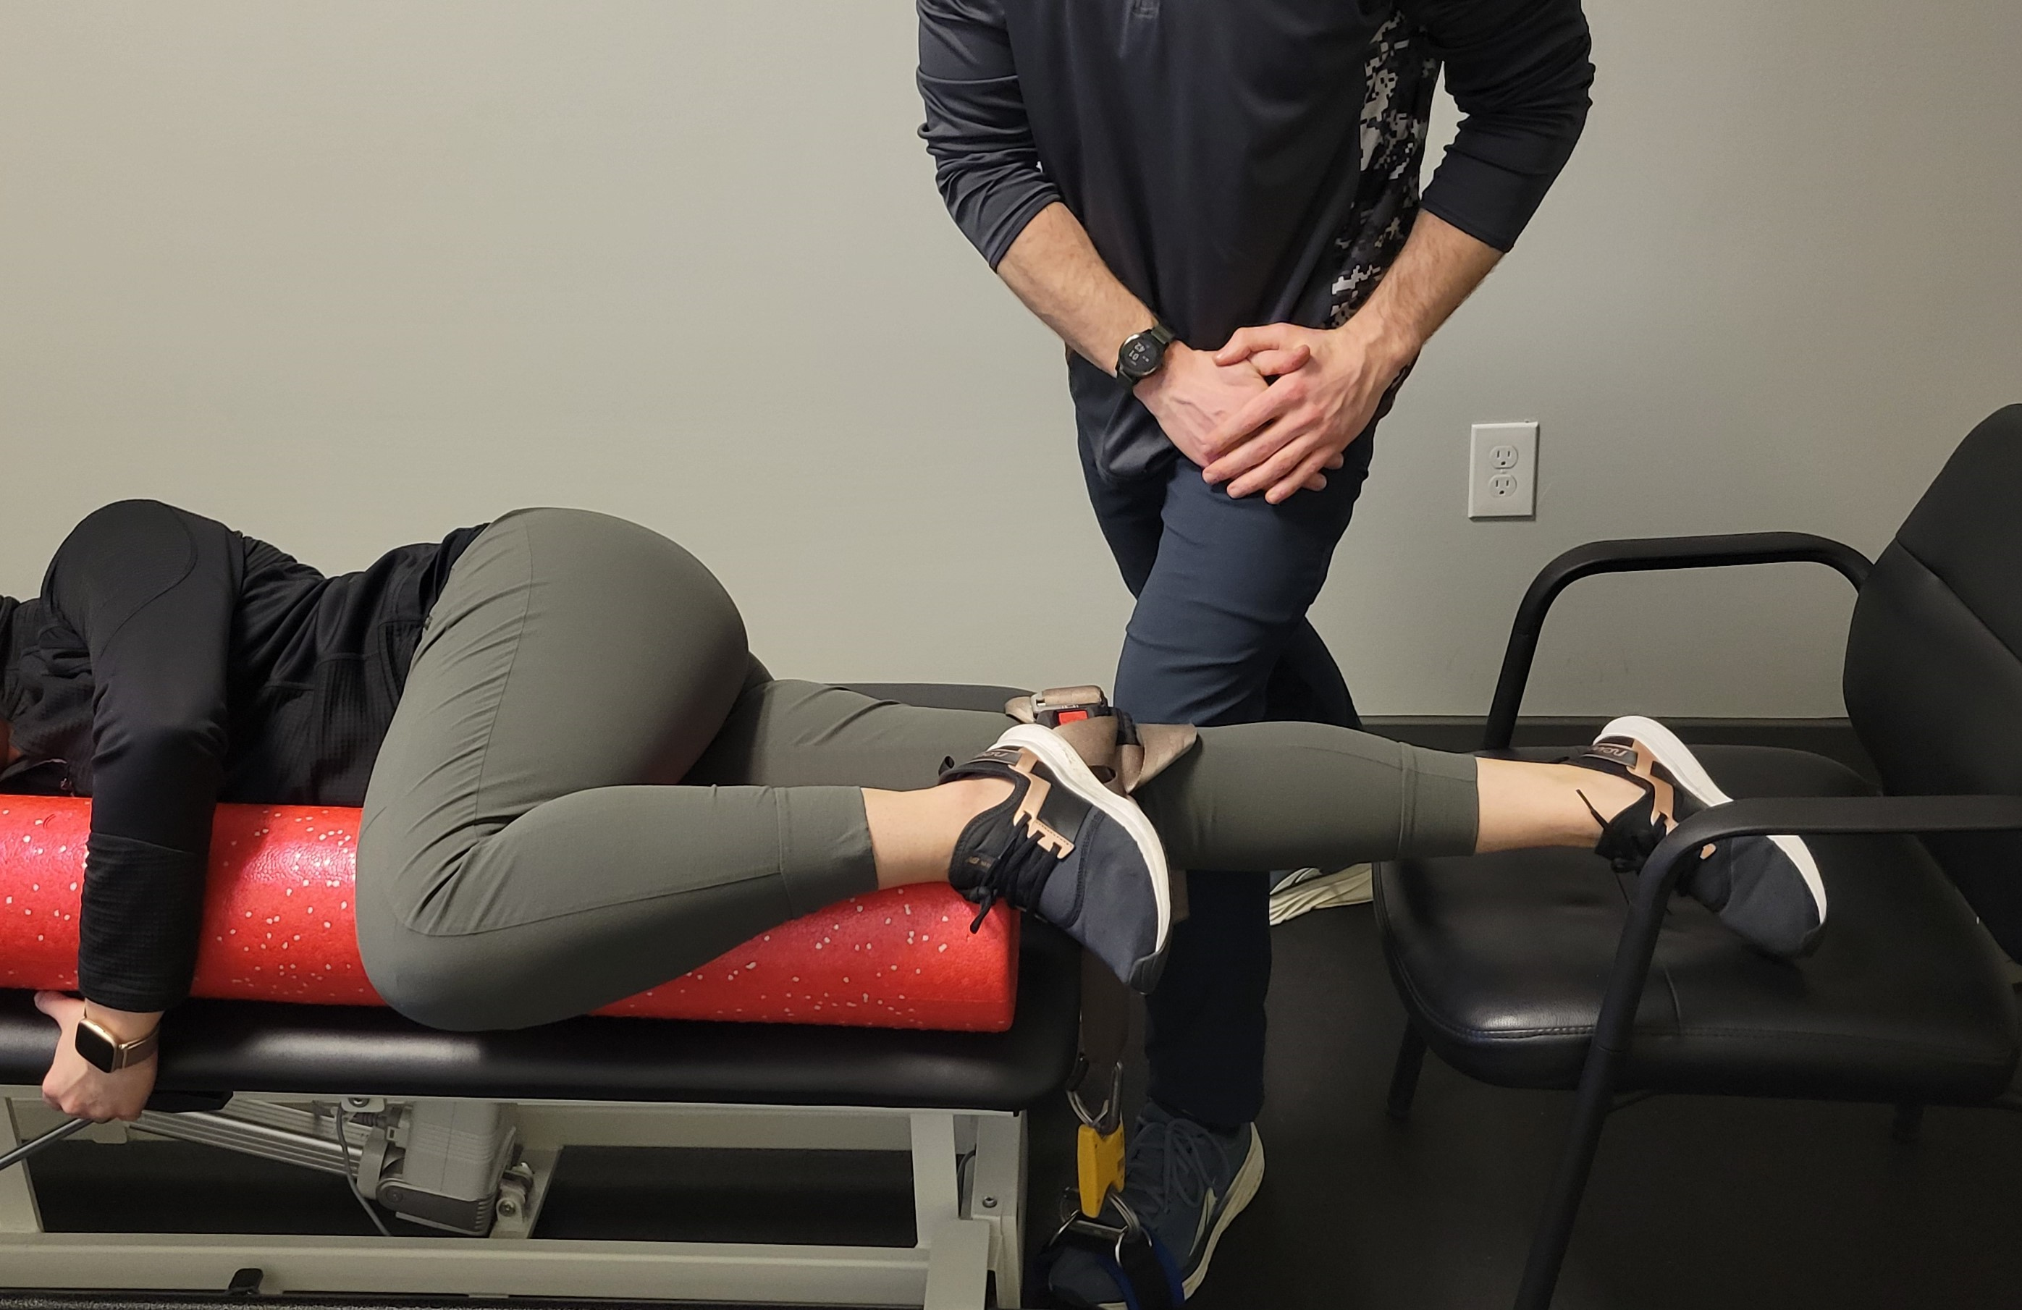
Adduction – Sidelying, Foam Roller

Slide 44
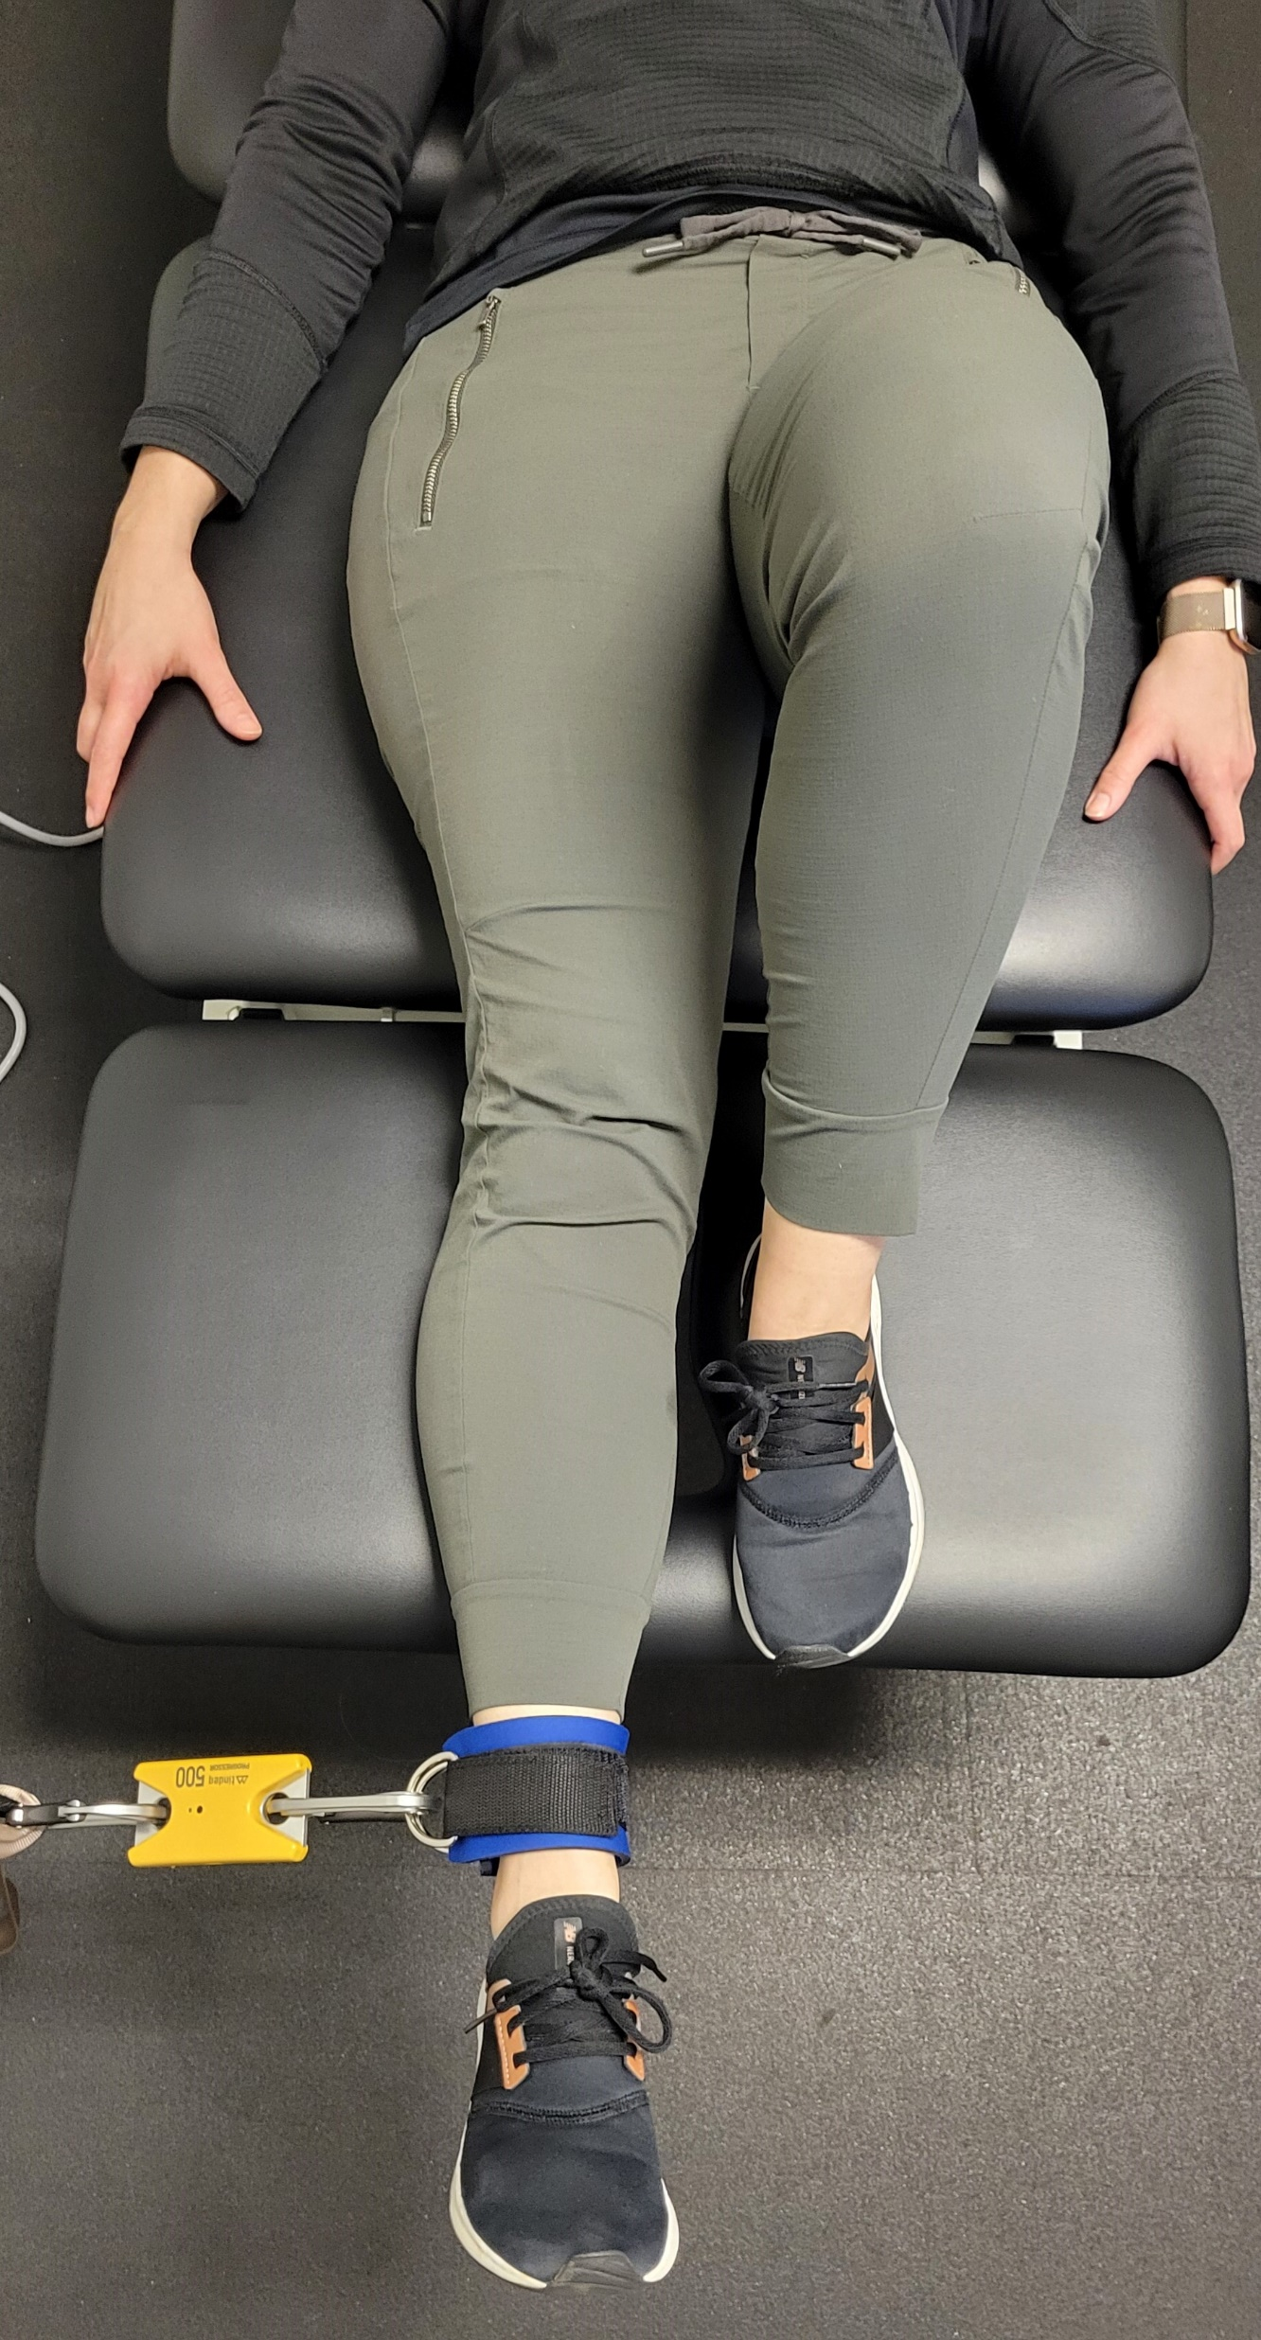
Adduction
Supine

Slide 45
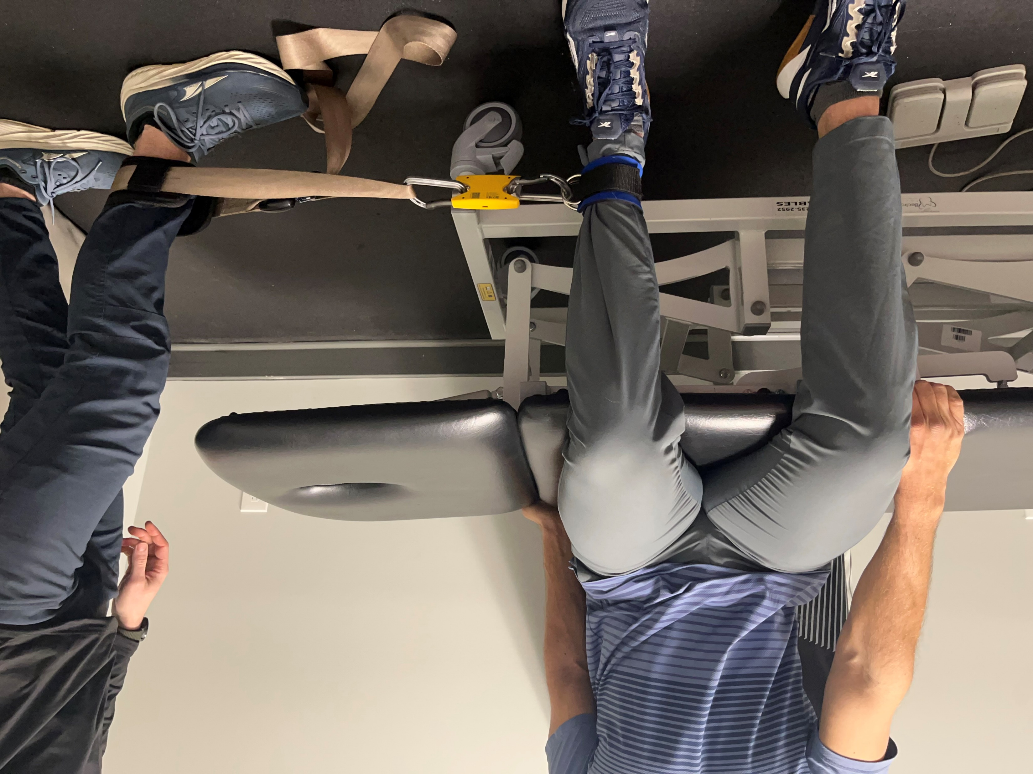
ER – Seated | IR = Reverse
Notes:
Optimal LT: 90 deg hip flexion
Evidence
Seated – greater reliability
Sidelying – better mimics dynamic knee valgus
IR?
Rarely tested. Not the primary function of any one muscle. Secondary function of many

Slide 46
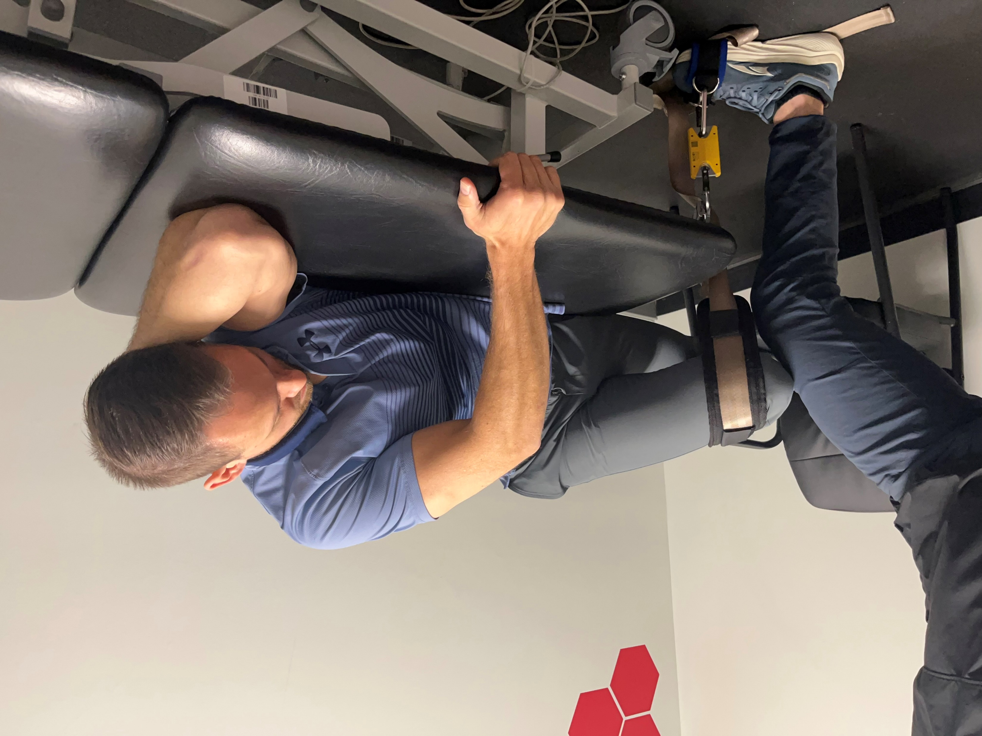
ER – Sidelying
Notes:
n

Slide 47
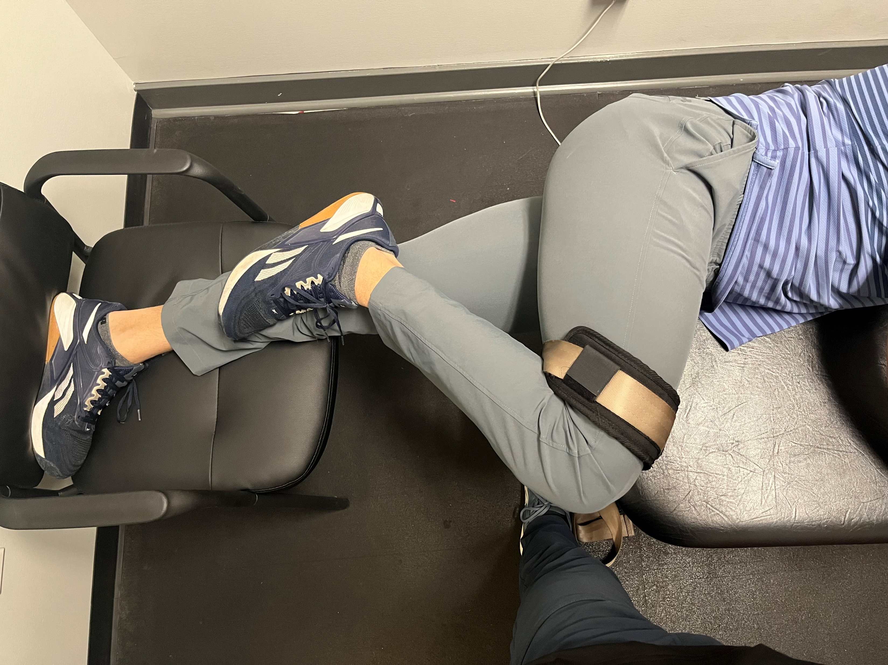
ER – Sidelying Cont.
Notes:
Medial malleolus of top leg hooked just under medial tibial plateau
Strap just proximal to femoral condyles

Slide 48
The Shoulder

Slide 49
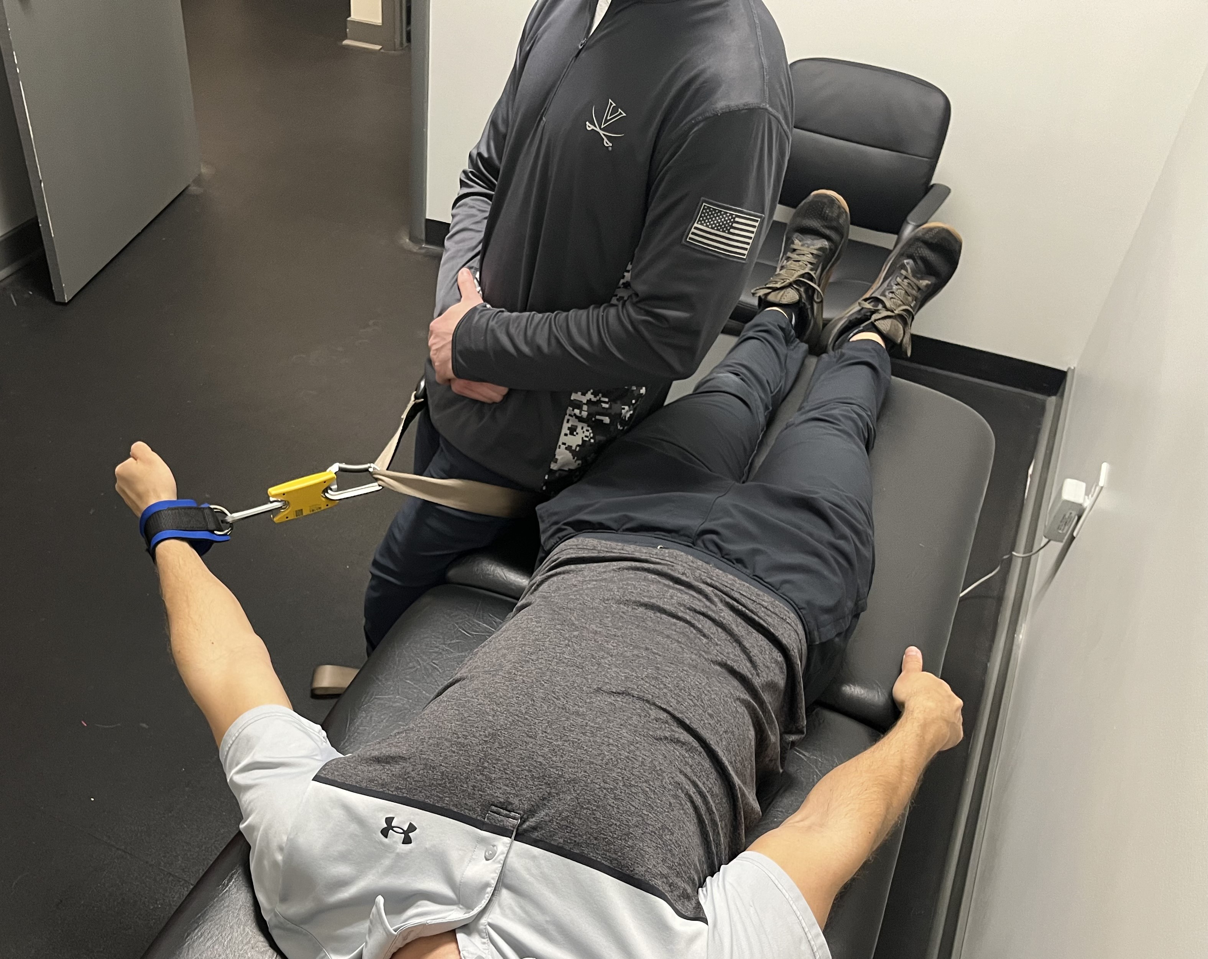
Abduction
Notes:
Optimal LT: not available
Evidence:
45 deg shoulder abduction, 0 at elbow
*All shoulder positions consideration
Supine = easier to stabilize shoulder and surrounding joints = greater reliability and validity; however, most things patients are doing involving their shoulder joint is in standing
Not wrong to test in standing

Slide 50
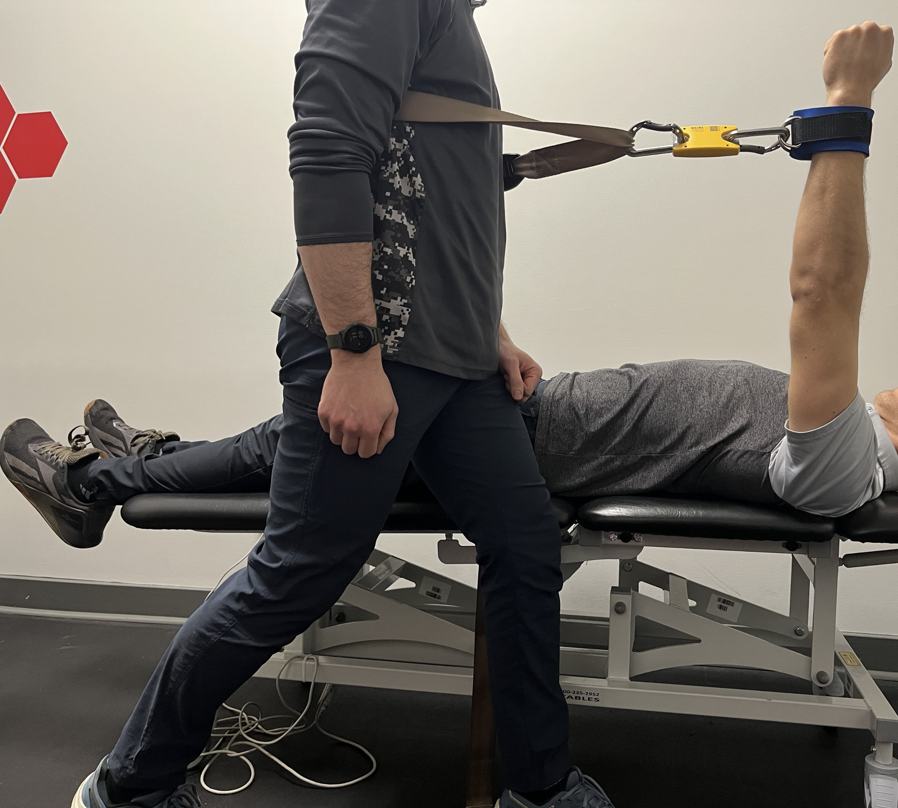
Flexion
Notes:
Optimal LT: 0 deg shoulder flexion, 0-30 deg elbow flexion
Evidence
Supine or seated 90 deg shoulder flexion, 0 at elbow

Slide 51
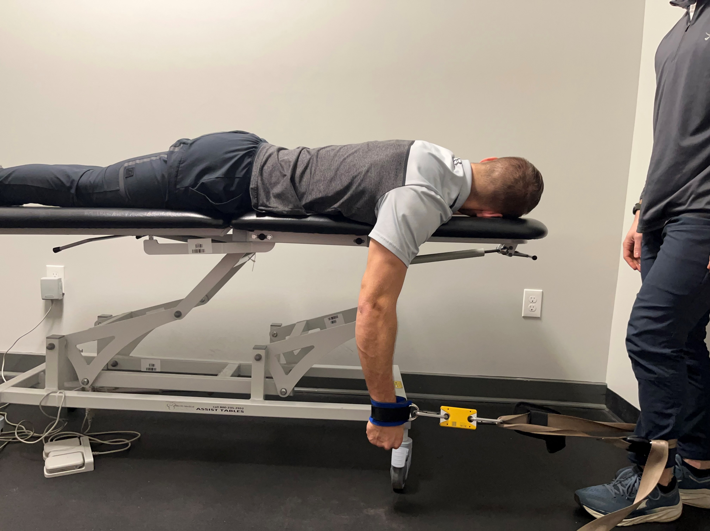
Extension
Notes:
Optimal LT: 80 deg shoulder flexion, no data on elbow position
Evidence
Same as flexion positions
Consider
Lat activation (strain)

Slide 52
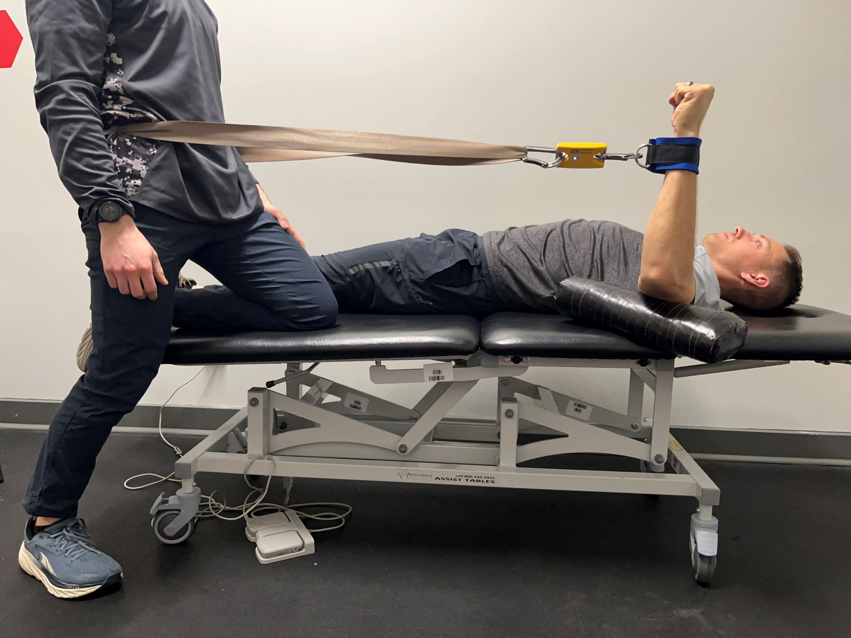
ER
Notes:
Optimal LT for IR/ER: 70 deg shoulder abduction
Evidence
Supine 90 deg shoulder abduction, 90 deg at elbow

Slide 53
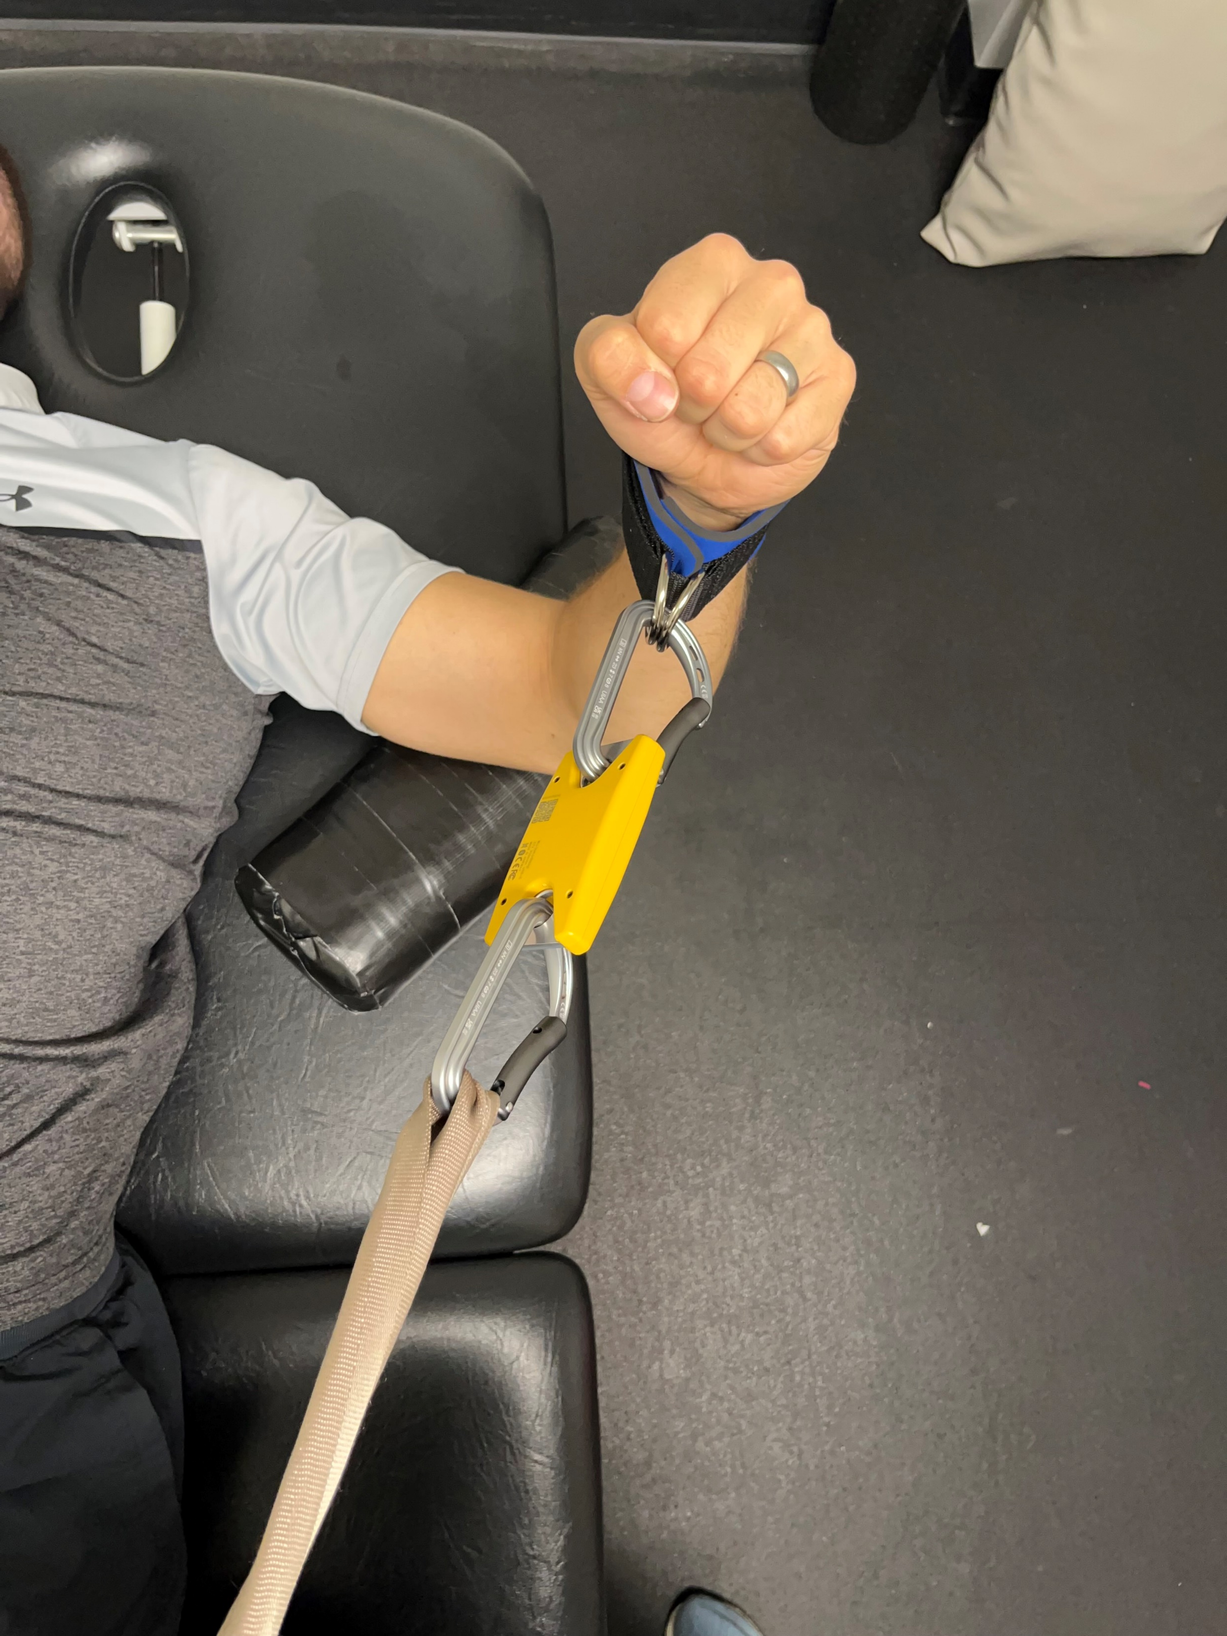
ER Cont.
Notes:
Shoulder at 70 deg abduction here for optimal LT relationship, keeping belt perpendicular to this (have to get on the table slightly and have patient slide over)
To avoid set-up hassle, can assess at 90 degrees shoulder abduction

Slide 54
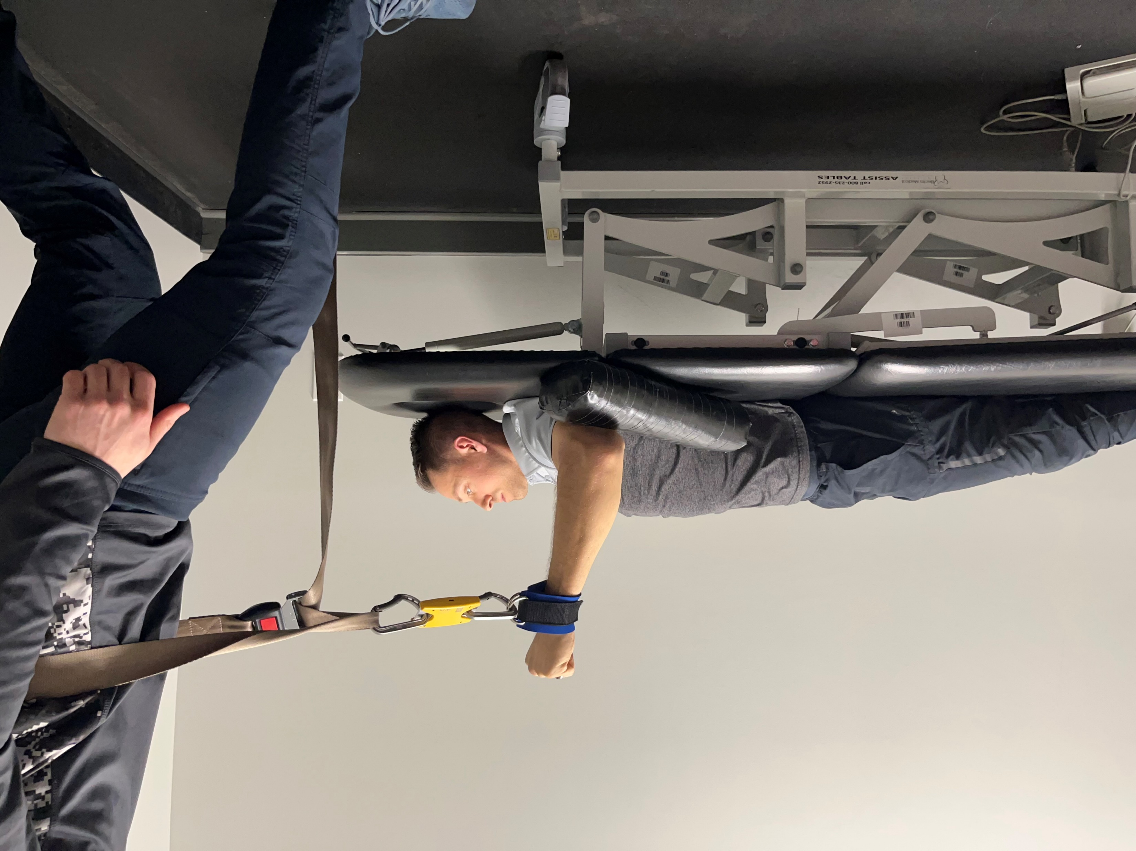
IR
Notes:
n

Slide 55
Extras
From Research Articles

Slide 56
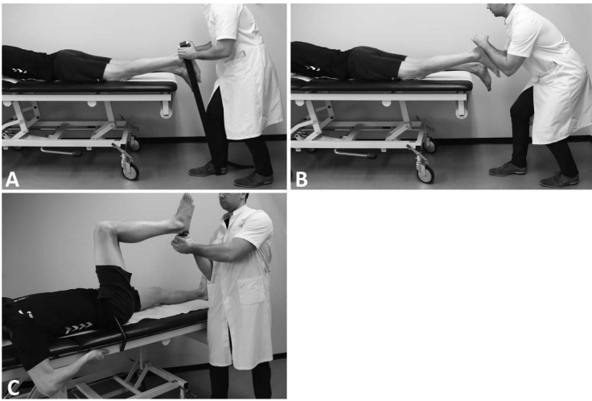

Slide 57
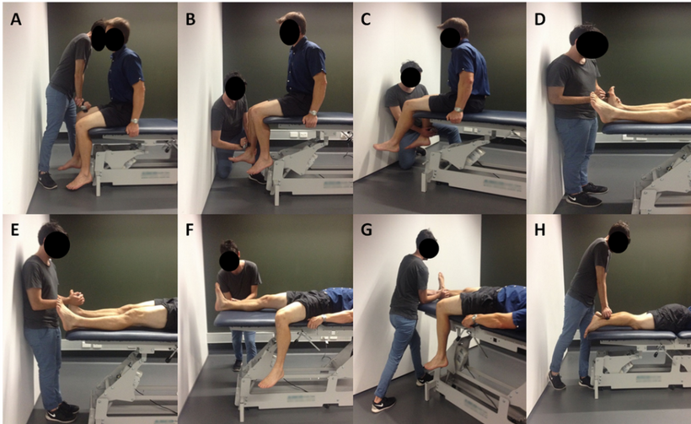

Slide 59
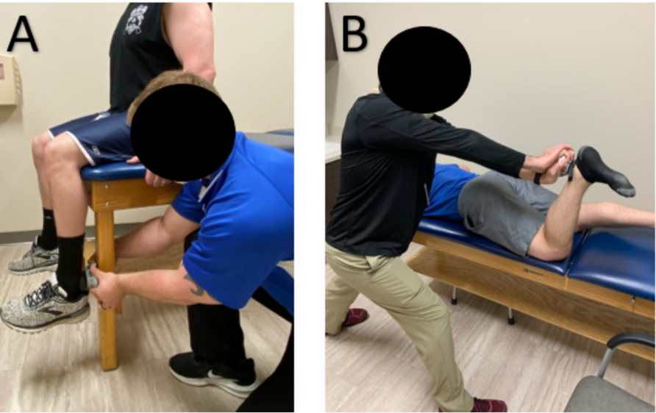

Slide 60
Questions to Consider

Slide 61
1) Do you have to consider optimal L-T relationship?
Notes:
Optimal LT position = greatest torque… important for clinical picture? If high performing athlete maybe. Otherwise, symmetry probably more important.
Consider
How provocative is testing position? Do you want to test in more provocative positions vs. position of maximal strength? Depends on patient goals, what level of function they are returning to (someone with shoulder pain with a goal to reach over head vs baseball player)

Slide 62
2) Does mitigating gravity matter?
Notes:
Consider supine shoulder and hip testing
Easier to stabilize and isolate a joint, Increases reliability. Less functional, but point of HHD is to isolate specific motions to aid in POC

Slide 63
3) What do you want out of these measures?
Notes:
Have to consider convenience, peak force, injury prone positions. Most papers out there = positions of convenience
Testing a muscle (isolating) or a movement (probably could do better functional test for this)?

Slide 64
4) Any benefit to testing in injury prone positions?
Notes:
Just how weak is a patient in injury prone position? Benefit to increasing strength in positions of injury? Probably.
Ex. Near end range hip flexion and knee ext for proximal HS injury?

Slide 65
5) What’s the problem with normative value comparison?
Notes:
Little data out there at this time. Have to test in the same position as the study, or else you’re comparing two totally different things.
Also note, need a standardized clinic set up or you can’t compare patient data b/w practitioenrs

Slide 66
Photo Credits:
Brandon & Heather
Notes:
Little data out there at this time. Have to test in the same position as the study, or else you’re comparing two totally different things.
Also note, need a standardized clinic set up or you can’t compare patient data b/w practitioenrs

Slide 67
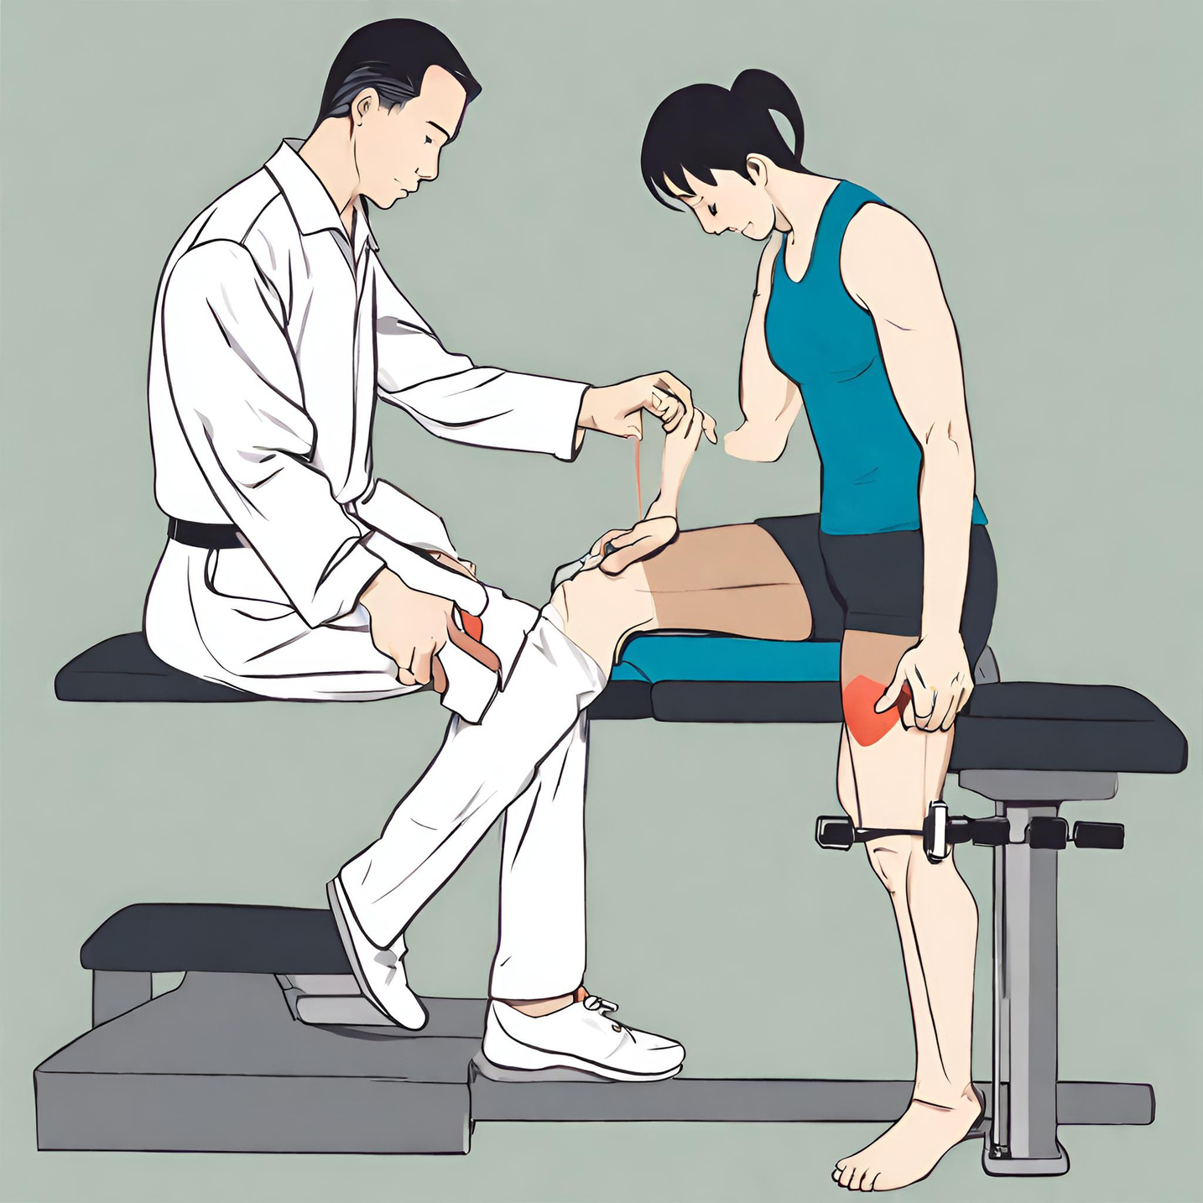
Notes:
AI generated picture of dynamometry strength testing in PT

Slide 68
References
  Norris, R., Morrison, S., Price, A., Pulford, S., Meira, E., O'Neill, S., Williams, H., Maddox, T. W., Carter, P., & Oldershaw, R. A. (2023). Inline dynamometry provides reliable measurements of quadriceps strength in healthy and ACL-reconstructed individuals and is a valid substitute for isometric electromechanical dynamometry following ACL reconstruction. The Knee, 46, 136–147. Advance online publication. https://doi.org/10.1016/j.knee.2023.12.006
  Whiteley, R., Jacobsen, P., Prior, S., Skazalski, C., Otten, R., & Johnson, A. (2012). Correlation of isokinetic and novel hand-held dynamometry measures of knee flexion and extension strength testing. Journal of science and medicine in sport, 15(5), 444–450. https://doi.org/10.1016/j.jsams.2012.01.003
  Mentiplay, B. F., Perraton, L. G., Bower, K. J., Adair, B., Pua, Y. H., Williams, G. P., McGaw, R., & Clark, R. A. (2015). Assessment of Lower Limb Muscle Strength and Power Using Hand-Held and Fixed Dynamometry: A Reliability and Validity Study. PloS one, 10(10), e0140822. https://doi.org/10.1371/journal.pone.0140822
  van der Made, A. D., Paget, L. D. A., Altink, J. N., Reurink, G., Six, W. R., Tol, J. L., & Kerkhoffs, G. M. (2021). Assessment of Isometric Knee Flexor Strength Using Hand-Held Dynamometry in High-Level Rugby Players Is Intertester Reliable. Clinical journal of sport medicine : official journal of the Canadian Academy of Sport Medicine, 31(5), e271–e276. https://doi.org/10.1097/JSM.0000000000000793
  Eymir, M., Unver, B., & Karatosun, V. (2024). Reliability, Concurrent Validity, and Minimal Detectable Change of the Hand-Held Dynamometry for the Assessment of Knee Muscle Strength in Patients With Revision Total Knee Arthroplasty. Archives of physical medicine and rehabilitation, 105(1), 34–39. https://doi.org/10.1016/j.apmr.2023.05.002
  Ushiyama, N., Kurobe, Y., & Momose, K. (2017). Validity of maximal isometric knee extension strength measurements obtained via belt-stabilized hand-held dynamometry in healthy adults. Journal of physical therapy science, 29(11), 1987–1992. https://doi.org/10.1589/jpts.29.1987
  Bohannon R. W. (2017). Reference Values for Knee Extension Strength Obtained by Hand-Held Dynamometry from Apparently Healthy Older Adults: A Meta-Analysis. The Journal of frailty & aging, 6(4), 199–201. https://doi.org/10.14283/jfa.2017.32
  Chamorro, C., Armijo-Olivo, S., De la Fuente, C., Fuentes, J., & Javier Chirosa, L. (2017). Absolute Reliability and Concurrent Validity of Hand Held Dynamometry and Isokinetic Dynamometry in the Hip, Knee and Ankle Joint: Systematic Review and Meta-analysis. Open medicine (Warsaw, Poland), 12, 359–375. https://doi.org/10.1515/med-2017-0052
  Larson, D., Lorenz, D., & Melton, B. (2022). Can Clinician-Stabilization with Hand-Held Dynamometry Yield a Reliable Measure of Knee Flexion Torque?. International journal of sports physical therapy, 17(6), 1095–1103. https://doi.org/10.26603/001c.37907
  Chamorro, C., Arancibia, M., Trigo, B., Arias-Poblete, L., & Jerez-Mayorga, D. (2021). Absolute Reliability and Concurrent Validity of Hand-Held Dynamometry in Shoulder Rotator Strength Assessment: Systematic Review and Meta-Analysis. International journal of environmental research and public health, 18(17), 9293. https://doi.org/10.3390/ijerph18179293
  Dixon, E. J., Sánchez De La Cruz, C. R., & Artese, A. L. (2022). Evaluating the Influence of Gravity on Shoulder Strength Measures Assessed via Handheld Dynamometry. Journal of sport rehabilitation, 31(7), 933–936. https://doi.org/10.1123/jsr.2021-0375
  McKay, M. J., Baldwin, J. N., Ferreira, P., Simic, M., Vanicek, N., Burns, J., & 1000 Norms Project Consortium (2017). Normative reference values for strength and flexibility of 1,000 children and adults. Neurology, 88(1), 36–43. https://doi.org/10.1212/WNL.0000000000003466
  Holt, K. L., Raper, D. P., Boettcher, C. E., Waddington, G. S., & Drew, M. K. (2016). Hand-held dynamometry strength measures for internal and external rotation demonstrate superior reliability, lower minimal detectable change and higher correlation to isokinetic dynamometry than externally-fixed dynamometry of the shoulder. Physical therapy in sport : official journal of the Association of Chartered Physiotherapists in Sports Medicine, 21, 75–81. https://doi.org/10.1016/j.ptsp.2016.07.001
  Couch, J., Sayers, M., & Pizzari, T. (2021). Reliability of the ForceFrame With and Without a Fixed Upper-Limb Mold in Shoulder Rotation Strength Assessments Compared With Traditional Hand-Held Dynamometry. Journal of sport rehabilitation, 30(8), 1246–1249. https://doi.org/10.1123/jsr.2020-0434
  Bazett-Jones, D. M., & Squier, K. (2020). Measurement properties of hip strength measured by handheld dynamometry: Reliability and validity across the range of motion. Physical therapy in sport : official journal of the Association of Chartered Physiotherapists in Sports Medicine, 42, 100–106. https://doi.org/10.1016/j.ptsp.2020.01.005
  Fulcher, M. L., Hanna, C. M., & Raina Elley, C. (2010). Reliability of handheld dynamometry in assessment of hip strength in adult male football players. Journal of science and medicine in sport, 13(1), 80–84. https://doi.org/10.1016/j.jsams.2008.11.007
  Toonstra, J., & Mattacola, C. G. (2013). Test-retest reliability and validity of isometric knee-flexion and -extension measurement using 3 methods of assessing muscle strength. Journal of sport rehabilitation, 22(1), 10.1123/jsr.2013.TR7. https://doi.org/10.1123/jsr.2013.TR7
  Waiteman, M. C., Garcia, M. C., Briani, R. V., Norte, G., Glaviano, N. R., De Azevedo, F. M., & Bazett-Jones, D. M. (2023). Can Clinicians Trust Objective Measures of Hip Muscle Strength From Portable Dynamometers? A Systematic Review With Meta-analysis and Evidence Gap Map of 107 Studies of Reliability and Criterion Validity Using the COSMIN Methodology. The Journal of orthopaedic and sports physical therapy, 53(11), 655–672. https://doi.org/10.2519/jospt.2023.12045
  McKay, M. J., Baldwin, J. N., Ferreira, P., Simic, M., Vanicek, N., Hiller, C. E., Nightingale, E. J., Moloney, N. A., Quinlan, K. G., Pourkazemi, F., Sman, A. D., Nicholson, L. L., Mousavi, S. J., Rose, K., Raymond, J., Mackey, M. G., Chard, A., Hübscher, M., Wegener, C., Fong Yan, A., … 1000 Norms Project Consortium (2016). 1000 Norms Project: protocol of a cross-sectional study cataloging human variation. Physiotherapy, 102(1), 50–56. https://doi.org/10.1016/j.physio.2014.12.002
  Schwery, N. A., Kiely, M. T., Larson, C. M., Wulf, C. A., Heikes, C. S., Hess, R. W., Giveans, M. R., Solie, B. S., & Doney, C. P. (2022). Quadriceps Strength following Anterior Cruciate Ligament Reconstruction: Normative Values based on Sex, Graft Type and Meniscal Status at 3, 6 & 9 Months. International journal of sports physical therapy, 17(3), 434–444. https://doi.org/10.26603/001c.32378
  Garcia, S. C., Dueweke, J. J., & Mendias, C. L. (2016). Optimal Joint Positions for Manual Isometric Muscle Testing. Journal of sport rehabilitation, 25(4), jsr.2015-0118. https://doi.org/10.1123/jsr.2015-0118

