Slide 1
The Foot and Ankle Lab
David Luedeka PT, DPT, MS,CSCS
Keila Strick PT, DPT, CSCS
Caroline Williams, PT, DPT,MS, GCS
Nick Roche, PT, DPT, CSCS
Notes:
Welcome to the first lab content lecture in CKC System’s course on the foot and ankle. Throughout each lecture we will introduce various lab topics and skills to help apply the concepts to real life situations. Each lab will include 4 chapters: first the evaluation chapter where will learn skills to help examine your clients and understand the diagnostic process. Next, there will be a movement analysis discussing biomechanic associated with normal and abnormal movement patterns. Following the movement analysis chapter will be the evolutionary mismatch chapter where we will explain the clinical application of the mismatches taught in the lecture series. And lastly, the intervention chapter to explain why certain exercises or treatment techniques can be necessary for optimal long-term client outcomes. The following videos modules will pertain to the foot and the ankle.

Slide 2
Evaluation
Notes:
Welcome to chapter 1 covering the essential parts of the evaluation process specifically focusing on the foot and ankle. Keep in mind that the following demonstrations do not fulfill the comprehensive evaluation process, but are components of an objective exam that we find to be most significant.
As medical professionals, 70-80% of the diagnostic process comes from a thorough subjective exam or talking with your clients and fully understanding their medical histories.
The evaluation also known as the objective exam, will help to paint a fuller picture of the clients presentation through hands on testing and movement analysis and will supplement the subjective examination.

Slide 3
Foot and Ankle Landmarks
Notes:
This exam starts with a brief assessment of static posture. This assessment should always be done barefoot. You cannot have a full understanding of SL stability and LE function unless you can see the way the foot functions barefoot.
Landmarks of the feet that you should be aware of are:
Medial and lateral malleoli
Medial arch
Navicular tuberosity which will be more prominent in the case of excessive pronation
Take note of the toe positions
Forefoot vs midfoot vs rearfoot

Slide 4
Bilateral and Unilateral Standing
Notes:
Patient will stand with feet about hip width apart and feet pointing forward.
Take note of resting posture:
Where does the big toe align?
Are the toes flexed?
Does one foot turn out or in?
What is the midfoot position?
Supination or pronation?
Slight pronation
Subtalar neutral? Plug what that means and how we can assess
After assessing posture barefoot in bilateral stance, you must then look at foot and LE posture in single leg stance. This is important because we function on one leg through the majority of the gait cycle and through other everyday tasks.
Locate midline (bellybutton). Have client stand on one leg and observe how much the COM shifts over the stance phase leg.
Allow the shift to occur and notice what the foot is doing? Is it struggling to purchase the ground? Is the weight evenly distributed across the plantar surface of the foot? Is the arch collapsing more than it was in bilateral standing? Is the big toe remaining in contact to the ground?
Compare to the other side
Was there a greater COM shift on one side compared to the other? How does the foot stability compare?
Reduce frontal plane deviation by cuing to the patient to not shift bodyweight over stance phase leg.
How does the function of the foot change? It may appear that they were stable, but when you reduce the shift in the frontal plane, the foot will struggle more to achieve subtalar neutral.
Compare side to side.

Slide 5
Gait Analysis: Sagittal and Frontal Planes
Notes:
The next step in the exam process is to assess gait function. You always want to perform this test as part of your screening because not only is walking a functional everyday movement for most people, but understanding the overall quality of multi-joint functional movement, can help put clues together and understand patterns of the underlying cause to symptoms. Furthermore, it can inform treatment approaches.
Although we are currently talking about the foot and the ankle, primarily, it is impossible to do this portion of the lab without looking at the effects up the chain. Everyone who is able to walk should undergo a gait analysis. Keep in mind, gait analysis will be evaluated with increased forces at higher speeds if it is relevant to the client’s goals and function. For example, if they are an athlete.

Slide 6
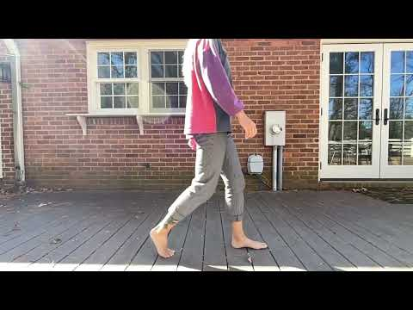
Notes:
This is the sagittal plane view of the the gait cycle. We are going to focus on the lower limb, particularly the foot and ankle for this demonstration.
Appropriate Ankle DF throughout the gait cycle
initial heel contact
COM progression
Clearance for swing
Great toe extension at toe off
Appropriate loading response and shock absorption from initial heel contact to the mid foot during stance (pronation)

Slide 7
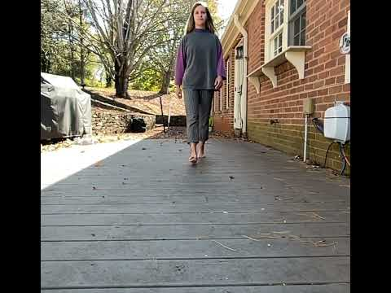
Notes:
This is the frontal plane view of the the gait cycle. Where we will also focus on the foot and ankle for this demonstration.
Want to make sure the foot faces forward the whole time and not having to turn in or out to compensate for sagittal plane
If the toes do turn in or out, try and understand why that may be occurring.
Upon initial contact, is the foot in slight supination and then pronation during the stance phase. These frontal plane movements should be not far off from subtalar neutral.
They shouldn’t be in full pronation or supination throughout, but instead starting slightly supinated and rolling into pronation
Notice where the foot is contacting the ground relative to midline. Is the foot positioned appropriately beneath the COM

Slide 8
Range of Motion Testing
Notes:
We don’t tend to spend a ton of time discussing how we measure passive and active range of motion, as these skills are not the focus of our course. However, we will talk about ROM for sagittal plane motion at the ankle and great toe due to it’s notable consequences up the chain.

Slide 9
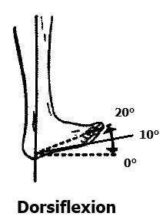
Ankle Dorsiflexion Motion
10-25 degrees is considered normal
10 degrees needed for normal gait
Notes:
Assess with knee bent and evaluate passively (pure ankle quality of motion)
Compare side to side for range, quality of motion, and end feel. Is it the same?

Slide 10
Knee to Wall Test (ADD Photo)
Considered Normal:
  4 inches without compensation into pronation/external rotation

Slide 11
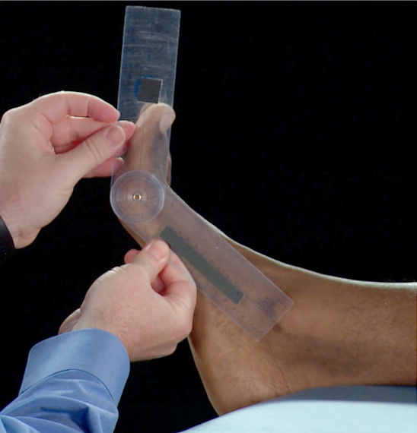
Great Toe Dorsiflexion ROM
Normal 0-70°
Functional requirements of gait 45°
Notes:
Can look at gross ROM and ensure that it is functional.

Slide 12
Movement Analysis
Notes:
This chapter in the foot and ankle lab is on movement analysis. Movement analysis is one of the most important components of the objective exam because not only does it allow you to view clients holistically and functionally, but the movement faults that can be observed will help guide your treatment approach.

Slide 13
Speed and Force of Movement Impact Gait Patterns
Notes:
When assessing movement, it is important to understand that the forces transferred through the lower extremity, based on the speed of forward motion, are dissipated to various degrees by different mechanisms.

Slide 14
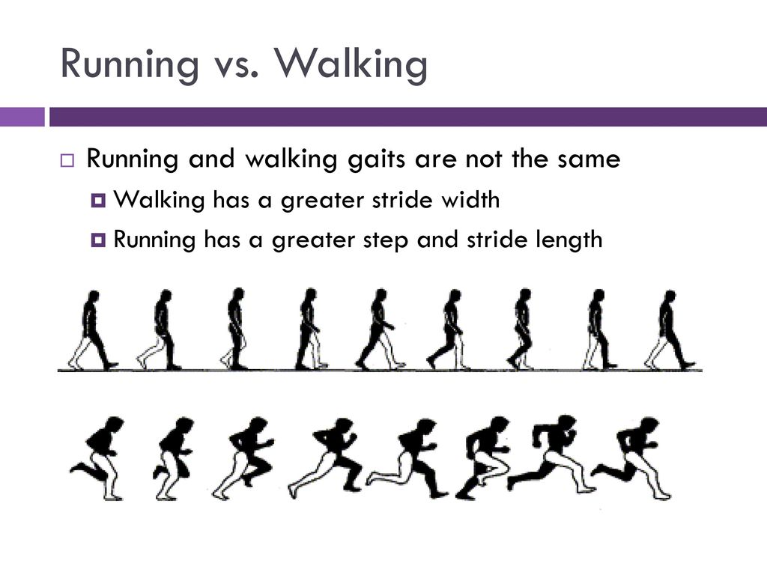
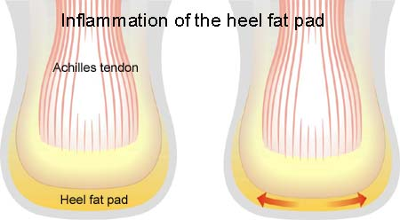
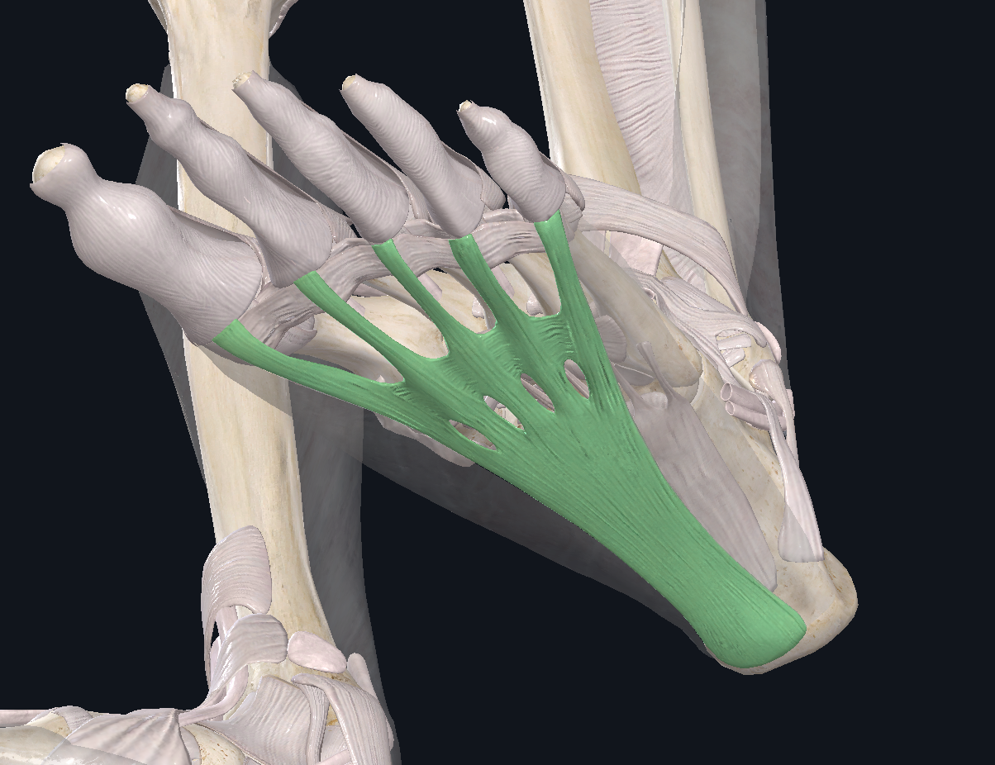
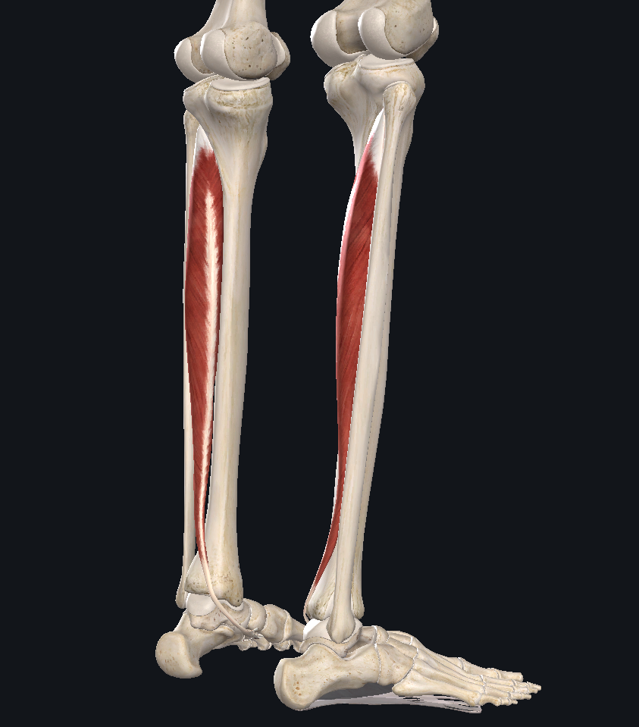
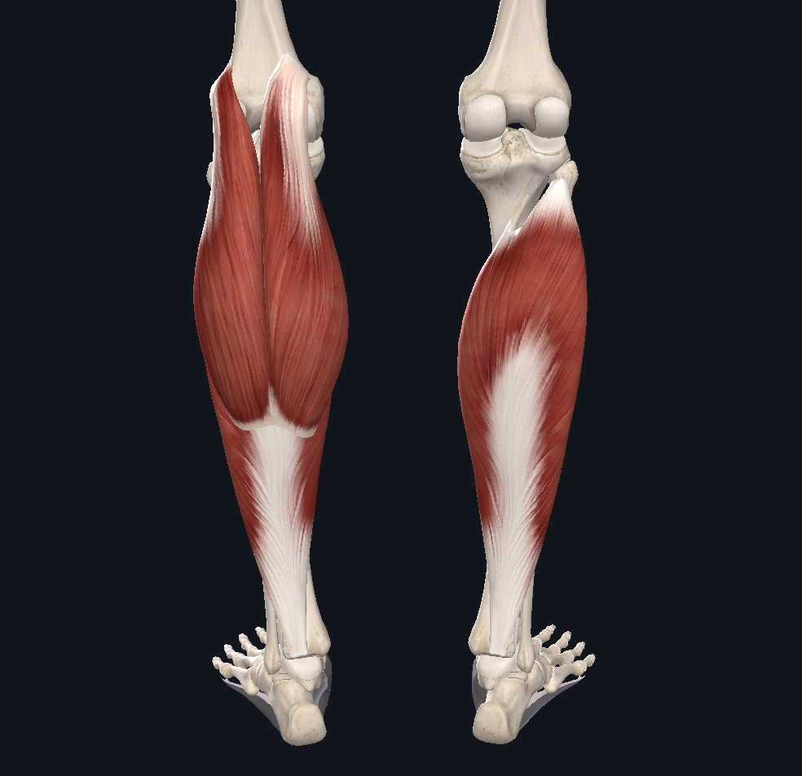
How these structures work to dissipate force
Notes:
It is well know that as gait speeds increase the force transferred through the single leg can be 2 to 5 times one's’ body weight. Based on how much force youre dissipating through the legs (aka the speed of your gait), different structures of the foot will play larger roles in helping to absorb shock.
Let’s review how the active and passive structures of the foot and ankle create stability throughout the continuum of gait speed and force dissipation.
Keep in mind, at all speeds, these structures will function together, but the varying speeds and associated force production will change the percentage of contribution from each structure.

Slide 15
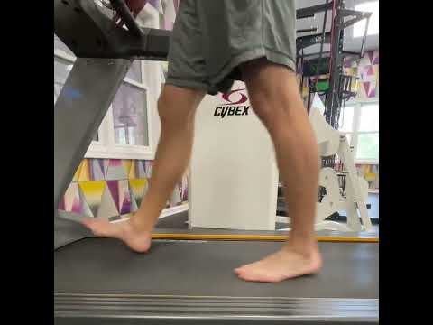
Walking
2.5 mph
Notes:
This video demonstrates what happens when walking at slower speeds.
Most initially heel strike and the calcaneal fat pad dissipates force. As weight is transferred over the foot the passive and active structures of the midfoot function to absorb load.

Slide 16
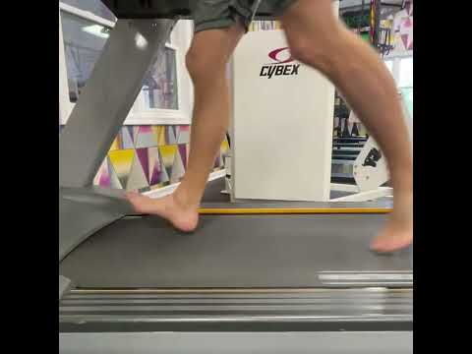
Jogging 5.5 mph
Notes:
Next, we will observe the structures involved at a faster pace such as jogging at 5.5 mph.
With the same subject and without coaching, as the speed of gait increases to a jog, the calcaneal fat pad is not designed to dissipate the increasing loads. The initial foot contact will occur more in the midfoot as opposed to the heel. The responsibility is transferred to the muscles that control pronation and stabilize the arch. Passive structures such as the spring ligament and plantar fascia work with the activate structures to dissipate load as well.

Slide 17
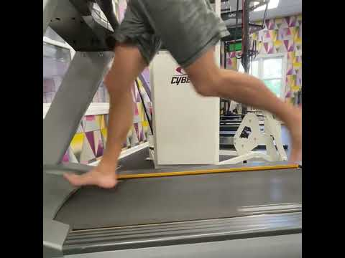
Sprinting/Running
9.8 mph
Notes:
Finally, let’s review the same subject without coaching running at 9.8 mph.
At these speeds, the individual will begin to strike the ground first with the forefoot to allow the gastroc soleus complex, the largest muscles of the lower limb, to absorb shock eccentrically and then concentrically function to propel the body forward.
In this condition, it is important that the midfoot locks via the contraction of stabilizing muscles, primarily the posterior tibialis. This locking mechanism provides a longer lever so the gastroc soleus complex can function effectively and efficiently as a second class lever.

Slide 18
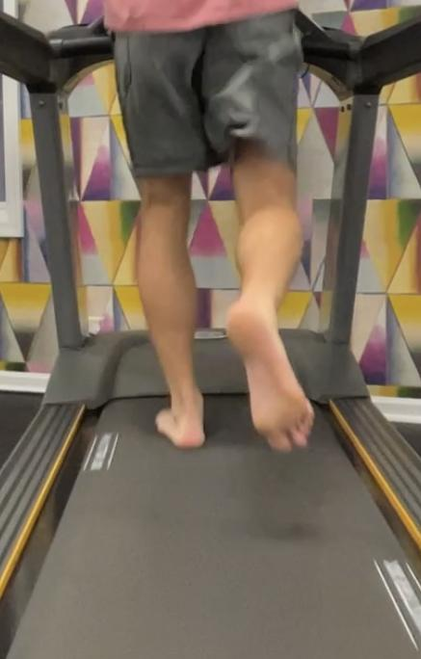
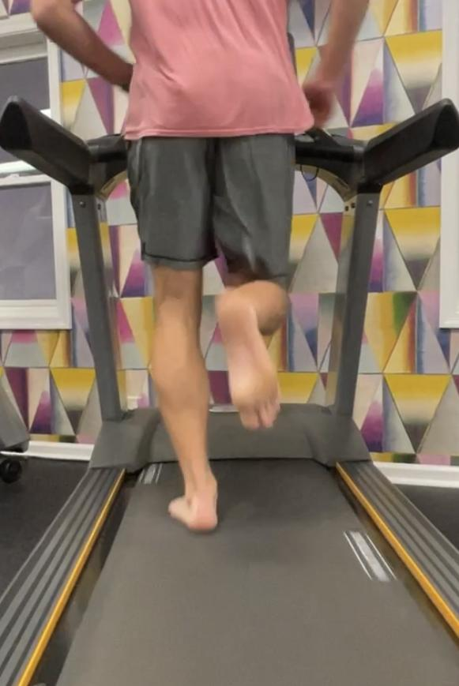
Jogging 5.5 mph
Running 9.8 mph
Notes:
Finally, just to emphasize the point we just made, we can see here the calf musculature is noticeably more engaged in the sprinting demonstration video on the right

Slide 19
Abnormal Gait: Hallux Valgus (Bunions)
Notes:
After reviewing examples of the normal gait cycle, we will now focus our attention on dysfunctional movement faults caused by specific body impairments. Let’s start with the big toe.

Slide 20
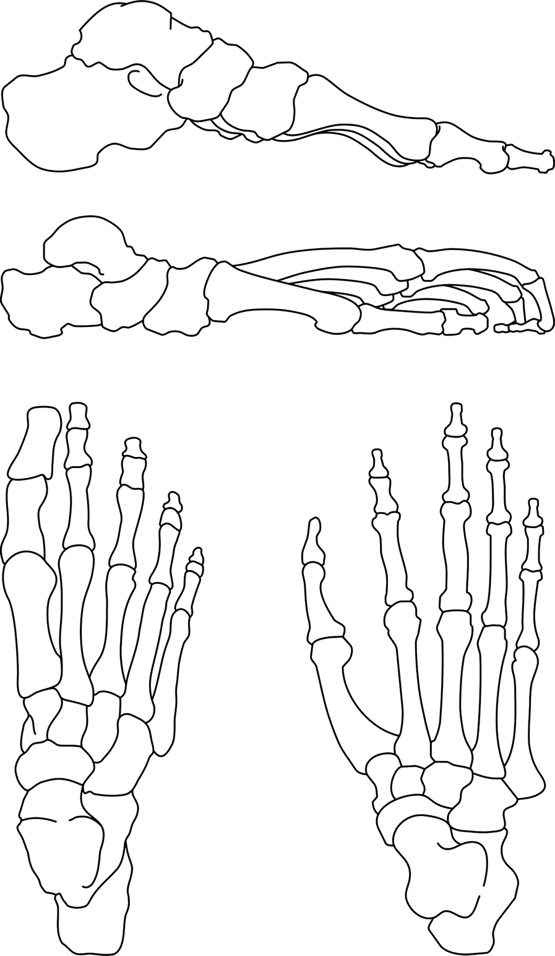
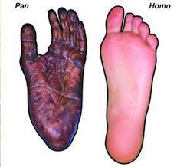
The Great Toe Migration
Notes:
The migration of the more robust great toe to its position next to the second toe helps support frontal plane stability needed for functional unipedalism. This along with some other key adaptations including a more stable subtalar joint and the development of a medial arch designed to dissipate force were essential to the stability and efficiency in our movement patterns.
Recall that 70% of the human gait cycle takes place on one leg. And it is well known that this percentage increases with increased gait speed. Evolutionary changes were made to facilitate stability in single limb stance.
There is a reason the big toe is big and the little toe is little. A bigger first toe allows for improved leverage to assist in supporting the medial longitudinal arch. Supporting the arch at the foot is a critical step in maintaining frontal plane stability up the kinetic chain.

Slide 21
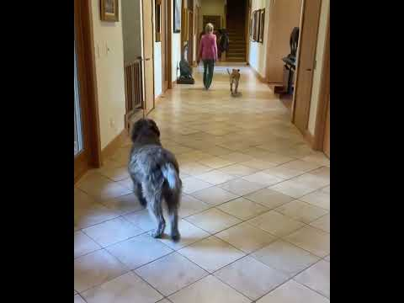
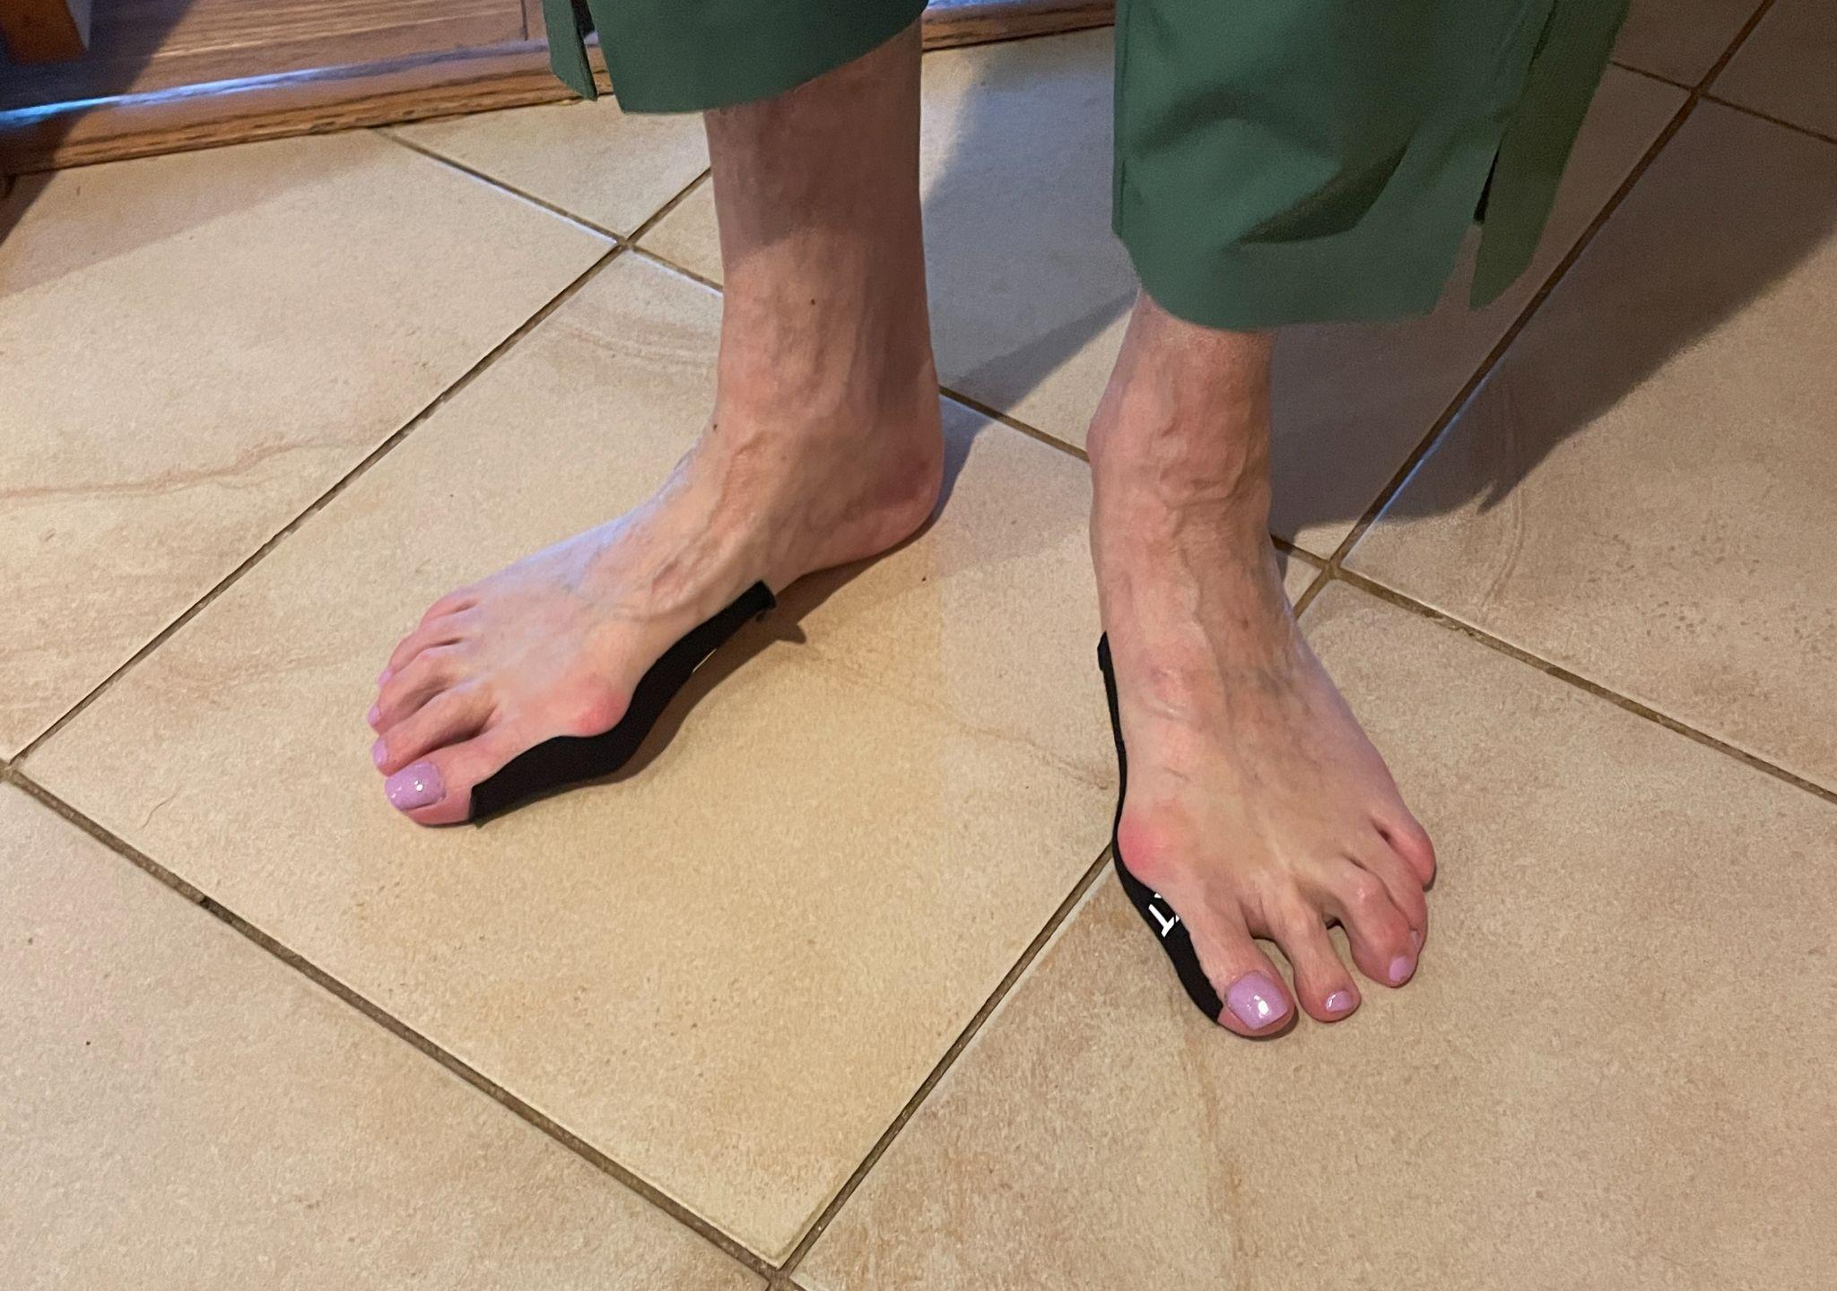
Gait Dysfunction: Hallux Valgus (Bunions)
Notes:
Let’s see what happens when the great toe loses this proper alignment and is unable to effectively support frontal plane stability.
In this example, in the case of hallux valgus aka bunions, the big toe has lost the position to provide medial foot stability. As a result, the subject is weight bearing more aggressively on the lateral aspect of her foot. She is also striking the ground closer to midline and directly beneath her center of mass to compensate. It is almost like she is walking on ice skates. If she were to strike the ground further laterally, she would require a lot of hip and big toe strength to stabilize the frontal plane. With the hallux valgus present, she is unable to.
Furthermore, another compensation that can be observed with this example is the lateral/external rotation of the lower leg. This is a compensation that attempts to improve frontal plane stability

Slide 22
Abnormal Gait: Limited Ankle DF
Notes:
Next, let’s see what happens when the ankle is too tight at midstance in the case of limited dorsiflexion due to excessively tight achilles.

Slide 23
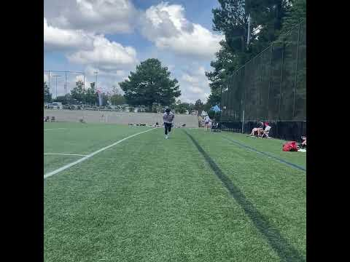
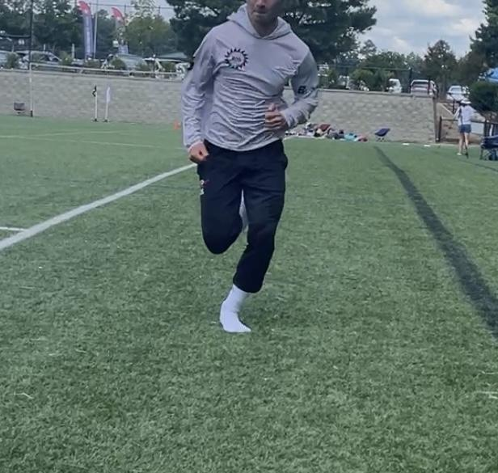
Gait Dysfunction: Limited Ankle DF
Notes:
Since limited DF ROM will restrict the ability to progress COM over the foot in the sagittal plane, the body will compensate in the transverse and frontal plane.
Most commonly, when someone has limited DF, you will see the foot turn outward at midstance as they transition to toe off due to their inability to bend at the ankle joint. You can that here in this video demonstration.
Because he is turning his foot out, the structures that control pronation have weakened overtime. As he increases movement speed, these weakened structures cannot lock the midfoot and control the eccentric increased loading associated with these increased forces.
Keep in mind, there are multiple gait patterns and compensations that exist to accommodate decreased ankle mobility and this is not the only one. A couple examples that aren’t seen here include reduced heel contact time with a bouncing gait, or excessive knee extension.

Slide 24
Abnormal Gait: Limited 1st MTP Extension
Notes:
This next abnormal gait presentation looks at the impact of reduced great toe extension.

Slide 25
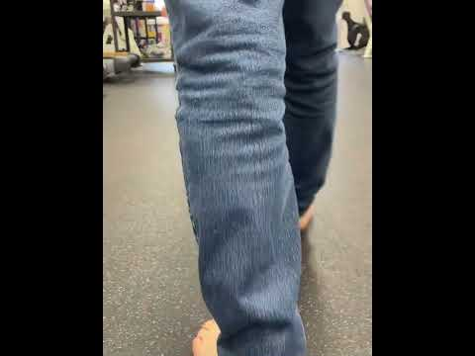
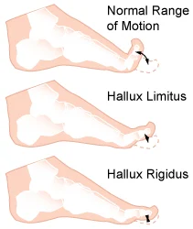
Gait Dysfunction: Limited Great Toe Extension
Notes:
What happens if one is unable to extend the great toe when transitioning from midstance to toe off?
Recall that you need approximately 45 degrees of great toe extension for normal gait. This subject has hallux rigidus which severely limits first toe extension. Let's analyze a video of him walking.
With limited motion of the the great toe, the intrinsic and extrinsic muscles of the medial arch weaken over time. This is due to the fact that one is unable to achieve the normal biomechanics associated with walking. It’s like having a cast on the big toe and the muscles around it atrophy.
As a result, the subject must turn his foot out in a similar manner to what we saw in the case of bunions. The purpose of this compensation is to increase contact area to improve frontal plane stability as the arch is failing to serve its role.

Slide 26
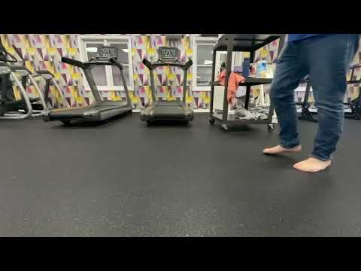
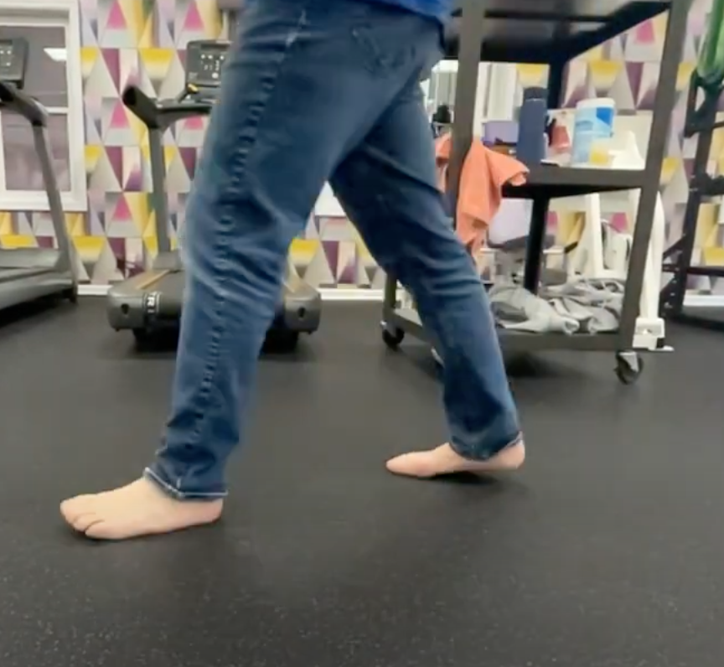
Gait Dysfunction: Limited Great Toe Extension
Notes:
In the the sagittal plane we can appreciate different compensations that exist.
Notice due the inability to achieve the toe-off extension in the terminal stance phase of the gait cycle, he is unable to generate any vertical displacement with the gastroc / soleus complex. As a result, his heel lifts off the ground early and requires excessive motion at the hip to allow for foot clearance.

Slide 27
Movement Dysfunction: Unable to Maintain Subtalar Neutral
Notes:
The next example we will analyze is how excessive pronation and a weakened posterior tibilias muscle impact functional motion.

Slide 28
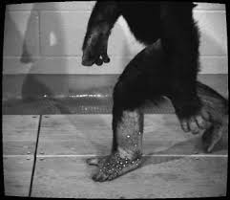
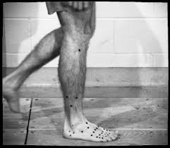
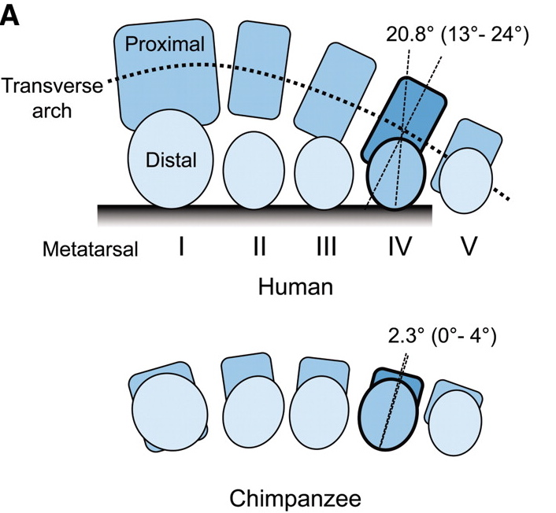
The Medial Arch
Notes:
Before we start, let’s review the evolutionary adaptations of the arch.
As bipedalism developed and hominids became functional unipeds, the need to dissipate ground reaction force increased as the body mass was supported by one LE during most of the time in the gait cycle.
The foot went from needing to be flexible with the ability to grasp onto trees to needing to become stable and capable of pushing off the ground along with absorbing force with each step.
Though both chimpanzees and homo sapiens possess the same 26 foot bones, homo sapiens adapted to have a much stiffer mid foot through the increase in ligamentous support, increased joint congruency through changes in bone shape and orientation, and reinforcement through the muscular action. These changes allows for the formation of both a medial longitudinal and transverse arch.

Slide 29
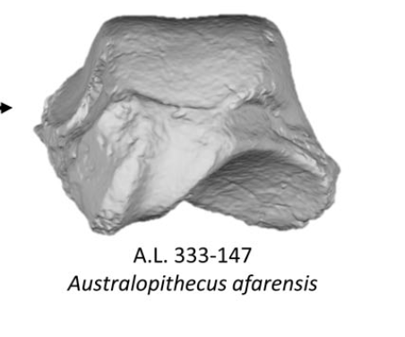
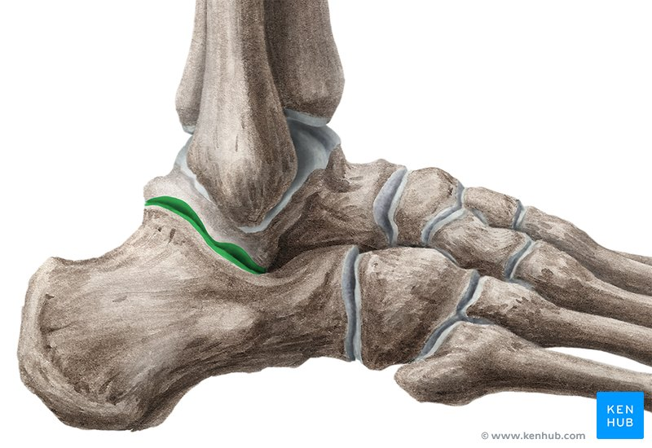
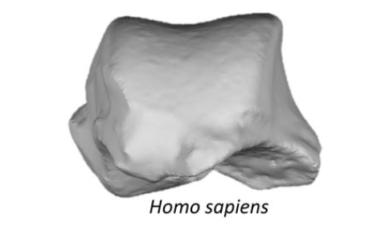
More Stable Subtalar Joint
Flattened Subtalar Articular surface
Notes:
Perhaps the most impactful bony adaptation of the foot and ankle are the changes to the subtalar joint.
The adaptations to the subtalar joint greatly contributed to the stability in the foot. The subtalar joint flattened, and increased joint contact surface area. This change decreases the range of motion available, but improves overall stability. Maintaining the neutral alignment of the subtalar joint is critical to LE stability. Subtalar neutral is maintained by both passive and active structures.
Throughout the course, you will see that if you can’t maintain subtalar neutral during gait and functional compound movements, then there will be drastic effects up the kinetic chain.

Slide 30
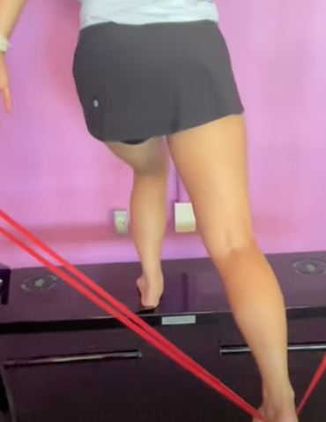
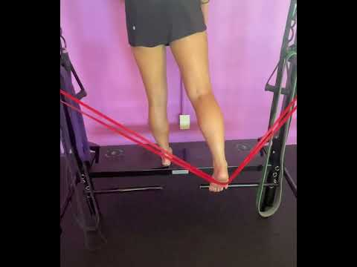
Movement Dysfunction: Flat Feet
Notes:
Instead of looking at gait for this example, we will use a single leg movement with only one point of stable contact which best mimics our functional movement patterns.
This individual has a weakened arch and is unable to hold subtalar neutral as she collapses into pronation when loaded.
First, the tibia falls inward and the rest of the kinetic chain will begin to compensate. Instead of falling over in the direction of the tibia, the upper leg shifts in the opposite direction to position the COM over the BOS. This causes increased knee valgus or functional Q-angle, which is associated with increased injury rates at the knee joint.
There are many aberrant motion patterns we could discuss as a result of suboptimal foot function, we just highlighted a few common ones. All of these aberrant motion patterns can impact injury risk, performance, movement speed, fall risk, and more.

Slide 31
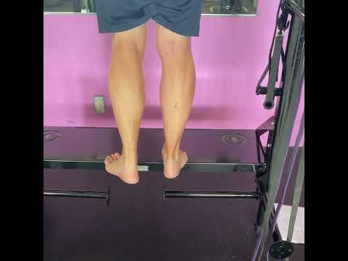
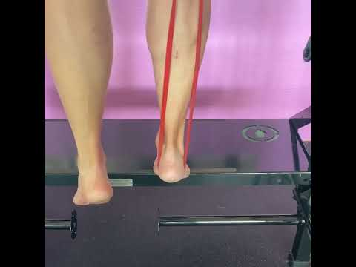
Posterior Tibialis Weakness
Notes:
In this example, you can see during this single leg calf raise, when the posterior tibialis struggles to lock the mid foot as seen in the video to the left, the individual is more unstable throughout the motion. You can see this through the loss of subtalar neutral and the swaying of his COM.
Just by offloading a small percentage of his weight with the assistance band, in the example on the right, he is better able to hold ankle stability. This can be observed by looking at the distance of the achilles from each malleoli. In this video, the achilles equally bisects the two ankle bones.

Slide 32
Evolutionary Mismatch
Notes:
We’ve talked about the importance of the active and passive structures in maintaining subtalar neutral, arch stability, and dissipating ground reaction forces. In order for the active structures to function properly they must remain strong and biomechanically sound. The cushioning and restrictive nature of modern footwear both contribute to altered biomechanics and disuse of the active stabilizers of the foot.

Slide 33
Heel Strike
Notes:
Let’s begin by discussing modern cushioned shoes. Cushioned shoes allow individuals to comfortably heel strike even when gait speeds increase. Overtime, when the active stabilizers of the foot are not used properly or how they are intended to be used, they weaken.

Slide 34
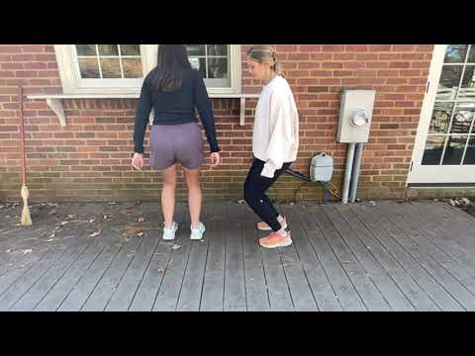
Effects of Cushioned Shoes: Heel Strike
Try this at home!
Notes:
First, we’ll do a quick demo. You can try this at home. Jump with running shoes or sneakers on and land on your heels.
How high can you jump? How comfortable are are you landing on your heels? When we watch these two individuals try this, they get pretty high off the ground.

Slide 35
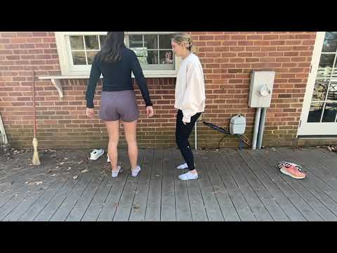
Effects of Cushioned Shoes: Heel Strike
Try this at home!
Notes:
Okay, now let’s do the same thing without shoes on.
Notice how much less willing you are to jump and land hard when you don’t have the cushion support of your shoes.
Each step we take demonstrates this effect. If we are heel striking and relying on cushion to absorb forces, as speeds and forces through the foot increase, then the natural progression of the active stabilizers to dissipate force is lost.
We can see this more clearly in the following videos.

Slide 36
Jogging
5.5 mph
Notes:
Recall this video of the structures involved with jogging gait speeds.
In a more evolutionarily natural barefoot gait, force dissipation occurs through muscles and passive structures that control pronation and stabilize the arch as the initial foot strike occurs at the midfoot.

Slide 37
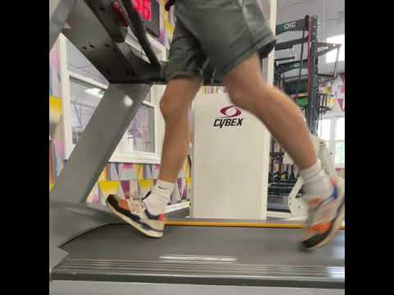
Jogging
5.5 mph
Notes:
What is happening here when he wears cushioned shoes? Is he landing with the same foot contact? This is the same subject, at the same speed, without any coaching.

Slide 38
Sprinting/Running
9.8 mph
Notes:
Now let’s review what happens at higher speeds. In sprinting gait, the midfoot locks to provide a longer lever so the gastroc soleus complex can function to eccentrically dissipate load. The initial foot contact occurs at the forefoot.

Slide 39
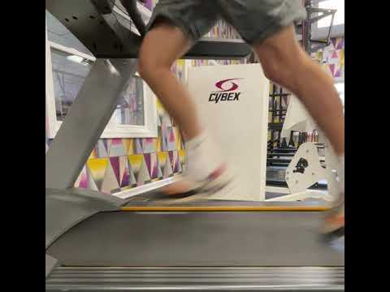
Sprinting/Running
9.8 mph
Notes:
Again, this is the the same subject, at the same speed, without any coaching.
Cushioned shoe essentially thickens the heel fat pad and allows for unnatural force dissipation through heel striking at higher speeds. The consequence of heel striking at higher speeds is an overstriding gait. With an overstriding pattern, the knee is placed in a closed packed position when accepting load and the muscles around the knee are less able to dissipate this load. This results in the bones and passive structures absorbing initial impact at a faster rate, versus the more desirable active structures which slow and dissipate these forces.
Overtime what happens to passive and active structures? If we continue to be reliant on the cushion of our soles to dissipate forces rather than our foot and leg musculature, injuries to these passive structures are more at risk to occur and our natural mechanisms are weakened.

Slide 40
Disclaimer
Notes:
Disclaimer: your musculoskeletal structure needs to be well prepared to make these biomechanical switches in running activity if you have historically always been a heel striker. You must slowly make this transition because the muscles need time to adapt. When injury does occur in a normal gait pattern, it is typically due to the musculoskeletal system being ill-prepared.

Slide 41
Running Cadence

Slide 42
Running @ 165-180 bpm is generally a good strategy to encourage both a shorter stride and midfoot-forefoot strike… Let’s try it
Helpful cue: “find a cadence that feels most comfortbale in this range”
Notes:
This is not the answer for everyone, but it generally is a helpful cue for most people, especially habitual heel strikers (recall increased rates of vertical GRF in heel strikers and its correlation to stress injuries!)
Landing just under your ASIS (or just in front of the hip), i.e., a short stride, encourages landing on your mid-forefoot.
Citation:
Basheer M. ameen R. QUANTIFYING THE IMPACT OF RUNNING CADENCE ON BIOMECHANICS, PERFORMANCE, AND INJURY RISK: A PHYSICS-BASED ANALYSIS. Science Journal of University of Zakho. 2024;12(2):237-243. doi:10.25271/sjuoz.2024.12.2.1233

Slide 43
Decreased Stability
Notes:
Another effect of cushioned shoe wear is decreased stability. The cushioning of the shoe itself is an unstable surface, making it very difficult for the feet, specifically the great toe, to purchase the ground effectively and influence arch position. The cushioning in modern footwear impairs sensory input in static and dynamic tasks.

Slide 44
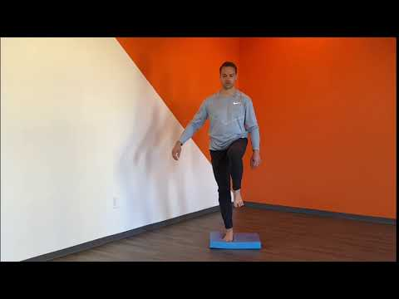
Effects of Cushioned Shoes: Decreased Stability
Notes:
We can use the airex pad in the video above as an extreme example of what cushioned shoes might do to the foot and the rest of the kinetic chain.
When he initiates single leg stance, he shifts his COM over to the right which facilitates achieving balance by re-positioning his COM over his base of support through a weight shift versus through the combined muscular effort of the foot, hip and core stabilizers.
Now notice the foot struggling to stay stable. A lot of research equates increased EMG activity with improved muscle function, however, that’s occurring because the foot is struggling to purchase the ground. Not because the muscles are functioning to stabilize the frontal plane as intended.

Slide 45
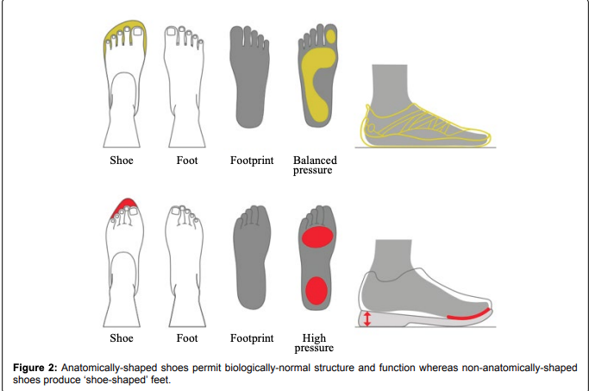
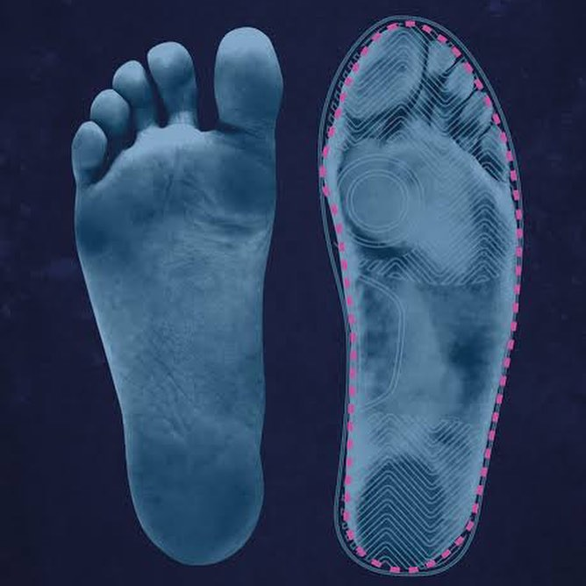
Effects of Cushioned Shoes: Decreased Stability
Notes:
Finally, the other reason footwear can inhibit foot stability is due to its restrictive nature. As we’ve mention ad nauseum, the big toe needs the ability to spread and contact the ground to facilitate proper foot function.
Narrow toe boxes and tight socks constrict the motion of the great toe similar to putting a cast over a joint. This lack of motion weakens the abductor hallucis. That, combined with the tightness of the connective tissues between the toes cause the great toe to migrate to an adducted position overtime. This is the reason we see bunions so commonly in modern day culture.
When the big toe is not in its proper position, we lose frontal plane stability because the big toe is unable to function as effectively to support the medial longitudinal arch.

Slide 46
Intervention
Notes:
We just spent a lot of time looking at dysfunctional movement patterns, now let’s talk about some ways to treat and address these movement faults!

Slide 47
Treatment: Bunions
Notes:
We will begin this section discussion treatment options for hallux valgus aka bunions

Slide 48
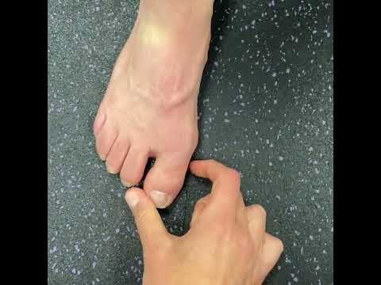
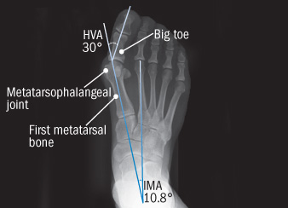
Hallux Valgus / Bunions
Notes:
Before you begin implementing a treatment plan, you must first assess one’s capacity to improve toe position.
In this video, we can see that while this individual has a pretty aggressive bunion, they have the capacity to improve because the ROM is available.
Additionally, this individual was able to respond to verbal and tactile cueing to activate and engage the intrinsic muscles that will help to improve the alignment and function of the great toe.
After you begin foot strength training, you will monitor the progress of the angle overtime.

Slide 49
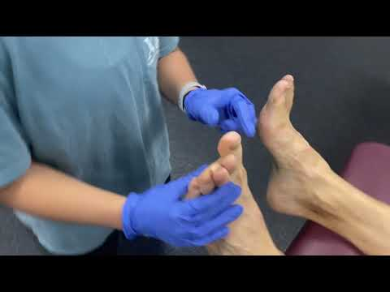
Strengthen the Abductor Hallucis
Notes:
As you might recall, the abductor hallucis works in an open chain to support the alignment of the big toe. Therefore, we want to strengthen this muscle in an open chain. We can do this with someone providing manual resistance to the medial side of the big toe as demonstrated here in this video.

Slide 50
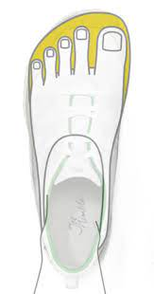
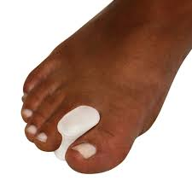
Improve Great Toe Alignment
Notes:
Not only should we consider which specific muscles to target, but improving the conditions in which the feet are functioning under is also a crucial component of intervention. Remember, bunions don’t exist in non shoe wearing communities.
Promoting minimalist footwear with a wide toe box can help restore foot function, though this process must be gradually. Additionally, toe spacer and taping can help to stretch the tight connective tissue associated with hallux valgus.
In the case of chronic bunions, the joint changes might permanently restrict motion and you may require external support such as taping or orthotics.

Slide 51
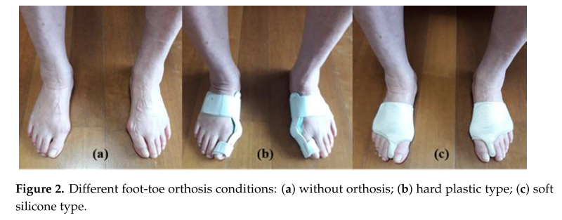
Great Toe Orthotics & Hallux Valgus that is Not Correctable
Notes:
Kim Y. Effects of Foot-Toe Orthoses on Moment and Range of Motion of Knee Joint in Individuals with Hallux Valgus. Life. 2023;13(5). doi:10.3390/LIFE13051162
Biomechanical gait variables collected from 24 participants with hallux valgus using soft and hard orthotics. Found rigid orthosis at the big toe to correct for hallux valgus was significantly better than soft/silicone orthosis at decreasing knee adduction and external rotation moments with implications for knee OA with age and hallux valgus
Rigid orthosis are the best at controlling motion up the chain and promoting proper joint alignment, however, current models are bulky and uncomfortable, and not realistic to wear with shoes. Also have to consider the rotational component of bunions that alters the action of the flexor hallucis longus, big toe orthotics don’t address this

Slide 52
A Word about Proper Footwear
Notes:
We’ve talk a lot of the effects of cushioned shoes and modern footwear so now let’s follow up with some potential solutions and ways we can maximize proper biomechanics and LE function with the footwear we choose.

Slide 53
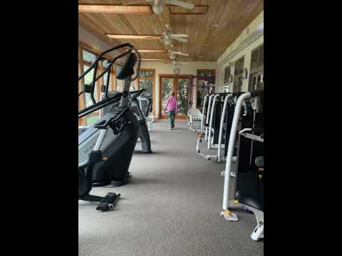
Orthotics
Notes:
We’ll start this conversation with orthotics. Orthotics are a tool, frequently overprescribed, but in some cases very necessary.
Remember our subject with bunions? Because the hallux valgus has limited potential to heal fully due to the fused 1st MTP joint, orthotics are utilized in this example on the left. The orthotic offers medial arch support that she is unable to achieve due to the limitations in her own foot structure and musculature. You can notice that the orthotic is improving her ability to point her toes directly ahead and reducing the amount of frontal plane aberrant motion that is occurring compared to the video on the right.
In the majority of the cases, orthotics should be used to help offload tissue during an injured or weakened state. The goal should not be to become reliant on them, but rather slowly work your way out of needing them. The way that this is achieved is that once symptoms are under control, in addition to wearing the orthotics, the individual is concurrently strengthening of the natural mechanism. Over time, they should be able to wean off of their need for the extrinsic foot support because their own intrinsic mechanisms are sufficient.

Slide 54
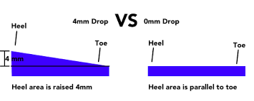
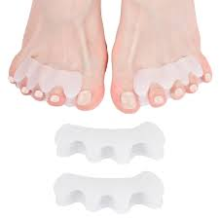

Proper Footwear
Notes:
Minimalist shoe wear - encourage proper gait mechanics
Wide toe box shoes
Heel drop in shoes - 0mm
Increased heel drop promotes heel contact gait pattern at all speeds which takes away from natural progression of mechanisms
Pre set in a plantar flexion - requires more DF throughout the gait cycle
Even when in a neutral position of the foot, the heel will contact first
When you are supposed to transition to more of a midfoot strike, you can’t because the cushion will contact first
Cascade of events that can result in foot weakness and loss of function/ and exacerbate faulty biomechanics
Promotes plantar fasciitis and achilles tendonitis
Toe socks - Toes move freely in shoe
Toe spacers to stretch out tight tissue
Xu J, 2025 (UVA PhD student in Kinesiology Dept.)
Xu J. The Effects of Rehabilitation and Minimalist Shoes on Pain, Strength, and Function in Adults With Plantar Fasciopathy. Published April 23, 2025. Accessed June 15, 2025. https://libraetd.lib.virginia.edu/public_view/d791sh753
Individuals with plantar fasciitis who performed strengthening exercises (calf raises and foot intrinsic exercises) daily for 8 weeks, with or without the addition of minimalist shoes, significantly decreased pain and increased their function. A larger % of those in the group with minimalist shoes achieved MCID in self-perceived function. Most importantly, the addition of minimalist shoes did not take away recovery ability.
**If you’ve never back squatted before, you wouldn’t walk up to a barbell and try to move 200lbs. That is the same reason that if you have deconditioned feet, you shouldn’t immediately jump to barefoot and minimal shoewear all the time. Your body needs time to adapt.

Slide 55
Treatment: Achilles Stretch w/ Midfoot Support
Notes:
One of the movement dysfunctions we reviewed was the impact of decreased ankle dorsiflexion on our gait. Decreased ankle mobility due to tight achilles is a common impairment that can results in many compensations up the chain. Let’s spend time reviewing how to stretch the achilles.

Slide 56



Achilles Stretch
Notes:
There are many options to stretching the calf and achilles structures. For example, you can assume a split stance position, use a step to hang your heel off the edge, or a slant board like we can see here.
When stretching the achilles, we emphasize maintaining subtalar neutral. Here in this example you can see in order to reduce the midfoot collapse, we provided medial support to the arch. You can compare the foot and ankle alignment looking at the pictures to the right - one without the arch support, and one with it.
If you remember from the movement analysis section, it is common to see frontal and transverse plane deviations to compensate for restricted motion. For example, individuals may pronate at the midfoot or external rotate their feet outwards to accommodate the mobility deficit. We want to make sure we reduce those compensation during intervention because if we don’t, are we really solving the problem?
Lastly, the connective tissue of the achilles is dense and requires extensive time under tension to produce meaningful change when stretching. For this reason, the greatest efficacy requires long duration holds 2-3 minutes and frequent bouts throughout the day.

Slide 57
Treatment: Functional Foot/Ankle Strength
Notes:
The feet are often neglected and many clinicians and trainers won’t ask that their clients remove their shoes at all. However, after everything we’ve discussed and learned we can see just how foot function impacts the rest of the body.
It is clear where we stand in terms of the importance of strengthening the foot muscular, but how do we go about this? We will talk about some of our favorite exercise to use as part of the training process in the next demos.

Slide 58


Seated On-Point: Flexor Hallucis Longus and Brevis
Notes:
This first exercise is called seated on point and it targets the flexor hallucis longus and brevis.
You can resist this exercise by looping a band around the long band holders in the front of the step. If you need to assist this exercise, you can put the band beneath the heels.
In this exercise, you will raise up on your toes without bending at the first MTP joint. You should be barefoot or in toe socks when performing this exercise.
This is training the flexor group in a closed chain which best mimics function and with proper training, these muscles will greatly improve arch biomechanics.
Note, imporatnt to coach foot muscle coordination first with toe yoga and arch draws if not already present

Slide 59

Seated On-Point: Flexor Hallucis Longus and Brevis
Notes:
During this exercise, it is important to be aware of compensations or signs of weakness. One common compensation is the patient leans their trunk back to reduce the load on the feet.
Another common sign of weakness is pictured above. In this example, the flexor hallucis longus is overpowering the brevis and flexing the great toe at the distal joint because the FHB cannot maintain a rigid lever. We can also see the little toes are starting to flex in an attempt to assist the big toe muscles.

Slide 60




Single Leg Calf Raise - Maintain Subtalar Neutral
Notes:
One of the most important muscles in terms of foot function is the posterior tibialis as it plays a major role in stabilizing the arch and helping to dissipate ground reaction forces. This muscles functions in a closed chain so we must train it in a closed chain.
While there are several modifications to make this exercise easier or harder to match the needs of the client, we are going to review the example above, which happens to be one of the most advanced variations of this exercise.
This individual is performing a single leg calf raise while maintaining subtalar neutral and with a resistance band pulling her into pronation. The posterior tibialis muscle first engages to supinate the foot against the red band and then maintains a contraction to stabilize the arch and create a rigid lever at the midfoot for the gastroc soleus muscles to effectively lift the heel.

Slide 61
Treatment: Functional LE Single Leg Exercise
Notes:
In order to holistically address foot and ankle function, the structures need to work successfully together in compound movement patterns.
For that reason, the last exercise we will review is the single leg split squat with only one foot on a stable surface to fully challenge the stabilizing mechanism of the LE. You will notice that this exercise and variations of single limb movements will come up frequently in intervention plans due to the holistic nature and functional demands of this exercise.

Slide 62


Split Squat - Functional Movement
Notes:
As you know, stability starts at the foot. One of the best ways to target foot strength is through barefoot single leg training because without first stabilizing at the foot, the quality of the entire movement will decrease.
Trying to stabilize your arch and keep your big toe fixed to the ground is challenging to do against body weight and gravitational forces. As one is able to stabilize the foot against these forces, the single leg exercises become more effective at targeting the larger muscle groups around the hip and knee joint.

