Slide 1
General Lab Concepts
Prior to Starting an Exercise Program
David Luedeka PT, DPT, MS, CSCS
Keila Strick PT, DPT, CSCS
Caroline Williams, PT, DPT, MS, GCS
Nick Roche, PT, DPT, CSCS

Slide 2
Client History

Slide 3
Initial client interaction:
Very important component in developing an exercise plan and for anyone in a health related field

Slide 4
It all begins with listening!
Before collecting objective data and determining exercise prescription, you must first take a thorough client history.
Notes:
Tell me about what’s been going on?

Slide 5
Taking History and Developing Rapport
Arguably the most important part of any client/patient interaction
Repeat answers
  Makes sure you are interpreting the info correctly
  Lets the client know you care
Listen for clues
  Patterns to when symptoms present vs resolve
Ask open-ended questions
Notes:
“Just to make sure I understand, you have been having pain with running for three months. Do I have that right?” - summarize, check in to ensure understanding
Same idea with teach back education: “Just to make sure I explained that correctly, can you summarize in your own words what we discussed?” ensures client understands

Slide 6
What information do we want to gather from the patient history?

Slide 7
Pre-Participation Screening

Slide 8
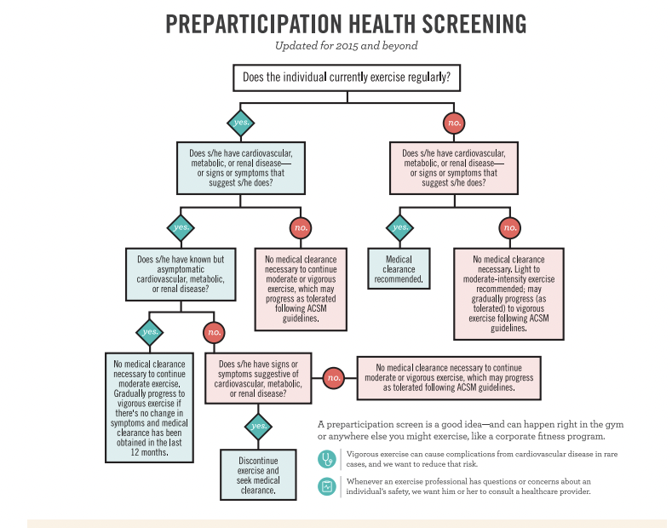
ACSM Pre-Participation Screening
Notes:
Updated to support current evidence that most people are indicated to exercise, and risk of adverse events are pretty low.
Clients at student health will complete this, and we have a copy at FCAP to begin implementing prior to initiation of exercise for new clients as well.

Slide 9
Signs and symptoms suggesting CV, metabolic, renal disease (ACSM 11th edition)
Pain/discomfort (pressure, ache) in chest, shoulders, arms, neck, jaw that may result from ischemia
Shortness of breath at rest/with mild exertion
Dizziness/syncope
Orthopnea: dyspnea in reclined position alleviated with upright positioning
Paroxysmal nocturnal dyspnea: shortness of breath waking person up after ~2 hours of sleep and resolves with upright position
Ankle edema
Palpitations/tachycardia (elevated HR)
Intermittent claudication: “cramping” pain during exercise/exertion relieved within 1-2 minutes of rest
Known heart murmur
Unusual fatigue/shortness of breath with usual activities
Notes:
(acsm’s guidelines for exercise testing and prescription 11th edition)
Signs and symptoms suggesting CV, metabolic, renal disease
Pain/discomfort (pressure, ache) in chest, arms, neck, jaw that may result from ischemia
Shortness of breath at rest/with mild exertion
Dizziness/syncope
Orthopnea: dyspnea in reclined position alleviated with upright positioning
Paroxysmal nocturnal dyspnea: shortness of breath waking person up after ~2 hours of sleep and resolves with upright position
Ankle edema
Palpitations/tachycardia (elevated HR)
Intermittent claudication: “cramping” pain during exercise/exertion relieved within 1-2 minutes of rest
Known heart murmur
Unusual fatigue/shortness of breath with usual activities

Slide 10

Identify Red Flags!
The presence of a sign or symptom or a cluster of signs and symptoms, identified during the history, systems review, or objective exam process, that indicates the need to refer out to a physician
Beyond the scope of our profession
Notes:
At all points in the care plan

Slide 11
Is this person appropriate for PT/Exercise, or do I need to refer out?
Musculoskeletal Pain
Systemic Pain
Mechanically based pain
Better at rest
Continuous or intermittent
Appropriate for continued care!
Not aggravated by mechanical stress
Can be constant
MD referral necessary!

Slide 12
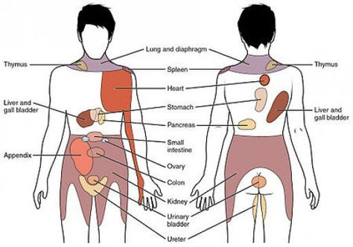
Referred Pain
Referred pain: pain perceived in area other than site of injury/source
MSK referred pain
Radicular versus referred pain
Organ system/visceral referred pain
How to tell? Characteristics
  Constant versus changing intensity
  Change in pain after meals?
  Nature of pain? Sharp, dull, etc
Notes:
What is referred pain?
Can be MSK sourced Mitch L hip bursitis referred pain to L knee
Radicular versus referred pain
Importance of screening back for extremity injury/pain
Organ/visceral referred pain (pain in area other than injury site - visceral afferent neurons synapse at level of afferent somatic nerve where pain response is distributed - “crossed wires” or “visceral sensory reflex”)
https://www.ncbi.nlm.nih.gov/pmc/articles/PMC10338069/

Slide 13
Review of Systems Screening Questions
10 item questionnaire identified responders with red flag conditions at 94.7% accuracy
23 item questionnaire identified responders with red flag conditions at 100% accuracy
Tested in an outpatient orthopedic setting
George et al., Development of a Review-of-Systems Screening Tool for Orthopaedic Physical Therapists: Results From the Optimal Screening for Prediction of Referral and Outcome (OSPRO) Cohort, Journal of Orthopaedic & Sports Physical Therapy, July 2015.
Notes:
372 / 393 responders
23 item captured all 393 responders that had a red flag condition
10 item questionnaire - more realistic in clinical setting

Slide 14
Review of Systems Screening Questions
10 Questions - Have you recently experienced?
Abnormal sensations (e.g. numbness, pins and needles)?
Headaches?
Night pain?
Sustained morning stiffness?
Lightheadedness?
Trauma?
Night sweats?
Constipation?
Easy bruising?
Changes in vision?
George et al., Development of a Review-of-Systems Screening Tool for Orthopaedic Physical Therapists: Results From the Optimal Screening for Prediction of Referral and Outcome (OSPRO) Cohort, Journal of Orthopaedic & Sports Physical Therapy, July 2015.
Notes:
A lot of these questions require further context before we can make a decision re: red flag

Slide 15

Is it safe to start an exercise program? If Unsure then Refer
Notes:
AKA let Keila and I know
-medical abbreviations (in education folder of Slack)
-two new exercises: standing erector spinae, and the diagonal set-up for step ups

Slide 16
Medical History

Slide 17
Practice History Taking
Listen and ask appropriate questions
In health related fields, the history is the most important component of the patient/client interaction
70 to 80% of diagnoses can be determined through a thorough history alone
In exercise prescription it helps to determine which exercises are appropriate for a given structural fault
Notes:
These “clues” guides where your thought process for the rest of your examination

Slide 18

Medical History
Chief Complaint(s)?
  Location?
  Nature? - e.g. achy, tingling, sharp, dull, throbbing
  Intensity? - e.g. 1-10 pain scale
  Duration? - e.g. onset acute, chronic, time for symptoms to resolve after onset
  Frequency?
Demographic
  Certain pathologies are more common in certain age groups
Notes:
Nature of the pain
Stabbing/Radiating/Burning: Neuropathic pain terms
Throbbing: Vascular in nature. Headaches?
Dull: Lower level but steady. Can change in intensity. Joint?
Sharp: Harsh severe and local. Organ system?

Slide 19
Demographics
Younger Population
Older Population
Congenital anomalies
Overuse injuries at developmental stage (common with no off season)
Disc imbalance
Female: ACL
Lots of others
Wear and tear
Osteoarthritis
Stenosis
Organ system issues
Lots of others
Notes:
Keeping this in mind as part of your detective work

Slide 20
Medical History
Is the pain constant or intermittent?
  Intermittent pain most likely mechanical.
  Constant pain that changes intensity is intermittent pain.
  Pure constant pain needs to be referred out to MD

Slide 21
Medical History
What makes the pain better? What makes the pain worse?
  E.g. Standing, sitting, motion, resisted motion, rest
  Helps to understand the pattern of symptoms
  Helps in developing the exercise plan
Timing of pain? Morning? Evening?

Slide 22
Medical History
Sought medical attention? Diagnostic imaging?
  If yes: What was the diagnosis?
  If no: Do they need to be referred to MD?
Sought treatment?
  If yes: What was done and did it work?
Other past medical history?

Slide 23
Medical History
Impact on daily activities and life participation?
  Work? Sport?
Goals for exercising or treatment?
Notes:
Importance of goals for person centered care: what are we getting people back to?
Specificity of program (sports, work, etc) to incorporate goals and interests
We are more than just our physical body! If we can make our clients feel comfortable and heard, and allow them to be at the center of their program, they are more likely to respond positively to our interventions and enjoy the process

Slide 24
Being a good listener and a detective at the same time
Listen to your client and repeat back to create closed loop communication
Listen for clues
Think about demographics and consider is it mechanical

Slide 25
Pre-Exercise Participation Exam Process

Slide 26

Anthropometric Measures
Height
Weight
Body Mass Index (BMI)
  BMI relevant measure? Depends on body type.
  Regardless, it has a role in degenerative joint disease.
Body fat percentage through bioimpedance scale

Slide 27
Body Fat Percentages
Normal value ranges based on gender and age
  Normal aging process: decrease in muscle mass and decreased Type 2 muscle fibers = increased body fat percentage
  Monitor change over time
Minimum % for men: 3%
Minimum % for women: 10-13%
Notes:
Body fat percentage through bioimpedance scale
Bioimpedance: BIA analysis is based on the principle that electric current flows at different rates through the body depending upon its composition. (specifically, adipose tissue is less conductive than muscle tissue or bone)
Results can be affected by hydration status, exercise, menstrual cycle for women, consumption of food/beverages and alcohol, as well as time of day
Castizo-Olier, J., Irurtia, A., Jemni, M., Carrasco-Marginet, M., Fernández-García, R., & Rodríguez, F. A. (2018). Bioelectrical impedance vector analysis (BIVA) in sport and exercise: Systematic review and future perspectives. PloS one, 13(6), e0197957. https://doi.org/10.1371/journal.pone.0197957

Slide 28
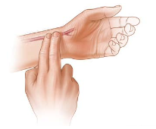
Resting Heart Rate
Palpation site most commonly used:
  Carotid (self)
  Radial (practitioner)
Assess for regularity, strength
At least 15 seconds (x4) but best to do full 60 seconds
  When irregular, always do full minute
Normal Resting (for adult) 60-100 bpm
  Above 100 at rest = sinus tachycardia
  Below 60 at rest = sinus bradycardia
Notes:
Abnormal:

Slide 29
Karvonen Method: HR Calculation
[(208-(0.7*age)) - Resting HR] x(__%) + Resting HR = Target HR
Notes:
.4 → mild
.6 → moderate
.85 → high intensity

Slide 30
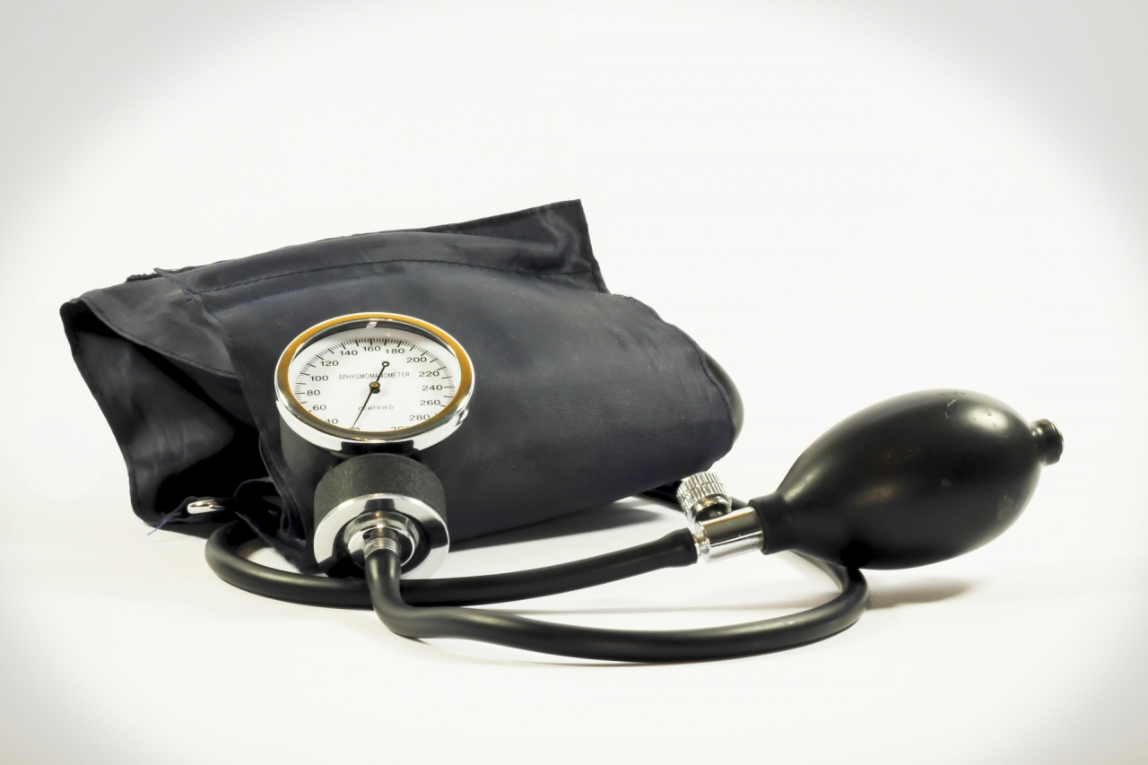
Blood Pressure
Taken seated and supported, post resting for 5 minutes, left arm, proper cuff size (80% of arms circumference), legs uncrossed, and client should have avoided smoking or caffeine
Systolic: Pressure in the artery when the heart muscle contracts.
Diastolic: Resting pressure in the artery
Notes:
HTN - diagnosed over multiple visits
Taken in same arm for repeated measures
DBP: pressure in the artery as the myocardium (heart tissue) perfuses itself
Source: American Heart Association

Slide 31
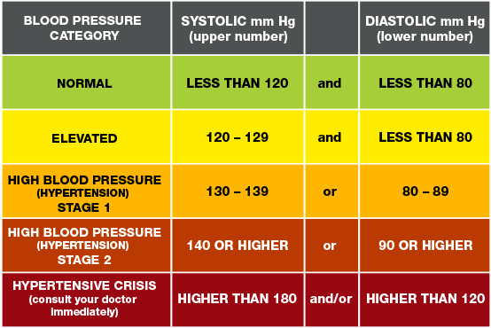
Blood Pressure - AHA Guidelines
Notes:
HTN - diagnosed over multiple visits

Slide 32
Blood Pressure and Exercise?
Systolic pressure: progressively increases @10 mm Hg per MET
  No exercise if systolic measurement is 250 mm Hg
Diastolic pressure: No change normally with exercise.
  No exercise if diastolic measurement is 115 mm Hg
ACSM Guidelines for exercise testing and prescription ;8th edition
Notes:
MET: Metabolic Equivalent of Task
Defined as multiples of the resting metabolic rate (RMR).
Based on the energy or Kcal required by untrained men or women to perform different physical tasks.
The tasks are ranked from light to extremely heavy.
The standard MET formula is (ml/kg/min) based on the equivalent that it requires 1 L of O2 consumed to expend 5Kcal of energy.
So, 2 Mets is 2 times RMR and 3 Mets is 3 times RMR, and so on.
Exercise physiology: Nutrition, Energy, and Human Performance. McArdle, Katch, and Katch; 8th edition

Slide 33
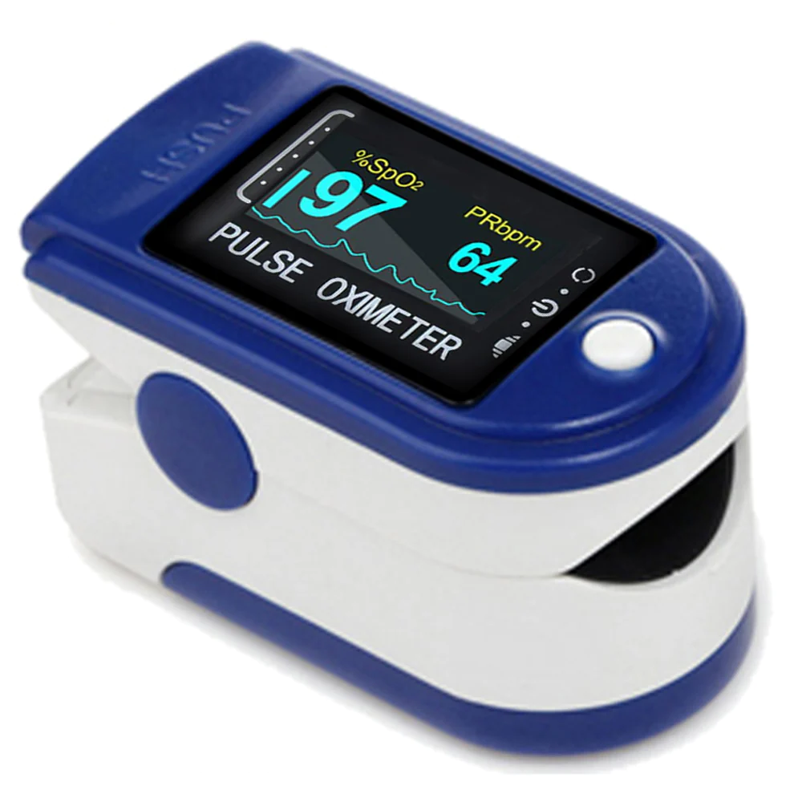
Oxygen Saturation & Respiratory Rate
Respiratory rate: number of breaths per minute taken at rest
  Normal adult: 12-20 breaths per minute
Oxygen saturation (SpO2):
  Consideration for those with cardiovascular or pulmonary diagnoses at rest and with exercise
  Normal adult: > 90%
Notes:
RR will increase with exercise because of increased demand: should be able to say 2-3 words between breaths
Reference: Yuan, G.; Drost, N.; McIvor, R. Respiratory Rate and Breathing Pattern. McMaster Univ. Med. J. 2013, 10, 23–25. https://www.mangalam.nl/wp-content/uploads/2018/12/Breathing-Pattern.pdf
Healthy lungs: SaO2 remains the same/slight increase in response to exercise
Cardiovascular or cardiopulmonary disease: decrease in SaO2 with exercise/exertion
SaO2 is the measurement of oxygen in arterial blood. When this is estimated by a pulse oximeter, it’s called SpO2
Mechanism: beams of light determine the percentage of your RBC’s which are carrying oxygen
2% error +/- typically
Best results: hand is warm, relaxed, below level of heart (allow a few seconds)
Factors affecting reading:
Cold hands
Movement
Nail polish/artificial nails
Thick skin
Darker pigmented skin
In those who smoke (may overestimate O2 sat)
This is because smoking increases carbon monoxide levels in your blood, and the oximeter cannot tell the difference between the gas carbon monoxide from oxygen.
Reference: American Thoracic Society
https://www.thoracic.org/patients/patient-resources/resources/pulse-oximetry.pdf

Slide 34
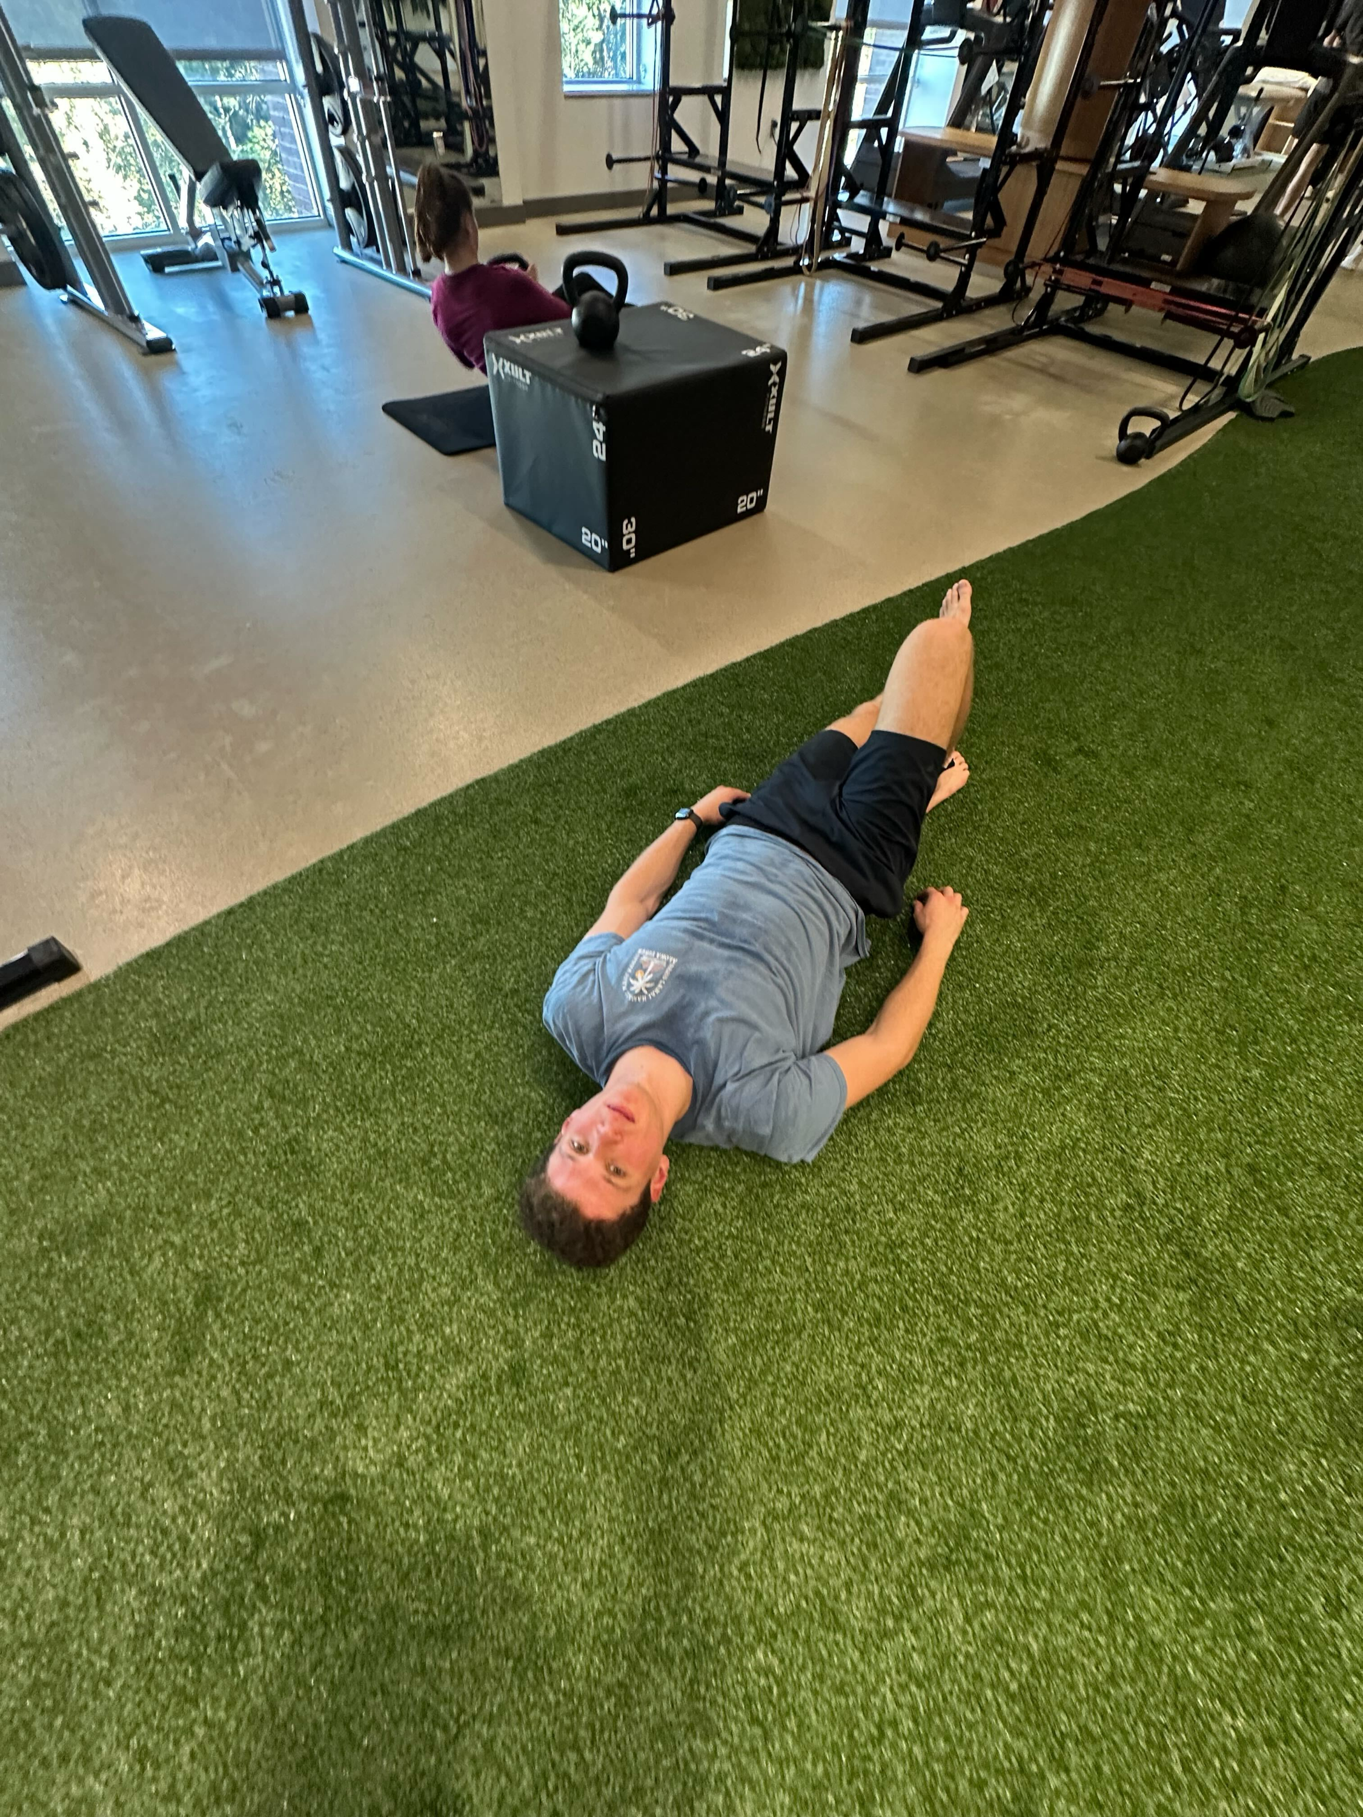
Lactate Threshold
What is it? Exertion point beyond recovery for the workout session; body produces more lactate than it can clear and it accumulates in the bloodstream
Signs in the clinic:
  Headache/lightheadedness/dizziness/fatigue
  Color – may look pale or flushed
  Look at HR – in the clinic we find their 40-60% HRR range (mild-moderate intensity) - if it is way higher, give them more time in between exercises for HR to come down
Look out for and clearly note deconditioned individuals (especially at SHW – it may be their first time exercising in months or even years)
Use your clinical judgment!
Exhibit A. Ethan
Notes:
Check in with clients, carefully rev up the intensity of their program (initially they may not get through as many exercises and that is okay)!
Lactate as a byproduct of anaerobic glycolysis

