Slide 1
The Knee and Hip Lab
David Luedeka PT, DPT, MS,CSCS
Keila Strick PT, DPT, CSCS
Caroline Williams, PT, DPT,MS, GCS
Nick Roche, PT, DPT, CSCS
Notes:
Welcome to CKC Systems lab course focused on the knee and hip. In this module we will review various topics with the goal of creating clarity and understanding of the concepts taught in the course lecture.

Slide 2
Evaluation
Notes:
When evaluating the hip and knee, static standing postures give will give you a clue as to what you will find as the exam progresses. However, keep in mind that as functional unipeds the really valuable information will be gathered when the subject is standing or functioning on one leg. Make sure that the structural exam is done with the subjects shoes off.

Slide 3
Postural Assessment, Landmarks, and LE Alignment
Notes:
When examining the static position of the knee, hip and pelvis it is important the subject stand with their feet in a normal resting position and in the same plane. Make sure the knees are locked straight.
Look at the foot position. Are they the same? Is the medial arch held high or is the arch collapsed? What is the general position of the knee joint? Is it neutral, varus or valgus? When reviewing this information think about what is happening up the kinetic chain.
Assess pelvic table in the frontal plane. Have any lower extremity discrepancies impacted the pelvic table position. It should be level and the spine should be straight. Look for symmetry in the low back musculature coming off of the pelvis. If there is a muscle imbalance most commonly there is a functional imbalance.
If the pelvic table is imbalanced then the spine will not be straight. Does it curve to the left or right? Does this fit with the possible muscle imbalance found? A good way to confirm this is to check gross left and right spinal rotation. It will not be symmetrical if the spine is curved. Spinal rotation will be reduced to the convex side of the curve.
What seem to be even minor imbalances can cause dysfunction.

Slide 4
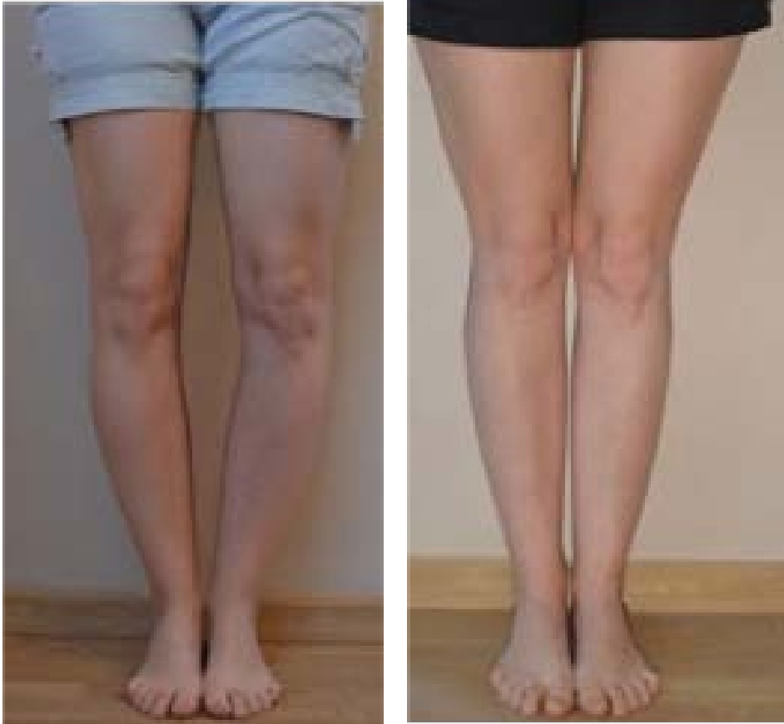
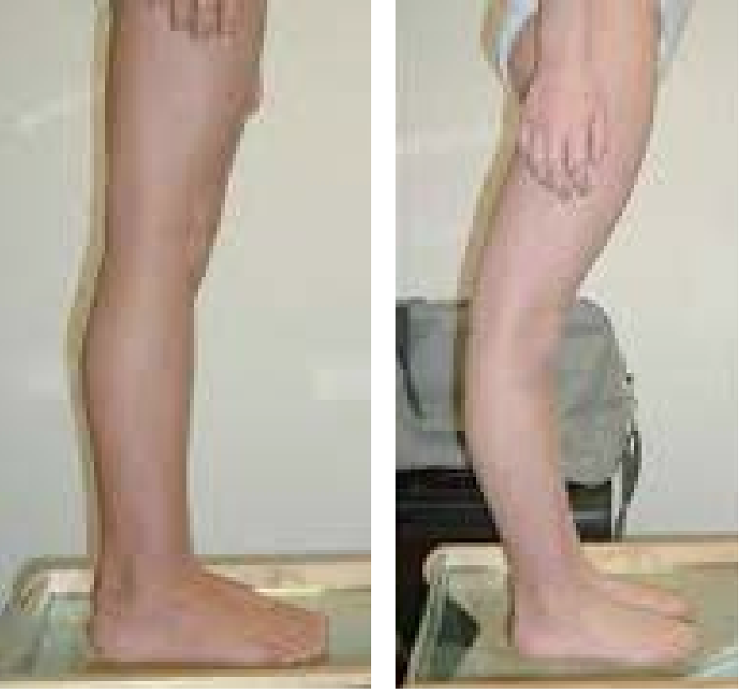
Examples of Knee Postures
Varus
Valgus
Normal
Hyperextension
Notes:
In this slide we can review some examples of static knee postures we may find. It is important to look for symmetry. If there is more hyperextension on one knee than the other it will cause frontal plane imbalances.
Knee varus or bow-legged. The knees are pushed away from midline
Knee valgus or knocked kneed. The knees move towards midline and may contribute to an excessive q-angle when on 1 leg.
Knee in a normal sagittal plane position
Knee hyperextension described as having a recurve of 10 degrees or greater

Slide 5
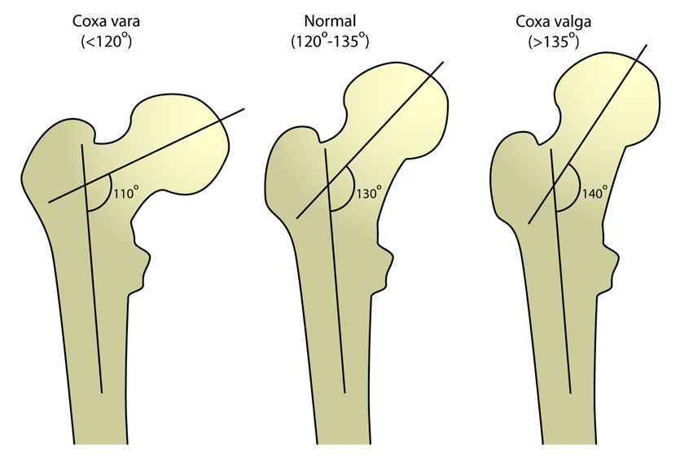
Angle of Inclination
Describes frontal plane position of the femoral neck.
WNL ~120-135°
Coxa Vara <120°
Coxa Valga >135°
Notes:
The angle of inclination describes the elevation angle of the neck of the femur as if comes off the acetabulum in the frontal plane.
In this slide we can see examples of other conditions that can influence the length of a leg.
Non symmetrical Coxa valgus can unilaterally increase LE limb length
Non symmetrical Coxa varus can unilaterally shorten LE limb length
X-rays are considered the gold standard to precisely measure this alignment and it cannot be done clinically.

Slide 6
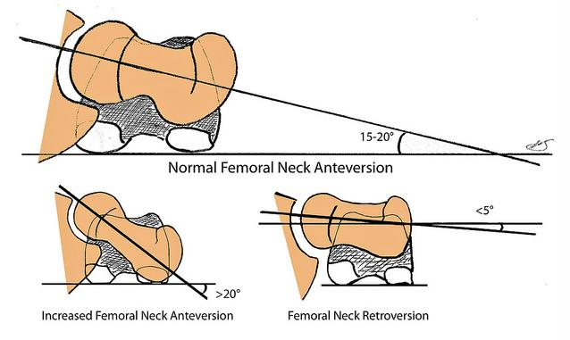
Femoral Anteversion
Describes transverse plane position of the femoral neck in the acetabulum
WNL Anteversion ~10-20°
Retroversion <10°
Excessive Anteversion >20°
Notes:
Femoral anteversion describes the structural transverse plane alignment of the femur in the acetabulum. Excessive anteversion (inward rotation) or retroversion (external rotation) is considered abnormal. These angles can create asymmetries and causes leg length discrepancies. The clinical test to measures these angles is called the craig’s test, which we will review next. Furthermore, in the movement analysis chapter, we will go more in depth on the effects of excessive anteversion on gait mechanics.

Slide 7
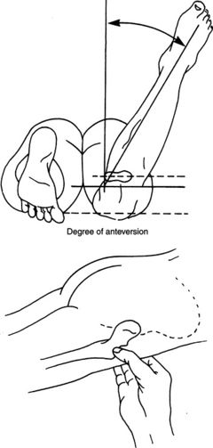
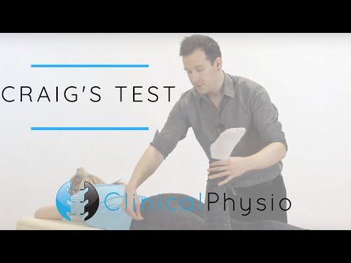
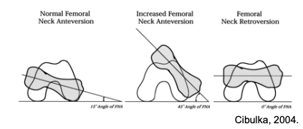
Craig’s Test
Clinical Physio. (2020, July 28). Craig's Test for Hip | Clinical Physio Premium [Video]. YouTube. https://www.physio-pedia.com/Craig%27s_Test
Notes:
The craigs test is used to assess femoral torsion or femoral alignment in the transverse plane. To perform the test the subject should be lying prone.
With the client prone locate the greater trochanter.
Then while maintaining pressure on the greater trochanter, Internally and externally rotate the femur until you identify the spot where the greater trochanter is most prominent and parallel to the table surface.
Then look at the lower leg position.
Measure the angle of the tibial shaft relative to vertical.
Normal is 10-20 degrees
Excessive anteversion >20 can functionally lengthen a LE limb and cause the subject to toe inward.
Retroversion <10 can functionally shorten a LE limb
The video here is for your reference.

Slide 8
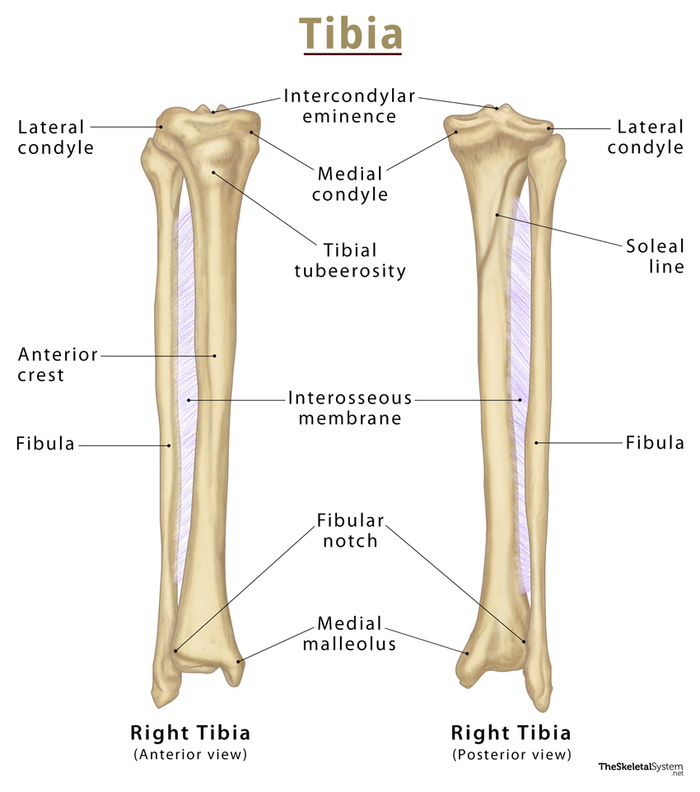
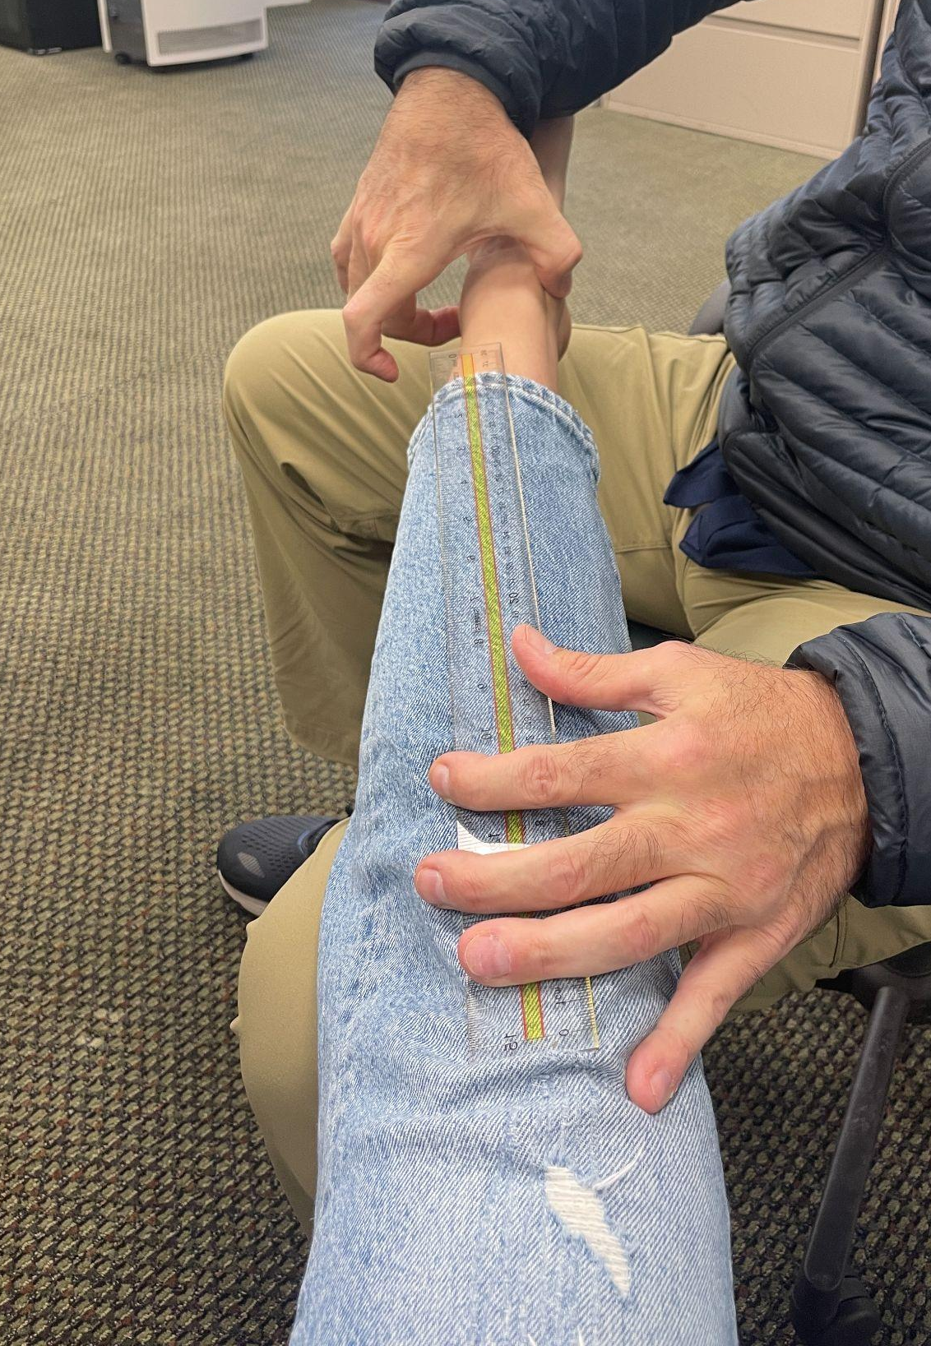
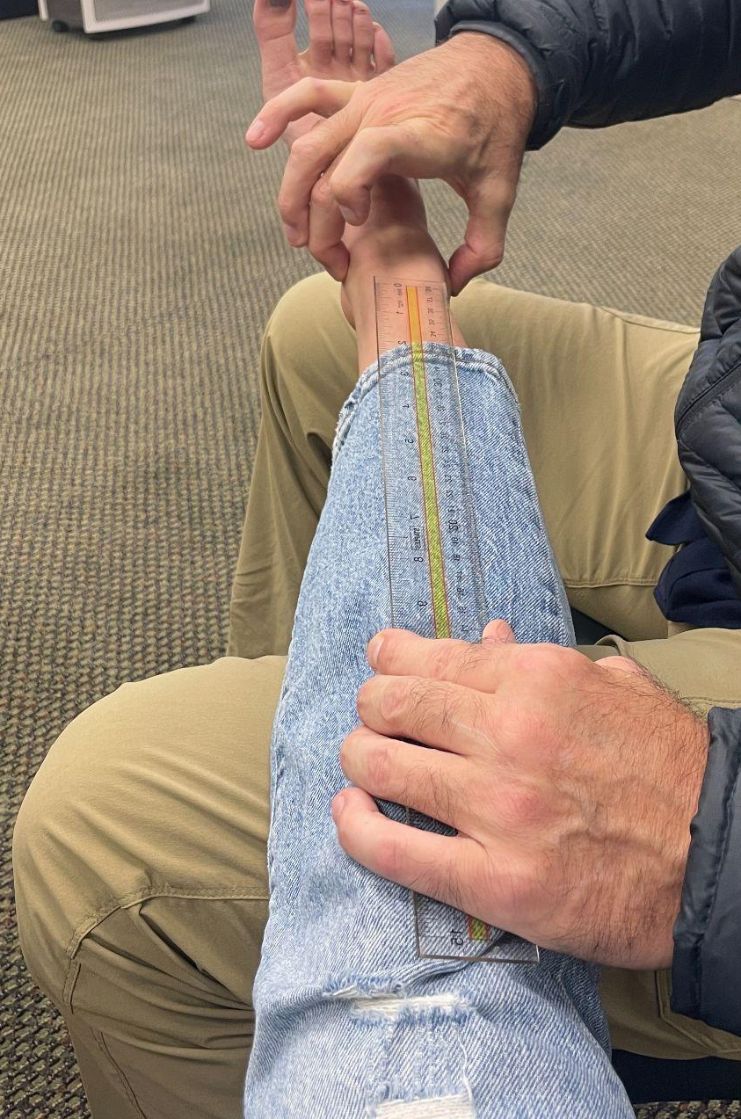
Tibial Torsion
Tibial torsion is a twisting of the lower leg bone.
WNL = tibia externally rotated ~20-30°
Notes:
The angle of the tibia rotation in the transverse plane is described as tibial torsion. It is the difference in position of the tibial condylar plane when compared to the plane of the malleoli of the lower leg. It may occur in conjunction with abnormal transverse plane alignment of the hip, which we are reviewing next, or it can occur in isolation.
Excessive internal tibial torsion can cause a functional LE limb lengthening and a toe in gait.
This is a very difficult thing to measure precisely in a clinical setting. Our assessment approach is performed by palpating the tibial tuberosity, extending a line down the shaft of the tibia from this bony landmark, and assessing that line relative to a line that connects the medial and lateral malleoli. Compare side to side.
This technique is imperfect, but offers a good way to gauge symmetry. You can see in the images above, there is greater external tibial torsion on the L compared to the R limb. This is the results of a post traumatic fracture and ORIF to stabilize the injury on the L

Slide 9
Single Leg Functional Standing
Notes:
As mentioned at the start of this section it is important to see what happens when the subject is standing and functioning on one leg. Sometimes you can see dramatic functional differences.
Locate midline (bellybutton). Ask the subject to stand on one leg. Give them time to balance. Observe how much the COM shifts over the stance phase leg.Then examine what is happening throughout the LE
How is the foot dealing with the load? Maintaining subtalar neutral? Excessive supination?
What is happening at the knee. Does it dive in excessively? Increased q angle?
Look at the pelvis? Does it drop? Is the subject able to maintain pelvic stability?
Compare sides
Was there a greater lean to one side compared the other? What could be the cause of this?
Leg length discrepancy
Hip stability / glute med strength

Slide 10
Gait Analysis: Sagittal, Frontal, and Posterior View
Notes:
Similar to the ankle and foot lab, we will perform a gait analysis with the focus primarily at the knee and hip.

Slide 11
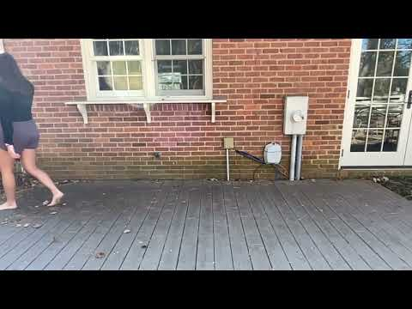
Notes:
In this video we are looking at a sagittal plane view of gait and specifically focusing on the hip and knee position.
Magnitude of hip flexion and extension should be similar like a pendulum at initial contact
Knee extension at initial contact
Hip extension at toe off
Swing - Combination of hip, knee flexion and ankle DF during swing phase to ensure foot clearance
Arm swing will occur opposite arm and opposite leg throughout the gait cycle

Slide 12
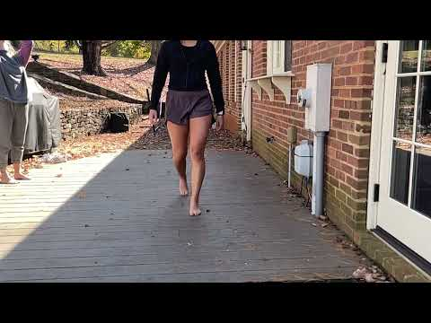
Notes:
Frontal view of gait - looking at the knee, hip and pelvis positioning
Pelvis is staying level and held at a right angle
Contralateral pelvic drop during stance phase might indicate glute or trunk weakness
Patella should be forward facing and not turning in or out
This gives an idea of what is happening at the femur in terms of its frontal and transverse plane alignments
Looking more holistically at the Q angle which combines the pelvic, hip, and foot alignments

Slide 13
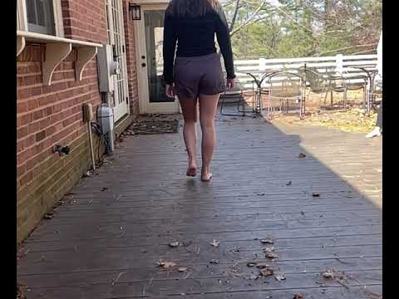
Notes:
Here we can see a posterior view of the gait cycle.
This view helps to better see the pelvic table alignment.
When one foot is in contact with the ground, you want to look at the opposite side and see that it is level
Again, a drop more than a few degrees might signify a frontal plane weakness

Slide 14
Special tests: A Supplementary Tool
Notes:
Let’s review a few objective tests for both the hip and knee. For the purposes of this course, we won’t go into too much depth on each one as you may have learned these skills elsewhere or can access resources online.

Slide 15
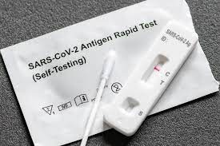
Sensitivity and Specificity
Sensitivity
Correctly identify if a patient with a dysfunction/injury
True Negatives
Negative tests rules out - SNOUT
Specificity
Correctly identify if a patient does not have a dysfunction/injury
True Positives
Positive test rules in - SPIN
Sensitivity is ~50% - negative test doesn’t mean you don’t have COVID
Specificity is ~97% -positive test means you likely have COVID
Notes:
Special tests to help rule up or down certain diagnoses but these tests will never provide the whole answer. More importantly, a thorough client interview with a clear understanding of the clinical presentation will help guide the exam process and understanding of the patient case.
Two concepts that are important to be familiar with are sensitivity and specificity.
A test’s sensitivity is the ability of the test to correctly identify if a patient with a dysfunction/injury. A highly sensitive test will be better at diagnosing a true negative. If someone tests negative on a highly sensitive test, you can more confidently rule out whatever you were testing for. Highly sensitive helps to rule out if negative, but if positive, it doesn’t definitely help you rule in. SNOUT
A test’s specificity is the ability of the test to correctly identify someone without the dysfunction/injury. A highly specific test increases the likelihood of diagnosing true positives. If someone tests positive on a highly specific test, you can be fairly certain they have what you are testing for. In the case of a negative test, you cannot confidently rule it out. SPIN

Slide 16
Special Tests for Knee Structures
ACL
  Anterior Drawer (SN .18-.92 and SP .78-.98)
  Lachman’s (SN .78 SP .95)
PCL
  Posterior Drawer (SN .90 and SP .99)
Meniscus
  Thessaly (SN .65-.92 and SP .83-.97)
  McMurray's (SN .7 and SP .71)
MCL
  Valgus stress test (SN .78 and SP .67)
https://www.physio-pedia.com/Category:Knee_-_Special_Tests
Notes:
Going through all these tests is out of the scope of this class, but here is reference list of some techniques that relate to the knee joint and specific soft tissue structures. These tests have variable sensitivity and specificity and can be a helpful supplemental diagnostic tool but must be done in conjunction with a thorough subjective history and clinical picture.

Slide 17
Special Tests for Hip Structures
Impingement / Intra articular / Hip OA
  FADIR (SN .95)
  FABER (SN .71)
  Scour /Compression (SN .62-.91 and SP .43-.75)
https://www.physio-pedia.com/Hip_Examination

Slide 18
Hip ROM

Slide 19
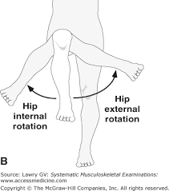
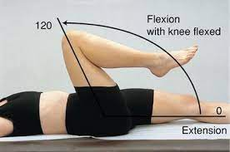
Hip ROM
Hip flexion
  WNL ~0-120°, usually no end feel because pelvis will rotate before
Hip extension
  WNL ~0-20°
Hip internal rotation
  WNL ~0-45°, firm end feel
Hip external rotation
  WNL ~0-45°, firm end feel

Slide 20
Knee ROM

Slide 21
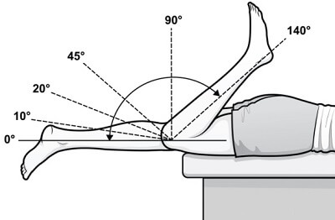
Knee ROM
Knee flexion
  WNL ~0-150°, soft end feel
Knee extension
  WNL ~0°, firm end feel
Assess quality of motion and compare side to side
Acute or chronic ROM limitation?

Slide 22
Functional SL Strength and Stability
Notes:
While it is true humans are bipedal we are functional unipeds. During gait your lower extremities are not doing the same thing at the same time. In fact 70 percent of the walking gait happens with only one leg in contact with the ground. This percentage grows as the speed of motion increases.
So it is very important to both evaluate and exercise ones lower extremity strength on one leg.

Slide 23
Single Leg Squat Test
Assess Quality of Movement
6 criteria - Lose point if:
Hands lift off hips
Ipsilateral trunk lean
Pelvic tilt or rotation
Medial foot lifts
Dynamic knee valgus (medial to 2nd toe)
Overall loss of balance
5 criteria - Lose point if:
Ipsilateral trunk lean
Pelvic tilt or rotation
Hip adduction or internal rotation
Dynamic knee valgus (medial to 2nd toe)
Overall loss of balance
Hall MP, Paik RS, Ware AJ, Mohr KJ, Limpisvasti O. Neuromuscular evaluation with single-leg squat test at 6 months after anterior cruciate ligament reconstruction. Orthop J Sports Med. 2015;3(3).
Notes:
How is the static Q angle commonly measured? Q angle measurements usually take place with the client lying or standing on both legs. A true measure of one's Q angle occurs when standing and squatting on one leg.
A single leg squat test as described by Crossley et. al. is an objective way to measure the quality of one's single leg functional strength. This test is represented by the 5 point criteria on the right of the slide.
The criteria on the left of the slide is similar to Crossley et. al.. However, a criteria is added to evaluate if one primarily functions on the outside of the foot without engaging the medial arch and the associated active and passive structures. If the medial foot comes off the ground while standing on one leg than the COM is being pushed to far over the stance leg. By placing the hands on the hips it negates the opportunity for the arms to contribute to balance. This better evaluates ones LE anatomy's ability to stand and function on one leg
Measure of both strength and stability
Performance of the SLST was similar to that described by Crossley et al.¹² Briefly, the patients were asked to stand on a 20-cm box with their arms held out in front of them. The SLST was demonstrated by one of the study investigators. Patients were advised not to lean forward and were told to place their free leg behind them to make it easier to assess pelvic tilt and hip adduction. Patients were asked to squat to 60° of knee flexion in a slow, controlled manner at a rate of approximately 1 squat per 2 seconds. The patients were allowed 3 practice attempts with each limb prior to the actual trial. Three trials were performed for each limb. The trials were captured on digital video, with the video camera placed approximately 3 m in front of the participant on a tripod at the height of the patient’s pelvis. A single orthopaedic surgeon reviewed the videos to grade the tests.
Grading of the performances (Table 1) was based on the presence of ipsilateral trunk lean, pelvic tilt (Figure 1) or rotation, hip adduction or internal rotation, dynamic knee valgus, or overall loss of balance, as described by Crossley et al.¹² A good performance required the absence of all 5 pathologic criteria in 2 of 3 trials. Poor performance was characterized by the presence of any of the 5 pathologic criteria in 2 of 3 trials (see the Appendix for Crossley grading).

Slide 24
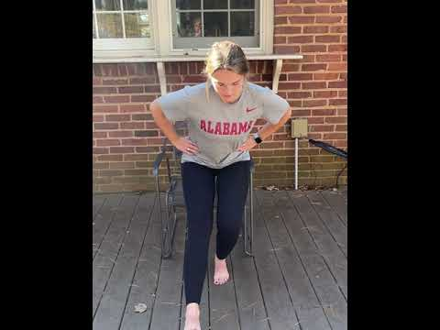
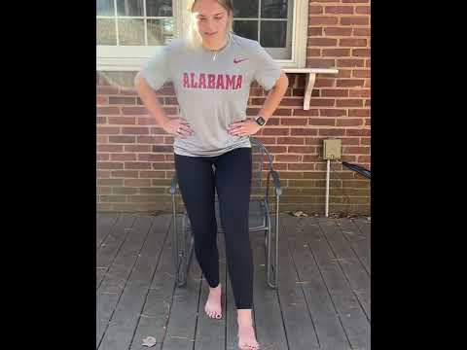
Single Leg Squat Test
Notes:
Assessing the video embedded in this slide what grade would you give this subject if we were to use the 6 point criteria as mention in the previous slide. Remember to evaluate both legs to look for discrepancies.
Evaluating the left leg I would give this subject a 6 out of 6. After the first rep there are no movement faults that are described in the prior slide.
Evaluating the right leg gives us a different result. The subject is less stable. The knee dives inward past the 2nd toe, the pelvis does not remain level, and there is an ipsilateral trunk lean. It is important to objectify the difference and develop a treatment plan to correct the movement faults.

Slide 25
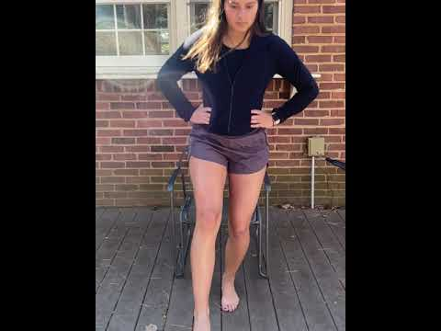
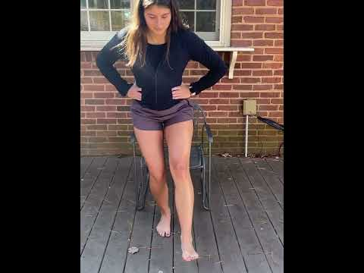
Single Leg Squat Test
Notes:
Let's practice this skill again. Once again we can see differences between the left and the right legs. The SLST on the left leg is normal and I would grade this subject a 6/6 on the left leg as I do not think she loses a point.
It is a different story on the right leg. The knee collapses inward past the second toe and there is a trunk lean to the stance leg. I would give this subject a 4/6 on her right leg. Again this information helps to develop the treatment plan.
Remember this test is taking place simply standing on one leg. What would happen if the she was running when the forces are even more substancial.

Slide 26
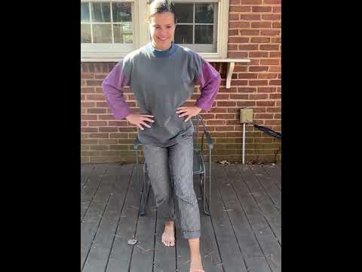
Suboptimal Single Leg Squat Test

Slide 27
Movement Analysis
Notes:
When assessing gait it is important to understand that congenital LE anomalies can impact single leg function. Why is this important? Because these anomalies cause frontal planes imbalances and therefore will cause or accentuate the movement faults as described by the SLST.

Slide 28
Abnormal Gait: Excessive Anteversion
Notes:
One of the LE anomalies that can impact LE function is excessive LE anteversion.

Slide 29
Femoral Anteversion and Retroversion
(Femoral transverse plane alignment)
Notes:
What is femoral anteversion. It is simply the angle that the neck of the femur comes out of the acetabulum. Normal angles are between 15 and 20 degrees. If the angle is greater than 20 degrees the hip is described as having an excessively anteverted position. The leg toes inward. If angles are around 5 degrees the hip is described as being in a retroverted position.
Why is this important? Because excessive anteversion anatomically lengthens ones leg and impacts frontal plane function. Conversely a retroverted hip anatomically shortens one's leg. This also has consequences as it relates to frontal plane function and stability.

Slide 30
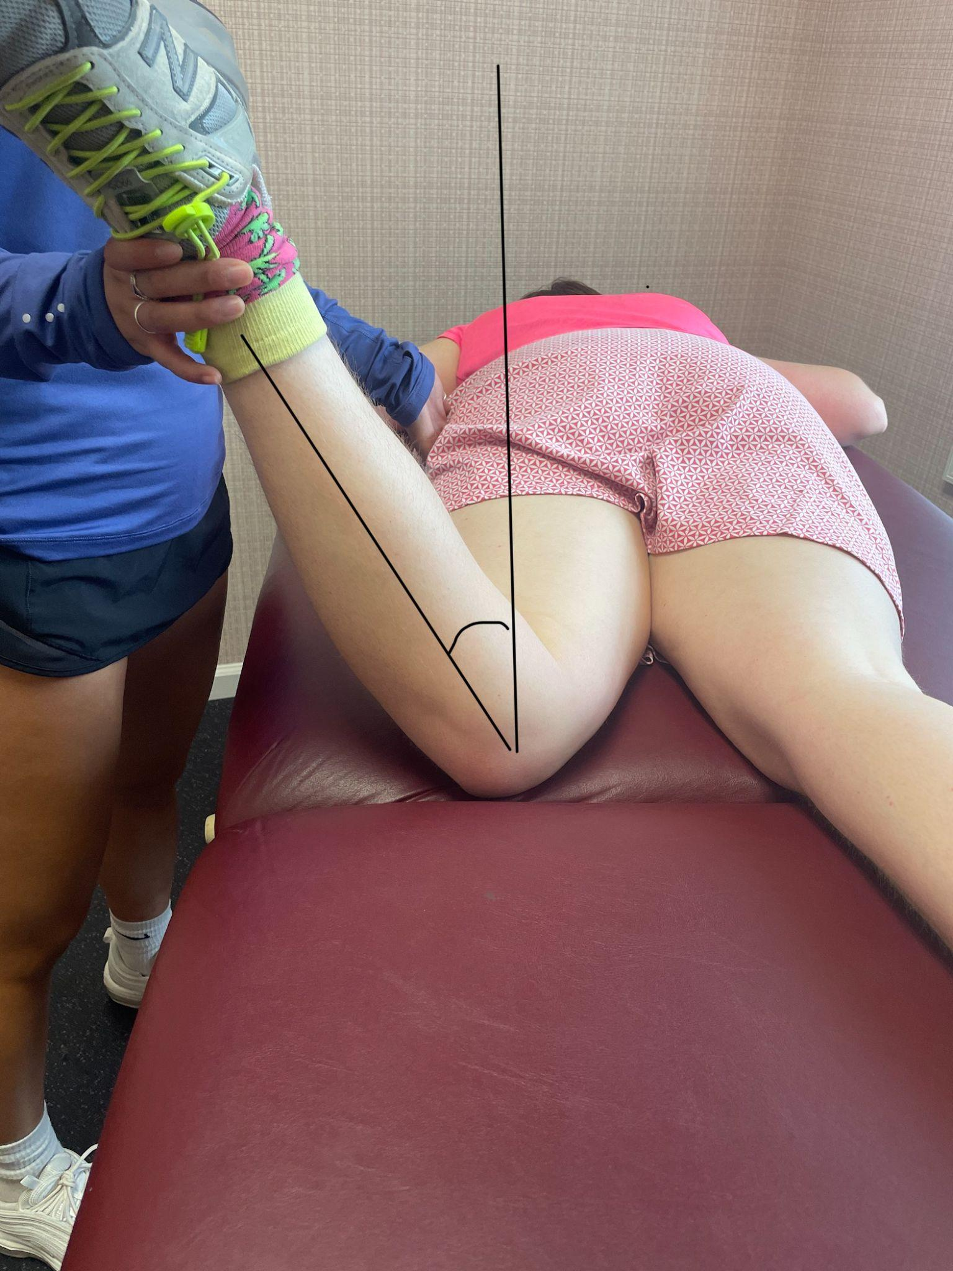
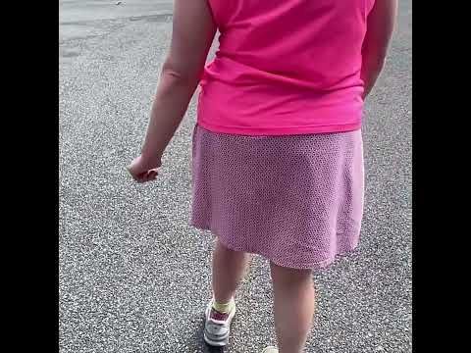
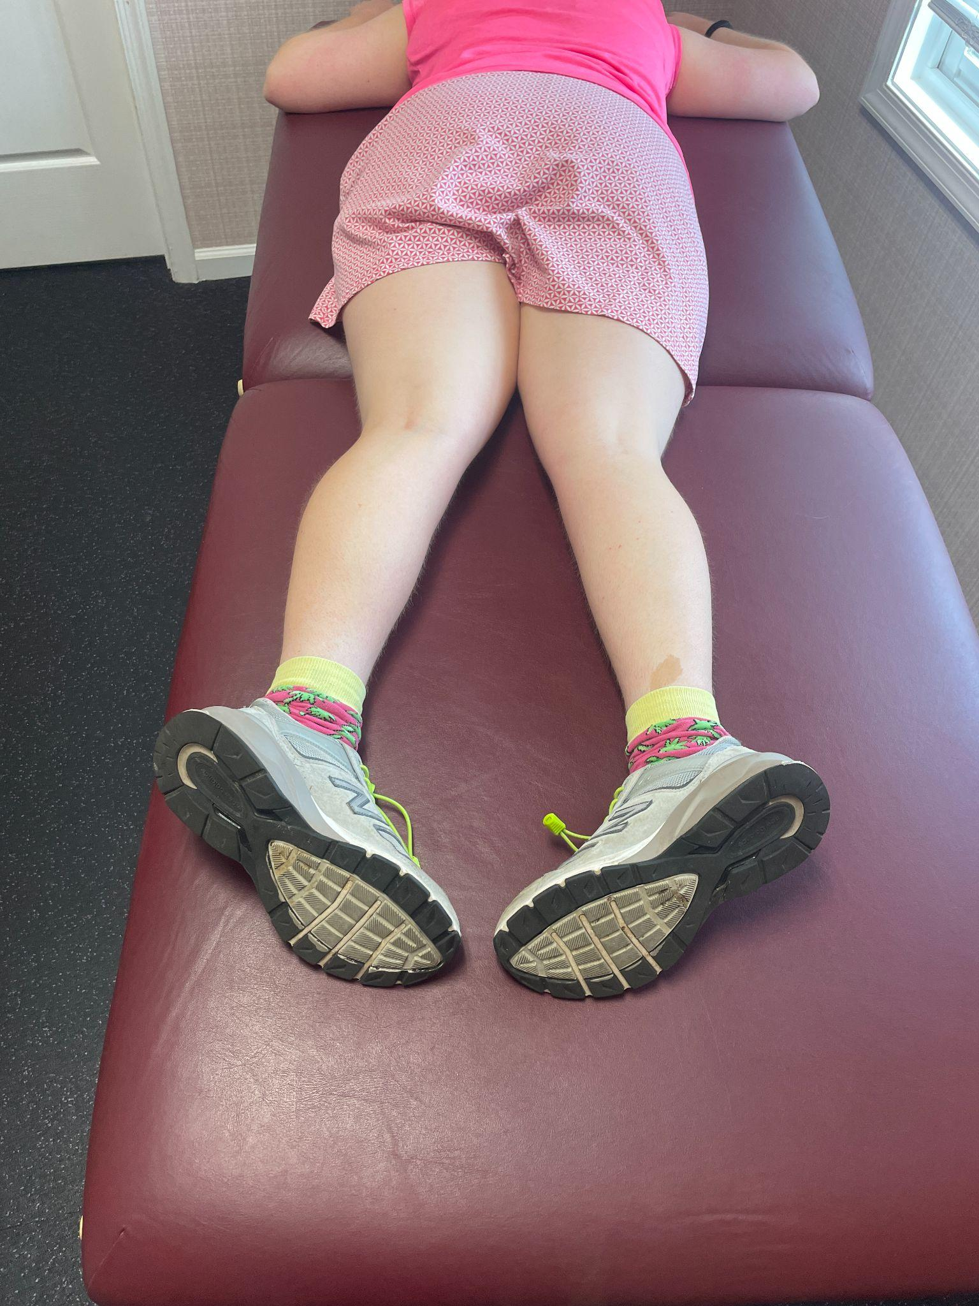
Gait with Excessive Anteversion
Notes:
We have a subject in this slide that demonstrates the impact of excessive hip anteversion. This subject has bilaterally anteverted hips but it is worse on the left as compared to the right. The excessive anteversion anatomically lengthens the left leg causing increased difficulty managing frontal plane stability when on left stance. As a result the subject has to post over the left leg to remain balanced. The anteverted position decreases medial foot muscle function which contributes to the posting.
This has consequences up the kinetic chain. It can cause scoliosis and muscle imbalances.

Slide 31
Abnormal Gait: Frontal Plane Weakness / Compensation
Notes:
Lower extremity function and abnormal gait can also be associated with muscle weakness. Muscle weakness can occur either from injury or deconditioning.

Slide 32
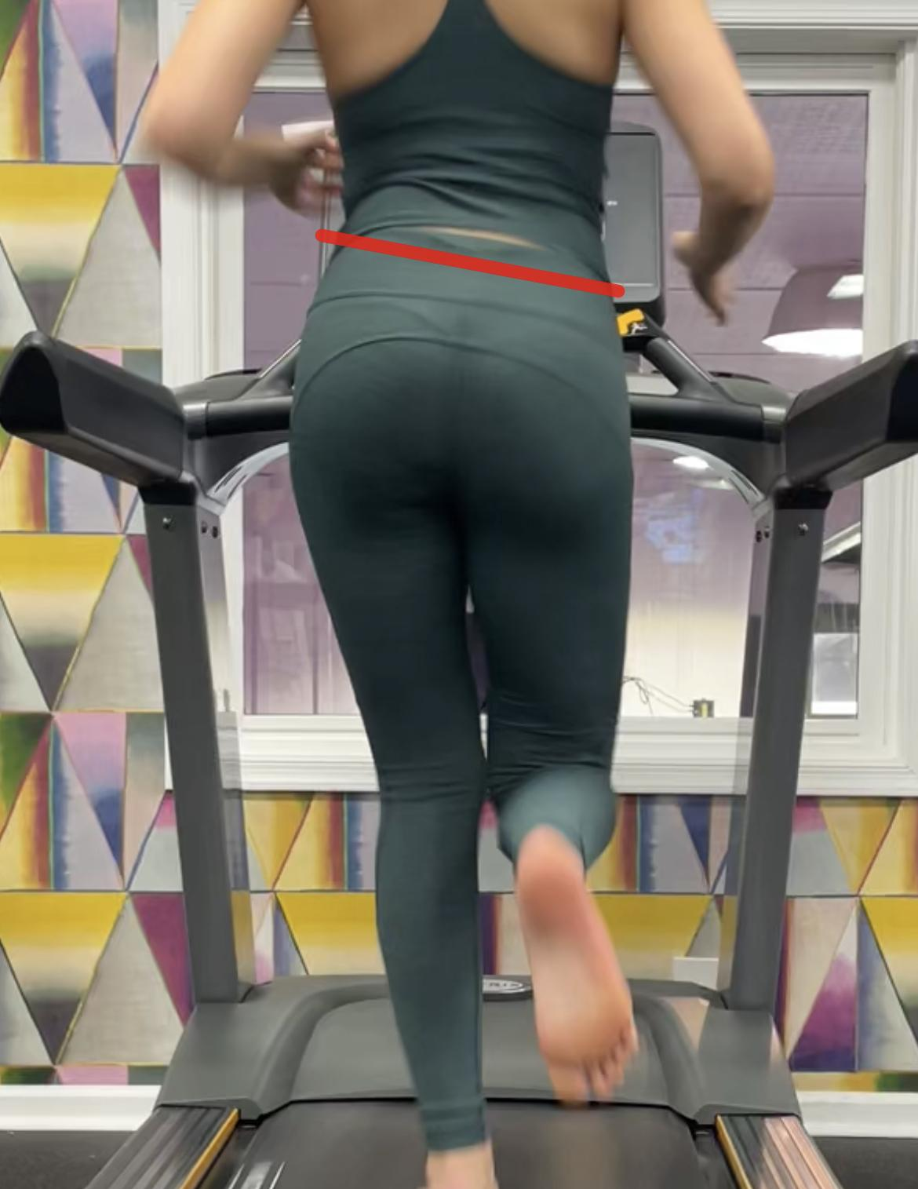
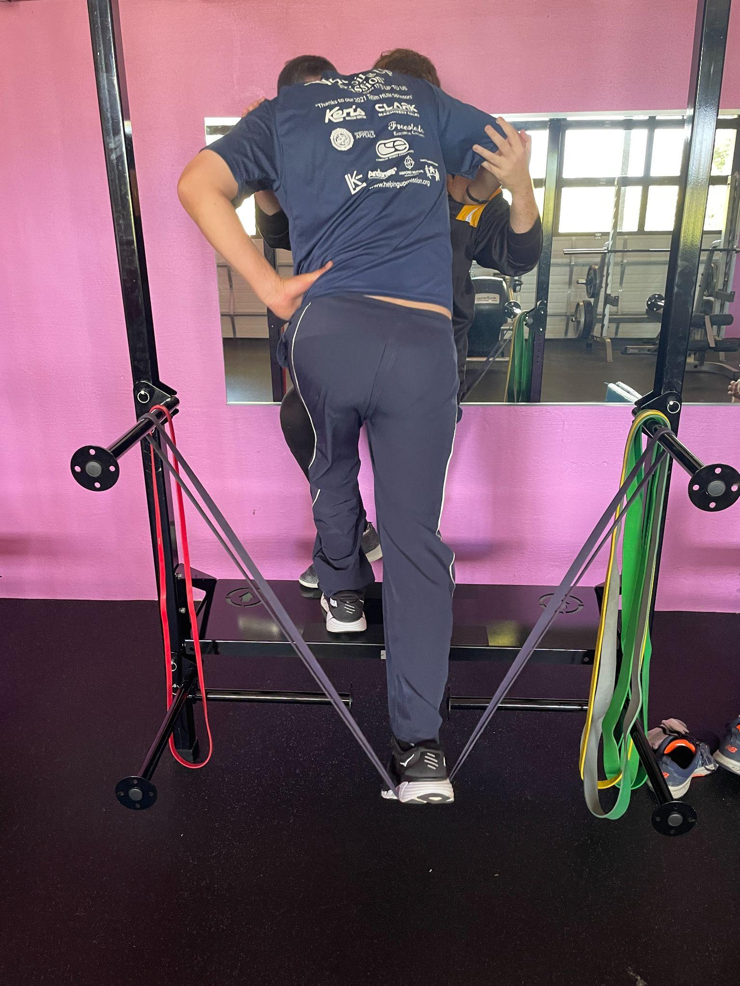
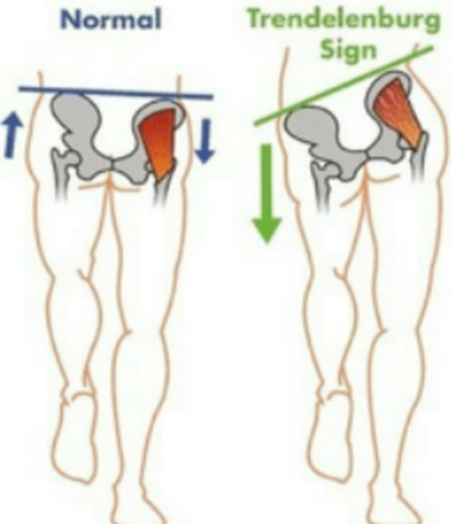
Contralateral Pelvic Drop
Notes:
Let's review the picture on the left of a subject running on the treadmill. This subject is recovering from an injury to one of her frontal plane stabilizing muscles. Recall the SLST, This subject was able to perform the SLST with a perfect score. However, when the demands on the frontal plane stabilizing muscles are increased as in running, the subject is not able to maintain frontal plane stability. Compensations due to the weakness in the left hip stabilizers include: Ipsilateral trunk lean and a contralateral pelvic drop.
In the picture on the right the subject demonstrates significant frontal plane instability due to intrinsic foot and hip muscle weakness. What do you think this subjects gait looks like? I bet lots of insufficiency.

Slide 33
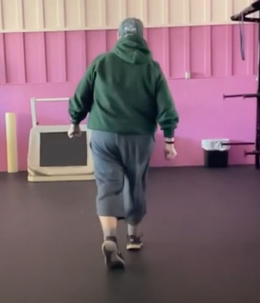
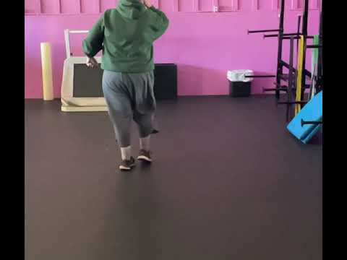
Trendelenburg Gait
Notes:
In this slide we can see the manifestation of weak gluteal/intrinsic hip muscles on the gait cycle. This subject demonstrates excessive frontal plane motion due to the Inability to stabilize frontal plane when on single leg stance in the gait cycle. As such the subject must lean there COm over their BOs to gain stability. This is commonly referred to as a trendelenburg gait pattern.

Slide 34
Abnormal Gait: Excessive Knee Extension
Notes:
Now let’s look at abnormal gait as a results of excessive knee extension.

Slide 35
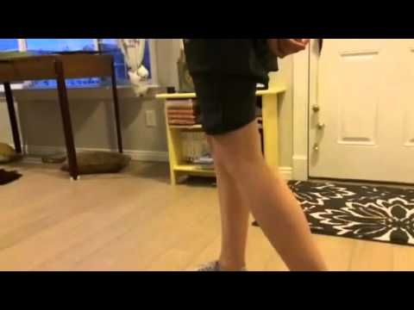
Genu Recurvatum (Hyperextension)
Taylor Stapleton. (2016, May 23). Genu Recurvatum Gait 3 [Video]. YouTube. https://www.youtube.com/watch?v=qEGA8ZgSmdI
Notes:
Genu Recurvatum, otherwise known as knee hyperextension, is a common gait abnormality. It can be the consequence of a weakened posterior chain (HS, glutes, and plantar flexors), excessive joint laxity, or commonly, the consequence of tight achilles.
In this example, this subject has excessively tight achilles and plantar fascia which limits her ability to go into pronation and dorsiflexion during the stance phase of gait. To assist with maintaining stride length and transition from midstance to toe off, she hyperextends her knees and oftentimes it will abruptly lock out. The hyperextending of the knees allows her to remain in a more relative ankle plantarflexion position during stance phase.
This compensatory pattern has the likelihood of overstretching the posterior knee capsule and structures, and overloading the anterior articular surface of the tibiofemoral joint and menisci. It may result in ligamentous or meniscal injury, along with potential for knee OA down the road.

Slide 36
Evolutionary Mismatch
Notes:
Recall, relative to the upper body, Homo sapiens lower extremities underwent significant evolutionary adaptations in response to the evolutionary adaptive pressures placed on them.

Slide 37
Frontal Plane Instability
Notes:
As it relates to the lower extremities, the evolutionary mismatch of the knees, hips, and pelvis is that we did not evolve to stabilize heavy body masses on single limb. In modern day culture, humans are larger and the muscle structures designed to support the frontal plane are weaker and frequently asked to do more than what they are capable of.

Slide 38
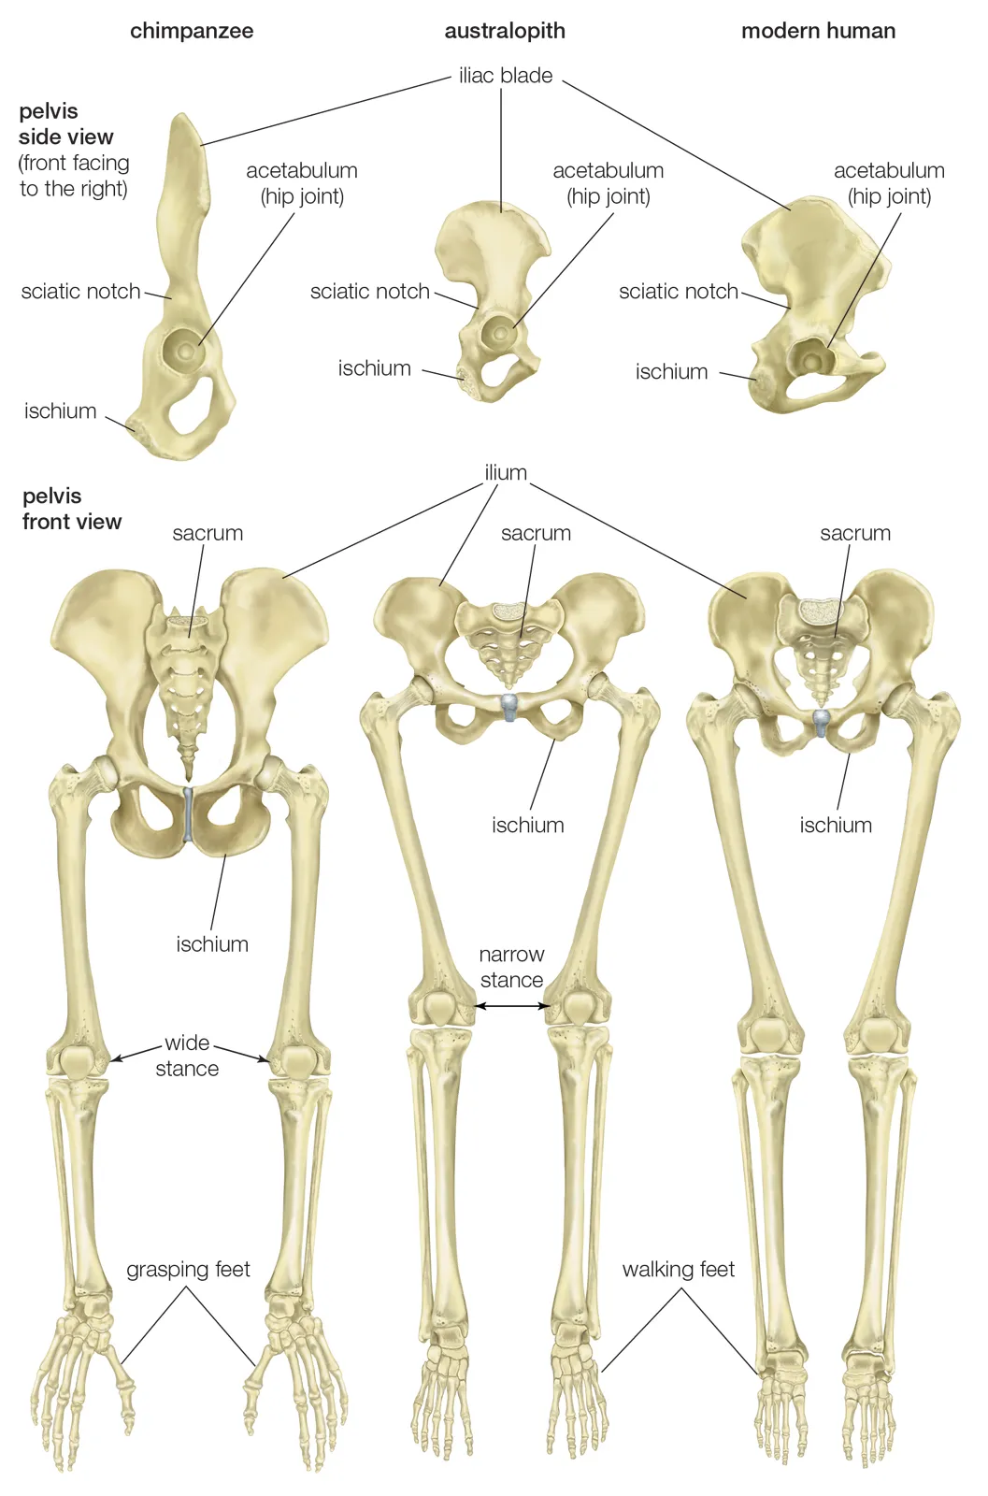
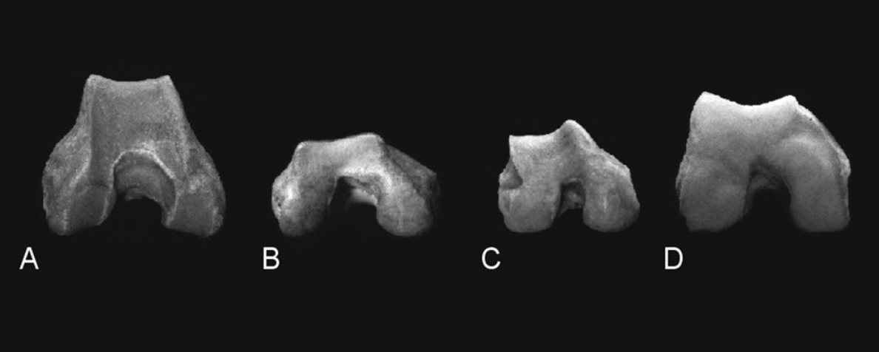
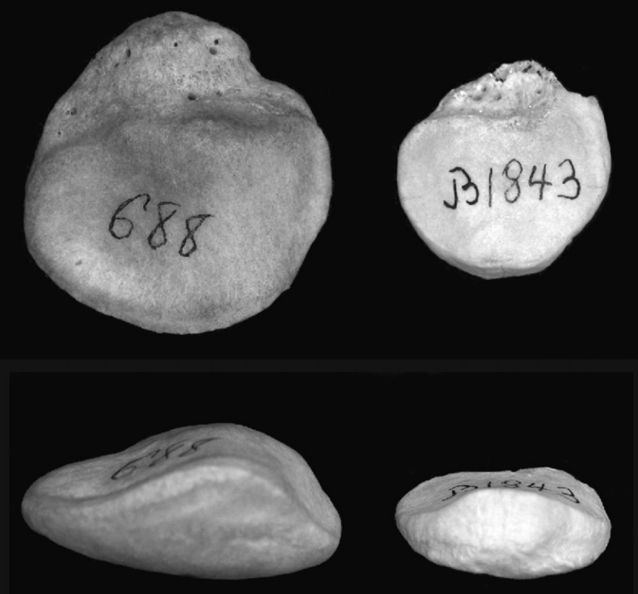
Primate Ancestor
Homo Sapien
Notes:
As bipeds, but really functional unipeds, efficiency and stability in single limb stance was necessary for our survival.
In our evolutionary past we had femurs that dropped straight down from the pelvis, the femoral condyles were less robust, and the articular surface of the patella was relatively flat.
In order to facilitate stability on one leg, Homo sapiens developed a femoral obliquity angle. This adaptation enables the foot to fall closer to midline and position the BOS beneath the COM. This creates a challenge when stabilizing the frontal plane on one leg.

Slide 39
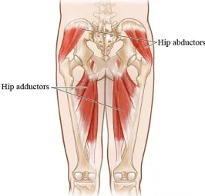
Abductor vs Adductor Imbalance
Frontal Plane Instability
https://squatuniversity.com/2017/09/27/fixing-the-pulled-groin/
Notes:
In the evolutionary process toward bipedalism, muscular adaptation was not as significant as boney changes. We have retained a significant amount of adductor muscle mass and have correspondingly much less abductor musculature. 50 plus million years of quadrupedal primate gait decreased the need for hip abductor strength. We needed the adductor muscles to cling to trees and climb.
Keep in mind that cultural evolution has dramatically impacted modern man's body mass and body fat percentage. We are fatter and bigger than we have ever been as a species. These forces challenge our hip abductor stability strength in ways it is not capable of of handling. As such, anatomical structures of the knee are commonly injured. Patella, meniscal and ligament damage are frequent orthopedic pathologies seen in modern humans. These risks are increased as the forces of athletic competition are placed on our LE structure.

Slide 40
Intervention
Notes:
In this final segment of the knee and hip lab we will discuss intervention techniques for the movement faults and frontal plane challenges mentioned earlier.

Slide 41
Single Leg Exercise that Challenges Frontal Plane Stability
Notes:
Exercise intervention should include true single limb training, but what constitutes true single limb training? Let’s review now in the upcoming slides.

Slide 42
Can you train control of dynamic knee valgus and improve frontal plane stability?
2025 systematic review looking at exercise and improvements in frontal plane knee and foot posture
  Short and Sweet:
    Plyometric training, functional exercise, and foot exercises help reduce knee valgus in individuals with increased knee valgus. --> You can train control of knee valgus
  Detail:
    Exercises: foot intrinsic strengthening, Nordic hamstring curls, core strengthening, short foot exercise, forward leans, supervised plyometric training (jump and landing techniques), supervised squats and lunges with verbal and visual feedback
    Results: improvements in dynamic knee valgus control and arch function
Cömert GM, Gruber M. Exercise Modalities for Improving Frontal Plane Knee and Foot Posture in Healthy Adults: A Systematic Review. Sports. 2025;13(2):52. doi:10.3390/SPORTS13020052/S1
Notes:
Study
Of note, hip strengthening (external rotation and abduction) alone did not affect dynamic knee valgus. Most of this occurred in an open chain and is therefore not as functional for CKC dynamic knee valgus control.
Arch function? Navicular drop test was improved, i.e. the resting foot posture showed a higher arch
Takeaway for home programs: Short foot, Toe Pro Leans, squats and lungs and plyometrics with feedback about biomechanics, can all be effective at controlling dynamic knee valgus. However, the “functional exercises” employed in current literature is not truly single leg

Slide 43
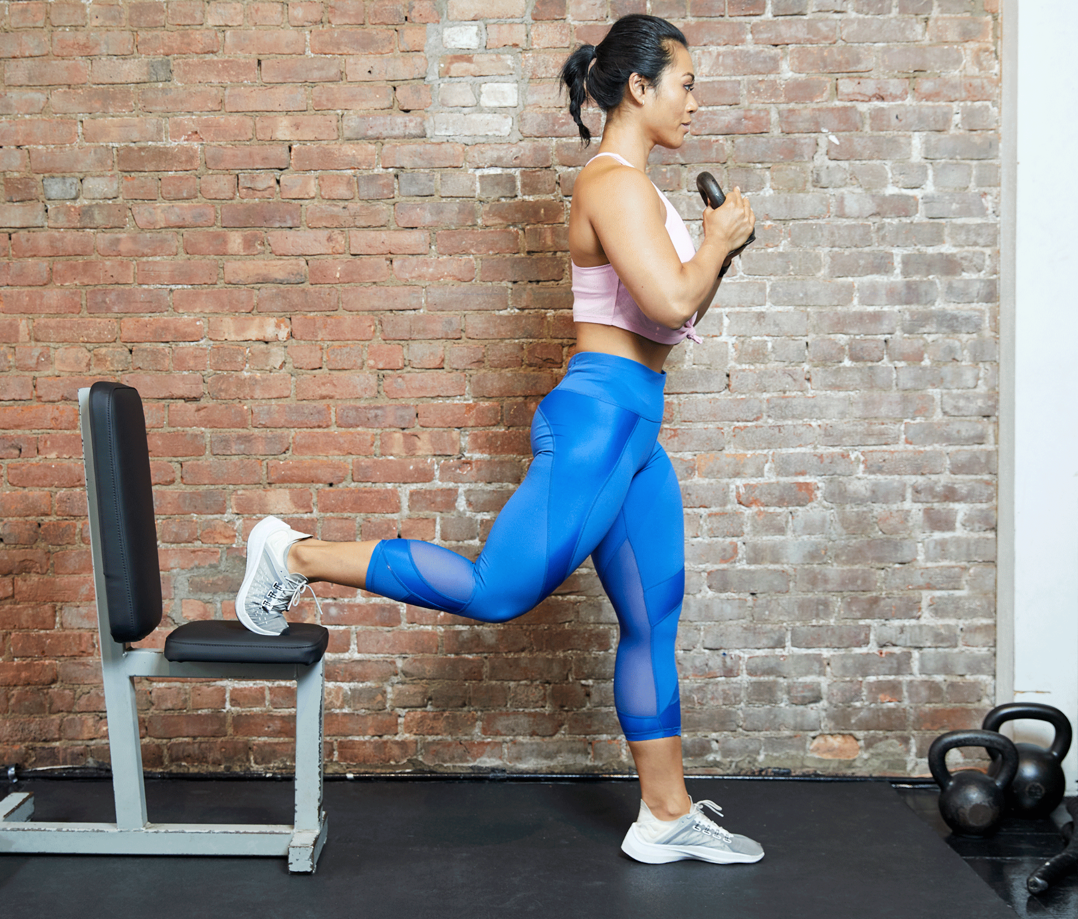
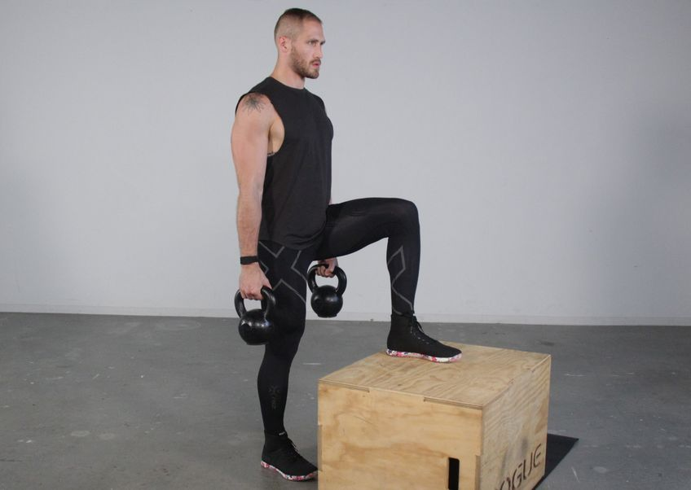
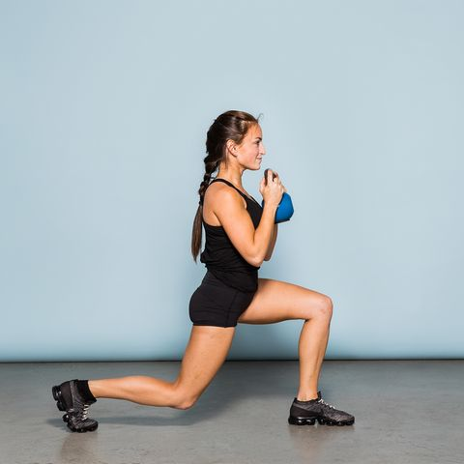
Are these exercises truly single leg?
Notes:
When the rear foot is in contact with a stable surface, can we really define the exercise as a single leg exercise? The contact of the rear foot on a stable surface creates a larger base of support.
The exercises here are designed to target the strength of the leading limb, but with the opposite leg on a stable surface, it is able to offer assistance through unlimited GRF available through contact with the ground.
True single leg exercise are challenging to perform when done correctly.

Slide 44
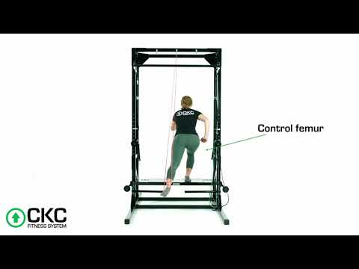
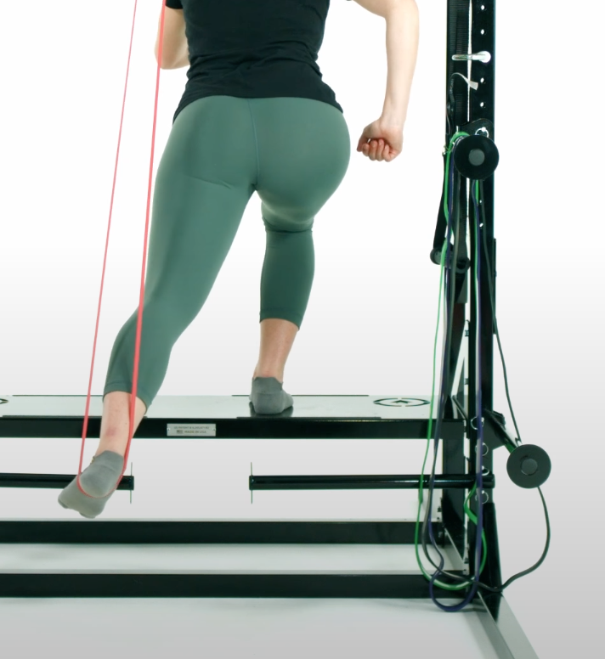
Split Squat 1x Support
Notes:
Split squats with the rear limb on an unstable surface challenges the frontal and transverse stabilizers of the feet, hip, and core when working on single limb movements.
This example is an advanced version of this exercise as limited assistance is available through the red band. That band is only looped onto one hook, creating an even greater stability challenge.
Notice how the knee is positioning in line with the second toe and translating slightly beyond the toes. Her hip, knee and foot are aligned in a similar plane in the image seen to the right.
A stable foot, hip, and core will help control the frontal plane and position of the knee joint. Learning how to perform exercises such as this one, can greatly improve movement coordination, strength, and stability that translates well to functional movement patterns.

Slide 45
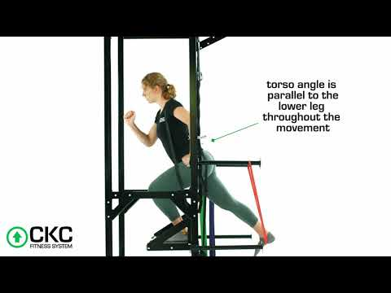
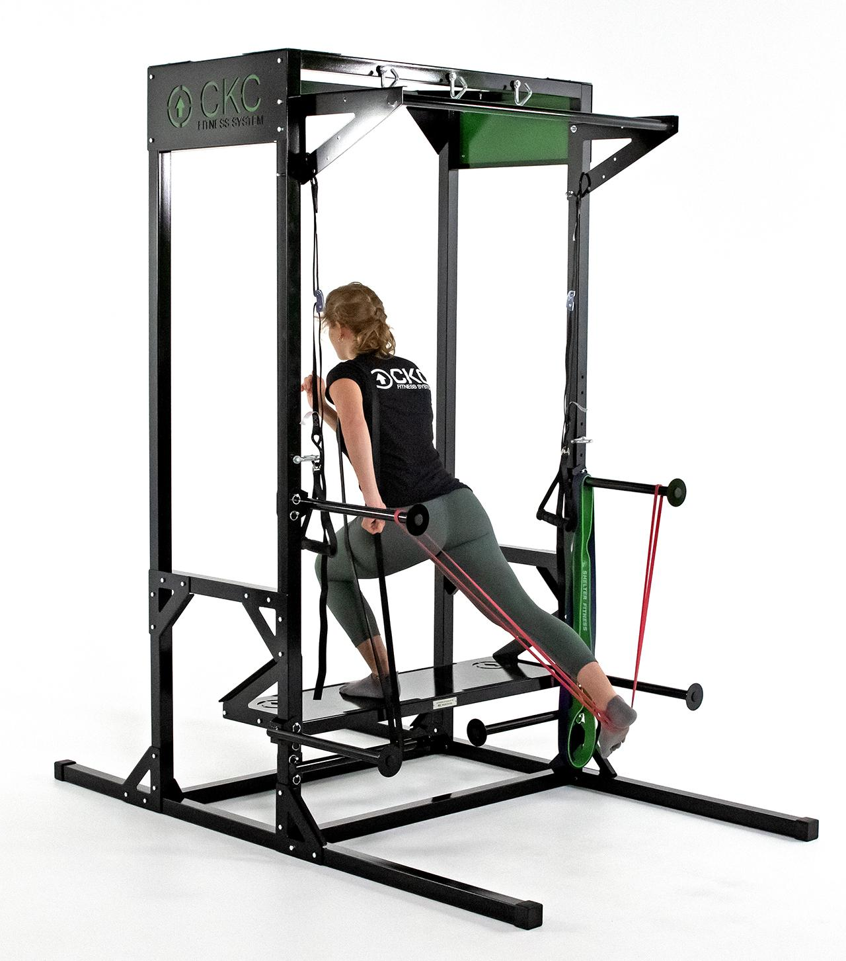
Split Squat 2x Support with Resistance
Notes:
This exercise is similar to the previous one except now the exercise is supported by a band with two contact points on the frame, which enhances stability, and she is resisting the motion with a band over her shoulder on the stance phase side.
Modifications can be made to this exercise in order to increase or decrease resistance along with increasing or decreasing stability depending on the needs of your clients.

Slide 46
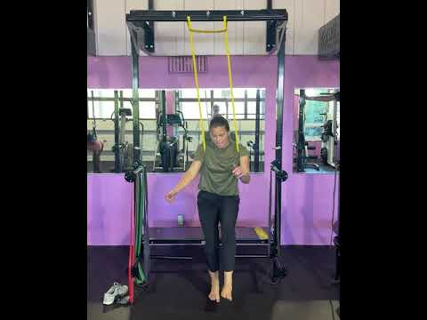
Single Leg Squat Variations
Notes:
Again, here is another example of a single leg exercise. This exercise is offloading bodyweight via an assistance band around the trunk. Even with this assistance, stability is being greatly challenged.
The focus should be to maintain a level pelvis, limit knee valgus, and keep the big toe, forefoot and heel, firmly in contact with the ground.
To increase difficulty, one could hold weight in their hands or wear a weight vest.

Slide 47
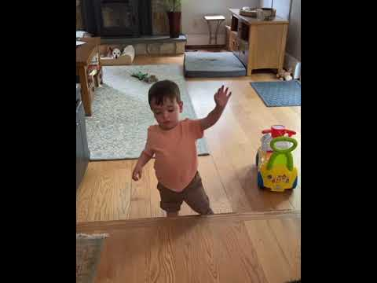
Single leg exercises are tough!
Notes:
All in all, remember that “true” single limb exercises are advanced and extremely challenging for even top athletes to perform when done with good form.
Sometimes, you might even need to use your hands.

Slide 48
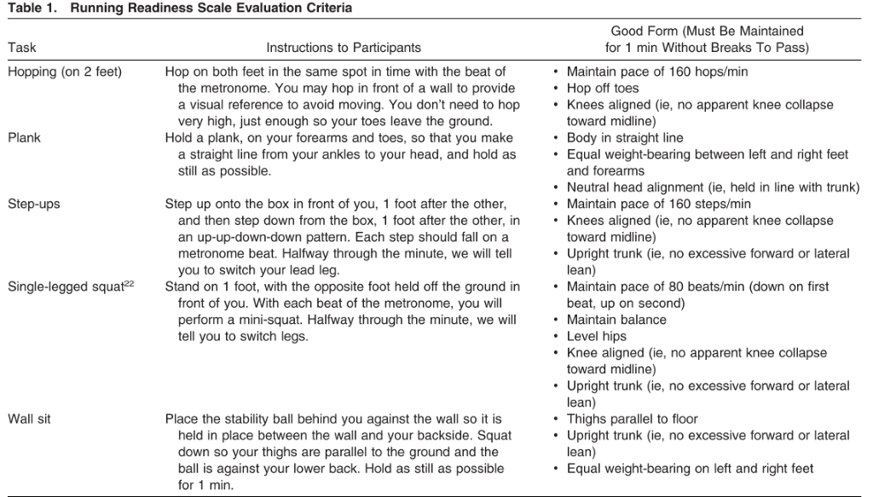
Does Frontal Plane Movement Faults at the Knee/Hip During Exercise Translate to Running? Yes
Running Readiness Scale (RRS)
  Looks at 5 tasks, higher score (5/5) = good form with all these tasks.
Harrison K, Williams DSB, Darter BJ, et al. The Running Readiness Scale as an Assessment of Kinematics Related to Knee Injury in Novice Female Runners. Journal of Athletic Training. 2023;58(2):120-127. doi:10.4085/1062-6050-404-21
Notes:
Running Readiness Scale
Helpful to look at as there is a lot of research on this evaluation tool, and it looks at 2 single leg tasks and the ability to control them in the frontal plane. For our purposes, we can disregard the plank, hopping, and wall sit. There is not a lot of quality research currently available looking at frontal plane instability with true single leg tasks so we have to get creative.

Slide 49
Does Frontal Plane Instability at the Knee/Hip During Exercise Translate to Running? Yes
Running Readiness Scale (RRS)
  When researchers saw significant hip adduction, contralateral pelvic drop, and knee valgus with hopping, step ups, and single leg squats, this was correlated with seeing the same during running
    i.e. frontal plane deviations seen during exercise correlate to running! And we now know this is trainable based on previous studies.
Harrison K, Williams DSB, Darter BJ, et al. The Running Readiness Scale as an Assessment of Kinematics Related to Knee Injury in Novice Female Runners. Journal of Athletic Training. 2023;58(2):120-127. doi:10.4085/1062-6050-404-21

Slide 50
Does Frontal Plane Stability Matter? Yes!
Another Running Readiness Scale (RRS) study
  113 college track and field athletes
  Those scoring < 3/5 were almost 5 times more likely to experience a lower extremity injury vs. athletes scoring > 4/5
Luedke LE, Reddeman ES, Rauh MJ. The Running Readiness Scale and Injury in Collegiate Track and Field and Cross Country Athletes. Journal of athletic training. 2025;60(4):301-307. doi:10.4085/1062-6050-0309.24,
Notes:
Recall the RRS emphasizes good form in the frontal plane with a handful of LE movements (knee valgus and contralateral pelvic drop for Ex. With step ups and SL squat). If good form isn’t present = lower score = correlated to higher risk of LE injury

Slide 51
Closed Chain vs Open Chain Exercise
Notes:
In exercise and proper strength programming, the principle of specificity states that in order to improve certain skills, functions, or movements, the training should closely mimic said skills, function, and movements.
When we target specific muscle groups, we must consider how these muscles contribute to the activities and functions of daily life and sport (if we’re working on sports performance specifically).

Slide 52

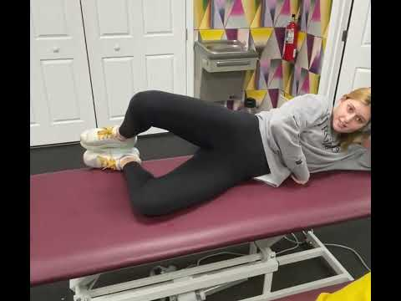
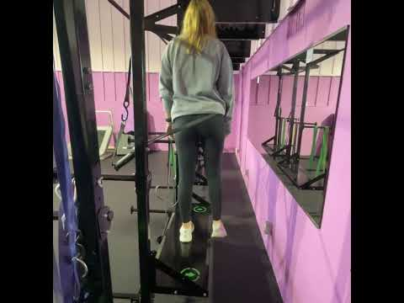
Gluteus Medius Strength - OKC vs CKC
Notes:
Let’s start with the gluteus medius. In an open chain, it works to abduct the femur away from the body, but with standing single limb tasks such as walking, the gluteus medius is working in a closed chain to stabilize the pelvic table.
In the example to the left, we have what is commonly known as the clamshell exercise. While this exercise might provide EMG activity to the gluteus medius, it poorly translates to functional tasks.
On the right, it a more appropriate way to challenge this muscle. Proper training of this muscle can help reduce injury and stress to the joints of the LE and the spine. Ideally this exercise is done barefoot, but unfortunately this video doesn’t show that.

Slide 53
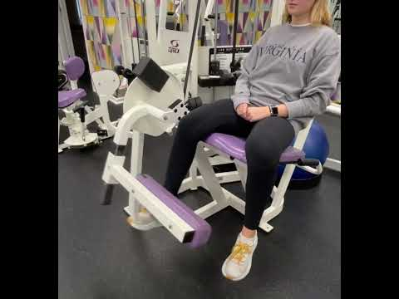
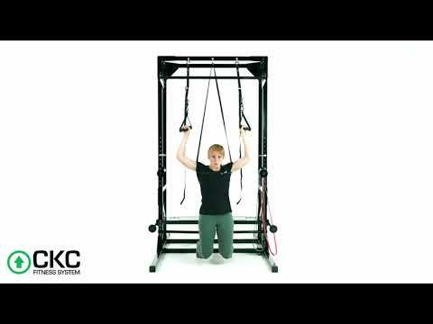
Quad Strength - OKC vs CKC
Notes:
Next, let’s talk about the quads with an open chain and closed chain example. On the left, this is a leg extension weight machine and on the right, we have closed chain kneeling squats.
Finally, this is not to say there is never a time and place for open chain exercise, but here, we tend to prioritize the closed chain example as again, it better mimics functional movement patterns.

Slide 54
Confidential and Proprietary Information
The concepts presented in this presentation are the proprietary intellectual property of CKC Systems LLC. These materials are intended solely for informational purposes and may not be reproduced, distributed, or disclosed without the express written consent of CKC Systems LLC.
For more information, visit www.ckcfitness.com
© 2025 CKC Systems LLC. All rights reserved

