Slide 1
The Shoulder Lab
David Luedeka DPT, MS, CSCS
Keila Strick DPT, CSCS
Notes:
Welcome to CKC Systems lab course focused on the shoulder. In this module we will review various topics with the goal of creating clarity and understanding the concepts taught in the course lecture.

Slide 2
Evaluation
Notes:
When starting the objective exam of the shoulder keep in mind that the client history of present illness is still the most important component of the entire evaluation. Also make sure to rule out other causes of shoulder pain such as a cervical spine pathology and visceral concerns.

Slide 3
Differential Diagnosis
Notes:
When determining if the cervical spine may be the cause of the clients shoulder symptoms, there are a few key findings that can help you in the process of the exam.
Typically, taking a thorough medical history will help rule up or down whether or not the source of the symptoms are related to the neck or the shoulder. If the shoulder is the source of the discomfort, then some type of mechanical deformation of the joint should elicit pain. If neck and shoulder motions or positions do not cause symptoms, it is important to rule out visceral concerns. Lots of organ system pathology can refer to the shoulder joint.
Regardless of what you can conclude from the subjective questioning, you should always screen the cervical spine within your objective examination.

Slide 4
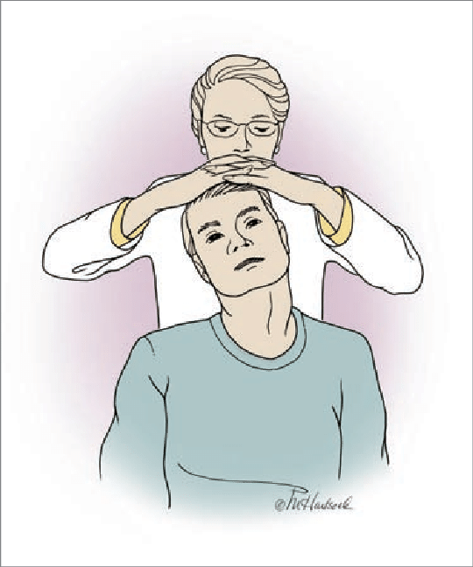
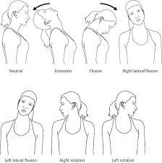
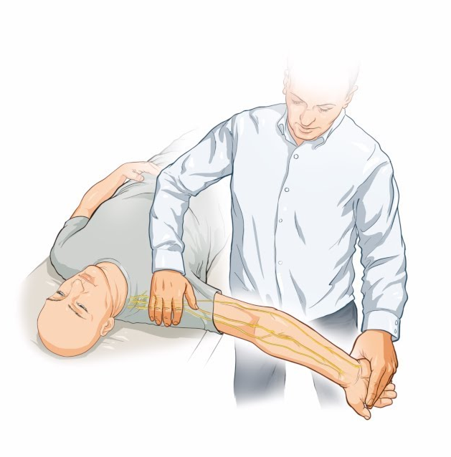

Screening the Neck
Spurling’s Sign
Active ROM
Nerve Tensioning
Sustained Flexion
Notes:
While there are many tests out there specific to the cervical spine, we prioritize a few as it helps to rule down major and common cervical pathologies that may refer pain to the shoulder.
Assessing active ROM can help determine if position or motion at the neck is related to shoulder symptoms. It provides the opportunity to look at the quality of motion and compare side to side. Similar to the lumbar spine unit, we can have the client sustain positions of the neck. If a client is symptomatic with sustained flexion, for example, it might indicate a disc is compressing on a nerve.
Spurling’s sign is a test that maximally closes the lateral foramen where the nerve roots exit to the upper extremities. This test combines ipsilateral SB, rotation, and extension and in this position, the examiner will apply an axial compressive load. Symptoms in this position may indicate facet joint irritation or stenotic changes that are compressing the nerve roots.
Finally, nerve tensioning looks at the peripheral nervous system which originates from the cervical spine and helps provides indications of nerve irritability or brachial plexus injury. Like all tests, you should compare side to side.

Slide 5
Shoulder ROM
Notes:
After screening the cervical spine, it is helpful to quickly assess shoulder active range of motion. This provides an efficient way to observe quality of the motion, compensatory patterns, muscle function, and joint range of motion for the shoulder.

Slide 6
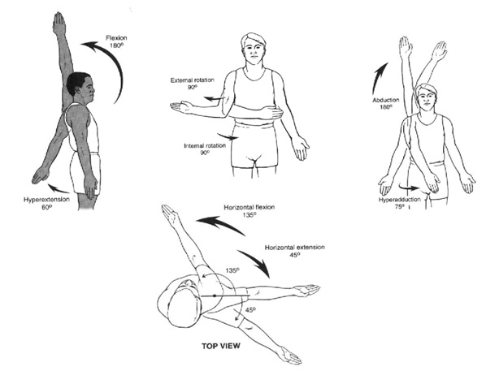
Shoulder ROM
Flexion and Extension
  Flex WNL ~160-180°
  Extend WNL ~50-60°
Internal and External Rotation
  WNL ~80-90°
Abduction
  WNL ~180°
https://m.blog.naver.com/PostView.naver?isHttpsRedirect=true&blogId=nopaindays&logNo=220844582935
Notes:
The glenohumeral joint is a ball and socket articulation which means it is very mobile and offers many degrees of freedom. While the the shoulder joint is very mobile, it is not very stable. We will see later how that impacts injury and function.
In general, the primary osteokinematic movements you want to observe are: forward flexion, scaption, internal rotation, external rotation, and abduction. Like all ROM testing you should compare side to side and look at overall quality of motion.

Slide 7
Shoulder Special Tests
Notes:
Similar to what we did when reviewing the LE, let’s talk about special tests for the shoulder joint.

Slide 8
Special Tests for Shoulder Structures
Labrum / Bicep Tendon
  Biceps Load II (SN .897 and SP .966)
  O’brien’s Test (Varied)
Subacromial Impingement / RC
  Hawkins Kennedy (SN .62-.92 and SP .25-1)
  Neer Subacromial Impingement (SN .72 and SP .6)
Posterior Cuff
  ER Lag Sign (SN .46-91 and SP .94-1)
Supraspinatus
  Empty Can (SN .89 and SP .588)
  Full Can (SN .70 and SP .81)
Notes:
While going through all these tests is out of the scope of this class, we wanted to provide a list here as reference of some common techniques that relate to the glenohumeral joint and specific soft tissue structures.
As you can see, these tests have variable sensitivity and specificity and cannot be the sole diagnostic mechanism. However, each can serve as a helpful supplemental diagnostic tool only in conjunction with a thorough subjective history and clinical picture.
Review these at your own leisure as they are all accessible online.

Slide 9
Test Clusters for Rotator Cuff Disease
Notes:
As you just saw, there are so many tests available for similar shoulder joint pathologies. Tests have a higher likelihood ratio when they are clustered together and done in combination.
A likelihood ratio is the likelihood that a given test result is what would be expected in a patient with the target dysfunction compared to the likelihood that the same result would be expected in a patient without the target disorder.

Slide 10
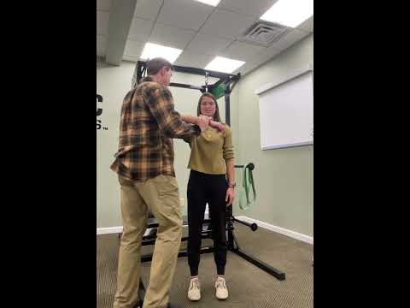
Rotator Cuff Dysfunction / Subacromial Pain
Test Cluster (Park HB, JBJS; 2005)
Painful Arc of motion
Hawkins
Resisted ER (weak/painful)
3/3 = (+)LR of 10.56
0/3 =(-)LR of .17
Notes:
While certain special tests have limited validity in isolation, they have been studied in groupings to see the best combination to assess rotator cuff pathology clinically.
With 3/3 positive tests, there is a significant probability that the individual has rotator cuff pathology. With 3/3 negative tests, there is a significant probability that the individual does not have rotator cuff pathology.
Here, we demonstrate the test cluster, starting with the arc of motion, followed by hawkins impingement, and finally, resisted ER. In this case, they are all negative, so we could confidently say that the rotator cuff is likely not the cause of the pain.

Slide 11
Similar Diagnostic Category & Treatment Approach
Subacromial pain
Partial rotator cuff tear
Bicep tendonitis
Rotator cuff tendinopathy
Bursitis
Impingement
Labral Tear
Notes:
All of these shoulder pathologies may have overlap in mechanisms of injury, functional impairments, and biomechanical faults. Despite having differing pathoanatomical diagnoses, they will all follow similar intervention strategies.

Slide 12
Scapulohumeral Rhythm
Notes:
Recall from the lecture content, scapulohumeral rhythm is the coordinated movement of the scapula and the humerus throughout shoulder motion. This considers motion at the scapulothoracic joint and the GHJ.
The movement should occur at a roughly 2:1 ratio of glenohumeral elevation and scapulothoracic upward rotation. Many have studied this relationship and multiple ratios have been determined, but 2:1 is well accepted and we will keep these values in mind for simplicity purposes.
Although the 2:1 ratio of scapulohumeral motion is the overall contribution to humeral abduction, this ratio is not uniform throughout the movement.

Slide 13
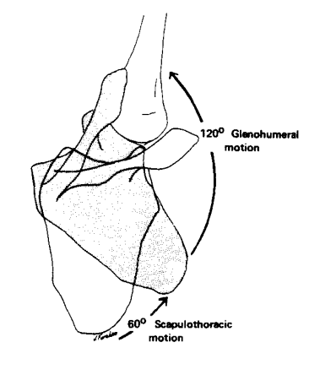
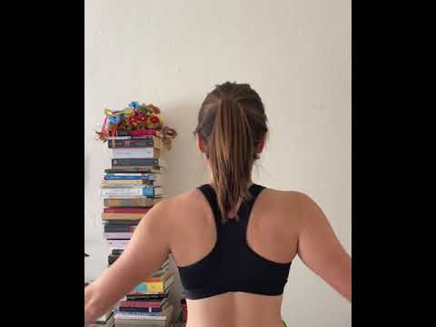
Scapulohumeral Rhythm
Notes:
Maintaining proper scapulohumeral rhythm is extremely important for function as it helps to preserve the length-tension relationships of the glenohumeral and scapular muscles and enables proper biomechanics of the shoulder joint. It is important to observe the quality of this rhythm in the evaluation process.
When the shoulder girdle is functioning absent of abnormal movement patterns, injury is less likely to occur to both the articular surface and also to the muscles and connective tissue around the joint.
We can watch a demonstration here. Initial motion of shoulder abduction should be GHJ dominant. As motion continues, there is more equal contribution from both the GHJ joint and scapulothoraic joint, and then finally towards end range, the motion should be scapulothoracic dominant. Most important, look for quality and symmetry.

Slide 14
Movement Analysis
Notes:
After reviewing some key components of the evaluation process, this chapter will focus on abnormal movement patterns in addition to comparing closed chain and open chain exercises and their impact on shoulder girdle biomechanics.

Slide 15
Abnormal Shoulder Motion
Notes:
It is important to objectively observe the quality and magnitude of shoulder motion. In the previous section, we reviewed normal scapulohumeral rhythm. Now let’s look at some abnormal movement patterns.

Slide 16
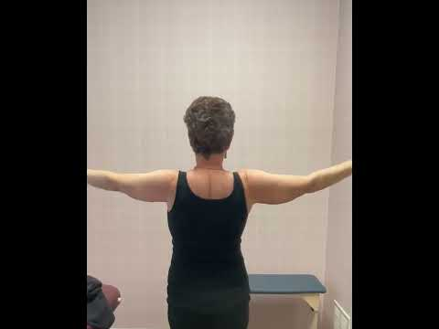
Scapular Dyskinesis
Notes:
This subject, diagnosed with surpraspinatus dysfunction demonstrates abnormal scapulohumeral rhythm. Notice that the rotator cuff has a difficult time stabilizing the GHJ during the initial stages of humer abduction. As such, there is an overcompensation of the scapulothoracic joint upwardly rotating to allow shoulder abduction.

Slide 17
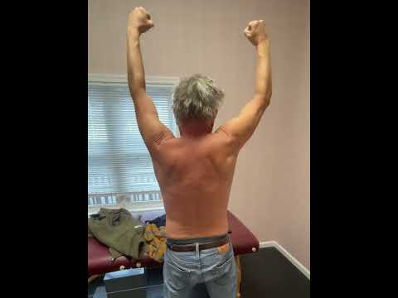
Scapular Dyskinesis
Notes:
Here is another example of scapular dyskinsia. This client has a confirmed rupture of his right subscapularis with supraspinatus involvement as well. Again, notice during the initial phases of movement, there is excessive scapular compensation to allow for humeral abduction. The scapula upwardly rotates and elevates very early on in the movement due to the deficit rotator cuff structure. The timing of the rhythm is off when compared to the left side.

Slide 18
Biomechanics Comparing Similar OKC and CKC Movements
Notes:
As the rotator cuff evolutionary mismatch theory has developed it is becoming clear that there is a an advanced neurological response to performing closed kinetic chain exercises. Research studies continuously show that the emg activity of the scapulothoracic musculature is greater when comparing closed vs open chain exercise.
For closed chain exercises that are performed from a hanging position, improved muscular activation and joint stability is most likely due to the impact that gravity has on the COM during these exercises. The distractive force created when hanging, theoretically initiates a neurological stability response to prevent dislocation. This response results in improved scapulothoracic rhythm.
For closed chain exercises that are performed with a compressional force vs a traction force, stability is created by ground reaction forces that are transferred through the glenohumeral joint.
These positions inherently decrease the need for RC stability. 50 plus million years of evolution created these biomechanics.

Slide 19
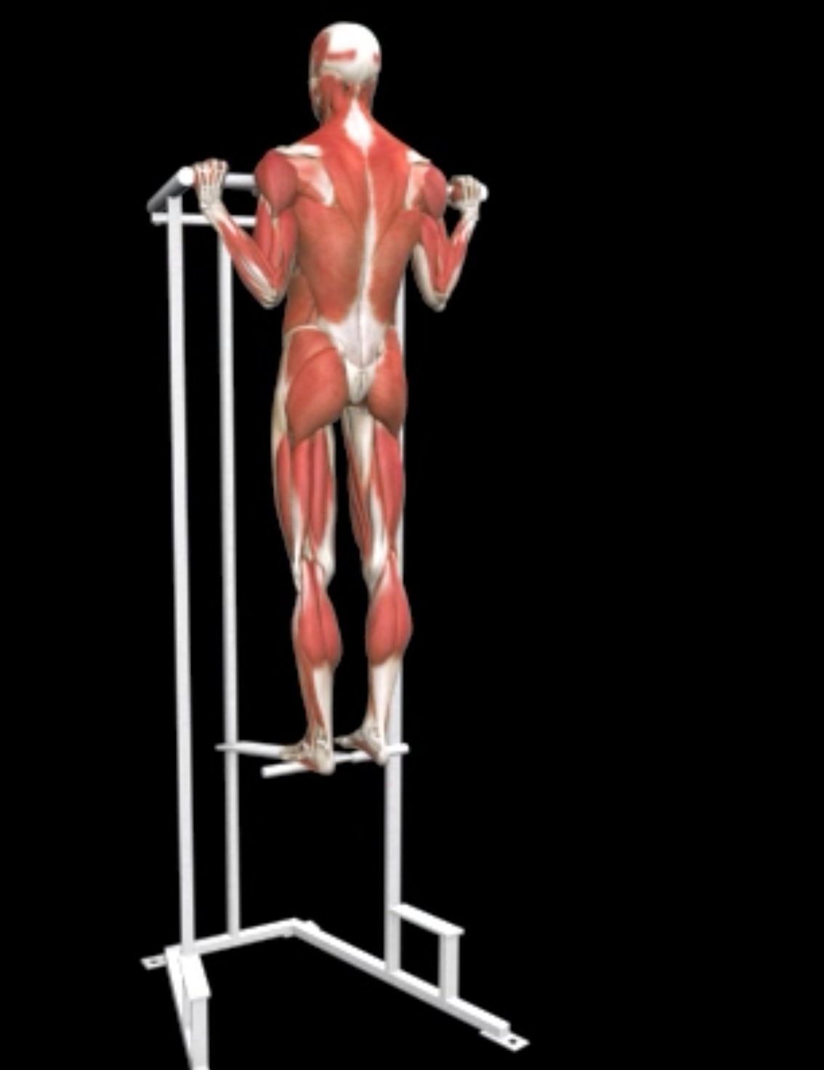
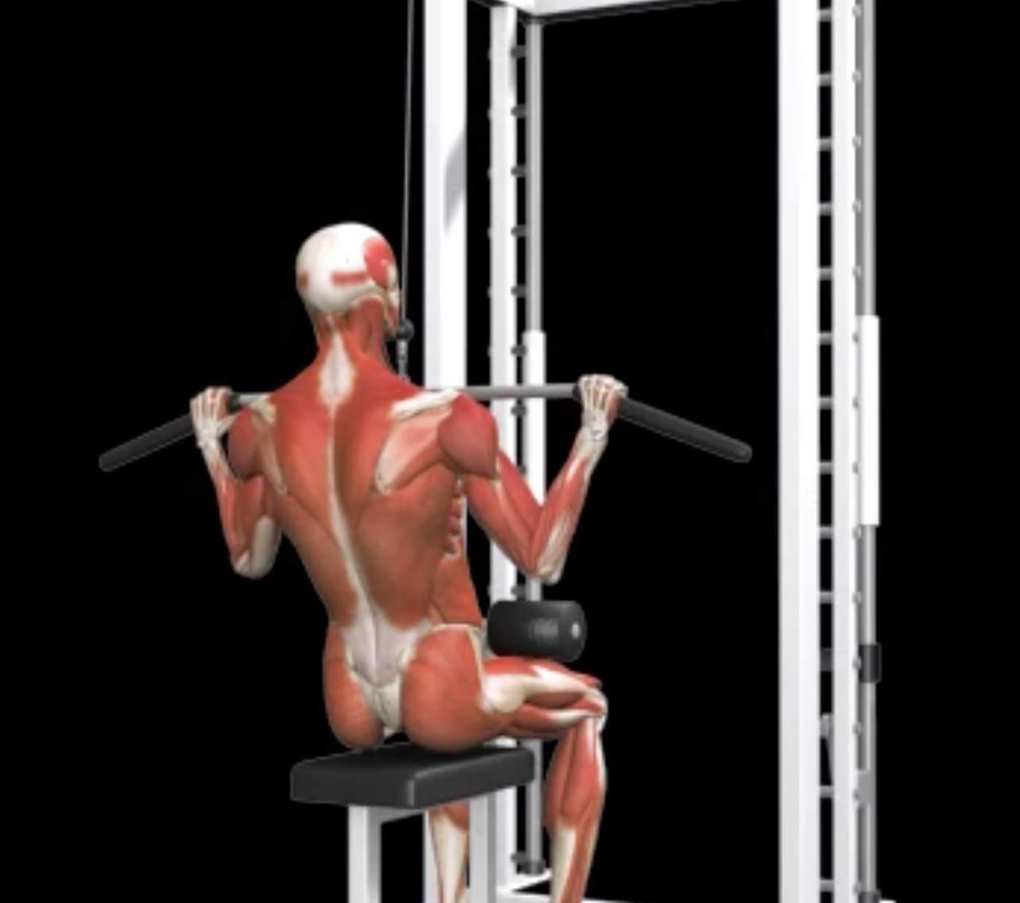
Open vs Closed Chain Scapular Impact
VS
Notes:
What is the difference between these movements? In the picture on the left, the COM is supported by the seat. In the picture on the right, the COM is exposed to the pull of gravity and the body mass is controlled by the fixed hand position.
The shoulder joint is formed by the scapula and the humerus. In hanging positions, the increased neurological response activating the muscles that control scapular motion, improve its alignment with the humerus during upper extremity movement. This enhanced muscular force coupling helps create stability within the GH joint.

Slide 20
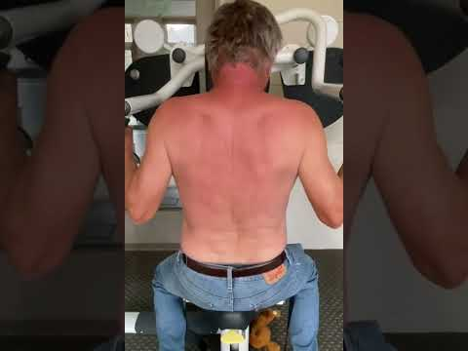
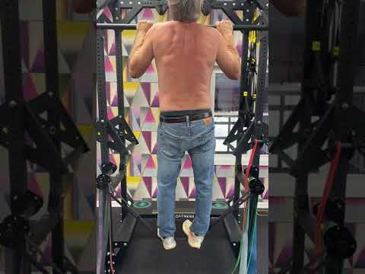
Open vs Closed Chain Spinal Impact
Notes:
These two exercises target the same major muscle groups. The one on the left takes place in an open chain, and the one on the right takes place in a closed chain.
Stability starts at the core. Proximal stability is necessary for distal stability. A stable spine allows the muscles that attach from the spine to scapula to have a stable attachment point for optimal function. EMG studies demonstrate that the core musculature is more active when the spine is subjected to the distractive forces created in the hanging position. Controlling ones COM is the key first step in the stability chain.
When the core muscles contract to stabilize the spine, the spine in turn is more stable. On the left, the subject does not have to control his COM. On the right, he does.

Slide 21
Lat Pulldown vs Pull-up
Notes:
When sitting to perform an exercise, as seen here, the COM is supported by the seat and there is less core muscle activation. Notice when his arms are in full elevation, the lower back musculature disengages. This decreases vertebral stability which in turn, decreases the optimal biomechanical function of the scapulothoracic musculature and allows the upper extremities to pulled into passive elevation.
We can see that motion occurring on the right side, the dysfunctional side, consists of aberrant movement patterns and the timing of his scapulothoracic movement is off. The aberrant patterns are made worse due to the lack of spinal stability at end range, which impacts the length tension relationship of the muscles that attach from the spine to the scapula.

Slide 22
Lat Pulldown vs Pull-up
Notes:
Let’s compare to the comparable closed chain exercise, the pull up.
We can see here that as the client’s body weight and gravity pulls his COM away from his fixed hands, it results in a distraction force at the shoulder. The difference between this exercise and the last example, is that the muscles of the core and scapular stabilizers never disengage throughout the full range of motion. As a result, the motion occuring at the scapula is smooth and symmetrical when comparing to the uninjured left side.

Slide 23
Open vs Closed Chain Muscle Activation
Notes:
Now that we’ve gone through these examples in detail, let’s take a step back. These exercises are performed at a similar 10 RM load, but notice the engagement of the muscles of the back during the pull-up compared to the lat pull down. You can see the definition of the lat, traps, interscapular muscles, and even the posterior rotator cuff throughout the entire movement.

Slide 24
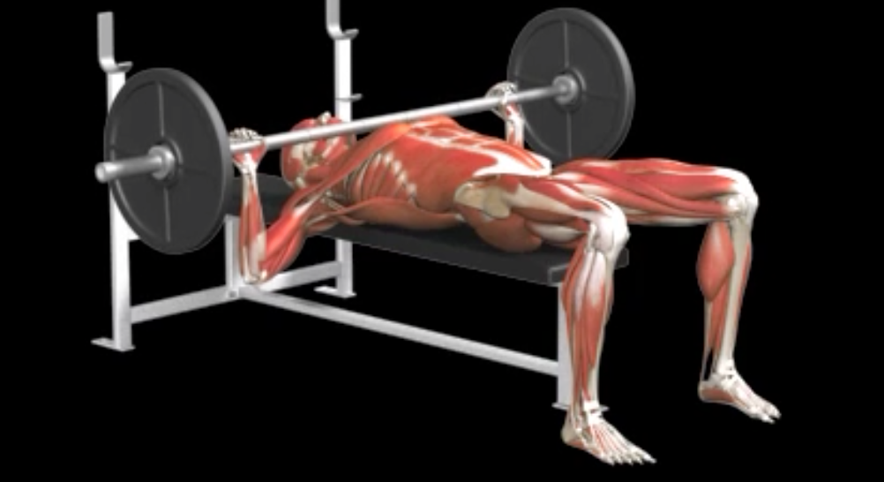
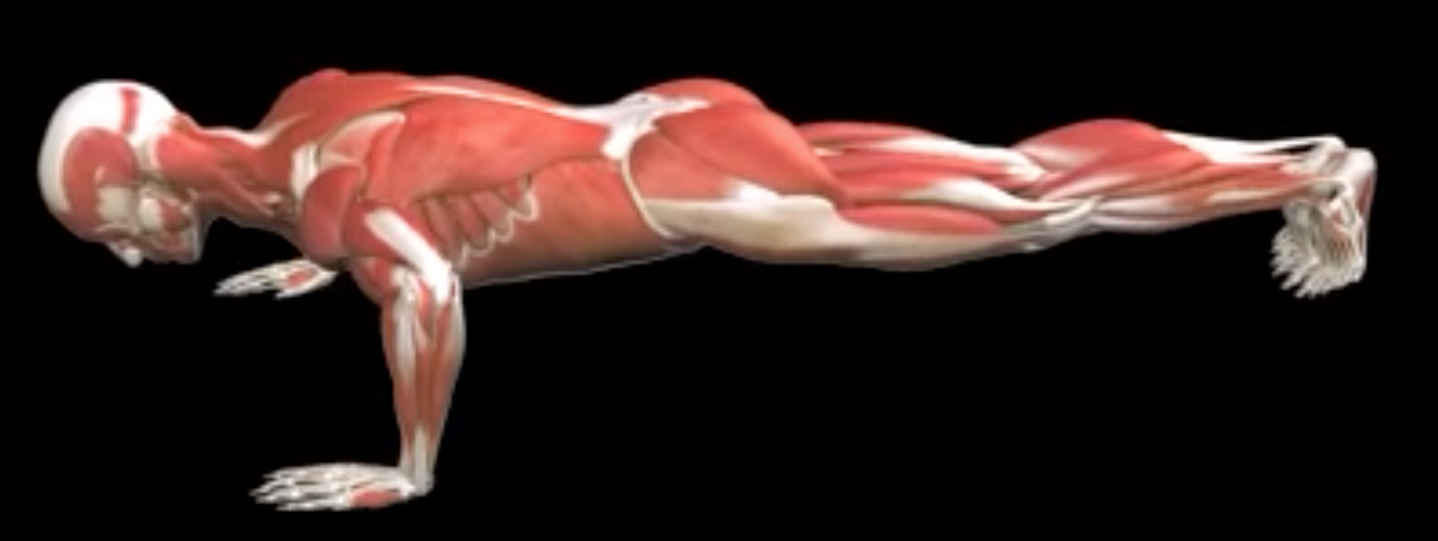
Bench Press and Resisted Push-up
VS
Notes:
Now let’s look at the bench press compared to the push-up.
Recall in the shoulder lecture we talked about how similar strength gains are attainable to the chest musculature regardless of the exercise chosen. If that’s the case, we should choose the exercise that is safer.
Why is it safer? What is the difference between these movements?

Slide 25
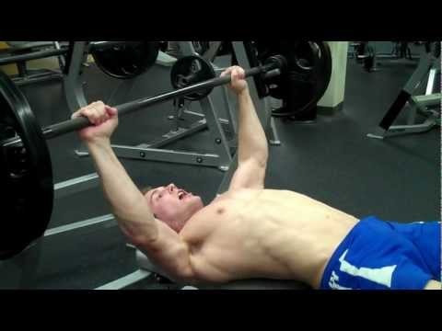
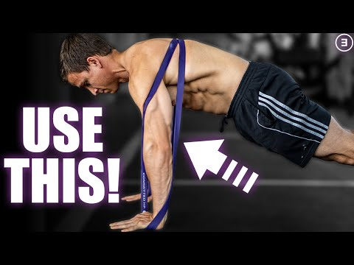
Bench Press vs Resisted Push-up
ScottHermanFitness. How To: Barbell Bench Press [Video]. YouTube. https://www.youtube.com/watch?time_continue=99&v=rT7DgCr-3pg&feature=emb_logo.
Published 2010. Accessed November 22, 2022.
E3Rehab. Band Resisted Push Ups for Strength | Hypertrophy | Rehab [Video]. YouTube. https://www.youtube.com/watch?v=8cTohcawjCM&t=49s. Published 2020. Accessed November 22, 2022.
Notes:
There are a few reason why a resisted push-up is a safer way to target strength gains in the upper extremities compared to the bench press. Again, it starts with core stability. With one’s body weight resting on a bench, spinal stability is not as necessary to complete the motion. Furthermore, the shoulder blades resting on the bench restricts free range of motion of the scapula. Recall that shoulder motion requires contribution from both the scapulothoracic joint and the GHJ. If we restrict motion at the scapula, then greater demand is placed on the GHJ and consequently, the rotator cuff structure as it must stabilize the load as motion occurs.

Slide 26
ScottHermanFitness. How To: Barbell Bench Press [Video]. YouTube. https://www.youtube.com/watch?time_continue=99&v=rT7DgCr-3pg&feature=emb_logo. Published 2010. Accessed November 22, 2022.
Notes:
Let’s watch this example of this subject performing a barbell bench press.
The back is excessively arched and he is resting in an anterior tilt of his pelvis. This posture indicates decreased activation of his spinal stabilizers. While some of his superficial abdominal muscle might engage through a valsalva technique, the deep intrinsic spinal stabilizer are not required to achieve this motion.
Notice how his shoulder blades are fixed to the surface of the bench. If the scapulae cannot adequately retract, excessive stress is placed to the anterior aspect of the shoulder and rotator cuff structure.

Slide 27
E3Rehab. Band Resisted Push Ups for Strength | Hypertrophy | Rehab [Video]. YouTube. https://www.youtube.com/watch?v=8cTohcawjCM&t=49s. Published 2020. Accessed November 22, 2022.
Notes:
Here we have the equivalent closed chain upper extremity exercise - a resisted push-up. When performing exercise such as a push up, the joint compression created by ground reaction forces improves GH joint stability. This in turn decreases the need for the rotator cuff musculature to stabilize the joint.
But there’s more… if we drew an arrow directly down from where the COM is, we can appreciate what the core musculature must have to do to combat that downward force.
This individual is maintaining a neutral spine and not allowing his back to arch. The spinal stability demonstrated here allows the scapulothoracic muscles which attach to the spine, to function effectively. Additionally, in this position, the shoulder blades are free to move as intended. The co-contraction of the muscles around the shoulder structure allows for proper scapulohumeral rhythm.

Slide 28
Evolutionary Mismatch
Notes:
Recall that while the lower body underwent significant changes to accommodate the forces associated with bipedal gait, it was not necessary for the upper extremities to go through as many adaptations.

Slide 29
Similar Anatomy;
Different Function
Notes:
When compared to our last common ancestor, the chimpanzee, we have very similar shoulder structures, however, we use our UE in very different ways.
Thinking through this design function mismatch might help to understand why rotator cuff dysfunction occurs in ~7/10 individuals throughout their lifetime.

Slide 30
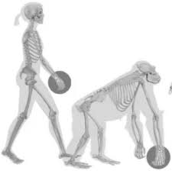
Emergence of Rotator Cuff Evolutionary Mismatch Theory
Rotator cuff injury occurs in ~70% of human adults by the 7th decade in life
Rotator cuff tears were found to be non-existent in the shoulders of non-human primates.
Plate JF, Bates CM, Mannava S, et al. Age-related degenerative functional, radiographic, and histological changes of the shoulder in nonhuman primates. J Shoulder Elb Surg. 2013;22(8):1019-1029.
Notes:
Given our similar anatomy, if ~7/10 humans will suffer from rotator cuff dysfunction within their lifetime, wouldn’t we expect a similar percentage in the chimpanzee population? While this seems like a plausible conclusion to draw, it is not the reality.
Plate and colleagues studied age-related degenerative changes and tissue injury of the shoulders in non-human primates. Through this research, rotator cuff tears were found to be non-existent in this population.
This was one of the primary studies that helped validate my thought process in the development of the RC mismatch theory.

Slide 31
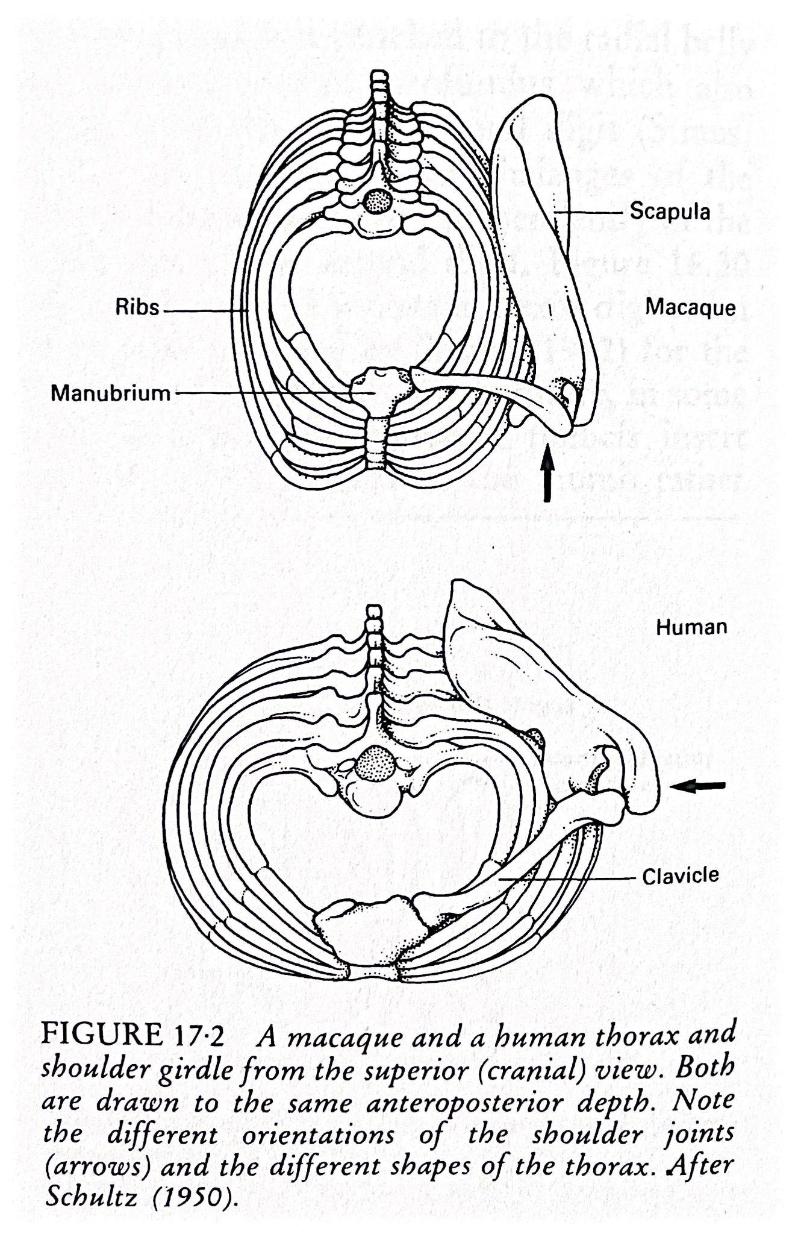
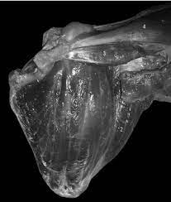
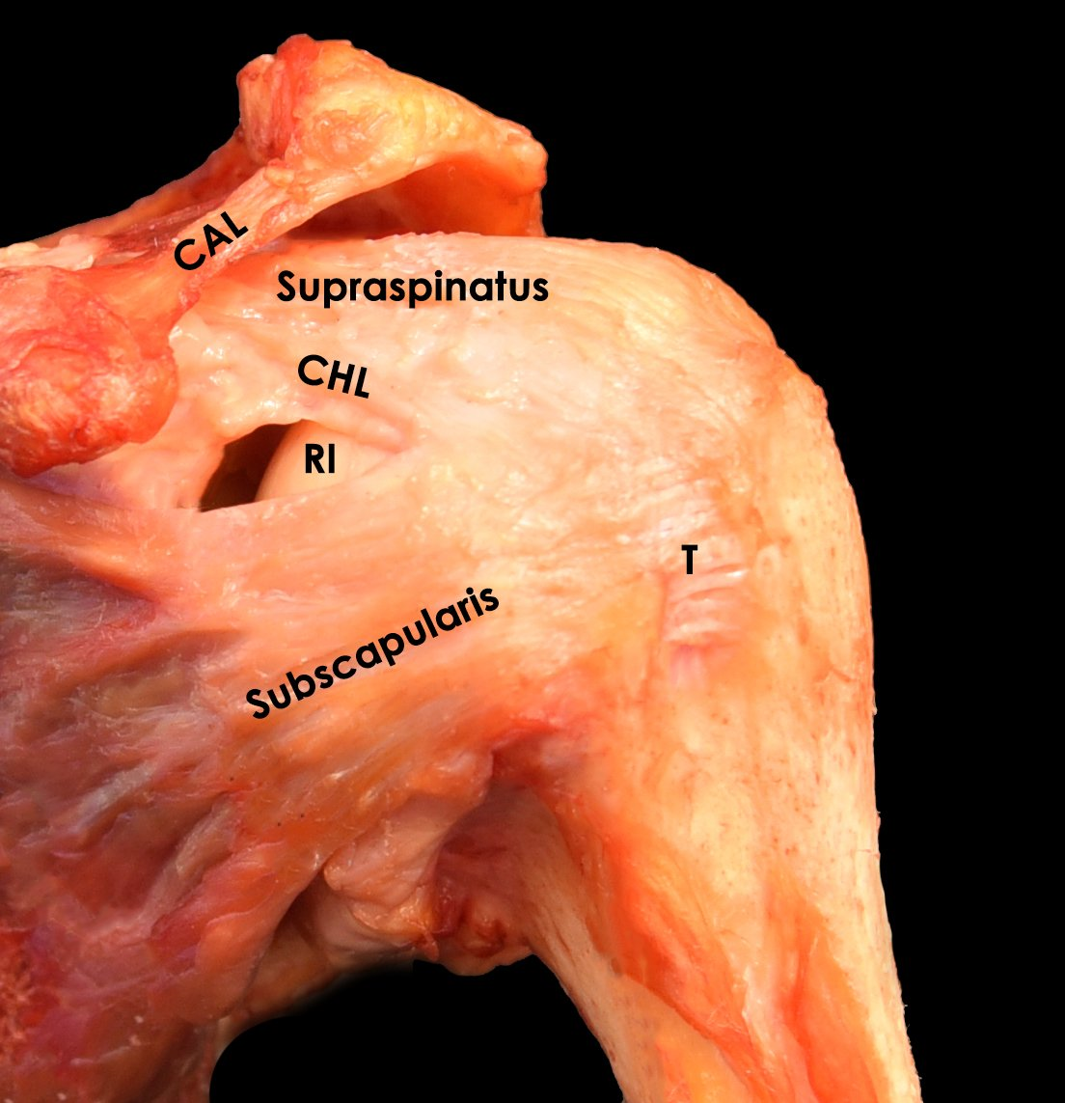
Comparative Anatomy
Similar shoulder structures - but do we function the same way?
Primate
Homo Sapien
Notes:
The major forces that adapted and shaped the primate shoulder girdle over the course of 50 million years of evolution were considerable closed chain compressive and distractive forces. Compressive forces when ambulating on all fours and distractive forces when hanging and swinging from branches.
Meanwhile, the forces that did not impact adaptation to the primate shoulder girdle, were minor loads in an open chain. This is because the significant forces that shaped the shoulder girdle were enough to create a structure capable of manipulating lighter loads, such as holding food and scratching one’s back. We didn’t require additional changes for those actions. Therefore, no significant adaptations occurred to accommodate supporting great loads in an open chain.

Slide 32
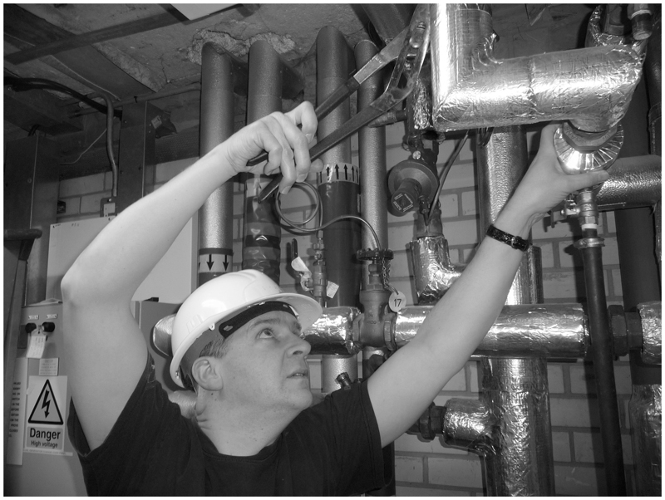

Everyday Function
Repetitive, loaded open chain movements at end range motion
Linaker CH, Walker-Bone K. Shoulder disorders and occupation. Best Pract Res Clin Rheumatol. 2015;29(3):405-423.
Notes:
Let’s reiterate that last point: no significant adaptations occurred to accommodate supporting great loads in an open chain.
How do we function in today’s world? Many occupations and every day tasks require repetitive, awkward ranges of motion, sometimes heavily loaded, open chain movements.

Slide 33
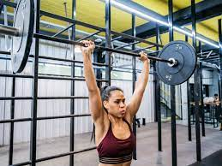
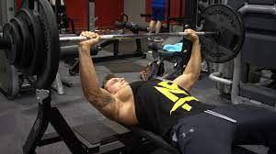
Resistance Training
Heavily loaded open chain movements, overhead or restricting scapular movement
Notes:
Furthermore, traditional strength and resistance training frequently incorporates heavily loaded upper extremity open chain movements.
The shoulder press and bench press demonstrated in this slide are just a couple of commonly seen exercises that put the shoulder structures under a great deal of stress. Though capable, these exercises are something our anatomy was not truly designed to accommodate.

Slide 34
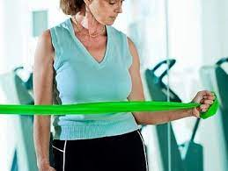
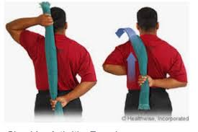
Traditional Approach to RC Rehab
Notes:
Finally, how do we traditionally rehab and strengthen the shoulder? As a physical therapist and strength and conditioning specialist, I can confirm that the exercises pictured in the slide have been the predominant form of exercise for clients with tight painful shoulders for most of my 30 year career.
The literature is full of conflicting studies evaluating these approaches. The truth is, even with this OKC based approach, the treatment of shoulder pain and dysfunction is still a real problem in modern society. Given the less than optimal success rates of these approaches, we have started to see other techniques emerge to help those with RC dysfunction.

Slide 35
Intervention
Notes:
What is the first thing you think of when you have a client who presents with a tight painful shoulder. For the most part we are taught that if a joint is tight, it should be stretched, and if it is weak, it should be strengthened.
Given the frequency of shoulder joint dysfunction in homo sapiens and the moderately high failure rates of our medical approach to treating shoulder dysfunction, maybe we should step back and reevaluate our interventions. Does every tight joint need to be aggressively stretched? Should we initially perform open chain PRE on damaged/overworked rotator cuff tissue?
Let me introduce and explain to you to a new treatment approach to add to your tool box.

Slide 36
A New Approach
Notes:
Like many of you, as a physical therapist and medical fitness specialist, I have stretched many tight painful shoulder joints throughout my career. Attempting to restore shoulder ROM, especially post surgical intervention, can be a very painful experience for patients/clients. Many never return for follow up appointments.
The less than successful outcomes and the client discomfort associated with the mainstream approach, started me on this journey to develop a more thoughtful approach to treating shoulder joint dysfunction. As we introduce this new approach, please keep in mind the evolutionary mismatch theory presented earlier in this lab.

Slide 37
A New Model to Treat RC Dysfunction
Rest and No Stretch
Tendon Adaptation
Closed Chain Progressive Resistive Exercise
Restore Open Chain Function
Notes:
The new treatment approach has 4 components.
The First component is rest. Even if the shoulder is tightening. Let it rest. Give mother nature time to heal the tissue.
Next, recall that the tendon is not comprised of the same tissue as the active muscle. It does not respond to stress in the same way. It needs long duration holds at a stimulus below pain threshold. Do this until the tendon is strong.
Thirdly, and this may be done in conjunction with the second step, begin to strengthen the scapulothoracic and glenohumeral joint musculature using closed chain exercises. This is the best way to strengthen the shoulder without overstressing the cuff.
Lastly, restore open chain function and strength.

Slide 38
Rest and No Stretching
Notes:
We will now review each of these steps in more detail. The first is rest. Rest can often be a dirty word in the rehab/exercise profession. Truth be told, rest is important at many levels. Rest is needed to allow damaged tissue time to maximize its healing potential.

Slide 39

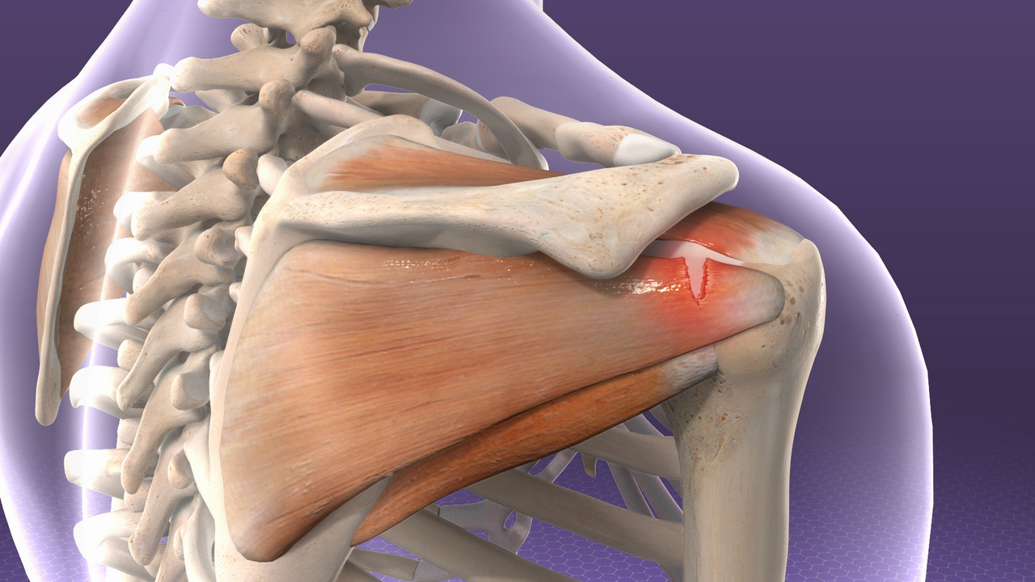
Rest and No Stretching
https://www.hopkinsmedicine.org/health/conditions-and-diseases/rotator-cuff-tendinitis
https://www.verywellhealth.com/the-towel-shoulder-rotation-stretch-2696336
Notes:
I am often asked: What if the shoulder joint tightens up? I always respond with “who cares”. There is good news in that–no more stretching painful/tight shoulders.
Let's step back and think about why a shoulder could be tightening. We all agree that the rotator cuffs main job is to stabilize the GH joint. Can it optimally stabilize when damaged? The answer is no. The shoulder joint capsule responds by tightening down to stabilize and protect the shoulder, thus giving the rotator cuff time to heal. When we stretch the shoulder, we are just loosening the capsule and placing more stress on the RC tissue. Let mother nature do her thing. Give the RC a break.
ROM should not be the focus as most of the closed chain exercise force the UE into full ROM without irritating the cuff and causing discomfort. Overtime, as the cuff has time to heal, ROM will naturally and spontaneously improve.

Slide 40
Tendon Adapation
Notes:
Looking at RC pathology objectively, the next question to ask yourself is, what type of tissue am I trying to improve with my treatment? If the tendon of the muscle is what is you are attempting to impact, then a long duration tendon toughening or connective tissue adaptation phase may be needed to restore function. Let’s talk about why that’s the case.

Slide 41
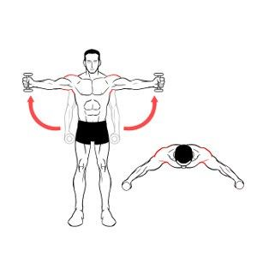
Connective Tissue Adaptation
https://ar.pinterest.com/pin/355432595594480368/
Notes:
Recall that the tendon is not made of the same tissue as the muscle. It is made of mostly of collagen–by the way a tissue that is not very stretchy–and elastin.
Collagen reacts to appropriate levels of stress by adding more collagen tissue in order to resist these new stressors. If the stress is too great, the tissue can fail. The stress/resistance applied to collagen has to be below the level that causes pain and the research shows it has to be held for long durations. Remember, blood supply to tendons is limited so it can take a long time for them to heal.
Review the exercises in the slide above. They are not repped. They are isometrically held for time.

Slide 42
Closed Chain PRE:
Distractive Forces
Notes:
In the shoulder lecture you learned that using closed chain exercise to treat those with shoulder dysfunction was a way to strengthen the shoulder/scapulothoracic musculature while limiting the stress on the vulnerable RC tissue. Let’s start by reviewing closed chain hanging exercises.
As we’ve mentioned, we evolved under distractive forces where, when the hands are fixed, the COM is being pulled away from the shoulder through gravitational forces and the spinal and scapular stabilizing muscles must contract in order to combat this distractive pull. In these hanging positions, the muscles around the shoulder girdle that engage is a neurological protective response to resist dislocation or instability. Through this subconscious muscle activation, muscle force coupling improves, biomechanics improve, and the GHJ is then subject to forces and loads it is able to tolerate without failure.

Slide 43
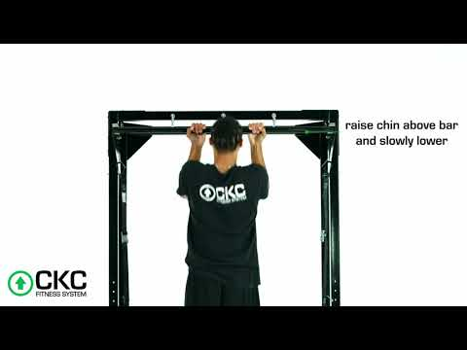
Chin-ups
Notes:
With the realization that chin and pull ups best minic the condition in which our shoulders evolved under, it was clear that this exercise could be beneficial to those with rotator cuff dysfunction. The problem is, chin ups are hard. It might seem crazy to have someone who is in shoulder pain perform such a hard exercise. In fact, most healthy people can’t perform chin ups.
However, by offloading one’s bodyweight, as seen in this video, you can target high reps with low load. Rehab programs must begin with low load at a higher volume so the injured tissue is given enough time to adapt.
You’d be surprised how many people can’t lift their arm over their head, but can perform assisted chin ups pain free.
Again, this all has to do with the co-contraction of the muscles around the spine and scapula that help to create a stable environment and restore proper biomechanics of the shoulder girdle, that the reduces stress on the injured cuff.

Slide 44
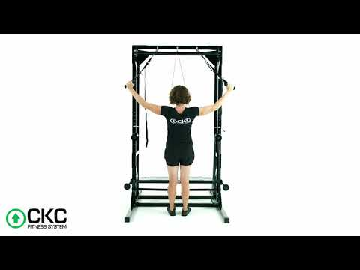
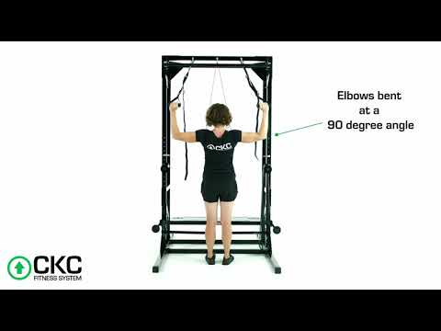
Shoulder Y’s and W’s
Notes:
Similarly to chin ups and pull ups, other UE exercises where the hands are fixed and the body weight is suspended will offer benefits in terms of maximizing strength while minimizing pain, and creating the best healing environment possible.
While these suspension straps are not purely closed chain, the hands are fixed in place enough to mimic those conditions. TRX type exercises for the UE must be done a an angle of at least 45 degrees from the ground so the joint tractions enough to elicit a neurological muscle protective response. If the client is too vertical, then then distractive forces around the GHJ are lost.
Seen to the left are shoulder Y’s which target the interscapular muscles and lower traps.
Now on the right we have shoulder W’s which primarily target the posterior cuff musculature. This is a very effective way to target strength gains of the teres minor and infraspinatus without asking these muscles to overwork to stabilize the GHJ.

Slide 45
Closed Chain PRE:
Compressive Forces
Notes:
Again, closed chain exercise to treat those with shoulder dysfunction is the most effective way to strengthen the shoulder musculature while reducing stress on the vulnerable RC tissue. Now, lets review closed chain exercise with compressive forces.

Slide 46
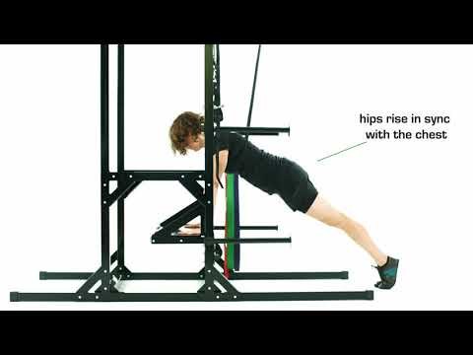
Push-ups
Notes:
Recall that when ground reaction forces are transmitted through the shoulder it gives the joint intrinsic stability. Because the joint has improved stability, the cuff does not have to work as hard. Thus the shoulder and its associated muscles get stronger without creating more damage to the RC tissue.
Similar to the chin-ups, push-ups are a challenging exercise for most to perform, especially in an injured state. In order to reach targetted higher rep ranges and maintain the compressive forces of gravity, one can offload their bodyweight. Doing a vertical push-up against the wall, for instance, would lose these external stabilizing forces.

Slide 47
Restore Open Chain Function
Notes:
The final step of the intervention process is to restore open chain function and this is really only necessary when the specificity principle dictates.
When performing open chain intervention strategies, we will always monitor load and reps. We would always advice against high load low rep open chain movements due to the stress it puts on the rotator cuff.

Slide 48
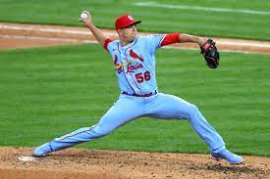
Restore Open Chain Function
Notes:
One of the main comments I receive when presenting this approach is “it all makes sense, except for the fact that modern man's UE functions in an open chain and this theory goes against the specificity of training theory we are all taught as a principle of exercise program design”.
We do not promote the idea that CKC exercise is the only form of exercise that should be performed when training the shoulder musculature. We realize sometimes there is a need to strengthen the tissue to resist open chain forces, however, it should be done with a mindset of RC conservation.
The major multijoint strengthening exercises when load is substantial will be performed in a closed chain. Save the RC for when it will be needed as the only anatomical structure able to dynamically stabilize the GH joint.

Slide 49
How to treat rotator cuff disease?
Exercise our shoulders the way they were designed to be used over the course of 50+ million years
Ground reaction compressive forces to offer external stability to the glenohumeral joint
With proper scapular humeral rhythm - achieved with force couples stabilizing the scapula in a closed chain
Neurological stability around the scapula due to controlling the effects of gravity pulling the body weight down and tractioning the shoulder joint
Notes:
Let’s summarize the rationale for this approach. Closed chain exercise should be the dominant form of multijoint UE exercise intervention with the goal of superior strength adaptations and reducing the stress on the vulnerable rotator cuff tissue.
This occurs in two ways: gravitation compression and increased neurological muscular activity.
Let’s exercise our shoulders in the way they were designed to be used over the course of 50+ million years.

