Slide 1
The Spine Lab
David Luedeka PT, DPT, MS,CSCS
Keila Strick PT, DPT, CSCS
Caroline Williams, PT, DPT,MS, GCS
Nick Roche, PT, DPT, CSCS
Notes:
Welcome to CKC Systems lab course focused on the spine. In this module we will review various topics with the goal of creating clarity and understanding of the concepts taught in the course lecture.

Slide 2
Evaluation
Notes:
When evaluating the spine it is important to understand the lumbar spine position is influenced by what happens lower in the kinetic chain. If the pelvic table is imbalanced the spine will come off of the pelvis via the sacrum at an angle. It will cause a spinal curve. Since the center of mass is located in the lower core the imbalance impacts muscle function.

Slide 3
Postural Assessment
Notes:
When evaluating the spine have the subject stand with their feet in a natural position under their COM with their shoes and socks off. Make sure the knees are fully extended.
In the frontal plane evaluate the pelvic table and determine if it is level. Look at the shoulder position and see if it is level. Compare ES muscle mass: If unequal it gives a clue that forces are impacting the LE and core musculature unequally. Excessively developed erector spinae musculature can indicate a spinal instability.
When assessing the sagittal plane look at the lumbar lordosis. Is it normal, reduced or excessive? Too much lordosis can overstress the facet joints and not enough lordosis can place too much stress on the spinal disc.
Next, look at the thoracic and cervical spine. You should expect thoracic kyphosis and then the spine recurves back to cervical lordosis.
The position of the head relative to the body may help assess for normal sagittal plane posture. With a forward head position, there may be excessive thoracic kyphosis and cervical lordosis.
These are difficult things to measure without imaging, but clinical experience and assessing multiple spines, will help understand what constitutes normal.

Slide 4
Scoliosis and Patterned Findings
Notes:
If you suspect the spine position is shifted due to an unequal pelvic table, but are unsure if it is significant, there are are some findings that can help you make a decision. Is the erector spinae muscle mass larger on the opposite side of the suspected longer leg? If so, that is an indication there is an imbalance. Why does this occur? Because the erector spinae is responsible in assisting pelvic stability and has to lift the pelvis through a greater ROM.
If the spine is shifted and held in a non functional side bending than gross spinal rotation will be will be greater to the concave side of the shift. With a stable pelvis evaluate gross spinal rotation. If it is not symmetrical that is an indication there is an imbalance. The concave shift of the spine should occur on the higher sided pelvic table.
Why do we care about even minor imbalances? Because it can have an effect on joint loading, muscle performance and single leg function.

Slide 5
Correcting Frontal Plane Imbalance: Party Trick
Notes:
Although it is commonly taught that lower level spinal curves should be monitored and not treated keep in mind that even minor imbalances can cause dysfunction. Minor discrepancies can be treated with with a heel lift.
Lets review just how impactful a heel lift can be. When we place a 1/2 inch lift under this subjects foot watch what happens to gross spinal rotation motion.
Rotation will increase the taller side.
Clinically, standing directly behind the client will help to see this discrepancy.
Now when the lifts are removed the motion is symmetrical

Slide 6
Heel Lifts and
Frontal Plane Correction
The Context

Slide 7
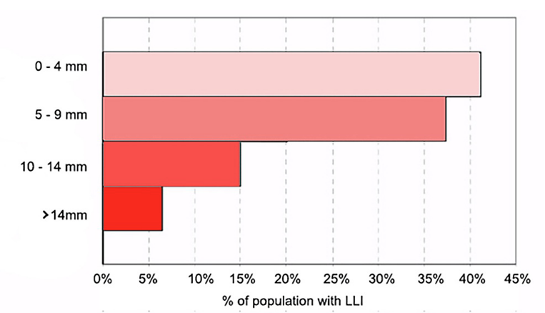
Limb Length Discrepancy (LLD) Prevalence
LLD within 20 mm affects 40-70% of adults
  Associated with increased prevalence of LBP
LLD < 10 mm present in almost 90% of people
Colonna S, Casacci F, Borghi C. Scoliosis and Lower Limb Inequality: To Lift or Not to Lift, That Is the Question. Cureus. 2024
Notes:
LLI (inequality) or LLD (discrepancy), same thing. Will help broaden research net

Slide 8
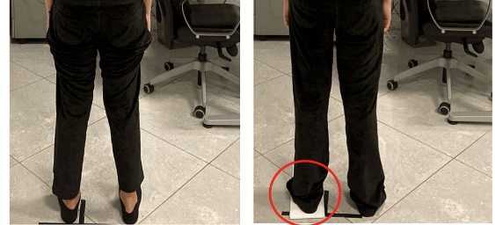
Limb Length Discrepancy (LLD) Assessment
The block test is the most useful clinical tool for assessing LLD
  We use lifts instead of blocks
Gold standard is AP radiograph (X-ray)
Colonna S, Casacci F, Borghi C. Scoliosis and Lower Limb Inequality: To Lift or Not to Lift, That Is the Question. Cureus. 2024 (image)
Alfuth M, Fichter P, Knicker A. Leg length discrepancy: A systematic review on the validity and reliability of clinical assessments and imaging diagnostics used in clinical practice. PLoS ONE. 2021

Slide 9
Limb Length Discrepancy (LLD)
& MSK Impairment
Hip Pain
  More often present in the long leg
    Studies look at OA mainly
  What about the glute med?
LBP – Disc
  More common on the short leg
Knee Pain
  Varies
Consensus that LLD > 20 mm is frequently a problem. Some evidence that LLD as little as 5 mm can lead to long term pathology
  Clinically we know this is true
The cut off for clinically significant LLD is 15 mm… we disagree
Gordon JE, Davis LE. Leg Length Discrepancy: The Natural History (And What Do We Really Know). Journal of Pediatric Orthopaedics. 2019
Notes:
LBP
Brinke et al. In 1999, looking at 132 patients treated for a herniated disc. Author noted a prevalence of herniated nucleus pulposus on the short side in men and a statistically significant association of herniated nucleus pulposus on the short side in women
Another study from 2005, 33 patients, showed positive LBP treatment with a lift, "there seems to be a consensus that LLD > 20 mm are frequently a problem. There is some evidence that LLD as little as 5 mm can lead to long term pathology"

Slide 10
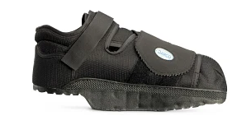
Limb Length Discrepancy (LLD)
& Heel Lift Efficacy
Close to 90% of patients treated with a heel lift had partial or complete pain relief
  Impairments: LBP, hip pain, knee pain
Diabetic foot ulcer study from 2025
  Foot ulcer → Offloader boot
  Half of the patients had LLD corrected, half didn’t
  Group that had LLD corrected:
    Significantly less likely to report hip pain
      Not even the main outcome! (amputations, new ulcers, healing time)
1. Campbell TM, Ghaedi BB, Tanjong Ghogomu E, Welch V. Shoe Lifts for Leg Length Discrepancy in Adults With Common Painful Musculoskeletal Conditions: A Systematic Review of the Literature. Archives of Physical Medicine and Rehabilitation. 2018
2. López-Moral M, García-Madrid M, Molines-Barroso RJ, Sanz-Corbalán I, Tardáguila-García A, Lázaro-Martínez JL. Clinical Efficacy of a Contralateral Shoe Lift in Patients with Diabetic Foot Ulcers and Induced Limb-Length Discrepancies: A Randomized Controlled Trial. Adv Wound Care (New Rochelle). 2025
Notes:
Diabetic foot ulcer study
All outcomes improved in corrected LLD group, hip pain happened to be a secondary outcome measure of interest
Discuss posting over taller leg altered biomechanics scouring the hip joint (hip OA) and increased external hip adduction torque to the glute med on the taller side (GM tendinopathy/tear, greater trochanteric bursitis)
Interesting, control group without LLDP correction were much less likely to adhere to the off loader boot, potentially due to discomfort/pain
Image Citation
https://www.graylinemedical.com/products/darco-heelwedge-off-loading-shoes-darco-heelwedge-off-loading-shoe-black-size-s-womens-7-5-10mens-6-8-hq1b?variant=31851008852025&msclkid=9cf1615e8eff12d02a8609c5fb0cabdc&utm_source=bing&utm_medium=cpc&utm_campaign=Medline%20(%2435%20-%20%24100)-G8556152876&utm_term=4585856845164786&utm_content=%2435%20-%20%24100

Slide 11
Cause of Leg Length Discrepancy
Higher Pelvic table | Lower Pelvic table
Excessive hip anteversion | Hip retroversion
Anatomically longer LE | Anatomically shorter LE
Tibial internal torsion | Excessive tibial external torsion
Excessive arch supination | Excessive arch pronation
Coxa valgus | Coxa varus
Joint Replacement | Genu recurvatum
 | Knee flexion contracture
 | Unilateral Knee or HIp OA
 | Knee Varus or Valgus
Notes:
This is a summary slide reviewing the possible causes of LE limb length discrepancies and its impact on the pelvic table. We have no control over fixing this, except some of the arch changes

Slide 12
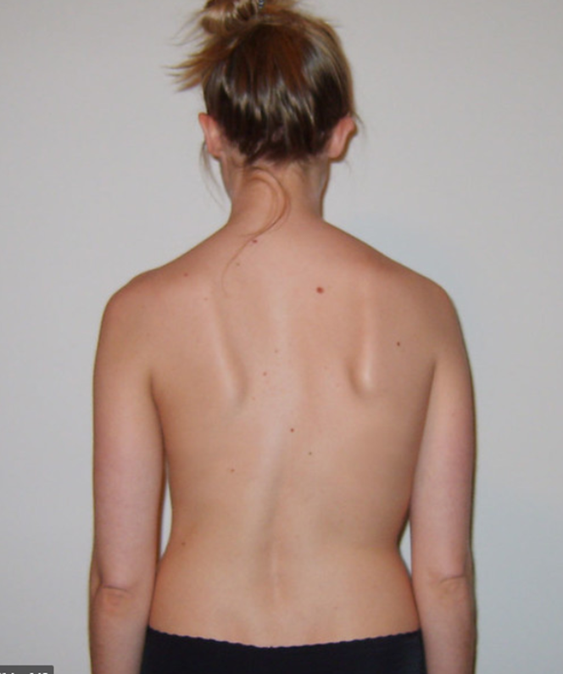
Compensation of Leg Length Discrepancy Pattern Recognition
Higher Limb Side | Lower Limb Side
Hip compensated through external rotation | Hip compensates through internal rotation
Smaller erector spinae muscle mass | Larger erector spinae muscle mass
Greater ipsilateral trunk rotation | Decreased ipsilateral trunk rotation
Concave lumbar / spinal shift away | Convex lumbar / spinal shift towards
Greater instability on SL on longer limb (increased Q-angle, pelvic drop, trunk lean) | Greater stability on SL with reduced compensatory mechanisms
Notes:
This is a summary slide reviewing what will be seen functionally if there is a pelvic table imbalance

Slide 13
Gait Analysis: Sagittal and Frontal View

Slide 14
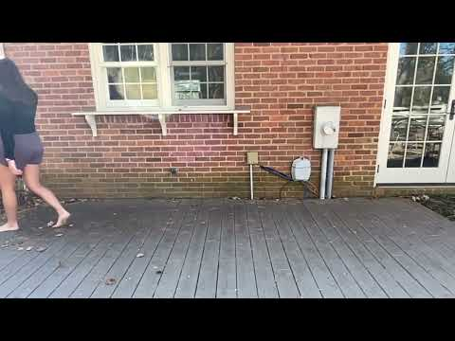
Notes:
Spine in upright with minimal to no trunk flexion
Opposite arm and leg throughout the gait cycle

Slide 15
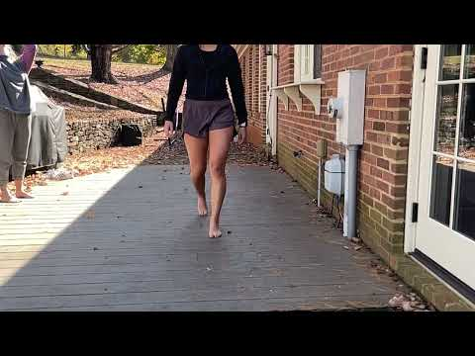
Notes:
Trunk lean
Common to see ipsilateral trunk lean with weakened

Slide 16
Sustained Position:
Flexion, Extension, and Quadrant Testing
Notes:
Sustained Flexion
After asking the patient for their baseline symptoms, have the patient flex forward and sustain posture for about a minute or until symptoms come on. This can be done seated or standing.
This position produces compression anteriorly and tension posteriorly
Pain worsening may indicate a disc imbalance and is common in a younger demographic.
If pain improves it may indicate stenosis or spinal degeneration.
Consider leg radiating or referred symptoms - symptoms moving away from the spine is worsening or peripheralizing, and symptoms moving towards the spine is improving or centralizing
Sustained Extension
This position produces compression posteriorly and tension anteriorly
Pain improving might indicate that the posture is helping to recede a bulging or herniated disc compressing on nerves
If pain worsens, it may be due to overstressing the facet joints or closing the nerve root canals
Again, pay attention to any referred or radiating leg pain. Centralization of symptoms is good.
Quadrant Testing
The objective is to look for foramen narrowing
Maximal foraminal closing occurs in the lumbar spine with ipsilateral side bend, rotation, and extension - effective way to screen for facet joint pathology or stenotic changes in the lateral foramina
we do this standing and on a single leg if possible because it ensures maximal axial loading. It can be done seated if patient is unable.

Slide 17
Differentiate - Muscle or Passive Tissue Injury?
Notes:
The consensus of research demonstrates that most acute back pain episodes will resolve within a few weeks with or without treatment. The main responsibility of medical fitness professionals is to determine the biomechanical cause of the back pain and design an exercise program with the goal of improving the condition.
One of the evaluation tools used to determine the tissue involved in the dysfunction is passive and active motion testing.
As mentioned in the prior slide if sustained positions increase symptoms it most likely a non muscular structure like the disc that is causing the symptoms.
If the pain is caused by active motions or muscular contraction it is more likely a muscle strain.
Resisted motion testing should include:
Straight leg bridges to evaluate the erector spinae (on table)
Abdominal rhythmic stabilization in hook lying to evaluate multifidus - the lumbar rotator muscles
Keep in mind when a client is in acute back pain it will be difficult to determine cause because all tests may be positive. The client may just need to rest. The client interview is important in putting together a hypothesis to formulate a long term treatment plan.

Slide 18
Movement Analysis
Notes:
When assessing gait it is important to understand that leg length discrepancies, even if seemingly insignificant, can impact single leg function. Leg length discrepancies can be caused by anatomical or functional reasons. An anatomical reason would be femoral neck excessive anteversion and a functional discrepancy would be caused by a knee joint contracture. Why is this important? Because these anomalies cause frontal planes imbalances that go up the kinetic chain and impact spine position.

Slide 19
Leg Length Discrepancy/LE Instability
Impact on the Spine (Frontal Plane)
Notes:
Next let's talk about how the spine is impacted when a leg length discrepancy is present. If say the right leg is functionally longer due to a knee joint contracture on the left leg the non symmetrical forces will impact the spine. How? The functionally longer right leg will lift the right side of the pelvis causing a tilt that slopes from high right to low left. This causes the spine position to be off center and requires a compensation to bring the COM symmetrically between the BOS. The compensation is a recurve of the spine to the right. We will see in the next video examples how this fault impacts both the frontal and transverse plane function of the spine.

Slide 20
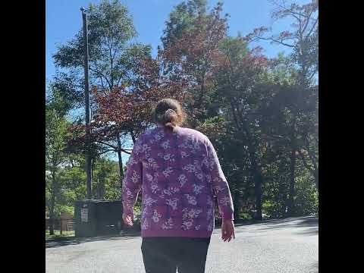
Excessive Trunk Lean
Notes:
In this example it has been determined that this subject has an anatomical discrepancy causing the right LE to be longer than the left. This in turn pushes the right pelvis higher than the left. The result is causes a seemingly insignificant spinal recurve to the right. This slight recurve however has significant impacts.
As mentioned in the lecture series of this course we did not evolve to have optimal frontal plane musculature to support our increased body mass. With the pelvis being positioned lower on the left ones body has to work extra hard to lift the pelvis on that side to allow for swing to occur. So, you trunk lean to the right and the contralateral erector spinae muscles work extra hard to lift the pelvis. You can observe this excessive trunk lean throughout the subject’s gait cycle. In these cases you will often find non symmetrical erector spinae muscle development.
How could this movement fault impact spinal pathologies? What if this patient was dx with spinal stenosis? Which side would be impacted more? I say the right.
So, it is important to correct leg length discrepancies even if minor.

Slide 21
Leg Length Discrepancy/LE Instability
Impact on the Spine (Transverse Plane)
Notes:
Stability is the key to spinal function. The spine did not evolve to be a prime mover. When leg length discrepancies are present the stress on the spinal structure is increased to compensate for the asymmetry. The spine is asked to do more than what it evolved to do. We just mentioned in the prior slides what happens in the frontal plane. What about the transverse plane. There are impacts there as well

Slide 22
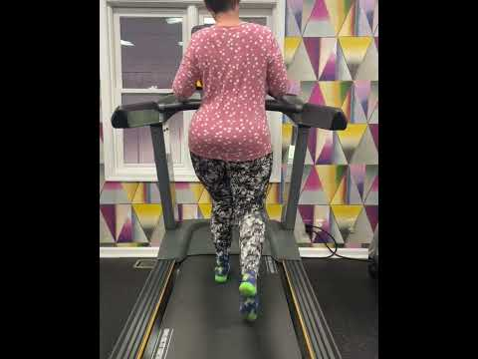
Excessive Trunk Rotation: Left Leg Long
Notes:
In this example the subject has congenital anomalies in both hips that decrease ROM and a LE limb length discrepancy that impacts the frontal plane motion as discussed in the previous slides. The limited motion in the hip creates weakness in the gluteals that impacts the subjects ability to stabilize the pelvis when on stance phase. With a limited ability extend the hip at terminal stance, there is excessive transverse plane motion to achieve toe off.
So, given the loss of hip motion, hip muscle weakness, and the frontal plane imbalance what spinal pathologies would you expect to see? This subject is Dx with spondylolisthesis of her lumbar spine.

Slide 23
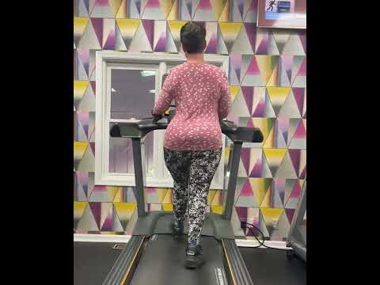
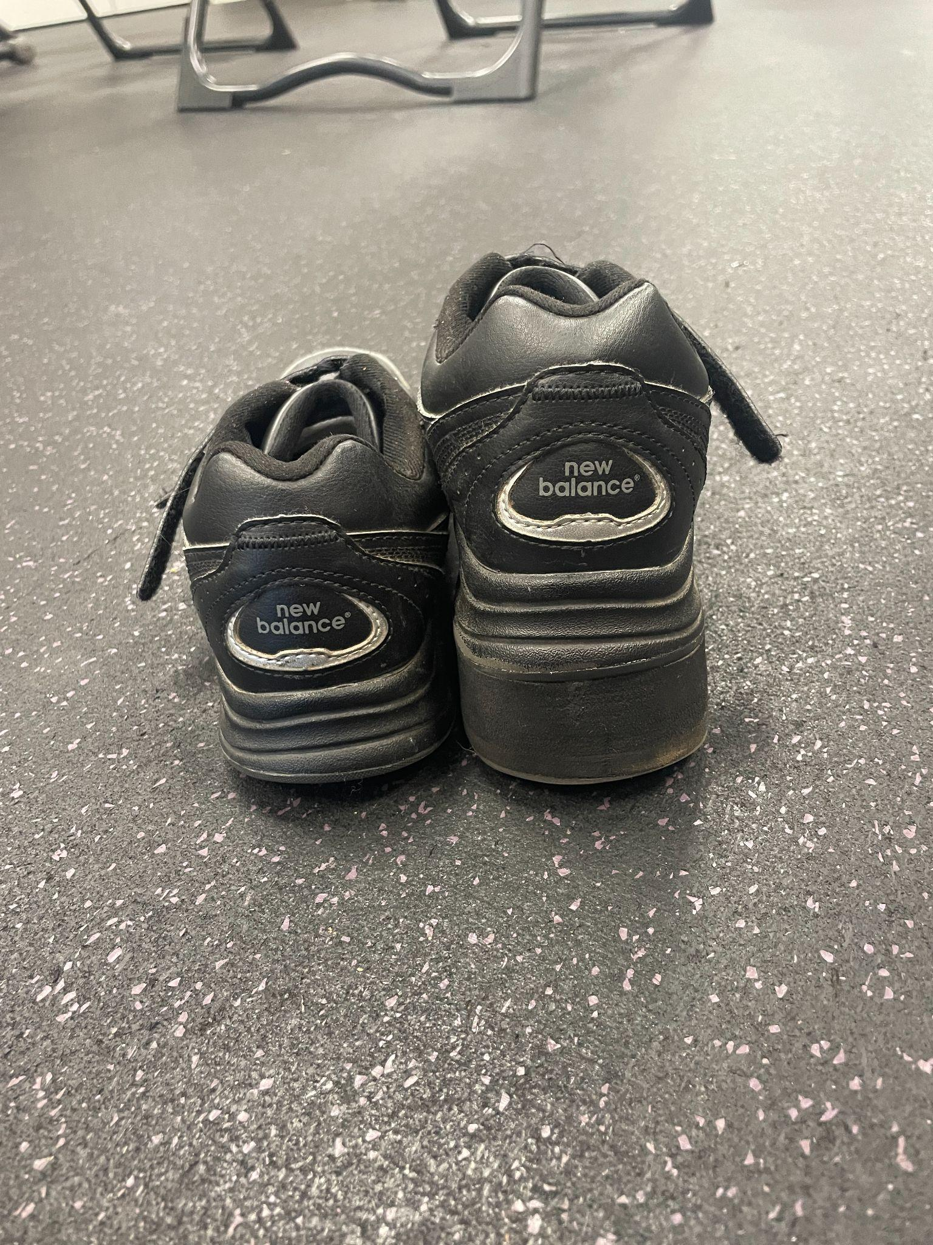
Excessive Trunk Rotation: Shoe Correction
Notes:
In this slide you can see the impact of at least correcting the frontal plane with a significant external shoe lift. The spinal posting is much reduced. For safety the subject is holding on to the treadmill. Without the hold the posting would have been much more evident in the last slide.

Slide 24
Now you try!
Walk with one shoe on and off to feel for yourself what a leg length discrepancy can feel like
Do you land heavier on one side?
Is the stance phase time longer on one side?
Does your trunk want to lean to a particular side?
Does your hip want to pop out to a particular side?

Slide 25
Assess for Spinal Stability
Notes:
Spinal stability is phrase commonly used by medical fitness professionals. Panjabi defines this term well - spinal stability is the ability of the spine under physiologic loads to limit patterns of displacement so as not to damage or irritate the surrounding tissue and with spinal stability, one can prevent deformity or pain due to structural changes.
However, how we quantify what constitutes “good spinal stability” can be challenging. The next slides are going to review some ways we can assess spinal stability.

Slide 26
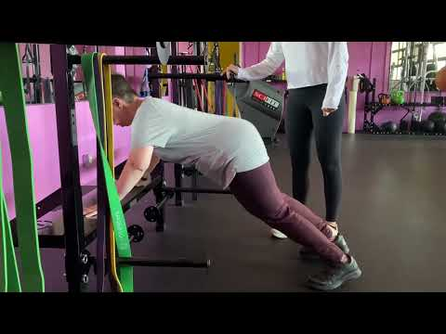
Decreased Core Stability during Push-up
Notes:
In plank positions, spinal stability can be assessed through one’s ability to maintain level hips (parallel to the ground) and maintain the lumbopelvic angle in the sagittal plane. To determine the appropriate lumbopelvic angle, one would first exaggerate an anterior pelvic tilt and then a posterior pelvic tilt and then find the middle position between the two.
Here, as this client performs push-ups, she is failing to maintain spinal stability. This can be observed during the upward phase, her back is arching and when at the top of the movement, her hips elevate too high.

Slide 27
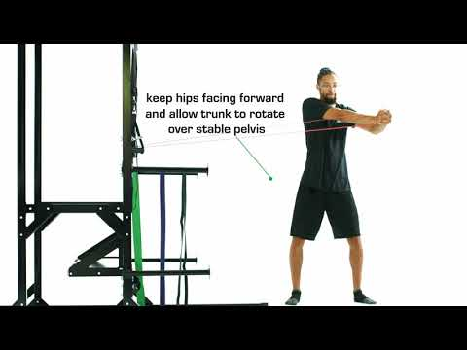
Transverse Spinal Stability - Pallof Press
Notes:
Another way to assess spinal stability can be done with standing plank variations. Here, this subject is demonstrating a pallof press with rotation and maintain a stable trunk throughout the motion.
From a sagittal view, you can see he is maintaining the neutral alignment and not favoring an anterior or posterior pelvic tilt position.
When he rotates his trunk against the bands resistance, you can see good pelvic lumbar dissociation as he is keeping his hips facing forward while rotating around the stable base.

Slide 28
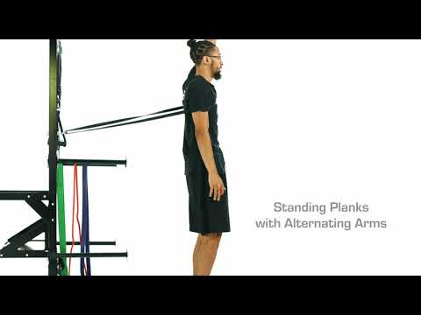
Sagittal Plane Stability - Standing Plank
Notes:
We can look at another standing plank variation with the focus on maintaining a neutral and stable spine in the sagittal plane.
Here, this individual is being pulled back the resistance band and also is alternating his arms back and forth. He must stabilize against perturbation forces associated with the UE movement. As he moves his arms, he is changing the demand on the trunk muscles which further challenges core stability.
Notice how throughout this exercise demonstration, as the band pulls him back, he is not leaning into it and angling his body. He is remaining upright and stabilizing with muscular effort as opposed to leaning his COM into the band.

Slide 29
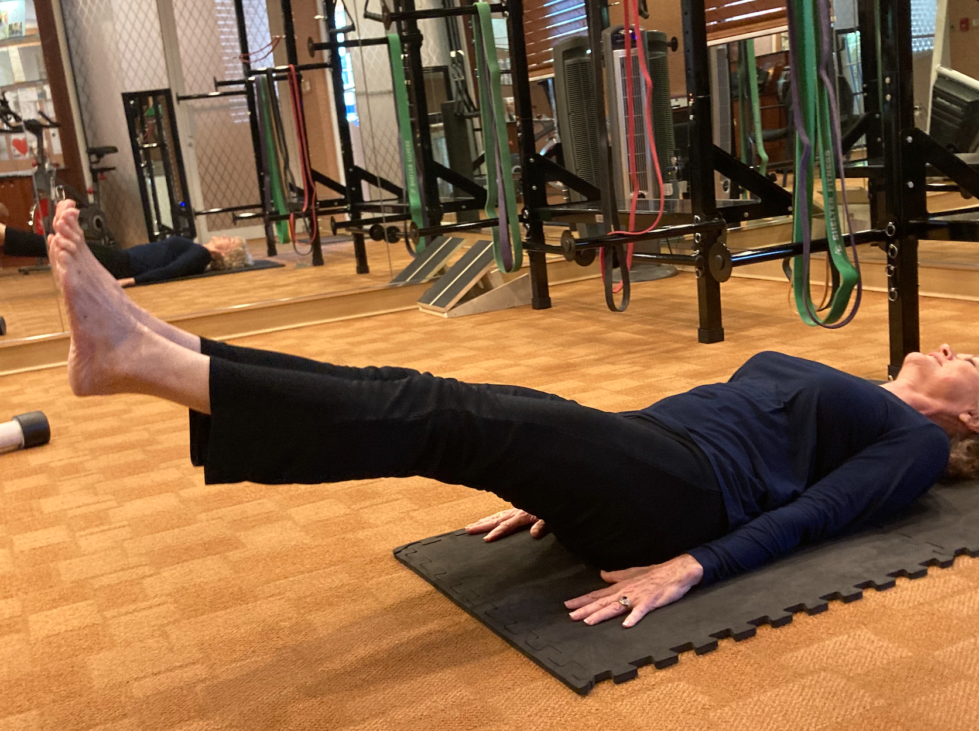
Supine Core Hollow Holds
Notes:
Finally, spinal stability can be assessed in a supine position as well through variations of hollow holds. With this example, the weight of the legs serves as the resistance load. The longer the lever of the legs / the further from the body the legs extend, the harder the core has to work to stabilize. You can make it even harder by adding the arms.
You can observe spinal stability with this exercise through the individual’s capacity to keep the lumbar spine fixed to the ground and still maintain a consistent breathing pattern.

Slide 30
Hip Hinge Squat
Notes:
The hip hinge squat is a commonly taught multi joint lower extremity exercise. It has the opportunity to place the low back at great risk to injury. Coaching technique for this exercise often includes instructions to limit the translation of the knee towards the toes. Why? It has been thought that we need to protect the knees. So, I ask why do we have a patella? We have evolved a patellar mechanism, that when allowed to move toward the toes, actually improves the quadriceps leverage to create extension at the knee joint. When performing a hip hinge squat and limiting the translation of the knee joint towards the toes the COM is positioned at the back of the BOS. This along with the load being placed on the back creates the need for the trunk to lean forward in order to maintain stability. In this position the low back muscles are engaged to lift loads they have not evolved to handle. Recall the spine evolved to be stabilizers not prime lifter. If this argument against the back squat was not enough consider the Ilioinguinal ligament.

Slide 31
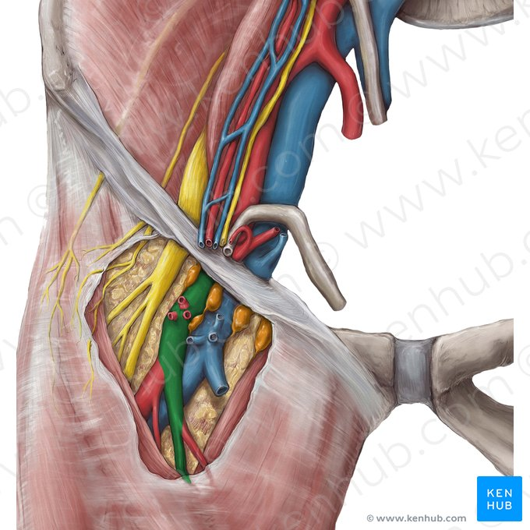
Ilioinguinal Ligament
Notes:
The Ilioinguinal ligament runs from the ASIS to the pubic tubercle. One of its functions is to protect the kinking of the femoral artery, nerve, and vein when the hip is in extreme flexion. When performing full ROM squats, with a shoulder width BOS, the lumbar lordosis is impossible to maintain as the femur contacts the Ilioinguinal ligament and continued motion to maintain stability occurs due to spinal flexion.
Lets review the protective nature of this tissue with a subject lying on a table.
As you can see in this video when the femur is at neutral, as the hip approaches 90 degrees of flexion, the femur will butrice the ligament and cause posterior pelvic tilt, aka the butt wink. Then resulting in spinal flexion
When we clear this ligament through abduction and external rotation of the femur at the hip joint, the motion is allowed to occur due to the angle of the ligament.

Slide 32
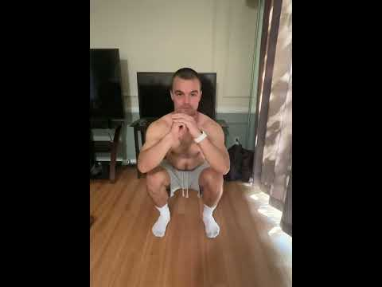
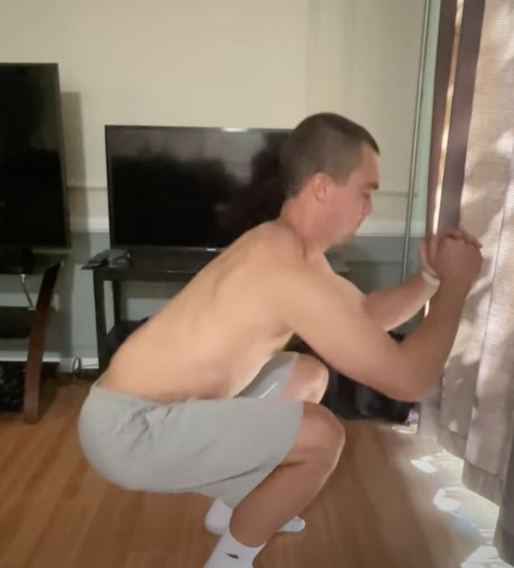
Narrow BOS squat
Notes:
Lets review a squat with a standard BOS, to full depth and with instructions to limit full knee translation to the toes.
As the depth of the squat increases, the femur impacts the Ilioinguinal ligament. The only way to maintain the COM position within the BOS is for the subject to flex his spine forward. This places the disc at great risk to injury. Recall from the lecture portion of this class the anatomical structure of the disc is not designed to handle posterior tensile force.

Slide 33
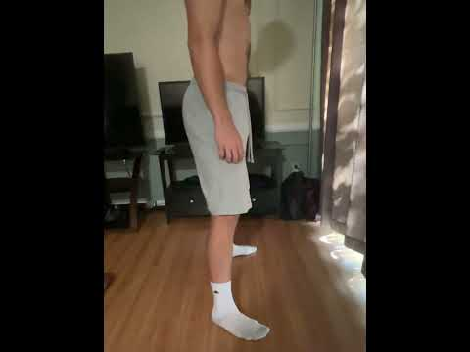
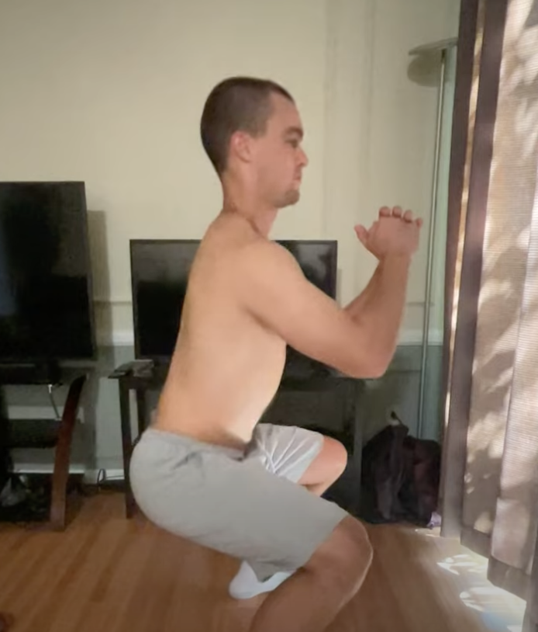
Wide BOS squat
Notes:
A much safer alternative is the front squat done with a wide base of support.
The spine is maintained in a stable position, the disc is loaded properly, and the squatting motion only occurs at the hip and knee joints. Emphasizing structures that are designed to handle this load as opposed to the spine, which is not. Due to the angle of the ilioinguinal ligament it does not impede hip flexion when the BOS is wider.

Slide 34
Evolutionary Mismatch
Notes:
If you are a medical professional in the modern world, clients with low back pain will keep you in business.
From an evolutionary standpoint, we evolved to become bipedal as a means to travel greater distances efficiently primarily in search food sources. The structure of our spines is ill-prepared to handle the stresses of modern life.

Slide 35
Up to 80% of Adults Experience LBP
Notes:
This is why low back pain is the most common musculoskeletal condition and it impacts nearly everyone at some point their life!

Slide 36
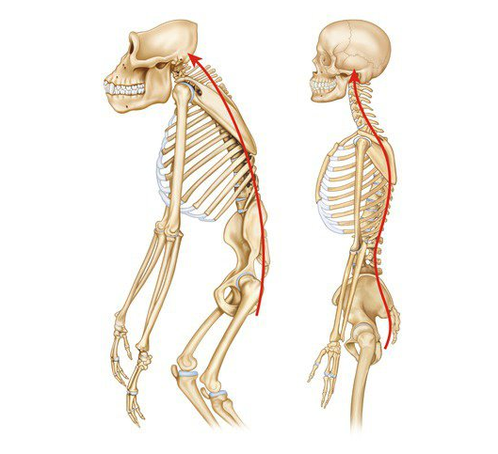
Evolutionary Changes in the Sagittal Plane
Notes:
Homo sapiens have an S-shape curvature to our spines in the sagittal plane to allow for upright posture. This adaptation helps with gait efficiency by placing the COM over the the BOS. Primates, on the other hand, have one C curve which makes it difficult to stand and walk on two legs as their COM is positioned in front of them.
While the curvature of the homo sapien spine and the shape of the vertebral wedges were changes that allowed for better absorption of ground contact forces and gait efficiency, the adaptations of the disc structures were not near as significant comparatively.

Slide 37
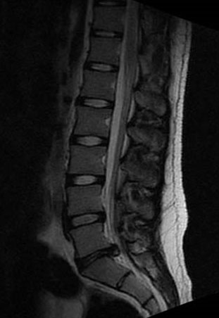
Vertebral Shape
Hypothesis
Decreased lumbar lordosis and lumbar shape more similar to primate ancestor are more prone to disc injury
https://pro.spineuniverse.com/case-studies/stover/clinical-presentation-significant-disc-bulge
Notes:
Vertebrae of humans with disc problems are closer in shape to those of our closest ape relatives, the chimpanzee that have more of a C-curve to their spine. This flat back position makes the disc vulnerable to injury in modern times.
The MRI above help to demonstrate this point. You can see how the lumbar spine has limited lordosis aka a flat back and we can see the disc issues associated with this structural fault.

Slide 38
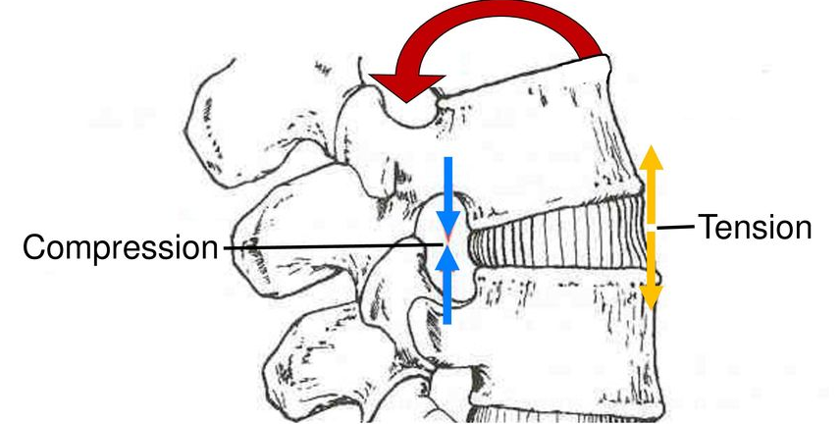
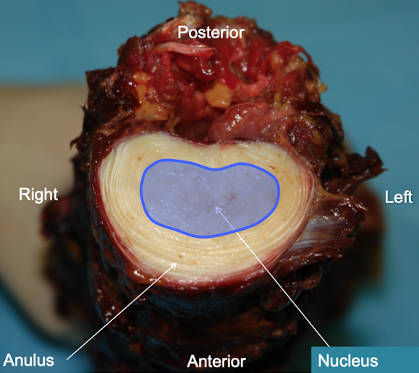
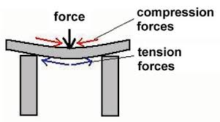
Tension-Compression Relationship
Notes:
Specifically, our spines evolved under tensile forces in the anterior aspect of the spine, and compressive forces at the posterior aspect. This helps explain why the annulus and anterior longitudinal ligament are so much thicker than its posterior counterpart.
When you think about this relationship, it is easy to understand why a viscous disc is vulnerable to flexion forces. With spinal flexion, we are reversing the compression-tension relationship. Adding excessive loads to these spinal structures when the spine is flexed forward will only exacerbate these forces.

Slide 39
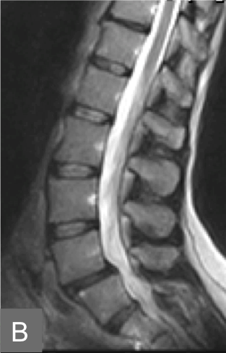
Overshoot
Hypothesis
Too much lumbar lordosis can increase joint loading and increase risk for instability and facet joint stress
L4
L5
©2015 Splendiani A et al.
Notes:
On the other end of the spectrum, with vertebral bodies that are either too wedge-shaped or with a lumbar posture that is excessively lordotic, it is more likely to result in excessive compression to the posterior spine. These individuals tend to be more prone to spondylolisthesis aka spinal instability and facet issues.
In this image, you can see that the L4 vertebrae is translated anteriorly compared to the L5 segment.
All of these slides are to say that out structure has evolved overtime and our adaptations are not orthopedically perfect. We must train with these structural considerations in mind.

Slide 40
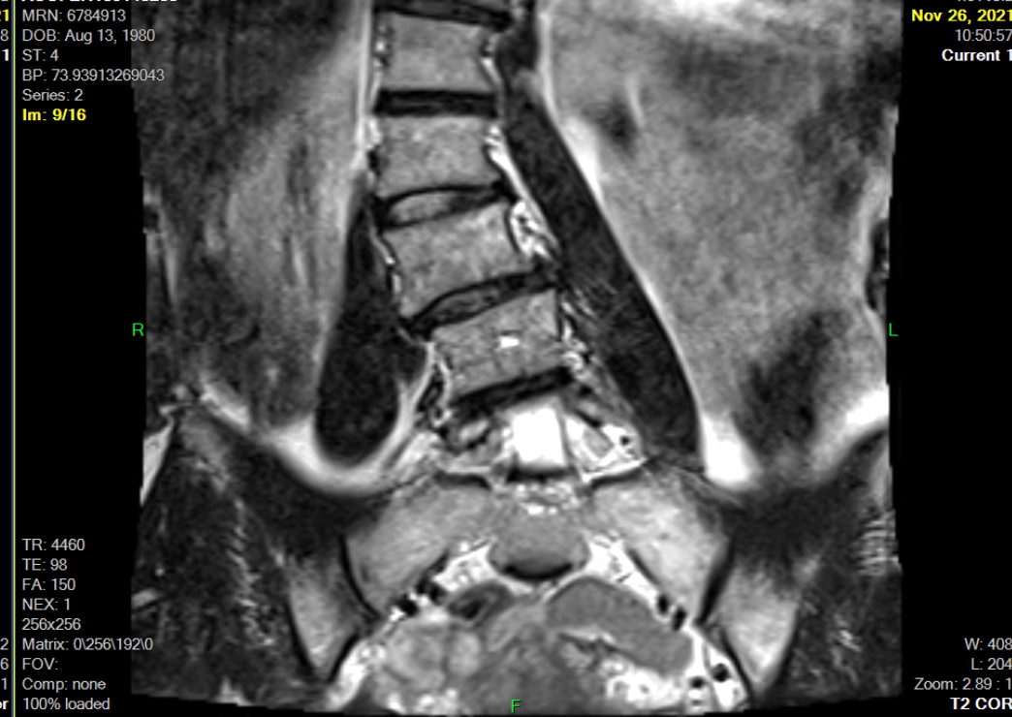
Discs Response to Sustained Postures
Notes:
Finally, let’s review a more severe case of this client. While there is a lot to unpack here, we will just focus on the discs and how they have responded to sustained compression and tension forces over time.
The nucleus of the disc from each visible lumbar segment are positioned more to the right side (or the left of the image) in response to the compression forces on the left (or the right of the image). This is an example in the frontal plane, but the nucleus will respond similarly to compressive forces in the sagittal plane.

Slide 41
Intervention
Notes:
In this final segment of the spine lab we will discuss intervention techniques. These exercises are useful when considering long-term spinal health in terms of designing exercise programs with a goal of functional longevity and injury prevention.
This chapter is not comprehensive, but intended to introduce a few important concepts.

Slide 42
Squat with a Stable Spine
Notes:
When designing a treatment plan functional LE multi joint motions should be prioritized. However, the safest way to squat is with a wide BOS and the load placed closer to the COM. We should begin to move away from the hip hinge back squat as a staple of LE strengthening.

Slide 43
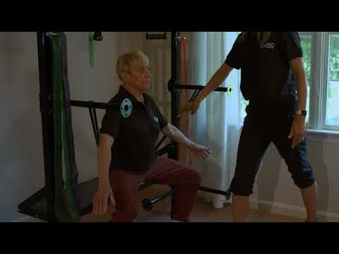
Sumo Squat vs Hip Hinge
Notes:
For the reasons just mentioned, when bilateral squats are performed, we advise front squats as opposed to back squats, and a sumo/plie BOS as opposed to a narrow/standard BOS. This ensures that the spinal posture can remain upright and neutral when squatting to a full depth. This can be seen in the video example above.
You will notice her back is not flexing forward throughout the movement, and the depth of the motion occurs through hip and knee flexion rather than trunk flexion and hip hinging.

Slide 44
Single Leg Strength Training
Notes:
In each lab now, we’ve emphasized the importance of single leg strengthening. Single leg strength training is beneficial for many reasons in regards to spinal health. Let’s go through them.

Slide 45
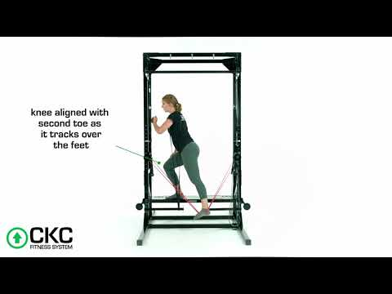
Single Leg Strength Training
Notes:
If you recall in the LE labs, focusing on the biomechanics of the LE during true single limb movements improves the mechanics up the chain.
If you lose stability at the foot, then the knee will fall inwards, the hip will shift out, and the spine will lose its frontal plane stability in an attempt to stay balanced. These seemingly minor faults in the distal chain can change the loading pattern on the spine. Therefore, working on SL stability is essential for spinal health.
Maintaining proper alignment of the spine is critical in treating pathologies such as spinal stenosis or a disc bulge.
Furthermore, when looking to improve strength metrics in the LE, frequently in the strength and conditioning world, we resort to heavily loading bilateral squats. With SL training, we can gain the same level of strength without excessively loading the spine! The disc and facet joints were not designed to accommodate heavy loads.

Slide 46
Traction
Notes:
When we think about the injuries that occur to the spinal structures, oftentimes, they involve compressive forces. Our spines are constantly under gravitational load. With increase body mass indices, these compressive loads are even higher.
Whether injury is related to the disc structure, degeneration, nerve compression, foraminal narrowing, etc. spinal traction can be a very useful tool.

Slide 47
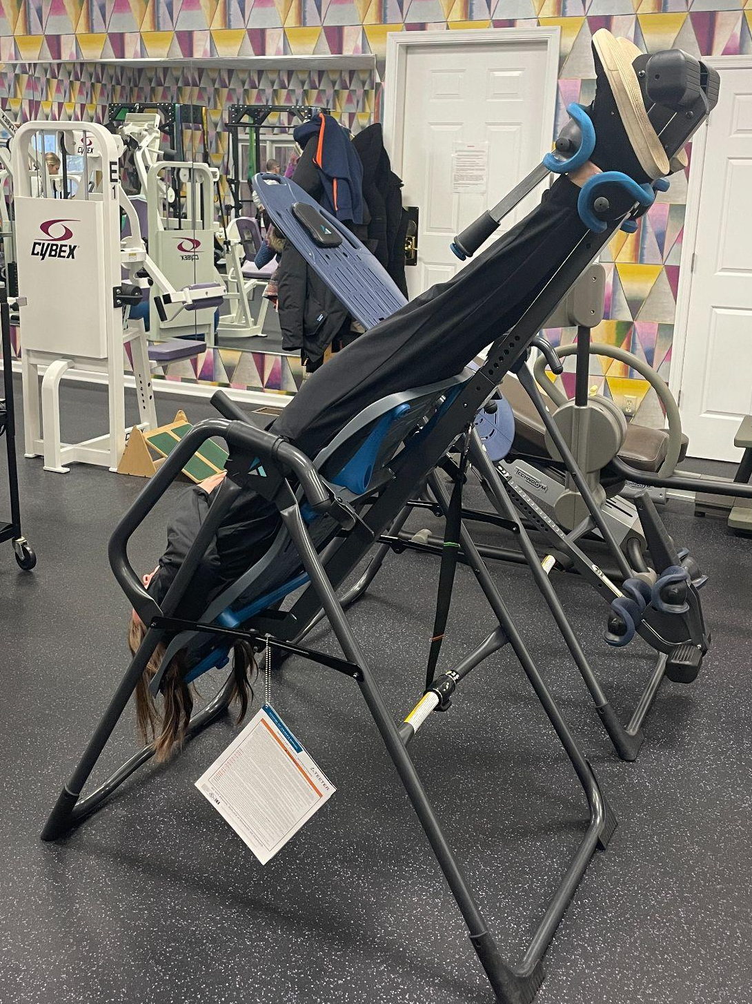
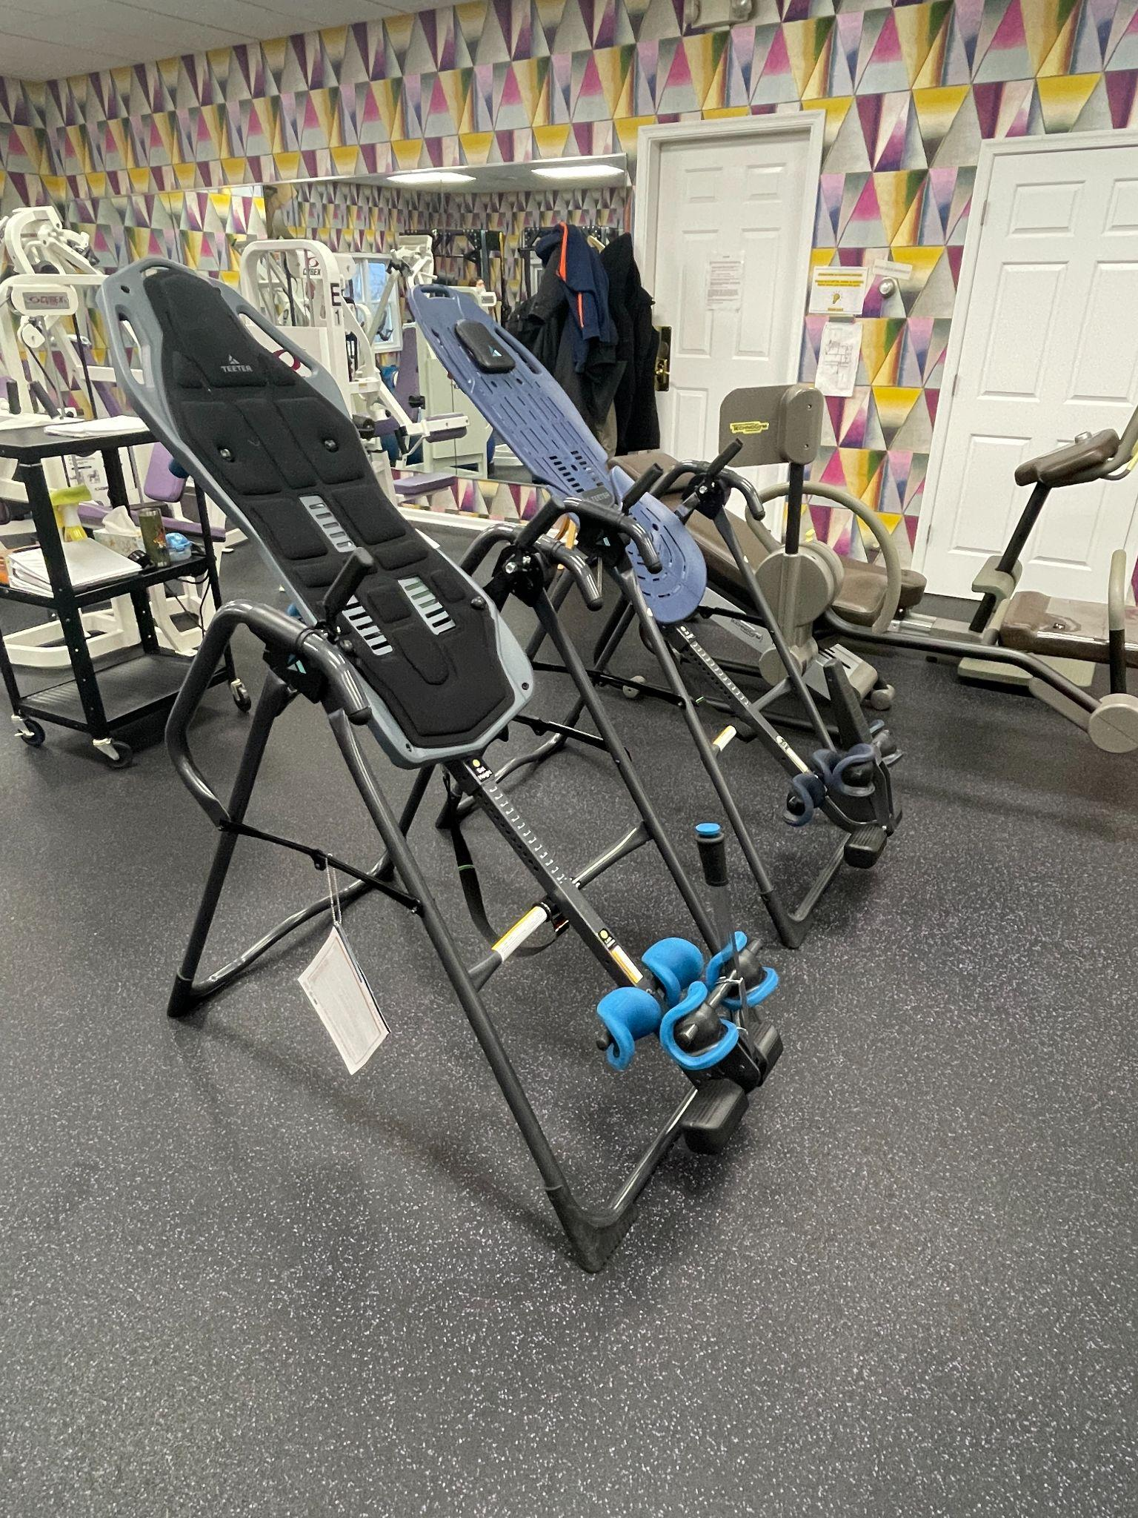
Inversion Table
Notes:
Inversion tables are one of the best ways to stretch the spine as it produces significant tractioning at each segment and eliminates the impact of gravity.
An effective stretch is achievable at reduced angles on the inversion table. This is the preferred form of traction, assuming the patient is able to tolerate it, compared to modalities that have the patient lie horizontally, due to the large decompressive pull it offers to the spine without gravitational effects.
Traction can be both a preventative and rehabilitative tool. This stretching technique might be contraindicated in some cases, such as in the case of severe spinal instabilities. Having a clear picture of the client presentation will help to inform clinical decision-making.

Slide 48
Stabilize
Notes:
When injury and symptoms are a result of the inability to maintain spinal stabilize and the proper alignment of the vertebral segments, the solution is to re establish that stability needed to accommodate function.

Slide 49
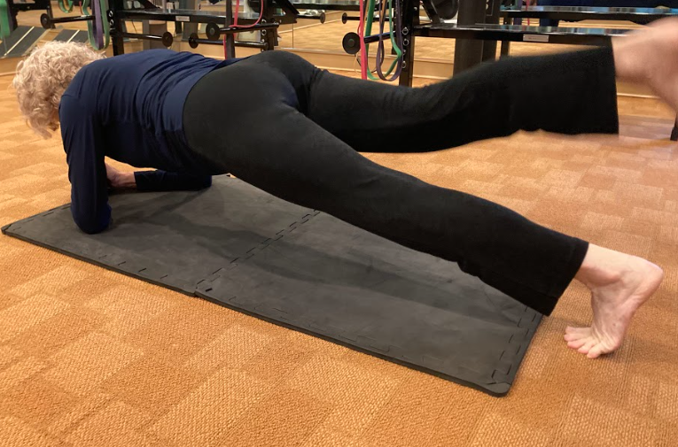
Spinal Stability Exercise
Notes:
As you saw in the movement analysis section of this lab, there are many ways to assess and analyze spinal stability. The same thing goes with training it.
Instead of going through one exercise at a time, we will use this time to discuss general guidelines to consider when targeting this form of strength.
Supine and prone variations of core exercises are more functional when they offer a dynamic component. Few things in life require us to hold a sustained contraction of the core. We need to learn to stabilize in various positions against dynamic forces as seen in these examples. Standing core stability can increase the functionality of these exercise even further.
For each exercise that targets core strength, consider ways to regress and progress each. Also, try to find ways to best quantify what it means to maintain stability at the core in each position. Lastly, how will you cue these exercises in a way your clients will best respond?

Slide 50
Exercise with Directional Preference
Notes:
Information gathered from taking a thorough client history, performing an objective evaluation and assessing movement quality will help guide treatment as it relates to exercise selection.

Slide 51
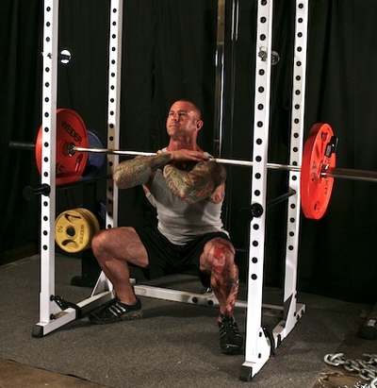
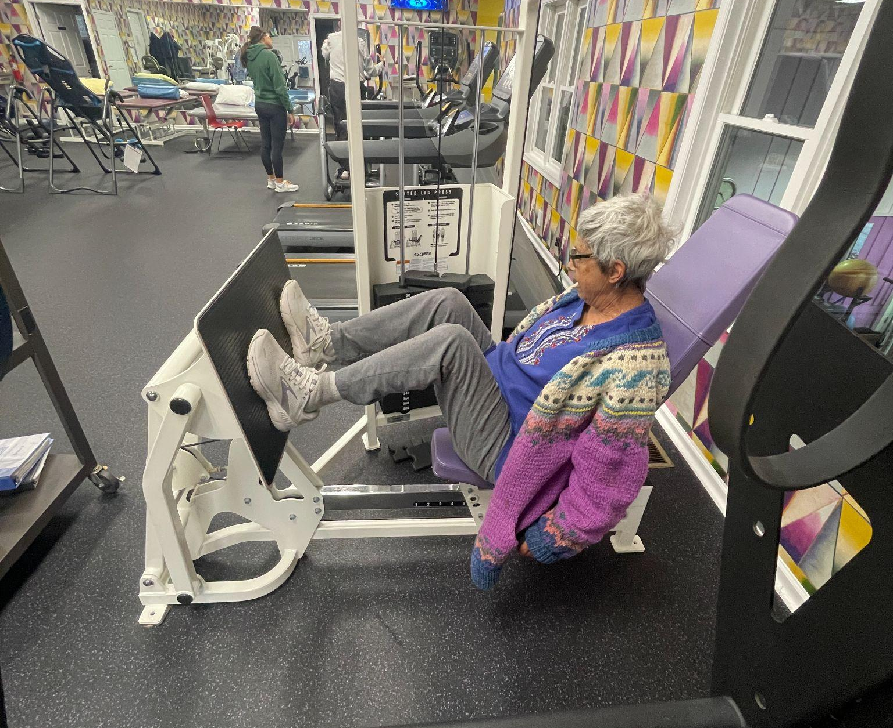
Extension Based
Flexion Based
(c) 2008 Ryan Elmore Photography
Notes:
Let’s say the client has mentioned that they have pain whenever they drive in a car or sit for too long and they were positive for symptoms when in sustained flexion. They feel better when they correct their posture and extend their back. In this case, this client would respond better to extension based exercise programming. When targeting leg strength, we might promote upright squats.
Conversely, if a patient were telling you that pain is better when sitting vs standing and their pain is associated with spinal extension, then this individual would benefit from flexion-based leg training as seen on the right.

Slide 52
Problem Solving and Thinking Outside the Box
Notes:
Oftentimes with treatment and intervention, there is not a one size fits all. Helping clients improve their condition sometimes requires thinking outside the box.

Slide 53
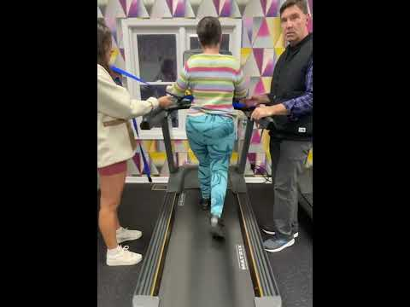
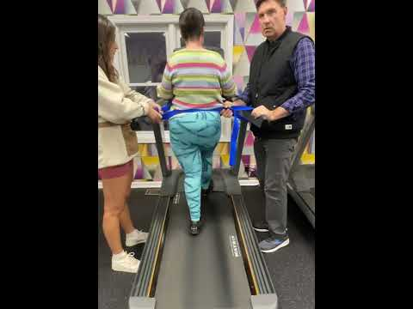
Motor Learning & Retraining Movement Patterns
Notes:
With the same patient who has a learned pattern of excessive transverse plane motion due to a frontal plane imbalance, after correcting the leg length discrepancy with an external lift, we now need to retrain her gait pattern as she has learned to compensate for most of her life.
Let’s first watch the video on the left. We can see she is still getting a lot of hip rotation, albeit, it is less than it was when she was barefoot.
Now, let’s watch the video on the right. With restricting the transverse plane with a mobility strap, we are able to force her to extend the hips.
These videos demonstrate the same walking speed.
This individual who has frequent episodes of LB and hip pain will benefit from improving her movement mechanics to help appropriately load her joints.

Slide 54
Confidential and Proprietary Information
The concepts presented in this presentation are the proprietary intellectual property of CKC Systems LLC. These materials are intended solely for informational purposes and may not be reproduced, distributed, or disclosed without the express written consent of CKC Systems LLC.
For more information, visit www.ckcfitness.com
© 2025 CKC Systems LLC. All rights reserved

