Slide 1
The Feet
David Luedeka PT, DPT, MS, CSCS
Keila Strick PT, DPT, CSCS
Caroline Williams, PT, DPT, MS, GCS
Nick Roche, PT, DPT, CSCS
Notes:
Welcome to first segment in our course series for Evolutionary Mismatches and Functional Human Motion. In this lecture we will cover the structure of the foot, both past and present. Additionally, we will review the cultural evolutionary mismatch and how this mismatch may contribute to orthopedic injury.
Pre Lecture Reading:
-Great narrative review of evidence supporting claims throughout the course
D’Août K, Elnaggar O, Mason L, Rowlatt A, Willems C. Footwear Choice and Locomotor Health Throughout the Life Course: A Critical Review. Healthcare 2025, Vol 13, Page 527. 2025;13(5):527. doi:10.3390/HEALTHCARE13050527

Slide 2
Evolution of the Foot
Notes:
Chapter 1, Evolution of the Foot.
In this chapter, we will review the foot structure of our last common ancestor and talk about evolutionary changes that occurred to that foot structure along with the driving factors of these adaptations.

Slide 3
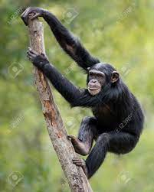
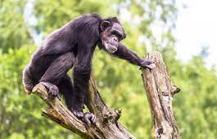
Our Evolutionary Past
Adapted to climb trees and walk on all fours, not adapted to ambulate as bipeds on two feet
Shutterstock. (2016, April 15). Young female chimpanzee climbing tree
Shutterstock. (2015, June 24). Chimpanzee climbing on tree
Aiello L, Dean C, 1990.
Notes:
In our evolutionary past, our feet were adapted to climb and walk quadrupedally, not to walk bipedally as we do today. With our need to become bipedal, there were significant changes in our lower extremity structure, including our feet.

Slide 4
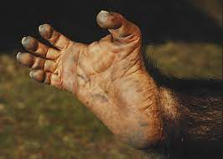
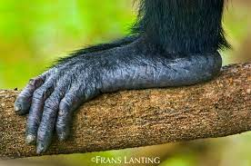
Our Evolutionary Past
The foot of a chimp…
Lacks an arch
Joints do not accommodate toe-off extension
Great toe and ankle are angle inwards
Gleadow, E. (2024, October 11). Geordie Greep – I Love My Family / Aching Knees review
Lanting, F. (Photographer). (n.d.). Pan troglodytes verus, Fongoli, Senegal. Amana Images.
Aiello L, Dean C, 1990.
Notes:
Due to the prioritization of climbing trees rather than ambulating as bipeds, the foot of a chimp lacks an arch, the metatarsal joints of the foot do not accommodate toe-off extension, and the big toe and ankle are angled inwards. When you look at the structure of a chimp’s foot, you might notice that it resembles more of a hand rather than a modern foot. It is more important for this species to be able to use these distal segments for gripping purposes rather than propulsion and shock absorption.

Slide 5
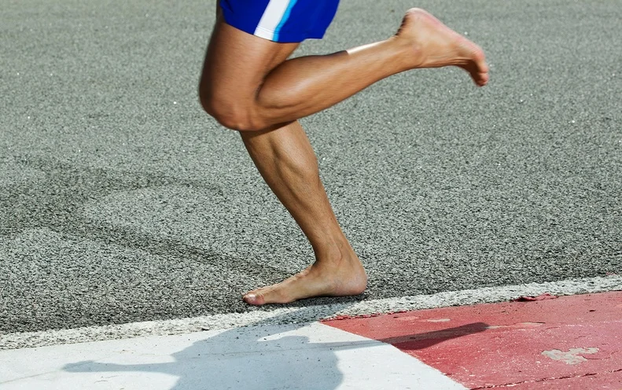
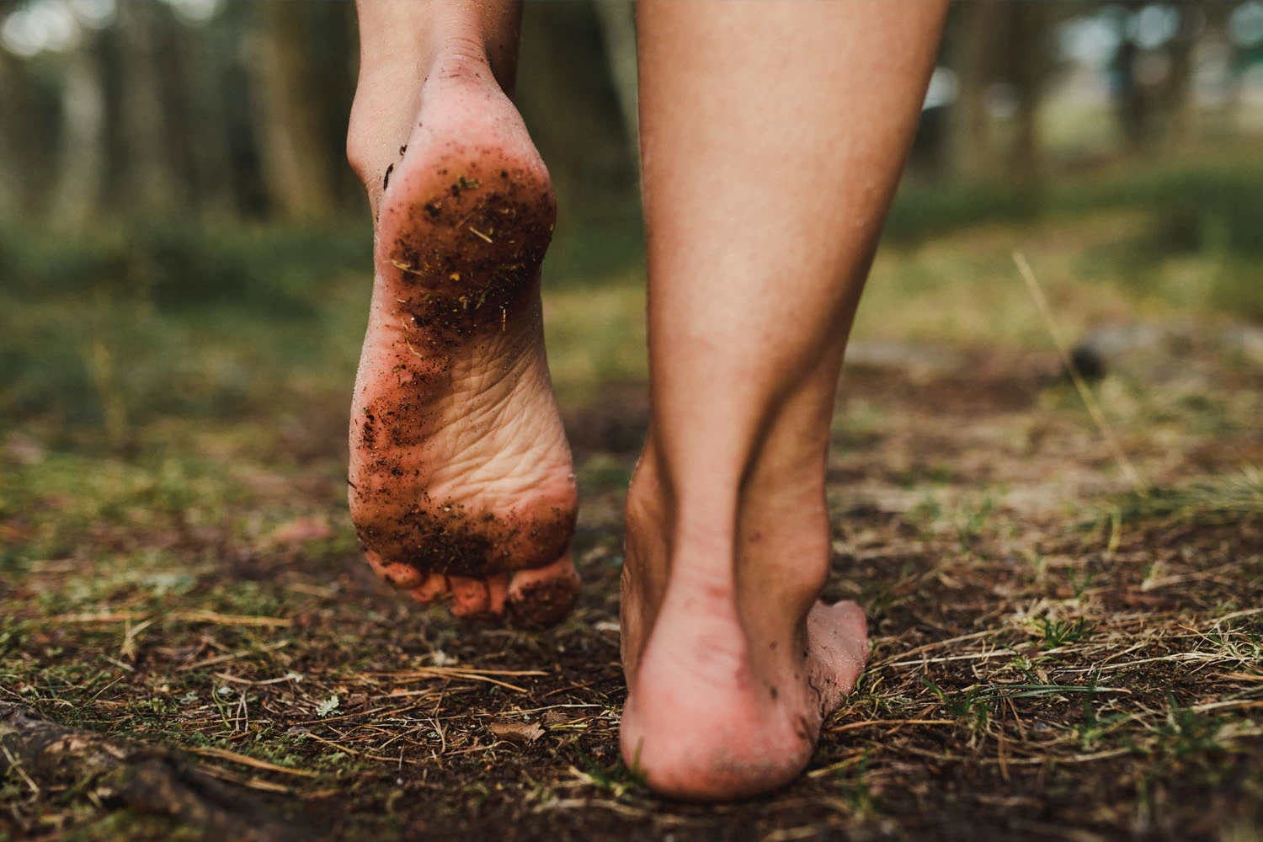
Evolutionary Changes
Occurred to improve our ability to walk on two legs and absorb ground reaction forces
Weintraub, K. (2019, June 26). Going barefoot is good for the sole. Scientific American.
Cordero, T. (2022, April 23). Grounding techniques: Safety and resilience. Cypress Wellness Center.
Hu D, Xiong CH, Sun R, 2021. Lovejoy CO, Latimer B, Suwa G, Asfaw B, White TD, 2009. McNutt EJ, Zipfel B, DeSilva JM, 2018.
Notes:
The rest of this chapter will be devoted to talking through the evolutionary changes that occurred to bring us to our structure today. These adaptations occurred due to our need to travel longer distances to obtain food, all while saving energy. Environmental changes favored chimps that had anatomical features that allowed them to stand erect. These features became adaptations overtime and the transition to bipedal motion had begun. Bipedal gait was theorized to be the answer to the need for chimps’ to expand their foraging range in order to obtain food to survive and reproduce.
The human foot is designed for bipedal gait, but let’s think about what bipedal gait is. In bipedal walking gait, we are only on two feet at a time for 30% of our gait cycle. We are on one foot for the other 70%. When running, 100% of our gait occurs on one foot at a time. The foot evolved overtime in an attempt to handle the forces associated with this functional unipedal gait.

Slide 6
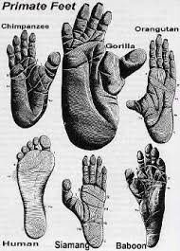
Evolutionary Changes
Further changes to promote bipedal gait…
Robust, adducted 1st MTP
  Positions great toe in line with other digits and facilitates push-off
Pinterest. (n.d.). Primate feet evolutionary comparison
McNutt EJ, Zipfel B, DeSilva JM, 2018.
Notes:
One of the first notable evolutionary changes was a big toe that transitioned to a position more in line with the other digits. The positioning of the big toe allowed for toe off extension, assisted in medial arch stability, and aids in frontal plane stabilization and mechanics up the kinetic chain.

Slide 7
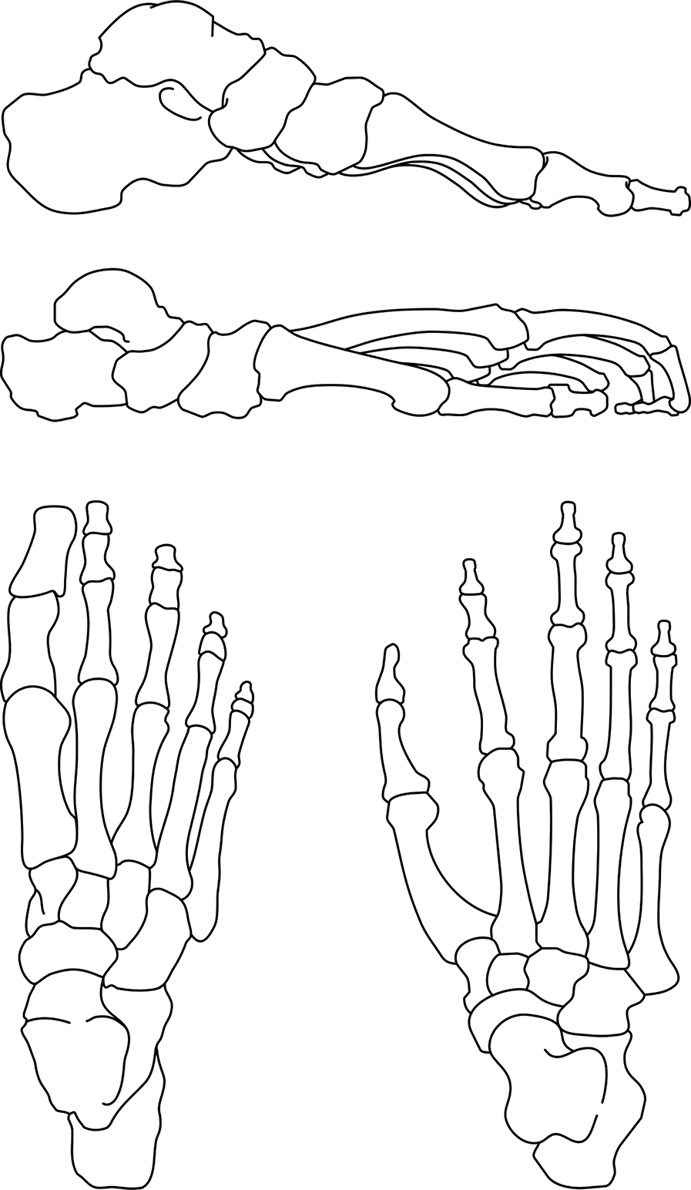
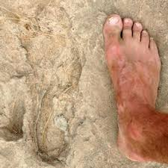
Evolutionary Changes
The foot of the first Hominins…
Arch began to form to aid in shock absorption
Stiffer lateral column helped to convert a grasping foot into a propulsive lever
Smithsonian National Museum of Natural History. (n.d.). Footprints from Koobi Fora, Kenya
Harrold, F., & Abboud, R. J. (2020, September 15). Chapter 2 – Biomechanics of the foot and ankle. In Musculoskeletal Key
Hu D, Xiong CH, Sun R, 2021. Lovejoy CO, Latimer B, Suwa G, Asfaw B, White TD, 2009. McNutt EJ, Zipfel B, DeSilva JM, 2018.
Notes:
As we look into the most prominent adaptations, we must talk about the medial longitudinal arch. The arch began to form in early hominins to aid in force absorption. As we developed from quadrupeds to bipeds, we were exerting more force through our feet. It was necessary to develop a structure to begin to absorb these higher forces.
We also developed a stiffer lateral column to form a more rigid lever to aid in propulsive force during gait.
Collectively, these changes allowed for greater force dissipation through our foot structure and improved gait efficiency.

Slide 8
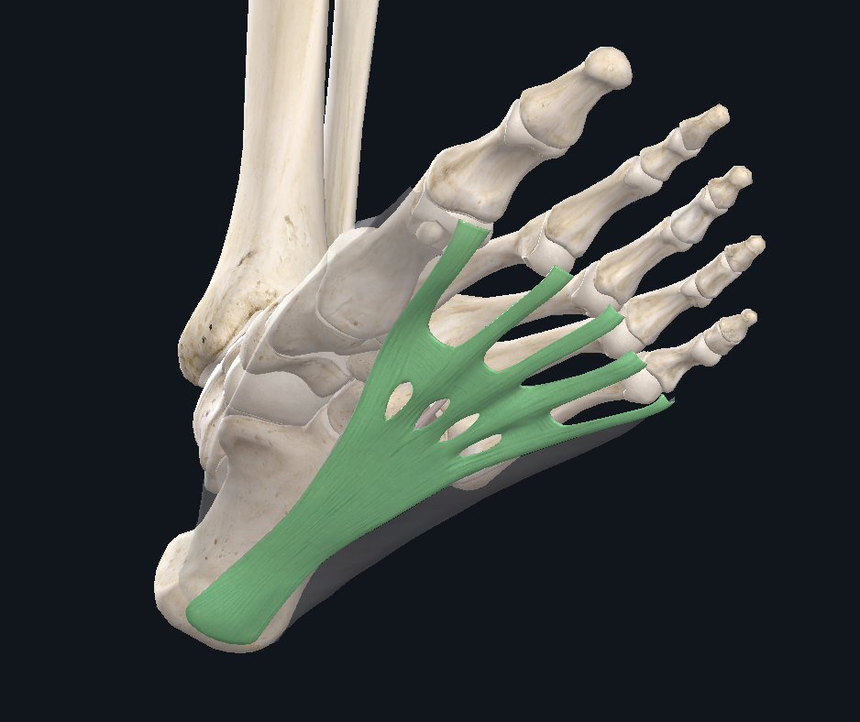
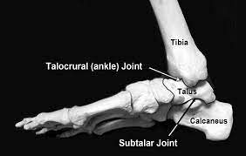
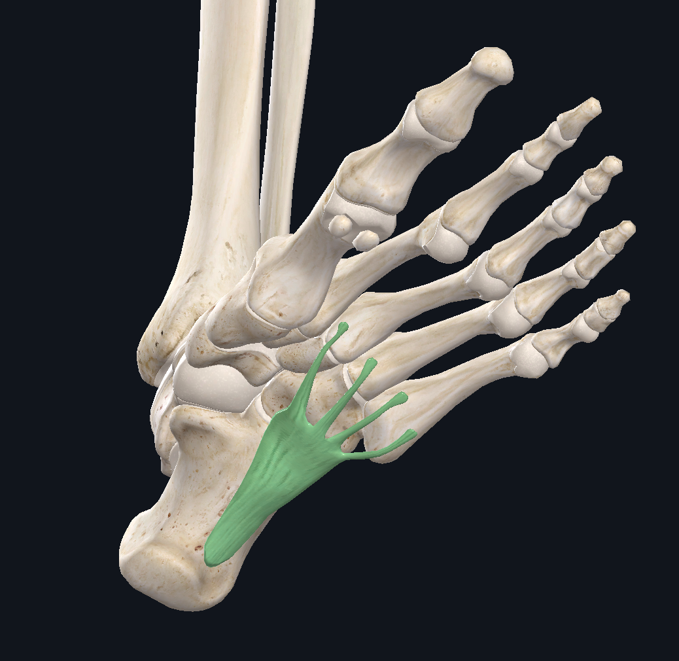
Evolutionary Changes
Further changes to promote bipedal gait…
Thick plantar fascia and “spring” ligament
  Resist tensile forces at the foot
  Absorb load with gait
  Assist in toe off and plantar flexion
  Put metatarsals in external torsion
Complete Anatomy 3D4medical
McNutt EJ, Zipfel B, DeSilva JM, 2018.
Notes:
One of the adaptations that is critical in force absorption and maintenance of the arch was a thick plantar fascia and spring ligament. The thickening of these passive structures enhanced our ability to dissipate ground reaction forces as we became bipedal, (functional unipeds.) The thickening of the plantar fascia also brought the metatarsals into external torsion which contributed to the medial longitudinal arch. We will touch on the function of these structures in more detail in the functional anatomy chapter.

Slide 9
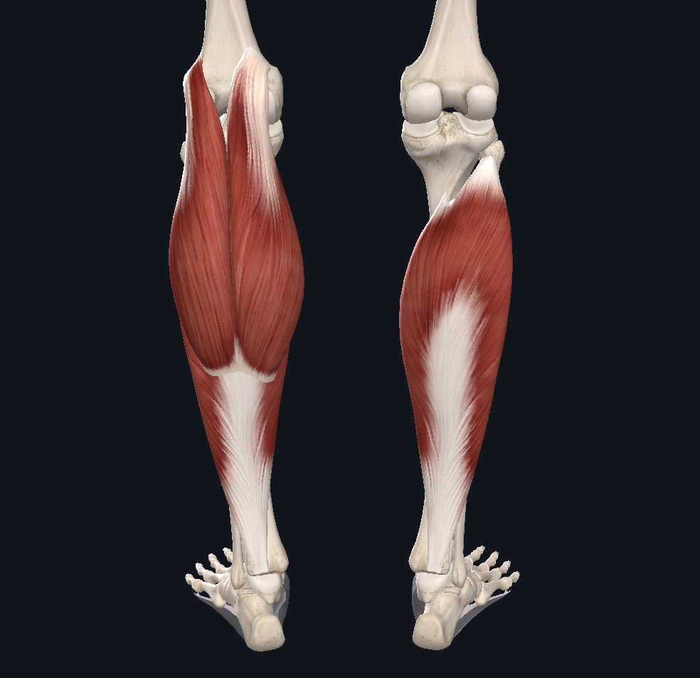
Evolutionary Changes
Further changes to promote bipedal gait…
Highly developed gastrocnemius / soleus complex
  Dissipate ground reaction force eccentrically
Elsevier. (n.d.). Plantaris muscle. In Complete Anatomy: Muscular System
McNutt EJ, Zipfel B, DeSilva JM, 2018;.
Notes:
As the ground reaction forces associated with functional unipedalism increased, humans’ gastrocnemius/ soleus complex developed to handle the eccentric forces that occur at the ankle during the running and sprinting gait cycles.
The gastroc soleus complex plays a huge role in force dissipation in bipedal running. As speed increases, we move from a heel striking gait to a midfoot strike in running and a forefoot strike in sprinting. As that happens, the gastroc/soleus complex functions eccentrically to absorb load and lower the heel upon ground contact. But more on that later. This is just meant as a general overview.

Slide 10
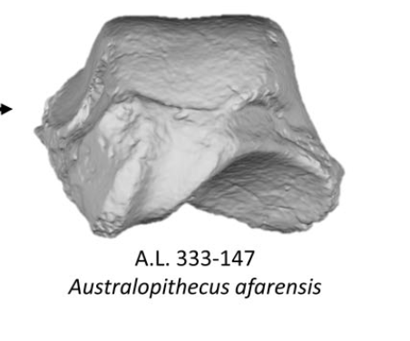
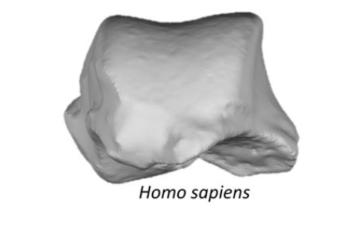
Evolutionary Changes
Further changes to promote bipedal gait…
Flattened subtalar joint
  Decrease mobility and increase stability
Complete Anatomy 3D4medical
McNutt EJ, Zipfel B, DeSilva JM, 2018.
Notes:
As we transitioned to bipedalism, more stability was needed at the foot. We developed a flattened subtalar joint to decrease mobility and increase stability in order to improve the rigid propulsive lever.

Slide 11
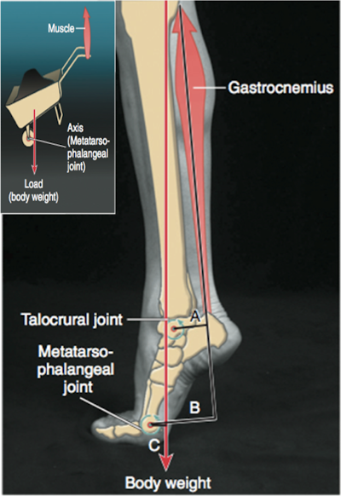
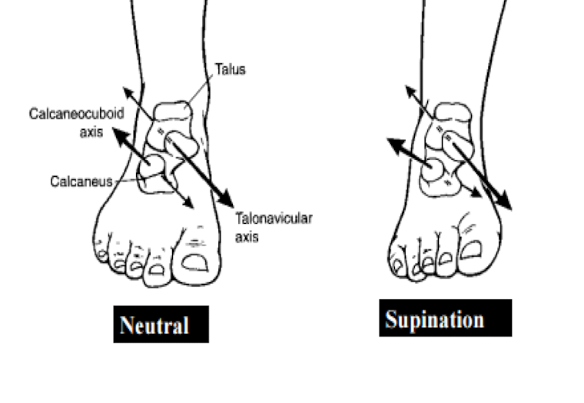
Evolutionary Changes
Calcaneus with robust posterior tuberosity
Calcaneocuboid joint locking mechanism
Elongated midfoot
Complete Anatomy 3D4medical
McNutt EJ, Zipfel B, DeSilva JM, 2018.
Notes:
In addition to what has already been mentioned, there are other evolutionary changes that contribute to a rigid midfoot and improved the mechanical advantage of the plantarflexors. Some of these changes include the development of the calcaneocuboid joint locking mechanism and an elongated midfoot.
Drawing slide: Circle neutral vs supinated position
As you can see, when the foot is in a neutral or pronated position, the transverse tarsal joints run parallel to one another and allow for more movements. When the foot is in a supinated position, the joint axes cross, and therefore lock. This locking mechanism moves the fulcrum to the forefoot, rather than the hindfoot which effectively lengthens the internal moment arm of the gastroc/soleus complex and improves its mechanical advantage.
Improving the mechanical advantage both reduces effort, and increases vertical displacement resulting in better endurance and greater stride length. Capabilities that served great importance for the survival of the species.

Slide 12
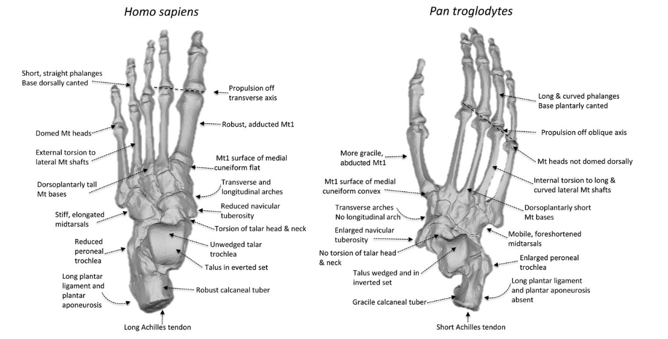

Complete Anatomy 3D4medical
Notes:
After learning about all of these adaptations, it is interesting to note that chimpanzees possess the same 26 bones found in the homo sapien foot. However, there are subtle differences that result in highly different functionality.
And that is it for the evolution of the foot chapter. The next chapter is Functional Anatomy Review

Slide 13
Functional Anatomy Review
Notes:
Chapter 2, Functional Anatomy Review
In this chapter, we will review important anatomical structures, both active and passive, in our feet and describe their function.

Slide 14
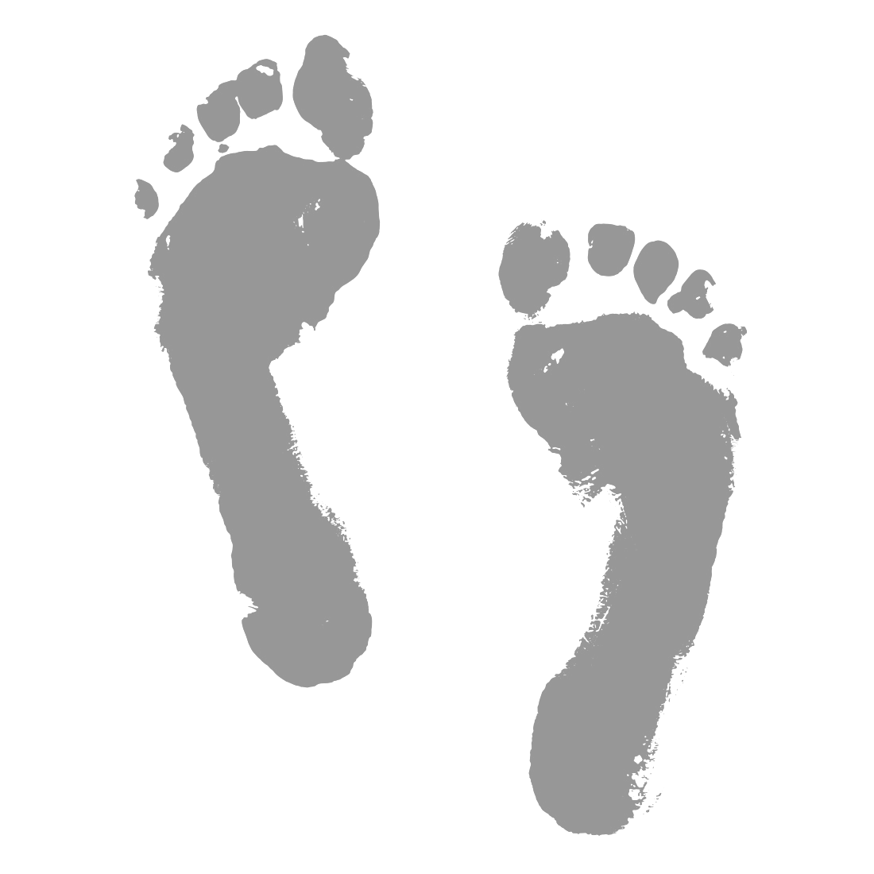
The Foot’s Natural Function
Arch and soft tissue structures = natural shock absorber
Fat pad on the calcaneus
Shift to mid/forefoot with increased loads as center of gravity is on top of base of support
Muscle structure and arch designed to dissipate ground reaction force (GRF) naturally
Wide toe box to allow for equally distributed peak pressures during load bearing
Holowka NB, Lieberman DE, 2018. D’Août K, Pataky TC, De Clercq D, Aerts P, 2009. Lieberman DE, Lieberman DE, 2012.
Notes:
Before we talk about important individual foot structures, let’s first take a step back and consider the foot’s natural function. The arch and its associated structures are designed to absorb and dissipate ground reaction force, stabilize the frontal plane, and provide stability to the forefoot when greater forces are produced and the gastroc soleus functions eccentrically to dissipate load.
The arch functions, in a heel to toe walking gait, to absorb ground reaction forces. We also have a fat pad on the calcaneus that helps to absorb load in heel to toe gait. However, the arch structure alone may not be adequate when we start to exert greater forces. As we increase movement speed, we shift from a heel strike to a forefoot or midfoot strike. This transition occurs to provide mechanical advantage to the posterior chain to improve horizontal force production. This shift to forefoot strike also increases the function of loading mechanisms in the LE in order to adequately accept load. The function of the arch musculature and passive structures is to absorb load at lower forces and aid the locking mechanism of the foot at higher forces. So when we shift to a forefoot or midfoot strike, the locking mechanism provides a stable forefoot through which the gastroc soleus complex can absorb and produce higher force.

Slide 15
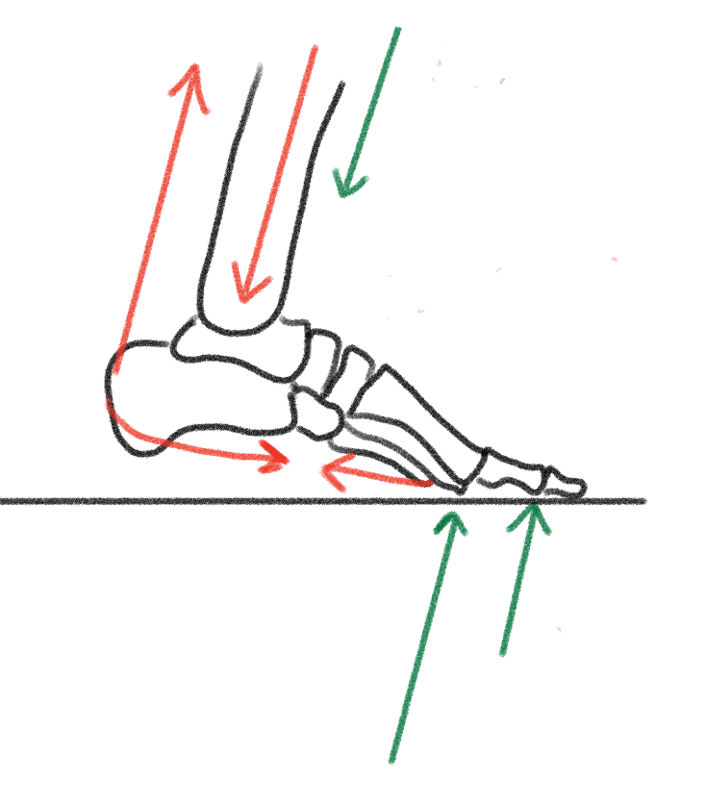
Forces that act on our MSK System: Internal and External
External Forces
Gravity, body weight, external resistance, ground reaction force
Internal Forces
Active
  Muscle/tendon
Passive
  Ligaments and fascia
Joint surface forces
  Tension
  Compression
Notes:
It is important to know the types of joints in the body because they dictate the direction of motion of the segment.
Force (mass x acceleration – typically gravity)

Slide 16
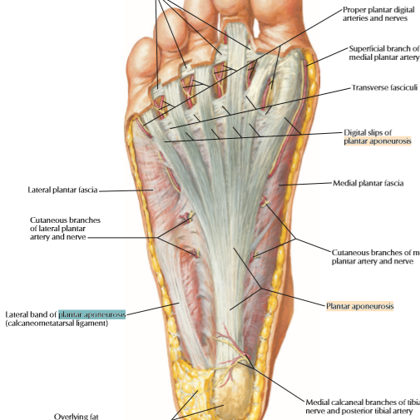
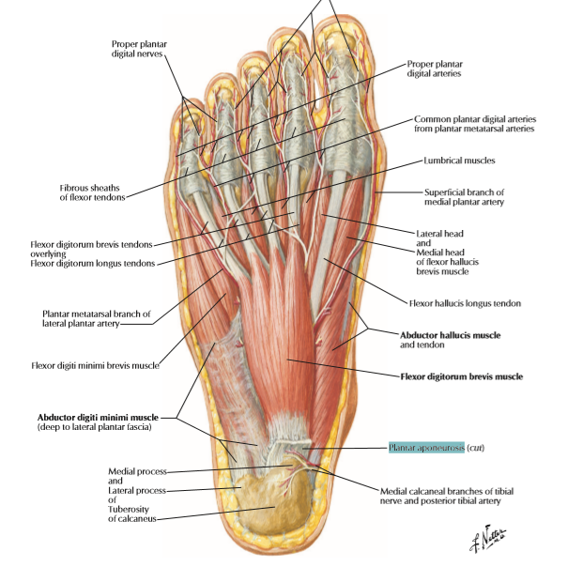
Plantar Fascia & Spring Ligament
Passively assists in maintaining arch
Complete Anatomy 3D4medical
Notes:
Now let’s get into the three main structures that help to support the arch. First, we have the plantar fascia. The plantar fascia is a thick fibrous aponeurosis that spans the base of the foot. It originates on the heel and inserts onto the metatarsal. The plantar fascia is a passive structure that plays a significant role in helping to maintain the position of the arch.

Slide 17
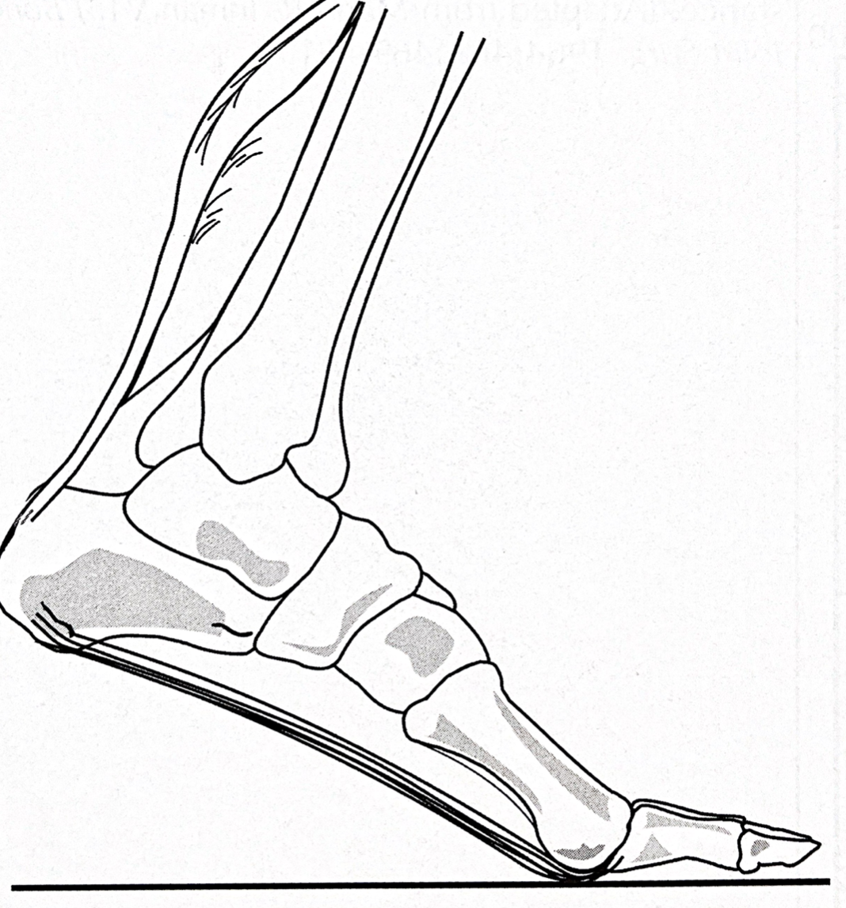
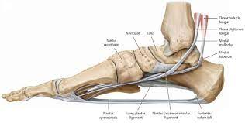
Plantar Fascia & Spring Ligament
Passively assists in maintaining arch
Complete Anatomy 3D4medical
McNutt EJ, Zipfel B, DeSilva JM, 2018.
Notes:
Drawing slide
The plantar fascia provides tension during heel to toe walking and provides a stable forefoot when running. As the heel contacts the ground in walking gait, the plantar fascia is lengthened. As the forefoot contacts the ground, the plantar fascia shortens to support the arch so it does not collapse into pronation, and to cause normal supination to allow the locking mechanism to occur to provide midfoot stability.
In sprinting gait, the plantar fascia assists in the locking mechanism. When the midfoot is locked, it provides a longer lever through which the gastroc soleus complex can function.

Slide 18
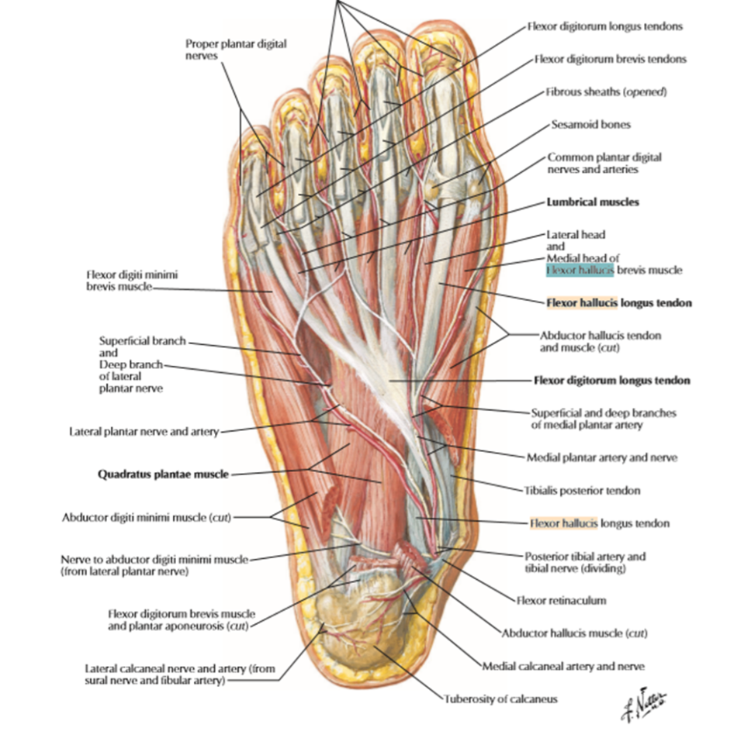
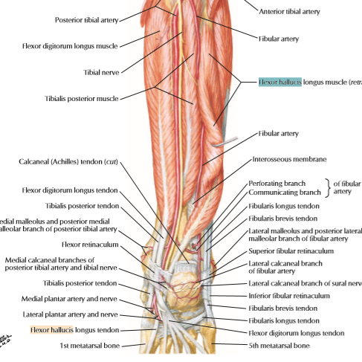
Flexor Hallucis Group
Actively assist in stabilizing the arch
Complete Anatomy 3D4medical
Notes:
The second main structure that helps to support the arch is the flexor hallucis group which consists of the flexor hallucis longus and the flexor hallucis brevis. Let’s talk about the function of these muscles. In an open chain, the flexor hallucis longus and brevis flex the great toe. However, when in a closed chain, when the great toe is on the ground, the flexor hallucis group cannot flex the toe. Instead, it assists the passive structures in stabilizing the arch against ground reaction forces.
Not about about picking up marbles, towel crunches. The FHL functions in a closed chain

Slide 19
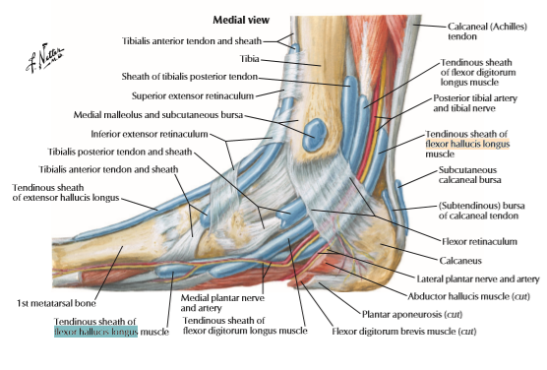
Posterior Tibialis
Supports arch when under load
Complete Anatomy 3D4medical
Notes:
The final main structure is the posterior tibialis. In an open chain, the posterior tibialis inverts the foot. However, in a closed chain, because the posterior tibialis inserts on the navicular and the medial cuneiform, it also helps the passive structures in stabilizing or raise the arch. In particular, the post tib can bring the foot into slight supination in order to allow the passive structures to create a rigid foot.

Slide 20
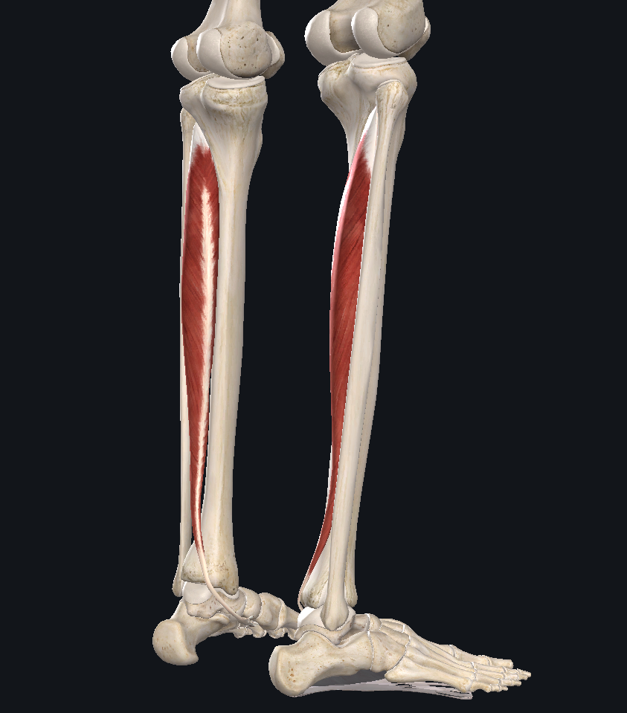
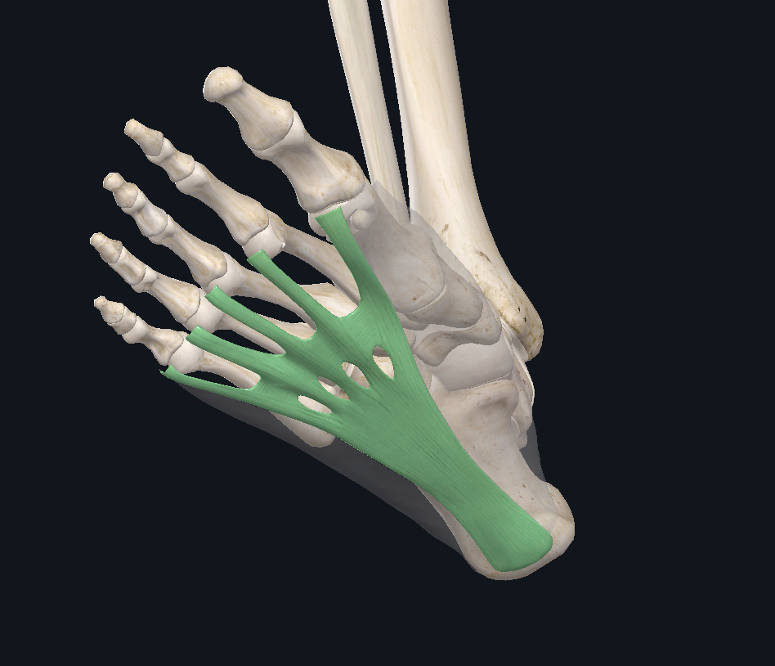
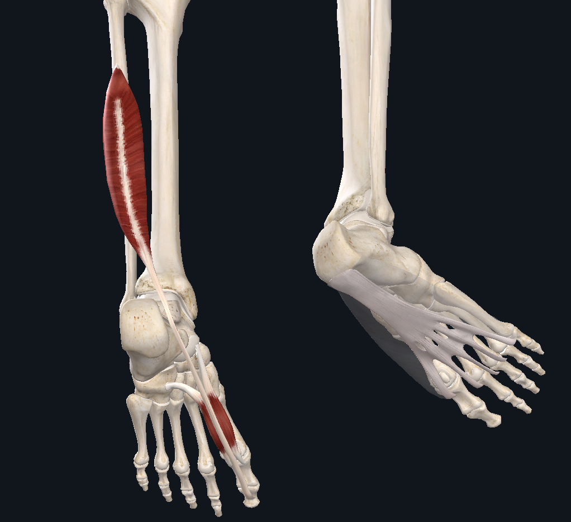
Anatomy Review
Complete Anatomy 3D4medical
Notes:
Here is a quick review of the three structures we just went over. From left to right we have the posterior tibialis, the plantar fascia, and the flexor hallucis group. The main takeaway from this chapter is that the arch is designed to handle load, and the three structures I just mentioned are the main structures that stabilize the arch.
And that is it for the functional anatomy review chapter. The next chapter is The Evolutionary Mismatch

Slide 21
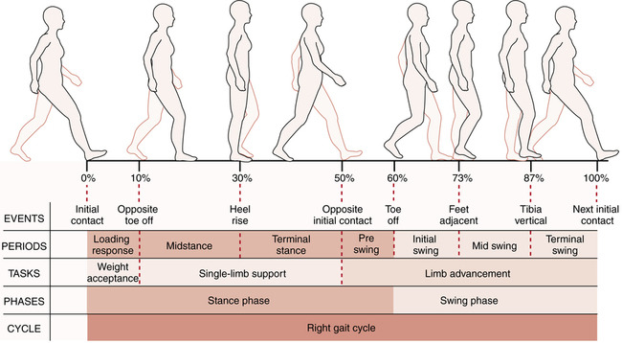
The Spectrum of Foot/Ankle
Malleability & Rigidity
The phases of gait
Balance of rigidity and malleability
  Heel strike – supinated
  Midstance – supinated → pronated
  Terminal stance to pre swing – pronated → supinated

Slide 22
Foot & Ankle Rigidity/Supination
Main goal = gait efficiency
During walking:
  Supination → joint locking → rigid lever for movement efficiency
Asghar A, Naaz S, 2022.
Notes:
Transverse arch: cuboid and cuneiform bones, the metatarsal bases and torsion of the metatarsal shafts. Geometrical dome provides resistance to sagittal plane bending (folded paper analogy).
Humans have a much more distinct transverse arch than apes

Slide 23
Foot & Ankle Malleability/Pronation
Main goal = force dissipation
During walking:
  Pronation → unlocking of the midfoot → force dissipation
Notes:
Increased gait speed → increased contribution of muscle activity (e.g. gastroc/soleus complex)
As intensity of gait increases (walking → running), contribution of muscle effort shifts to larger muscles (post tib → calf complex)

Slide 24
What happens when one link fails?
Posterior Tibialis
Tibial External Rotation
Plantar flexors (weak contribution)
Subtalar joint supination
Locking of transverse tarsal joint
Intrinsic foot musculature
Windlass Mechanism
Stable Midfoot
Hu D, Xiong CH, Sun R, 2021.
Notes:
As mentioned, there are key contributors to foot function. This diagram helps to demonstrate the effects of when one mechanism fails, the entire foot structure will struggle to function as it’s designed to.
The ability to achieve a supinated position is essential for the function of the foot. The post tib muscle is one of the most important inverter. So if an individual has posterior tibialis tendonitis, you can then see that the subtalar joint can’t effectively supinate and then the transverse tarsal joint won’t lock. Even if you have strong intrinsic foot muscles and a working windlass mechanism, these two features will suffer due to the inability of the posterior tibialis to invert the subtalar joint.
One ineffective mechanism can lead to a cascading of events to follow. A weak posterior tib will decrease arch function... Decreased arch function will weaken foot intrinsic muscles such as the flexor hallucis group…weakened intrinsic muscles lead to overstressing the plantar fascia… overstress the plantar fascia results in an ineffective windlass mechanism… And the list could go on..

Slide 25
The Evolutionary Mismatch
Notes:
Chapter 3, The Evolutionary Mismatch
In this chapter, we introduce the mismatch for the foot and begin talking about some of the consequences.

Slide 26
The Mismatch: Modern Footwear
“It is human nature to assume the world around us is normal, but from an evolutionary perspective wearing big, cushioned shoes unquestionably is abnormal. Instead, it was normal for millions of years to walk and run barefoot.
…the mismatch theory does raise the reasonable hypothesis that humans are maladapted to wearing shoes in some ways that contribute to certain injuries.”
Lieberman DE, Lieberman DE, 2012.
Notes:
Daniel Lieberman best introduces the cultural mismatch of modern shoewear,
“It is human nature to assume the world around us is normal, but from an evolutionary perspective wearing big, cushioned shoes unquestionably is abnormal. Instead, it was normal for millions of years to walk and run barefoot. This does not mean, of course, that how our barefoot ancestors lived ‘‘normally’’ in the Paleolithic is better than how we live today. This obviously is a superficial and false kind of logic (would we be better off without antibiotics or aseptic surgical methods?) However, the mismatch theory does raise the reasonable hypothesis that humans are maladapted to wearing shoes in some ways that contribute to certain injuries.”
To put it simply, we aren’t arguing that we shouldn’t wear shoes, but our feet developed to function in a way that shoes can limit which can lead to orthopedic dysfunction and injury.

Slide 27
The Mismatch: Modern Footwear
First evidence ~45,000 years ago
  Neanderthals - wrapped skins around their feet kept them warm in the winter
  These shoes were minimalist and without the cushioning and stability provided by modern shoes
Culturally, we have evolved to accept that cushioned modern shoes with support are essential for modern humans
Trinkaus E, Shang H, 2008.
Notes:
So then, when did footwear begin? Anatomical evidence demonstrated by Trinkaus et al indicates that the use of supportive footwear began approximately 45,000 years ago.
The functionality of footwear at that time served to keep feet warm during cold months. While this is some of the first evidence of modern footwear, these shoes 45,000 years ago looked different then the cushioned sneakers of today’s world as they were still considered minimalist with the lack of extrinsic stability. Some “shoes” were simply furs wrapped around the foot.
In today’s culture, we have evolved to accept that cushioned modern shoes with support are necessary for human function.

Slide 28
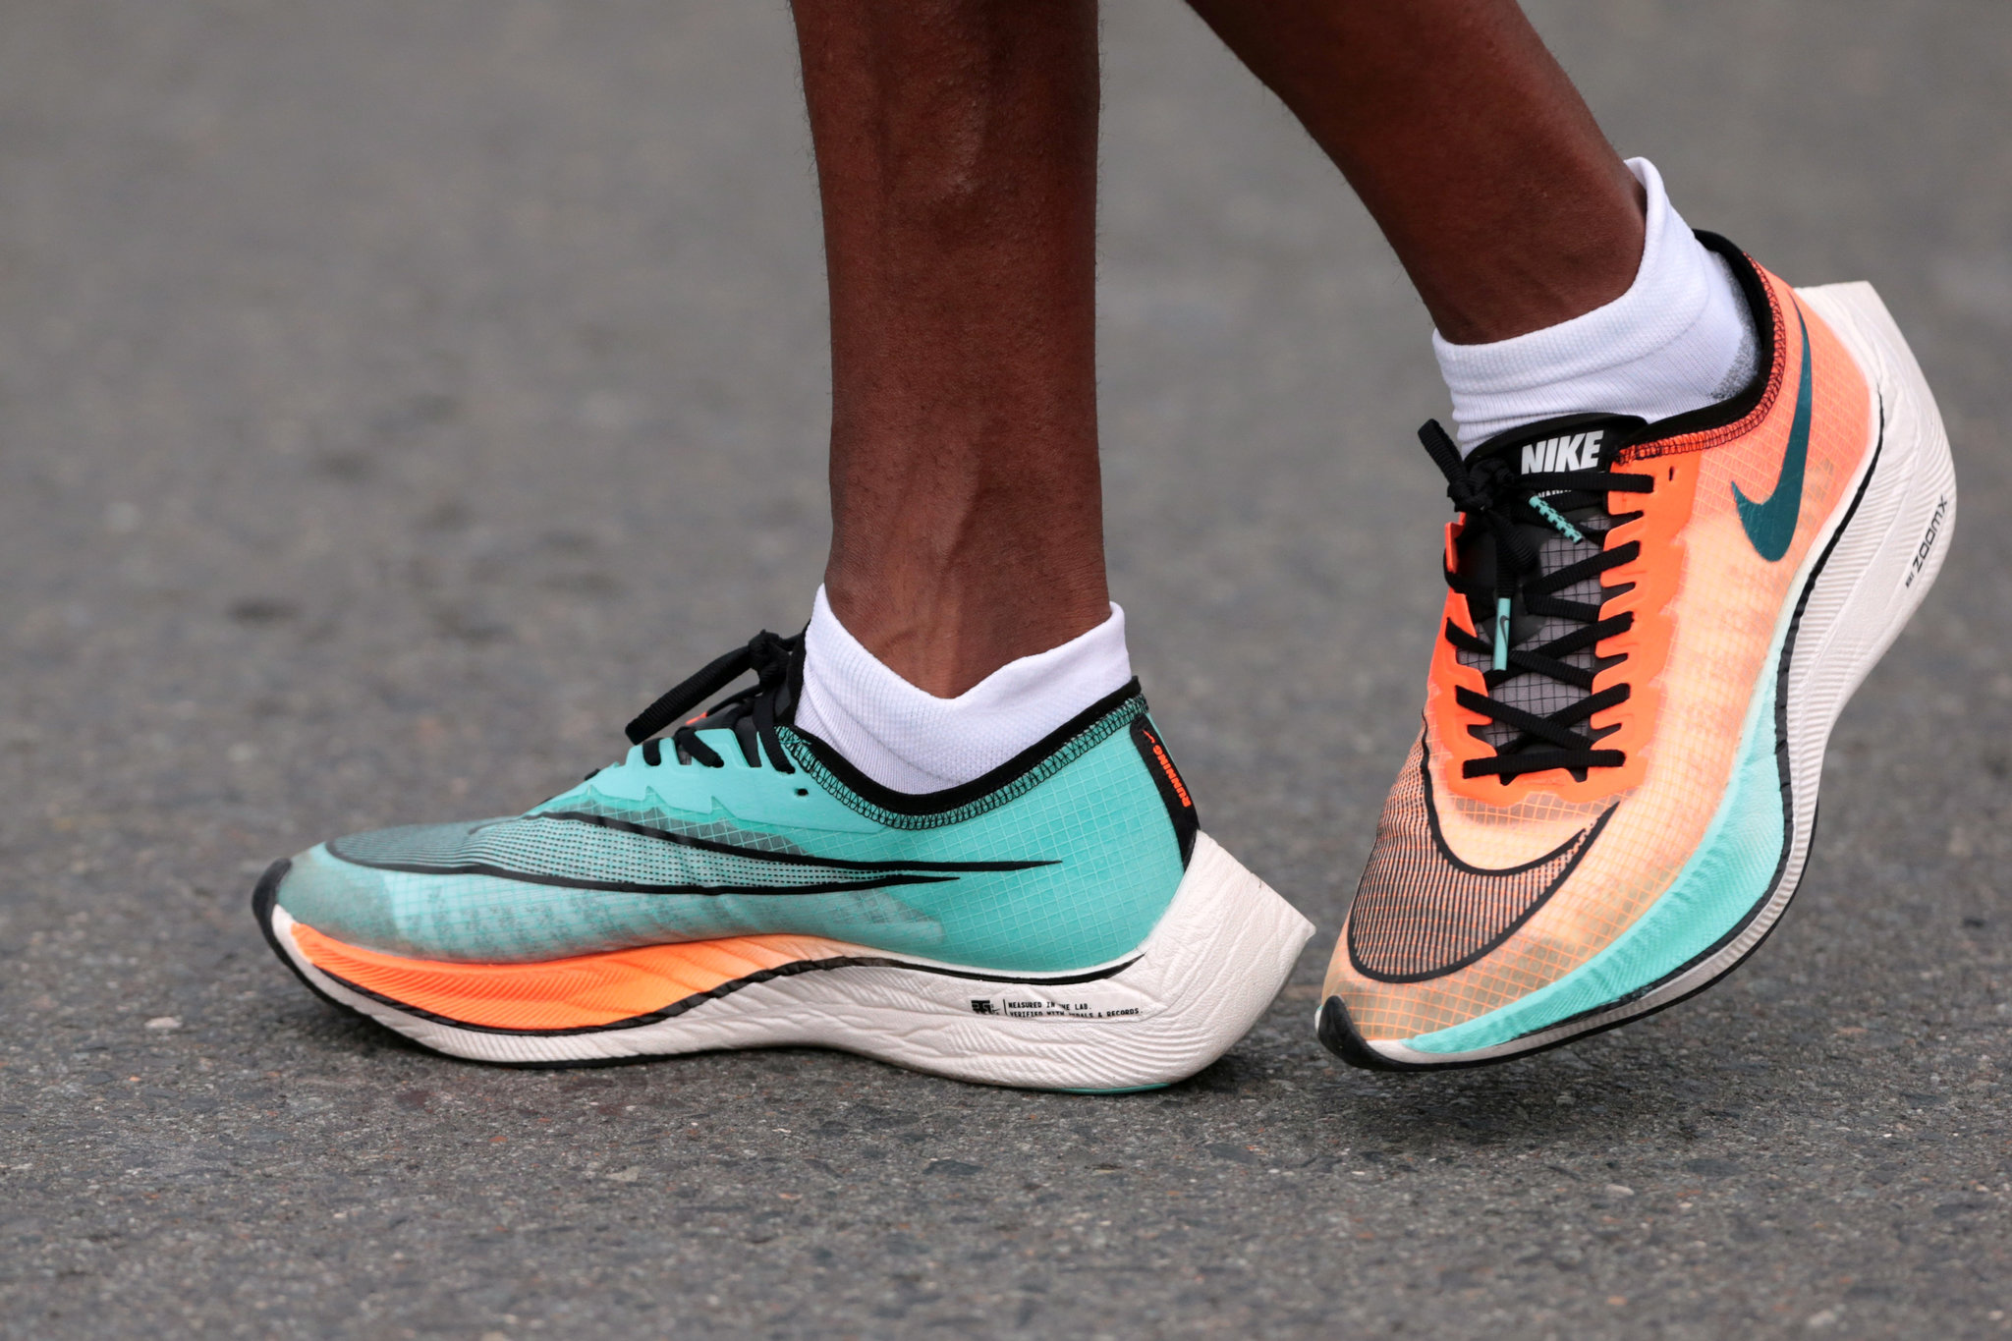
The Mismatch: Modern Footwear
Cushioned shoes are a relatively new technology
  Footwear might have become habitual about 30,000-45,000 years ago
  Constrictive footwear appeared long after hominin feet were anatomically modern
Reuters Staff. (2020, January 24). Nike's Vaporfly running shoes and tumbling records
Trinkaus E, Shang H, 2008.
Notes:
When we consider the 7 million year timeline from when we diverged from our last common ancestor and human evolution as a whole, we can appreciate the fact that cushioned shoes are a relatively new technology. While the evidence of the first use of footwear dates back ~45000 years ago, it started to become more habitual between 30-40,000 years ago. Cushioned shoe wear appeared long after our foot structures were anatomically modern.

Slide 29
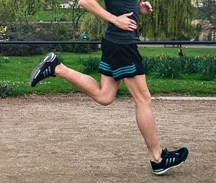
The Mismatch: Modern Footwear
Consequences of modern shoe wear:
Shoes limit proprioception.
Modern shoes with elevated heels, stiff soles, cushioning, and arch support may facilitate different gait form than appears to be common among habitual barefoot runners
Shoes can contribute to weak and inflexible feet
As the base of support, foot structure impacts function and structure up the chain
Brar, R. (2018, March 5). Heel strike isn’t the problem, over striding IS: Dispelling running myths. 3CB Performance
Lieberman DE, Lieberman DE, 2012.
Notes:
How can modern cushioned shoes affect our structure and function? Modern shoes can limit our proprioception on ground contact and impact our running gait. When you watch barefoot runners, we find that they are primarily forefoot or midfoot strikers while those who run with cushioned shoes are more likely to be heel strikers. This can impact force absorption during gait.
Socks and shoes have also been shown to contribute to weak and inflexible feet. Think about if you put your arm in a cast. Your arm muscles will atrophy, right? Socks and shoes do something similar to your feet. Those who wear restrictive footwear more often than not will have weaker feet. If the structures we talked about in the last chapter do not have to work as hard to assist in the function of the arch, then the associated active structures will atrophy. And because stability starts at the foot, when we have a weakened arch structure, we will see impacts up the chain into the knee, the hip, and even the spine. But don’t just take our word for it. Let’s dive into some research in the next chapter, The Evidence-Direct Effects.
It is clear that humans did not biologically evolve to wear cushioned and restrictive footwear, rather, we have a foot structure that is built to accept ground reaction forces and dissipate shock through the use of our arches. We developed mechanisms that favored efficient barefoot walk and running with toe off mechanics.

Slide 30
The Evidence
Direct Effects Part I
Notes:
Chapter 4, The Evidence
In this chapter, we will talk about the direct effects shoes have on our feet. We will be looking into the research that suggests shoes contribute to foot weakness and dysfunction, research that shows altered gait mechanics due to shoe wearing, and research that suggests that restrictive footwear can impact foot development.

Slide 31
The Effect of Modern Footwear
Direct Effects:
Decreased intrinsic muscular development and arch function, and poor pressure distribution across the gait cycle
Encourages deviation from a natural gait pattern
Impact to the great toe
Notes:
In the last chapter, we touched briefly on some of the effects of wearing cushioned shoes. The three main direct effects of shoe wearing are as follows.
One, because shoes can decrease the forces that our arch has to handle, there will be decreased intrinsic arch strength and decreased arch function. We commonly see weak feet in western cultures and that is one reason why.
Two, wearing cushioned shoes can encourage a heel strike during running gait. As we increase movement speed, barefoot runners typically shift from a heel strike to a forefoot strike to better handle ground contact forces. Because cushioned shoes help to absorb load, runners often don’t feel it is necessary to forefoot strike during running gait, but the forces involved with heel striking at higher velocities can increase injury risk.
And three, restrictive footwear with narrow toe boxes can increase the prevalence of hallux valgus.

Slide 32
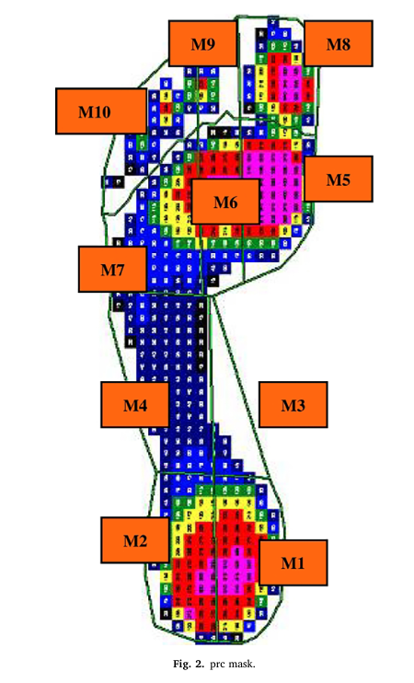
The Effect of Modern Footwear
Direct Effects:
Decreased intrinsic muscular development and arch function, and poor pressure distribution across the gait cycle
Encourages deviation from a natural gait pattern
Impact to the great toe
Pol, F., et al. (2021). Structural and functional foot and ankle characteristics associated with falling in older people.
Holowka NB, Wallace IJ, Lieberman DE, 2018.
Notes:
Direct effect number one. Shoes lead to an overall decrease in arch strength. When our feet cannot grip the ground and function as intended and when shoes dissipate most of the load that the foot is designed to dissipate, the intrinsic arch stabilizer muscles do not have to work very hard. When these muscles are not loaded, they lose strength and lose function.
Show airex pad demonstration with the scale?
Discuss arch function with demonstration - stand on air-ex pad
When we can’t grip the ground, our arch muscles cannot work - this is similar to the effects of shoes
Additionally, as we decrease function, we decrease strength of these working muscles due to not actively engaging them.

Slide 33
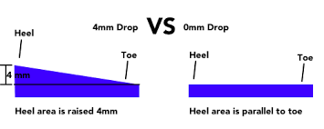
Effects of Minimalism Shoes
Minimal support footwear <4mm:
  Increase demands on the intrinsic muscles that support the arch, rather than relying on extrinsic shoe support.
  Increases plantar intrinsic muscle size and strength.
  Makes greater use of the spring-like function of the longitudinal arch and its associated muscles.
  Promotes stiffer arches.
Xu J, Saliba SA, Jaffri AH, 2023. Miller EE, Whitcome KK, Lieberman DE, Norton HL, Dyer RE, 2014.
Notes:
This study looked at foot strength in those that wear cushioned shoes with a slightly elevated heel, common in most modern shoes, compared to those who wore more minimalist shoe styles. The study found that minimalist shoes increase the demand on the intrinsic arch musculature, so those muscles are stronger. As such, there is greater surface area and volume of the plantar muscles which indicates muscle hypertrophy. The study also found that minimalist shoes allowed users to make better use of the spring-like function of the longitudinal arch and the structures involved.
So what does all this mean? It means that shoes that allow our feet to more closely mimic our natural foot function improve strength and function in the foot!
2023 Systematic Review:
Assessed efficacy of using minimalist shoes as an intervention to change plantar intrinsic foot muscle size and strength. Found increased intrinsics foot muscle hypertrophy (7-10.6%) and strength (9-57%). With longer duration intervention yielding larger effects
Same as above but more up to date and done by UVA researchers!

Slide 34
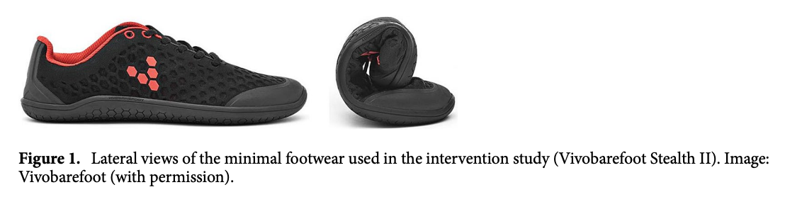
Effects of Minimalism Shoes
Minimal support footwear for 6 months with daily activities increases intrinsic muscular development by 57% in the intervention group
Curtis R, Willems C, Paoletti P, D’Août K. 2021.
Notes:
This second study had very similar findings to the first study. This study looked at three groups. One group that wore cushioned shoes and continued to wear them. One group that wore minimalist shoes and continued to wear them. And one group that wore cushioned shoes, but transitioned to minimalist shoes. The study found that neither the cushioned shoe group nor the minimalist shoe group had significant improvements in foot strength over the six month course of this study. However, the minimalist group had a higher baseline foot strength. The group that transitioned from cushioned shoes to minimalist shoes had a 57% increase in intrinsic muscular development within 6 months by simply performing daily activities. 57%! When we transition to a more natural function of the foot without the cushioning of modern shoes, our feet get stronger because they are allowed to function as they were designed to! And that was without targeted strengthening.
N = 22 for intervention group

Slide 35
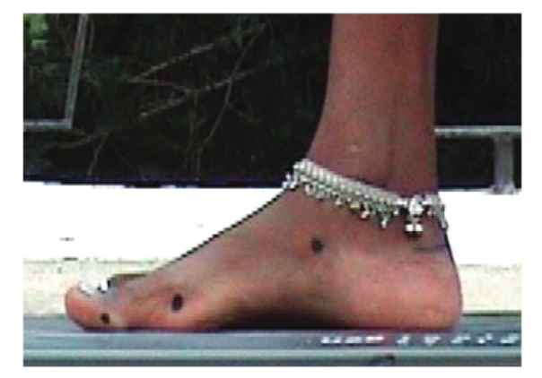
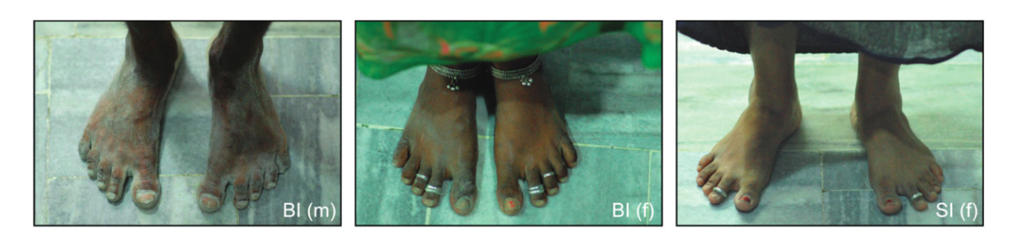
Consequences of Cushioned Shoes
Western subjects - slender feet, with more focal and higher peak pressures at the heel, metatarsals and hallux.
Barefoot walkers - wider feet and more equally distributed peak pressures
Minimally shod walkers – stiffer arch, large foot intrinsic muscles
D’Août K, Pataky TC, De Clercq D, Aerts P, 2009. Holowka NB, Wallace IJ, Lieberman DE, 2018.
Notes:
This next study looked at foot structure in shoe wearing, partially shoe wearing, and non-shoe wearing communities. It was found that shoe-wearing communities, typically western populations had more slender feet with higher peak pressures during gait at the heel, the metatarsals, and the great toe. Barefoot communities, on the other hand, had wider feet with more distributed peak pressures during gait.
So what does this mean? Those who wear shoes have higher peak pressures on their heel, metatarsals, and great toe compared to non-shoe wearers which means that their ability to distribute force is decreased. This lack of force distribution can influence gait and chances of injury. It can also affect how much load actually goes through the arch which can lead to decreased arch strength. We also see a generally wider foot, especially the toe box, when we do not constantly wear shoes with a narrow toe box that constrict our toes and limit their ability to spread and grip the ground. Even socks can constrict the toes to a level that impacts foot development.
This was a RCT with ___participants.
2 indian cohorts - one with and one without shoes
And 1 westernized shoe wearing cohort.
The shoe-wearing indian cohort wore primarily open-toed wider shoes.
Additionally - Holowka et al, 2018:
Minimally shod populations had:
Higher and stiffer longitudinal arch in static stance
Higher CSA in abductor hallucis, abductor digit minimi, and flexor digitorum brevis
Longitudinal arch had less deformation and higher stiffness during dynamic gait
Authors conclude that supportive and restrictive conventional shoe wear could likely impact intrinsic foot strength and arch stiffness

Slide 36
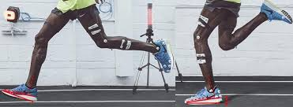
The Effect of Modern Footwear
Direct Effects:
Decreased intrinsic muscular development and arch function, and poor pressure distribution across the gait cycle
Encourages deviation from a natural gait pattern
Impact to the great toe
Sweat Elite. (n.d.). Mo Farah – Technique transformation analysis.
Notes:
Direct effect number two. Shoes can encourage a heel strike. When we think about running, the first thing that we think of is the increase in velocity. In barefoot runners, that increase in velocity is accompanied by a shift from heel strike walking to midfoot or forefoot strike running. This transition takes place due to the increased need for force dissipation through a single leg and the need for horizontal force production. Running puts 3-5x your bodyweight through your foot, so the foot and other lower extremity musculature have to absorb that much more load. In order to do that, we shift to forefoot running to allow the gastroc soleus complex to absorb load and create force.

Slide 37
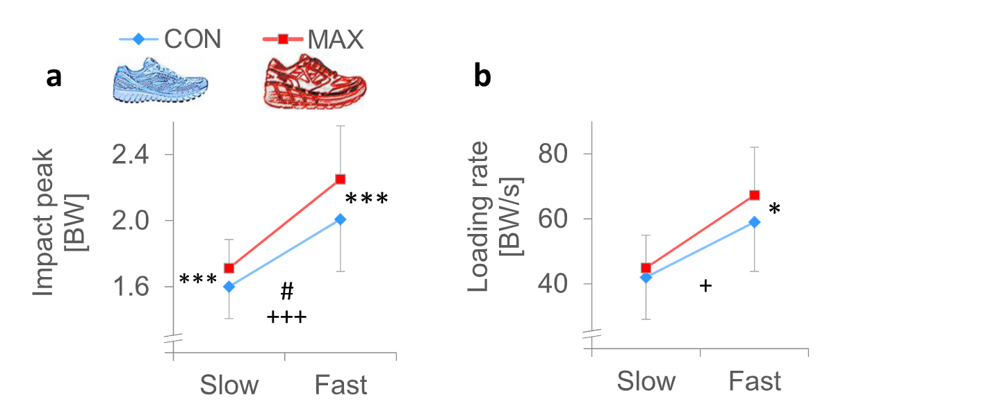
Consequences of Cushioned Shoes
Cushioned shoes encourage a heel strike running pattern
Running in highly cushioned shoes increases leg stiffness and amplifies impact loading
Kulmala J-P, Kosonen J, Nurminen J, Avela J, 2018.
Notes:
This study looked at motion patterns and loading mechanics between minimalist shoe wearers and cushioned shoe wearers. This study found that people who wore more cushioned shoes were more likely to heel strike. The study also found an increased leg stiffness in the cushioned shoe group. In running mechanics, the lower extremity musculature such as the gastrocnemius and soleus, and the quadriceps have to absorb load. However, when heel striking, impact loading, the rate of loading on ground contact is much greater and can inappropriately transfer forcers up the kinetic chain which increases risk of certain injuries to the musculoskeletal system. But we’ll talk more about that later.
Kulmala J-P, Kosonen J, Nurminen J, Avela J. Running in highly cushioned shoes increases leg stiffness and amplifies impact loading. Published online 2018.

Slide 38
Compared to Cushioned Shoes, Habitual Barefoot Walkers Have…
Lower peak plantar pressures and pressure impulses. Why?
          Increased forefoot spreading under load
          Reduced step/stride length and increased cadence
          Flatter foot placement, increased knee flexion, and a reduced peak vertical ground reaction force at initial contact
Franklin S, Grey MJ, Heneghan N, Bowen L, Li FX, 2015.
Notes:
This study looked at motion patterns and loading mechanics between minimalist shoe wearers and cushioned shoe wearers. This study found that people who wore more cushioned shoes were more likely to heel strike. The study also found an increased leg stiffness in the cushioned shoe group. In running mechanics, the lower extremity musculature such as the gastrocnemius and soleus, and the quadriceps have to absorb load. However, when heel striking, impact loading, the rate of loading on ground contact is much greater and can inappropriately transfer forcers up the kinetic chain which increases risk of certain injuries to the musculoskeletal system. But we’ll talk more about that later.
Kulmala J-P, Kosonen J, Nurminen J, Avela J. Running in highly cushioned shoes increases leg stiffness and amplifies impact loading. Published online 2018.

Slide 39
The Effect of Modern Footwear
Direct Effects:
Decreased intrinsic muscular development and arch function, and poor pressure distribution across the gait cycle
Encourages deviation from a natural gait pattern
Impact to the great toe
Notes:
And the final direct effect of modern shoewear is increased rates of hallux valgus.

Slide 40
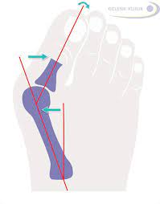
The Evidence: Hallux Valgus
Study looking at the incidence of hallux valgus in partially shoe-wearing communities
  Unshod communities had <2% incidence of hallux valgus, while shoe wearing communities were 16% in men and 48% incidence in women
  The extent of the hallux valgus deformity was directly correlated with years of shoe wearing
Gelenk-Klinik. (n.d.). Hallux valgus – Conservative treatment or surgery? Gelenk-Klinik
Shine IB, 1965.
Notes:
Before we dive into the research, what is hallux valgus? Hallux valgus is a pathology in which the great toe migrates towards the midline of the foot. Have you ever heard of bunions? That’s hallux valgus. Over time it can cause deformation, damage, and pain to the 1st metatarsophalangeal joint. Another impact of hallux valgus is in overall arch function. We will discuss this in more detail in the next few chapters, but when the great toe migrates inwards, it is no longer in a position to stabilize the arch. Those with hallux valgus tend to have greater foot weakness and aberrant motion patterns.
But now let’s dive into the first study. This study looked at the incidence rates of hallux valgus in shoe wearing and non-shoe wearing communities. Hallux valgus was found in less than 2% of the population in shoeless communities, while it was found in 16% of men and 48% of women in shoe wearing communities. That’s a massive difference! Not only was the incidence of hallux valgus noted to be larger in those who wear shoes, but it was found to be directly correlated with years of shoe wearing.

Slide 41
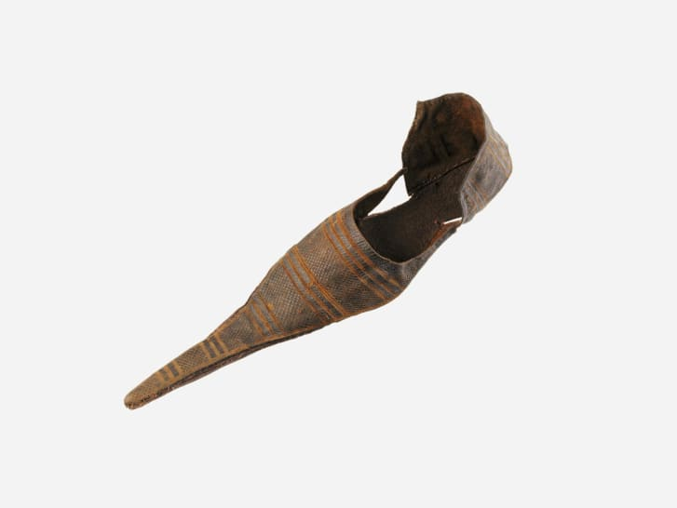
The Evidence: Hallux Valgus
“The increased prevalence of hallux valgus identified in individuals from the 14th to 15th centuries coincided with the adoption of new footwear with pointed toes. Those that adopted this fashion trend appear to have been more likely to develop balance and mobility problems that resulted in an increased risk of falls.”
Constrictive footwear between the ages of 20-39 may be critical for developing hallux valgus in later life.
Ancient-Origins. (2021, June 11). Medieval winklepickers really were a health hazard
Dittmar JM, Mitchell PD, Cessford C, Inskip SA, Robb JE, 2021.
Notes:
This next study looked at the prevalence of hallux valgus in people from the 14th and 15th centuries. They found that upon the adoption of more constrictive footwear, rates of hallux valgus increased. Between the 11th and 13th centuries, the rate of hallux valgus was only around 6% compared to 27% in the 14th and 15th centuries when people started to wear this constrictive footwear. The study also found that hallux valgus was found more often in wealthier populations where individuals were more likely to wear shoes with a narrow toe box
So this study points towards the fact that shoe wearing, especially shoes with narrow toe boxes, can increase rates of hallux valgus
https://www.cnn.com/style/article/bunions-pointy-shoes-medieval-britain-scn/index.html#:~:text=Known%20as%20poulaines%2C%20pointy%20leather,common%20today%2C%20especially%20among%20women.
27% of the skeletons dating from the 14th and 15th centuries suffered from bunions, compared with only 6% that dated back between the 11th and 13th centuries
Wealthier, higher-status individuals living in urban areas were more likely to have suffered from bunions, the study of the skeletons, which came from four different cemeteries around Cambridge, suggested.

Slide 42
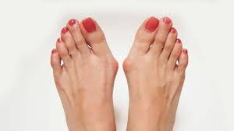
The Evidence: Hallux Valgus
Study looking at the incidence of hallux valgus in 130 twin pairs to evaluate genetic vs environmental factors to hallux valgus
  74 identical, 56 fraternal - women 31-87 y/o
  The use of footwear with a narrow toe-box was significantly associated with hallux valgus.
      Environmental factors are the key
TDO Therapy. (2023, September 8). Hallux valgus relief: Embrace comfort with wide fit shoes.
Munteanu SE, Menz HB, Wark JD, et al, 2017. Arbeeva L, Yau M, Mitchell BD, et al, 2020.
Notes:
Finally, we have this study that looks at the rates of hallux valgus in both fraternal and identical pairs of twins. It was once thought that genetics played a large role in the rates of hallux valgus, however, this study concluded that it is more likely a result of a shared environment. This could be concluded because the incidence of hallux valgus between pairs of twins were similar regardless of whether or not they were identical or fraternal. According to the classical twin model, if the genetic link for developing hallux valgus were strong, then you would expect that pairs of identical twins would be more likely to share the pathology if one of them has it, compared to sets of fraternal twins. While there is a familial link present in hallux valgus, this familial link is likely attributed to a similar upbringing than it is genetic code. Think of it like cultural genes rather than biological genes. If your family wears shoes more often, you will be more likely to wear shoes often. As such, your chances of developing hallux valgus will increase.
Based on newer research, we know there exists both a genetic and environmental component to bunions. This can be explained by epigenetics. A good analogy to explain this follows: genes are like light switches in a house, epigenetics are like dimmer switches that can turn up/down or completely off, how much the gene is expressed
And that is it for the Direct Effects chapter. The next chapter is The Evidence: Indirect Effects Part 1

Slide 43
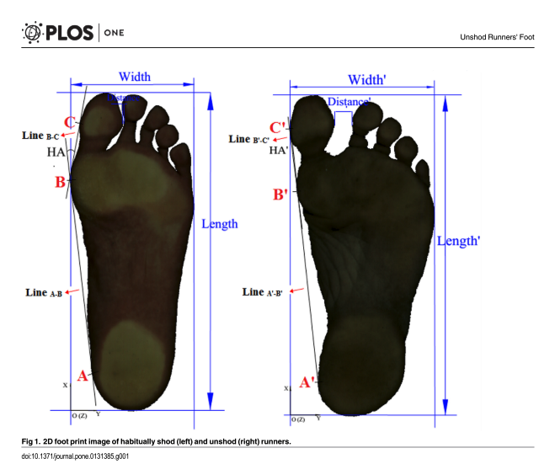
The Evidence: Hallux Valgus
168 habitually unshod runners vs. 196 habitually shod runners, significant difference in hallux valgus angle
Which big toe position has a greater impact on impacting stability up the chain?
Shu Y, Mei Q, Fernandez J, Li Z, Feng N, Gu Y, 2015.
Notes:
Summary: assessed differences between foot morphology for 2 comparable groups of habitually unshod Indian (n = 168) and habitually shod (n= 196) Chinese runners and found that unshod runners had a significantly decreased hallux angle (decreased hallux valgus) compared to shod runners. Good photos showing the difference between the 2 groups!

Slide 44
The Evidence:
Indirect Effects Part I
Notes:
Chapter 5, The Evidence: Indirect Effects Part I
In the last chapter we discussed the direct effect of shoe wearing and provided research to back up our claims. But how do those effects impact our function and injury risk? That’s what we will discuss in the next few chapters.

Slide 45
The Effect of Modern Footwear
Indirect Effects
When one component of arch stability fails, other components compensate
Improper loading mechanics and overloading connective tissue structures (e.g. bones, fascia)
Consequences of decreased foot function up the chain
Notes:
Three major consequences are injury rates in the foot and ankle due to weak feet, overload to passive structures due to improper loading mechanics, and consequences of decreased arch function up the chain, especially in the frontal plane.
The first indirect effect we will discuss is injury risk when arch structures fail to function. When one component fails, the other components have to compensate which can lead to overload and injury to those structures.

Slide 46
Combined Effort to Maintain the Arch
When we consider our functional anatomy…
The plantar fascia, posterior tibialis, and the flexor hallucis group maintain the medial longitudinal arch
The arch is critical in dissipating ground reaction forces, especially as speed increases
If one of these anatomical components fails, it increases the stress on the other components leading to dysfunction
Notes:
But let’s take a step back. Let’s quickly review the three main structures that help to support the medial longitudinal arch. We have the flexor hallucis longus and brevis, the fascia and connective tissue, and the posterior tibialis. Those three structures work together to maintain the arch and dissipate load, but as we discussed in the last chapter, those muscles can weaken due to cushioned shoes. As those structures weaken, they can no longer perform their function whenever ground reaction force overcomes their ability to absorb load. So what happens when one structure is too weak? The others have to compensate!
For example, what would happen if the posterior tibialis were weak? The force that would typically be mitigated by the posterior tibialis would have to be be dissipated by the plantar fascia and the flexor hallucis group. Those two structures would be overloaded which could lead to pathologies such as plantar fasciitis or flexor hallucis tendinitis. And it works the same way if the flexor hallucis group were weak. The excess force would have to be absorbed by the posterior tibialis and the plantar fascia which could lead to posterior tibialis tendinitis or plantar fasciitis. And what if the plantar fascia is inadequate? It’s the same pattern! The posterior tibialis and flexor hallucis group would be overloaded.

Slide 47
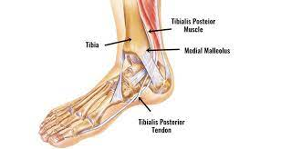
The Evidence: Fallen Arch Consequence
Increased posterior tibialis muscle activation in those with flat feet, a compensation to reduce arch overload
  Posterior tibialis tendonitis is a common condition for those with flat feet. They are at risk for tearing the tissue.
SportsInjuryClinic.net. (n.d.). Posterior tibial tendon dysfunction (PTTD) – Symptoms, Treatment.
Murley GS, Menz HB, Landorf KB, 2009. Cifuentes-De la Portilla C, Larrainzar-Garijo R, Bayod J, 2019.
Notes:
Let’s talk about this study. This study looked at people with flat feet, which is common in those with weak feet. They found that increased posterior tibialis activation was a compensation method to reduce arch overload. They also found that this puts excessive strain on the posterior tibialis which can lead to dysfunction and injury. Posterior tibialis tendinitis is a very common pathology and some individuals are even at risk for tearing the tissue.
How would we treat posterior tibialis tendonitis? Well, because we know what other structures are important in maintaining the arch, we would consider short term orthotics to mitigate stress on the posterior tibialis while we strengthen the flexor hallucis group to aid the posterior tibialis in maintaining the arch and dissipating load.

Slide 48
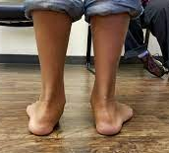
The Evidence: Importance of FHL
Study looking at the affects of flexor hallucis tendon rupture in RA-patients
  FHL tendon rupture associated with 1st MTP damage
  Without function of the flexor hallucis we are prone to flat feet
Dr. Babajide A. Ogunlana, DPM, FACFAS. (2020, May 2). What’s to know about flat feet? West Houston Foot & Ankle Center
Baan H, Drossaers-Bakkers WK, Dubbeldam R, Buurke JJ, Nene A, Van De Laar MAFJ, 2007.
Notes:
This next study looks at rheumatoid arthritis patients with flexor hallucis longus tendon ruptures. The study found two things. One, 1st MTP joint damage is associated with flexor hallucis tendon ruptures. And two, without the function of the flexor hallucis longus tendon, we are prone to flat feet. Now, as trainers or PT’s we can’t do too much about a full tendon rupture other than mitigate other consequences, but this study shows the importance of the flexor hallucis group in the arch.
Recall, if FHL is impaired, what structures get overloaded? Post tib and plantar fascia! Also recall, in individuals with flat feet, what structure has to work a lot harder? Post tib! Double whammy
Draw on slide picture in this section of the script:
But now, let’s take a minute to consider another pathology, hallux valgus. This study has already shown the importance of the flexor hallucis group, but what happens to the great toe during hallux valgus? The great toe migrates inwards towards the midline of the foot. In that case, is the toe in an advantageous position to stabilize the medial longitudinal arch? Not anymore! The great toe is in its anatomical position in order to function to assist in arch stability. And that is also the reason why the big toe is big! It needs to have the strength to stabilize the arch in a closed chain or resist forces that seek to collapse the arch.

Slide 49
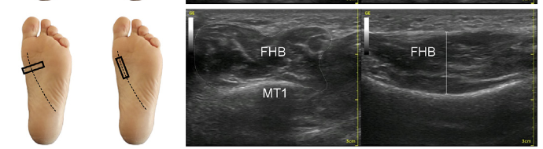
The Evidence: Fallen Arch Consequence
Consequences associated with having inadequate plantar fascia that is commonly associated with pes planus
  Result: When the plantar fascia is thin, as in pes planus, the great toe flexor adapts by getting bigger.
Angin S, Crofts G, Mickle KJ, Nester CJ, 2014.
Notes:
This final study looks at compensations common in those with flat feet due to inadequate function of the plantar fascia. It is more likely that we will find pes planus when the plantar fascia is thin and cannot store or dissipate enough load. This study finds that the flexor hallucis group increases in size and strength when the plantar fascia cannot help to maintain the arch. And that fits our pattern. When one arch structure fails, the others have to pick up the slack and compensate!
In conclusion, whenever we see weakness in one structure, we always have to be on the lookout for overcompensation or injury risk for another. The plantar fascia, the posterior tibialis, and the flexor hallucis group all work together to stabilize the arch and it is our job to make sure they are all working together to maintain the arch to both improve function and decrease injury risk.
And that is it for the Indirect Effects Part 1. The next chapter is The Evidence: Indirect Effects Part 2

Slide 50
The Evidence
Indirect Effects Part II
Notes:
Chapter 6, The Evidence: Indirect Effects Part II
In this chapter, we will be discussing another indirect effect of shoe wearing, overload to connective structures due to improper loading patterns.

Slide 51
The Effect of Modern Footwear
Indirect Effects
When one component of arch stability fails, other components compensate
Improper loading mechanics and overloading connective tissue structures (e.g. bones, fascia)
Consequences of decreased foot function up the chain
Notes:
In the evidence chapter, we discussed how shoe wearing increases the chance of heel striking during running gait. As we increase our speed, going from walking to running, we should be transitioning our center of gravity forward in order to shift our weight from the heel to the forefoot or midfoot to more efficiently dissipate load. But when we wear highly cushioned shoes, we are more likely to continue to heel strike. Now, the reason we shift from a heel strike to a midfoot strike is for force dissipation purposes. Our arch structure, our gastrocnemius/soleus complex, and even our quadriceps help to dissipate load when midfoot striking, but cannot perform that function as efficiently with a heel strike. So where does all that force go? It goes into our passive structures including the plantar fascia and bony structures as well. We will go over some research linking heel striking with increased risk of both stress fractures and plantar fasciitis, but first, let’s compare heel striking and midfoot striking in more detail.

Slide 52
Heel Strike vs. Midfoot Strike
Sweat Elite. (n.d.). Mo Farah – Technique transformation analysis.
Notes:
Drawing slide
Let’s take a look at this picture. The first image shows a heel strike and the second a midfoot strike. Here are some of the biggest differences.
One, the initial impact. Looking at the first image, the calcaneus is the first structure that has to deal with the ground reaction forces associated with running. In walking gait, we can heel strike because the fat pad of the calcaneus and other associated structures are adequate to absorb those low level loads. However, those structures are not adequate when forces increase in running. Cushioned shoes allow the heel to absorb the increased forces, but dissipation of the ground reaction force is limited, so the loading rate up the kinetic chain is substantially higher. The second image demonstrates a midfoot strike. With midfoot striking, we utilize the arch and its associated structures to both absorb and dissipate the loads associated with running thus decreasing loading rate.
And what about the gastroc/soleus complex? As speed increases to a sprint, we shift our COG forward in order to transition to a forefoot strike and create more horizontal forces with our posterior chain. When we move to a forefoot strike, the stiffness of the arch provides a longer lever through which the gastroc/soleus can function. But how does it function? It functions eccentrically to absorb and dissipate load while lowering the heel to the ground. When the heel makes contact with the ground first at higher velocities, the calf muscles have no chance to absorb load.
We can also take a look at the COG position compared to the BOS. In the heel strike image, look how far in front of the COG the foot lands. It’s almost acting like a braking force at that point. When we look at the midfoot strike image, we can see how the foot is almost directly under the COG. At higher speeds, the COG may even shift to be in front of the foot. This occurs to shift to a forefoot strike to allow the gastroc soleus complex to absorb load. We can also look at the knee angle. The knee is almost in full extension in the first image. Can the quadriceps accept load? Yes, the knee isn’t completely locked, but look at the angle in the second image. There is greater knee flexion and the knee is almost right below the COG, in an ideal position to accept vertical load.
After talking through these images, it is clear that a midfoot or forefoot strike is more efficient at dissipating load, compared to a heel strike which does not dissipate force effectively. But where does that force go if it’s not dissipated? Into the passive structures leading to higher rates of injury.
Demonstration video instead:
Let’s take a minute to go through a small exercise. Pause the video if you need too, but I want everyone to try this. Put on some cushioned shoes and jump and land on your heels. Now, take those shoes off and jump and land on your heels. Pause…………. How did that feel? Not too great, right? But I’m sure you felt much more of a jolt when you landed on your heels without shoes. I bet you didn’t even jump as high with your shoes off because you instinctively knew that jarring force would feel worse. Those are similar forces to what we put through our structure when heel striking at higher velocities. And keep in mind that we put 3-5x our body weight through one foot when running.

Slide 53
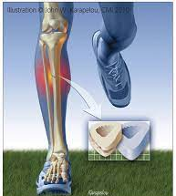
The Evidence: Stress Fracture
Systematic review determining relationship between lower extremity stress fractures and ground reaction force
  Similar GRF in subjects with or without lower-limb stress fractures, however…
  There was a significant difference between vertical load rate between the injured and control group
  Increased vertical loading rate occurs with rear foot strike
InTraining Running Centre. (n.d.). Stress fractures and bone stress.
Van der Worp H, Vrielink JW, Bredeweg SW, 2015.
Notes:
Now that we understand the mechanics and forces behind heel striking, let’s dive into the research. This first study looked at ground reaction force and stress fractures in runners. The study found that there was not a significant difference in ground reaction forces between those who heel strike and those who midfoot or forefoot strike. However, there was an increased loading rate up the kinetic chain with those who heel strike. This increased vertical loading rate was associated with higher incidence of stress fractures. So this study links heel striking with stress fractures.
van der Worp et al., 2016
Systematic review and meta-analysis assessing injured vs noninjured runners and vertical GRF
Vertical ground reaction force loading rates were higher in patients with a history of stress fractures

Slide 54
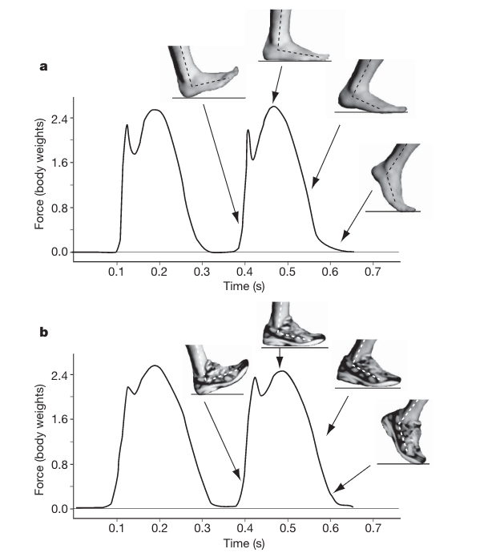
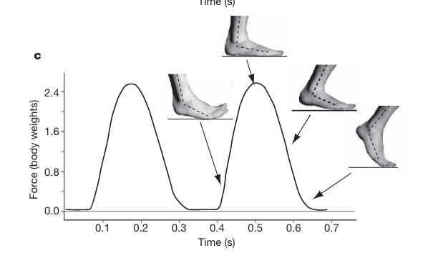
The Evidence: Stress Fractures
Study looking at biomechanical factors associated with tibial stress fractures
  Hard heel striking associated with increased risk of stress fractures when compared to forefoot striking while running.
Milner CE, Ferber R, Pollard CD, Hamill J, Davis IS, 2006. Lieberman DE, Lieberman DE, 2012.
Notes:
Drawing slide
This second study (Milner) looks at biomechanical factors associated with stress fractures. The study found that heel striking is associated with an increased risk of tibial stress fractures, but let’s look at their findings in more detail. First, let’s look at these two graphs on the left. The first graph shows a heel strike gait without shoes, and the second graph shows a heel strike gait with shoes. You’ll notice that both graphs have two peaks. One upon initial contact, and the second at maximal force, but it’s not the maximal force that we want to look at. We are more interested in the first peak, which we will call the impact transient. Notice the near vertical line that leads to the first peak. That line shows an exceptionally high rate of loading, which we know from the previous study can increase the risk of stress fractures. But why does it increase risk of stress fractures? When loading occurs at a high rate, it indicates that loading mechanisms such as the arch and the gastroc soleus complex are not adequately dissipating load. So instead, that load is transferred at a high rate into connective tissue structures such as the tibia, contributing to incidence rates of stress fractures. We should also consider high impact load rates in regards to force transference into joints such as the knee and hip joints.
The graph on the right tells a different story. That graph shows loading forces with midfoot strike gait. There is no rapid rate of loading. There is no impact transient. And without the rapid loading rate, there is also a decreased risk of stress fractures due to proper force absorption and dissipation by the arch and other structures.
Rearfoot strike running creates a high impact peak very quickly as compared to forefoot strike. This is why heel striking is associated with risk to stress fractures because the high impact induced stress on the body, particularly joints and bones.
Forefoot strike, does not generate an impact transient, even in the barefoot condition. The impact transient associated with RFS running are sudden forces with high rates and magnitudes of loading that will travel rapidly up the body. This loading mechanism can contribute to high incidence running-related injuries.
Other background information:
Impact peak - is the greatest force seen during the initial landing. This small peak prior to the main landing is often only seen in rear foot strike landing.
Active peak - greatest force detected during foot strike (during midstance when COM is over the foot)
Loading rate - how rapidly forces build up and can either be averaged over parts of the graph or at an instantaneous peak. This measures steepness of the curve during this initial landing

Slide 55

The Evidence: Plantar Fasciitis
Study looking at biomechanical and anatomical factors associated with a history of plantar fasciitis in female runners
  Increased vertical loading rate is associated with increasd risk of developing plantar fasciitis. Recall, heel striking is related to increased vertical GRF
Speck, J. (2016, November 6). The real cause of plantar fasciitis. Pivotal Motion Physiotherapy
Pohl MB, Hamill J, Davis IS, 2009.
Notes:
This final study looked at factors associated with plantar fasciitis in female runners and found that heel striking is linked with increased risk of plantar fasciitis. Poor loading mechanics may be putting excessive stress on the plantar fascia. As the heel makes contact with the ground, the calcaneus locks in place, but the midfoot continues to move forward. This causes more tension on the plantar fascia. These tension forces cannot be mitigated by other arch structures until the big toe makes contact with the ground, so the plantar fascia is typically overloaded in a heel striking gait which can lead to plantar fasciitis.

Slide 56
The Evidence: Plantar Fasciitis
Also consider the horizontal ground reaction force
  Heel striking results in rapid horizontal force attenuation vs. forefoot striking = broader loading and better attentuation
Speck, J. (2016, November 6). The real cause of plantar fasciitis. Pivotal Motion Physiotherapy
Notes:
Note, research hasn’t caught up to this yet, but it is the likely explanation for the increased risk of plantar fasciitis in runner that experience higher vertical GRF loading rates (heel strikers)

Slide 57
The Evidence
Indirect Effects Part III
Notes:
Chapter 7, The Evidence: Indirect Effects Part III
In this chapter, we will be discussing another indirect effect of shoe wearing. We will discuss how weak feet can impact other structures and biomechanics up the kinetic chain.

Slide 58
The Effect of Modern Footwear
Indirect Effects
When one component of arch stability fails, other components compensate
Improper loading mechanics and overloading connective tissue structures (e.g. bones, fascia)
Consequences of decreased foot function up the chain
Notes:
When we look at foot function, we always have to consider how the foot can impact movement at other joints. Our feet are our base, so when the foot isn’t stable, can our knee be stable? Can our hip be stable? Our spine? The answer is no. When the foot can’t properly stabilize against ground reaction forces, we will be unstable.
Let’s take a look at this demonstration and how the foot can impact stability (airex pad demonstration)

Slide 59


Consequences of Cushioned Shoes
Cushion shoes cause a loss of sensory input and make it more difficult for the feet to “purchase” the ground
Restrictive footwear impairs the ability of our toes to spread out, weakening the foot musculature causing balance and ambulatory biomechanical dysfunction
  How does your foot position affect the kinetic chain?
Protalus. (2020, October 1). What is a toe box? (Definition & positioning)
Road.cc. (n.d.). M2O Merino Crew Compression Socks
Notes:
When restrictive footwear contricts our toes, impact our ability to purchase the ground, and weaken our arch musculature it can cause dysfunction up the kinetic chain. But how exactly does foot strength and position affect the kinetic chain?

Slide 60
The Evidence: Impact up the chain
UVA study looking at how the arch supports medial gluteus muscle activation
  Maintaining the arch increased Gluteus medius activation during the single leg squat
  Orthotic corrects frontal plane instability
Hertel J, Sloss BR, Earl JE, 2005. Sadler S, Spink M, de Jonge XJ, Chuter V, 2020.
Notes:
Let’s consider this study. In this study, they looked at gluteus medius activation with and without orthotics, arch supports. They found that gluteus medius activation was greater when the participant wore the arch supports, but why? Was it something about the arch support itself, or was it about foot position?

Slide 61
The Evidence: Impact up the chain
Talking point: The foot position and the arch function are very important to the function of the rest of the lower extremity during bipedal motion. Think forced center of gravity shift.
Drawing example:
Hertel J, Sloss BR, Earl JE, 2005.
Notes:
Drawing slide:
We would argue that it is more about the foot position.
General script for drawing:
So let’s draw it out. Here is the pelvis, the legs, and the feet. When we have weak arches, we are more likely to fall into pronation. And what force does pronation put on the body? Which way is it trying to push me? Towards the direction of the pronation. So what do we do to compensate? We lean the other direction to bring our COG over our base of support. And when we lean over to one side we are using our body weight and position for stability rather than the gluteus medius. So of course they would find increased gluteus medius activation in the arch support group, their foot position was better and they didn’t encounter the forces or compensate the way we just described here! In fact, because the gluteus medius doesn’t have to work as hard on the side we lean over to a greater degree, we will find that gluteus medius to be weaker and that we are less stable on that leg. Aberrant motion patterns such as excessive lean to one side impacts movement and even muscle activity up the kinetic chain.

Slide 62

The Evidence: Impact up the chain
A study looking at how the great toe affects the knee joint - Relationship between lower extremity alignment and hallux valgus in women
  Increased Q angle found in women who have hallux valgus.
    Why?
  What if you correct the big toe?
    Improves knee alignment
Steinberg N, Finestone A, Noff M, Zeev A, Dar G, 2013. Kim Y, 2023.
Notes:
This next study looks at the relationship between hallux valgus and LE alignment. The study found that women with hallux valgus tended to have a larger Q-angle. But why? We’ve discussed this in past chapters, but can the great toe really help to stabilize the arch when it migrates towards midline? No, it is in a disadvantageous position. When the great toe can’t help to stabilize the arch, the arch is more likely to fall into pronation. The individual is more likely to have flat feet. Excessive pronation in gait can lead to an increased functional q-angle, dynamic knee valgus. And think about those forces when we are putting 3-5x our body weight through a single foot when running or jumping and landing. Those forces will overcome arch strength more easily and contribute to knee injuries. Whether the arch collapses due to hallux valgus or just overall foot weakness, it can contribute to aberrant motion patterns at the knee.
We will touch on this more in the knee chapter, but it is important to consider that there are no muscles around the knee joint that contribute to frontal plane stability, only passive structures. So the knee joint has to rely on the foot and hip musculature for frontal plane stability. When the foot fails, it has a massive impact on the knee.
Kim et al., 2023
24 participants with bunions, corrected with a soft or rigid orthotic to correct the hallux valgus. Rigid splint results in significantly better correction of knee adductin and external rotation moments

Slide 63

The Evidence: Fall Risk
Study looking at functional foot and ankle characteristics associated with falls in older individuals
  Fallers had reduced ankle strength (sagittal and frontal plane), reduced flexor hallucis strength, decreased 1st MTP extension ROM, greater loading through the medial aspect of the foot, and decreased center of pressure excursion
  Also see increased presence of bunions
ProHealthcare Products. (n.d.). What is the main cause of plantar fasciitis?
Menz HB, Auhl M, Spink MJ, 2018. Pol F, Forghany S, Hosseini SM, Taheri A, Menz HB, 2021.
Notes:
Weak feet can also be a factor in fall risk. This study found that reduced flexor hallucis strength and loading through the medial aspect of the foot, pronation, can be associated with falls in older individuals.
Menz et al, 2018 systematic review, bolsters claims
Looking at impact of foot problems on fall risk in community dwelling older adults. Fallers more likely to have foot pain, hallux valgus, plantar fasciitis, reduced ankle DF ROM, reduce toe PF strength, and increased plantar pressures (not doing a good job actively dissipating force)
Meta analysis showed that hallux valgus was significantly associated with falls (meta analysis only possible on a few variables due to lack of studies)

Slide 64


The Evidence: Fall Risk
Studies support great toe flexor strength as a significant independent factor in predicting balance and function in older people
  With a weak great toe flexor, older adults are more likely to fall and have functional deficits.
Rehab My Patient. (n.d.). Toe
Menz HB, Auhl M, Spink MJ, 2018. Wei Z, Zeng Z, Liu M, Wang L, 2022.
Notes:
These systematic reviews support previous findings that great toe flexor strength is a significant independent factor in predicting balance and function in older people. With a weak flexor hallucis group, we find decreased function and increased fall risk in older individuals due to foot instability.

Slide 65
Orthotics – Intro
Orthotics are commonly used to address excessive pronation or flat feet
  Why? Is that the best approach?
Treatment for certain foot dysfunction (e.g. plantar fasciitis) are commonly orthotics as they can reduce the load on the injured tissue
Okamura K, Fukuda K, Oki S, Ono T, Tanaka S, Kanai S, 2020.
Notes:
In medical fields, orthotics are commonly used to treat foot injuries among other pathologies. For example, with plantar fasciitis, arch supports are used to decrease load on the tissue. But we also see running stores select shoes with more arch support for people that fall into more pronation. Is accommodating pronation really the best way to approach foot health?

Slide 66
Orthotics:
Orthotics, Exercise, or Both?
A randomized controlled trial looking at foot exercises and orthotics in treating symptomatic flatfoot
  Short foot exercises + orthotics = better outcomes than orthotics alone to improve pain, function, and altered foot pressure
A study looking at the effect of arch exercises on pes planus - Effects of plantar intrinsic foot muscle strengthening exercise on static and dynamic foot kinematics: A pilot randomized controlled single-blind trial in individuals with pes planus
  A decrease in the severity of pes planus was found in those who performed arch exercises.
Elsayed W, Alotaibi S, Shaheen A, Farouk M, Farrag A, 2023. Pohl MB, Hamill J, Davis IS, 2009.
Notes:
These treatment approaches may lessen symptoms, but do they really address the underlying reasons why the injury occurred? No. The plantar fascia was likely overloaded to the point of injury because the flexor hallucis group and the posterior tibialis weren’t dissipating enough load during activity. If that’s the case, is the answer to add an arch support to ensure the plantar fascia doesn’t experience this overload? No. We should be aiming to strengthen the posterior tibialis and the great toe flexors to address the reason the injury occured in the first place.
There is actually a study that found that arch strengthening exercises can decrease pes planus. Arch exercises can actually lead to an increased arch in those with flat feet.
The Elsayed study shows that foot intrinsic exercises and orthotics are better than orthotics alone for improving outcomes.

Slide 67
Orthotics - Downsides
This study examined 15 adults with flatfoot deformity and modeled the force production of foot intrinsic muscles with and without orthotics in their shoes
  They found that wearing the orthotic decreased both joint forces and the muscle activity of flexor hallucis longus and flexor digitorum longus
Peng Y, Wang Y, Wong DWC, et al, 2021.
Notes:
Peng et al, 2021
Results above. Implications? While you won’t find research to support this yet, we can make the deduction that if orthotics decrease intrinsic foot muscle activity, if worn prolonged, they will likely result in muscle atrophy and could exacerbate the problem and create a reliance on this external device.
Significance of the decrease joint forces with the orthotic in? Shows that when the foot is maintained in a more optimal position (not flat-foot/excessively pronated), the joints in the foot/ankle are more optimally loaded.

Slide 68

Orthotics – So What?
Not black and white
Orthotics may need to be used early on when treating those with foot dysfunction to prevent orthopedic issues up the kinetic chain
Orthotics should be avoided once natural foot biomechanics are restored
Podiapro. (n.d.). Flat foot.
Notes:
So if orthotics simply mask the problem, should we ever use them? Well, it’s not black and white. Arch supports can be used in the acute phase to mitigate symptoms and give the injured tissue rest while it heals. But if we leave that orthotic in forever, the foot musculature will continue to grow weaker. An orthotic alone would never address the why behind the injury. Any time we suggest someone use an orthotic for an injury like plantar fasciitis, we also program specific foot strengthening exercises to strengthen the posterior tibialis and the flexor hallucis groups with the aim of decreasing the stress on the plantar fascia and increasing arch capabilities. Orthotics even have a use in injuries up the chain like meniscus tears. IF symptoms increase when the knee goes into a more valgus positioning, it may be worth using an arch support to stabilize the foot to ensure it does not contribute to the increased q-angle. However, any time we use an orthotic, whether it be for foot injuries or injuries up the chain, we should always have the goal of restoring natural foot function and removing it at some point
Ideally: orthotics + foot strengthening. Eventually wean off orthotics. Though there is no one size fits all answer here

Slide 69
Conclusion
Notes:
This concludes CKC Systems foot course lecture. Next we will move on to the foot lab component. Thank you for coming along on this journey. Remember, while we touched on some of the most important considerations the foot, there is still much more to learn.

Slide 70



References

