Slide 1
The Knee, Hip, & Pelvis
David Luedeka PT, DPT, MS, CSCS
Keila Strick PT, DPT, CSCS
Caroline Williams, PT, DPT, MS, GCS
Nick Roche, PT, DPT, CSCS
Notes:
Hi, I’m Keila Strick and I will be leading you through lecture two in our course series for Evolutionary Mismatches and Functional Human Motion. In this lecture we will cover the structure of the knee, hip, and pelvis, both past and present. Additionally, we will review the evolutionary mismatches and how these mismatches may contribute to orthopedic injury.

Slide 2
Evolution of the Knee, Hip, Pelvis
Notes:
In this chapter we will be discuss the evolutionary changes of the knee, hip, and pelvis and compare past to present structure

Slide 3
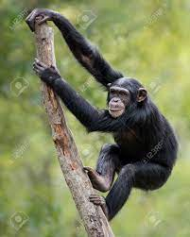
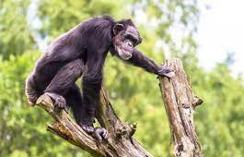
Our Evolutionary Past
Adapted to climb trees and walk on all fours, not adapted to ambulate as bipeds on two feet
Aiello L, Dean C, 1990. Holowka NB, Wallace IJ, Lieberman DE, 2018. Holowka NB, Lieberman DE, 2018.
Notes:
In our evolutionary past, our lower extremities were better adapted to climb and walk quadrupedally, rather than adapted to walk on two legs, as we do today. With our need to become bipedal, there were significant changes in our lower extremity structure, including our knee and hip joints.

Slide 4
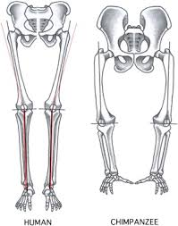
Evolutionary Changes
Occurred to improve our ability to walk on two legs, maintain center of mass within base of support, and absorb ground reaction forces
Aiello L, Dean C, 1990. Holowka NB, Wallace IJ, Lieberman DE, 2018. Holowka NB, Lieberman DE, 2018.
Notes:
Compared to our last common ancestor, our lower extremity structures were adapted to enable upright, bipedal gait, rather than walk quadrupedally and climb trees. The changes in morphology and function of these lower extremity joints occurred for the same reasons as the foot and ankle which we reviewed in the last lecture: The reason being, as natural selection favored bipedal gait, our lower extremities required the ability to absorb energy during ground contact through stance phase, maintain stability in single limb stance, and also, produce power for higher speeds.
Similar to the foot and ankle chapter, environmental changes favored chimps that had anatomical features that allowed them to stand upright and walk on two limbs because this form of locomotion allowed chimps to efficiently travel greater distances in search of calories to survive and reproduce.

Slide 5
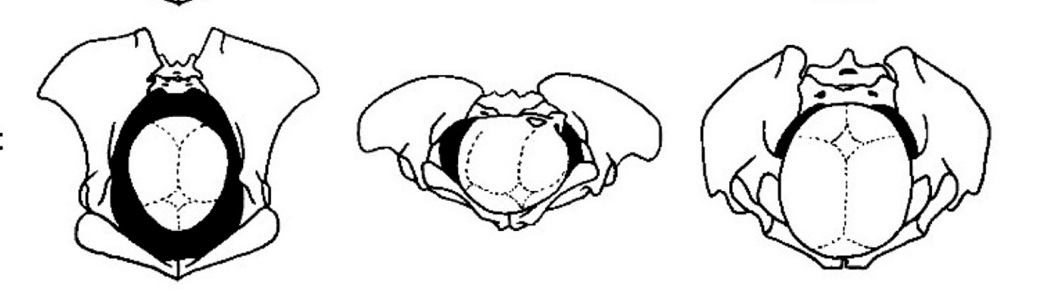
Evolutionary Changes
Homo
Larger birth canals and wider hips in homo sapiens to support increased brain size
Chimpanzee
Fay, J. C. (2013). Emergence of the cephalopelvic disproportion in humans as compared to chimpanzees. In Disease consequences of human adaptation
Hogervorst T, Bouma HW, de Vos J, 2009. Pavličev M, Romero R, Mitteroecker P, 2020.
Notes:
But wait, there is another special consideration as we talk about the hips and pelvis.
Pelvic adaptations had to support larger brains in humans, while also supporting efficient bipedal motion. This means, a larger birth canal, but not too large. Chimps’ birth canals had a large anterior to posterior dimension, but not a wide medial to lateral dimension. What do wider hips mean for our gait function? We will review that in just a moment.

Slide 6
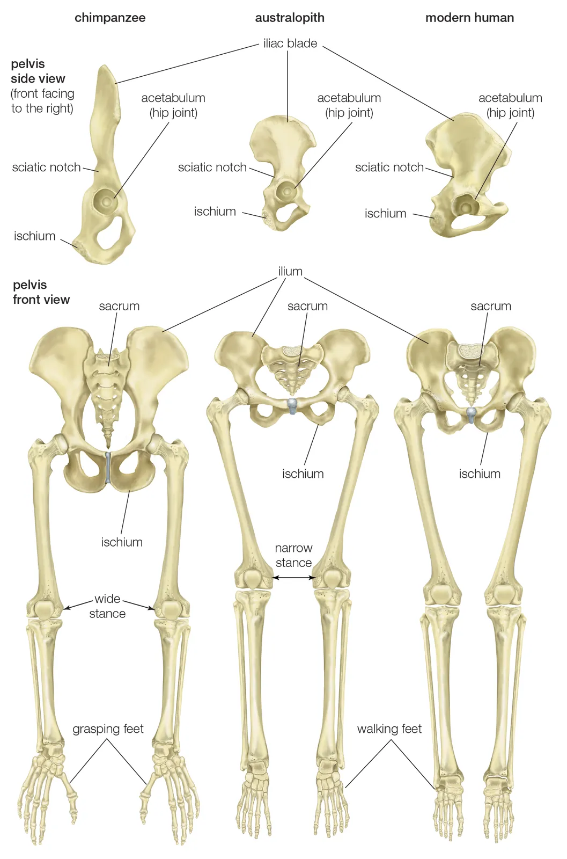
Evolutionary Past:
Knee and Patella
Femoral Obliquity angles are close to 0 degrees
Intercondylar grooves are not as deep in chimpanzees
Smaller Condyles
Patella is relatively flat
Miller CK, DeSilva JM, 2024.
Notes:
This slide highlights the most notable anatomical adaptations of our evolutionary past relating to the knee joint. If you look at the images here, to the left, we have the lower extremity skeleton of a chimp and to the right, is the lower extremity skeleton of the homo sapien. As you can see, one of the most obvious differences is the inward angulation of our femurs compared to our past structures. This is referred to as the femoral obliquity angle.
Additionally, although it is not as clear in this picture, the joint surfaces of the knee differ from our primate past, as they had to adapt to changes in biomechanical loading at the knee joint. In the upcoming slides you’ll learn about the driving causes as to why these adaptations occurred.

Slide 7
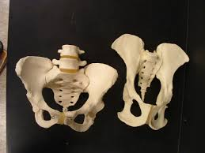
Evolutionary Past:
Hip and Pelvis
Apes' pelvis orientation functions to allow hip motion primarily in the sagittal plane
Gluteal muscles adapted to extend the femur not support frontal plane motion
Adult primate’s average body fat percentage <5%
Pond CM, Mattacks CA, 1987. Warrener AG, 2017.
Notes:
Now we are moving up the human chain and talking about the main adaptations of our evolutionary past as it relates to the pelvic and hip structures.
The pelvis and hip structures underwent profound morphological changes from our last common ancestor to homo sapiens. These dramatic changes occurred despite having nearly identical genomes. While a varied gene pool doesn’t explain these differences, pattern shifts in the regulation and expression of the genes do. Natural selection favored primates that were better adapted for efficient bipedal walking.
Our last common ancestor had a pelvis structure oriented primarily in the sagittal plane and their gluteal muscles supported movement in the sagittal plane by functioning to extend the hip joint, whereas human gluteal muscles have been better adapted to support sagittal in addition to frontal plane motion by functioning to abduct the femur and stabilize the pelvis.
Another important fact to consider before moving forward is the average body fat percentage in an adult primate compared to modern-day humans. Adult primates have an average body fat of <5%. A national health survey conducted in the early 2000’s found that Americans average 28-40% body fat percentage, when what’s considered healthy range for men and women is 9-18%, and 20-33%, respectively. That is a significant difference.
In the upcoming slides we are going to go one by one and more in depth into each item listed in these last two slides, comparing past structure with current structure, and the reasons behind the changes that occurred.

Slide 8
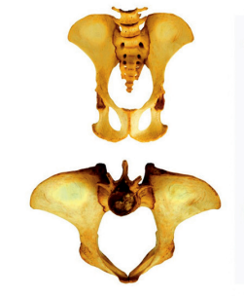
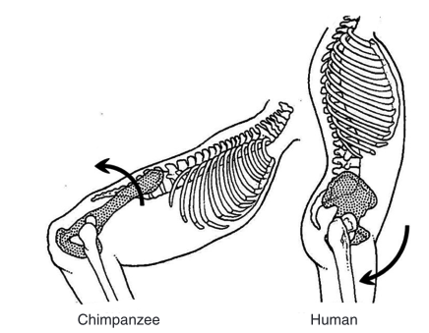
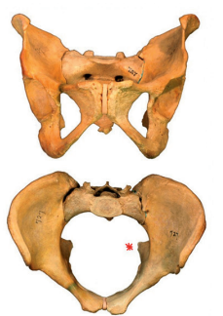
Evolutionary Changes
Chimpanzee
Homo
Hogervorst T, Bouma HW, de Vos J, 2009.
Notes:
The first notable change that we will review is the orientation of the pelvis. To the left we can see the chimpanzee pelvis and to the right is the homo pelvis.
As we briefly already mentioned, in our quadrupedal ancestors, the pelvis was positioned in a sagittal plane alignment, where as the homo sapien pelvis is oriented in a frontal oblique plane. This change repositioned the origin of the gluteus medius, minimus, and tensor fascia latae muscles, effectively switching their function to become hip abductors instead of hip extensors. Why is this important?

Slide 9
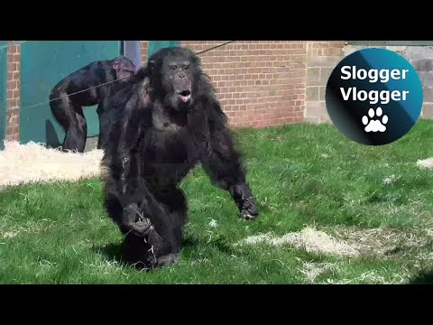
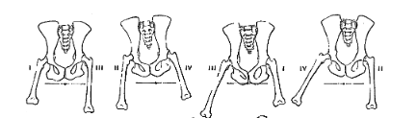
Evolutionary Changes
Chimps don’t have the hip musculature to offer frontal plane stability
This leads to excessive frontal plane motion
Thompson NE, O’Neill MC, Holowka NB, Demes B, 2018.
Notes:
Although we are considered “bipeds” we are really functional unipeds, remember, 70% of the walking gait cycle and 100% of the running gait cycle is in single limb stance!
Since we were functioning on a single pillar for the majority of locomotor behavior, having structures that aided in frontal plane stability were essential for our survival. Without frontal plane stability, we were prone to increased fall risk, patellar dislocation, excessive wear on the joint surfaces, and much more. At the time we began to transition to bipedalism 6-7 million years ago, these disadvantages could have been death sentences. Furthermore, without adapted features to control excessive frontal plane motion, the energy-expenditure of walking increases drastically.
Okay, now picture here a chimp walking upright. Notice the amount of side to side sway that occurs…This is also known as a Trendelenburg gait pattern. By avoiding side to side movement, we saved energy, decreased aberrant motion patterns, and reducing stress through the knee and hip joints.
Play video at “okay, now picture a chimp…”
Thompson et al., 2018 detail:
Thompson: Assessment of 3D motion in chimpanzees and humans to assess differences in step width, COM frontal plane motion, trunk kinematics and COM power during bipedal gait. Findings reflect chimpanzee step widths and mediolateral COM shifts are 3x that of humans (after scaling for size) as well as significantly higher thorax excursion over the stance phase leg (AKA "compensated Trendelenberg sign" in humans). The authors attribute smaller trunk/COM excursion in human SL stance as well as narrower step widths to valgus position of knees and ADDucted femur position in humans.

Slide 10
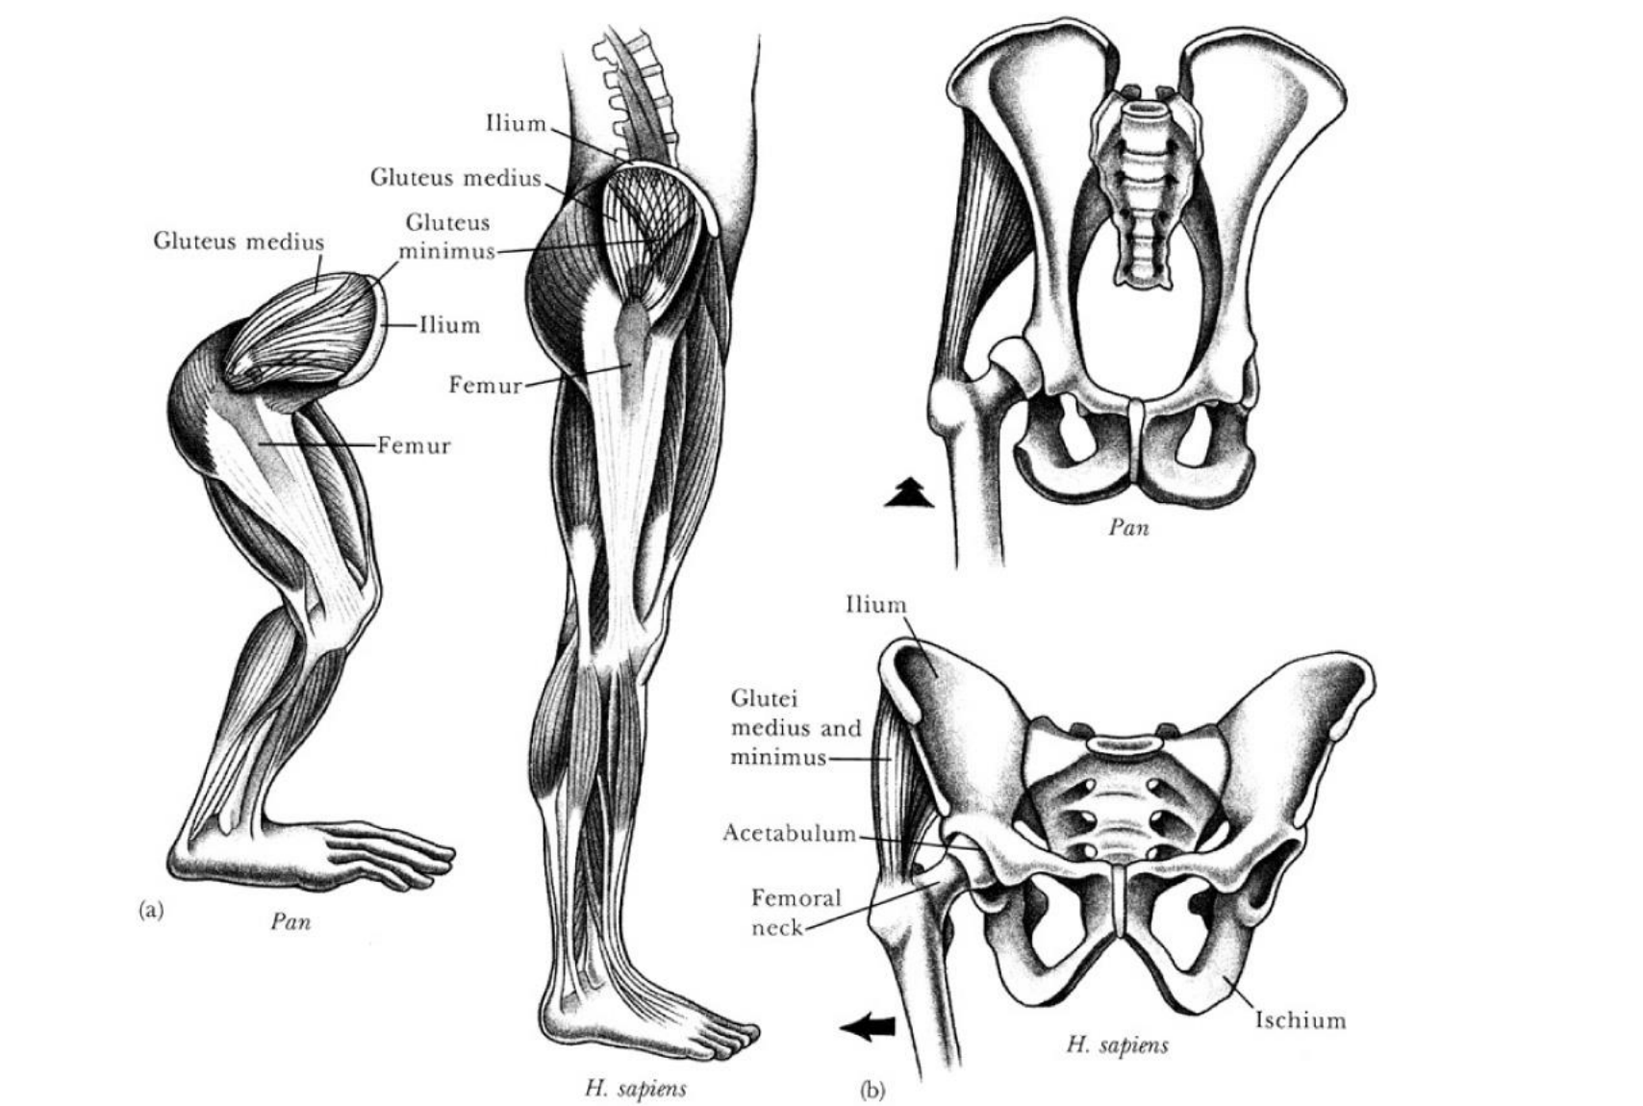
Evolutionary Changes
Notes:
This slide just builds off of our last points and offers some more visual representation on the change in function of the glute structure from our evolutionary past to present.
You can see here there is a both a lateral and frontal view of the pelvic regions for both chimpanzees and homo sapiens. Based off the line of pull of the glute muscles, in chimps, we can see that the glute medius and minimus are going to act as hip extensors. In humans, these muscles are critical for offering lateral stability during gait. Because the muscles are on the side of the body, with each step of gait, the lateral glutes contract to prevent the opposite pelvis from collapsing.

Slide 11
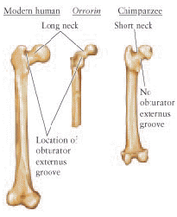
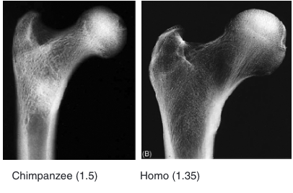
Evolutionary Changes
Longer neck of the femur to improve gluteal lever and assist with frontal plane stabilization
Richmond BG, Jungers WL, 2008. Rein TR, 2020.
Notes:
The ability to better control frontal plane movement was so essential in becoming effective bipedal creatures, we evolved to have numerous adaptations to support frontal plane stability.
Modern humans when compared to chimps, have a longer femoral neck at the proximal femur. This increased femoral neck, elongates the lever of the gluteus medius, so the muscle becomes more efficient when contracting to abduct the hip joint, or more functionally, stabilize the pelvis in single limb stance.
This was also in response to needing wider hips to support childbirth. Further medial to lateral widening between the hip joints, increases the external moment arm of one’s body weight, which requires increased hip abductor function to compensate. Increasing internal muscle effort, however, is not energy efficient. Therefore, increasing the internal moment arm through elongation of the femoral neck was an effective evolutionary adaptation.
Rein et al. 2020 detail:
Summary: FNL increases the moment arm for the glute med/min and improves its mechanical advantage which is important in bipedal gait. This study assessed femoral neck length (FNL) for 28 non-extinct primate species, with each species being assigned to a locomotor and phylogenetic category. Findings showed that bipeds were located farthest above the line of best fit for FNL and were characterized by the longest FNL when size was taken into account, followed by knuckle-walking African apes and orthograde clamberers (OC) (orangutans) with comparable size estimates. Values for arboreal quadrupeds that perform high proportions of leaping (AQL) fell mostly above the line of best fit, whereas those of arboreal quadrupeds that perform higher proportions of climbing (AQC) fell mostly below the line of best fit (shortest FNL). Authors find that mode of locomotion is correlated with FNL, with a positive relationship between bipedalism and FNL.
Extra nuance:
In the most recent literature review, we found research to support that in early hominin evolution, both the femoral neck length and pelvic obliquity angle increased, but have slightly decreased over time. Probably doesn't matter for our purposes. Research can sound contradictory to our claims is all, but it really isn't

Slide 12
Drawing: Elongation of femoral neck

Slide 13
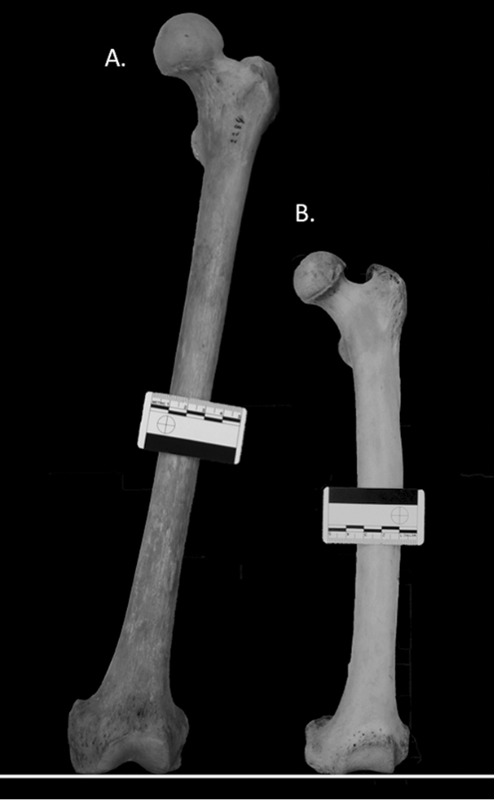
Evolutionary Changes
Past: Femoral Obliquity angles are close to 0 degrees.
  Femurs are straight
Present: Increased femoral adduction to place foot closer to midline
Aiello L, Dean C, 1990. Hogervorst T, Bouma HW, de Vos J, 2009. Hunt KD, Dunevant SE, Yohler RM, Carlson KJ, 2021.
Notes:
Continuing the discussion on the femur bone in particular, we can also appreciate it’s orientation in the frontal plane. In our evolutionary past, we didn’t have an obliquity angle, as in the femurs were straight or in some cases rounded outwards, rather than angled inwards. Why was that? Well, for starters, this orientation was better adapted for tree climbing and wrapping around branches. Additionally, when we think about how chimps walk versus homo sapiens, we can see that throughout the quadrupedal gait cycle, there is never a point where only one limb is in contact with the ground; rather, there are always two extremities supporting one’s body mass.
Hunt et al., 2021 detail:
Summary: analysis of femoral shaft obliquity in modern humans, forest chimpanzees and dry-habitat chimpanzees as well as austraplith records. Found Austroplists>humans>dry>forest chimps. Dry-habitat chimps who are more bipedal/forage from shorter bush plants were found to have greater obliquity angles than forest chimps.
TL;DR – Chimps that spend more time foraging on the ground (vs in trees), had to get their COM within their BOS more

Slide 14
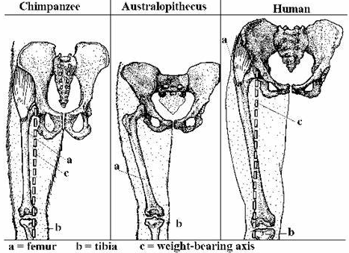
Femoral Obliquity angles
Tina Clements. (n.d.). Femurs are more inwards than outward as humans evolved [Pinterest pin]. Pinterest
Notes:
Physics tells us that in order to maintain our balance, our center of mass must remain within our base of support. Okay, so knowing this, picture standing on one leg while maintaining a level pelvis and without dramatically leaning our trunk over to the stance leg. Would it be easier if our femurs were directly beneath the hip joint OR angled slightly inwards so our foot could fall closer to midline? From an energy conserving standpoint, the latter option would be preferred. This is because, fewer compensatory frontal plane aberrant motions will occur when we strike closer to midline thus allowing us to save energy. And as we know, those who could get around more efficiently, could travel greater distance in response to climate change and food shortages which ultimately promoted survival and reproduction.
While this change in structure offered advantages, when we get to the evolutionary mismatch chapter, you will see how these adaptations may result in a biomechanical disadvantage in the lower extremity, potentially increasing risk of injury.

Slide 15
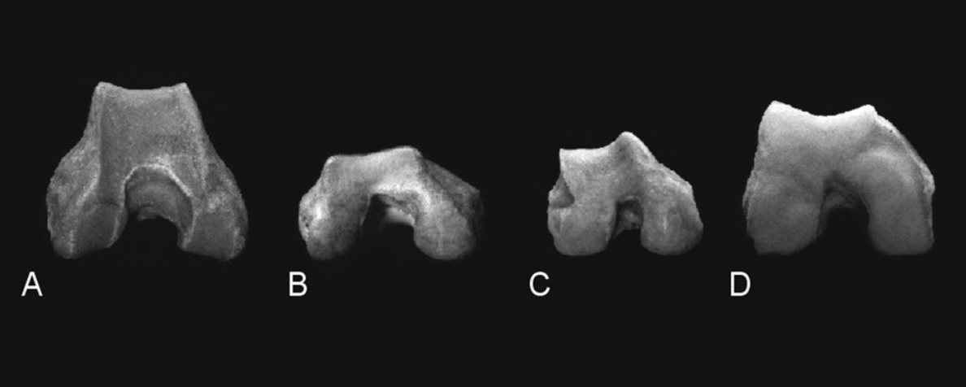
Evolutionary Changes
Past: Intercondylar grooves are shallow
  Why? Think about patella and obliquity angles
Present: Deeper intercondylar grooves and larger, more anteriorly projecting condyles
Aiello L, Dean C, 1990. Tallman M, 2016. Miller CK, DeSilva JM, 2024.
Notes:
As mentioned, the obliquity angle of the femur offered great advantages for gait efficiency by placing the base of support beneath the center of mass. This angle along with increasing the femoral neck length, is a balance of improving our efficiency and mechanical advantage of the gluteus medius, without increasing risk of injuries such as patellar dislocation which would have been life threatening to our ancestors. In fact, the australopithecus species had stretched the possibility of this equation with a wider pelvis, longer femoral necks, and greater obliquity angles relative to any other hominid or primate. The extent of these adaptations were toned down in homo sapiens likely due to the disadvantages associated with them in other hominids.
An obliquity angle too great results in an excessive adduction angle of the femur and therefore, increased dynamic knee valgus. This position of the knee makes the patella vulnerable to lateral dislocation during knee flexion activities. What needed to happen in order to combat this?
Compared to our evolutionary past, we have deeper intercondylar grooves allowing the patella to sit more securely within the groove. The asymmetrical nature of the groove also helps to prevent lateral dislocation as the lateral edge of the groove is elevated.

Slide 16
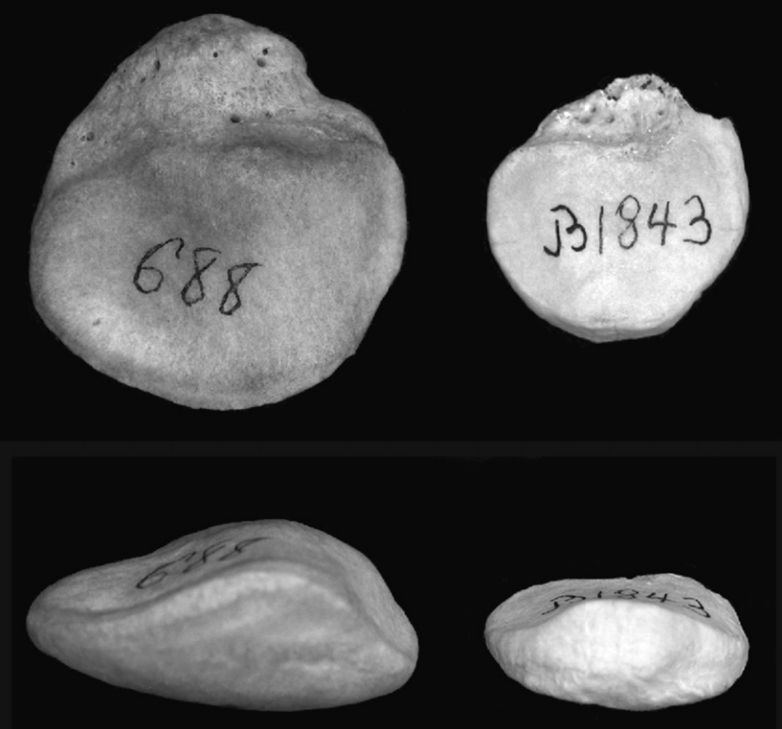
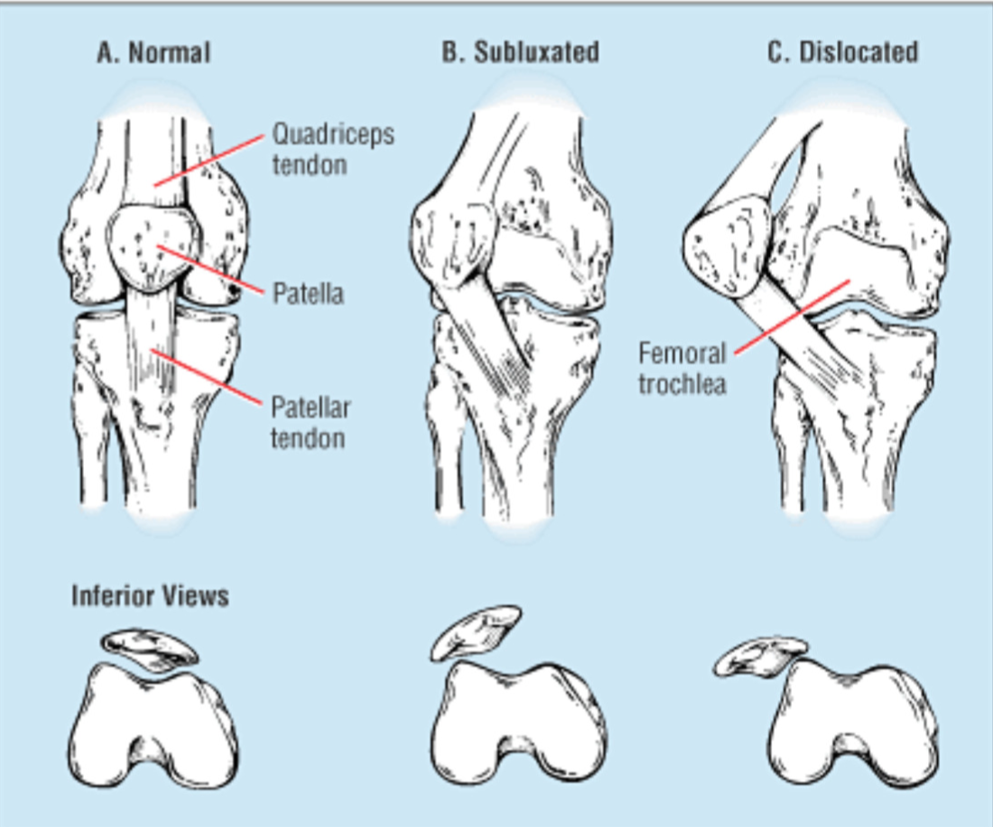
Our Evolutionary Past
Past: Patella is relatively flat
  Why? Stability in groove?
Present: Patella is more triangularly shaped
Aiello L, Dean C, 1990. Miller CK, DeSilva JM, 2024.
Notes:
The shape of the patella bone also improves its stability within the patellar groove. When we compare past and present kneecaps, present day structure has a more triangularly shaped patella. This change in shape is really to reduce the likelihood of dislocation or subluxation.
The kneecap labeled 688 is one of a modern human and the kneecap labeled B1843 is one of a chimpanzee. You can see in the human patella, there is midline elevation of the inferior surface, which allows it to better conform to the patellar groove of the femur and aids in preventing patellar dislocation during flexion.
Again, we can relate changes in the knee to frontal plane stability. Due to the increased obliquity angle of the femur and the frontal plane forces that the knee is subjected to, the patella would be extremely vulnerable to dislocation without increased joint congruency and the change in patella shape to allow for it to sit more firmly within the groove.
Overall, these adaptations may have helped with gait efficiency and limited what would be considered life-threatening knee injuries in our hunter and gatherer days. For example, without modern medicine, a patella dislocation would be a death sentence. Despite these structural adaptations, we are still very prone to injury due to challenges with controlling the alignment of our knees in single limb stance. This concept helps explain why certain orthopedic injuries such as patellofemoral pain syndrome and ACL tears are all too common.

Slide 17
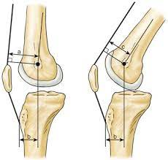
Evolutionary Changes
Past: Smaller femoral condyles
  Why? Think weight bearing
Present: Larger femoral condyles
Aiello L, Dean C, 1990. Miller CK, DeSilva JM, 2024.
Notes:
The last big structural difference that we will discuss in the knee is the increased size of the femoral condyles at the distal femur. As bipeds, we needed this greater bony structure. This change offers a couple different advantages.
The larger condyles in homo sapiens increases the articular surface of the distal femur and tibia. Being able to distribute force across a greater surface area reduces the stress on the joint during heel-strike and toe-off during walking or portions of the gait cycle when the knee is fully extended.
Additionally, because the condyles are projected further anteriorly, there is a greater mechanical advantage for knee extension. This is due to the fact that it displaces the patella further anteriorly, and results in an increased moment arm about the knee joint because the quad tendon is slightly further away from the joint axis of rotation. One benefit of this increased lever arm is it improves our gait efficiency, and as we know, energy saving mechanisms were essential for our survival.
Furthermore, the position of the patella allows this moment arm to remain constant through all ranges of knee flexion. This means, we can successfully recruit our quadricep muscles regardless of the degree of knee flexion.
Nick Added: In summary, a lot of the evolutionary changes we see are to aid in energy efficiency: longer femoral neck to increase the mechanical advantage of the hip abductors, larger femoral condyles to increase the mechanical advantage of the knee extensors, increased femoral obliquity angle placing our COM further within our base of support so we expend less energy maintaining stability on one leg, etc.

Slide 18
Functional Anatomy Review
Notes:
This next chapter is the functional anatomy review of key structures in the lower extremity and pelvis. We are only going to touch briefly on a few of these structures as it relates best to the evolutionary mismatches to the knee, hip, and pelvic regions.

Slide 19
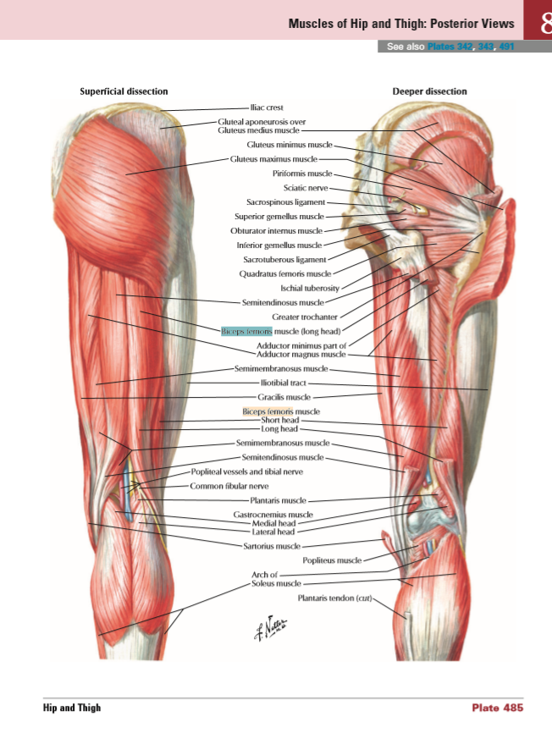
Function of the hamstrings in a closed chain
© 2005–2019 Elsevier. All Rights Reserved www.netterimages.com Netter, Atlas of Human Anatomy, 7e
Notes:
Two main muscle groups that cross the knee joint are the quadriceps and hamstrings. These two muscle groups often work synergistically to control compound movements.
The hamstrings consist of three muscles: the semitendinosus, semimembranosus and biceps femoris short and long head. These muscles are strong and make up the bulk of the muscle mass on the posterior thigh.
In an open chain, the hamstrings flex the knee. In a closed chain, the hamstrings provide a stabilizing force to the knee to allow for controlled knee extension by the quadriceps, this is known as co-contraction (muscles on all sides of a joint contracting to promote stability). During stance phase, the hamstrings contract concentrically to extend the hip joint for improved force production. The action of the hamstring muscles significantly contribute to our ability to run, jump, and move at higher speeds.

Slide 20
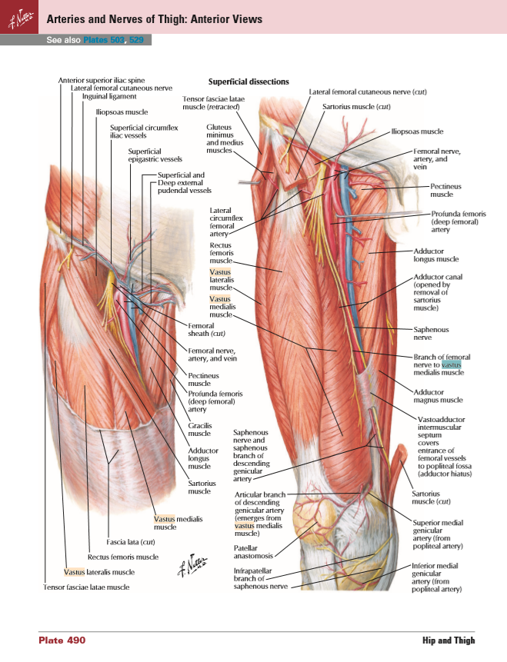
Function of the quadriceps in a closed chain
© 2005–2019 Elsevier. All Rights Reserved www.netterimages.com Netter, Atlas of Human Anatomy, 7e
Notes:
The quadriceps consist of 4 individual muscles: rectus femoris, vastus lateralis, vastus medialis, and vastus intermedius. These muscles are also some of the strongest in the body and originate proximal to the knee joint and insert on the patella via the quad tendon. The tendon encapsulates the patella contributing greatly to kneecap stability.
In an open chain, these muscles function to extend or straighten the knee joint. In a closed chain, these muscles primarily function eccentrically to help lower the body and bend the knees in a controlled fashion such as when you descend stairs or go from stand to sit. These large muscles also contribute significantly to help stand, walk, run, jump, etc. as they work to absorb shock upon landing impact.

Slide 21
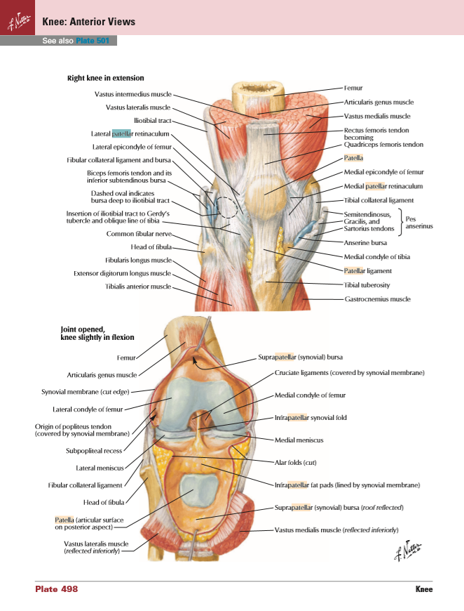
Anatomy Review: The role of the patella
© 2005–2019 Elsevier. All Rights Reserved www.netterimages.com Netter, Atlas of Human Anatomy, 7e
Notes:
I know we briefly reviewed the significance of the patella in the evolutionary changes chapter but the function is important to reiterate.
The patella increases the mechanical advantage of the quads via increasing the internal moment arm (moving th attachment site further from the joint axis) and allowing the quads to act as effective knee extensors through the entire ROM of the knee. If the patella wasn’t there, the quas would act as a knee flexor at a certain point. We will draw out on the next slide.
This means, we have a mechanism and structure that allows the knees to track beyond the toes, and in fact, it was designed specifically for closed chain lower extremity function and supporting greater degrees of knee flexion for functional movement.

Slide 22
Draw: Patella Mechanical Advantage

Slide 23
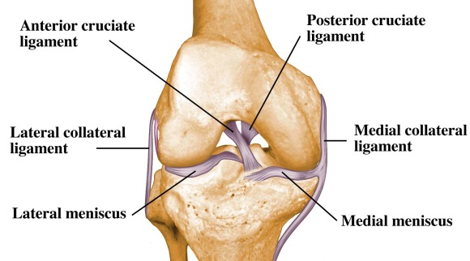
Anatomy Review: The role of the ACL
© 2005–2019 Elsevier. All Rights Reserved
Notes:
Within the knee joint, we have many ligamentous and cartilaginous passive structures that help to stabilize the knee. Of those structures includes the anterior cruciate ligament which runs posteriorly to anteriorly and lateral to medial within the knee joint.
When asked about the role of the ACL, the common answer is, it functions to prevent anterior translation of the tibia on the femur. However, we emphasize its role in both the frontal and transverse planes during single limb stance as it serves in limiting dynamic knee valgus by offering joint stability.
We may have ligaments, menisci, and a joint capsule to offer support at the knee joint, but are there any significant intrinsic muscles that help to prevent frontal plane motion at the knee? No, there are not. Due to the lack of intrinsic muscle support at the knee, the stability of the joints above and below is crucial to maintain frontal plane stability at the knee. We need stability at both the foot and the hip in order to protect against excessive dynamic knee valgus and forces that can result in aberrant knee motions.

Slide 24
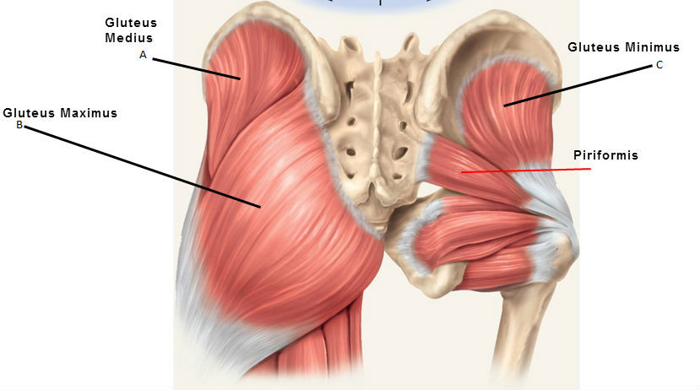
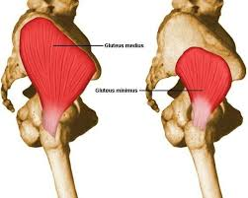

Anatomy Review: Function of the gluteus medius in a closed chain
Notes:
Speaking of stability at the hip, here is perhaps one of the most functionally important muscles in the human structure - the gluteus medius.
In an open chain, the gluteus medius abducts and internally rotates the hip. In a closed chain, it functions against ground reaction forces to either elevate or stabilize the contralateral pelvis.
Our transition from quadrupeds to bipeds required some of the gluteal muscles to alter in function from the sagittal to frontal plane. The gluteus medius is arguably the most important muscles in the lower extremity as it relates to frontal plane stability.
While this muscle can be found in the lateral aspect of the hip, its function serves great importance both up and down the chain. Specifically for the knee, because the knee has no significant active intrinsic stabilizers, as we just mentioned, the joint relies heavily on muscles in the foot and hip for stability. Without proper activation of the gluteus medius in a closed chain, the position of the knee will likely fall into excessive knee valgus. This is a vulnerable position to the knee and increases risk of ACL tears, meniscus injury, joint damage, dislocations, and more. And as forces increase in motions such as sprinting, jumping, landing, and cutting, the gluteus medius becomes more and more important in preventing knee injuries.

Slide 25
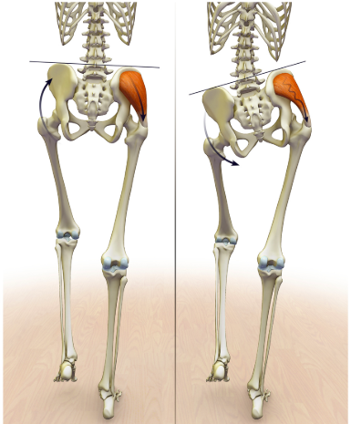
Gluteus medius in a closed chain
Gluteus medius: can you see what it actually does in closed chain function.
  How do we traditionally exercise this muscle?
Notes:
So if the primary function of the gluteus medius is to aid in frontal plane pelvis stability in a closed chain, the best way to train this muscle should be specific to that functional movement. Unfortunately, too commonly do we see open chain clam exercises or isolated strengthening in a gravity-eliminated state. We must instead focus on single limb, closed chain exercises, that limit frontal plane compensatory movements.

Slide 26
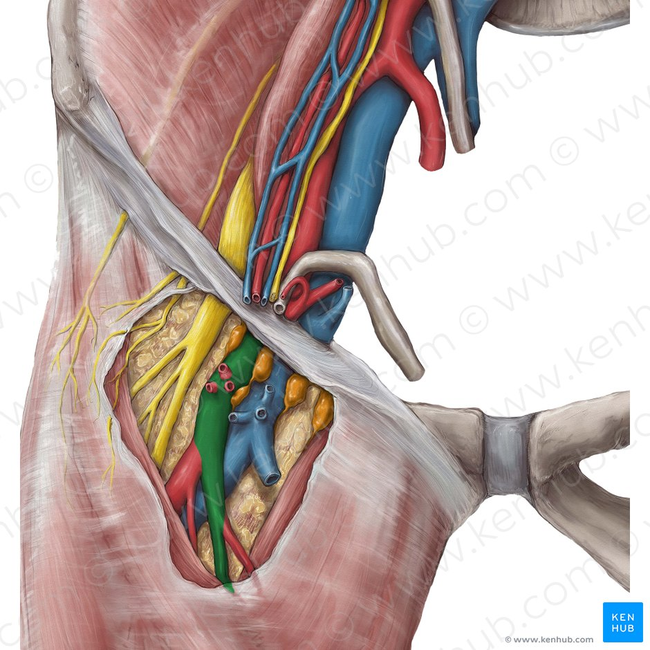
Ilioinguinal Ligament
Protects vital tissue
Attachment point for abdominal oblique muscles
The “butt wink” another factor in a narrow base of support squat with the hip hinge.
  Put your spine at risk
Hannah Bryce Ely, CMI. (2014, March 18). KenHub Anatomy Illustrations
Notes:
We don’t talk about this anatomical structure as much, but the ilioinguinal ligament is something we need to have a strong understanding of before we move forward.
This ligaments crosses from the ASIS of the ilium to the pubic tubercle. If you recall, this ligament serves to protects 3 very important structures: the femoral artery, nerve, and vein. It also serves as the attachment point for the abdominal oblique musculature.
The ilioinguinal ligament is thick and robust for a good reason, but the size and location has an impact on function. When squatting in deeper flexion ranges of motion and a narrowed base of support, the ilioinguinal ligament prevents crimping of the femoral structures by causing the butt wink. The butt wink is a common phrase used in the strength and condition world that essentially describes a posterior pelvic tilt in deeper squat ranges. But what does this pelvic movement cause at the lumbar spine? No matter how hard you try, it will lead to lumbar flexion at a certain depth of your squat. As we review the evolutionary anatomy of the spine, you will see why this is a position we don’t want to encourage, especially under high levels of load such as when performing a barbell squat.
Updated version of this slide that builds off the above notes:
When hip flexion is exhausted in a narrow BOS squat, further ROM requires a posteiror pelic tilt and resultant lumbar flexion. This is due to our anatomy limiting anterior hip ROM (the ilioinguinal ligament getting in the way) and the need to maintain our COM within our BOS (balance)
We theorize that the butt wink is due to the ilioinguinal ligament buttress; however, the current evidence will not show this. Really, there isn’t any evidence to explain the cause of the butt wink. Anatomically and biomechechanically it makes a lot of sense.
Be warned, if you look this up online, all you will find is that butt wink is due to mobility restrictions and it is mostly non-sense. Even with perfect mobility, you still butt wink and put your lumbar spine at risk when loaded in this position.

Slide 27
The Evolutionary Mismatch
Notes:
After reviewing the changes that occurred at the knee, hip, and pelvis structures, primarily to support bipedal motion, enhance gait efficiency, and support larger brained offspring, this next chapter focuses on the evolutionary mismatch as it pertains to the knee and proximal lower extremity.
Remember, evolution does not seek perfection but rather the survival of our species. That being said, some of the changes we have reviewed have put us at a biomechanical disadvantage to control frontal and transverse plane forces which can then lead to orthopedic injury at the knee, hip, and low back.

Slide 28
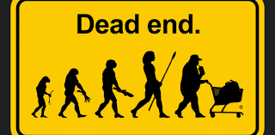
The Mismatch: BMI Increase
BMI increased with greater knowledge and the subsequent slowdown in biological evolution.
Hunters and gatherers until 12,000 years ago → Agricultural Revolution.
Evolved to store calories for millions of years. Now we suffer from excess.
Zihlman AL, Bolter DR, 2015. Lieberman DE, Kistner TM, Richard D, Lee IM, Baggish AL, 2021.
Notes:
An increased BMI is the first and one of the most impactful mismatches in modern-day society.
Our structures evolved over millions of years to support smaller body mass indices, and within the last 20,000-80,000 years, our size and weight has increased significantly.
While large brains were advantageous for our species survival, advanced thinking brought about cultural evolution such as the emergence of agriculture. For millions of years, as hunters and gatherers, we had to travel great distances in search for calories which were difficult to come by. Therefore, we evolved to store these calories as fat, increasing our chance of survival when calories were inevitably scarce again. We were hunter and gathers until about 12,000 years ago.
In recent history, with farming and the agricultural revolution, for westernized cultures, calories are no longer hard to come by. As a society, we are heavier than we’ve ever been.
The list of associated health consequences to obesity could fill up an entire course in itself, but for the sake of this presentation, we’ll talk about some structural implications.
We are now trying to stabilize this larger and heavier body mass with muscle structures that are designed to support a smaller individual. This does not mean that our muscles are incapable of supporting frontal plane motion, but it does mean we need specific training to address these weaknesses and consider the impact and added stress of a heavier structure.

Slide 29

The Mismatch: Sedentary Lifestyle
Now sedentary with inactive lifestyle.
Cultural evolution strikes again with machines.
  Need more muscle structure and improved biomechanics to cope with increased body mass index.
Zihlman AL, Bolter DR, 2015. Lieberman DE, Kistner TM, Richard D, Lee IM, Baggish AL, 2021.
Notes:
So, over the past few thousand years, our BMI have increased drastically. But has our structure had the time to adapt to these new forces? Probably not as biological evolution can’t keep pace with cultural evolution and despite these mismatches, they are not shortening the lifespan in a way that would prevent passing on these genes to the offspring.
To add to this unbalanced equation, increased sedentary and inactive lifestyle in Western cultures has further exacerbated this mismatch. Not only are we dealing with larger and heavier structures, but our lifestyle leads to weakness of stabilizing musculature due to disuse and unspecified training regimens.
Both increased BMIs and increased sedentary lifestyle have further challenged our already biomechanically disadvantaged structure and our stabilizing structures have to work even harder against external forces.
When we aren’t able to stabilize these greater forces, especially in the frontal plane, we are more at risk for injuries such as ACL tears, meniscal injury, osteoarthritis, gluteal tendinitis, femoral acetabular impingement syndrome, labral tears, and so much more.
Nick Note – Research to support lack of frontal plane stability and ACL injuries, but not research to support the other injuries. Clinically and biomechnically, we know this to be true, but you won’t see it in the research.

Slide 30
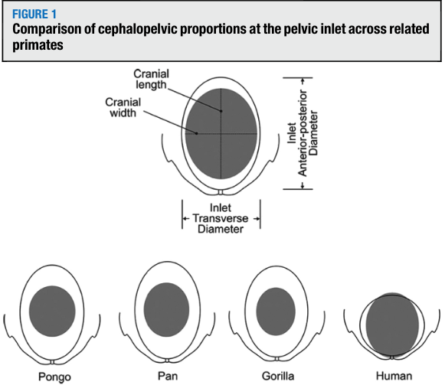
The Mismatch: The Obstetrical Dilemma
Big Brains affect the design of the pelvis
  Humans have a very long dependent period out of the womb. Why?
  Frontal plane adaptation found a balance
Pavličev M, Romero R, Mitteroecker P, 2020.
Notes:
Advanced brains did not just bring about cultural change, but it also led to a mismatch in the pelvis.
It is well accepted that the reason women tend to have wider hips than men is for the purpose of childbirth, but let’s dive deeper.
Many animals can function fairly well, at least walk, within hours or weeks of leaving the womb, but human babies take from 9-18 months to take their first steps. Human babies are pretty much useless at survival for the first few years of life. Doesn’t it seem like it would be advantageous for humans to also give birth when the baby was developed enough to walk or even developed enough to walk within the first 3 months? After all, supporting one’s individual life was hard enough back then, nevermind having to also support additional life of their offspring for several years.
So then why do we have such a long dependent period? It relates to brain development as it takes significantly longer for the human brain to develop compared to most animals because we have larger, more advanced brains. A baby’s head is ¼ - ⅓ the size of its body. Women need hips that are wide enough for the baby’s head, but not too wide where they are at a biomechanical disadvantage for bipedal gait.
In this graphic, you can see the comparison of closely related primates. As you can see, humans show a very close fit between the pelvic inlet and the fetal cranium (showed in gray) compared to other primate species. This picture depicts the fact that the human birth canal is literally as small as it could possibly be to support childbirth.
How does all of this affect hip width? It is a delicate equation to think about. It is a balancing act between having a pelvis wide enough to provide higher birth survival rates of these larger brained humans, without having a pelvis so wide that the mother is less likely to survive. The middle ground was found through natural selection.

Slide 31
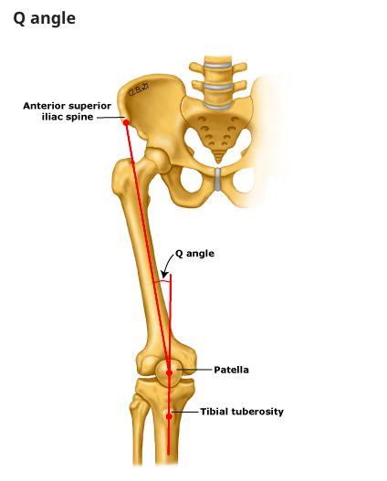
The Mismatch: Q-angle
The Q-angle
  Why do females have a larger Q-angle on average?
As hip width increases, so does energy expenditure with gait
Gordon Bettis J, Young K, Wise J, et al., 2022. Grunstra NDS, Betti L, Fischer B, et al., 2023.
Notes:
While wider hips could have led to an increased birth canal, easier childbirths, and perhaps a decreased dependency period of infants, there is a reason the hips did not continue to extend wider.
The Q-angle describes the frontal plane position of the knee and is defined as the angle formed between the quadriceps and patella tendon as it related to the muscle structures. As it related to bony landmarks, it is an angle formed when a line is drawn from the center of the patella to the ASIS, and then from the center of the patella to the tibial tubercle. Normal Q angles for men is 13 degrees and for women 18 degrees when standing.
Wider hips, result in greater Q-angles, and greater Q-angles require increased intrinsic stability to support the knee joint. There is a great reliance on knee joint congruency and ligaments to stabilize the joint, but if you recall since the knee does not have intrinsic musculature of its own, the strength of the hip and foot contribute significantly to knee position and stability.
Okay, now think about obliquity angle and frontal plane forces in the gait of someone who has a wide enough pelvis to 1. Either give birth with ease, or 2. give birth to an infant when they are slightly more independent. Wider hips increases the external moment arm of one’s body weight in single leg stance, meaning our intrinsic stabilizing mechanisms are challenged and are more likely to fail. When these mechanisms fail, we are at a much higher risk of severe knee injuries. Furthermore, women would also be less energy efficient with gait, decreasing their ability to travel as far in search for food to supply energy not only for themselves, but also for the fetus. Their gait pattern, might resemble what a chimpanzee looks like when walking upright due to the chimps’ lack of hip abductors to stabilize the frontal plane.
Think about homo sapiens being functional unipeds and needing stability on one leg
Grunstra et al., 2023:
"There is strong empirical evidence off functional tradeoffs and antagonistic selection in the human pelvis," I.e. "an increase of energy expenditure with pelvic width" (as pelvic width increases, the energy cost of gait increases, specifically looking at the hip abductor muscles.
Also a good explanation of the human "obstetrical dilemma" = human parturition mortality is higher than other primates, in part due to the tight pelvic-cephalic inlet that is a balance b/w successful child birth and energy cost of bipedal locomotion

Slide 32
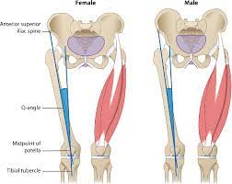
The Mismatch: Knee Vulnerability
The knee relies on joint congruence and passive intrinsic structures (ligaments and joint capsule) for stability.
Active stability at the knee relies on foot/hip musculature
The result: increased risk of ACL tears, especially in females. Why?
Meniscus injury?
Pappas, E. R. (2018, October). Do female athletes get ACL injuries because of their anatomy? Relentless Athletics.
Parsons JL, Coen SE, Bekker S, 2021
Notes:
While evolution successfully found a balance between enabling a birth canal jusssttt big enough to birth a bigger brained baby and also just narrow enough to allow for efficient bipedal walking, the resulting Q-angle to support functional unilateral motion creates a biomechanical challenge.
We can see this specifically in the rates of ACL tears in female versus male athletes. Females are 3 to 6 times more likely to rupture or injury their ACLs compared to their male counterparts of the same age. Why is that?
Well, recalling the ACL anatomy and orientation, (back to front, outside to inside) those who can’t adequate control the frontal and transverse movement of the knee in single leg stance and at higher speeds, are more at risk. Biomechanically, the increased external moment arm of the body weight associate with wider hips, requires even stronger intrinsic muscular support to prevent knee injury.
Meniscus Injury Clarification:
Research is conflicting on whether males or females have higher menisuc injury rates. It depends on what sport you looks at (higher rates in female basketball players). Most findings point to meniscus tears being more common in men due to their involvement in more aggressive high impact sports (rugby, football); however, biomechanical challenges are more common in females due to increased Q angles evidenced by increased non-contact ACL tears. These injuries often go hand in hand.

Slide 33
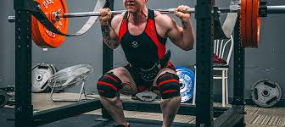
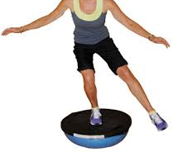
The Mismatch: Nonfunctional Training
Modern day resistance/functional training
  LE strength and hypertrophy in bilateral stance - not functional
  Excessive spinal load to strengthen legs - spinal structure not designed to be a prime lifter
  Training stability on unstable surfaces
  Training with excessively cushioned shoes
Culturally, do we promote strengthening the single leg stance stability mechanisms above and below the knee joint?
Cawley, S. (2025, May 14). Front Squat vs Back Squat: Differences, benefits & muscles worked. SOLE Fitness.
Ergotec Health. (2017, March 3). The FIFA 11+ Program Part 1. Ergotec Health
Behm DG, Muehlbauer T, Kibele A, Granacher U, 2015.
Notes:
I’m now going to discuss a cultural mismatch relating to how we resistance train. This point is a culmination of all the previous slides as it considers how we train and exercise our bodies relating it back to both how we function today, and how our bodies were designed to function.
Strength training is well recognized as one of the most important contributors to modern-day health. For orthopedic injury prevention in particular, functional training is something you might be familiar with, as in training in a way that best mimics everyday use of your body.
We often see heavy back squatting as a primary form of targeting strength and hypertrophy of the LEs. Some questions to think about - While yes, that will make your legs stronger, but is there a safer and more functional way to train? Can we hit the same fitness and performance goals without overloading our spines? If you are squatting heavy enough where you require a weight belt to offer external core stability, is this truly a load your body can handle? Functionally, do we need to produce maximum force off of two legs? Or would it be better to have the motor ability, strength, and stability to produce maximal force off of one leg?
Shifting gears a little…What do we commonly see when people are training stability? Oftentimes, they are standing on an unstable surface or with shoes on. Studies indicate a force and power output of less than 30% of what is possible on a stable surface. Why is that? When the foot can’t purchase the ground and stabilize, we can’t maintain as effective of a contraction in the muscles of our lower leg.
Finally, we are doing single leg exercises, are we eliminating all forms of compensation and truly assessing the quality of motion? And are we doing single leg exercises on truly only one pillar? As in, reducing hand hold assistance, and eliminating ground contact of the non-working limb?
You all have heard the phrase you are only as strong as your weakest link! When it comes to strength training we need more specific training to target our weakest link, which is more common than not, the frontal and transverse plane stabilizers in the hip and foot in single limb stance.

Slide 34
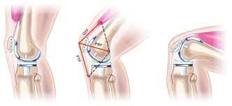
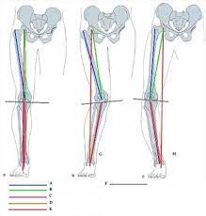
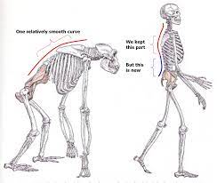
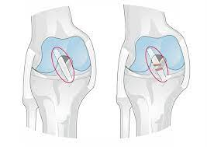
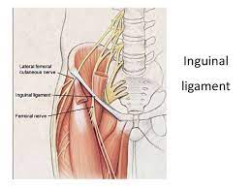
Quick Recap
Notes:
At this point, we have learned that we have a structure that allows us to maintain our quadricep mechanical advantage in greater degrees of knee flexion; we have learned that we are functionally challenged in the frontal plane when in single limb stance due to a number of factors; we learned that some of the knee ligamentous structures are perhaps more important in their role in the frontal and transverse planes rather than the sagittal plane; and finally we learned that we have a robust ligament at the front of our hip that forces us into spinal flexion when it abuts the femur in deep hip flexion. And although we haven’t hit this point in the lecture series yet, you will soon learn about the anatomy of the spine and the forces it was designed to undergo and support, along with why some positions make it vulnerable to injury.

Slide 35
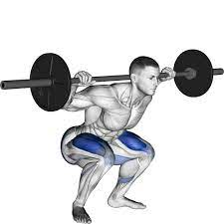
The Mismatch: Hip hinge w/ load
The fallacy of the hip hinge / incidence of low back pain
  Current culture teaches us to squat with the use of a hip hinge.
    Why do we have a patella?
    So we do not use the knee in the way it was designed to be used, but in turn as you will learn later, we often use the spine in a way it is not designed to be used.
Judgeme Team. (2023, October 28). Maximize your squatting potential: Discover the benefits of men's squat shoes. Castiron Lift
Notes:
So knowing what you know now, we are going to review the next cultural evolutionary mismatch which is a the fallacy of the hip hinge.
In modern-day culture, it is common to teach the hip hinge mechanism when squatting. With more experienced gym goers, they will add load to this position. For those of you that don’t know what a hip hinge is, it is a position that requires the hips to move backwards to target the posterior chain musculature and in order to maintain center of mass within the base of support, the trunk must lean forward. This position requires less anterior knee translation, as in, it is typical for the knees to remain behind the toes or in line with the toes.
While the squat is an extremely valuable exercise to learn, is hip hinging really the best way to approach this movement? Think about the structures we just reviewed. When we squat with a hip hinge, we are not training the knees as functionally, as they are truly designed to move past the toes. In lower ranges, the ilioinguinal ligament also forces spinal flexion at lumbar segments which are the most at risk for injury.
As strength and conditioning became more mainstream in the 70-80s, it is hypothesized that reducing the anterior stress on the knee was to protect the ACL and knee joint, and therefore, keeping the weight back through your heels and hip hinging is the best way to squat. However, this form inappropriately transfers force to the spine. The spine is one of the most vulnerable structures and the muscles of the core were never designed to be prime lifters. Our lower extremity quads, hamstrings, and glutes however, were designed to be prime lifters.
I want to reiterate that we recognize squatting is an important part of strength training, but when targeting lower extremity strength, we must consider how can we best protect vulnerable structures in addition to emphasizing the musculature that will prevent injury. As we go through lab content and exercise demonstrations for the lower extremity, you will learn safer ways to hit your strength training goals. Additionally, the next lecture on the spine will go more in depth on how to best protect our backs from injury.

Slide 36
The Evidence
Notes:
In this chapter we are going to review research studies that support the evolutionary mismatches of the knee, hip, and pelvis. Keep in mind, there is a lot more literature that could be included, but for the sake of today’s lecture, we will just highlight a handful!

Slide 37
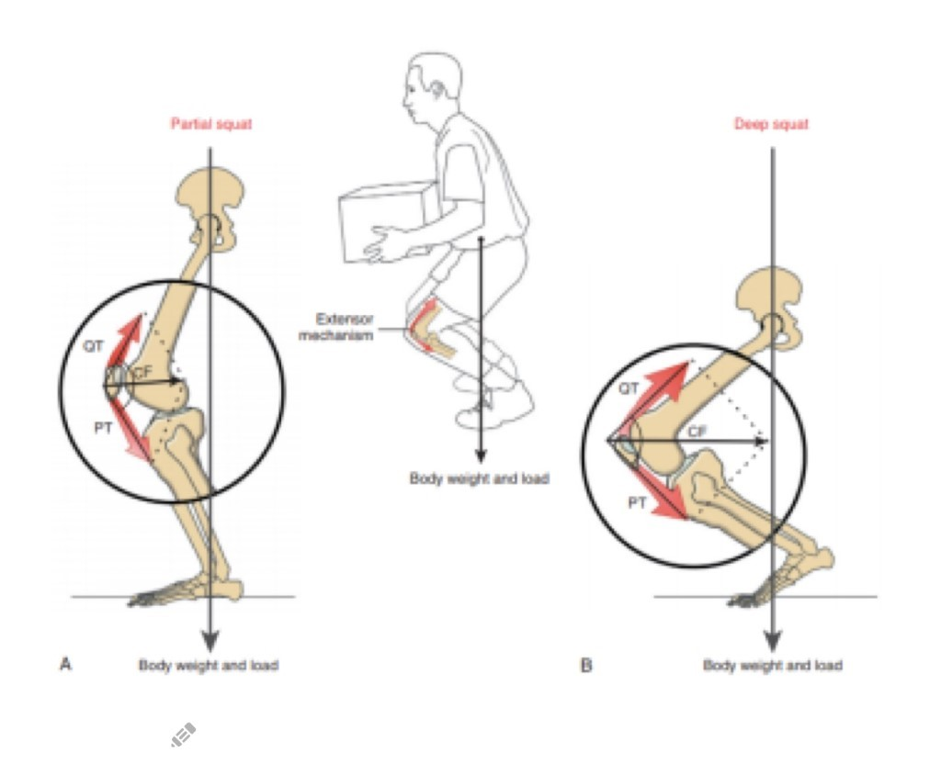
Overview of the Evidence:
Knee Evolutionary Mismatch
Part I – Considerations in the Sagittal Plane and The Role of the Patella
Part II – Considerations in the Frontal Plane and Dynamic Knee Valgus
Notes:
And the final direct effect of modern shoewear is increased rates of hallux valgus.

Slide 38
The Evidence
Part I – Considerations in the Sagittal Plane &
The Role of the Patella
Notes:
Chapter 5, The Evidence: Indirect Effects Part I
In the last chapter we discussed the direct effect of shoe wearing and provided research to back up our claims. But how do those effects impact our function and injury risk? That’s what we will discuss in the next few chapters.

Slide 39
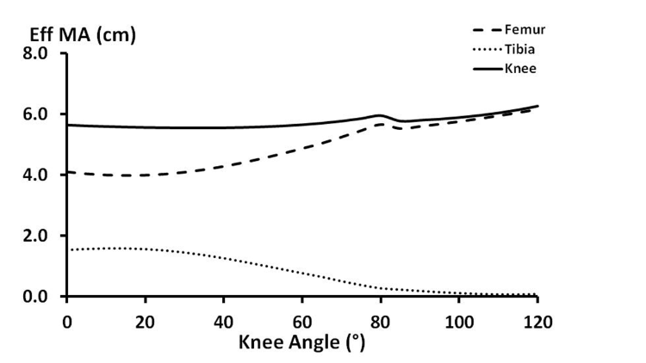
The Evidence: Role of Patella
On the role of the patella, ACL, and joint contact forces in the extension of the knee
  Patella keeps the effective moment arm of the quadriceps tension about the knee joint constant.
  When squatting (CKC), the patella allows us to extend the knee regardless of the amount of flexion
    This pattern is consistent with the kinematics of closed chain motion.
    The thigh rotates on a stationary tibia.
Cleather DJ, Southgate DFL, Bull AMJ, 2014.
Notes:
This study is the basis of our discussion of the patella In the functional anatomy review chapter and found that the role of the patella is to keep the effective moment arm of the quadriceps tendon constant. Due to the patella, the moment arm does not increase or decrease significantly through the full range of knee flexion and extension. As such, the force production capability of the quadriceps remains stable across those ranges.
If the patella were not present, the moment arm of the quadriceps tension would become variable across ranges of knee flexion. With increased knee flexion, the moment arm would continue to shorten because the tendon would move closer to the joint axis of rotation, which decreased the mechanical advantage of the quads. In theory, the moment arm could even cross the axis of rotation which would change the function of the quadriceps from knee extensors to knee flexors.
In day to day function, it is critical for our quadriceps to be capable of producing high forces within all ranges of knee flexion. For example, when our knee crosses in front of our toes, which is common in athletic movements and daily activities such as descending stairs, there is a greater degree of knee flexion and it is important that our quadriceps can aid in dissipation or production of force in those ranges.
This study also found as knee flexion angles increase, tibial extension decreases. It is clear that the effective knee moment remains relatively constant during knee flexion, but the way in which this knee moment is produced changes. In early knee flexion, there is an extension moment acting upon both the femoral and tibial segments, however, in greater degrees of knee flexion there is greater contribution from femoral rotation which is consistent with closed chain function at the knee joint.

Slide 40
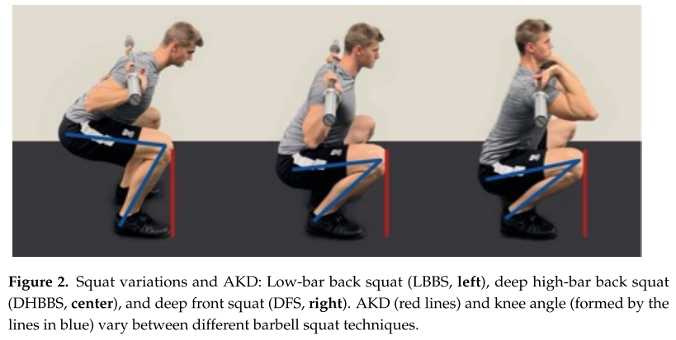
The Evidence
This review examined joint kinetics occurring when forward displacement of the knees is restricted vs. when such movement is not restricted during a barbell squat
  Restricting forward movement of the knees inappropriately transferred stress to the hips and low-back region.
  Appropriate joint loading during this exercise requires the knees to move slightly past the toes
Illmeier G, Rechberger JS, 2023.
Notes:
This next study looked at joint kinetics in restricted and unrestricted barbell squats. A restricted squat does not allow knee anterior knee displacement past the toes, whereas the unrestricted squat does allow for anterior knee displacement past the toes. The study found that the restricted squat may minimize stress on the knees, but in doing so, the force is inappropriately transferred to the hips and low back.
But let’s think about this in a little more detail. Should our aim be to decrease stress to the knee? In the last slide, we discussed how the knee moves past the toes in day to day movements and during high force athletic movements. We should be training our knees to be able to handle these forces associated with anterior knee displacement. There are some cases, such as meniscus injuries and patellar or quadriceps tendinitis, in which we would want to temporarily decrease knee stress, but our overall goal should be to train the knee to handle those forces.
When we take into consideration that forces were inappropriately transferred to the hip and low back during the restricted squat, it becomes even more clear that we should be performing lower extremity exercises allowing our knees to pass our toes. There will be further discussion of the squat and the low back in the spine segment of the course.
The authors conclude this review by stating that:
“For a large number of athletes, it may be favorable or even necessary to allow a certain degree of anterior knee displacement in order to achieve optimal training outcomes and minimize the biomechanical stress imparted on the lumbar spine and hip. Overall, restricting this natural movement is likely not an effective strategy for healthy trained individuals. With the exception of knee rehabilitation patients, the contemporary literature suggests it should not be practiced on a general basis.”
Authors conclude that current evidence reflects that knees over toes during squatting poses no health risks and should not be deliberately limited in healthy individuals
Restricting knee translation during a back squat “increased external hip torque by 973%.” Vs unrestricted squats increase knee torque by 28%

Slide 41
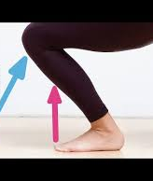
The Evidence
Kinematics of the trunk and the lower extremities during restricted and unrestricted squats
  Subjects showed significantly increased ROM for thoracic curvature during restricted squats.
  Unrestricted squat → larger ROM in the knee and smaller changes in the curvature of the thoracic spine and segmental motions within the trunk.
    This in turn, reduces stress on the back.
To strengthen the muscles of the leg, the unrestricted squat may be the best option for most people.
GMB Fitness / Praxis Method. (2021, July 8). Squatting with knees past your toes
List R, Gülay T, Stoop M, Lorenzetti S, List Renate, 2013.
Notes:
This next study found that there was a significant increase in the ROM of the thoracic spine curvature when performing the restricted squat. This increased ROM put inappropriate forces through the spine, so the study concluded that most individuals should allow their knee to move past the toes during the squat.
When movement is limited at one joint, we can expect a compensation elsewhere. No movement happens in isolation. In the case of the squat, when knee ROM is restricted, we can expect greater ROM in the spine. But why? When we do not allow our knees past our toes, our COG is displaced posteriorly. In order to maintain our COG over our BOS we commonly increase hip and spine flexion which can put those regions at greater risk of injury.

Slide 42
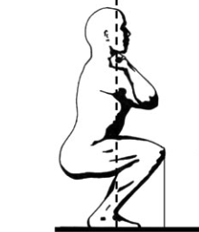
The Evidence
Analysis of the Load on the Knee Joint and Vertebral Column with Changes in Squatting Depth and Weight Load
  With increasing flexion, the wrapping effect contributes to an enhanced load distribution and enhanced force transfer with lower retropatellar compressive forces
  Menisci and cartilage, ligaments and bones are susceptible to anabolic metabolic processes and functional structural adaptations in response to increased activity and mechanical influences
  Effective training exercise for protection against injuries and strengthening of the lower extremity.
WOD Nation. (2018, April 11). How to elevate your Olympic squat to maximum potential: Six key methods. Medium
Hartman H, Wirth K, & Klusemann M, 2013.
Notes:
This study reviewed over 164 articles to determining the safety of deep knee flexion. In deep knee flexion, the knees must translate past the toes.
It was found that with increased knee flexion, the additional contact between the quad tendon and intercondylar notch contributes to enhanced load distribution and force transfer at the joint. Therefore, lower risk of injury. This is known as the “wrapping effect” which we allude to when we discuss the role of the patella. As the wrapping effect occurs, there is a decline in retropatellar compressive stress.
Humans show that increasing activity level lead to increased anabolic biomechanical and structural adaptation of cartilage tissue which increases mechanical stress tolerance, therefore protecting against degenerative changes. This is consistent with the findings of this study: despite increasing load and flexion range at the knee joint and weight lifting for a good portion of their lives, there were no cartilage defects of these weight lifters.
Given this information, effective training to the knee structures should allow the knees to translate past the toes to adequately load the tendons and soft tissue in the joint. Further, this posture allows us to reduce the load to the vulnerable spine.

Slide 43
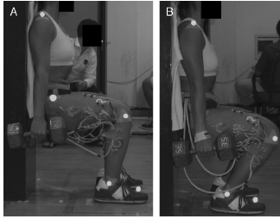
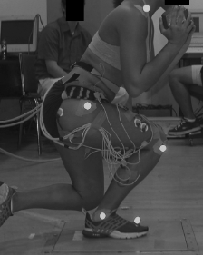
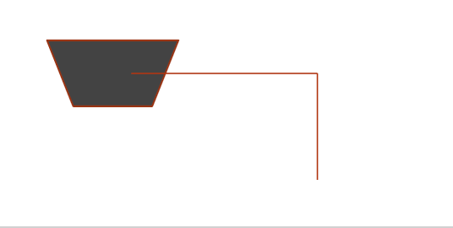
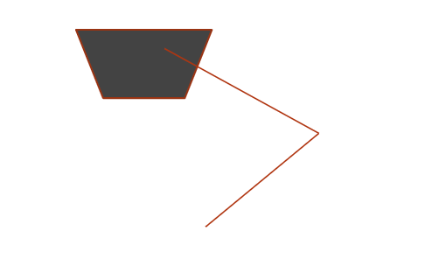
The Evidence
Patellofemoral Joint Force and Stress during the Wall Squat and One-Leg Squat
  Results support - anterior knee translation beyond the toes while performing squatting exercises increases patellofemoral force & stress compared with maintaining the knees over the feet
But wait a minute. Think about the center of gravity position during the wall squat?
Escamilla RF, Zheng N, Macleod TD, et al., 2009.
Notes:
This study assessed the joint force and stress at the knee joint during 2 versions of a wall squat and a single leg non-wall squat. The first image here demonstrates the wall squat long where the feet are further from the wall. The second image is the wall squat short where the feet are close to the wall. And the final image is the one-leg squat demonstration.
As hypothesized, PF force & stress were greater during the wall squat short compared with the wall squat long, but only at 90° knee angle during the squat ascent. At 90°, the knees translated beyond the toes in the wall squat short, but the knees remained over the feet in the wall squat long. These results support the belief that anterior knee translation beyond the toes while performing a squat increases the stress on the knee compared with keeping your knee behind your toes.
But let’s pause here and critically think for a second. When we perform a wall squat, where is our COM? It is behind the BOS as we are using the wall to prevent us from falling. This also disengages the posterior chain, so our quads are the sole mechanism to supporting the bent knee posture. With activation of the quads alone and increasing the knee flexion angle, of course we can expect the patellofemoral stress and force to increase. However, is this how we function? No, it isn’t. In reality, we have our knees move past our toes and a co-contraction of the anterior and posterior muscles work together to maintain our COM with our BOS.
Wall squat demo - not functional because they’re not controlling the COM, the wall is.

Slide 44
The Evidence
Patellofemoral Joint Force and Stress during the Wall Squat and One-Leg Squat
  The wall squat short and the one-leg squat both resulted in similar amounts of anterior knee translation at maximum knee flexion, but patellofemoral force and stress were significantly lower in the one-leg squat compared with the wall squat short
Escamilla RF, Zheng N, Macleod TD, et al., 2009.
Notes:
That leads us to the next point in the study. The wall squat short and the one-leg squat both resulted in similar amounts of anterior knee translation at maximum knee flexion, but patellofemoral force and stress were significantly lower in the one-leg squat compared with the wall squat short between 90° and 70° knee angles during the squat ascent.
The primary cause of the greater patellofemoral force and stress between in the wall squat short compared with the one-leg squat was greater quadriceps force during the wall squat short. The estimated quadriceps forces that were calculated in the current study using our EMG-driven knee model were approximately 30-40% greater in the wall squat short compared with the one-leg squat.
In contrast, between 90° and 70° knee angles during the squat ascent, the estimated hamstring forces that were calculated were approximately 60-70% greater in the one-leg squat compared with the wall squat short. The lack of co-contraction of the hamstrings and quads in the wall squat short is due to the lack of need to actively support one’s body mass with the BOS because the trunk is positioned behind them rather than leaning slightly forward parallel to the tibia.
Nick Note: = the importance of functional training for long term joint health

Slide 45
The Evidence
Is there a Limit to Knees Over Toes?
Systematic review of patellofemoral pain syndrome (PFPS) and squatting
  Squatting knees beyond the toes is an aggravating actor for PFPS
  Weak hip musculature is a correlated factor for PFPS. Why?
Pereira PM, Baptista JS, Conceição F, Duarte J, Ferraz J, Costa JT, 2022.
Notes:
Takeaway, there is a limit to how far the knees can translate over the toes without overburdening the knee. You can safely allow anterior knee translation in a closed chain as long as you maintain a balanced contribution between the knee and hip extensors. Letting the knees go too far can disrupt the arthrokinematics of the knee and create too much patellar compression.
Poor biomechanics (over-relying on the quads and therefore weak hip musculature) is likely associated with PFPS. Not allowing the glutes to help out.
Image citation: Neumann – Figure 13-28

Slide 46
The Evidence
A biomechanical comparison of back and front squats in healthy trained individuals
  Although more weight can be lifted during the back squat, muscle activity tested equally at 75% of 1RM.
  For the lower extremities, you can target the same strength adaptations with less strain to the lumbar region
So what?
  The position of the bar on your back as you descend makes you lean forward to maintain your COM over your BOS → increased stress on the spine vs. Front squat allows you to load the spine more axially.
  We will see later that compression + lumbar flexion = increased injury risk
Gullett JC, Tillman MD, Gutierrez GM, Chow JW, 2009. Gallagher S, Marras WS, Litsky AS, Burr D, 2005.
Notes:
This study compares the EMG activity of a front squat versus a back squat. During both forms of a squat, leg strength was targeted comparably at 75% of 1RM. Individuals however could squat more with the back squat. Why do you think that is? Because the weight of barbell back squat is positioned posterior to the BOS, the trunk must lean forward to prevent falling. The erector spinae and back muscles are responsible for the added load to the barbell, and not the LE muscles. We will learn more about this in the spinal component of the class, but overall, front squats not only encourage a more neutral spine, but it also reduces the axial compression on the spine while maintaining the same LE strength adaptations as a back squat.
Why can we lift more in a back squat? We posit, if the BOS is stabilized to be the same:
To maintain the bar position, you cannot lean forward at the trunk, this causes you to overextend the knees past the toes, this disengages the mechanical advantage of the hip and the movement becomes more quad dominant.
Likely some difference due to the larger erector spinae external moment arm in a front squat

Slide 47
The Evidence
Talking Points:
  What happens during the hip hinge squat?
    The quads are fighting to keep your center of gravity in your base of support. This actually increases patellofemoral stress.
  Eccentric loading patterns are different and not specific to how we function.
Escamilla RF, Zheng N, Macleod TD, et al., 2009.
Notes:
Given these findings, let’s circle back to the hip hinge! During the hip hinging motion, especially when you add weight to your back, the COM is positioned posteriorly. Two things must occur to prevent you from falling. We already talked about the need to lean forward and increase spinal flexion, but additionally, the quads must fight to support center of gravity from falling backwards, similarly to the wall squat. This quad contraction will increase abnormal patellofemoral joint forces.
Yes, during the hip hinge motion, we might feel our hamstrings and glutes firing, but are they activated in a way that is functional? Not really. The hamstrings and glutes serve a greater role in concentric function to produce force with running and jumping aiding in . During a hip hinge back squat, how is the posterior chain really working? Well, as the trunk leans forward to prevent falling backwards, the hamstrings and the glutes have to then activate eccentrically to combat the forward trunk lean.
During the hip hinge squat, the combination of the hamstring, gluteals, and erector spinae are responsible for eccentrically controlling trunk position and extending the torso and hip as you return to erect posture. This puts the spine at great risk to injury, as the erector spinae are assisting in restoring the torso to an upright position, which is why we can back squat more than we can front squat. We will dive deeper in to these concepts in the lecture on the spine.

Slide 48
The Evidence
Part II – Considerations in the Frontal Plane & Dynamic Knee Valgus
Notes:
Chapter 5, The Evidence: Indirect Effects Part I
In the last chapter we discussed the direct effect of shoe wearing and provided research to back up our claims. But how do those effects impact our function and injury risk? That’s what we will discuss in the next few chapters.

Slide 49
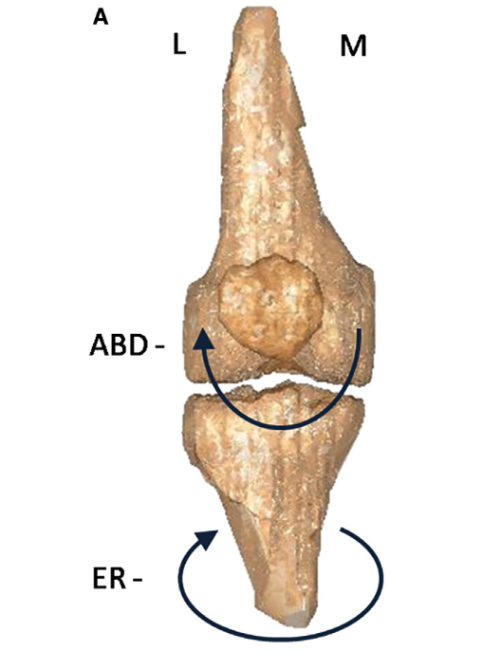

The Evidence
A comparison of tibiofemoral and patellofemoral alignment during a neutral and valgus single leg squat: An MRI study
  Compared to the neutral single leg squat, the forced valgus single leg squat resulted in more tibiofemoral external rotation.
  Movement into knee external rotation was significantly related to increasing lateral patellar displacement.
Talking Points:
  What other tissue is stressed? ACL?
Noehren B, Barrance PJ, Pohl MP, Davis IS, 2012.
Notes:
This study looks at the consequences of dynamic knee valgus by comparing 3D imaging of tibiofemoral and patellofemoral alignment during a neutral squat and one with increase hip adduction and internal rotation. It was found that with increased valgus, there was an increase in tibiofemoral external rotation. This position was significantly related to greater lateral patellar displacement.
Dynamic knee valgus does not just increase lateral displacement on the patella.. What else could this positioning impact? Dynamic knee valgus puts the knee at higher risk of injury… from patellar subluxations to osteoarthritis, meniscal injury to ACL tears.

Slide 50

The Evidence
Biomechanical Measures of Neuromuscular Control and Valgus Loading of the Knee Predict Anterior Cruciate Ligament Injury Risk in Female Athletes
  Female knees that went on to ACL injury (compared to uninjured)
    8.4° greater knee abduction angles at IC and 7.6° greater at maximum flexion
    Sagittal plane variables were not significant predictors
Hewett TE, Myer GD, Ford KR, et al., 2005.
Notes:
205 female athletes participating in high-risk sports including soccer, basketball, and volleyball were prospectively measured for neuromuscular control using 3D kinematics and kinetics during jump-landing. 9 athletes went on to tear their ACLs these 9 had significantly different knee posture and loading compared to the 196 who did not rupture their ACLs.
Those who tore their ligament had a 2.5x greater knee abduction moment and 20% higher ground reaction force and a shorter stance time. Therefore, increased motion, force and moments occured more quickly. The knee abduction moment predicted ACL injury with 73% Sp and 78% Sn and the dynamic valgus measures showed a predictive value of .88.
This is all to say that female athletes with increase functional dynamic valgus are at increased risk for tearing their ACLs.
When we recall the function of the ACL, we know that is plays an important role in knee stability in the frontal and transverse planes. When it comes to reducing knee valgus, we have to train the function of the gluteus medius to support pelvic stability and reduce femoral rotation in addition to targeting foot stability to allow for absorption and dissipation of load at higher forces which then decreases the stress on the knee in both the transverse and frontal planes.

Slide 51

The Evidence
Does the change in Q angle magnitude in unilateral stance differ when comparing asymptomatic individuals to those with patellofemoral pain?
  When in unilateral stance, patients with patellofemoral joint pain demonstrate greater than expected increase in Q-angle which could increase loading on the patellofemoral joint
Herrington L, 2013.
Notes:
This study compared Q-angle measurements in bilateral and unilateral stance of females with and without patellofemoral joint pain. This study found a strong positive relationship between bilateral and unilateral stance Q-angles that could be used to predict unilateral Q-angles in individuals. However, when assessing the unilateral Q-angle for symptomatic individuals, they found that those with pain had greater than predicted increase in q-angles in single leg stance compared to the asymptomatic group.
You can see in the graph here that the predicted and actual Q-angle values in those without injury were pretty close. Conversely, for the injured group, the predicted value was much lower than the actual value.
Why was this the case? Was it the pain that increased the q-angle? Not likely. But rather, the Q-angle likely contributed to the onset of pain.

Slide 52
The Evidence
Biomechanical Factors Associated with ACL Injury
Larwa et al., 2021 – Systematic Review of the biomechanical mechanisms related to ACL Injury
  Female injured athletes showed a greater difference in knee valgus with load progression but no difference in initial contact, i.e. dynamic knee valgus is a more important measure to look at than static knee valgus
  Other findings: stiff landing, poor core stability, weak hip abduction strength, increased knee valgus, landing with a heel strike position
Larwa J, Stoy C, Chafetz RS, Boniello M, Franklin C, 2021. Khayambashi K, Ghoddosi N, Straub RK, Powers CM, 2016.
Notes:
Larwa et al.
Athletes unable to control the amount to which their knee collapses inward dynamically were more likely to sustain an ACL injury. We should be looking at and training dynamic Q angle control!
Note
Q angle – resting structure, we can’t change
Dynamic knee valgus or dynamic Q angle – how we response to load, we can change

Slide 53
The Evidence
Hip Strength as a Predictor for ACL Injury
Khayambashi et al., 2016 – Pre-ACL injury hip strength in injured vs. Non-injured athletes
  In the 15 athletes that sustained an ACL injury, hip external rotation and abduction strength measures were significanty lower
Larwa J, Stoy C, Chafetz RS, Boniello M, Franklin C, 2021. Khayambashi K, Ghoddosi N, Straub RK, Powers CM, 2016.
Notes:
Khayambashi et al.
Assessed isometric hip abduction and ER strength in 501 athletes, at season end, 15 noncontact ACL injuries were confirmed. In this subset, hip ER and ABD strength measures were significantly lower compared to the non-injured athletes
Important Nuance
Strength measures were taken in an open chain and is limited in its ability to indicate closed chain function. Be a careful consumer of research!

Slide 54


Dynamic Knee Valgus
Clinical Consideration
Fallacy of the standard Q angle measurement.
Sex differences
  The relatively wide pelvis and short femur of women creates a larger Q angle.
Physio-Pedia. (n.d.). Q angle. In Physio-Pedia.
Goldberg, P. (2022, November 1). Does a larger Q angle cause knee and hip pain? Massage & Fitness Magazine
Notes:
Throughout this lecture, we have repeatedly mentioned the importance of frontal plane stability and the changes that occurred in our structure that have made it increasingly difficult to maintain stability in the frontal plane.
We have also referenced the Q-angle and knee valgus and its impact on injury a few times throughout the class. Clinically, how is the Q-angle measured? Commonly, we look at this alignment in either a supine position or bilateral standing position. This method, however is a flawed as it relates to predicting injury and function. Instead, we should spend more time clinically, assessing the dynamic knee valgus angle at varying degrees of knee flexion during functional movement patterns.
We wanted to conclude this lecture segment with this clinical consideration, but we will be demonstrating these concepts and clinical tools more in depth during the lab portions of this class.

Slide 55

Dynamic Knee Valgus
Clinical Consideration
The importance of the kinetic chain
  Helpful graphic for understanding the implications of knee valgus on surrounding bones/joints
Skouras AZ, Kanellopoulos AK, Stasi S, et al., 2022.

Slide 56
Conclusion
Notes:
This concludes CKC Systems lecture on the knee, hip and pelvis. Thanks for following along. Join us in our next segment of Evolutionary Mismatch Theory and Functional Human Motion on the spine!

Slide 57



References

Slide 58
Confidential and Proprietary Information
The concepts presented in this presentation are the proprietary intellectual property of CKC Systems LLC. These materials are intended solely for informational purposes and may not be reproduced, distributed, or disclosed without the express written consent of CKC Systems LLC.
For more information, visit www.ckcfitness.com
© 2025 CKC Systems LLC. All rights reserved

