Slide 1
The Shoulder
David Luedeka PT, DPT, MS, CSCS
Keila Strick PT, DPT, CSCS
Caroline Williams, PT, DPT, MS, GCS
Nick Roche, PT, DPT, CSCS

Slide 2
Evolution of the Shoulder
Notes:
In this first chapter we will review the evolutionary changes of the shoulder.
The first step in understanding why this treatment approach worked, is to begin the process of reviewing our anatomy, both past and present. Let’s get started.

Slide 3
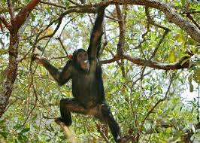
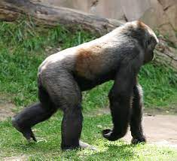
Our Evolutionary Past
Adapted to climb trees and walk on all fours, not adapted to ambulate as bipeds on two feet
Aiello L, Dean C, 1990.
Notes:
Our primate ancestors have upper extremities that are adapted for quadrupedal ambulation and to climb trees. Quadrupedal gait and the need to climb shaped the primate shoulder in unique ways from a musculoskeletal and neurological standpoint. Think about it, you need a shoulder joint that can withstand ground reaction forces and yet retain significant amounts of mobility to allow for climbing. The need for stability and mobility in the same structure is a complex thing to engineer.

Slide 4
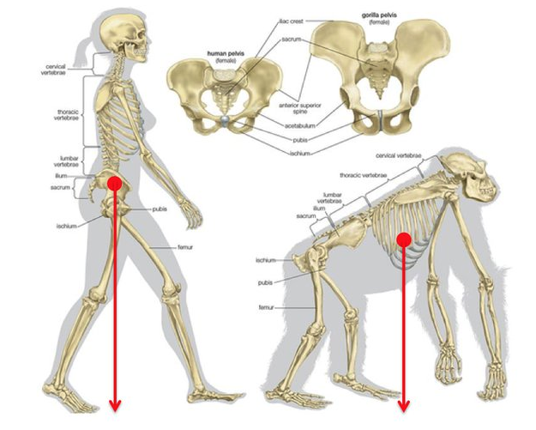
Evolutionary Changes
Evolutionary changes to the shoulder joint are insignificant relative to the spine and lower extremities
Pathwayz. (n.d.). Ape vs. hominin skeletons
Lieberman DE, 2013.
Notes:
As hominins evolved from our last common ancestor natural selection did adapt the shoulder structure, but the changes were not as dramatic when compared to the lower extremity and spine. Why? The adaptations to the lower extremity and spine were more important for the reproductive success of hominins. Recall, most of the evolutionary adaptations were facilitated by the need to eat. The lower extremity changes were much more important in allowing for the expansion of hominins foraging range.

Slide 5
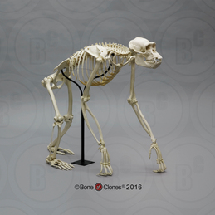
An Overview of our Evolutionary Past
Non-human primates compared to Homo sapiens…
Triangularly shaped rib cage
Sagittal plane alignment of scapulae
More proximal deltoid attachment
Increased congruence - larger glenoid and smaller humeral head
More joint congruent acromion (Type III - hooked)
Fused rotator cuff tendons
Bone Clones, Inc. (n.d.). Chimpanzee skeleton, articulated (Replica)
Lieberman DE, 2013.
Notes:
The shoulder structure of our primates ancestors includes: a large glenoid surface to allow for dissipation of ground reaction forces, more of a sagittal plane orientation of the shoulder blade due to triangularly shaped ribs, a more proximal deltoid attachment, a hooked acromion to help improve joint congruency and fused rotator cuff tendons ( unique to primates).

Slide 6
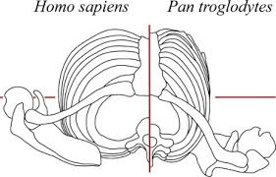
An Overview of Evolutionary Changes
Evolution of the shoulder
  Barrel rib cage
  Shoulder girdle oriented in frontal oblique plane, laterally directed glenoid
  More distal deltoid attachment
  Decreased congruence - smaller glenoid and larger humeral head
  Less robust acromion (Type I and II )
  Fused rotator cuff tendons
Roach, N., & Richmond, B. G. (2015). Relative shoulder position in humans and chimpanzees [Figure 6]. In Clavicle length, throwing performance and the reconstruction of the Homo erectus shoulder. Journal of Human Evolution.
Sonnabend DH, Young AA, 2009. Lieberman DE, 2013.
Notes:
While it is important to understand that evolutionary changes to the hominin shoulder were not as significant as the changes to the lower extremities and the spine, there are adaptations that occurred as we became bipedal. The rib cage expanded causing the shoulder blade to be repositioned, the moment arm for the deltoid muscle increased, the glenoid decreased in size, the humeral head increased in size, the acromion decreased in size, and importantly we retained fused rotator cuff tendons.

Slide 7
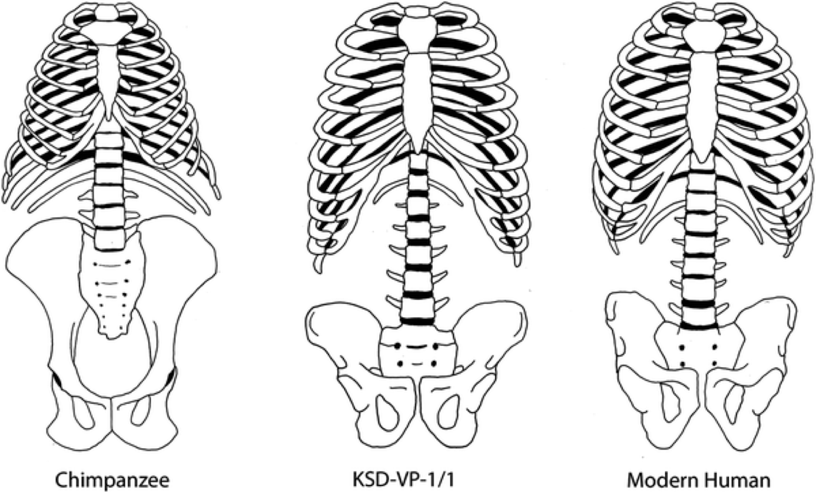
Shoulder Evolutionary Changes
Primate Rib cage
Triangularly shaped rib cage
Hominin Rib cage
Barrel shaped rib cage to accommodate increased lung capacity
Sonnabend DH, Young AA, 2009. Chan LK, 2014.
Notes:
The need for food increased humans foraging range and our hominid ancestors had to walked/jog up to 9 miles a day to meet their metabolic needs. Because of the greater musculoskeletal demands on the cardiorespiratory system, more lung capacity was needed to supply the oxygen. The rib structure grew in size to accommodate this increased lung capacity.
Sanchis-Gimeno JA, Lois-Zlolniski S, María González-Ruiz J, et al. Association between ribs shape and pulmonary function in patients with Osteogenesis Imperfecta. Journal of Advanced Research. 2020;21:177-185. doi:10.1016/j.jare.2019.10.007 - this study supports the relationship between rib cage and lung capacity

Slide 8
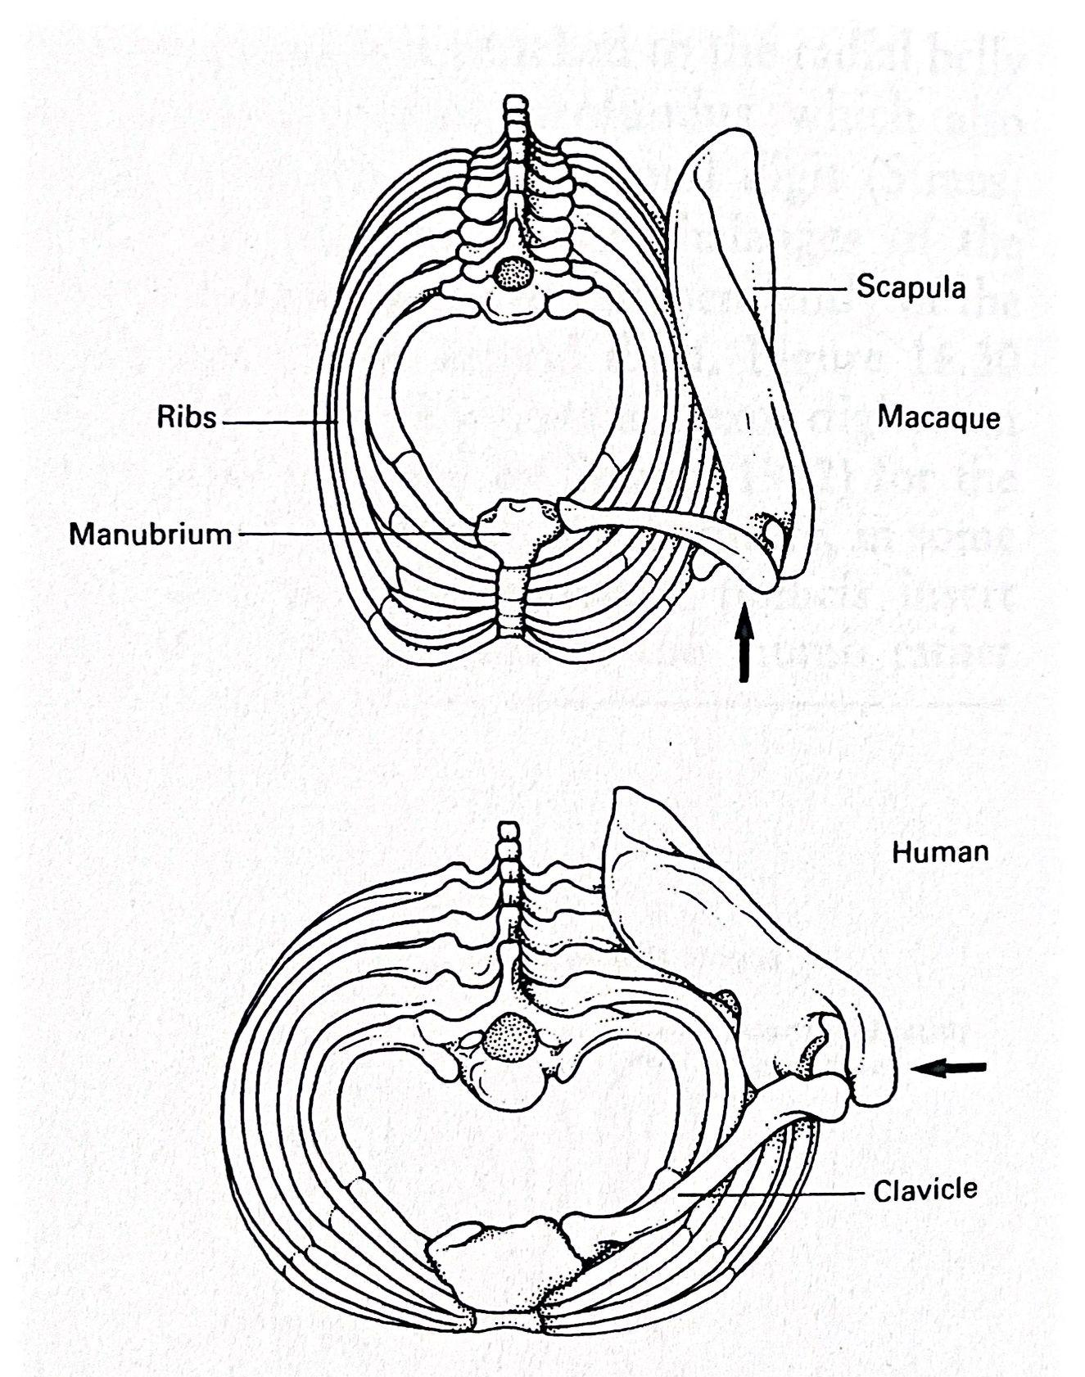
Shoulder Evolutionary Changes
Past
Sagittal plane alignment of the scapulae
Present
Oblique frontal alignment of the scapulae to accommodate increased rib / lung size
Aiello L, Dean C, 1990.
Notes:
Humans shoulder blades are positioned in a frontal plane when compared to our primate ancestors whose shoulder blades are positioned more in a sagittal plane. As such, humans glenoids are more laterally directed. Why is this theorized to have occurred?
Rib cage adaptations facilitated the positional change of the shoulder blade. A barrel shaped rib cage pushed our scapulae from a sagittal plane into an oblique frontal plane. Primates’ sagittal plane shoulder blade position, as a result of a more triangularly shaped rib cage, is advantageous for allowing the dissipation of ground reaction forces through the shoulder complex during the gait cycle.
It is important to understand that this shoulder blade adaptation was less influenced by a specific functional need of the shoulder but rather as a way to accommodate greater lung capacity. The evolutionary question asking if we evolved to throw or if throwing was easier because of the shoulder blade position may have its answers in the changes to the rib cage structure.

Slide 9
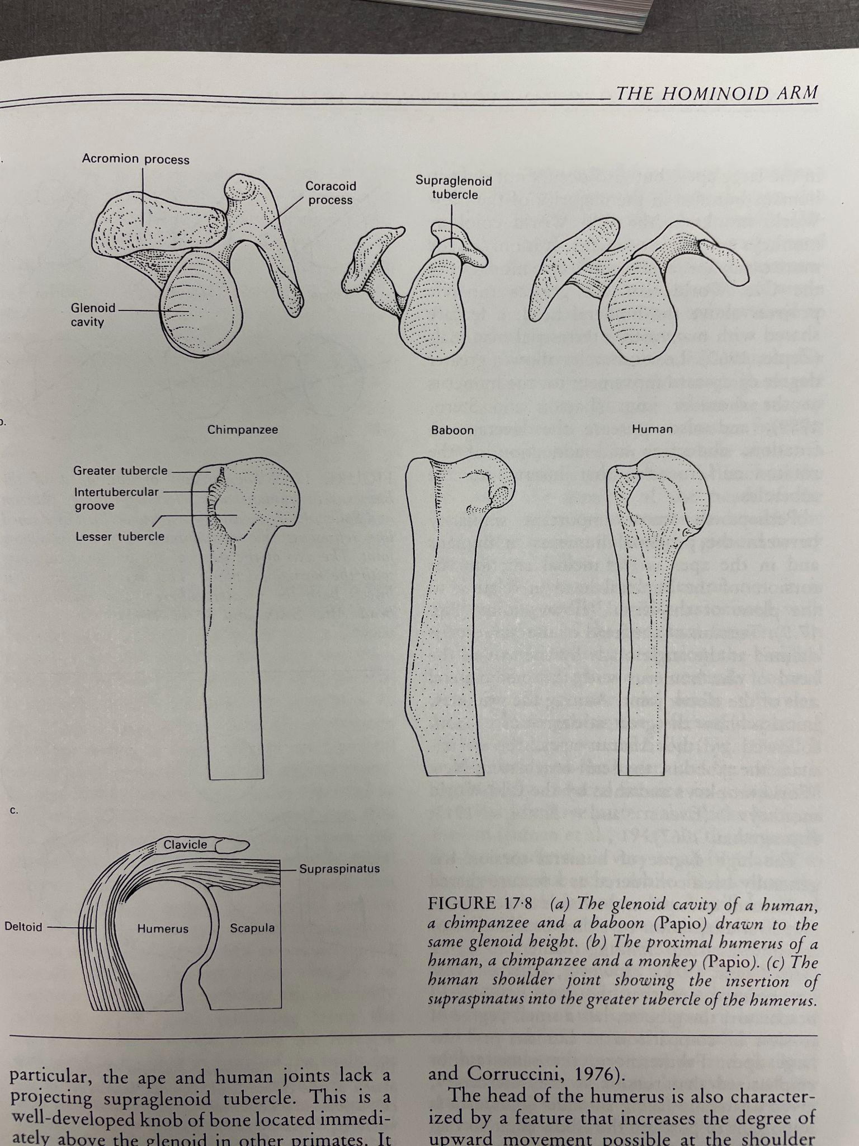
Shoulder Evolutionary Changes
Primate ancestor
Larger glenoid fossa
Increased joint congruence
Humans
Smaller glenoid fossa
Decreased joint congruence
Swartz SM, 1989.
Notes:
As we became bipedal, the need to dissipate ground reaction forces through the shoulder joint decreased. The glenoid responded to this decreased stress by reducing in size.
Remember, the bone structure of the primate shoulder was adapted over millions of years in response to the weight bearing forces placed upon it. As such, primates shoulders have larger glenoids and greater joint congruence to tolerate the greater forces transferred across the joint.
When hominids became bipedal, the shoulder joints were no longer subjected to these closed chain stresses resulting ultimately in bone loss. It can therefore be concluded, that increased shoulder joint mobility is likely a byproduct of a smaller glenoid and a decrease in joint congruency, rather than a necessity to our survival.

Slide 10
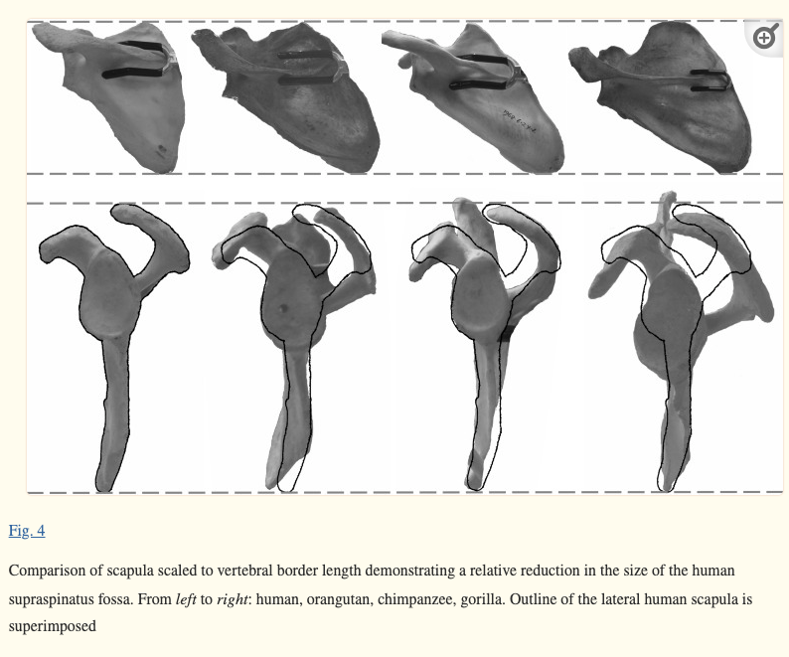
Shoulder Evolutionary Changes
Past
More joint congruent acromion (Type III - hooked)
Present
Less robust acromion (Type I and II )
Chimpanzee (left), Modern human (right). Modern human lateral Outline of human scapula is superimposed on the chimpanzee’s scapula in lateral view.
Potau JM, Bardina X, Ciurana N. 2007. Swartz SM, 1989.
Notes:
Looking more closely at the primate shoulder joint, one of the biggest differences seen when compared to hominins, is the size and shape of the acromion. A chimpanzees acromion is more robust and primarily hooked shaped (known as a type 3 acromion). Why? According to wolff's law, bone growth occurs in response to increased biomechanical stress. Certainly quadrupedal ambulation increased the forces across the shoulder joint. Like the glenoid, the acromion responded by increasing its size.
As bipedalism evolved in humans, the stresses across the shoulder joint decreased. In response to the decreased forces the size and shape of the acromion changed. It became smaller and flatter. The more common type 1 and type 2 acromion found in humans allows for improved overhead motion. However, keep in mind, this adaptation did not happen because natural selection sorted for it. The improved ability for humans to move there arms overhead is a result of the loss of bone structure when the compressive forces in the joint decreased as bipedalism became prominent.

Slide 11
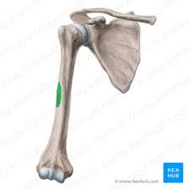
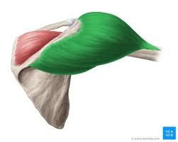
Shoulder Evolutionary Changes
Past
  Decreased leverage
  Proximal deltoid tubercle
Present
  Increased leverage of deltoids
  Distal migration of deltoid tubercle
Kenhub GmbH. (n.d.). Greater tubercle of humerus: location, muscle attachments
Kenhub GmbH. (n.d.). Deltoid muscle.
Gómez M, Casado A, De Diego M, Arias-Martorell J, Pastor JF, Potau JM, 2020.
Notes:
Another change that occurred to our shoulder structures was a distal migration of the deltoid tuberosity on the humerus. The deltoid tuberosity serves as an attachment point for the three deltoid muscles. This bony landmark is larger in chimpanzees as it has to support a more powerful deltoid muscles to accommodate arboreal and quadrupedal locomotion.
In humans, this muscles is not as powerful and the muscle attachment site is less robust, however, the distal migration of the tuberosity allowed for an improved mechanical advantage of the middle deltoid muscle. This is an important adaptation as this muscle reinforces the supraspinatus as serving as an additional glenohumeral joint stabilizer in modern humans.

Slide 12
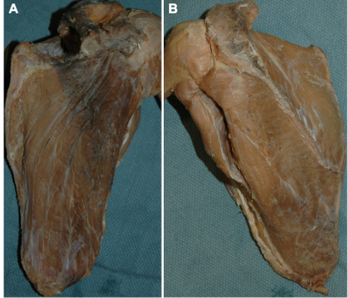
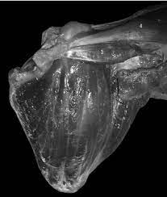
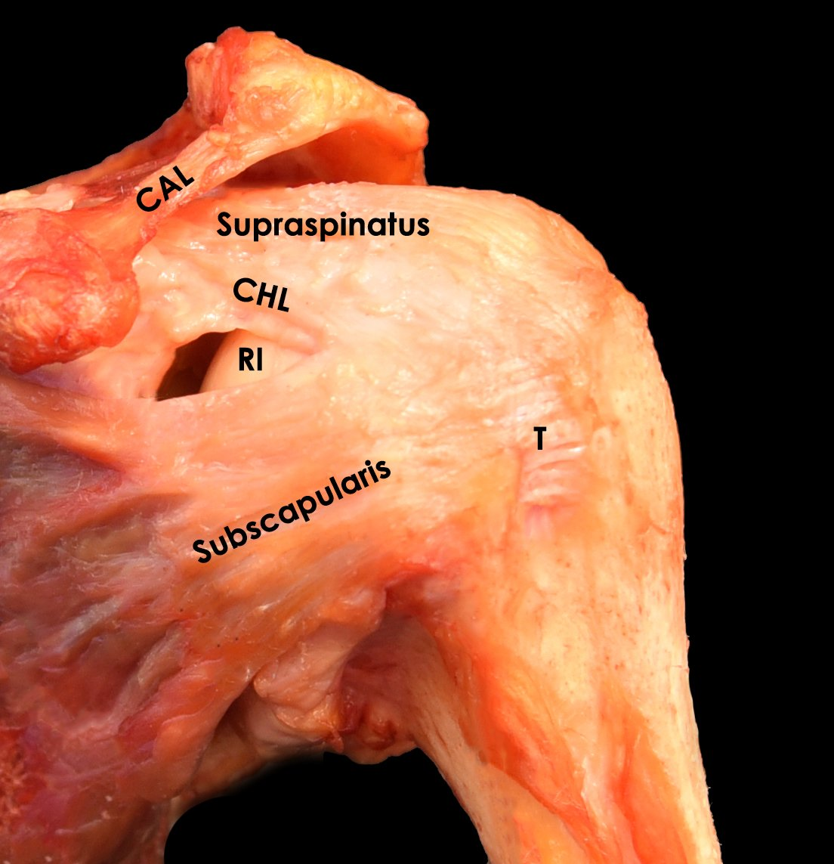
Evolutionary Similarities
Past & Present: Fused tendons of rotator cuff structure
Bello-Hellegouarch, G., Potau, J. M., Arias-Martorell, J., & Pérez-Pérez, A. (2012). Anterior view of the dissection of Pan troglodytes showing the anterior side of the rotator cuff muscles and some other muscles of the shoulder and arm [Figure 3]. In The rotator cuff muscles in Hominoidea: Evolution and adaptations to different types of locomotion.
Brusalis, C. M., Chan, J. J., Jackson, G. R., Khan, Z. A., Kaplan, D. J., Allahabadi, S., & Verma, N. N. (2023). Advanced subscapularis repair techniques. Operative Techniques in Sports Medicine, 31(1), Article 150981.
Mathewson, M. A., Kwan, A., Eng, C. M., Lieber, R. L., & Ward, S. R. (2014). Comparison of rotator cuff muscle architecture between humans and other selected vertebrate species. Journal of Experimental Biology, 217(2), 261–273.
Plate JF, Bates CM, Mannava S, et al., 2013.
Notes:
After reviewing some of the a key changes that occurred in humans shoulder structures through evolution, it is time to talk about a significant commonality.
One aspect of human shoulder structure that has remained unchanged is the rotator cuff. Both humans and primates have a fused rotator cuff tendon structure. While other quadrupeds usually have 4 distinct RC tendons, primates and humans have RC tendons that are fused. Why? Remember the complex engineering of the stability and mobility needs of the primates shoulder. Most other quadrupeds do not have the need for open chain joint stability. Primates need both joint congruency, but not too much, and mobility to allow for open chain motion. A more fused rotator cuff structure improves joint stability and is able to stabilize open chain motion.
As in the prior slides think about this. If the shoulder joint was naturally selected to allow for greater motion and open chain function, would we see greater changes to the rotator cuff structure?

Slide 13
Functional Anatomy Review
Notes:
This next chapter in the shoulder lecture series will focus on a functional anatomy review. This is not an ordinary overview of the shoulder anatomy. It will focus on the the closed chain function of the key shoulder and shoulder girdle musculature.

Slide 14
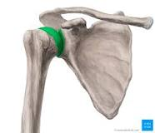
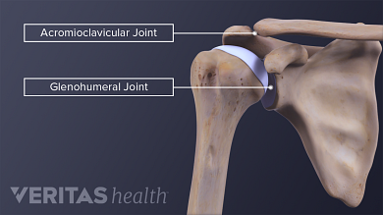
Glenohumeral Joint
Large humeral head
Small glenoid
Ball and socket
  Very mobile
Mobility at the cost of stability
  Passive stabilizers
  Active Stabilizers
© 2005–2019 Elsevier. All Rights Reserved
Notes:
Let's get started. First we have the glenohumeral joint. This joint is the most mobile joint in the body. Note the size of the humeral head in relation to the glenoid and the lack of joint congruency. Shoulder joint mobility comes with a cost: instability.
We have both passive and active structures that help to stabilize this joint during motion. Passively, the joint capsule, labrum and surrounding ligaments all contribute to the support the GHJ. The active stability is provided by the rotator cuff musculature.
Begin to think about how gravity and closed chain motion impacts the GHJ.

Slide 15
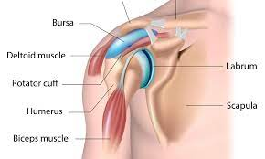
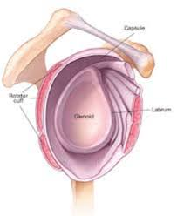
Glenoid Labrum
Fibrocartilaginous ring attached to the outer rim of the glenoid
Provides some additional depth and stability.
Functions as a static stabilizer
© 2022 UpToDate, Inc. and/or its affiliates. All Rights Reserved.
Notes:
The glenoid labrum assists in providing passive stability for the GHJ. This cartilaginous tissue sits snug against the glenoid fossa and increases the joint contact between the humeral head and glenoid fossa.

Slide 16
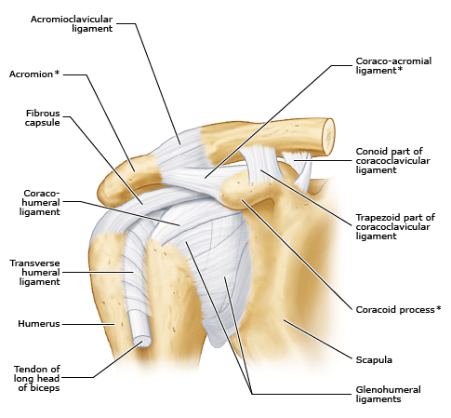
Joint capsule and ligaments
Glenohumeral ligaments
Coracohumeral ligaments
Joint Capsule
Notes:
Please review the joint capsule and the glenohumeral ligament which provide stability for the glenohumeral joint.

Slide 17
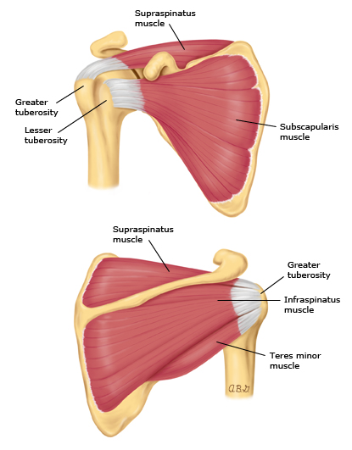
Rotator Cuff
Supraspinatus
Infraspinatus
Teres Minor
Subscapularis
Insert: Lesser tuberosity of humerus (supra and sup scap); greater tuberosity (infra and teres minor)
Innervation: Subscapular nerve
Action: dynamically stabilize the humerus in the glenoid fossa
© 2022 UpToDate, Inc. and/or its affiliates. All Rights Reserved.
Notes:
We briefly just reviewed the passive structures that support the glenohumeral joint. We will now spend time discussing the active structures that support the shoulder. The primary active structures that support the stability of glenohumeral joint are a group of 4 muscles referred to collectively as the rotator cuff. The RC is made up of the supraspinatus, infraspinatus, teres minor, and subscapularis.
While these muscle have individual open chain functions such as internal, external rotation, and shoulder abduction, the true function of the RC cuff is to provide dynamic stability to the GH joint throughout various motion patterns. These little muscles were not designed to be prime lifters.
During open chain motion, the RC functions to pull the head of the humerus into the glenoid fossa to increase stability, which then allows the major muscles of the upper back, chest, and shoulder to function as the prime movers.
During closed chain shoulder joint motion the rotator cuff muscles continue to provide stability. However, the demand on the RC musculature is lessened due to either the intrinsic stability that occurs with ground reaction forces through the joint or the neurological stability created by the scapular stabilizing muscles when they are exposed to distractive forces.
Let's review some of the muscles that attach to the scapula in the next few slides

Slide 18
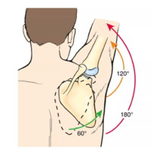
Scapulohumeral Rhythm
Coordinated movement of the scapula and the humerus
  2:1 ratio - glenohumeral elevation and scapulothoracic upward rotation (ratio is nonlinear)
Preserves the length-tension relationships of the glenohumeral muscles
Limits relative arthrokinematic movement between the two bones
Pagare, V. (Ed.). (n.d.). Scapulohumeral rhythm. Physiopedia.
Inman B, Saunders J, Abbott L, 2004.
Notes:
Before we begin to discuss the muscles that are attached to the shoulder blades it is important to understand scapulohumeral rhythm. The scapula is the base of the glenohumeral joint. Its position as it relates to the humerus is important to understand. Generally for every 2 degrees of GHJ motion there is 1 degree of scapula motion to maintain GHJ relationship.
The following muscles help move and stabilize the shoulder blade during upper extremity motion.

Slide 19
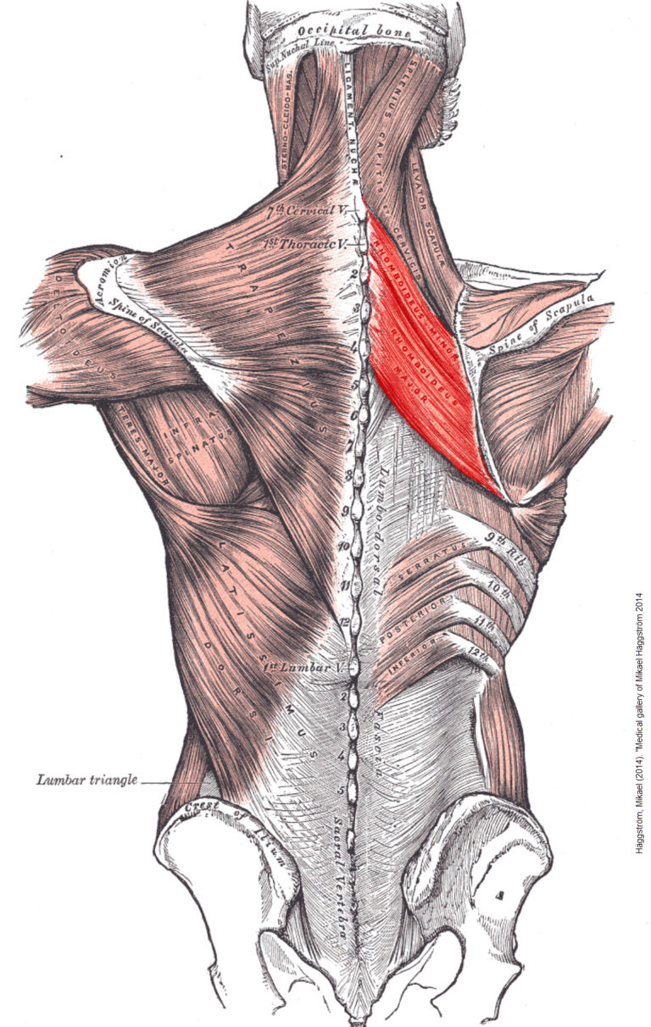
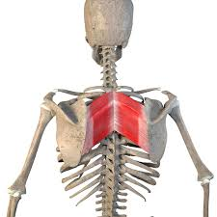
Rhomboid Major and Minor
Origin: Upper thoracic SP (major); Lower cervical SP (minor)
Insertion: medial border scapula
Innervation: Dorsal scapular nerve
Functions stabilize the shoulder girdle and hold shoulder blade in place against distraction forces
Arm elevated
Arm by side
MadiGraphics. (n.d.). 3D illustration of rhomboid major and minor muscles on white background [JPEG image]. Adobe Stock
Notes:
Please review the relevant anatomical facts of the rhomboid muscle.
Similar to the spine lecture, we don’t want to spend a lot of time reviewing open chain anatomy as you can find this in any textbook, but we will discuss the actions of the following muscles from both an evolutionary and closed chain anatomy standpoint.
Closed chain shoulder joint motion in the upper extremity doesn't just happen when you are on all fours. It occurs when the distal segment of your upper extremity is fixed and your center of mass is suspended in a hanging position. The pull up exercise is an example of a closed chain motion of the upper extremity that does not happen on all fours.
The closed chain function of the rhomboid muscles is to stabilize the scapula drawing it toward the spine against the distractive forces associated with hanging closed chain shoulder function.

Slide 20
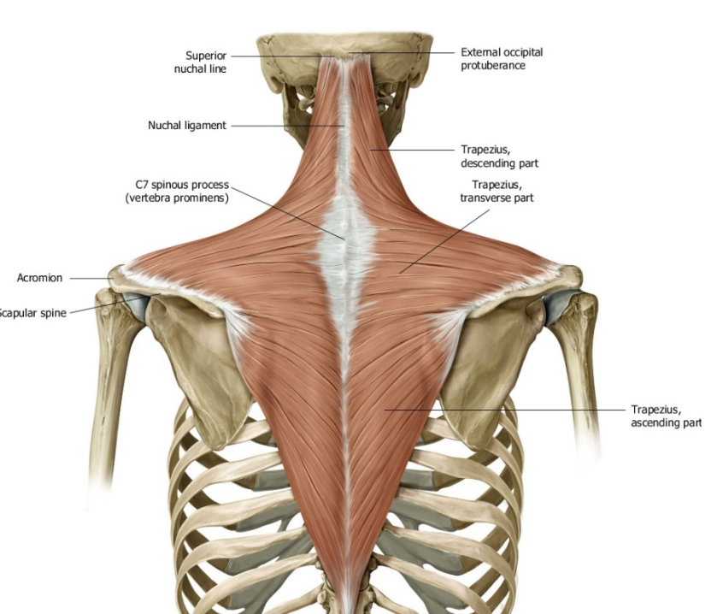
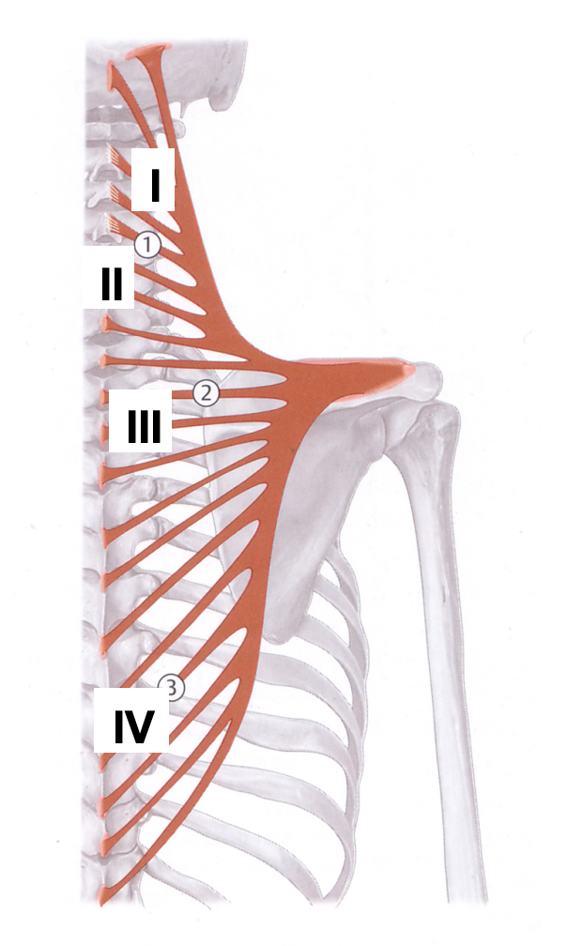
Traps (I-IV)
Origin: Occipital bone, and SP from upper cervical to lower thoracic
Insertion: lateral clavicle (I), acromion (II), scapular spine (III), medial scapular spine (IV)
Innervation: Spinal accessory nerve
Functions to stabilize the shoulder girdle through coupling patterns in all closed chain motion
Schuenke, M., Schulte, E., & Schumacher, U, 2014.
Notes:
In an open chain, the trapezius muscles is said to be a scapular rotator, elevator and depressor. In closed chain motion, it assists in scapular stability regardless of the scapular position. So, for example if the scapula is rotated upward, there are trapezius fibers resisting the upward motion and pulling the scapula downward. This force coupling helps the scapula to retain its anatomical position on the rib cage.

Slide 21
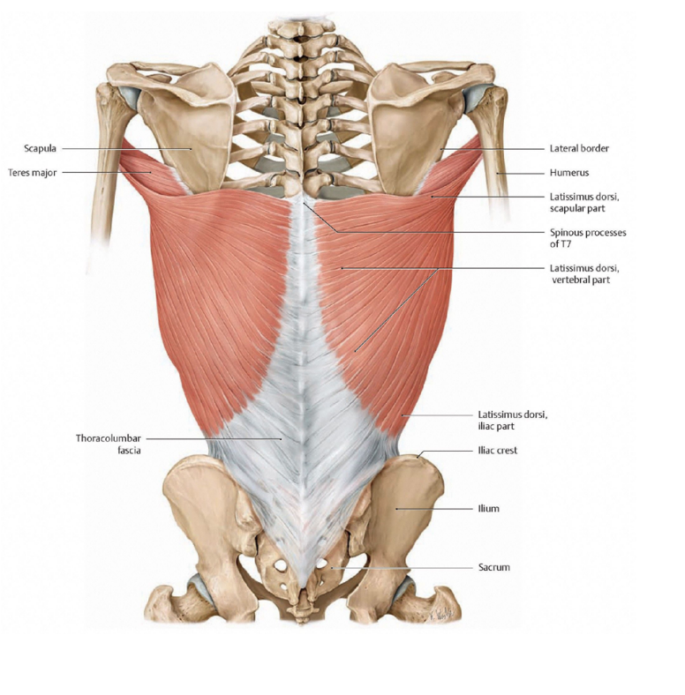
Latissimus Dorsi
Origin: Lower thoracic SP, thoracolumbar fascia, posterior iliac crest, ribs 9-12, inferior angle of scapula
Insertion: medial border bicipital groove
Innervation: thoracodorsal nerve
Functions to raise the torso and counters distractive forces
Schuenke, M., Schulte, E., & Schumacher, U, 2014.
Notes:
In an open chain it is taught that the latissimus dorsi is a humeral depressor, extensor, adductor and internal rotator.
The closed chain function of the latissimus dorsi is to raise the torso towards the arms as in the pull up motion. It also counters the distractive forces at the glenohumeral joint when in a hanging position.

Slide 22
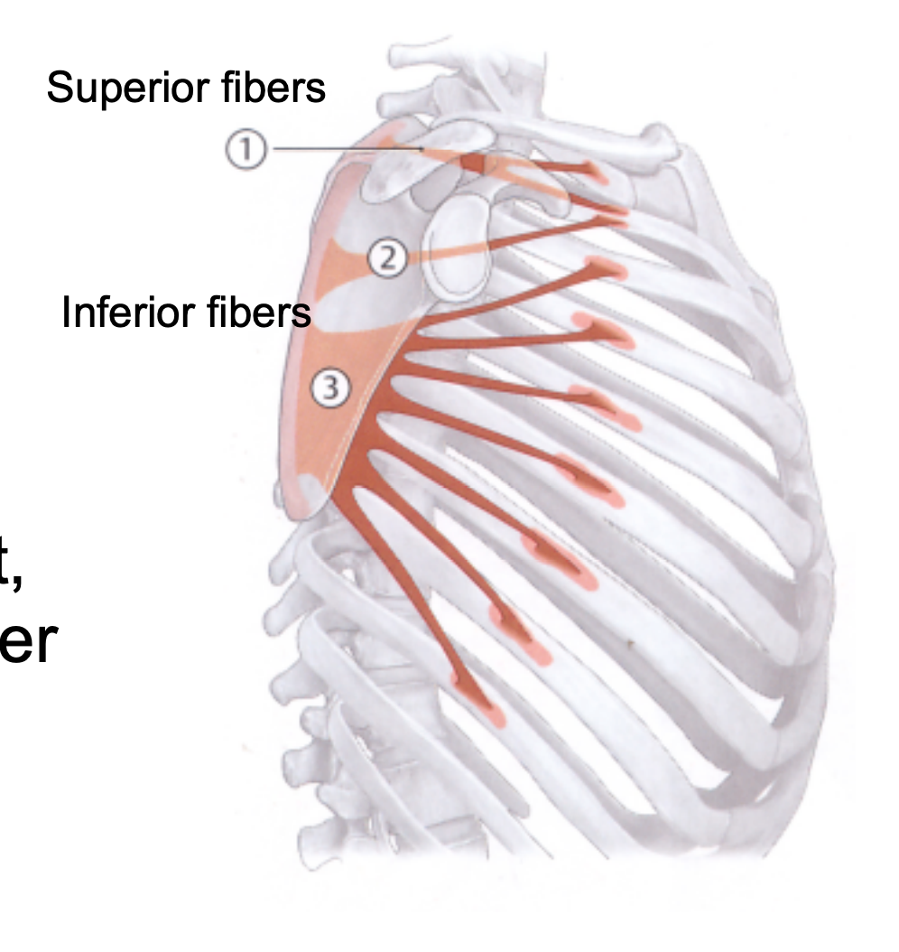
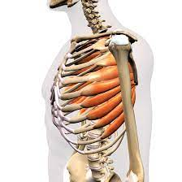
Serratus Anterior
Origin: lateral surface upper ribs
Insertion: medial border of scapula superior angle
Innervation: long thoracic nerve
Functions to stabilize the medial border of the scapula against the thoracic wall
Pozzi F, Plummer HA, Sanchez N, Lee Y, Michener LA, 2019.
Notes:
In open chain motion, the serratus anterior protracts, upwardly rotates the scapula, and stabilizes the medial border of the scapula against the thoracic wall.
Similarly, in a closed chain, the serratus anterior also functions to stabilize the medial border of the scapula against the rib cage. However, the level of muscle activation is much higher in a closed chain motion when compared to an open chain motion. For example, the SA is much more engaged during push-ups compared to the bench press due to the distraction forces caused at the shoulder blade when GRF are transferred through the GHJ.

Slide 23
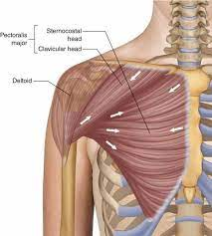
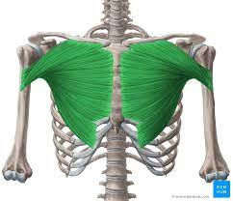
Pec Major
Origin: Sternum and clavicle
Insertion: lateral border bicipital groove
Innervation: Medial and lateral pectoral nerve
Functions to assist in stabilizing the humeral head on the glenoid fossa.
MadiGraphics. (n.d.). 3D illustration of rhomboid major and minor muscles on white background [JPEG image]. Adobe Stock.
Calatayud J, Borreani S, Colado JC, Martin F, Rogers ME, 2014.
Notes:
In an open chain it is taught that the pec major will function to adduct and internally rotate the humerus.
The closed chain function of the Pectoralis major is to prevent the humerus from abducting away from the torso. Its job is to pull the humerus towards the side of the torso.
Additionally, this muscle reinforces glenohumeral joint stability, acting to support the rotator cuff when the function of these muscles is less than optimal.

Slide 24
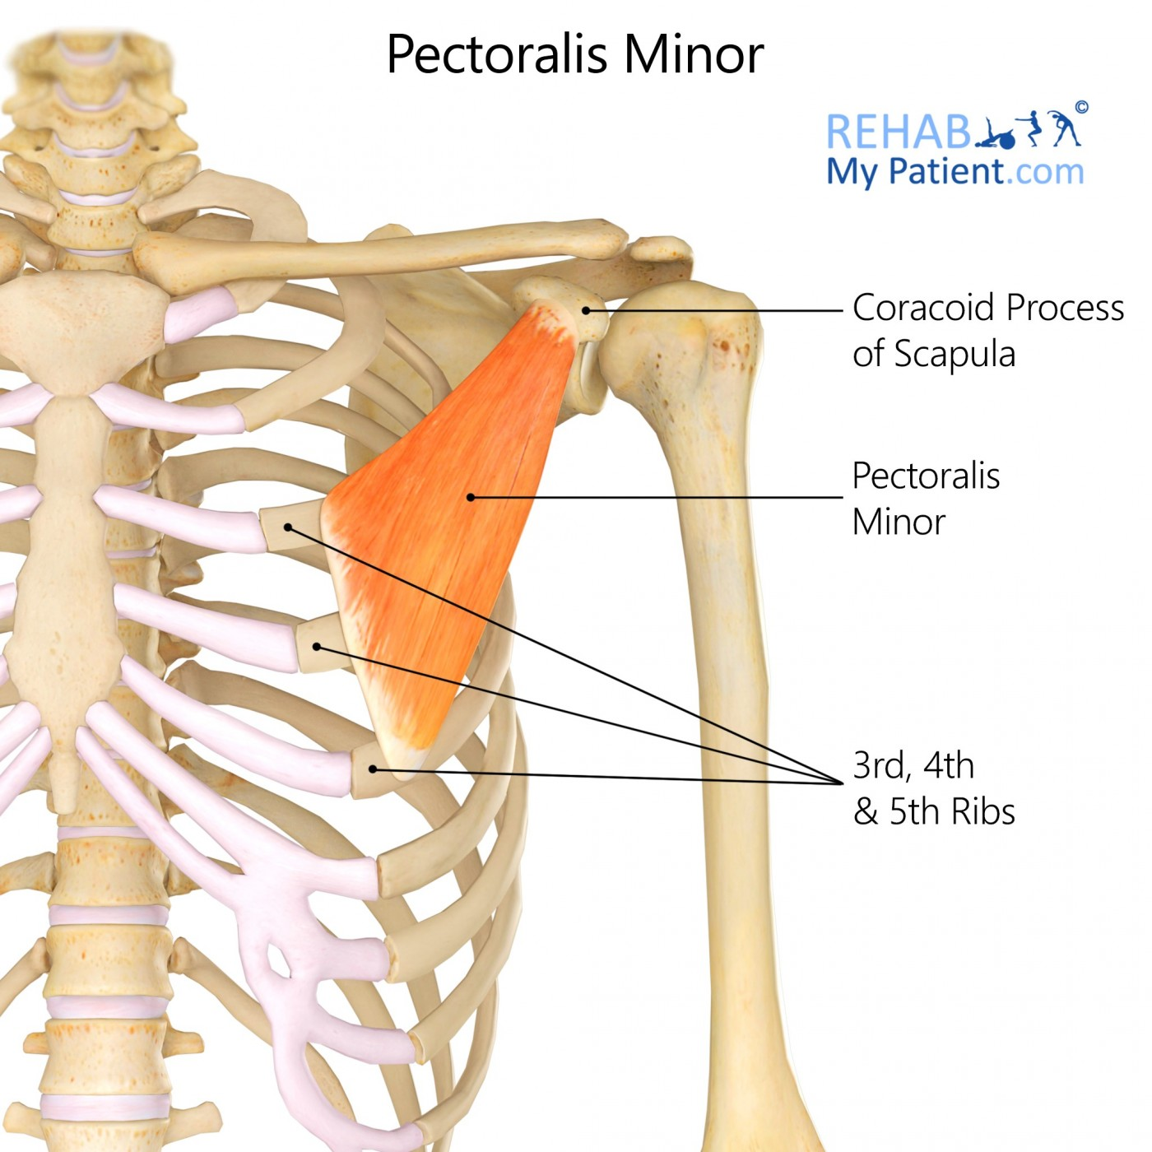
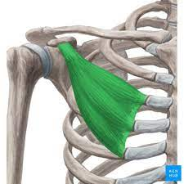
Pec Minor
Origin: anterior ribs 3-5 minor
Insertion: coracoid process of scapula
Innervation: Medial pectoral nerve
Functions to stabilize the scapula against the thoracic wall
Perry, C. (2022, August 31). Pectoralis minor muscle: Origin, insertion and action. Kenhub.
Notes:
In an open chain, the pec minor can depress and downwardly rotate the scapula.
The closed chain function of the Pec minor is stabilize the scapula against the thoracic wall. When the scapula is subjected to distractive forces, such as in a push up, it contracts to keep the lateral border of the scapula against the rib cage.

Slide 25
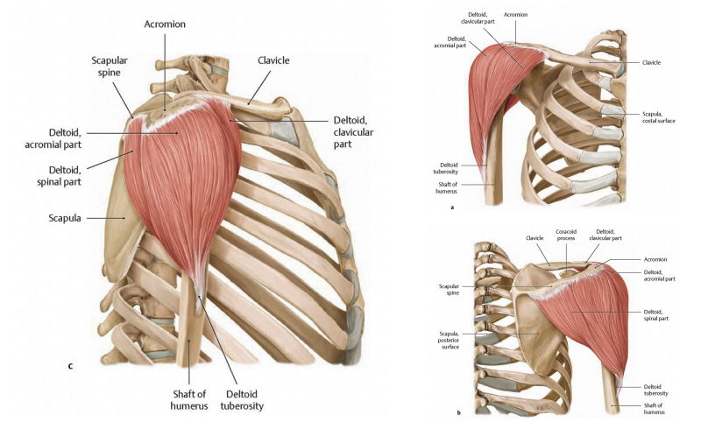
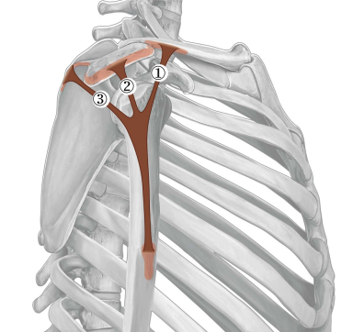
Deltoids (Anterior, Middle, Posterior)
Origin: Lateral clavicle, acromion, scapular spine
Insertion: deltoid tuberosity
Innervation: Axillary nerve
Functions
Schuenke, M., Schulte, E., & Schumacher, U, 2014. Khandare S, Arce RA, Vidt ME, 2022.
Notes:
The deltoids have the the classically taught function of open chain shoulder abduction, flexion and extension.
Another important function of the deltoid, and similar to some other major muscles we just reviewed, is that the deltoid reinforces the rotator cuff in stabilizing the humeral head on the glenoid joint surface.
The middle deltoid is able to provide GHJ stability when the supraspinatus muscle is impaired. There is research to back this up and we will review it in the next slide.

Slide 26
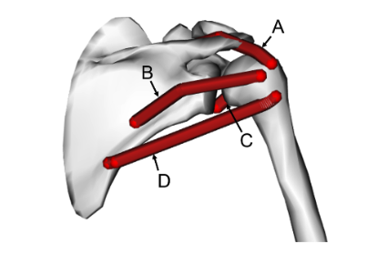
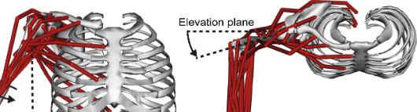
Rotator Cuff Compensation
Muscle compensation strategies to maintain glenohumeral joint stability with increased rotator cuff tear severity: A simulation study
Muscle activation patterns of teres major, all deltoids, pectoralis major, and latissimus dorsi, suggest these muscles would be co-activated to stabilize the GHJ w/varying levels of rotator cuff dysfunction
Khandare S, Arce RA, Vidt ME, 2022.
Notes:
This study did a simulation of muscle activity that occurs around the shoulder girdle in various degrees of rotator cuff injury. When the cuff was unable to perform at 100% strength, various surrounding muscles would co-activate to effectively stabilize the GHJ.
According to this simulation, regardless of injury severity, the joint contact force vector remained relatively constant and the body was able to preserve the concavity compression of the GHJ through the activation and compensation of the muscles around the shoulder.

Slide 27
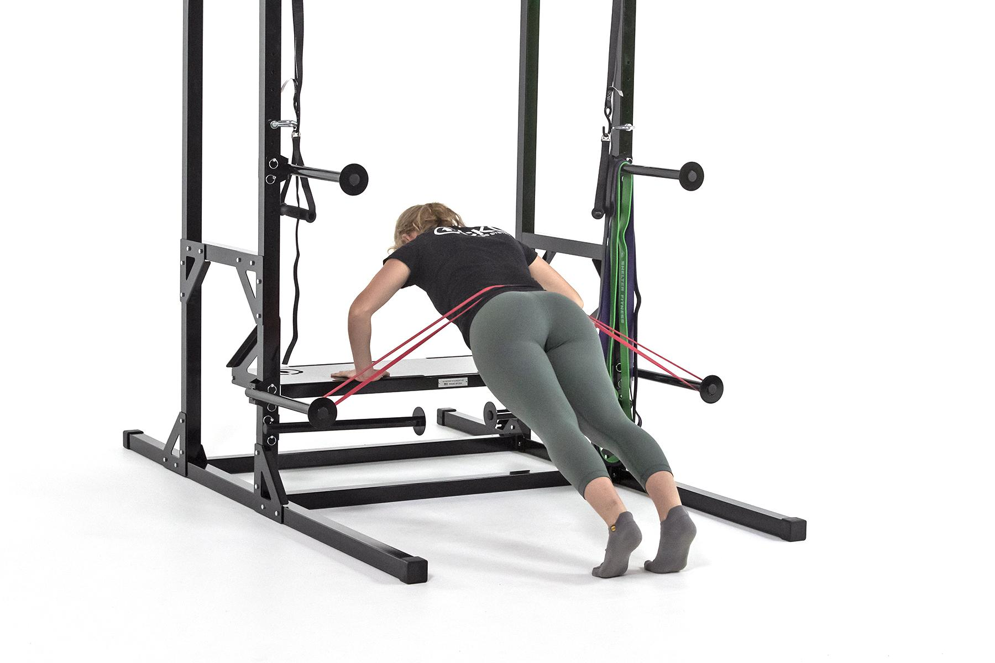
Synergistic Contraction w/ Closed Chain Motion
Closed chain exercises compared to open chain improve …
Intersegmental coordination
Synergistic muscle activity
Motor unit synchronization
All associated with functional activities. Are we evolved to function in isolation with heavy loads?
Pozzi F, Plummer HA, Sanchez N, Lee Y, Michener LA, 2019.
Notes:
The previous slide just demonstrated how smart our bodies can be in terms of the compensatory mechanisms that occur to create a stable environment allowing for safe and efficient movement patterns.
Through OKC movement patterns, however, these compensatory techniques at the shoulder are not sustainable, and overtime, the arthrokinematics can be damaged. The unstable fulcrum makes it very difficult to strengthen the muscle around the joint without resulting in pain and further joint and tendon damage.
Closed chain movement at the GHJ provides stability independent of the rotator cuff. As such, the rotator cuff is not overworked trying to provide stability. This stability allows us to strengthen the major muscles around the joint, thus further developing the strength of the synergistic mechanism resulting in improved pain levels and functional capacity.

Slide 28
The Evolutionary Mismatch
Notes:
In this next chapter we will introduce the evolutionary mismatch associated with the shoulder. For the shoulder, these mismatches are cultural evolutionary mismatches as opposed to biological evolutionary mismatches.

Slide 29
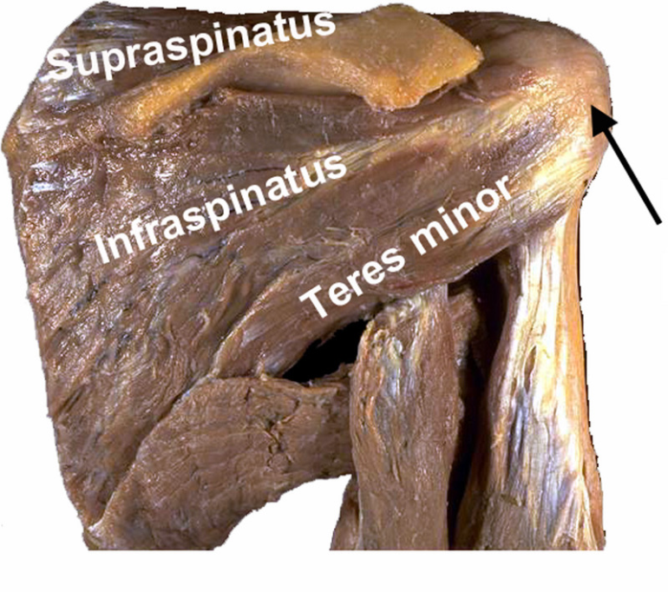
Evolutionary Similarities
Chimps and humans have similar rotator cuff structure. Fused tendons.
Other quadrupeds have separate cuff tendons
Why the difference?
  Theorized to have a more robust cuff structure as chimps need open chain stability?
Human Rotator Cuff
Chimpanzee Rotator Cuff
Mathewson, M. A., Kwan, A., Eng, C. M., Lieber, R. L., & Ward, S. R. (2014). Comparison of rotator cuff muscle architecture between humans and other selected vertebrate species. Journal of Experimental Biology, 217(2), 261–273.
Plate JF, Bates CM, Mannava S, et al., 2013.
Notes:
We talked in an earlier slide about the complex need in the primate shoulder design to dissipate ground reaction force and have a mechanism for open chain stabilization. Some of the structure of the primate shoulder including a larger glenoid and slightly increased joint congruency, was adapted to dissipate ground reaction force, However, primates needed other mechanisms to improve stability and allow for the mobility of open chain motion.
Evolutions answer was the more robust and fused RC structure. Now, begin to contemplate how hominids use their shoulder joint vs how chimps use their shoulder joint.

Slide 30
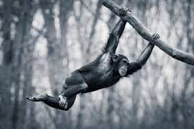
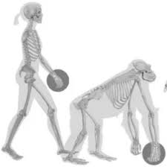
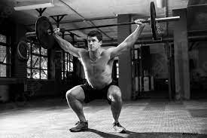
The Evolutionary Mismatch
Chimps and Humans have very similar shoulder structure
Do we use it in the same way?
The stability vs mobility design struggle
Not all open chain motion is the same. (Light vs heavy loads).
Santago AC, Plate JF, Shively CA, Register TC, Smith TL, Saul KR, 2015.
Notes:
When our primate ancestors produce significant amounts of force with their upper extremities, it usually happens within the biomechanical parameters of closed chain motion. Modern humans, on the other hand, use their shoulders primarily in an open chain when producing significant amounts of upper extremity force.
What stability mechanisms do we lose when we load the shoulder in an open chain? Recall the primates rotator cuff, which is very similar to ours, evolved to have the assistance of closed chain stabilizing mechanisms when producing significant amounts of force. When we load the shoulder in an open chain without the assistance of closed chain stability, the rotator cuff is the lone stabilizing mechanism.
This structure was never designed to work alone.

Slide 31
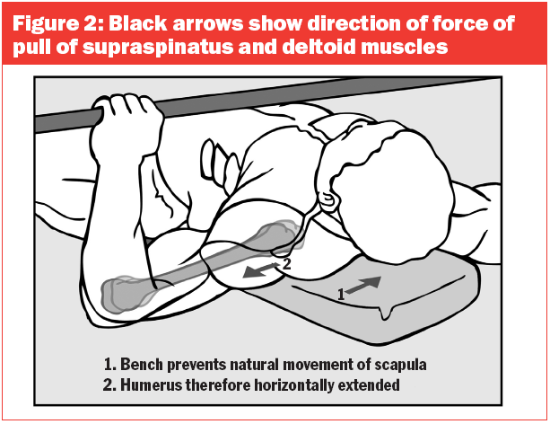
Another Cultural Mismatch
Excessively loading the upper extremity musculature without closed chain stability support. A recipe for RC tears
The bench press example
  Lying on the shoulder blades disrupts scapulo/humeral rhythm
  Increases GHJ motion
  RC has to stabilize this excessive motion
Pengine W.
Notes:
We have learned that the rotator cuff structure is not designed to stabilize heavy loads in an open chain. Its role is to help stabilize the head of t he humerus on the glenoid during upper extremity motion, thus providing a stable fulcrum for the muscles around the shoulder joint to work effectively. It evolved to have the assistance of closed chain forces when stabilizing heavy loads.
In modern culture, we perform progressive resistance exercises in an open chain, with heavy loads and in patterns that produce significant amounts of torque at the shoulder joint.
Lets review an exercise that takes place in an open chain and with heavy loads. The bench press.
What happens to our shoulder structure during the bench press? A flat bench restricts movement of the scapula. Recall the importance of maintaining scapulohumeral rhythm. When the scapula is not contributing to the movement, more motion is required at the GHJ. Excessive motion occurring at the ball and socket joint, demands more of the rotator cuff to stabilize. Over time, the rotator cuff tendons breakdown leading to shoulder pain and dysfunction.

Slide 32
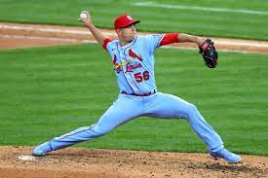
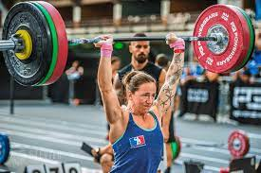
Re evaluate UE PRE
Re evaluate how we use and apply resistance to the vulnerable RC tissue?
Limit repetitive overhead activity
Be careful with loading the shoulder in an open chain.
  Especially if the scapulo-humeral rhythm is disrupted
Rotator Cuff Tendinopathy, edited by T.W. Post, published by UpToDate, 2022.
Notes:
Are we demanding too much from this vulnerable tissue? While we can’t change the fact that we function primarily in an open chain, we can change the way we resistance train the upper extremity.
The rotator cuff was designed to stabilize the GHJ with the assistance of closed chain forces. It is advantageous to exercise the upper extremity in multi joint patterns with closed chain forces to reduce the stress on the RC and preserve its health for the times it is needed to stabilize lighter loads in an open chain.
Let's review some of the evidence that supports this cultural mismatch in the next section of the shoulder series.

Slide 33
The Evidence Part I:
Support for Evolutionary Mismatch
Notes:
Lets review the evidence that supports the RC evolutionary mismatch theory.

Slide 34
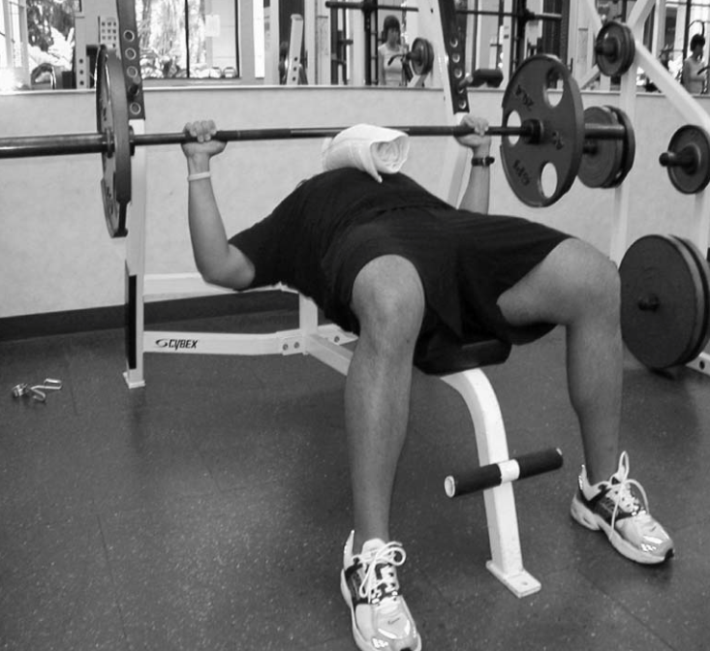
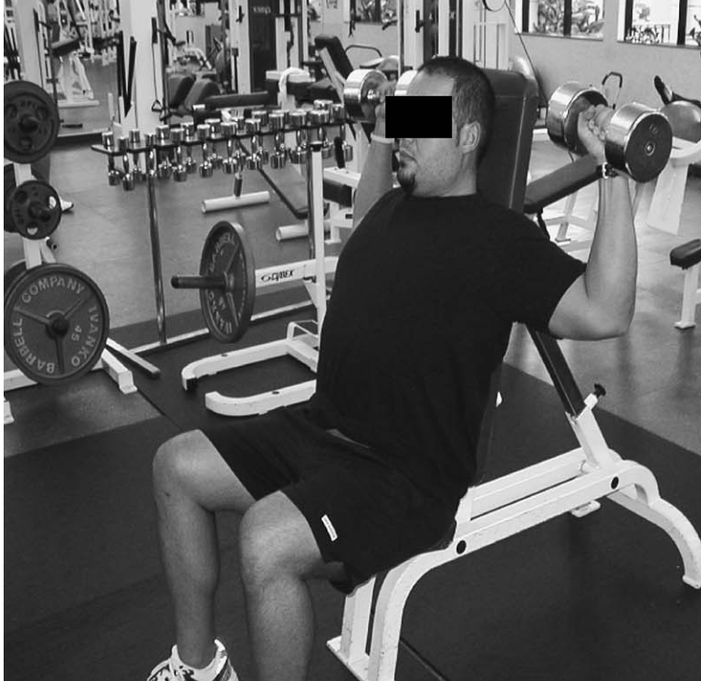
The Evidence
Shoulder Injuries Attributed to Resistance Training: A Brief Review
Most common sites of soft tissue injury included the biceps, rotator cuff, and pectoralis major muscles
Bench press frequently implicated as the causative factor
90 degrees of shoulder abduction and external rotation also position associated with injury
Kolber MJ, Beekhuizen KS, Cheng MSS, Hellman MA, 2010.
Notes:
Recall limiting motion at the scapula with cause excessive motion at the GHJ. Another position associated with instability is 90 degrees of shoulder abduction and ER. Based on these vulnerable position we just described, we shouldn’t be surprised that the bench press and open chain shoulder press were a causative factor for shoulder injury. With increased mobility and instability at the glenohumeral joint, the rotator cuff is likely overworked.

Slide 35

The Evidence
Shoulder pain disorders
The shoulder is the second most common joint for which the general population seeks medical attention.
RC is the most common problem
  Incidence of rotator cuff problems increases with age and is as high as 70% in the 70 to 79 y/o age group
Yamaguchi, Ken MD, Ditsios, Konstantinos MD, Middleton, William D. MD, Hildebolt, Charles F. PhD, Galatz LMM, Teefey SAM, 2006.
Notes:
In the human population, shoulder injuries are the second most common musculoskeletal disorder in which individuals will seek medical attention. Of these patients, the majority have rotator cuff dysfunction. The incidence of shoulder pathology increases as you age.
Compared to our last common ancestor, despite having similar shoulder structures, Homo sapiens are unique when it comes to the alarming incidence of rotator cuff pathology.

Slide 36
The Evidence: RC Pathology Chimps Vs Humans
Age-related degenerative functional, radiographic, and histological changes of the shoulder in non-human primates
11 monkeys (of varying ages)
  0% with partial or full thickness rotator cuff tears
  67% with degenerative joint disease
Mathewson, M. A., Kwan, A., Eng, C. M., Lieber, R. L., & Ward, S. R. (2014). Comparison of rotator cuff muscle architecture between humans and other selected vertebrate species. Journal of Experimental Biology, 217(2), 261–273.
Plate JF, Bates CM, Mannava S, et al., 2013.
Notes:
Let’s compare modern hominids to our primate ancestors. In the studied primate population, rotator cuff tears are nearly non-existent. In the study of 11 monkeys of varying ages none had partial or full thickness RC tears.
It was found, however, that their rates of joint arthritis were nearly 70%. Why is that? Chimps wear out their shoulder joints through the repeated dissipation of ground reaction forces. Joint OA is less common in human shoulders, as we primarily use the upper extremity in an open chain. When cases of human shoulder joint OA do occur it is frequently caused by RC dysfunction. When the RC is dysfunctional it fails to properly stabilize the humeral head on the glenoid with upper extremity motion, the joint is scoured, and the cartilage wears out.
BTW, humans have a similar incidence of joint OA in our lower extremity joints as chimps do in their upper extremity joints.

Slide 37
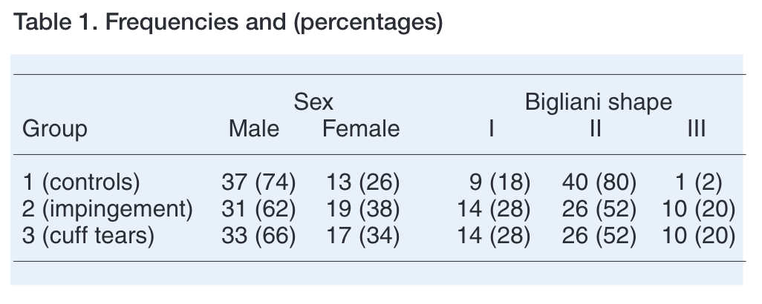
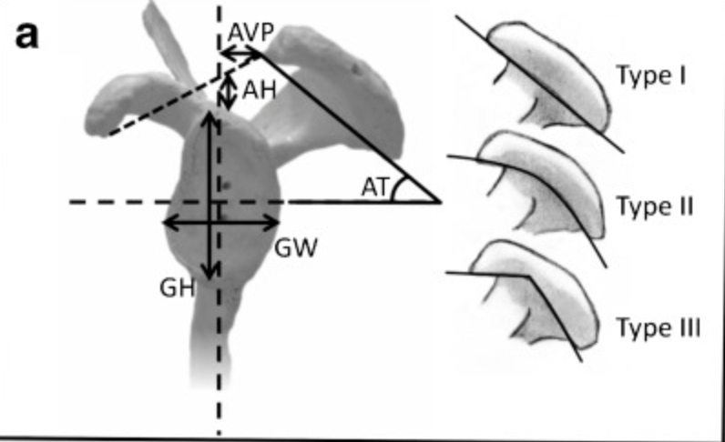
The Evidence
Correlation of acromial morphology with impingement syndrome and rotator cuff tears
Hooked acromion only occurred in patients with rotator cuff tears
There are other anatomical features associated with RC dysfunction in humans.
Balke M, Schmidt C, Dedy N, Banerjee M, Bouillon B, Liem D, 2013.
Notes:
So why are humans so prone to RC disease? This study looked at 50 patients with documented full-thickness supraspinatus tears, 50 patients with subacromial impingement syndrome with an intact rotator cuff, and 50 controls without symptoms related to impingement and a strong intact cuff.
Within the control group, only 2% of individuals had a type III acromion. This percentage is similar to the incidence we’d expect to see across the general population. That said, a type III acromion is quite rare. However, a type III acromion is not nearly as rare when we observe just the symptomatic groups. 20% of the impingement and RC tear groups had a hooked shaped acromion. Compare that to 2%. The increased percentage in the symptomatic patients indicates a predisposition to RC related injury associated with acromion type.
A hooked acromion is just one of the many studied anatomical features in humans that is commonly associated with risk of RC injury.
So then it must be the humans joint structure that is causing so much RC disease.

Slide 38
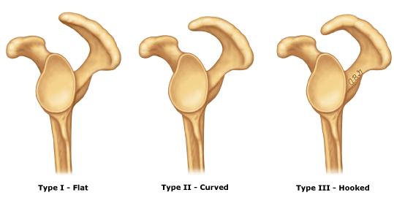
The Evidence: Acromion Shape
Subacromial space in African great apes and subacromial impingement syndrome in humans.
Primates - 60-70% with type III acromions
Humans - < 3% with type III acromions
  According to other sources - < 10%
Simmer Filho, J., & Kautsky, R. M. (2021, October 25). Limites da artroscopia na instabilidade anterior do ombro. Revista Brasileira de Ortopedia.
Potau JM, Bardina X, Ciurana N, 2007.
Notes:
As mentioned in the prior slide, humans with a type III acromion are more likely to suffer from shoulder impingement and rotator cuff disease. However, the hooked shape acromion is the least common type of acromion found in humans. It is present in less than 10% of individuals. RC disease is much more prevalent than that.
As we learned earlier chimps generally do not get RC disease. Based on the current evidence of rotator cuff tears seen in non-human primate species, we might expect to find that type 3 acromions are not prevalent in the chimp population. However, that is not the case. This “high risk” feature is present in 60-70% of primates. Yet they don’t suffer from the same level of RC dysfunction as humans. Do chimps use their shoulders the same way?
Are there other structural differences in the scapula that cause RC disease?

Slide 39
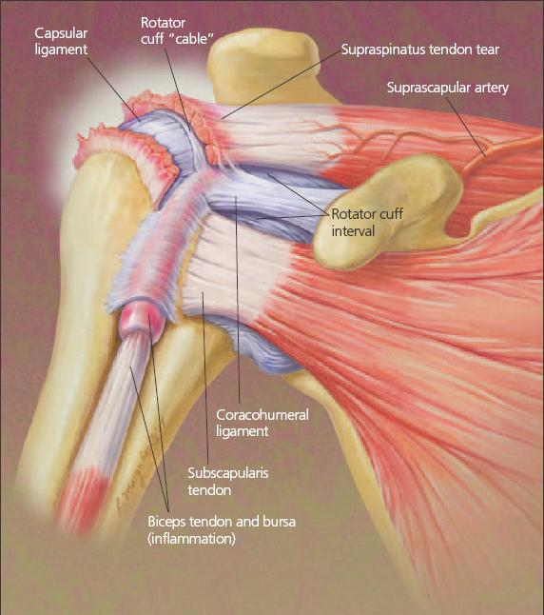
The Evidence
Human evolution and tears in the rotator cuff
Evidence of rotator cuff tears is completely devoid in the non-human primate literature
Studied - 22 human, 42 primates dry bone scapula
Of the 10 anatomical features associated with rotator cuff dysfunction/tears in humans, none were shown to be accentuated and significantly different between species
Craik JD, Mallina R, Ramasamy V, Little NJ, 2014.
Notes:
In the prior slide we mentioned that a type 3 acromion increased the likelihood of rotator cuff disease in humans. However, that same bony morphology does not impact the rotator cuff disease rates in the chimp population.
Here is another study demonstrating the lack of RC tears in the primate population. In this study, other structural features on the scapula that are associated with rotator cuff tears in humans were studied across primate species. Of these 10 anatomical features associated with rotator cuff tears in humans, none were shown to be significantly different in chimp populations that don’t experience this common orthopedic dysfunction.
So, the bony anatomy of the scapula and the RC structure are similar when comparing chimps to humans. However, humans are more prone to RC dysfunction. Why do we have such varied rates of injury?
We theorize it is do to the RC evolutionary mismatch.

Slide 40
The Evidence Part II:
A Stable Environment
Notes:
With the evidence we’ve shared up until this point, it should be clear that humans have a propensity towards rotator cuff tears and shoulder impingement injuries. This is the case, despite having very similar shoulder structures as our last common ancestor who does not suffer from this shoulder dysfunction.
We’ve theorized that this discrepancy in injury rates is due to the differences in how we use our shoulder structures. Modern humans function in ways that place a lot of stress on the rotator cuff. If the role of the cuff is to help stabilize the GHJ, then positions that are more inherently stable would reduce the demands on this stabilizing structure and therefore lesson the injury risk. Let’s review some of these positions.

Slide 41

The Evidence: Compression
Glenohumeral stability from concavity compression. Quantitative analysis
Concavity-compression of the humeral head into the glenoid is a most efficient stabilizing mechanism
  Important mechanism for providing stability in mid-range of GHJ motion where capsule and ligaments are lax
Lippitt SB, Vanderhooft JE, Harris SL, Sidles JA, Harryman DT, Matsen FA, 1993.
Notes:
Ground reaction forces through a joint increase its stability.
In this study, 10 cadaveric specimens were used to determine the degree to which compression of the humeral head in the glenoid fossa stabilizes it against translating forces. Compressive loads of 50N and 100N were applied to the humeral head perpendicular to the the glenoid surface. Translational forces were then applied to the humeral head until the humeral head dislocated over the glenoid lip. More translational forces were needed to dislocate the shoulder when the greater perpendicular force was applied - 100 vs 50N.
The study concludes that the concavity-compression of the humeral head into the glenoid is a most efficient stabilizing mechanism.
What is happening at the shoulder when the arm is supporting the body’s weight? Think about the push-up position.

Slide 42

The Evidence: Reaction Forces
Experimental investigation of reaction forces at the glenohumeral joint during active abduction
90 degrees of scapular plane abduction = most stable GHJ
Reaction forces at the GHJ counterbalance the mass moment of the UE during shoulder motion
Directly related to the activity of muscles (deltoid and supraspinatus) across the joint
  Why is a 90 degree angle is so stable?
Apreleva M, Parsons IM, Warner JJP, Fu FH, Woo SLY, 2000.
Notes:
It's not just about compression in the joint, the position of the humerus in the glenoid also contributes to stability. As the shoulder joint moves, reaction forces of the RC and Deltoid counterbalance the mass moment of the upper extremity. At 90 degrees abduction, the muscles around the shoulder joint have the best mechanical advantage to provide glenohumeral joint stability. Stability of the glenohumeral joint depends on seating of the humeral head into the glenoid. Seating occurs not only through gravitational compressive forces, but also through our muscles’ ability to contract thus pulling the humeral head closer to the joint surface.
Why is this 90 degree angle the most stable? Because millions of years of evolution say so. What position is your upper extremity in when you are on all fours?

Slide 43

The Evidence: External Stability
Biomechanical Differences of Open and Closed Chain Exercises with Respect to the Shoulder
Supraspinatus muscle activity was shown to be decreased in closed chain exercise when compared to a comparable open chain exercise
Dillman CJ, Murray TA, Hintermeister RA, 1994.
Notes:
What happens if we do not utilize ground reaction forces, caused by gravity, when resistance training our upper extremities?
This study compared OKC and CKC equivalent exercises. This graph demonstrates the EMG activity of shoulder muscles during a bench press and a push-up. Notice how active the supraspinatus is during the bench press (on the right) when compared to the push-up (on the left).
When the supraspinatus is less active, we can assume it does not have to work as hard to create joint stability. For the push-up in particular, we maximize GHJ congruence through not just the position of our arms relative to our body, but also with the coupling effect of gravity pushing downwards and ground reaction force equal and opposite pushing upwards at the joint. As you can see, a closed chain environment allows for other external factors to help create stability at this joint and we no longer have to rely on the small rotator cuff to be our sole mechanism of providing stability.
We have known this for a long time, and yet we still force open chain motion on the most commonly injured RC tendon.

Slide 44

The Evidence: External Stability
In the same study, the supraspinatus is just as active when we compare wall push-ups with lower load bench press. Why?
Dillman CJ, Murray TA, Hintermeister RA, 1994.
Notes:
Not all push ups are alike when it comes to stabilizing the shoulder joint.
In this example comparing the wall push up to a lighter load bench press, the supraspinatus activity is almost equal. Why is the supraspinatus so much more active during the wall push-up? Are gravity and ground reaction forces able to stabilize the GHJ in this position?

Slide 45

The Evidence
Shoulder musculature activation during upper extremity weight-bearing exercise
Alterations of weight-bearing exercises, by varying the amount of arm support and force, resulted in very different demands on the shoulder musculature.
Specifically, the infraspinatus was particularly active during the weight-bearing exercises used in this study
  Is it a good idea to reduce supraspinatus stress?
Uhl TL, Carver TJ, Mattacola CG, Mair SD, Nitz AJ, 2003.
Notes:
So if the supraspinatus is less active during the military style push up where is the muscular stability coming from? This study suggests that it is coming from the posterior musculature of the shoulder and the infraspinatus was particularly active during weight bearing exercises and co-contracts with the posterior deltoids.
While the posterior cuff including the infraspinatus and teres minor are still 2 of the main musculature components of the rotator cuff structure, they are far more robust than the supraspinatus and can handle a greater load. Injury to this tissue frequently occurs secondary to an injured supraspinatus.
When we take this one step further and consider why the infraspinatus is more engaged with increased weight bearing, it is functioning more so to block the posterior shear forces at the GHJ when it is under the influence of gravitational forces, rather than working aggressively to stabilize a long unstable lever.
Since the supraspinatus is the most vulnerable of the RC structure it is most likely a good idea to shift the burden away from it.

Slide 46



The Evidence: Neurological Recruitment
Kinematic and electromyographic comparisons between pull-ups and lat-pull down exercises
Greater levels of spinal stability required with suspended pulling exercises
Doma K, Deakin GB, Ness KF, 2013.
Notes:
Now we have learned that we can create intrinsic stability in the shoulder joint through optimal positioning and compression forces. Can we also elicit a stabilizing response at the core if we exercise in a manner where the core is not supported? These next studies suggest we can.
Here is a study that looks at the EMG activity of certain muscles during comparable pulling type exercises: the pull-up and the lat pull-down. These exercises target similar muscles. However, the lat pull-down is an open chain movement with a stable core while the pull-up is a closed chain movement with an unstable core. The chin-up exercise demonstrates greater shoulder joint range of motion.
In the chin up, the unfixed segment (core) and the greater shoulder joint ROM increases instability and thus increased emg activity was found in the erector spinae and biceps musculature when compared to the lat pulldown. This study is the first step in understanding the increased emg activity in exercises that take place in a hanging position.

Slide 47

The Evidence: Neurological Recruitment
Muscle activity and spine loading during pulling exercises: Influence of stable and labile contact surfaces and technique coaching
Distraction forces w/ chin-up & pull-ups cause greater core muscle activity as they assist in the exercise and attempt to stabilize the spine
Higher EMG activity of muscle attaching scapula to the spine with CKC pulling compared to OKC pulling exercises
  Proximal stability at the shoulder helps the rotator cuff
McGill SM, Cannon J, Andersen JT, 2014.
Notes:
This study supports the idea that there is an increased need for stability with hanging pulling exercises. While this study does not evaluate the scapulo spinal stabilizers, it does look at the primary superficial core stabilizers. One of its comparisons is the emg activity between the chin up/pull up exercise and the reverse trx fly. The chin/pull up demonstrated significantly higher amounts of emg activity in all the core musculature studied.
So it is not just the erector spinae, the major core muscles are all more engaged when performing pulling movements from a hanging position.
However, no emg activity was studied on musculature that directly attached the shoulder blade to the spine. Does dealing with this instability cause increased scapulothoracic stability? Being the base of the rotator does it reduce RC stress?

Slide 48


The Evidence
Instruction and feedback for conscious contraction of the abdominal muscles increases the scapular muscles activation during shoulder exercises
During various shoulder exercises, when participants increased conscious abdominal contraction, EMG activity of the serratus anterior and upper, middle, and lower traps also increased
Vega Toro AS, Cools AMJ, de Oliveira AS, 2016.
Notes:
Does the stability in the core transfer to the scapula stabilizers?
This study looked at emg activation of the traps and serratus anterior while performing closed chain shoulder exercises. It was found that EMG activation of these targeted muscles improved when the participants were cued and instructed to engage their abdominal muscles. So, core activation can improve scapular muscle activation.
The exercises used in this study caused compressive, rather than distractive, forces at the shoulder joint. As such, they cannot be used to directly correlate to hanging closed chain movements and emg activity. However, the study does support a facilitatory effect and the notion that proximal stability leads to greater muscle fiber recruitment at the joints distal to it. So, more core stability, results in more scapular stability.

Slide 49

The Evidence
Scapular muscle activity in overhead and nonoverhead athletes during closed chain exercise
High levels of EMG muscle activity in lower and middle traps with the supine pull-up exercise.
When we strengthen in isolation, you don’t get the additional contribution from the scapular stabilizers that engage due to a neurological response for the needs to stabilize. And without that, you passively force that “impingement” position.
Tucker WS, Bruenger AJ, Doster CM, Hoffmeyer DR, 2011.
Notes:
And finally, this study shows the high muscle activity that occurs in the scapular stabilizers during closed chain suspensory exercises. It can be theorized that the increase in activity in stabilizing muscles can thought of as a neurological protective response that occurs when the joints of the body are subjected to a strong traction force. When the weight of the body is suspending through the upper extremities, the surrounding muscles subconsciously increase their activation to protect against dislocation.
This neurological muscular response may also offer protection against going into a passive impingement position of the shoulder. During open chain motion, such as a lat pull-down, we are targeting muscles more so in isolation as opposed to synergistically in a closed chain. Without the co-contraction of the proximal muscles that offer joint stability at the spine, scapulothoracic, and GHJ, our shoulders are susceptible to passive impingement.
So we now have evidence supporting the other side of closed chain exercise. The side without ground reaction compression. Is it Evolutionary?

Slide 50
The Evidence Part III:
CKC vs OKC Exercises
Notes:
Closed chain exercises are advantageous because they help create a more stable and safe environment for the rotator cuff to function. In this chapter let’s review more evidence that supports the use of closed chain exercise in our resistance training protocol and rehab approach.

Slide 51




The Evidence
Electromyography activation of shoulder muscles during open and closed chain exercises for upper extremity
Pozzi F, Plummer HA, Sanchez N, Lee Y, Michener LA, 2019.
Notes:
Let’s start with this study which compared open and closed chain exercises targeting the upper extremity musculature.
The following slides will compare the closed and open chain equivalent at equal intensity - 5 rep max.
In this graph, you can see that in the closed chain push up, there is lower activation of the deltoid and upper trapezius, but greater for the serratus anterior, middle and lower trapezius, core musculature, and infraspinatus compared to the horizontal press.

Slide 52



The Evidence
Electromyography activation of shoulder muscles during open and closed chain exercises for upper extremity
Pozzi F, Plummer HA, Sanchez N, Lee Y, Michener LA, 2019.
Notes:
In this graph, the closed chain chin-up demonstrated greater muscular activity for all muscles analyzed compared to the lat pull-down.

Slide 53



The Evidence
Electromyography activation of shoulder muscles during open and closed chain exercises for upper extremity
Pozzi F, Plummer HA, Sanchez N, Lee Y, Michener LA, 2019.
Notes:
The next exercise in this study compared closed chain inverted rows to horizontal rows. Again, the activation of the infraspinatus, serratus anterior, and middle and lower trapezius was greater compared to the open chain row. The deltoid was the only variable muscle but still favored closed chain exercise.

Slide 54



The Evidence
Electromyography activation of shoulder muscles during open and closed chain exercises for upper extremity
Pozzi F, Plummer HA, Sanchez N, Lee Y, Michener LA, 2019.
Notes:
What happens when we compare the tricep dip to the tricep press down? Again, muscular contraction favored the closed chain performance. I think at this point we are noticing a trend!

Slide 55



The Evidence
Electromyography activation of shoulder muscles during open and closed chain exercises for upper extremity
Pozzi F, Plummer HA, Sanchez N, Lee Y, Michener LA, 2019.
Notes:
Still not convinced? Again, greater muscular activation in closed chain shoulder depression compared to open chain shoulder depression.
Throughout the previous slides, it is clear that when evaluating emg activity between exercises that target specific muscles either in a closed chain or open chain that the closed chain exercises engages the spinal and scapulothoracic stabilizers to a much greater extent. This stability controls the scapular position and maintains the correct biomechanical alignment for the vulnerable RC tissue.
Why train the upper extremity any other way? Let's continue with the evidence supporting closed chain upper extremity PRE.

Slide 56

The Evidence
Muscle activity levels in upper-body push exercises with different loads and stability conditions
Elastic-resisted push-ups induce similar EMG stimulus in the prime movers as the bench press at high loads while also providing a greater core challenge.
Two biomechanical similar exercises, same intensity - does the body know the difference?
Calatayud J, Borreani S, Colado JC, Martin F, Rogers ME, 2014.
Notes:
I am often asked if closed chain exercise can improve muscular performance to the same extent as open chain exercise when targeting similar muscles.
This study compared EMG muscle activity during a bench press and push-up exercise. Here we are comparing two biomechanically similar exercises at the same relative load and intensity. Does the body understand the difference? Both produce similar strength adaptations. It's all about the load and volume! Not the exercise you are doing. Why not choose the safer alternative?

Slide 57

The Evidence
Bench press and push-ups at comparable levels of muscle activity results in similar strength gains.
Calatayud J, Borreani S, Colado JC, Martin F, Tella V, Andersen LL.
Notes:
Here is the data from the previous study for your review. As you can see, with a six repetition maximum bench press and 6RM elastic band push-up, both groups improved their 1RM and 6RM tests significantly with similar gains. The control group remained unchanged.

Slide 58

The Evidence
Closed-kinetic chain upper-body training improves throwing performance of NCAA Division I softball players
3x/week for 12 weeks, the CC exercise resistance training group showed greater improvements in
  Throwing velocity
  ER peak torque & power
  Peak power shoulder flexion
Prokopy MP, Ingersoll CD, Nordenschild E, Katch FI, Gaesser GA, Weltman A, 2008.
Notes:
This study compared a comprehensive upper body closed chain resistance program to an open chain program, and looked at how adaptations impacted performance outcomes in 14 D1 collegiate softball players. The program was implemented 3x/week for 12 weeks and by the end of it, the closed chain group had better performance outcomes relating to speed, power, and torque as you can see listed here.

Slide 59



The Evidence
CKC exercises with eccentric and strength exercises for the shoulder injuries prevention in student rock climbers (RCT)
N = 84 (44 control, 40 experimental)
Shoulder injuries after 1 year
  3 total in experimental (2 mild, 1 moderate, 0 severe)
  21 total in control (8 mild, 7 moderate, 6 severe)
Kozin S, Cretu M, Kozina Z, et al., 2021.
Notes:
This study is a RCT that looks at injury prevention programs for 18-19 year climbers. A group of individuals particularly prone to shoulder injury. A group of 84 male rock climbers were randomized into 2 groups: an intervention group which performed specific closed chain exercises and instructed in proper climbing technique and a control group who only received the same instruction without closed chain exercise.
Each group went through a 1 year training program with 3-4 training sessions / week (150 total) for each group. Injuries were recording as minor (heals in <1 month), moderate (heals in 2-3 months) or severe (6-12 months). The injury rates during and after the 1 year of intervention were as follows:
The control had 8 mild, 7 moderate, 6 severe. The intervention group only had 2 mild, 1 moderate, and no severe injuries.
That’s 21/44 or 47% in the group who did not perform CKC exercises and only 3/40 or 7.5% in those who did. And none of these were severe in intervention group.

Slide 60

The Evidence
VS
Kozin S, Cretu M, Kozina Z, et al., 2021.
Notes:
Is there an evolutionary link to the way we should strength train our upper extremities? The research seems to say yes.

Slide 61
The Evidence Part IV:
The Future of RC Rehab
Notes:
In this final chapter we will talk about the pitfalls of the current approach to the treatment of those with rotator cuff dysfunction. All of the prominent clinical practice guidelines used for the treatment of those with rotator cuff disease are based on an open chain, range of motion focused protocol.
In this chapter, we hope to give you new insight into the treatment of those with rotator cuff pathology. Specifically, as it relates to rest, tendon adaptation, and the early introduction of closed chain exercise.

Slide 62



Current Model of Conservative Care
Traditionally, conservative management of rotator cuff disease consists of:
Open chain exercise
Stretching
Joint mobilizations
Manual therapy
Only include closed chain
exercise later on in the rehab process
The Physical Therapy Advisor. (2016, March 9). How to maintain healthy joint motion.
MEND Physical Therapy. (2020, January 23). How long should you hold shoulder isometric exercises? Sears, B. (2023, March 20). Rotator cuff exercises with a resistance band. Verywell Health. Rotator Cuff Tendinopathy, edited by T.W. Post, published by UpToDate, 2022.
Notes:
When someone experiences a rotator cuff injury, conservative therapeutic measures are usually the first step in the recovery process. The most typical conservative therapeutic care of rotator cuff dysfunction consists of open chain light exercise and passive stretching and joint mobilizations.

Slide 63


Clinical Presentation
Typical clinical signs and symptoms:
Limited range of motion
Pain with motion
Weakness
Decreased quality of life
Decrease ability to perform ADLs
Unable to perform athletically
MechanoTherapy. (2024, October 20). Frozen shoulder treatment: Rehabilitation techniques for restoring shoulder mobility. MechanoTherapy
Boda Health. (n.d.). Rotator cuff injuries and frozen shoulder.
Rotator Cuff Tendinopathy, edited by T.W. Post, published by UpToDate, 2022.
Notes:
With this patient presentation it is logical to design a treatment plan that is ROM focused? Maybe not. Ask yourself why is the shoulder tightening down? Why does it hurt when the arm moves?

Slide 64


Thinking more deeply about RC Dysfunction…
The RC functions to dynamically stabilize the glenohumeral joint
When RC is not functioning, the joint cannot effectively be stabilize
As a result, the joint capsule stiffens to increase stability and allow the vulnerable tissue to rest
Notes:
The body is constantly attempting to heal itself. The shoulder will tighten as a way to increase stability and allow the rotator cuff time to heal. If motion is limited does the cuff have to work hard to stabilize the joint?
When we force motion on a tight/painful shoulder, are we helping the healing process? I don't think so. We are attempting to improve motion that will in fact place more stress on the vulnerable RC tissue. My advise. Let it rest and tighten.
In addition when we prescribe exercises in an open chain we are putting undue stress on the damaged rotator cuff tissue. Remember tendons take time to heal and adapt with forces that are specific to the tendon. Time under tension, below pain threshold, is the key to adapting tendons.

Slide 65

Surgical Intervention
What happens when conservative management does not work?
Surgical intervention
  Studies show 20-91% of all RC repairs fail
    Percentage ranges depending on severity, other factors
  Is it the surgery or the post repair exercise protocol?
Does our current medical/exercise model have the answer?
Aouad, D., & El Rassi, G. (2021). Patient in beach chair position, with insertion of the anterolateral portal into the right shoulder under direct vision from the posterior portal.
Kluger R, Bock P, Mittlböck M, Krampla W, Engel A, 2011. Longo UG, Carnevale A, Piergentili I, et al., 2021.
Notes:
So what happens when conservative care fails?
Many will seek out surgical intervention. However, this invasive and expensive approach does not demonstrate optimal outcomes either. A significant percentage of these patients end up retearing this vulnerable tissue.
Is it a surgical issue? Or is it the ROM focused approach to the rehab process?

Slide 66

No Clear Path w/ RC Dysfunction
Systematic review limited to outcomes in patients (n = 4542) with full-thickness tears participating in randomized trials
Consistent improvements in shoulder symptoms and function at one-year follow-up regardless of treatment approach
Comparing surgical and nonsurgical management, no clear benefit to surgery
  Exception: Early on post surgery there seems to be improved functional outcome measures and reduced pain.
Conservative Care
Surgical Intervention
VS
Khatri C, Ahmed I, Parsons H, et al., 2019.
Notes:
Here is some data that may surprise you. This systematic review analyzed the long-term functional outcomes of patients with full-thickness rotator cuff tears comparing surgical and conservative management. Regardless of the treatment approach, all patients showed improvements with no clear benefit to surgery.

Slide 67
Comparing Conservative Approaches
Comparison of three types of exercise in the treatment of rotator cuff tendinopathy/shoulder impingement syndrome: A RCT
Compared OC, simple ROM and CC exercise.
  All three programs resulted in improvement of the functional outcome measure.
  CC group had highest dropout rate due to rigorous protocol
  CC group achieved most meaningful reduction in pain and disability
Open Chain Protocol
Closed Chain Protocol
Simple Range of Motion Protocol
VS
VS
Heron SR, Woby SR, Thompson DP, 2017.
Notes:
This study shows that when comparing different intervention programs for individuals with rotator cuff dysfunction, all individuals improved significantly on their functional outcomes over the course of the treatment period. The group participating in the closed chain program, however, had the highest dropout rate. When those who dropped out of the program were not included in the analysis, the closed chain exercise group showed the most meaningful improvement in terms of function and pain levels.
Why such the high dropout rate? It is likely due to the fact that CC exercises are more difficult to perform. Throughout the lab content, you will see how we can combat these challenges through the use of assistance loop bands.

Slide 68

The Case Study That Started It All
The use of a modified connective tissue adaptation phase and closed chain PRE program in the treatment of a patient with a failed rotator cuff repair: A case report
2 failed RC surgical repairs. Referred to total reverse arthroplasty
Closed chain PRE resulted in significant improvement in pain and function
A medical anomaly, but why?
Luedeka, Michener, 2013.
Notes:
This case study was special. This subject underwent 2 operations to repair a full thickness RC tear through the supraspinatus and partially through the infraspinatus. Both surgical interventions failed. The orthopedic surgeons did not have any more answers except for a reverse total shoulder arthroplasty.
A rehab program was initiated that focused initially on tendon strength and then on a multi joint, closed chain, progressive resistance exercise program. ROM was not the focus of the treatment protocol. The western ontario rotator cuff index was used to evaluate the functional outcome. Why choose this outcome measure. It has a section that looks at higher functional upper extremity activities. Sport specific activities to be exact.
The case study showed that with the use of progressive resistive closed chain exercise program the subject was able to return to higher levels of functional activity. It was not just self care, rom and pain that improved.

Slide 69

Safe & Effective PRE Needed in Rehab
Heterogeneous muscle gene expression patterns in patients with massive rotator cuff tears
Progressive and irreversible loss of RC function happens with RC disease. Muscle replaced w/ fat.
Fatty infiltration happens slowly over time as the anabolism / catabolism battle is slowly lost to the increasing mechanical stress on the tendon
Finosh, G. T., Dilisio, M. F., & Agrawal, D. K. (2016). The MRI images of RC. In panel A the normal RC anatomy and the attachment to the shoulder bones are shown. In Immunobiological factors aggravating the fatty infiltration on tendons and muscles in rotator cuff lesions. Molecular and Cellular Biochemistry.
Gibbons MC, Fisch KM, Pichika R, et al., 2018. Yi JW, Cho NS, Cho SH, Rhee YG, 2010.
Notes:
This slide demonstrates the importance of maintaining muscle function in the upper extremity and the remaining rotator cuff tissue. If the RC disease process is left unchecked it will progress and the muscle tissue will be replaced with fat.
Appropriate closed chain exercise and tendon care to the remaining structure can prevent this from occurring.

Slide 70

A New Treatment Approach
Prolonged rest and immobilization post injury or surgery
Early introduction to closed chain exercise to assist the RC in shoulder joint stability
Stop forcing joint motion and stretching the vulnerable tissue
Use of a long period of connective tissue adaptation for the tendon (high reps, low load)
Targeted open chain motion restoration after 10 to 12 months
Patient education to prevent reoccurrence
Notes:
We are not maximizing patient outcomes with the traditional approach to rotator cuff rehab.
So what should we do differently? A new approach is being used, which is producing superior outcomes, to treat those with RC tears and dysfunction.
The approach is not ROM focused. It includes a rest period, a tendon adaptation period and closed chain exercise is primarily used to restore upper extremity muscle strength.
We will teach you more about this new approach in the lab content of this course.

Slide 71
Conclusion
Notes:
This concludes CKC systems lecture on the Shoulder and the rotator cuff evolutionary mismatch. I hope this course gives you a new perspective on the treatment of RC dysfunction.
I know for me it was a good day when I no longer felt the pressure to have to stretch a tight painful shoulder and worry about patient retention. This approach offers a new, less painful, way to treat RC disease. It has proven to create superior outcomes when compared to the traditional approach.
Let this be the start of your why journey. Thank you

Slide 72



References

