Slide 1
The Spine
David Luedeka PT, DPT, MS, CSCS
Keila Strick PT, DPT, CSCS
Caroline Williams, PT, DPT, MS, GCS
Nick Roche, PT, DPT, CSCS
Notes:
Hello, my name is David Luedeka. I am a physical therapist and certified strength and conditioning specialist. I am the founder of CKC Systems. I have been a practicing clinician for almost 30 years now. During this time, I have been on a quest to gain a deeper understanding of our evolutionary anatomy in the hope that with a deeper understanding of the forces that shaped our structure, I would more effectively be able to assist my clients in overcoming their musculoskeletal dysfunctions. Through this process, I have gained valuable insight that will help you become a more impactful provider or trainer. I hope you have enjoyed learning about the foot, knee and hip with Keila and Frank. Join me now as I lead you through CKC systems course the spine!

Slide 2
Evolution of the Spine
Notes:
Welcome to Evolution of the spine. The most common musculoskeletal complaint people seek medical support for is low back pain. Studies show up to 80% of us will experience low back pain during our lives. As providers, do we ever step back and ask ourselves why?
To answer the why question when it comes to low back pain, you must go back in time. Past environments shaped our structure through evolution. Some of these structural adaptations remain with us today and are maladapted to modern culture.
Ultimately, this is the reason why up to 8 of 10 of us will experience low back pain. Why is it important to understand the root causes of these dysfunctions? Because it helps us understand how to effectively treat low back pain. Having a deeper understanding of our spinal structure and evolutionary mismatches will help healthcare providers design more impactful treatment programs. Now let's get started.
Urits I, Burshtein A, Sharma M, et al. Low Back Pain, a Comprehensive Review: Pathophysiology, Diagnosis, and Treatment. Curr Pain Headache Rep. 2019;23(3):23. Published 2019 Mar 11. doi:10.1007/s11916-019-0757-1

Slide 3
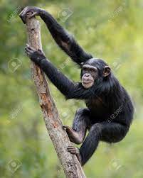
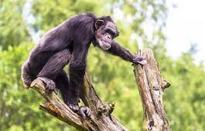
Our Evolutionary Past
Adapted to climb trees and walk on all fours, not adapted to ambulate as bipeds on two feet
Aiello L, Dean C, 1990. Holowka NB, Lieberman DE, 2018.
Notes:
In our evolutionary past, our ancestors were better adapted to climb and walk quadrupedally, rather than to ambulate on two legs like modern homo sapiens. As we learned in the last two lectures, there were significant adaptations in our lower extremity structure to allow for a more refined bipedalism. Today’s lecture will focus on the changes that occurred to our spines. These changes also made it easier for us to stand upright and walk bipedally.

Slide 4
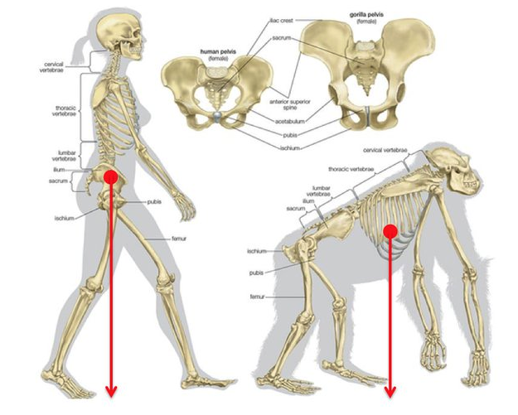
Evolutionary Changes
Why the changes to the spine?
The need to expand foraging area to attain more calories.
Allowed us to stand upright and maintain our COM within our BOS
Balanced bipedalism is more energy efficient.
Lieberman DE, 2013. Williams SA, Russo GA. 2015.
Notes:
What is theorized to be the main driver of the evolutionary adaptations to our spine? The quest for calories. Our spines adapted to allow us to stand upright and more efficiently walk on two legs. Bipedalism is more energy efficient when compared to quadrupedalism.
For those of you who have heart rate monitors and treadmills why don't you try something at home. Monitor your heart rate at an easy bipedal walking pace, say 2 mph, on flat ground. Now try the same thing crawling. During which mode of ambulation was your heart rate higher?

Slide 5
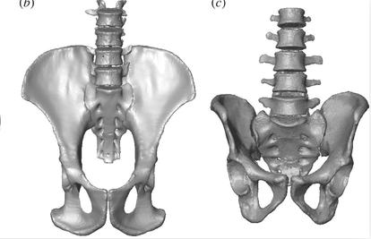
Our Evolutionary Past
Non-human primates compared to Homo sapiens…
Fewer lumbar vertebrae
Lack a lumbar lordosis
Spines are less flexible
Lack wedge shaped vertebrae
Been E, Gõmez-Olivencia A, Kramer PA, 2012. Lieberman DE, 2013. Williams SA, Russo GA, 2015.
Notes:
Our primate ancestors had fewer lumbar vertebrae and thus their spines were less flexible. Their vertebrae were not wedged shaped posteriorly and as such they lacked a lumbar lordotic curve. Our structural past made it difficult to place our COM within our BOS when standing, and thus bipedalism was difficult.

Slide 6
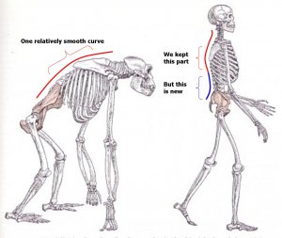
Evolutionary Changes
Increased number of lumbar vertebrae
Improved Mobility
Increased angle of lumbar vertebrae to allow for lordosis (wedging)
Primary and secondary curves
Been E, Gõmez-Olivencia A, Kramer PA, 2012. Lieberman DE, 2013. Williams SA, Russo GA, 2015.
Notes:
Modern Homo sapiens have 5 lumbar vertebrae that are wedge shaped posteriorly. This allowed us to place our COM within our BOS when standing. Another consequence? Our spines became much more mobile.
Let's look at some of these changes in more detail.

Slide 7
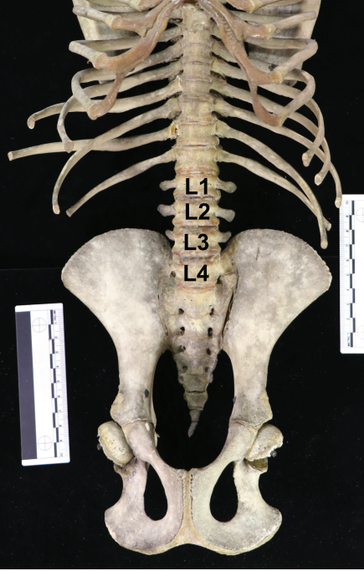
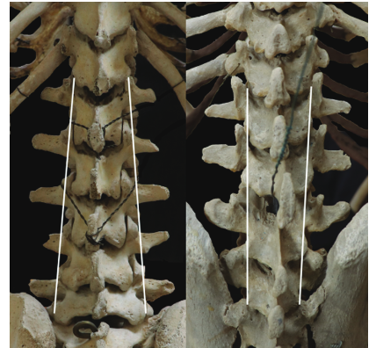
Evolutionary Changes
Past:
Fewer lumbar segments (3-4)
Present:
Increased number of lumbar vertebrae (5)
Selby, M. S., Gillette, A., Raval, Y., & Sampson, M. J. (2019). Dorsal view of human (Homo sapiens, left) and gorilla (Gorilla gorilla, right) lumbar spines. In Modern medical consequences of the ancient evolution of a long, flexible lumbar spine. Journal of Osteopathic Medicine
Selby, M. S., Gillette, A., Raval, Y., & Sampson, M. J. (2019). Ventral view of chimpanzee (Pan troglodytes) skeleton. In Modern medical consequences of the ancient evolution of a long, flexible lumbar spine. Journal of Osteopathic Medicine.
Williams SA, Russo GA, 2015.
Notes:
As you can see our primate ancestors had fewer lumbar vertebral segments. This is due to their increased need for spinal stability. Quadrupedal locomotion requires a strong and stable “bridge” between forelimbs and hindlimbs. The trunks more rigid structure resists flexion/bending moments during the quadrupedal gait cycle.
Think about where a primates COM is when they are on all fours and how gravity impacts its suspended position. If a primates spine were to be too flexible there would be lots of sag in the core. This sag would result in reduced efficiency in the quadrupedal gait.
Compare that to modern homo sapiens where our COM is supported in a position that allows for our LE to directly carry the load created by our mass. This is the main reason bipedal gait is more energy efficient. Homo sapiens do not need as much muscle activity to move about the planet.

Slide 8
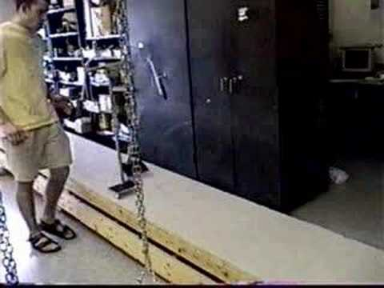
Evolutionary Changes: Gait Efficiency
Tedrake, R. (2024). Underactuated Robotics: Algorithms for Walking, Running, Swimming, Flying, and Manipulation[Course notes, MIT 6.832]. MIT CSAIL.
Notes:
To demonstrate that point, here in a video example, you can see this powerless, muscle-less, and brain-less structure moving independently. How is that? This passive walking machine moves by inertia and gravity, demonstrating just how efficient bipedal gait can be.

Slide 9
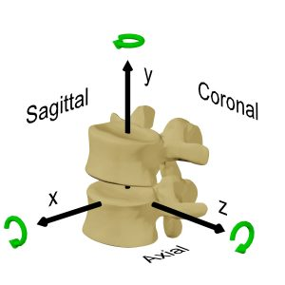
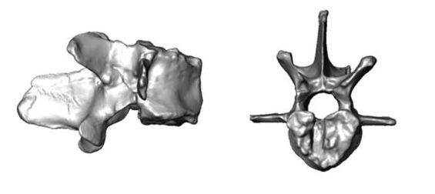
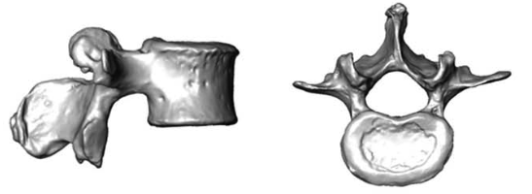
Evolutionary Changes
Old World Monkey
Past:
LS facets in frontal plane
Robust Processes
Present:
Sagittal orientation of LS facets
Homo sapien
90* from plane = axis of rotation:
X = coronal/frontal plane motion
Y = axial/transverse plane motion
Z = sagittal plane motion
Williams SA, Russo GA, 2015. Image source: Lumbar Spine Online Textbook
Notes:
As mentioned many times now our primate ancestors lumbar spine stability came from having fewer lumbar vertebrae, but there are other structural differences such as the orientation and size of the facets joints and processes. Our primate relatives have facets oriented to limit flexion/extension motion and more robust processes to block the same.
Image source: https://www.wheelessonline.com/issls/section-3-chapter-6-biomechanics-of-motion-preservation-technologies/#:~:text=This%20axis%20is%20the%20%E2%80%9Caxis,a%20neutral%20position%20(b).

Slide 10
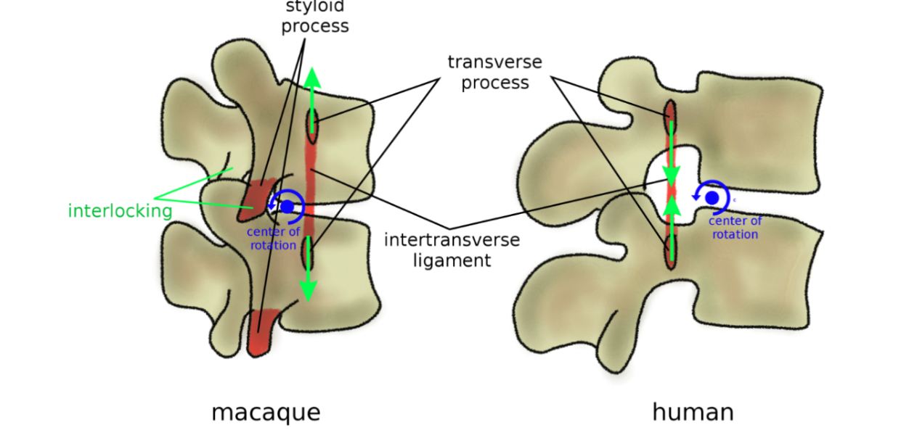
Evolutionary Changes
Past
Anteriorly positioned and forward angled transverse processes
Styloid process as bony block to extension movements (red)
Present
Further posteriorly positioned and angled transverse processes
Absent styloid processes
Galbusera F, Bassani T, 2019.
Notes:
This slide further demonstrates the loss of stability as we transitioned to bipedalism. This graphic depicts the anatomical protection mechanisms to avoid hyperextension in quadrupedal primates shown on the left, when compared with humans shown on the right.
In non-bipedal primates, the anteriorly positioned transverse processes and its associated ligament structure, help to limit extension sag and vertebral rotations. Additionally, their lumbar vertebrae commonly possess a styloid process which acts as an osseous block to facet sliding in spinal extension. In humans, however, these protection mechanisms were lost as the transverse processes are positioned posteriorly and we don’t have styloid processes.

Slide 11
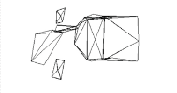
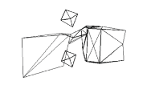
Evolutionary Changes
Homo sapien
Primate Ancestor
Past:
Non-wedged shaped vertebra
Present:
Increased wedging of lumbar vertebrae to allow for lordosis
Been E, Gõmez-Olivencia A, Kramer PA, 2012. Plomp KA, Viarsdóttir US, Weston DA, Dobney K, Collard M, 2015.
Notes:
So continuing on in our quest to stand upright, the lumbar spines became more wedge shaped, contributing to the creation of the lumbar lordosis. As you can see on the left, the posterior height of the human lumbar vertebral body is less than our primate ancestors allowing for a concave posterior curve.

Slide 12
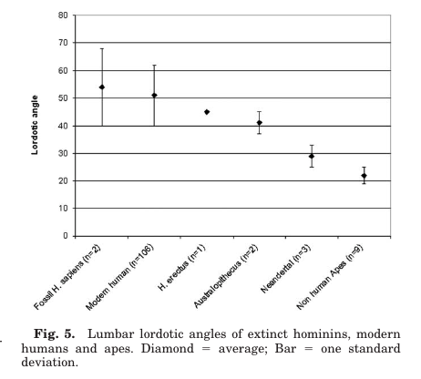
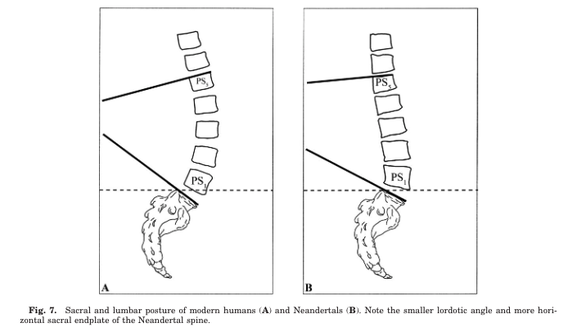
Evolutionary Changes
Past:
Limited lordosis
Present:
Increased angle of lumbar lordosis
Been E, Gõmez-Olivencia A, Kramer PA, 2012. Williams SA, Russo GA, 2015.
Notes:
What impact did all these anatomical changes have on the lumbar spine? Lets compare the Lumbosacral angles of primates and humans. Modern humans have average lumbosacral angle between 40-60 degrees while primates lumbosacral angles are less than 30 degrees.
Citation: Okpala F. Measurement of lumbosacral angle in normal radiographs: a retrospective study in southeast Nigeria. Ann Med Health Sci Res. 2014;4(5):757-762. doi:10.4103/2141-9248.141548

Slide 13
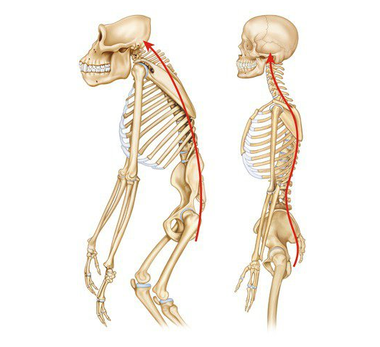
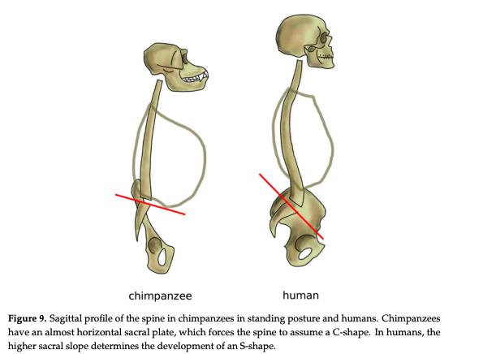
Evolutionary Changes
Past:
Primary spinal curve
Present:
Primary and secondary spinal curve
Galbusera, F., & Bassani, T. (2019). The spine: A strong, stable, and flexible structure with biomimetics potential
Galbusera, F., & Bassani, T. (2019). The spine: A strong, stable, and flexible structure with biomimetics potential
Williams SA, Russo GA, 2015.
Notes:
So what is the result of this increased lumbosacral angle? Homo sapiens have an undulating S-shape of their spines due to primary and secondary curves associated with upright posture. In humans, cervical lordosis originates earlier as babies lift their heads up, and lumbar lordosis occurs a bit later once we start walking.
As mentioned, these curves locate the body’s center of mass over the pelvis and base of support, enabling humans to maintain a bipedal posture and to run and walk comfortably and efficiently. Primates, on the other hand, have one C curve which makes it difficult to stand and walk on two legs.
Chimpanzees or other great apes have to exert a continual muscular effort to stand erect and keep from tipping forward. Their gait is clumsy and fatigue-inducing.

Slide 14
Functional Anatomy Review
Notes:
This next chapter, in the spine lecture series will focus on a functional anatomy review. This is not a comprehensive review, but will focus on the key components as they relate to the biological and cultural evolutionary mismatches of the spine.

Slide 15
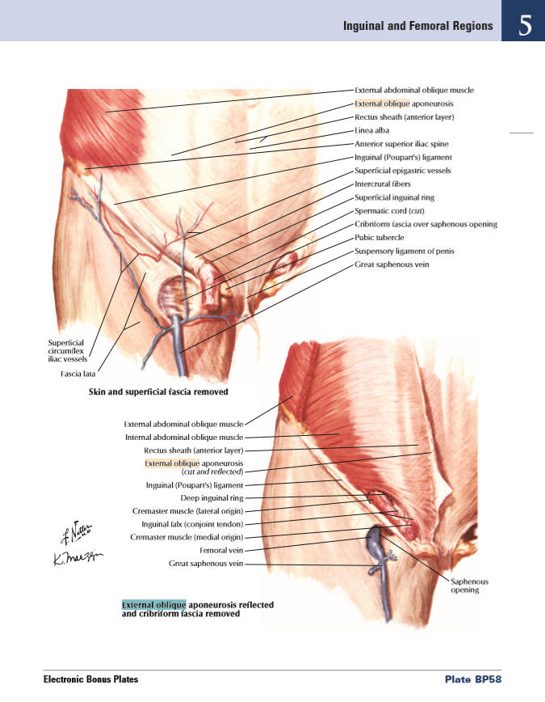
External Oblique
Origin: Ribs 5-12
Insertion: ilioinguinal ligament, linea alba, pubic tubercle
Innervation: Intercostal nerves (T7-T11)
Functions to manage the transverse plane rotation of the core, improving frontal plane stability
External Oblique
© 2005–2019 Elsevier. All Rights Reserved
White SG, Mcnair PJ. Abdominal and Erector Spinae Muscle Activity during Gait: The Use of Cluster Analysis to Identify Patterns of Activity.
Notes:
In this slide we will take the time to review the External oblique muscle. Take the time to review the origin, insertion, innervation, and function of this muscle.
We don’t want to spend a lot of time reviewing open chain anatomy as you can find this in any textbook, but we will discuss the actions of the external oblique as it relates to functional bipedal motion.
Generally speaking the right external oblique is most active throughout the gait cycle at left toe-off when the left leg is entering swing phase, indicating the need to stabilize the rotation of the trunk in transverse plane, by rotating towards midline and therefore shortening the lever.

Slide 16
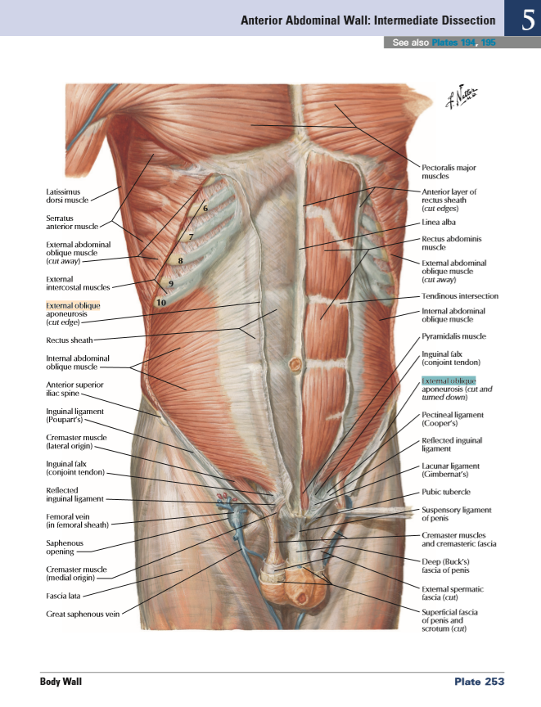
Internal Oblique
Origin: iliac crest, thoracolumbar fascia
Insertion: linea alba, inferior ribs
Innervation: Intercostal nerves (T7-T11)
Functions to manage the transverse plane rotation of the core, improving frontal plane stability
Internal Oblique
© 2005–2019 Elsevier. All Rights Reserved
White SG, Mcnair PJ. Abdominal and Erector Spinae Muscle Activity during Gait: The Use of Cluster Analysis to Identify Patterns of Activity.
Notes:
In this slide we will review the internal oblique muscle. Take the time to review the origin, insertion, innervation, and function of this muscle.
Again, we won’t spend time reviewing open chain function, but we will discuss the actions of the internal oblique as it relates to functional bipedal motion.
The right internal oblique peaks during left foot stance when the right foot is in swing phase. The pattern of peaking is opposite to the activation pattern of the external oblique. Both muscles are serving the same purpose, working synergistically to manage the rotational moment arms that occur with gait and reducing the demands of the pelvic and core stabilizer in the frontal plane.

Slide 17
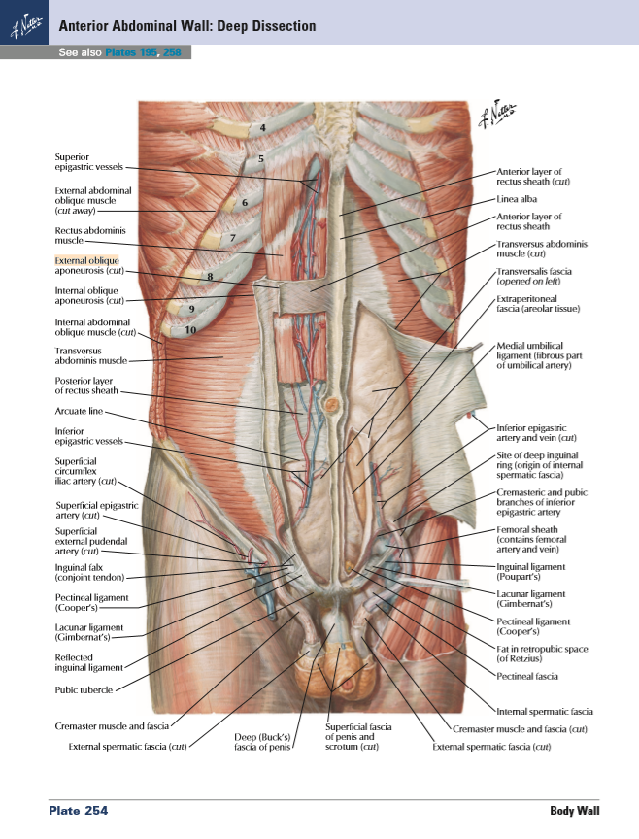
Transverse
Abdominus
Origin: Ribs 7-12, thoracolumbar fascia, iliac crest
Insertion: Linea alba
Innervation: Intercostal nerves T7-T12
Deepest layer of the abdominal muscles
Functions to stabilize the abdominal cavity
Transversus abdominal
© 2005–2019 Elsevier. All Rights Reserved
Notes:
In this slide we will look at the transverse abdominus muscle. Take the time to review the origin, insertion, innervation, and function of this muscle.
We will go into more depth on this particular muscle in the evidence chapter, but the main function of this muscle is to stabilize the abdominal cavity and help to brace the spine during most functional activities.

Slide 18
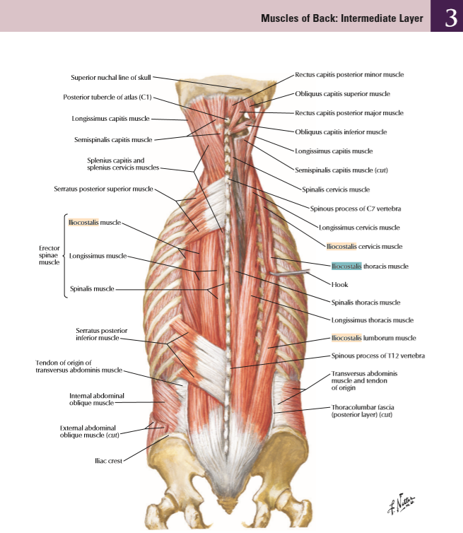
Erector Spinae
(iliocostalis, longissimus, spinalis)
Innervation: Dorsal rami
Superficial spinal extensors
Functions to stabilize an upright spinal posture and in an open chain, extend the vertebral column from a flexed position
Erector Spinae Group
© 2005–2019 Elsevier. All Rights Reserved
Notes:
In this slide we will review the superficial spinal extensors. Primates erector spinae musculature is much more developed than homo sapiens. Why? Primates erector spinae is much more involved in the quadrupedal gait function. As our COM was supported over our BOS with bipedal gait, it reduced our need for a robust erector spinae.
The erector spinae muscles function to stabilize an erect torso and extends the spine from a flexed position.

Slide 19
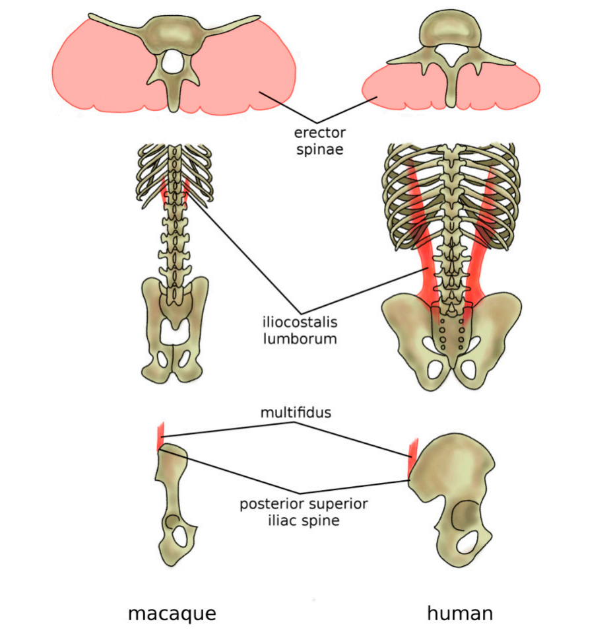
Erector Spinae Anatomy Comparison
Galbusera F, Bassani T, 2019.
Notes:
This graphic compares adaptations of the back musculature of humans to primates.
In humans and all other hominoids, the erector spinae functions as an extensor and spinal stabilizer to support an upright torso. In chimps, these muscles were much more involved in the quadrupedal gait cycle. Remember the video we just showed you? Bipedal gait is very efficient and requires much less muscle activity. These functional differences are reflected in the dramatic difference in muscle volume between the two species.
Additionally, you can see the position of the iliocostalis in humans is laterally located when compared to chimps and attach onto the pelvis, which provides a significant role in reducing aberrant frontal plane movement during the gait cycle.

Slide 20
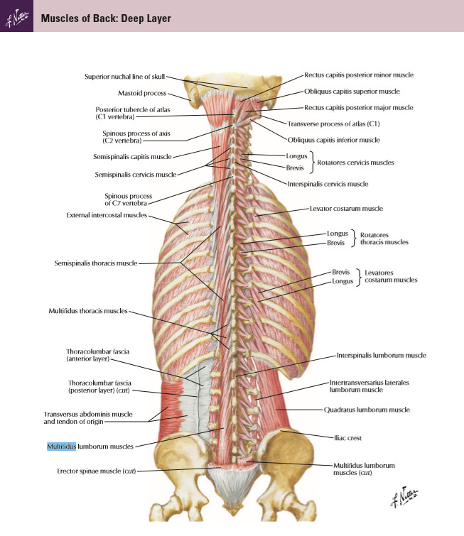
Multifidus and Semispinalis
Origin: (multifidus) Sacrum, spinal TP
Insertion: (multifidus): SP of vertebrae 2-5 superior
Origin: (semispinalis): spinal TP
Insertion: (semispinalis): SP
Innervation: Dorsal rami
Functions Deep intrinsic spinal stabilizers
Multifidus and semispinalis
© 2005–2019 Elsevier. All Rights Reserved
Notes:
In this slide we are looking at the deep intrinsic muscles of the spine. Take the time to review the origin, insertion, innervation, and function of these muscles.
Again, we won’t spend time reviewing open chain function, but we will discuss the actions of the multifidus and semispinalis as it relates to functional bipedal motion. These muscle stabilize the intervertebral segments of the spine when the spine is presented with destabilizing forces. This function is particularly important in humans as our spine evolved to have more mobility.

Slide 21
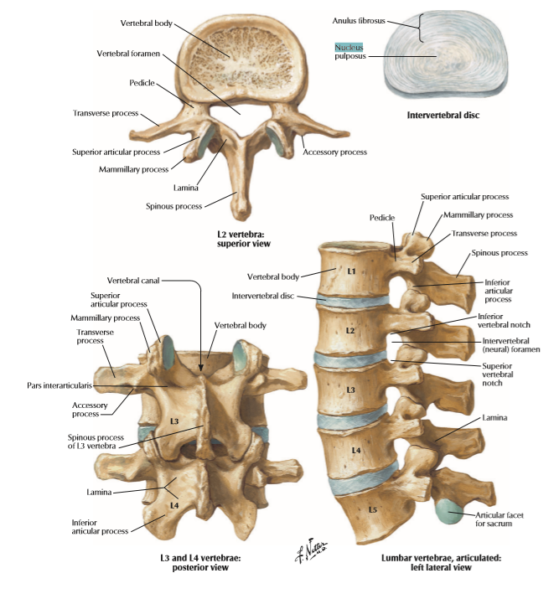
Nucleus pulposus and annulus
Disc - Mucoprotein
Annulus - Collagen type I fibers in concentric ring fashion
Functions
  Holds vertebrae together
  Allows motion
  Dissipates forces
© 2005–2019 Elsevier. All Rights Reserved
Notes:
Now let’s take a look as some passive structures of the spine.
Modern homo sapiens tend to have lots of disc problems. To better understand why you first need to review spinal anatomy. Except this time don't just focus on the names of the structures. Notice a few important aspects of the disc. The annulus is thicker anteriorly and the nucleus is positioned posteriorly within the disc. Think about why this happened. We will touch on that in the next chapter.

Slide 22
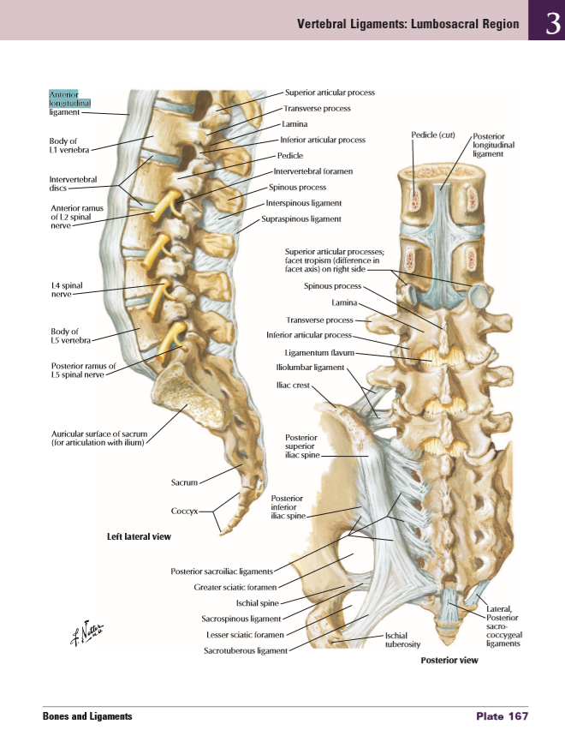
Anterior and posterior longitudinal ligament
Function to resist excessive sagittal plane motion of the spine
Constrain disc
Help hold the spinal alignment
© 2005–2019 Elsevier. All Rights Reserved
Notes:
In this slide we will review two of the main ligaments that hold the spine together. The anterior and posterior longitudinal ligaments. Like the disc take time to notice their structure. The anterior longitudinal ligament is much more robust than the posterior longitudinal ligament. Think about why this is? We will touch on this in the next chapter as well.

Slide 23
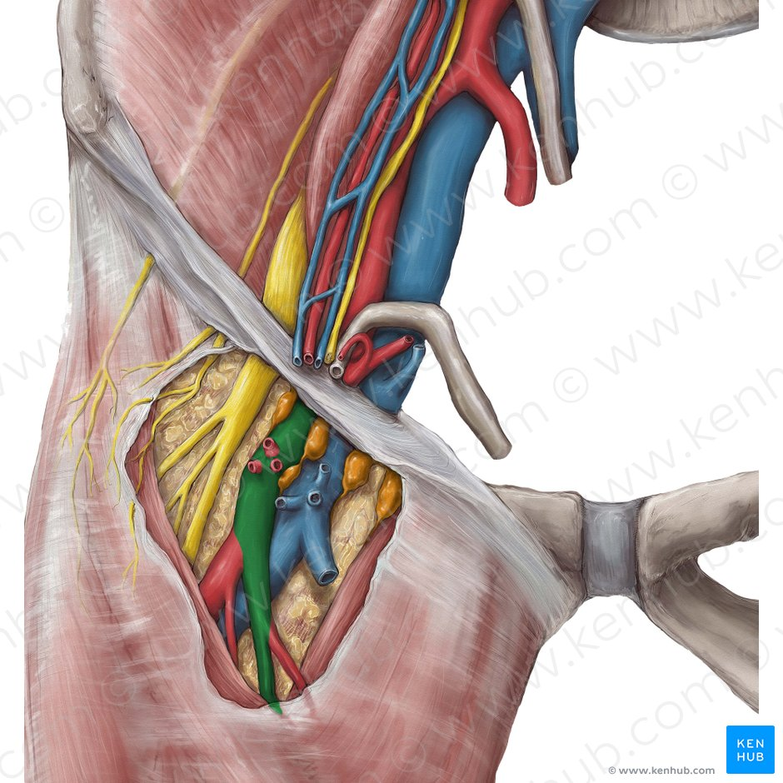
Ilioinguinal ligament
Protects vital tissue
Attachment point for abdominal oblique muscles
The “butt wink,” another factor in a narrow base of support squat with the hip hinge.
  Puts your spine at risk
Hannah Bryce Ely, CMI. (2014, March 18). KenHub Anatomy Illustrations
Notes:
Recall from the hip lecture, the ilioinguinal ligament serves to protect 3 very important structures: the femoral artery, nerve, and vein. It also serves as the attachment point for the abdominal oblique musculature.
When hip flexion is exhausted, further range of motion requires the pelvis to tilt posteriorly and the lumbar spine to flex, placing the spine in a more vulnerable position to injury.
We theorize that the ilioinguinal ligament’s size and location can impact function in another way as well. When deep squatting with a narrow base of support, the ilioinguinal ligament prevents further femoral motion to protect against crimping of the femoral structures and results in a posterior pelvic tilt, aka the butt wink.
HOWEVER, current evidence is still unable to agree which anatomical structure is the limiting factor in hip flexor ROM! That's why if you look this up, all you will find is that butt wink is due to mobility restrictions
In the next chapters you will understand why this is a position we don’t want to encourage, especially under high levels of load such as when performing a barbell squat.

Slide 24
Biological Evolutionary Mismatch
Notes:
Now that you have a better understanding of the evolutionary adaptations to the spinal structure that helped to allow us to become successful bipeds and have reviewed some important anatomical concepts, it is time to learn the anatomical mismatches as it relates to our spinal structure.
Remember, evolution does not seek perfection but rather the survival and continuation of the species. Our spinal structure is full of adaptations that were adapted in past environments and from a time in which we ambulated on all fours. Our spine is maladapted for many of the forces we apply to it in modern times. In this section we will review some of the most important spinal evolutionary mismatches.

Slide 25
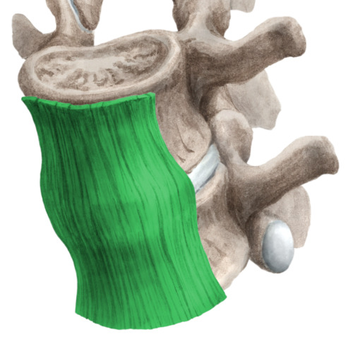
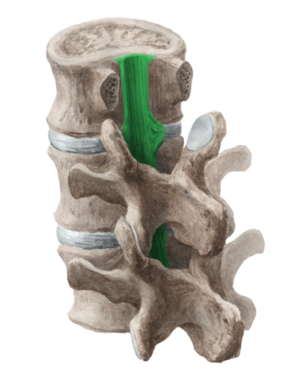
Biological Evolutionary Mismatch
The anterior longitudinal ligament is much thicker when compared to the posterior ligament…But why?
Hyler D, Walsh J, Little R, Slonim A, 1981. Eberlein R, Holzapfel GA, Fröhlich M, 2004.
© 2005–2019 Elsevier. All Rights Reserved
Notes:
Remember the ligaments from the functional anatomy review? What do you think is the "why"??
Hyler et al., 1981: Cross sectional area (CSA_ of primate anterior longitudinal ligament (ALL) were 10x larger than posterior longitudinal ligament (PLL) and were more securely attached to vertebral body.
Eberlein et al., 2004: Observed CSA discrepancy to human spine with more robust ALL, except for the fact that the ALL:PLL ratio is on the order of 2-3x in humans instead of 10x
FCAP team posits – is this due to evolutionary change as anterior tension decreases with bipedalism and prolonged spinal flexion??

Slide 26
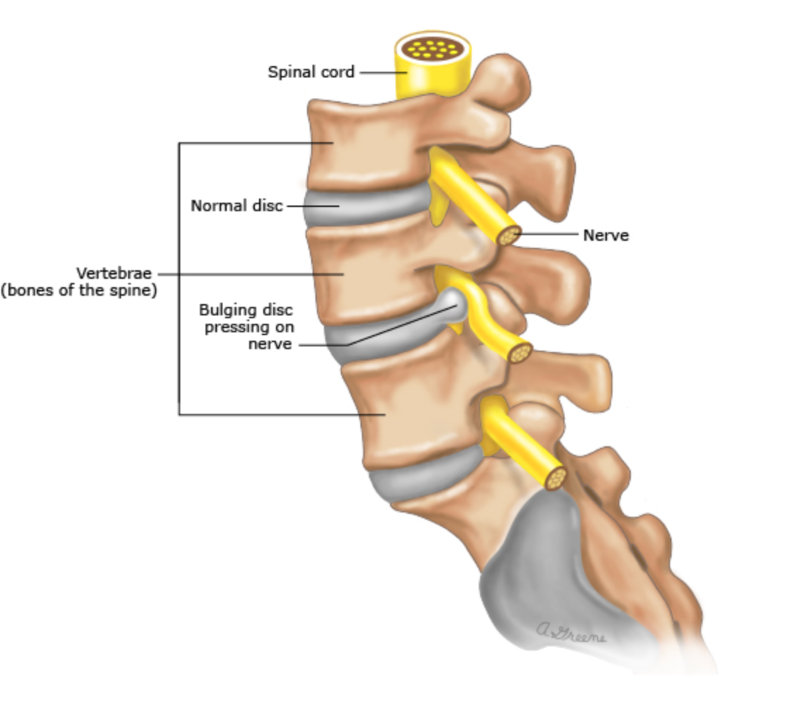
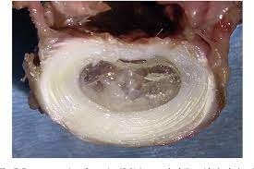
Biological Evolutionary Mismatch
Within the intervertebral disc, the nucleus is positioned more posteriorly and the annulus has thicker anterior fibers…But why?
© 2005–2019 Elsevier. All Rights Reserved
Notes:
Remember the components of the disc we talked about in the functional anatomy review? Have you had time to think about the why?

Slide 27
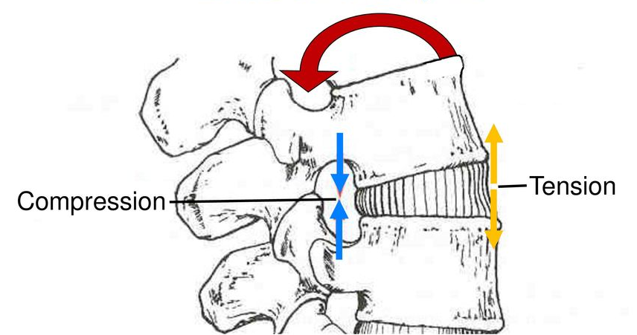
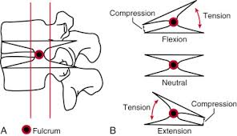
Evolutionary Mismatch
Tension vs Compression and Bernoulli's Principle
  Tension: pull apart
  Compression: push together
  Bernoulli's Principle: Fluid moves from higher to lower pressure
RadiologyKey. (2019, March 23). The thoracolumbar spine.
Notes:
To understand the why for both those questions we first need to review some physics. Tension is defined by a force that pulls something apart or stretches it. Compression is created when something is being pushed together and volume is reduced. Bernoullis Principle states fluid will move from higher to lower pressure.
Nick: Watermelon seed example if confused

Slide 28
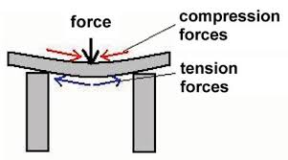
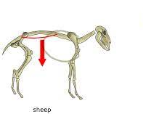
Evolutionary Mismatch
Retain features similar to non-human primates
  Substantial anterior longitudinal ligament
  Nucleus positioned more posteriorly in the disc
What forces did we evolve under?
TeachEngineering. (2024, September 11). Designing bridges
Galbusera, F., & Bassani, T, 2019.
Notes:
In this slide I ask you to reflect on a few of the forces our quadrupedal ancestors spines were subject to as they evolved. What impact does gravity have on quadrupedal and bipedal structure? Think about what happens to body tissue over time when it is exposed to either compression or tension forces.
In our evolutionary past the ALL was exposed to constant tension. This tension kept trying to tear the ligament apart. It responded by getting bigger and thicker.
On the other side of the spine the PLL was under compression. It had intrinsic joint stability. The ligament structure did not need to grow. These same forces acted on the disc itself shaping the structure of the annulus and the position of the nucleus.
It is important to keep in mind that evolution does not seek structural perfection, only the continuation of the species.

Slide 29
Biological Evolutionary Mismatch
Now do you understand why?
Kenhub GmbH. (n.d.). The vertebral column (spine or backbone).
Notes:
Now that you understand how tension and compression impact the evolution of our spinal structure, you should have a better understanding as to why the ALL is much thicker than the PLL, the anterior annulus is more robust than the posterior, and finally, why the nucleus pulposus is positioned further back within the disc.

Slide 30
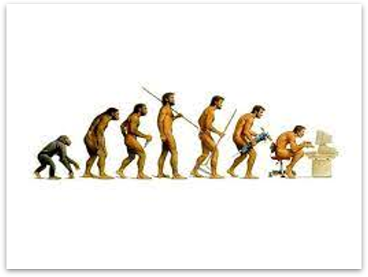
Cultural Evolutionary Mismatch
Adedoyin, R. (2017). Evolution of physical inactivity [Figure 2]. In Arise and Walk – A Theology of Exercise for Healthy Living
Notes:
We just reviewed the biological evolutionary mismatches and now we will discuss the cultural evolutionary mismatches. You will learn that in modern environments, we are not using our structures the way they were evolutionarily intended to be used.

Slide 31
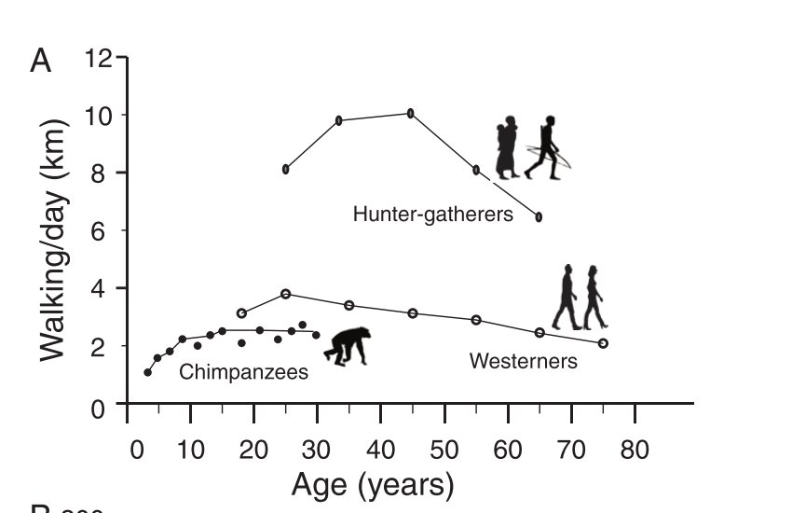
Cultural Evolutionary Mismatch
Modern culture / Mismatch
  Sit too much
  Exercise/move too little
  Increase in body mass indices
  Transition from hunter gatherers to industrial & agricultural revolution. Results?
Lieberman DE, 2013. Image source: Lieberman DE, Kistner TM, Richard D, Lee IM, Baggish AL, 2021.
Notes:
So let's step back and compare how modern man uses his/her spine and compare it to our evolutionary past. Our ancestors were very lean, they did not sit all day, they had to move to attain food, and they were responsible for many of the physical tasks associated with activities of daily living. Modern man sits more, moves less and has a much easier time attaining calories. As such we are weaker and heavier. How does this impact the spine?

Slide 32
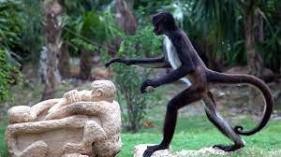
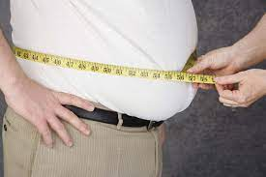
Cultural Evolutionary Mismatch
The agricultural revolution: About 12,000 years ago
  The end of foraging
  No more hunter gatherer
Primate body fat 2-9%
Modern hunter-gatherer BF: 10-25%
Western humans BF: 23-42%
Lieberman DE, 2013. Pond CM, Mattacks CA, 1987. Lieberman DE, Kistner TM, Richard D, Lee IM, Baggish AL, 2021.
Notes:
It is theorized that hominins evolved from our last common ancestor about 6 to 7 million years ago. For the vast majority of that time it was a struggle to attain enough calories to meet basic activity metabolic needs.
Keep in mind that during this period, the average hunter gatherer walked roughly 5-9 miles/day in search of food. Because calories were scarce, we evolved to store calories as fat if a plentiful food source was found.
Then, only about 12,000 years ago the agricultural revolution took place. Food became much more easily accessible. We did not have to spend so much energy attaining calories. As a species we have not been the same since.
Body fat percentages
2-9% in adult chimpanzees and other primates
10 to 15% and 15 to 25% body fat in male and female hunter-gatherers
23 to 31% and 32 to 42% in high income population
males and females
Lieberman DE, Kistner TM, Richard D, Lee IM, Baggish AL. The active grandparent hypothesis: Physical activity and the evolution of extended human healthspans and lifespans. Proceedings of the National Academy of Sciences of the United States of America. 2021;118(50):e2107621118. doi:10.1073/PNAS.2107621118

Slide 33
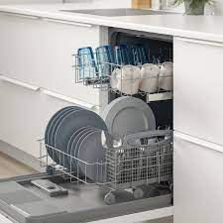
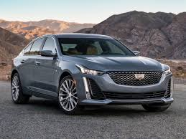
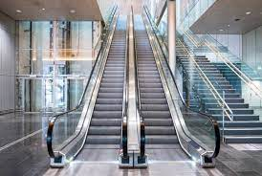
Cultural Evolutionary Mismatch
The Industrial revolution: Mid-18th century to early 19th century (~300 years ago)
  “Replace muscles with engines”
  The consequences of automation
Lieberman DE, 2013.
Notes:
The next cultural evolutionary milestone that impacted our structure was the Industrial revolution. It too profoundly altered our structure. Most successful products invented during the industrial revolution were labor-saving devices (cars, bikes, escalators, dishwashers, food processors, etc.). These devices lessoned our need for muscular activity and attacked our body composition. Body fat levels increased as we gained mass and lost muscle.
Think about the impact on our structure? All the aberrant motion patterns that had to develop to accommodate motion with a structure that was heavier and weaker.

Slide 34
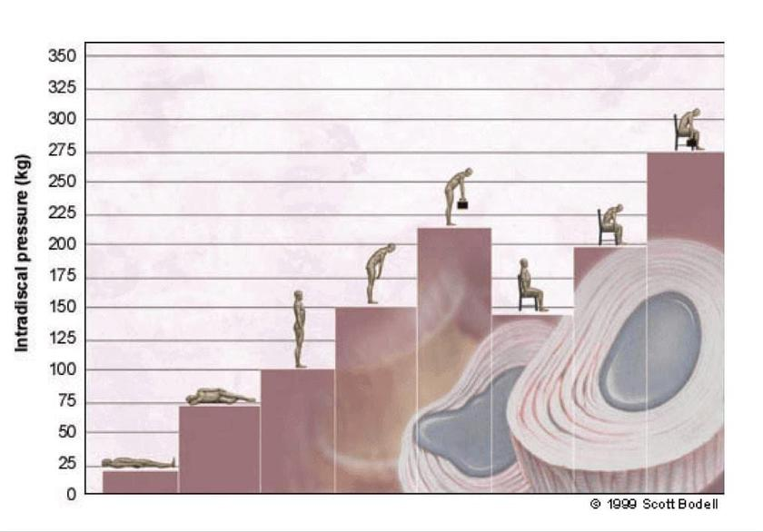
Cultural Evolutionary Mismatch
Sedentary lifestyle and desk jobs = too much sitting
Sitting posture and spinal flexion - increased intradiscal pressure
Notes:
We just learned about the tension and compression forces that our spinal structures evolved under. What happens to the tension compression curve in the spine when we sit? The tension and compression forces around the disc are switched. The posterior aspects of the disc are now under tension and the anterior aspects are under compression.
The nucleus is now subjected to forces that push it backwards into a less robust posterior annulus that is further damaged through repetitive strain. Let's think about what happens to the disc when it is under more compression and subjected to the forces associated with lumbar flexion. In modern day culture, not only are we too sedentary and sit too much, but our structures also have to support an increase body mass.
Li et al., 2022 findings:
Positions in spinal flexion increases IDP
*Recent literature is mixed on IDP sitting vs standing; however, it is clear that standing with a neutral spine has less IDP than standing with a flexed and/or loaded spine.
Note, studies mostly looking at unsupported sitting (position of lumbar spine is largely undefined)

Slide 35
When Biological & Cultural Evolutionary Mismatches Meet…
Notes:
So we have learned that our spinal structure is not perfectly evolved to cope with the forces placed upon it in modern culture. These structural vulnerabilities lead to spinal pathology when they are exacerbated by increased body mass, overall weakness, and a sedentary lifestyle. In modern times, some of the most widely taught strength and conditioning practices further challenge our spinal structure and greatly increase our injury risk.

Slide 36
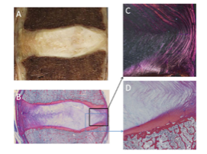
Evolutionary anatomy vs modern man
Increased BF% and waist circumference …
  Increased risk of acute and chronic low back pain
  Excessive compression to each vertebral segment
  Altered biomechanics impacting spinal loading patterns
  Poor healing environment: increased inflammatory factors and vascular insufficiency
You Q, Jiang Q, Li D, Wang T, Wang S, Cao S, 2022.
Notes:
In this slide we are going to spend some time specifically discussing the nucleus of the disc. The mucoprotein of the nucleus evolved over a time when our body mass was much less than it is in modern times. The disc has a very complex job. It has to hold vertebrae together, allow motion and dissipate compression. Recall the more aberrant motion patterns established as our body fat percentage increased. These aberrant motion patterns cause microtraumas to the posterior annulus causing it to breakdown. With this breakdown and the abnormal pressures in the nucleus, the nucleus can herniate posteriorly overtime.
In regards to the nucleus of the disc, degenerative processes include, enzymatic degradation that leads to decreased disc hydration. These changes are naturally brought on with age. However, they are facilitated with abnormal excessive physical loading.
To recap, it is not only the greater levels of forces on the disc associated with increased body mass indices that cause problems. It is the increased forces around the disc associated with aberrant motion patterns that are the real concern.
So, I would like you to consider a staple of modern strength and conditioning program education: the hip hinge squat.

Slide 37
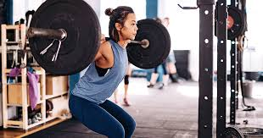
Evolutionary anatomy vs modern man
Rethinking the "Traditional Squat"
Current culture teaches us to squat with the use of a hip hinge. What's happening here?
    Increasing loads on the spine
    Spinal musculature is not designed to be prime lifter (evolutionary loss of muscle)
    Creating an aberrant motion pattern by not allowing the knees to go forward
    Hip goes behind ones BOS as such you must bend the COM forward
Shepherd, B. (2022, May 26). What is progressive overload? Live Science
Klein K, 1961.
Notes:
So let's talk about a commonly taught lower extremity strengthening exercise, the hip hinge squat. Squats are a great way to functionally strengthen the legs (I would argue that the single leg squat is better) however, is the hip hinge the best way to teach the squat?
The "no knees over toes" squat with a hip hinge can be tracked back to an extremely flawed research article that associated anterior tibial translation with increased shear stress on the knee. Despite its flawed methodology, the article became famous when sports illustrated interviewed the author in 1962. This "no knees over toes" phenomenon was adopted specifically by college football coaches and therefore the strength and conditioning world.
Klein K (1961). The deep squat exercise as utilized in weight training for athletes and its effects on the ligaments of the knee. J Assoc Phys Ment Rehabil. 15; Pp 6-11.

Slide 38
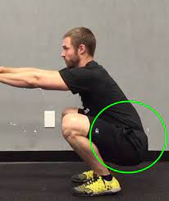
Evolutionary anatomy vs modern man
More on the hip hinge squat
The base of support also matters
The narrower the BOS the sooner the femur impinges on the ilioinguinal ligament causing spinal flexion
The wider the BOS the more hip motion prior to ilioinguinal ligament impingement
Notes:
Injury can also occur with another aberrant motion pattern that occurs when the hip hinge squat is performed with a narrow base and to full depth.
Recall one of the functions of the ilioinguinal ligament is to protect vital structures in groin from being kinked with excessive hip flexion. It protects the vital structures by arresting hip flexion motion and thus allowing lower limb circulation to remain unimpeded.
In the full depth hip hinge squat, as the femoral motion is blocked, the hip can no longer contribute to maintaining the COM over the BOS. In order to stay balanced in a narrow base deep squat, a posterior pelvic tilt and flexion of the lumbar spine must occur. Think of the consequences.

Slide 39
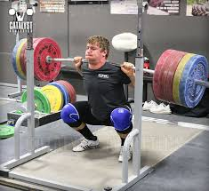
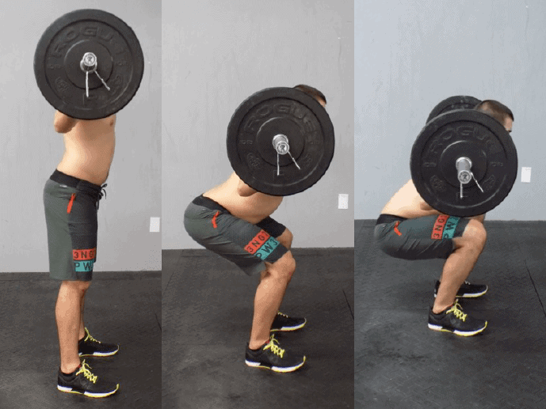
Evolutionary anatomy vs modern man
Neutral spine is ideal for injury prevention
Loaded spinal flexion AND loaded spinal hyperextension increase injury risk via inappropriate tissue loading
Khoddam-Khorasani P, Arjmand N, Shirazi-Adl A, 2020. Gallagher S, Marras WS, Litsky AS, Burr D, 2005. Shiri R, Falah-Hassani K, Heliövaara M, et al., 2019.
Notes:
Neutral spine can help mitigate injury risk, as too much spinal flexion (hypolordosis) or extension (hyperlordosis) can excessively and inappropriately load passive tissues.
Individual research summaries:
ADD: 3 NEW CITATIONS (summarized findings below)
Gallagher et al: Lumbar spinal flexion significantly affected cycles to tissue failure (next slide)
Khoddam-Khorasani et al: When lifting with severe lordotic vs. Neutral vs. Severe Kyphotic lumbar spine posture, neutral spine was ideal. Severe lordosis increased compression, shear forces, and erector spinae activity. Severe kyphotic posture showed decreased muscle activity and more force through passive structures.
Shiri et al: Manual handling of heavy loads increased risk of acute LBP and bending forward without support increased odds of low back pain
Previous slide content:
Modern ailments demonstrate the necessity and the delicate nature of lumbar lordosis for human bipedal locomotion
To protect the spine one attempts to maintain a strong lordosis
As the much stronger LE musculature is able to overcome greater loads the posterior spinal extensors can’t keep up
Humans have a greater lumbosacral angle and thus a lumbar spine lordosis
This lordosis is partially supported by the facet joints
These joints are not evolved to dissipate heavy loads
So, if the knees can't go forward than the hips have to go backwards. As the hip joint moves to the back of the base of support, the trunk has to bend forward to maintain the com within the bos. The low back should be held in a neutral position to protect the spinal structures. However, ultimately,failure to maintain neutral spine due to the "butt wink"leads to spine excessively loaded in a flexed position, increasing injury risk.
A question I am often asked: If I can hip hinge back squat and maintain my lumbar lordosis is the back squat still bad for me? This study may suggest yes. The increased loads dissipated by the vertebral joint structure in the bilateral back squat may contribute to degenerative joint disease and more serious pathologies.

Slide 40
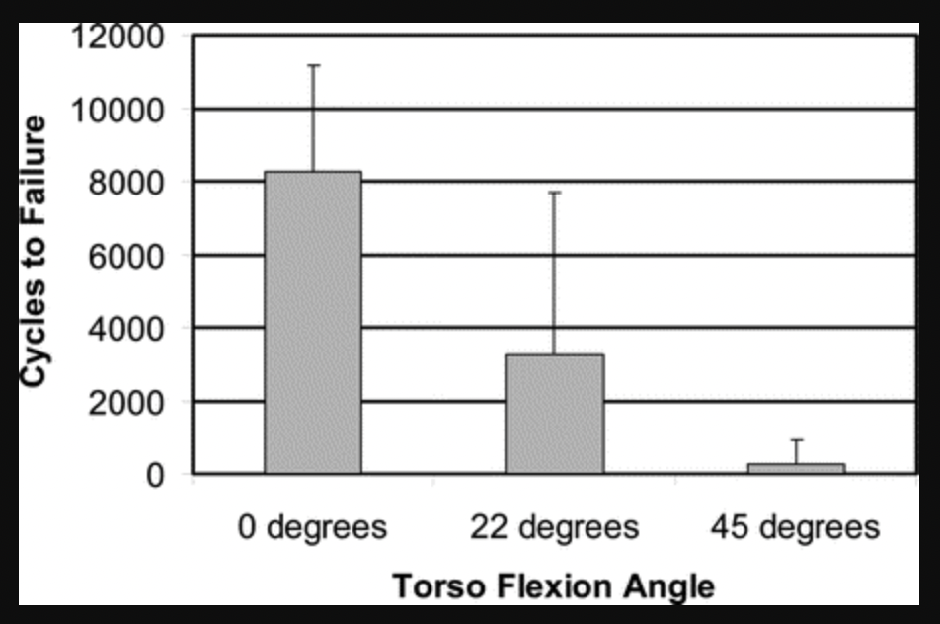
Loaded Lumbar Flexion: Injury Risk
Spinal flexion increases risk of tissue injury
  Lumbar spine segments at varying levels of flexion underwent axial compression cycles until injury
  0° flexion = 8,253 cycles to failure
  45° flexion: 263 cycles to failure
Tissue injury sites: posterior annular protrusion, facet joint fractures, vertebral body fractures, blood in posterior IV disc, vertebral endplate fractures
Gallagher S, Marras WS, Litsky AS, Burr D, 2005.
Notes:
one extreme in either lumbar direction – Flexion
Individual research summaries
ADD: 3 NEW CITATIONS (summarized findings below)
Khoddam-Khorasani et al: When lifting with severe lordotic vs. Neutral vs. Severe Kyphotic lumbar spine posture, neutral spine was ideal. Severe lordosis increased compression, shear forces, and erector spinae activity. Severe kyphotic posture showed decreased muscle activity and more force through passive structures.
Shiri et al: Manual handling of heavy loads increased risk of acute LBP and bending forward without support increased odds of low back pain
Summary: 12 fresh human cadaver spines were dissected into 3 lumbar motion segments and randomly assigned to 0*/22.5*/45* flexion. Each segment then underwent 15 mins creep loading with 9kg weight, then cyclical compression loading until point of tissue failure (vertebrae/disc). Researchers found that spinal flexion had a significant impact on cycles to failure, with 0* segments lasting average 8,253 cycles to failure, 22.5* lasting average 3,257 cycles and 45* lasing only average 263 cycles before failure. Lumbar segment did not appear to impact results. Endplate fractures, vertebral body fractures, facet joint fractures were all seen as common failure modes as well as posterior annular protrusion/blood in posterior central IV disc
Lots of newer support that loaded spinal flexion does result in injury
Manual handling of heavy loads increased risk of acute LBP and acute radiculopathy by 24% and 35%, and bending forward without support had a mean increased odds ratio of 21%
Shiri R, Falah-Hassani K, Heliövaara M, et al. Risk Factors for Low Back Pain: A Population-Based Longitudinal Study. Arthritis Care and Research. 2019;71(2):290-299. doi:10.1002/ACR.23710/
12 human cadaver spines, dissected into 3 lumbar motion segments, each assigned to creep load for 15 min with cyclical compression until the point of tissue failure. 0 degrees (8,200 cycles), 22.5 deg (3,200 cycles), and 45 deg (263) of flexion in each segment. Spinal flexion had a significant effect on cycles to failure. Noted defects included: endplate fractures, vertebral body fractures, facet joint fractures, and posterior annulus protrusion
Gallagher S, Marras WS, Litsky AS, Burr D. Torso flexion loads and the fatigue failure of human lumbosacral motion segments. Spine. 2005;30(20):2265-2273. doi:10.1097/01.BRS.0000182086.33984.B3
In vivo data lifting with severe lordotic vs. Neutral vs. Severe Kyphotic lumbar spine posture. Overall, neutral spine is ideal. Severe lordosis increased compression, shear forces, and ES activity. Severe kyphotic posture showed decreased muscle activity and more force through passive structures.
Khoddam-Khorasani P, Arjmand N, Shirazi-Adl A. Effect of changes in the lumbar posture in lifting on trunk muscle and spinal loads: A combined in vivo, musculoskeletal, and finite element model study. Journal of Biomechanics. 2020;104:109728. doi:10.1016/J.JBIOMECH.2020.109728

Slide 41
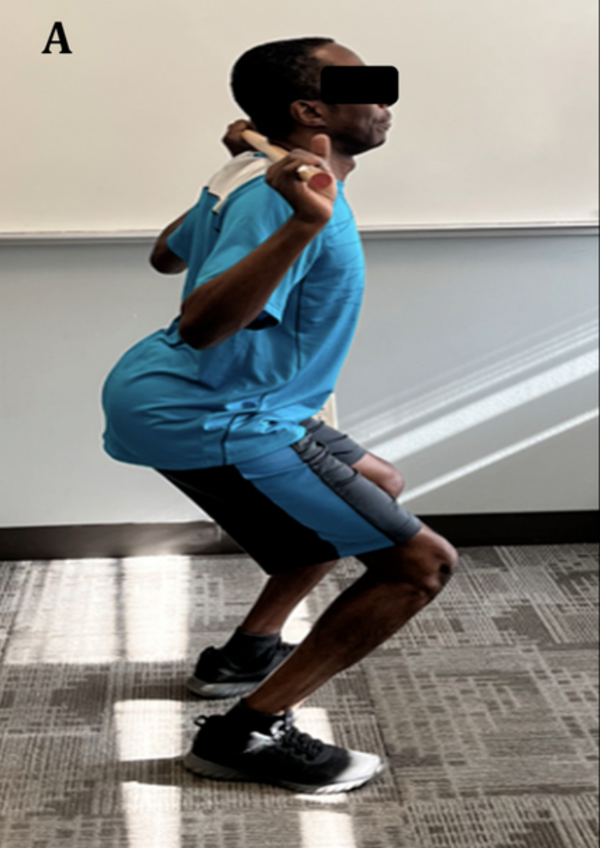

Loaded Lumbar Extension: Injury Risk
Excess lordosis also increases risk of tissue injury
  Lifting with a hyperlordotic lumbar spine posture:
    Increased vertebral segment compression
    Increased shear forces
    Increased risk of erector spinae failure
Khoddam-Khorasani P, Arjmand N, Shirazi-Adl A, 2020.
Notes:
Khoddam-Khorasani et al: In-vivo assessments of internal forces and load distribution found that when lifting with a neutral spine was ideal.
Lifting with a severe lordotic posture increased vertebral segment compression, shear forces, and increased risk of erector spinae failure.
image link: https://www.researchgate.net/figure/An-individual-performing-back-squat-with-an-A-exaggerated-lumbar-lordosis-and-B_fig1_385650238

Slide 42

Better Alternatives for LE Strength
The Plie/Sumo Squat
Wider BOS allows for greater hip motion with a stable/neutral spine
Truly loading the legs with a neutral spine
Flexed lumbar spine + excess load = decreased threshold to injury
Deniz E, Ulas YH, 2020. Gallagher S, Marras WS, Litsky AS, Burr D, 2005.
Notes:
During the back squat, the position of bar on back as you descend makes you lean forward to maintain COM over BOS, placing great stress on the spinal structures. Front squat allows you to more isotopically load the spine.
You are also able to lift more weight in a back squat (due to the placement of the load/bar) resulting in higher compression of tissues
Flexed lumbar spine + compression = dec threshold to injury (Gallagher et al., 2005)
OLD COURSE NOTES:
The plie or sumo front squat is a much safer and more effective exercise to teach clients. Have you ever thought about why 1 rep max loads are less when comparing someone's ability to perform a front squat vs a back squat?
What happens if you lean forward during a front squat? It is difficult to hold the bar on your shoulders. A front squat forces the exercise to take place with an upright posture. When the hip hinge is performed, the low back musculature contributes to lifting the com to a more upright position.
Something these muscles are able to do if the spine is flexed. Recall we lost erector spinae muscle mass as we evolved to become bipedal. These muscles are not adapted to overcome heavy loads when the spine is moving from a flexed to an upright position, but rather function to stabilize an erect spine.
However, if the spine is held in a neutral stable position the low back musculature functions to stabilize the spinal structure. A role it was evolved to handle. The stress of the squat motion is placed on the legs as it should be. The plie or sumo front squat is a much safer exercise than the hip hinge back squat while providing the ability to make the same, if not more impactful, strength gains.

Slide 43
SL vs DL Squat for EMG activity of ES
Increased ES activity with a bent forward posture (Where is COM?)
EMG measured in μV
ES not designed to be prime lifter
Squat Type | Descending (µV) | Ascending (µV)
Bilateral | 126.5 | 136.5
SL Foot Forward | 52.75 | 99.25
SL Foot Backwards | 77.25 | 105.25
Eliassen W, Saeterbakken AH, van den Tillaar R, 2018.
Notes:
This study demonstrates the emg activity in the erector spinae musculature when the single leg squat and the bilateral squat in the hip hinge are compared. The single leg squat is less dependant on the core musculature when compared to the bilateral hip hinge squat as you can see with the increased EMG ES activation here in this chart.

Slide 44




Better Alternatives for LE Strength
Single leg squat is an even better alternative
Safer for the spine
Functional unipeds
Targets stabilizing muscles of LE
More effective at developing strength and power
Greater muscle activation with lower tissue loads
Eliassen W, Saeterbakken AH, van den Tillaar R, 2018. Arakawa H, Mori M, Tanimoto M, 2023.
Notes:
Let's take the thought process one step further. The truly most impactful way to strengthen the LE is the single leg squat. If you don't believe me read the literature as referenced in this slide. Most are not able to do a single leg squat with proper form against their own body weight, let alone added load. So the compression on the spine with loads needed to strengthen the legs is less. This exercise also trains the stabilizing muscles around the hip and foot, something that is needed when 70% of human motion takes place on one foot.

Slide 45
Evidence Part I:
Cultural Influence of LBP
Notes:
We just reviewed some of the more important cultural evolutionary mismatches pertaining to the spine, and now we will present the evidence that supports these mismatches

Slide 46

The Evidence: Prevalence of LBP
The prevalence of low back pain: a systematic review of the literature from 1966 to 1998
Up to 8/10 people in more westernized cultures will experience LBP at some point in their life.
​​Walker BF, 2000.
Notes:
So this slide summarizes the start of my “why” journey. These numbers are shocking to me. Low back pain is a global pandemic. I wanted to understand why. In the context of our evolutionary anatomy and our cultural mismatches it is easier to understand. Given the advancements in medicine and science does this percentage sound shocking to you?

Slide 47

The Evidence: Prevalence of LBP
Low back pain = global pandemic
  Globally, lifetime incidence = up to 75 %
    Percentage varies depending on demographic, region, culture
Wu A, March L, Zheng X, Huang J, Wang X, Zhao J, Blyth FM, Smith E, Buchbinder R, Hoy D, 2020.
Notes:
Almost 20 years later, this incidence of LBP still holds true. This is a shockingly real number and more recent studies dig deeper into the data.

Slide 48

The Evidence: Prevalence of LBP
Global prevalence of low back pain systematic reviews: 2012 and 2022
Strong positive correlation between a country's Human Development Index (HDI) and overall mean prevalence of low back pain
Hoy D, Bain C, Williams G, et al, 2012. Chen S, Chen M, Wu X, et al., 2022.
Notes:
A more detailed look at the overall incidence is presented in this study. This 75 to 80% number is not consistent across the globe. Some regions of the world have much lower incidence of low back pain. Why? They are not as developed as western society and as such calories are harder to attain and many of the people in these countries have not experienced the “benefits” of the industrial revolution. They are not subject to the damage to our structure caused by the cultural mismatch associated with modern western society.
Both studies found that incidence is higher in high-income areas and more developed countries. The human development index (HDI) helps predict these trends. The HDI is a composite statistic of life expectancy, education, and per capita income indicators. It is used to rank countries into four tiers of human development. Countries with higher HDIs have higher prevalence of LBP.
Being physically active is an important factor in reducing the likelihood of experiencing LBP.

Slide 49


The Evidence: Physical Activity Decreases Risk of LBP
>3,000 Finnish subjects monitored over 11 years
Individuals who walked or cycled to work DECREASED risk of low back pain by 25%
Shiri R, Falah-Hassani K, Heliövaara M, et al., 2019.
Notes:
This next slide demonstrates the importance of physical activity to decrease likelihood of low back pain
A study of over three thousand people 30 years or older found that people who walked or cycled to work reduced their risk of experiencing LBP by 25% over the next 11 years.
How has modern culture influenced your activity levels?

Slide 50
Evidence Part II:
Biological Factors of LBP
Notes:
The next chapter of evidence will support the biological evolutionary mismatches that we just reviewed.

Slide 51

The Evidence: Evolution not perfection
Upright posture requires lordosis to support COM within our BOS
The benefits of this adaptation outweighed the increased shear forces placed on the lumbar segments
Castillo ER, Lieberman DE, 2015.
Notes:
We’ve talked about the importance of upright walking and bipedalism ad nauseam, but these biological changes still come at a cost, the cost is just less consequential and life threatening than the alternative.
Mechanically induced LBP is often thought to be a consequence of trade-offs in the spine due to selection for bipedalism from a quadrupedal ancestor. The costs of increased shear forces due to lordosis were offset by the benefits of positioning the upper body’s center of mass over the hips, stabilizing the trunk and decreasing the energy expenditure of upright posture.
Remember the goal of evolution is reproduction not perfection.

Slide 52

The Evidence: Evolution not Perfection
Modern ailments demonstrate the necessity and the delicate nature of lumbar lordosis for human bipedal locomotion.
  Humans have a long, flexible lumbar spine to produce lordosis.
  Need of a tilted pelvis and sacrum, humans have a greater lumbosacral angle, which places tremendous pressure on the lower lumbar spine.
Selby MS, Gillette A, Raval Y, Taufiq M, Sampson MJ, 2019.
Notes:
With the delicate need to balance enough lumbar lordosis but not too much to accommodate bipedal locomotion, those who are on either end of the scale may be more likely to have low back pain.
Commonly, back pain may result from an increased lumbar lordosis, which causes excessive load through the facet joints rather than vertebral bodies. These forces increase dramatically in people who are obese or pregnant.
On the other hand, reduction in lumbar lordosis, such as in flatback syndrome can also cause back pain.
Human lumbar lordosis is necessary for placing the trunk atop the pelvis and presents a balancing act not required of our closest primate relatives.

Slide 53
The Evidence: The Ancestral Shape Hypothesis
Vertebrae of humans with disc problems are closer in shape to those of our closest ape relatives, the chimpanzee, than are the vertebrae of humans without disc problems.
Homo sapien
Primate Ancestor
Plomp KA, Dobney K, Weston DA, Strand Viarsdóttir U, Collard M, 2019. Plomp KA, Viarsdóttir US, Weston DA, Dobney K, Collard M, 2015.
Notes:
Trying to evolve the perfect level of lordosis in the lumbar spine, however, is a challenge and the variability in our spines can help explain some of the modern issues as it relates to the prevalence of low back pain.
This slide emphasizes the variability aspect of features in the evolutionary process. Some of us retain a vertebral shape that does not promote spinal extension and posterior vertebral support. According to this study, individuals with vertebral shapes closer to our quadrupedal ancestors are more prone to disc herniation.
Since low back pain does not determine reproductive success these features continue to be passed on
Nick Note – IV disc herniation preferentially affects individuals with vertebrae towards the ancestral end of the range of shape variation within H. Sapiens and therefore are less well adapted for bipedalism → evolution is not perfect. Consider in the ancestral end, the image on the R, would this create more compression or tension posteriorly?

Slide 54

The Evidence: Overshoot Hypothesis
Increases lumbar lordosis and influences the development of spondylolysis by increasing direct contact between the neural arches
Plomp KA, Dobney K, Collard M, 2020.
Notes:
The same author found that on the other end of the spectrum, as in when there is excessive lordosis, individuals are more prone to spondylolysis due to the increase stress on the posterior aspect of the vertebra. This hypothesis was coined the “overshoot hypothesis” which describes vertebral shape on the highly derived end of the spectrum within homo sapiens.
When thinking about back pain it is important to realize that evolution has not perfected our spinal structure.
image citation: https://www.pauljeffordsmd.com/spondylolysis-pars-fractures-and-lytic

Slide 55
Evidence Part III:
The Flexed Spine
Notes:
So it is commonly understood that in western cultures we sit too much and have high body mass indices. So what happens to to the intervertebral disc when we sit too much with increased loads? Let's look at some of the research.

Slide 56


Evidence: Flexed spine controversy
Intradiscal pressure together with anthropometric data, a data set for the validation of models
Pressure values
  Relaxed standing 0.5 MPa
  Standing flexed 1.1 MPa
  Standing extended 0.6 MPa
  Sitting unsupported 0.46 MPa
  Lift 20 kg with round flexed
back 2.3 MPa
Wilke HJ, Neef P, Hinz B, Seidel H, Claes L, 2001.
Notes:
This is a brave sole. Putting a catheter in one's spine to measure pressure does not seem like a fun thing to do. Also, notice the posterior wedging of the L5 vertebral segment. He got the lucky gene.
When reviewing the data it is clear that there is not a big difference in the disc pressure between sitting and standing. This confirms the findings of the study in the last slide.
However, the pressures in the nucleus get much worse when excessively loaded and the spine is flexed. So increased pressures against a posterior annulus that is under strain is a recipe for disaster.
Makes you think about loading the spine and teaching the hip hinge doesn't it?

Slide 57

Evidence: Flexed spine controversy
Sitting versus standing: Does the intradiscal pressure cause disc degeneration or low back pain?
Pressure in the nucleus seems to be the same in both sitting and standing.
Talking Points:
  Is the disc just made up of the nucleus?
  What about if there are repeated annular strains?
Claus A, Hides J, Moseley GL, Hodges P, 2008.
Notes:
Recall from earlier slides that the load itself is not an isolated factor causing low back pain. Isotopical forces are more easily dispersed through the disc. This study demonstrated that intradiscal pressure is similar in both sitting and standing positions. What are they missing? When disc pressures are dissipated against a weaker posterior annulus it allows for the slow bulging/herniation process to begin. It is the sustained stress and breakdown of the posterior annulus that causes the damage and allows the disc to migrate backwards.
It is important to sit up straight while maintaining a lumbar lordosis for the sake of decreasing the posterior annular strain.

Slide 58

Evidence: It’s Not All About the Nucleus
The relationship between intervertebral disc bulging and annular fiber associated strains for simple and complex loading
Flexion movement produced the largest fiber associated strains (7.2%) at the annular surface of intact neural arch specimens.
The removal of the neural arch strongly increased the fiber associated strains by a factor of 2.4 to a value of 17.5%.
The outward disc bulging of 1.63 mm has increased by 0.58 mm due to the defect.
Heuer F, Schmidt H, Wilke HJ, 2008.
Notes:
Lets review the evidence as it relates to the flexed spine and the switching of the tension and compression forces.
This is a good study, even though it was done on non living tissue, because it looked at the stress on the posterior annulus of the disc when exposed to tension.
The study looked at the strain in the annulus in 2 ways. One with the neural arch and its associated structure intact and the other with the neural arch removed relying solely on the posterior annulus fibers to resist flexion strain. First it is important to notice that the less robust posterior annulus is the least effective at resisting flexion strain forces. That defect is worsened when the neural arch structure is removed.
Recall the anatomical review section of this lecture in which you learned that as we stood upright we lost posterior vertebral structure. That did decrease our ability to resist flexion strain

Slide 59

Evidence: A Flexed Spine
The prevalence of low back pain among athletes:
  Highest point prevalence amongst football players, skiers, and rowers.
  Lowest amongst golfers, triathletes, and shooters
Farahbakhsh F, Rostami M, Noormohammadpour P, et al., 2018.
Notes:
We’ve talked about the impact of a flexed spine at more of a micro level, but when we zoom out, we can appreciate how the repetitive nature of flexing the spine can increase one’s propensity towards low back pain.
This studied assessed rates of low back pain among athletes. Those with the highest prevalence include football players, skiers, and rowers.
A few things stand out - Football players tend to have high BMI and resistance train with heavy loads, Skiers and rowers, although lean, participate in a sport that requires lots of sustained spinal flexion. Both factors are contributory to low back pain.

Slide 60
Evidence Part IV:
Spinal Stability
Notes:
Spinal stability. It's all we talk about in the rehab/strength and conditioning literature when it comes to the treatment of LBP. There is lots of evidence demonstrating the need for spinal stability. However, we need to start thinking about functional spinal stability strength, not endurance.

Slide 61

Evidence for Spinal Stability
Contraction of the abdominal muscles associated with movement of the lower limb
Trunk muscle neurological activity occurred prior to neurological activity of the prime hip mover
Hodges P, Richardson C, 1997.
Notes:
First, lets review the evidence supporting the core musculature as a stabilizing force. This study utilized fine-wire surface EMG electrodes on 15 human subjects to record the activity of the hip prime mover muscles along with selected trunk muscles during hip flexion, abduction, and extension.
It was found that core musculature activation preceded each hip movement. The TrA was invariably the first muscle that was active for each hip action. Although reaction time for the TrA and oblique abdominal muscles was consistent across movement directions, reaction time for the multifidi and the rectus abdominis varied depending on the direction of limb movement.
There seems to be a rudimentary neurological response associated with lower extremity motion. The deep core musculature is not acting as a prime lifter. If it was, the contraction would happen simultaneously. It is acting to create abdominal cavity pressure to stabilize the spine.

Slide 62

Evidence for Spinal Stability
Flexion
Preparatory trunk motion accompanies rapid upper limb movement
Phasic activation of superficial trunk muscles was consistent with the direction of motion of the center of mass
In contrast, activation of the deep abdominal muscles was independent of the direction of limb motion, suggesting a non-direction specific contribution to spinal stability
Abduction
Extension
Hodges P, Cresswell A, 1999.
Notes:
This study is similar to the one just reviewed. However, it assessed core muscle activation with bilateral upper extremity motion. The deep abdominal muscles activated prior to UE limb movement independent of the direction of upper extremity limb motion. Specifically the transverse abdominis and the internal oblique muscle activation did not significantly differ between UE movement direction. This non-direction specific activation contributes to spinal stability.
It was found that activation patterns of the superficial trunk muscles; including the rectus abdominis, external oblique, and erector spinae were specific to UE limb movement direction.
The results from the last two studies we reviewed suggest that there is a neurological response that occurs prior to moving our limbs that helps to stabilize the spine by activating the muscles around it in anticipation of the reactive forces produced by limb movement in both the upper and lower extremity.

Slide 63

Evidence for Spinal Stability
Normal postural responses preceding shoulder flexion: co-activation or asymmetric activation of transversus abdominis?
Healthy subjects showed no bilateral anticipatory co-activation of TrA/IO in unilateral arm elevation
There was however, unilateral activation of the contralateral TrA/IO in anticipation of unilateral arm flexion
Davarian S, Maroufi N, Ebrahimi E, Parnianpour M, Farahmand F, 2014.
Notes:
So what if we just moved one arm up and down. Do we still get anticipatory neurological contraction of the core? The answer is yes, but not all symmetrical. This study looked at the anticipatory trunk activation in 18 healthy subjects for rapid unilateral arm flexion.
During right arm flexion, there was not bilateral anticipatory contraction of the transverse abdominis and internal oblique. There was however, unilateral activation of the left transverse abdominis and internal oblique. The vertical dashed line in the graph indicates the onset of right shoulder flexion. Prior to the right anterior deltoid engaging, all the trunk muscles engage in anticipation of the movement. All with the exception of the ipsilateral TrA and IO, which activates after the deltoid.
Theoretically, this activation pattern counters the increased bending forces on the trunk when the arm elevates and to achieve full UE elevation the thoracic spine needs to extend.
Nick Notes – LES (lumbar erector spinae), SLM (superficial lumbar multifidus),

Slide 64

Evidence for Spinal Stability
Trunk Muscle Activation at the Initiation and Braking of Bilateral Shoulder Flexion Movements of Different Amplitudes
All abdominal muscles were activated earlier with larger arm movement amplitude
TrA was the only muscle that also showed greater activation magnitude with increased trunk perturbation size, irrespective of perturbation direction
Saha, D., Gard, S., & Fatone, S. (2015). The effect of trunk flexion on able-bodied gait. PLOS ONE, 10(11), e0141777
Crommert ME, Halvorsen K, Ekblom MM, 2015.
Notes:
This information is very important and should impact your core training program design. The transverse abdominal muscle contracted harder with increasing levels of perturbation. The extra force is needed to stabilize the spine against the higher torque levels produced by the extremity musculature. This should have a direct impact on how we train the deep core. Do we typically add load to the deep spinal stabilizers or do we train for endurance?
It is important to apply overload to the deep core musculature to strengthen its ability to stabilize greater extremity force production.

Slide 65

Evidence for Spinal Stability
Core strength training for patients with chronic low back pain
Groups that performed exercises specific for improving the strength of the deep spinal stabilizers had better outcomes in terms of function and pain
Chang WD, Lin HY, Lai PT, 2015.
Notes:
This slide further demonstrates the importance of deep core PRE. This systematic review compares the outcomes of previous studies exploring the effectiveness of deep core muscle strength training and generalized core training targeting more superficial muscles for patients with chronic back pain.
All forms of exercise intervention help those with back pain, however, the groups that performed exercises specific for improving the strength of the deep spinal stabilizers had better outcomes in terms of function and pain.
Nick Notes:
-Control Group Exercises: curl ups, straight leg raises, push ups
-Experimental Group Exercises: 4 point kneeling/supine lying/sitting/standing core muscle activation, 10 x 10 sec holds. TA activation exercises. A/P pelvic tilts in supine, bird dogs, single leg bridge, other nonsense (See Gatti et al., 2011 study appendix, shows current state of PT for “core stability”, ridiculous photos)

Slide 66

The Evidence: Spinal Stability and Endurance
Available evidence does not reflect correlation between back muscle endurance and LBP. Why?
Consider:
  How do these studies measure spinal endurance?
  Where are our deep core stabilizers located?
  Is it functional?
Hamberg-van Reenen HH, Ariëns GAM, Blatter BM, van Mechelen W, Bongers PM, 2007.
Notes:
Function of Deep Spinal Stabilizers
We can posit that low levels of spinal loading may result in weak, unstable back tissues and increased risk of pain and injury. However,
Available evidence does not reflect a relationship between back muscle endurance and LBP. Why?
Consider:
How do these studies measure spinal endurance? (in pic: Sorenson test – primarily assesses superficial erector spinae musculature without regard for deep active stabilizers)
Where are our deep core stabilizers located? (obliques, transverse abdominis, multifidi)
Is it functional? Nope!
Will holding a 3 minute prone plank prepare our spines to resist the quick and forceful perturbation forces that are attempting to destabilize our core when performing ADLS or athletic movements? Probably not, as most of these movements occur while standing. The core stabilizers need to be functionally strong and have endurance.
Remember, stability is critical for optimal strength production and injury prevention. It has been said that “having strength without stability, is like shooting a cannon from a canoe”. How true.
Going one step further. Can you truly have a functionally stable spine if you do not have a stable foot and hip? We will review this further in our lab content.
Hamberg-van Reenen et al., 2007
Summary: systematic review including 24 prospective cohort studies reporting on the longitudinal relationship between physical capacity measures and the risk of low back pain. Researchers found strong evidence that there is NOT a relationship between trunk muscle endurance and the risk of developing low back pain.
Utilizing a properly designed PRE program is the optimal way to strengthen the deep core musculature. When designing a program to strengthen the core, function must also be taken into consideration.

Slide 67

The Evidence: Spinal Stability and Endurance
Are the size and composition of the paraspinal muscles associated with low back pain? A systematic review
  Found CSA of multifidus was:
    Negatively associated with onset of low back pain
    Predictive of low back pain in men up to 12 months later
    This correlation was NOT found in ES, psoas or QL
Dockins, S. (2019, April 30). Say hello to your transverse abdominis. Posture Lab
Ranger TA, Cicuttini FM, Jensen TS, et al., 2017.
Notes:
Ranger TA, Cicuttini FM, Jensen TS, et al. Are the size and composition of the paraspinal muscles associated with low back pain? A systematic review. The Spine Journal. 2017;17(11):1729-1748. doi:10.1016/J.SPINEE.2017.07.002
Findings = multifidus CSA was negatively associated with LBP and predictive of LBP in men up to 12 months later. This association was NOT found in QL, psoas and ES CSA (where evidence was conflicted)

Slide 68

The Evidence: Spinal Stability and Endurance
Effects of McGill stabilization exercises and conventional physiotherapy on pain, functional disability and active back range of motion in patients with chronic non-specific low back pain
  30 individuals with chronic low back pain
  After 6 weeks...
  Stabilization exercise group: significantly improved pain levels, improved functional disability and increased active back extension
  Conventional PT group (stretching, supine bicycles, glute bridges): NO change except increased back flexion
Ghorbanpour A, Azghani MR, Taghipour M, Salahzadeh Z, Ghaderi F, Oskouei AE, 2018.
Notes:
Ghorbanpour A, Azghani MR, Taghipour M, Salahzadeh Z, Ghaderi F, Oskouei AE. Effects of McGill stabilization exercises and conventional physiotherapy on pain, functional disability and active back range of motion in patients with chronic non-specific low back pain. J Phys Ther Sci. 2018;30(4):481-485. doi:10.1589/jpts.30.481
Summary: 30 individuals with non-specific LBP >6 months without radiating sx split into 2 intervention groups.
McGill stabilization group (bird-dogs, curl-ups and side bridges (for QL) had significant improvements in pain (p=0.001), functional disability (p=0.001), and active back extension range of motion (p=0.031) following six weeks exercises.
The group who performed conventional physiotherapy (stretching, supine bicycles, supine glute bridges) showed an increase in active back flexion range of motion but no statistically significant changes in pain, functional disability, and active back extension range of motion.
Photo link: https://www.daniwinksflexibility.com/bendy-blog/4-bird-dog-variations-for-bendier-backbends

Slide 69
Evidence Part V:
Rethinking Loading the Spine
Notes:
We’ve learned a lot to this point in the spinal lecture. We’ve learned about spinal functional anatomy, spinal evolutionary mismatches, the impact of various postures on our spinal structure, the factors that may increase one’s propensity for low back pain and how we should exercise the deep core.
Now, we are going to review the evidence that supports stopping something that is widely taught and is a staple of the modern strength and conditioning program. The hip hinge squat. Does the hip hinge back squat increase one's risk for spinal injury?

Slide 70

The Evidence: Impact of Loading Flexed Spine
Low back biomechanics during repetitive deadlifts (2022)
Review included 17 studies assessing forces at the lumbar spine
Maximal LS forces during 75-100% 1 RM deadlift:
  Compressive force: 18 kN (males) & 8 kN (females)
  Shear force: 3 kN (males) & 2 kN (females)
Reported lumbar spine injury thresholds:
  Compressive force threshold: 5-10 kN
  Shear force threshold: 1-2 kN
Ramirez VJ, Bazrgari B, Gao F, Samaan M, 2022.
Notes:
Summary: 2022 Narrative review of low back biomechanics during repetitive deadlifts
Study conducted form the lens of LBP being one of the main MSK conditions affecting active duty service members; paper is pushing to stop promoting deadlift culture in the military essentially, both from a testing and training perspective.
Looked at 17 studies looking at low back biomechanics, shearing forces, compressive forces, etc.
Important findings: "While performing 75-100% of the individuals 1 RM, maximum compressive spinal forces can reach 18 kN among men and 8 kN among women, and maximum shearing spinal forces can reach 3 kN among men and 2 kN among women. These values are concerning given reported injury thresholds for the lumbar spine segments that range between 5-10 kN and 1-2 kN, for compressive and shearing forces, respectively."

Slide 71

The Evidence: Collegiate Injury Rates
Top Injury Rates Across 15 Sports
Men’s - baseball, basketball, football (fall), football (spring), gymnastics, hockey, lacrosse, soccer, wrestling
Women’s - basketball, field hockey, gymnastics, lacrosse, soccer, softball, volleyball
Lower extremity 50+%
Upper extremity 40%
Trunk and low back <10 %
Hootman, Dick, Agel, 2007. Kerr ZY, Lynall RC, Roos KG, Dalton SL, Djoko A, Dompier TP, 2017. Kay MC, Register-Mihalik JK, Gray AD, Djoko A, Dompier TP, Kerr ZY, 2017.
Notes:
Let's start by looking at injury rates for high school and collegiate athletes. More than 50% of all reported injuries were to the lower extremity. Injuries to the upper extremity accounted for 40% of game and practice injuries. Trunk / Low back injuries were 3rd on the list accounting for <10% only.
Wrestling followed by gymnastics and football had the highest injury rates.
It is important to note that powerlifting was not a sport evaluated in this study.
Sources------------------
Kerr et al., 2017
Summary: Descriptive epidemiology study of non-time loss injuries in high school and collegiate athletes. Found that commonly injured body parts were hip/thigh/ upper leg (17.5%) and hand/wrist (18.2%), respectively. Trunk injuries including low back constituted 7.2% of high school NTL injuries and 9% of collegiate NTL
Kay et al., 2017
Summary: Descriptive epidemiology study of severe injuries in collegiate athletes.
Common severely injured body parts were the knee (32.9%, n = 1047), lower leg/ankle/foot (22.5%, n = 715), and head/face/neck (11.2%, n = 358). Trunk injuries constituted 5%.

Slide 72


The Evidence:
Injury Rates in Lifting Sports
The low back is the most frequently injured body part in elite competitive weightlifters
        Aasa U, Svartholm I, Andersson F, Berglund L, 2016. Tung MJY, Lantz GA, Lopes AD, Berglund L, 2024.
Notes:
What about highly trained individuals who compete in the olympic weight lifting? Surely the outcomes will be different with this highly trained group of athletes. Guess what? It isn't.
High quality evidence sugguests that the low back is the most common site of injury.
Specifically, A 2016 systematic review representing 9 Olympic weightlifting and powerlifting studies found the most common locations of injury were low back (43-59%), followed by the shoulder (6-53%), and knee (8-49%) regions.
Of note – rates of shoulder injuries were higher in powerlifters compared to weight lifters. Authors attributed this may be due to the bench press lift which is only included in powerlifting.
I will ask the question again, Is our spine designed to handle these excessive axial loads? Especially in the full depth squat position?

Slide 73



The Evidence:
Injury Rates in Lifting Sports
The Epidemiology of Injuries across the Weight-Training Sports
The low back and shoulder were consistently the most injured areas
Exercises associated with these injuries
  Deep squat
  Deadlift
  Tire flip
  Weight toss
Keogh JWL, Winwood PW, 2017.
Notes:
When looking specifically at the weight-training sports guess what body part is the most commonly injured? The low back.
Some of the movements most associated with injury include deep squats, deadlifts, tire flips, and weight toss.This study supports the argument that human spines have not evolved to tolerate heavy loads and motion patterns that can cause excessive spinal flexion with increased loads.
Are we noticing a trend?

Slide 74

The Evidence:
Injury Rates in Lifting Sports
The Epidemiology of Injuries across the Weight-Training Sports a Systematic review
Bodybuilding had the lowest injury rates
Strongman and Highland Games reporting the highest rates
Carl, R. L. (2016). Illustration of various events/poses in the weight training sports. In Weight training sports [Figure]. ResearchGate
Keogh JWL, Winwood PW, 2017.
Notes:
This systematic review assessed injury epidemiology across 6 different weight-training sports. The sports compared were weightlifting, powerlifting, bodybuilding, crossfit, strongman, and highland games. Bodybuilding had the lowest injury rates and strongman and highland games had the highest rates.
What’s the biggest difference between bodybuilding and strongman sports? Load and volume.

Slide 75

The Evidence: The Single Leg Squat
Comparison of Bilateral and Unilateral Squat Exercises on Barbell Kinematics and Muscle Activation
Unilateral squats with the same external load per leg produced greater peak vertical ground reaction forces than bilateral squats
Similar magnitude of muscle activation even though less load with a SL squat
Eliassen W, Saeterbakken AH, van den Tillaar R, 2018. Moran J, Ramirez-Campillo R, Liew B, et al., 2021
Notes:
Finally, this study demonstrates the effectiveness of the single leg squat. Can you build strength with the single leg squat? That is a question I am often asked. Sure you can. Load is the important variable. As long as you push against a load that arrests motion in the appropriate rep range you will get stronger. As referenced above the single leg squat is the apex predator when it comes to lower extremity strength training exercise.
Nick Notes – 4 RM determined for 14 resistance trained males in their early 20s. Along with increased vertical GRF and velocity of barbell movement in the SL squat group, researchers also saw similar magnitudes of muscle activity in the SL squat even though the weight was much lower. Less load on the spine, similar muscle response and likely similar muscle adaptation
This trends shows up in newer unilateral vs bilateral research as well:
Moran J, Ramirez-Campillo R, Liew B, et al. Effects of Bilateral and Unilateral Resistance Training on Horizontally Orientated Movement Performance: A Systematic Review and Meta-analysis. Sports Medicine. 2021
Both unilateral and bilateral training were effective at improving horizontal movement performance (10 m sprint, T test, pro agility). Key being, similar results while training at lower load with unilateral methods.

Slide 76
Conclusion
Notes:
This concludes CKC Systems lecture on the spine. Thank you for joining me on this evolutionary journey. I hope it was as exciting for you, as it was for me, the first time i discovered these truths. My desire was to give you a better understand of the “why” behind back pain. I hope this will impact the way you design programs for your clients.
Join me in our next segment of Evolutionary Mismatch Theory and Functional Human Motion, on the rotator cuff!

Slide 77



References

Slide 78
Confidential and Proprietary Information
The concepts presented in this presentation are the proprietary intellectual property of CKC Systems LLC. These materials are intended solely for informational purposes and may not be reproduced, distributed, or disclosed without the express written consent of CKC Systems LLC.
For more information, visit www.ckcfitness.com
© 2025 CKC Systems LLC. All rights reserved

