Slide 1
Introduction to Evolutionary Mismatch Theory
Implications for movement assessment, injury prevention / rehabilitation and exercise program design
David Luedeka PT, DPT, MS, CSCS
Keila Strick PT, DPT, CSCS
Caroline Williams, PT, DPT, MS, GCS
Nick Roche, PT, DPT, CSCS

Slide 2
Prerequisites & References
Recommended Course Background
Human anatomy or musculoskeletal anatomy
References
This course heavily refers to this text:
Daniel Liberman - The Story of the Human Body / Evolution, Health, and Disease

Slide 3
Learning Goals
Understand the overall process of human evolution, major evolutionary milestones and why they occurred
Learn meaning of cultural evolution and evolutionary mismatch hypothesis
Understand important cultural evolutionary events and significance of bipedalism
Learn relevance of content as it relates to current intervention strategy

Slide 4
Course Relevance
Understand the “why” behind injury and disease processes
Improve quality of care with clients
Emerging field of evolutionary medicine
Practice under the Medical Fitness Model

Slide 5
Evolution Overview

Slide 6
Evolution
Simply put = change over time
Purpose of evolution is not to seek perfection, but to continue the survival of the species.
The reproductive success of a species is determined by how its specific features interact with its environment.

Slide 7
Adaptation Vs Features
Feature
  attributes of a specific individual
Adaptation
  a feature becomes an adaptation when it promotes survival and reproduction in a given environment
Examples?

Slide 8
Evolution is not perfection
Human structure has evolved over millions of years
The environment in which Homo sapiens evolved has varied greatly over this time
Human structure retains adaptations directly related to survival of the species through the interaction with these past environments.
  Human structure is not perfectly evolved to cope with modern environments?
    Was that evolution’s purpose?

Slide 9
The start of human evolution
Humans and chimps share approximately 98% of their genetic code
But we are different
  Chimps are much more athletic, powerful and stable. A typical male chimp is twice as strong as a typical human male (Scholz & et, 2006).
  Chimps are quadruped
  Homo sapiens have greater brain power
Notes:
Scholz M. N. Study of monkey, ape, and human morphology and physiology relating to strength and endurance. Phase IX: The strength of five chimpanzee and seven human subjects. Aeromedical research. Published online 2006.

Slide 10
Why did we diverge?
Energy saving theories?
Chimps’ quadrupedal motion expends four times more energy when compared to human bipedal motion over the same distance
Bent joints absorb ground reaction forces and support center of mass vs joint stability to support the center of mass.
  Who wants to test this? Treadmill anyone?
Sockol MD, Raichlen DA, Pontzer H. Chimpanzee locomotor energetics and the origin of human bipedalism. Proc Natl Acad Sci U S A. 2007;104(30):12265-12269.
Notes:
Sockol MD, Raichlen DA, Pontzer H. Chimpanzee locomotor energetics and the origin of human bipedalism. Proc Natl Acad Sci U S A. 2007;104(30):12265-12269.

Slide 11
Evolutionary Milestones

Slide 12
6 or 7 Million years ago
Transition to Human begins
Environment favored pelvic adaptations to allow for efficient standing on the hind legs
  Forage and obtain food more effectively over greater distances
Early hominins were a structural mix between chimps and humans.
  Retained features to climb trees effectively
  Retained features to stand and awkwardly walk on their hind legs
Lieberman DE. The Story of the Human Body: Evolution, Health, and Disease. Vintage Books A Division of Random House LLC; 2013.
Notes:
Lieberman DE. The Story of the Human Body: Evolution, Health, and Disease. Vintage Books A Division of Random House LLC; 2013.

Slide 13
4 Million years ago
Adaptations occur in response to climate change again
4 million years ago major changes occur in teeth and head structure of the descendants of our last common ancestor, the Australopiths.
  Teeth and head changes associated with Australopiths enabled them to eat a wider variety of foods
  Enabled them to forage over greater distances in response to this climate change event
This favored further refinement in bipedalism
Lieberman DE. The Story of the Human Body: Evolution, Health, and Disease. Vintage Books A Division of Random House LLC; 2013.

Slide 14
2-3 Million years ago
More adaptations due to the Ice Age
Hunter gatherer emerged 2-3 million years ago
Many genus ‘homos’ occupied the planet
  Homo erectus evolved to have a body structure that would be recognizable as human today.
  Long legs, shorter arms, and a shoulder girdle which was rotated counterclockwise toward the spine at the medial border
Lieberman DE. The Story of the Human Body: Evolution, Health, and Disease. Vintage Books A Division of Random House LLC; 2013.
Harari, Y. N. (2015). Sapiens. New York: Harpers Collins.

Slide 15
Ice Age Change
When compared to humans, similarly sized mammals have smaller brains and the intestinal tracts that are twice as large
Higher quality food attained by hunting allowed for more energy to be used for brain development.
  Increased brain size enabled homos to use more complex tools and further fostered communication and cooperation
Martin, 1981; Chivers & Hladik, 1980; Aiello & Wheeler, 1995
Notes:
Martin, 1981; Chivers & Hladik, 1980; Aiello & Wheeler, 1995

Slide 16
More Ice Age change
Big Brains are rare in the animal kingdom
An odd characteristic of modern humans is that our brains and empty intestinal tract are approximately the same size
Homo sapiens brains account for 2 to 3% of the body weight but require 25% of the body’s energy.
Compared to other apes whose brains consume 8% of the body’s energy.
Big brains have a cost!
Needed more food for the brain and less energy for muscle development
So Why are chimps twice as strong?
Lieberman DE. The Story of the Human Body: Evolution, Health, and Disease. Vintage Books A Division of Random House LLC; 2013.
Harari, Y. N. (2015). Sapiens. New York: Harpers Collins.

Slide 17
Even More Ice Age Change
Cooked Food: about 300,000 years ago the genus homo began to use fire for protection, hunting, light and cooking.
  This made eating and digesting calories easier
  Improved energy consumption and fuel available
Lieberman DE. The Story of the Human Body: Evolution, Health, and Disease. Vintage Books A Division of Random House LLC; 2013.
Harari, Y. N. (2015). Sapiens. New York: Harpers Collins.

Slide 18
Even More Ice Age Change
Fostered cooperation to attain food as Homo erectus had to forage for up to 4 plus miles per day.
  This task would be difficult for a nursing mother, hence division of labor started.
    Females raised the young and gathered plant based foods while the males hunted
Lieberman DE. The Story of the Human Body: Evolution, Health, and Disease. Vintage Books A Division of Random House LLC; 2013.
Harari, Y. N. (2015). Sapiens. New York: Harpers Collins.

Slide 19
The Last Theorized Milestone
Homo Sapiens: The last remaining Homo
Evolved from archaic humans in Africa ~200,000 yrs. ago
Dispersed out of Africa about 70,000 to 100,000 years ago
  Temporal Lobes about 20% larger in Homo sapiens when compared to other archaic homos
    The facial structure of modern humans made us better at uttering clear, easy to interpret speech sounds at a rapid rate
Scally & Durbin, 2012; Harari, 2015; Bastir & et al, 2011; Lieberman, 2013
Notes:
Scally & Durbin, 2012; Harari, 2015; Bastir & et al, 2011; Lieberman, 2013

Slide 20
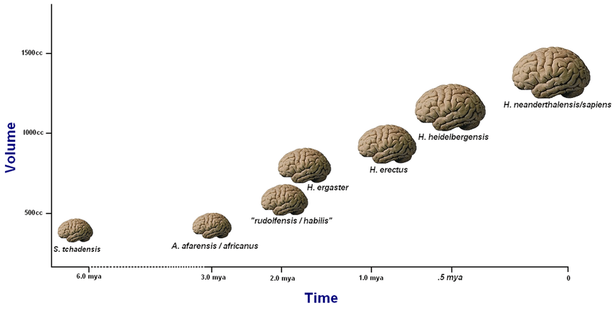
Bolhuis J. J., Tattersall I., Chomsky N., Berwick R. C. (2014). How could language have evolved? PLoS Biol. 12, 1–6.

Slide 21
Last Remaining Homo
The Cognitive Theory
  Due to changes in the sensory integration part of the brain, homo sapiens improved ability to learn
  Suggests why we are the last remaining homo on the planet
The Tree of Knowledge Mutation
  An adaptation through variability in the brain that separated Homo sapiens’ ability to “think” from others of the same genius
Lieberman DE. The Story of the Human Body: Evolution, Health, and Disease. Vintage Books A Division of Random House LLC; 2013.
Harari, Y. N. (2015). Sapiens. New York: Harpers Collins.

Slide 22
The Cumulative Effect of these Changes
More deliberate communication:
  Improved ability to vocally communicate. Allowed gossip.
    Exactly where is that food? Or threat?
  Created larger social networks by enabling sapiens to know whom they could trust. Expanded groups to about 150 individuals
Developed an imagination, create social constructs
  Allowed sapiens to speak of things that do not exist
  Think in terms of churches, nations, laws.
  Constructs that commonly bind thousands of people.
This last fact is what has allowed Homo sapiens to be the apex animal on the planet.
Harari, Y. N. (2015). Sapiens. New York: Harpers Collins.

Slide 23
Milestones Summary Slide
6-7 millions years ago
  Diverged from chimps - LCA
4 million years ago
  Teeth and head structure changes to consume wider range of food
2-3 million years ago
  Hunter gather, further refined bipedalism
~200,000 years ago
  Homo Sapiens evolved out of Africa
Lieberman DE. The Story of the Human Body: Evolution, Health, and Disease. Vintage Books A Division of Random House LLC; 2013.
Notes:
Finding sufficient energy to meet metabolic demands was a major evolutionary driver for our ancestors. Within the last 7 million years, we are going to review the most notable time periods in terms of human evolution.
This timeline has been taken from Daniel Lieberman’s book, titled The Story of the Human Body.
6-7 millions years ago
We diverged from our last common ancestor, chimps
4 million years ago
Teeth and head structure changes allowed us to consume a wider variety of food
2-3 million years ago
As Hunter gathers, bipedalism was refined
~200,000 years ago
Homo Sapiens evolved out of Africa and began to spread across the planet

Slide 24
Cultural Evolution

Slide 25
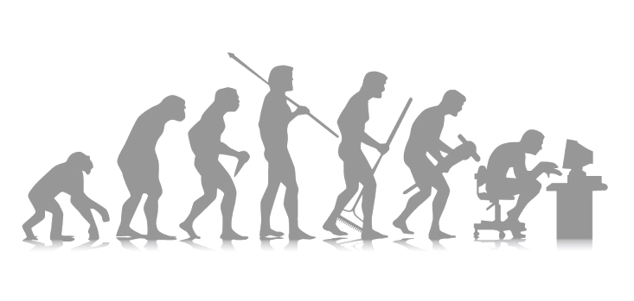
The Result of Big Brains?
A new change agent: Cultural Evolution
Human Culture
  Culture can be defined as the collective intelligence of a society: the learned knowledge, beliefs and values of a society.

Slide 26
The Result of Big Brains?
Cultural Evolution
The collective intelligence of society which changes over time.
The cognitive revolution in the 1950’s enabled sapiens to revise behavior quickly as knowledge was gained and needs changed
  Cultural change is the most powerful force of change on the planet, and is radically transforming our bodies
  “Cultural evolution has bypassed genetic evolution”
Lieberman DE. The Story of the Human Body: Evolution, Health, and Disease. Vintage Books A Division of Random House LLC; 2013.
Harari, Y. N. (2015). Sapiens. New York: Harpers Collins.

Slide 27
The Result of Big Brains?
Two significant cultural transformations:
The Agricultural Revolution: About 12,000 years ago
  The consequences of the end of foraging ?
The Industrial Revolution: Mid-18th century to early 19th century
  The consequences of automation and the decline in manual labor

Slide 28
Houston we have a problem
Body Weight: Then and Now
Early genus homo: 30-40 kg
Modern Homo sapiens: 40-80 kg
  Enough time to allow change of body mass?
    Was the change through natural selection or cultural evolution?
Consequences?
  Think structurally. Took millions of years for our hunter gather biology to evolve. Then exponential cultural growth allowed for farming about 12,000 years ago. Did we have enough time to evolve to tolerate such plentiful kcal resources?

Slide 29
Houston we have a problem
Over the course of 6 to 7 million years of human evolution there have been many environmental changes.
These different environments certainly affected human reproductive success and were the driving force of natural selection and biological evolution.
Now we have become smart enough to quickly manipulate and change our environment.

Slide 30
Cultural Evolution: Hold on?
Have we become too smart for our own good?
Homo sapiens have became the dominant predator on earth
  For the preceding millions of years Homo sapiens were a middle of the road species
  Sapiens biology was not given time to adjust to this rapid change as we retained many adaptations from our evolutionary past.
  This has created many evolutionary mismatches.
Lieberman DE. The Story of the Human Body: Evolution, Health, and Disease. Vintage Books A Division of Random House LLC; 2013.
Harari, Y. N. (2015). Sapiens. New York: Harpers Collins.

Slide 31
Cultural Evolution: Global Concerns
Consequences?
Other animals at the top of the food chain, such as lions and sharks, evolved into those positions slowly over millions of years. This enabled checks and balances that prevented lions and sharks from wrecking too much havoc on their ecosystem.
  For example, gazelles evolved to run faster and hyenas cooperated more.
Humans in contrast ascended so quickly to the top of the food chain that our ecosystem was not given time to adjust: Think climate change
Lieberman DE. The Story of the Human Body: Evolution, Health, and Disease. Vintage Books A Division of Random House LLC; 2013.
Harari, Y. N. (2015). Sapiens. New York: Harpers Collins.

Slide 32
Evolutionary Mismatch
Evolutionary Mismatch Definition:
Features that were adaptive in prior environments are now maladapted in the current environment
Consequences
  One third of the human genome has no function because it lost its function over time.
Lieberman DE. The Story of the Human Body: Evolution, Health, and Disease. Vintage Books A Division of Random House LLC; 2013.
The endcode project consortium. An integrated encyclopedia of DNA elements in the human genome, 2012

Slide 33
Evolutionary Mismatch
Discuss some examples of this mismatch hypothesis
  Propensity to store kcal
  Flat feet
  Osteoporosis
  Metabolic syndrome
  Increased ACL tears in females
  Low back pain

Slide 34
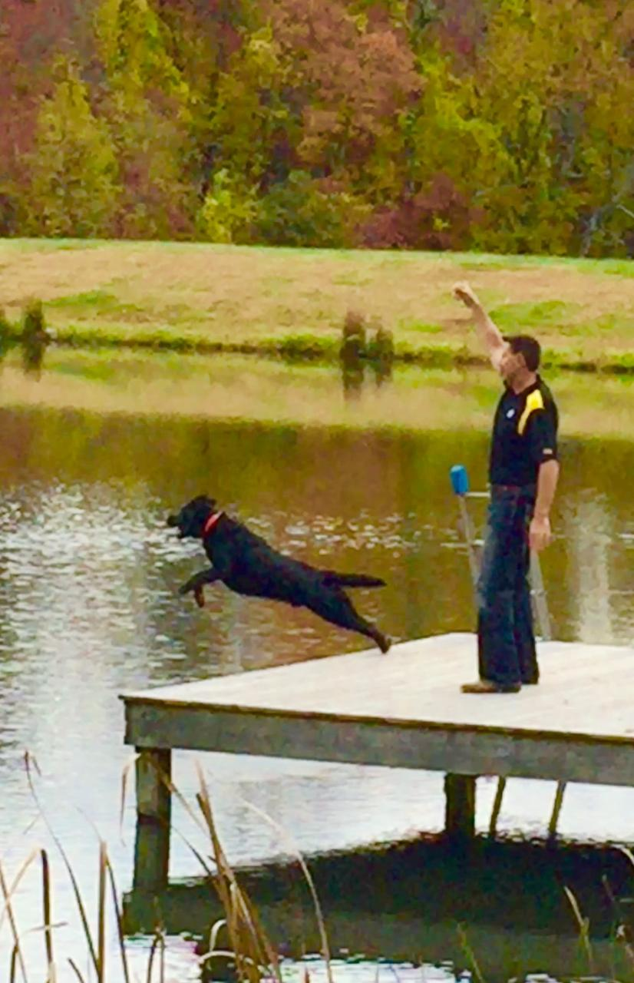
Evolutionary Mismatch
The Labrador retriever: It’s not his fault he is overweight
  More than a fifth of Labrador retrievers carry a genetic variation that predisposes them to weight gain.
  I promise he gets enough exercise, he weighs 90 lbs
What about us?
  Our bodies evolved over millions of years when it was a struggle just to attain enough calories from food to maintain basal metabolic needs.
  Because of this, our bodies are adapted to store calories, not easily expend them.
Raffan & al, 2016

Slide 35
Evolutionary Medicine
Relatively new field which combines evolutionary biology, health and disease
It is based on this mismatch hypothesis.
  This hypothesis looks at the environments that influenced our biological evolution and compares it to the modern environment in which we live.
  These environments can be very different.
  When prior adaptations interact with our modern environment, dysfunction and disease can result.
  There are many mismatches that affect our health.
Lieberman DE. The Story of the Human Body: Evolution, Health, and Disease. Vintage Books A Division of Random House LLC; 2013.

Slide 36
Relevance
Why do we care?

Slide 37
Relevance
Today’s students preparing for a healthcare career need to be able to recognize and design exercise programs with these mismatches in mind.
This course will focus on structural mismatches and how they influence human function.
  These structural mismatches cause many of the most common orthopedic problems that occur in the population today.
  Prior adaptations place the foot, knee, hip, spine and shoulder at great risk to injury when subjected to the stress of our modern environment and current norms in exercise program design.

Slide 38
Relevance
It is no secret that Americans face many healthcare challenges.
We are an aging population, which alone, will cause an increase in the utilization of healthcare services.
The reason for many of those seeking these services will be to treat these structural mismatches. The cost of treating these diseases already strains our national budget.
  These patients will be responsible to self manage these diseases as less and less money is available for therapeutic intervention.
  The need for medically based personal training services will only increase in the future.

Slide 39
Relevance
This class will teach students a new way to look at overall fitness with these structural mismatches in mind.
This new definition of structural fitness will have 3 components:
  Muscle performance
  Joint health
  Cardiorespiratory function
With this new understanding of structural fitness, those taking this class will be better prepared to help this population overcome these healthcare challenges.

