Slide 1
Introduction to KINE 3617
Service Learning in Medical Fitness
David Luedeka PT, DPT, MS, CSCS
Keila Strick PT, DPT, CSCS
Caroline Williams, PT, DPT, MS, GCS
Nick Roche, PT, DPT, CSCS

Slide 2

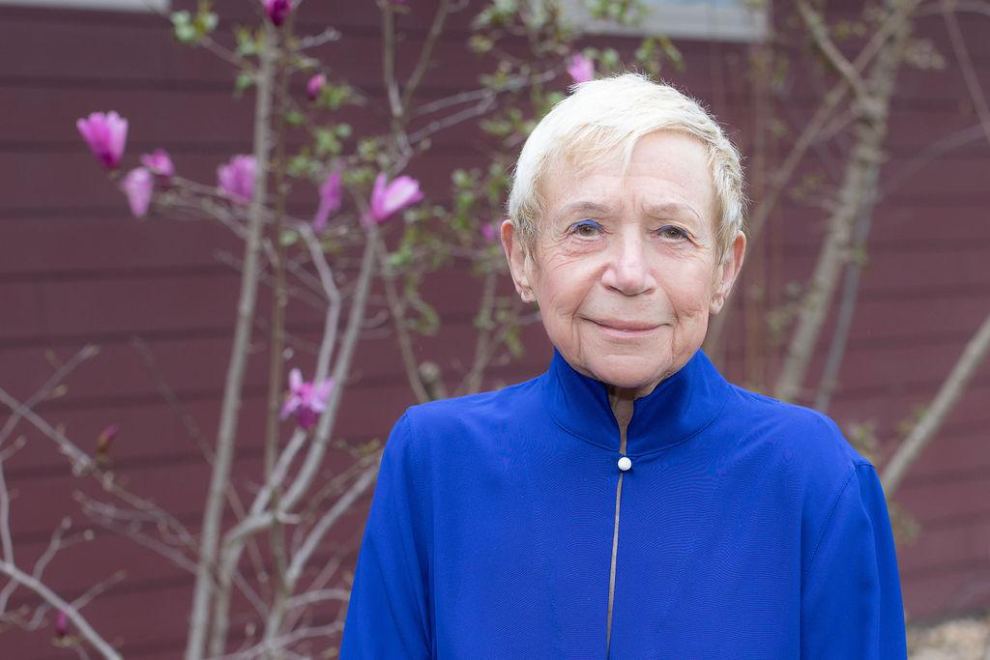




Leadership Team!

Slide 3
Relevant Courses & References
Relevant Course Background
Human anatomy or musculoskeletal anatomy
Biomechanics
References
Each lecture includes bibliography with references
This course heavily refers to this text: Daniel Liberman - The Story of the Human Body / Evolution, Health, and Disease

Slide 4
Learning Goals
Describe common evolutionary mismatches between human biology and current culture and consider how these mismatches impact modern day injury and inform functional exercise.
Demonstrate the skills to work with other students, professionals, and clients under a Medical Fitness model of care.
Adapt program design and communication to effectively work with clients across ability levels.
Understand and apply the tenets of exercise prescription when designing a high-quality progressive resistance training program.
Recognize and respond appropriately to medical emergencies.
Gain hands-on clinical exposure in evaluation and intervention techniques.

Slide 5
Course Relevance
Understand the “why” behind common movement faults, structural dysfunction and musculoskeletal injuries.
Improve confidence and quality of care with clients via hands-on learning experiences.
Practice under the Medical Fitness Model – a truly functional approach to resistance exercise.

Slide 6
Course Structure
KINE 3617 Part I
  Didactic: Foundational knowledge – understand evolutionary mismatches for each major body region
  Clinical: Shadow 2 hours per week
KINE 3617 Part II
  Didactic: putting it all together, more in-depth program design, case study examples
  Clinical: 10-15 hours per week (paid); work towards independence in client care; detail-oriented exercise intervention to address wellness goals
Notes:
teach evolutionary mismatch theories and introduce other topics: Introduction to Medical Fitness, Biomechanics, relevant MSK anatomy
They are required to shadow 1-2 hours per week but without clinical competencies because those will be done during class (every other week)
Part II
Taking 6-10 (depending on needed numbers) to continue to the internship (technically they are hired but will only be paid a small stipend while also taking the course that will refine skills)
Content in part II
Components of fitness, more indepth program deisgn and overall application of concepts taught in class
In person class 2 hours a week to teach concepts
Shadowing hours/training hours minimum of 8 hours per week (just like the internship)
They will get course credit and a stipend ($200-300 / month?)
If interns aren't deemed independent by the end of the class, they don't move on to independence, if they are, they are official!

Slide 7
Course Structure: Part I
Asynchronous video module completed prior to class
In-person at Fried Center SHW Wed 4-6pm
  Lecture: Foundational knowledge base
  Lab: Practice hands-on skills and review clinical competencies with course instructors
In-person clinic observation: Shadow 2 hours each week (individual schedules)
  Semester will be split between Crozet and UVA Clinics
  Clinical competencies review with course instructors and/or experienced interns

Slide 8
Part I Transition to Internship Requirements
Must meet following criteria to move on to Part II
  Obvious investment in learning course material – performance on clinical competencies, asking questions as needed
  Active engagement with classmates, course instructors, interns, clients during class and clinic observations
  Ability to meet expected minimum weekly requirements for clinic time at both clinics – during part II and following internship
  Contributes positively to FCAP's culture – team player, collaborative learning

Slide 9
Course Structure: Part II
Increased clinical hours to meet intern requirement of 10-15 hours per week (split between both locations)
  Paid $400 stipend/month (mid January to mid May)
2-credit course (2-3 hours per week of structured class time)
  In-depth review of exercise form, program design, and case studies
Achieving independence by end of semester
  Overtime, transition from shadowing to leading client sessions
  Independence = create/instruct a safe, appropriately dosed exercise program for clients' wellness goals

Slide 10
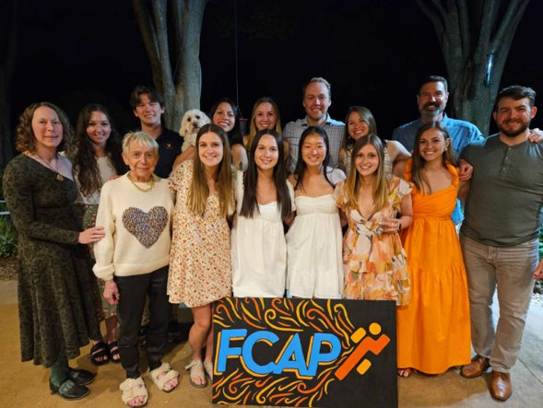
FCAP at a Glance
2 clinics
  FCAP Crozet: Founded in 2016, adjacent to Innisfree Village
  FCAP UVA SHW: Opened in November 2023
4 PTs, 100 interns!!
  30 current (7 in-training), 70 alumni

Slide 11
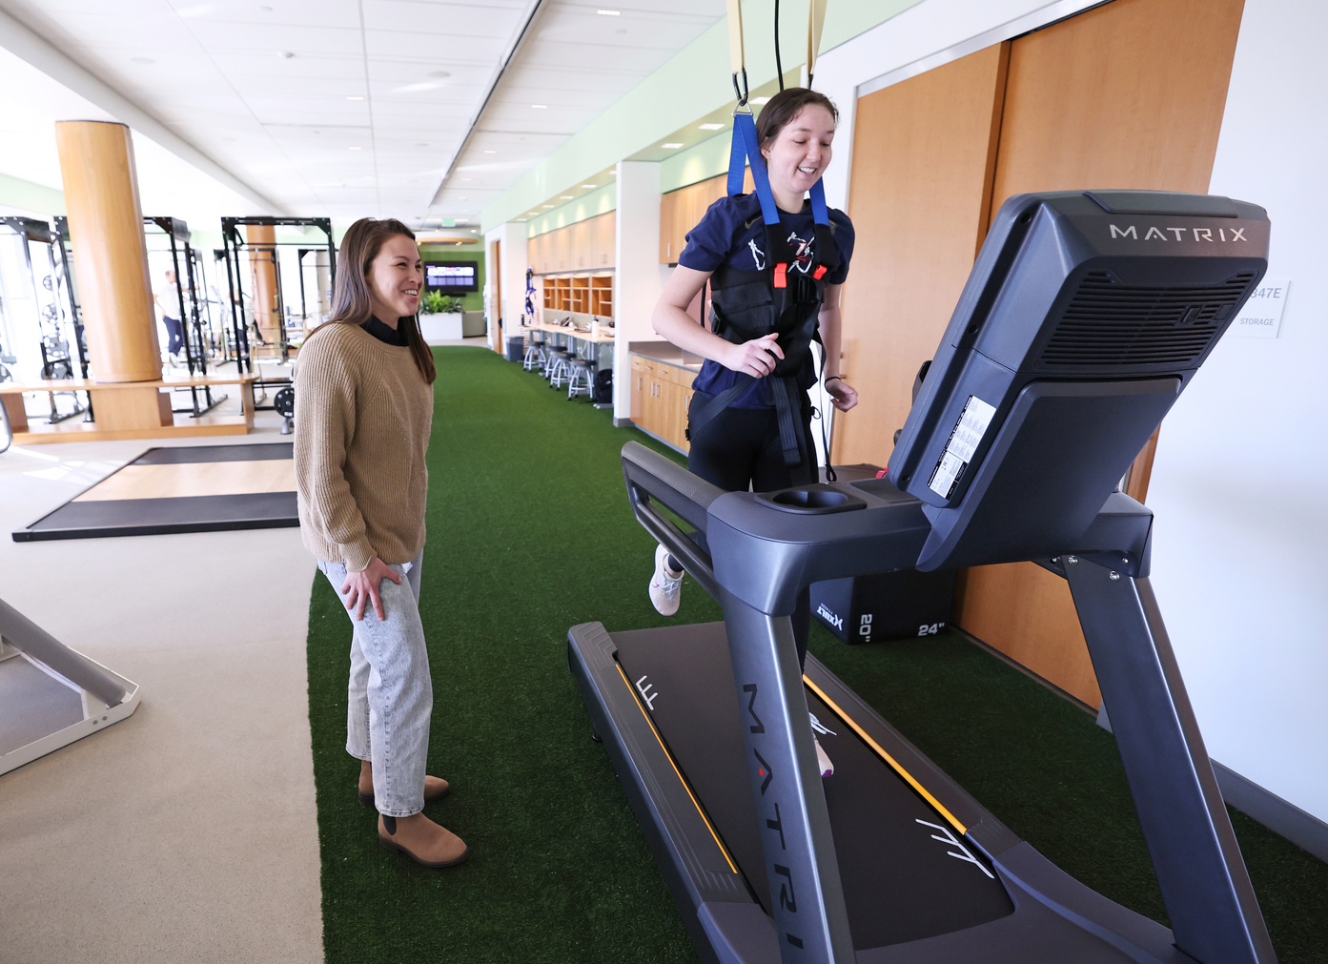
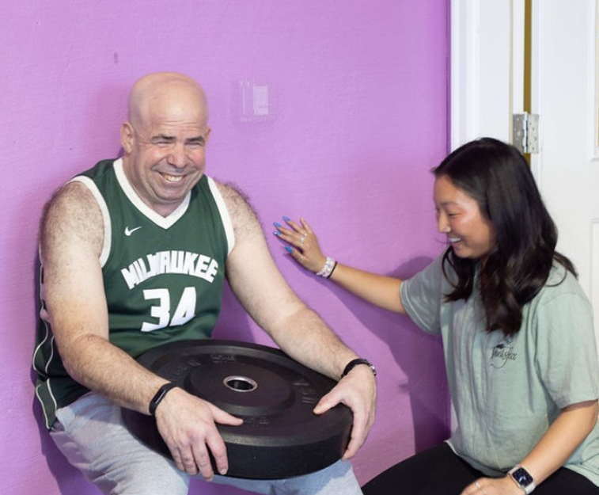
FCAP Mission Statement
The Fried Center for the Advancement of Potential provides physical therapy intervention and medical fitness training to persons with and without intellectual disabilities through student intern clinicians in an inclusive environment

Slide 12
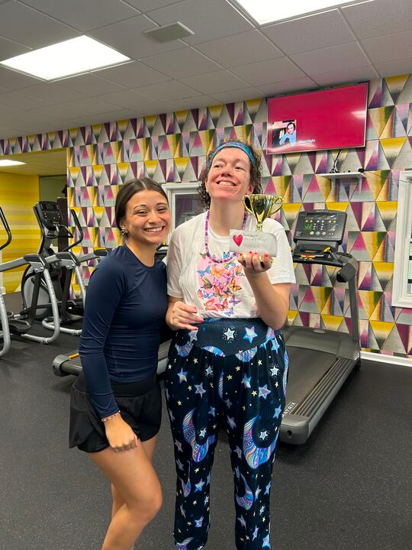
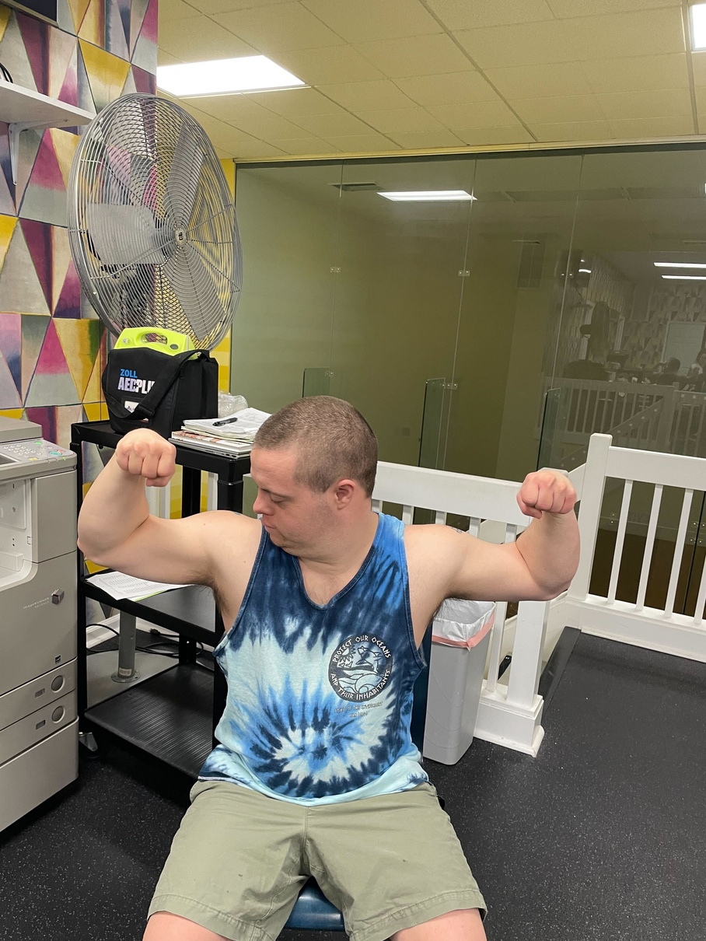
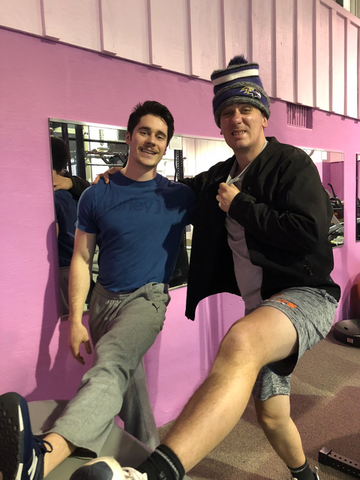
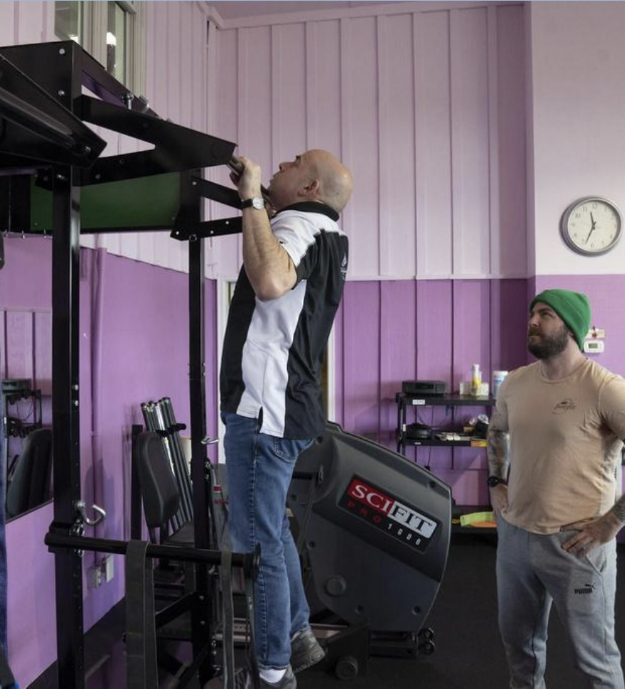
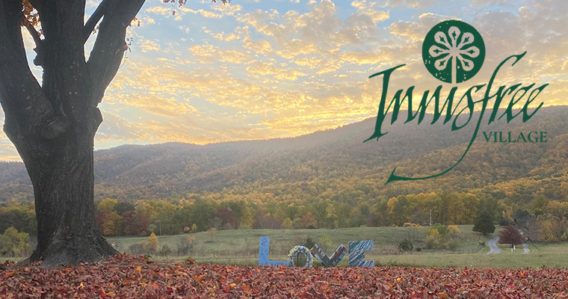
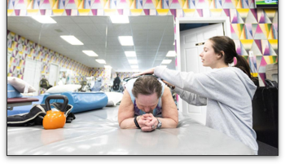
Fried Center at Crozet

Slide 13
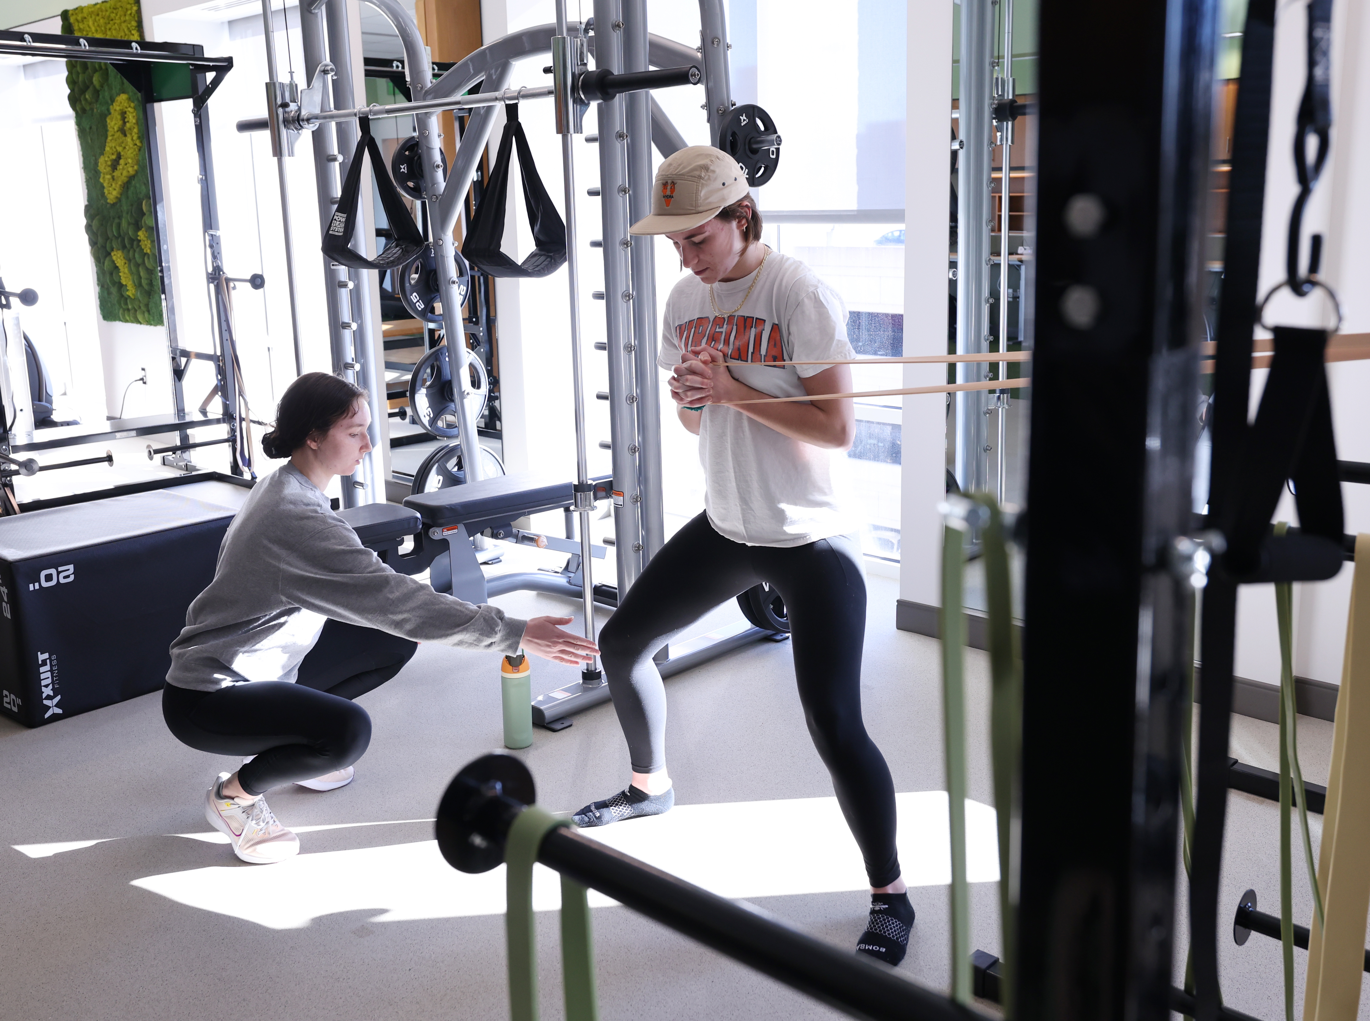
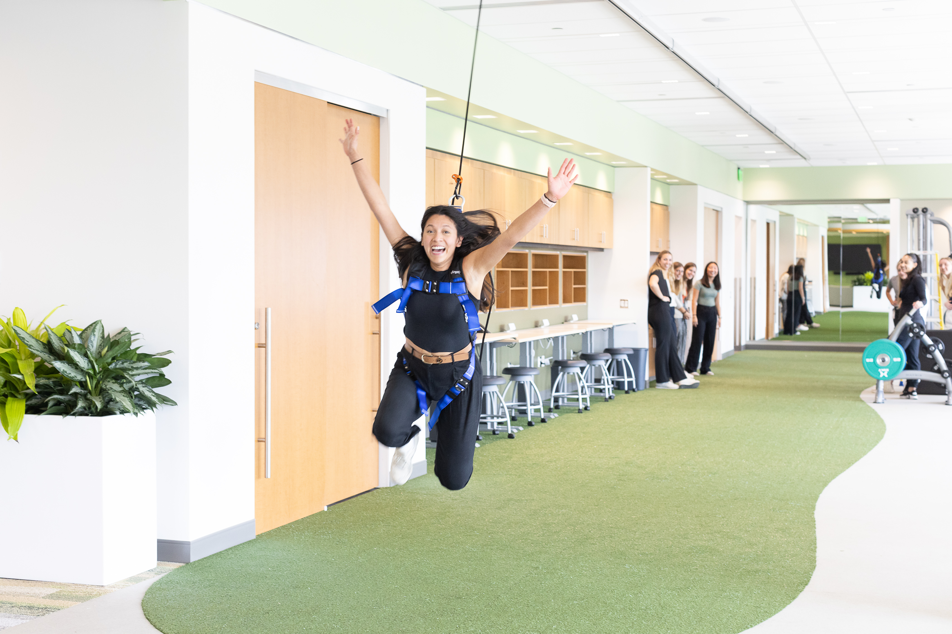
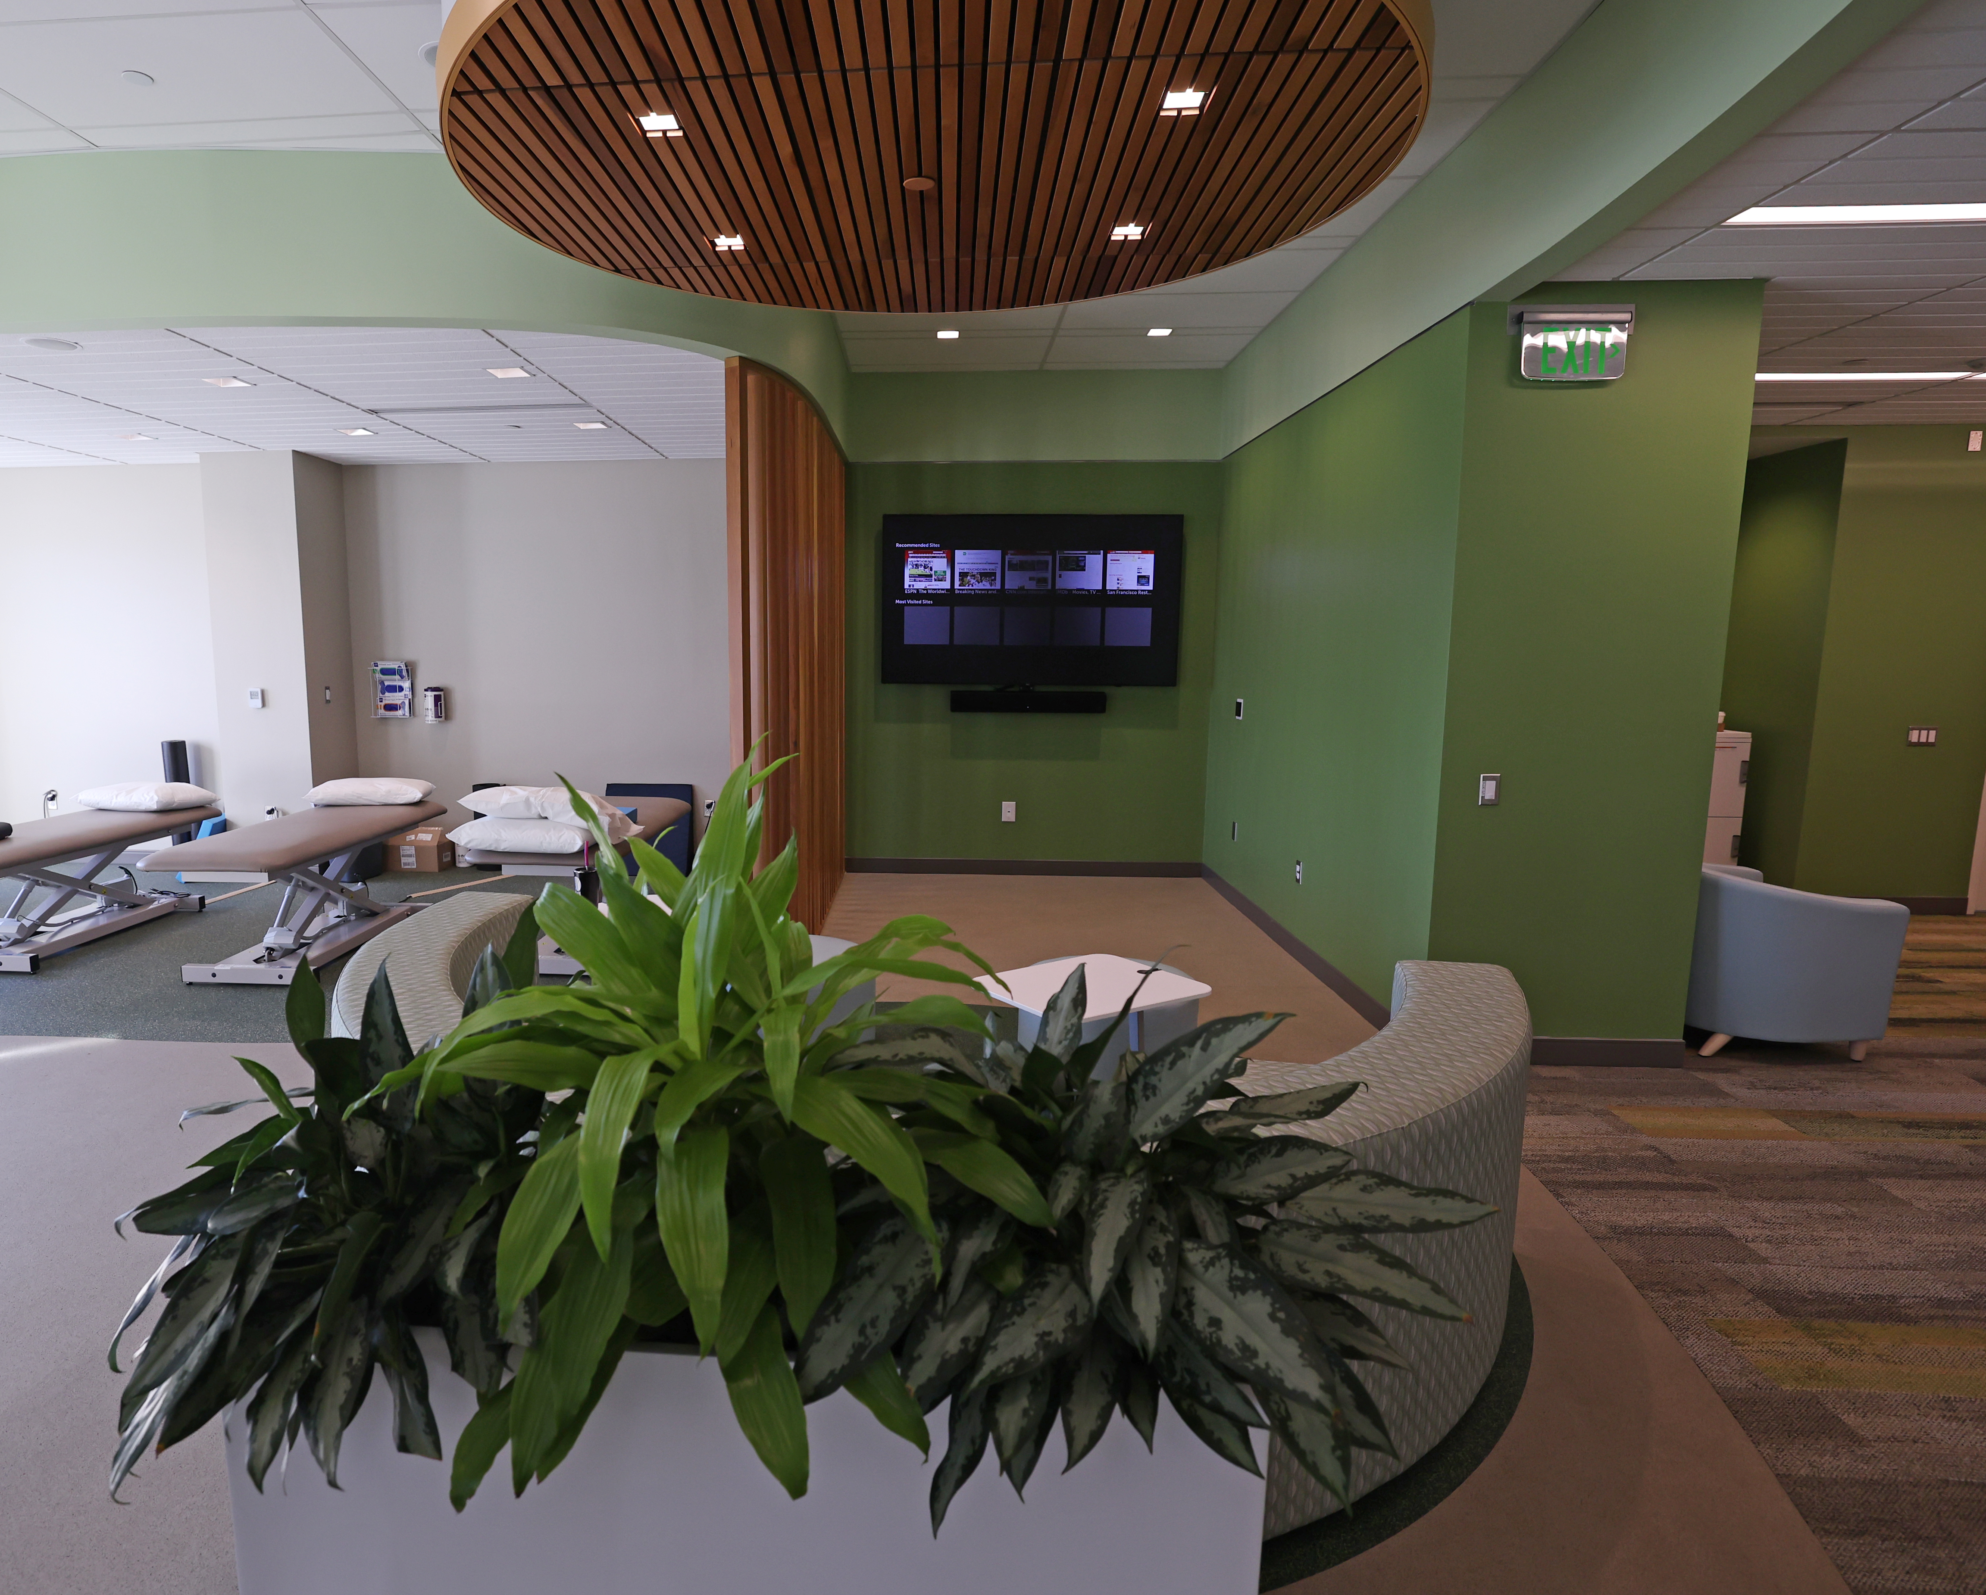
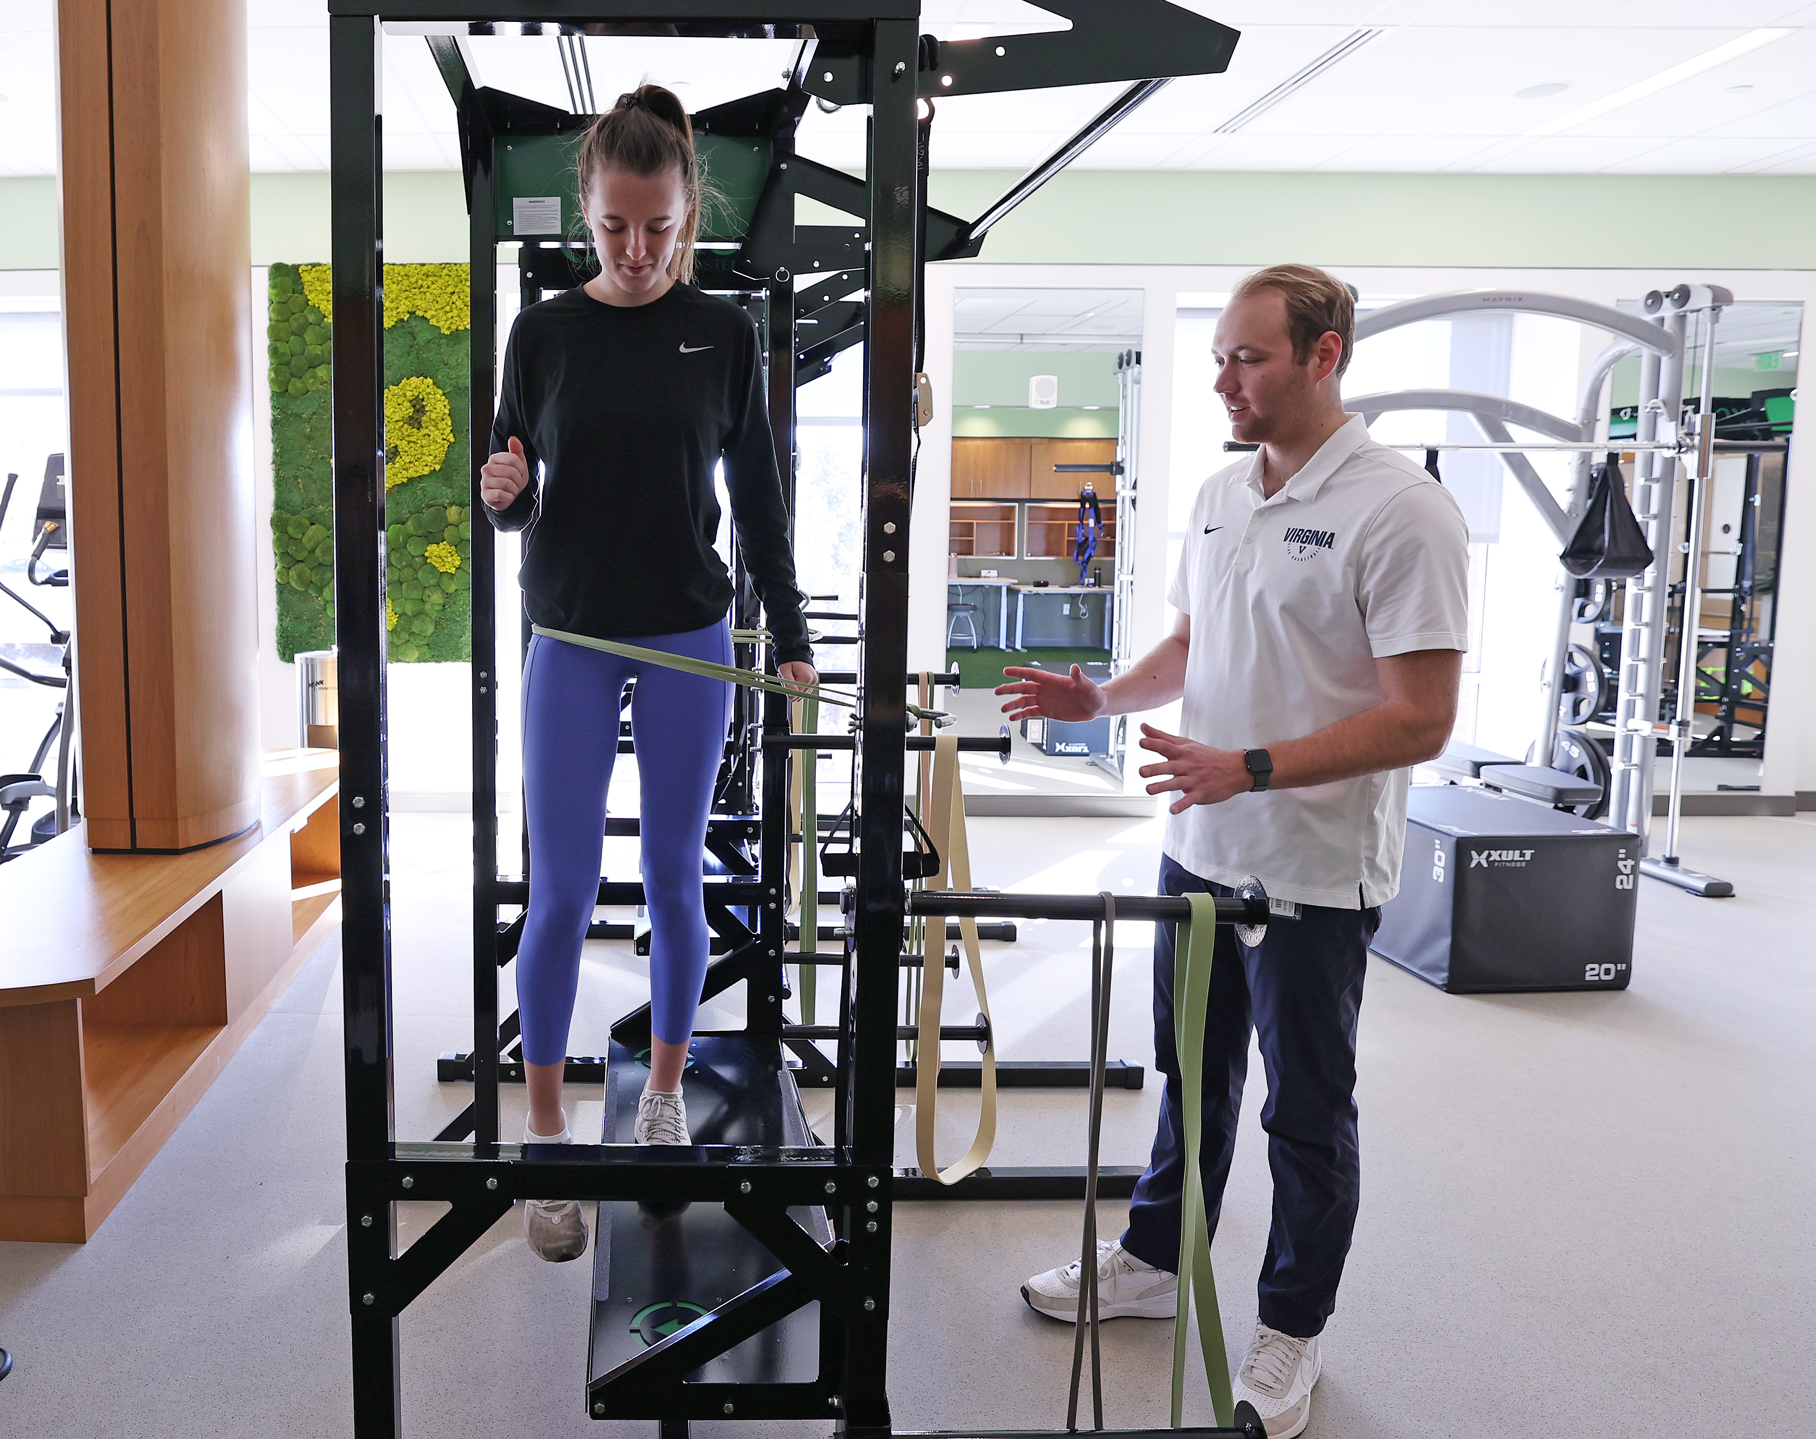
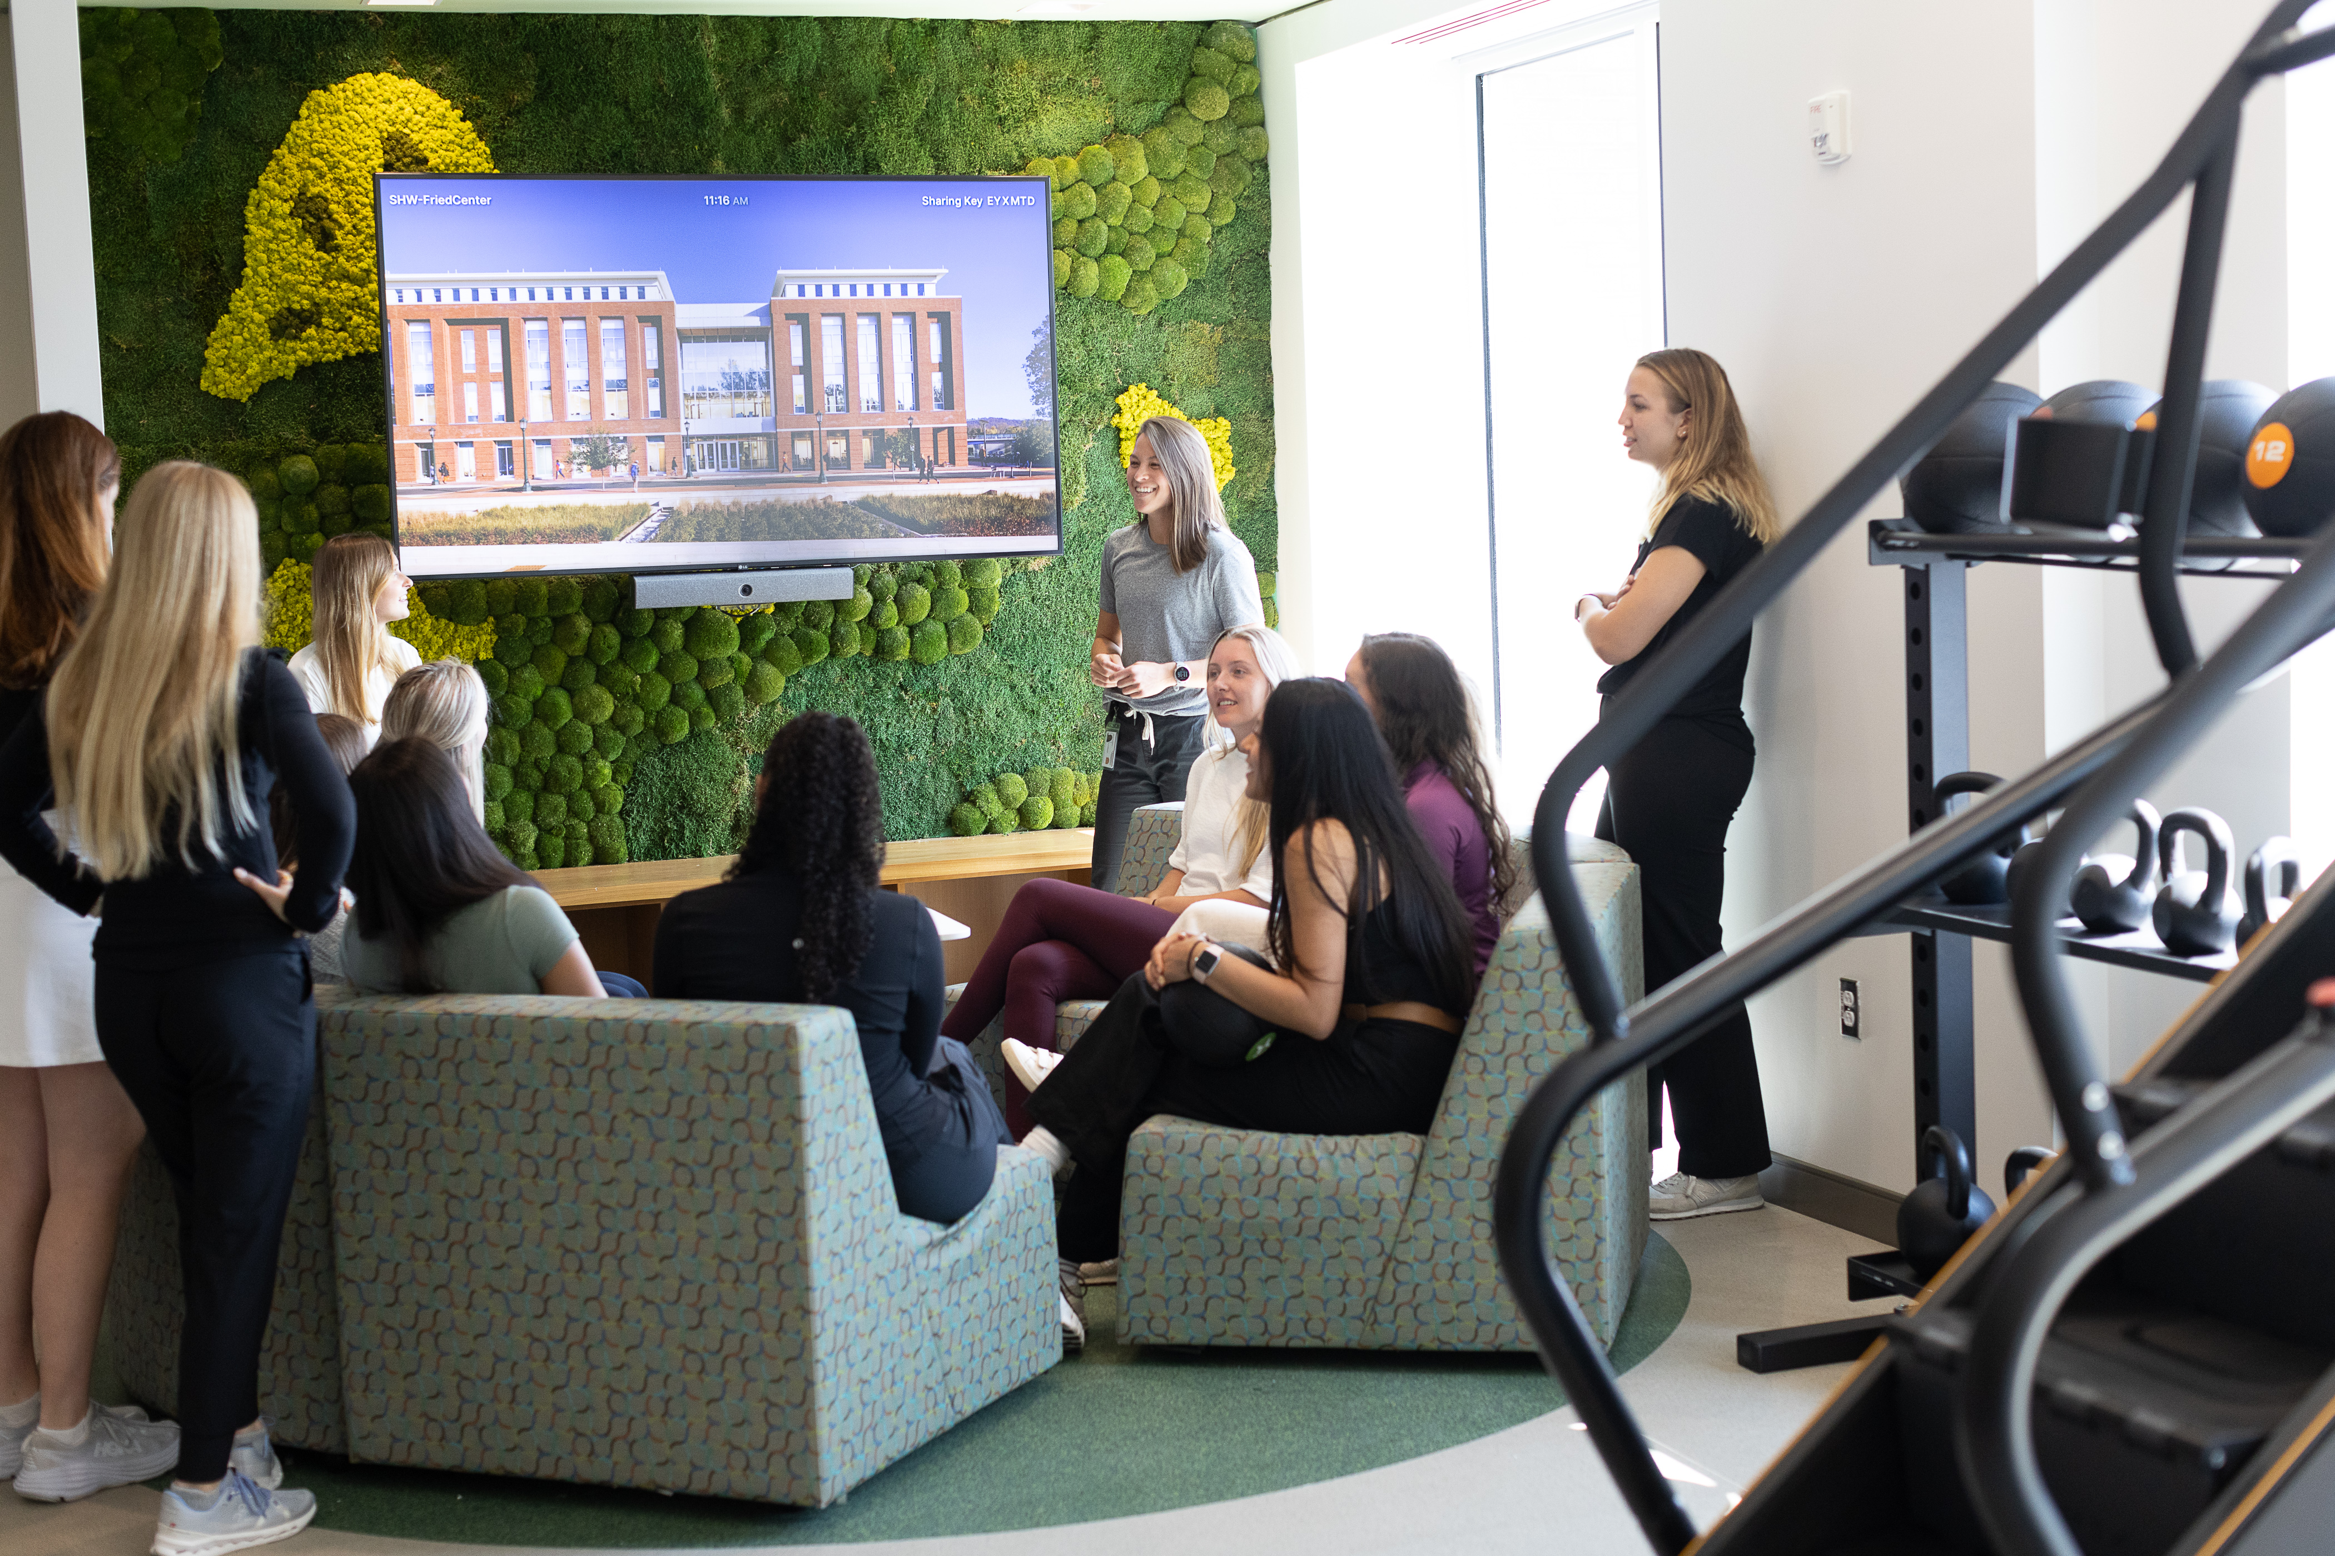
Fried Center at UVA SHW

Slide 14
Intro to Evolutionary Mismatch Theory
Notes:
Alright, we will begin this class with an introduction to evolutionary mismatch theory which really is the foundation of our entire course

Slide 15
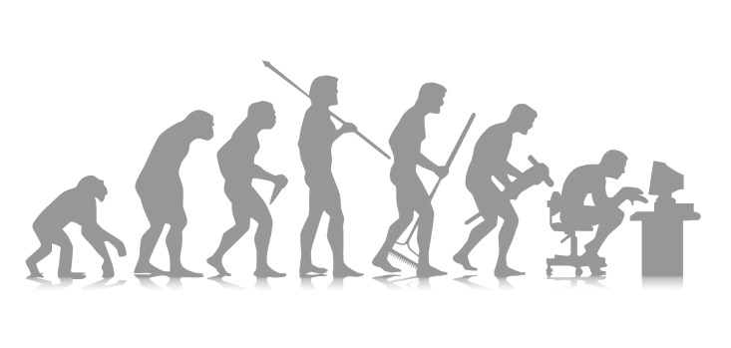
Evolution Defined
Simply put = change over time
Purpose of evolution is not to seek perfection, but to continue the survival of the species.
The reproductive success of a species is determined by how its specific features interact with its environment
Notes:
Simply put, evolution is just change over time.
The purpose of evolution is not to seek perfection, but to continue the survival of the species.
The reproductive success of a species is determined by how its specific features interact with its environment
Aka natural selection

Slide 16
Variability, Feature & Adaptations
Variability
  We are all different
Feature
  Attributes of a specific individual
Adaptation
  A feature becomes an adaptation when it promotes survival and reproduction in a given environment
Notes:
Let’s start by defining some key terms: variability, feature, and adaptation.
Variability simply indicates that we are all different. Features are attributes of a specific individual, and a feature becomes an adaptation when it promotes survival and reproduction in a given environment.
Feature: hair, fur color
Adaptation: color allows camouflage or attracts a mate

Slide 17
Let the Adaptations Begin
6-7 million years ago
  Diverged from chimps - LCA
4 million years ago
  Teeth and head structure changes to consume wider range of food
2-3 million years ago
  Hunter gather, further refined bipedalism
~200,000 years ago
  Homo Sapiens evolved out of Africa
Lieberman DE. The Story of the Human Body: Evolution, Health, and Disease. Vintage Books A Division of Random House LLC; 2013.
Notes:
Finding sufficient energy to meet metabolic demands was a major evolutionary driver for our ancestors. Within the last 7 million years, we are going to review the most notable time periods in terms of human evolution.
This timeline has been taken from Daniel Lieberman’s book, titled The Story of the Human Body.
6-7 millions years ago
We diverged from our last common ancestor, chimps
4 million years ago
Teeth and head structure changes allowed us to consume a wider variety of food
2-3 million years ago
As Hunter gathers, bipedalism was refined
~200,000 years ago
Homo Sapiens evolved out of Africa and began to spread across the planet

Slide 18
Last Common Ancestor
Diverged from chimps 6-7 millions year ago
Humans and chimps share approximately 98% of their genetic code, but we are different
Why the divergence: energy saving theories?
  Environmental changes favored chimps that more easily could stand and walk on two legs
  Quadrupedal motion is 4x the energy cost of bipedal
Sockol MD, Raichlen DA, Pontzer H. Chimpanzee locomotor energetics and the origin of human bipedalism. Proc Natl Acad Sci U S A. 2007;104(30):12265-12269.
Notes:
We diverged from chimps about 6-7 million years ago. Why did we diverge? It’s all about food and energy.
Humans and chimps share approximately 98% of their genetic code, but we are different. Think about how we move.
Chimps are primarily quadrupedal while homo sapiens are bipedal. Chimps’ quadrupedal motion expends four times more energy when compared to human bipedal motion over the same distance.
Environmental changes favored chimps that more easily could stand and walk on two legs because they had to forage greater distances to attain the necessary calories to sustain life.

Slide 19
Evolution is Not Perfect
Human structure has evolved over millions of years
The environment in which Homo sapiens evolved has varied greatly over this time
Human structure retains adaptations directly related to survival of the species through the interaction with these past environments.
Notes:
Human structure has evolved over millions of years
The environment in which Homo sapiens evolved has varied greatly over this time
Human structure retains adaptations directly related to the survival of the species through the interaction with these past environments.
Human structure is not perfectly evolved to cope with modern environments. Was that evolution’s purpose?
No. It’s about procreation and survival, not about making a perfect homo sapien.

Slide 20
Why us? Homo Sapien
The Tree of Knowledge Mutation
  An adaptation through variability in the brain that separated Homo sapiens’ ability to “think” from others of the same genius
The Cognitive Theory suggests why we are the last remaining homo on the planet.
  Theorized to be due to changes in the sensory integration part of the brain which improved our ability to learn
Lieberman DE. The Story of the Human Body: Evolution, Health, and Disease. Vintage Books A Division of Random House LLC; 2013.
Harari, Y. N. (2015). Sapiens. New York: Harpers Collins.
Notes:
Why are we the last remaining hominin. Currently the leading theory as to why our species remains while other hominids died off, is the cognitive theory based on the “tree of knowledge mutation”. This theory is based on changes in the brain that separated homo sapiens ability to think from others of the same genus.

Slide 21
Too Smart For Our Own Good
Big brains make us the dominant species
The agricultural revolution: About 12,000 years ago
  The consequences of the end of foraging ?
The Industrial revolution: Mid-18th century to early 19th century
  The consequences of automation and the decline in manual labor
Lieberman DE. The Story of the Human Body: Evolution, Health, and Disease. Vintage Books A Division of Random House LLC; 2013.
Notes:
Advanced brains make us the dominant species. What have big brains allowed us to accomplish? Some major milestones include both the agricultural and industrial revolutions.
The agricultural revolution occurred about 12,000 years ago and decreased our need to hunt and forage.
The industrial revolution occurred a few hundred years ago and decreased our need for manual labor and high energy expenditure with work related activities.

Slide 22
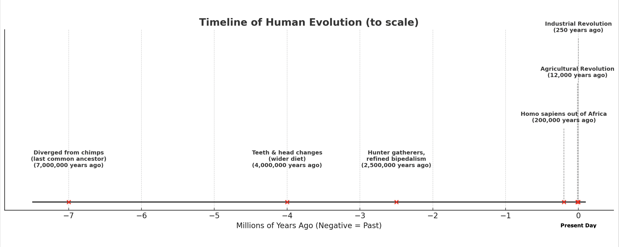
A Blip in Time

Slide 23
Evolutionary Mismatch Theory
The foundation of this course is the evolutionary mismatch theory
There are two main causes of evolutionary mismatches
  1) Biological evolution
  2) Cultural evolution
Notes:
The foundation of this course is the evolutionary mismatch theory
There are two main causes of evolutionary mismatch
1) One is Biological evolution
2) The other is Cultural evolution

Slide 24
Biological Evolutionary Mismatch Theory
An adaptation that we have evolved over millions of years may have been adapted to a prior environment, but is now maladapted to the current environment.
Notes:
For the purpose of this course, we will focus on structural evolutionary mismatches.
Human structure has evolved over the course of 7 millions of years in response to the kinetic forces acting on our structure. The environment in which these structural features evolved in, determined their success.
Evolutionary mismatches are features that were once advantageous to the survival of our species and were adapted to a prior environment. These features are now maladapted to the current environment in which we live.

Slide 25
Cultural Evolutionary Mismatch Theory
We have become smart enough to manipulate the environment in which we live. Environmental changes are happening so fast, there is no way for our biological evolution to keep pace.
Notes:
The other component of evolutionary mismatch theory is cultural mismatch which is driven by our ability to manipulate the environment in which we live. Environmental changes are happening so fast, because of our ability to change our own environment, there is no way for our biological evolution to keep pace.

Slide 26
Example of Evolutionary Mismatch
BMI then and now. Biological evolution favored storing calories as food was scarce
Propensity to store calories is now maladapted in our current environment
Our structure has evolved over millions of years to support a smaller structure. In the last 20,000-80,000 years, our size and weight has increased significantly.
Can you think of other examples?
Notes:
One of the best examples of an evolutionary mismatch that most people can appreciate is comparing our BMIs to our evolutionary past.
We evolved to store calories because they were hard to come by and attaining calories required high levels of energy.
However, we are no longer struggling to find food, so our propensity to store energy as fat is now maladapted to our current environment, and has caused other major health problems such as an increased risk for heart disease, type II diabetes, and so much more.
Our chapters moving forward will speak on individual structural mismatches and how we train and treat with these mismatches in mind.

Slide 27
Relevance
Preparing for a healthcare career need to be able to recognize and design exercise programs with these mismatches in mind.
This course will focus on structural mismatches and how they influence human function.
  These structural mismatches cause many of the most common orthopedic problems that occur in the population today.
  Prior adaptations place the foot, knee, hip, spine and shoulder at great risk to injury when subjected to the stress of our modern environment and current norms in exercise program design.

Slide 28
Relevance
It is no secret that Americans face many healthcare challenges.
We are an aging population, which alone, will cause an increase in the utilization of healthcare services.
The reason for many of those seeking these services will be to treat these structural mismatches. The cost of treating these diseases already strains our national budget.
  These patients will be responsible to self manage these diseases as less and less money is available for therapeutic intervention.
  The need for medically based personal training services will only increase in the future.

Slide 29
Important Definitions
Notes:
Hello, my name is Keila Strick and I will be taking you through the next portion of the course.
Now that we understand what an evolutionary mismatch is, we need to define a few key terms and concepts before we move forward with the rest of the course. This will be review for most of you.

Slide 30
Kinetics vs Kinematics
Kinetics - study of forces that affect motion of a body
  E.g. Friction, gravity, pressure, ground reaction force
Kinematics - study of the motion and position of an object, without regard to the forces acting on it.
  E.g. running, shooting a basketball
Notes:
Kinetics is the study of forces that affect motion of a body. Some examples include - Friction, gravity, pressure, and ground reaction force
Kinematics, on the other hand, is the study of the motion and position of an object, without regard to the forces acting on it. Some examples include - running or shooting a basketball

Slide 31
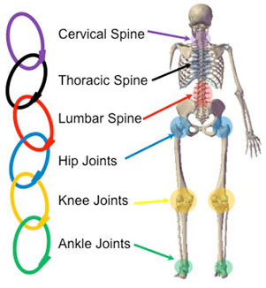
The Kinetic Chain
Our body = one big connected chain
Limbs are composed of rigid bones = levers
Connected by joints = links in the chain
Motion driven by muscular contraction at one segment, has an effect on other segments throughout the body
Notes:
Next we will discuss the kinetic chain, which is something you’re going to hear a lot about throughout the course.
Our body is one big connected chain where our limbs are composed of rigid bones connected by joints which are the links in the chain
Motion driven by muscular contraction at one segment, has an effect on other segments throughout the body
For example, if our feet are the base of the human kinetic chain, then foot function impacts the position and function of the knee, hip, spine, and shoulder.
The forces that impact the kinetic chain can be classified as either open or closed chain forces.

Slide 32
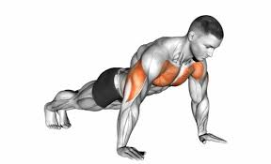
Closed Chain Movement
Distal segment is in contact with an immovable object (e.g. the ground), and in no way can the muscular force production overcome the mass of the object.
Characteristics of closed kinetic chain exercises
  Increased joint compressive forces
  Increased joint congruency
  Decreased shear forces
Notes:
Closed chain movement happens when the distal segment is in contact with an immovable object, such as the ground, and in no way can the muscular force production overcome the mass of the object. When one’s muscles’ contractile force is unable to overcome this distal load, contractions cause motion in the opposite direction.
Characteristics of closed kinetic chain exercise include:
Increased joint compressive forces
Increased joint congruency (and therefore increased stability)
Decreased shear forces to the joint
Push-ups are a great example of a closed chain movement where you exert effort against the ground, but instead of moving the ground downwards, you move your body upwards and your hands remained fixed throughout the exercise.

Slide 33
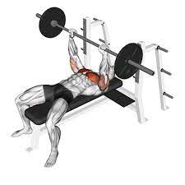
Open Chain Movement
Distal or terminal segment can move freely in space
Characteristics of open kinetic chain exercises
  Increased joint distraction and rotational forces
  Increased joint deformation (and therefore reduced stability)
  Increased shear forces
Notes:
Open chain exercise is the opposite and is best described by a muscle contraction that results in the distal or terminal segment moving freely in space, thus overcoming the load.
Characteristics of open kinetic chain exercise include:
Increased joint distraction and rotational forces
Increased joint deformation (and therefore reduced stability)
Increased shear forces across the joint
Here, we included an example of a bench press. This exercise targets the same muscles as a push-up, but your hands and weights move freely through space instead of your body.

Slide 34
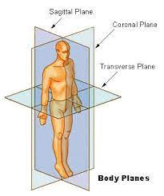
Planes of Movement
Sagittal
  Bisects the body left to right
  Flex / extend
Frontal/Coronal
  Bisects the body front to back
  Abduct / adduct
Transverse
  Bisects the body top to bottom
  Rotational movements
Notes:
Throughout the class, we will reference planes of motion frequently. If you’ve taken any human anatomy course, you will be familiar with these terms.
The sagittal plane bisects the body from left to right. So movements that occur about the sagittal plane often include flexion and extension.
The frontal, sometimes referred to as the coronal plane, bisects the body from front to back. Examples of movements that occur about the frontal plane often include abd and adduction.
Finally, the transverse plane bisects the body from top to bottom. Examples of movements that occur about the transverse plane often include rotational movements.

Slide 35
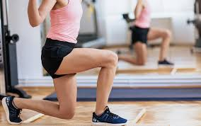
Functional Exercise
A form of exercise that involves training the body for the activities performed in daily life.
Oftentimes, these exercises are compound in nature
Functional exercise follows the principle of specificity
Notes:
The next definition we will review is functional exercise. Functional training is simply a form of exercise that involves training the body for the activities performed in daily life.
Frequently, these exercises are multi-joint in nature and the muscles causing this joint motion oftentimes function differently then they would when isolated during open chain motion.
The principle of specificity applies to functional training, like it does to all forms of training.
The specificity principle states that in order to improve a certain motion pattern, training should closely mimic that movement and the strength, speed, muscle activation pattern, and biomechanics associated with that movement
For example, in order to improve your ability to ascend stairs, it is best you perform step-ups as opposed to hamstring curls.
Most human functional movement takes place in a closed chain as it relates to lower extremity motion and in the open chain as it relates to upper extremity motion.

Slide 36
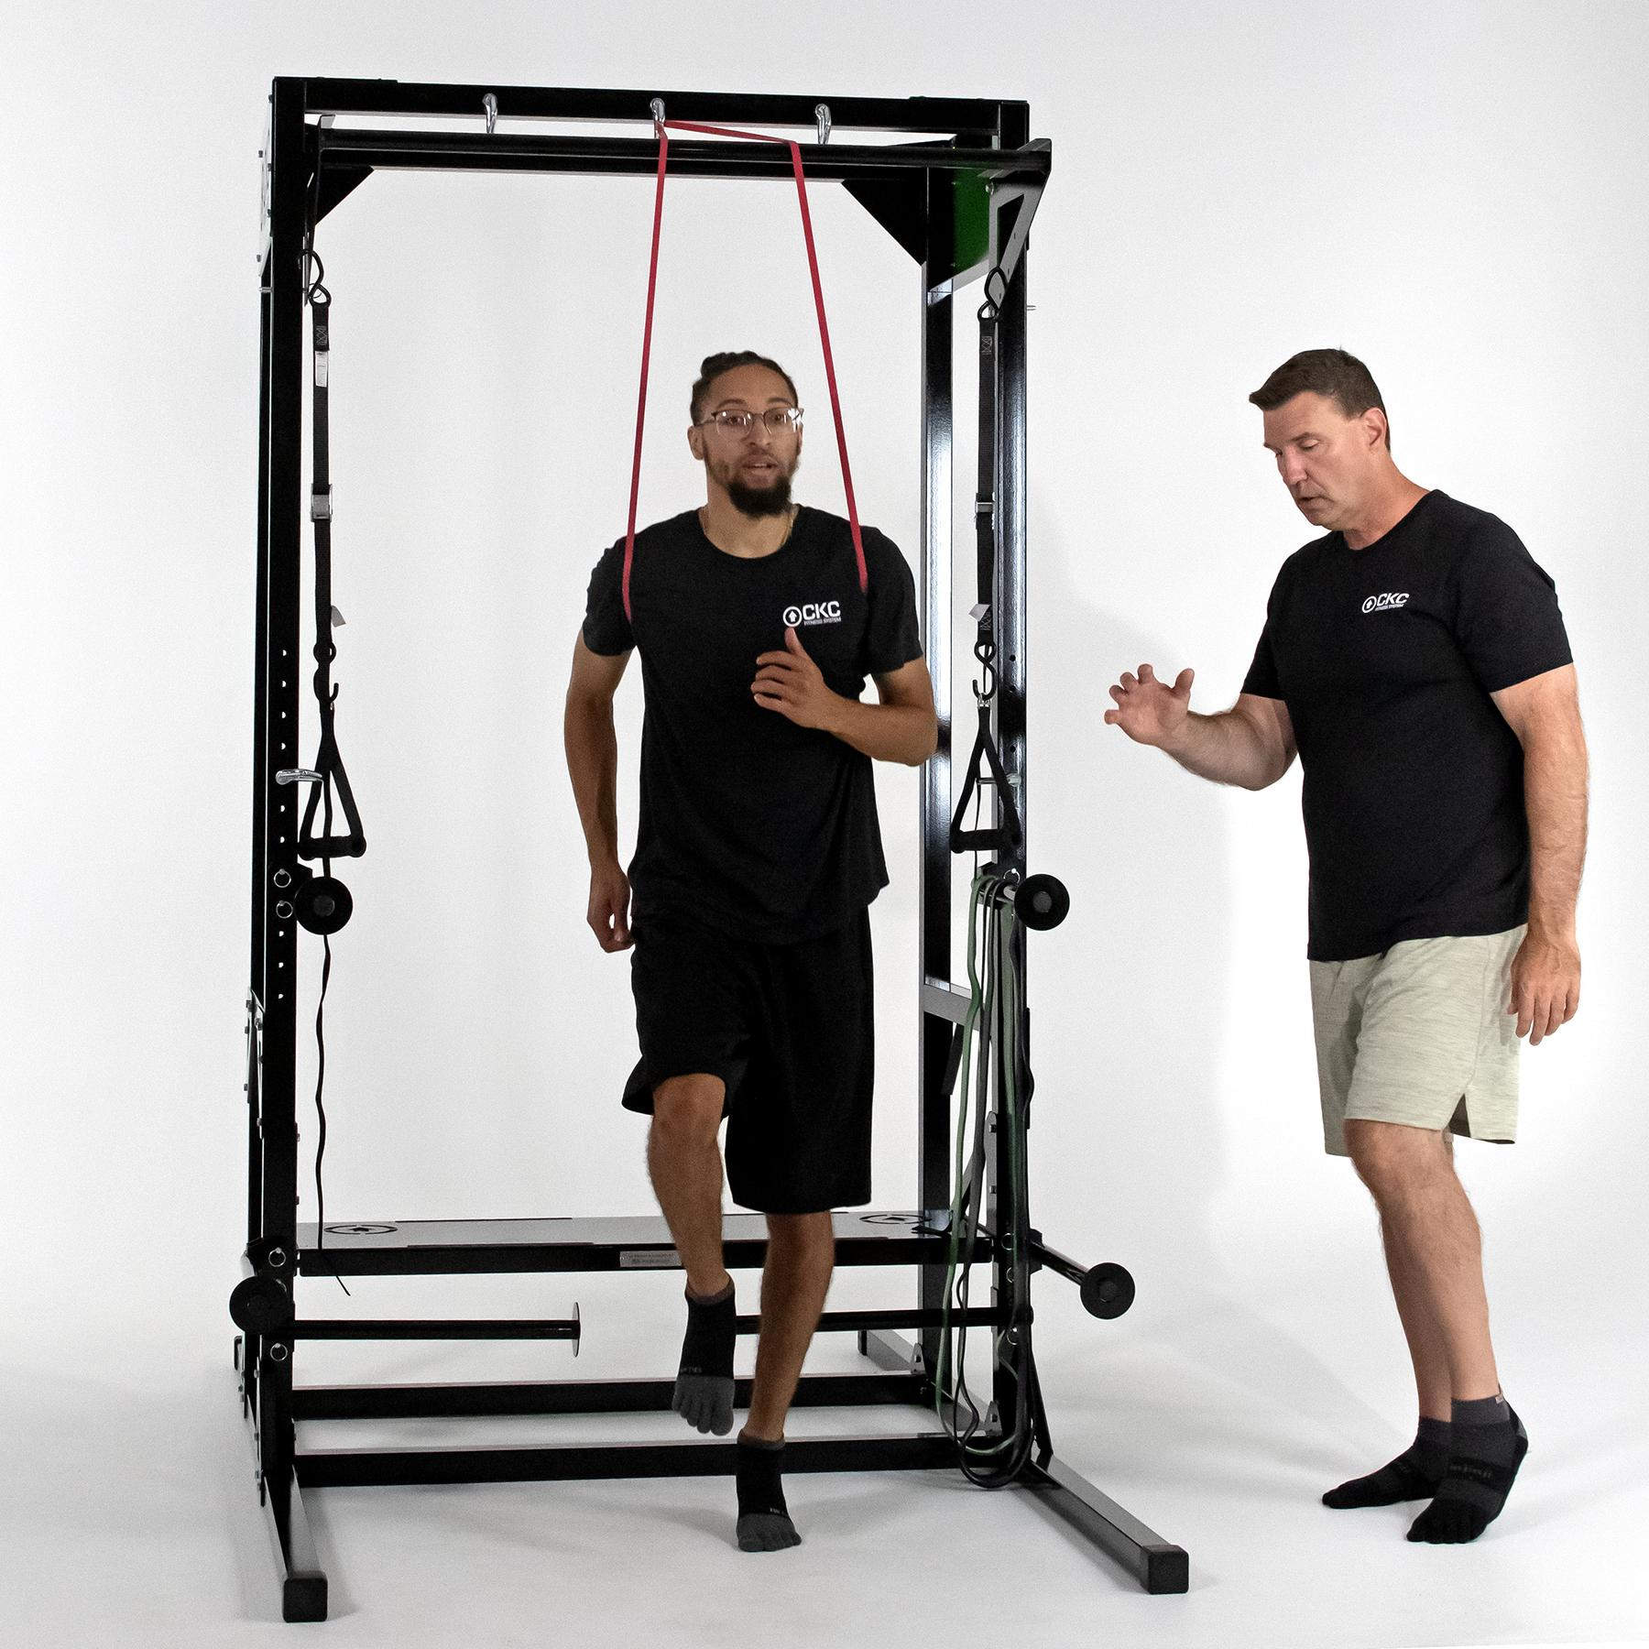
Functional Exercise
Let’s think about functional exercise in a deeper and more comprehensive way:
→ Not just considering how we move our bodies on a day to day basis, but considering how our structures were evolved to be used
Notes:
This being said, the emerging evidence may disrupt the specificity theory as it relates to upper extremity resistance training against significant load.
CKC Systems thinks about functional exercise in a deeper and more comprehensive way–not just considering how we move our bodies on a day to day basis, but also considering how our structures were evolutionarily designed to be used.
You will see how we apply our interpretation of functional exercise throughout the course. Next, you will meet Frank Morley who will take you through the foot lecture.

