Slide 1
Introduction to Medical Fitness
Exercise Considerations
David Luedeka PT, DPT, MS, CSCS
Keila Strick PT, DPT, CSCS
Caroline Williams, PT, DPT, MS, GCS
Nick Roche, PT, DPT, CSCS

Slide 2
Overview
Rethinking anatomy – multi-segmental approach
Exercise program planning
  The basics
  How we put this into practice
Clinical Examples

Slide 3
Exercise Principles

Slide 4
Exercise Principles
Specificity
Overload
Progression

Slide 5
Specificity Principle
States that exercises performed in a training routine should closely mimic the movements associated with the activity/sport you wish to improve
When designing exercise programs, the type, sequence, velocity of muscle contraction, etc. should be similar to performance goals
This is why functional training is relevant in modern program design
Notes:
This is one of the main reasons that functional training is so relevant in modern program design. What are the forms of training? They include strength, flexibility, and cardiovascular endurance. Joint health?

Slide 6
Overload Principle
  States that in order to have a positive effect on the system you are training, a stimulus needs to be applied that is greater than what those systems are currently accustomed to tolerate.
Without the stimulus overload, greatly limits an athlete’s ability to make improvements
Accomplished by manipulating
  Load, frequency, intensity, rest, or volume of exercise within the program design
Stress the body at a higher level than it is used to
Notes:
The three most common muscular overload phases:
Tendon adaptation phase
Hypertrophy phase
Strength phase

Slide 7
Progression Principle
States that in order to continue to produce higher levels of performance, the intensity of the training must become progressively greater.
Continued improvement is the goal of all exercise programs.
The ultimate goal is to reach one’s maximal physical potential.
Progression promotes long term training benefits
Increase intensity by raising number of weekly sessions, increasing load, changing type of exercise, etc.
Notes:
that a constant adaptation and changes in intensity, volume and time of the workout will prevent the stagnation of performance gains or increase performance gains faster than a repetition of the same workout

Slide 8
Program Design Variables

Slide 9
Program Design Variables
Needs Analysis
Exercise Selection
Training Frequency
Exercise Order
5. Resistance/Load
6. Volume
7. Rest

Slide 10
Needs Analysis
2 Steps:
Evaluate the athlete/client (i.e. goals, training status, injury status)
Understand the characteristics and requirements of the patient’s functional goals (sport, movement analysis, physiological analysis, etc.)

Slide 11
Exercise Selection
Choosing the appropriate exercises
  Follows specificity principle
Core / Compound exercises
  Recruit one or more large muscle areas and is multijoint
Assistance / Accessory exercises
  Recruit smaller muscle areas and are single joint

Slide 12
Frequency
Number of training sessions in a given time period (i.e. 1 week)
Progressive resisted exercises (PRE) recommendations:
  Traditionally 3 per week (increase or decrease with age and experience)
    Allows for rest days
  Minimum 2 per week
Cardiorespiratory exercise
  30 minutes of moderate-intensity most days
  OR
  20 vigorous-intensity 3 / days a week
Notes:
Fewer as we age - why?
The older we get we do not have the anabolic hormone levels required to recover quickly
Split routine can allow for training nearly every day while still providing proper rest

Slide 13
Exercise Order
Sequence of resistance exercises performed during one training session
Complex multi-joint exercises before simple single joint exercises
Large muscles before small muscles
If circuit training, it is better not to include exercises that work the same muscles in the same grouping
  Can group opposing movements/muscle groups (i.e. push & pull)
  Can group different body parts (i.e. LE, UE, & core)
  Complex movements in first grouping

Slide 14
Volume-Load
Load refers to the amount of weight assigned to an exercise set
Volume-load is a better way to think about load
In a given targeted rep-range, reps should dictate load
  I.e. if aiming for 10 reps, the load should not be too light where completing 20 reps is feasible, or too great, where the exerciser can only do 6 reps
Notes:
We’ll talk more about rep-range as we talk about training goals

Slide 15
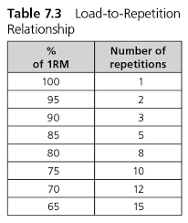
Load- Determined as a % of 1RM
Can also work in the reverse way - determine your 10RM and estimate your 1RM base on that
Study Q: If someone can lift 125 lbs 12x, what weight should they use for 6 repetitions?
https://canada.humankinetics.com/blogs/excerpt/methods-of-resistance-training

Slide 16
Volume
Determined by multiplying the number of sets performed by the repetitions done.
Sets of an exercise: The frequency of performing one particular exercise within an exercise session.
Reps are simply the number of times you perform an exercise in a particular set.
Exercise volume changes based on the overload phase you are in

Slide 17
Volume and Load Based on Training Goal
Training Goal | Load (%1RM) | Goal Repetition
Connective Tissue Adaptation Phase | <,= 65% | 15-20
Hypertrophy Phase | 65-80% | 8-12
Strength Phase | >80% | <8
High Volume Overspeed Phase | 40-60% | 20

Slide 18
Training Phases | Goals and Volume of Phases
Connective Tissue Adaptation Phase | Loads allow for connective tissue stress and “toughening” but are not optimal at stressing the muscle fibers; 2 sets is sufficient; good for beginners
Hypertrophy Phase | Loads allow for muscle fiber stress and increase muscle cell size, while some same benefits as connective tissue adaptation; 2-3 sets is sufficient volume
Strength Phase | Loads allow for muscle fiber stress and increased neurological stimulation; 3-5 sets needed to maintain volume; power work done in this phase
High Volume Overspeed Phase | As long as training to maximal volitional fatigue and as fast as safely possible, targets muscle hypertrophy, strength, and endurance, as well as increased power output while preserving long term joint health

Slide 19
Rest
Need rest period between sets and exercises
Training Goal | Rest
Connective Tissue Adaptation Phase | < 30 seconds
Hypertrophy Phase | 30 seconds - 1.5 min
Strength Phase | 2-5 min
High Volume Overspeed Phase | 2-5 min

Slide 20
Rest
  Rest is required as a part of an appropriately designed exercise program.
Muscle soreness: Full recovery is needed prior to the next exercise session.
Monitor progress: If performance decreases maybe not enough rest.
Psychological burnout
Older and more deconditioned my require more rest

Slide 21
Rest to Prevent Overtraining
Rest is an important factor in preventing overtraining.
After cycling through the phases described in the overload section, it is important to take 1 or 2 weeks off from the exercise program.
This gives the body time to heal and grow. It prepares the body to begin the sequence again. It is good to stay active in this rest period and to continue a cardiovascular regimen, but not to perform the resistance training routine.

Slide 22
Overtraining Syndrome
Can occur without an appropriately designed exercise program.
This syndrome causes a decrease in performance and makes the body more susceptible to injuries and illness.
The treatment of overtraining syndrome is a very long rest period.
Overtraining injuries and non compliance will occur when the principles of exercise program design are not followed.

Slide 23
Too much rest is not good…
Stopping exercising for an extended period of time results in musculoskeletal functional decline.
Atrophy starts after the first few weeks of stopping an exercise program
  Within several months, there is a complete loss of positive adaptations
If training decreases for any reason, higher intensities are needed in the exercise program design to maintain current levels.

Slide 24
Exercise Program Considerations

Slide 25
Cardiorespiratory
Cardiorespiratory exercise sessions should last for a duration of 20 to 30 minutes depending on intensity.
Heart rate average after exercise should be close to the desired target goal.
The goal is based on your fitness level and determined by using one of the many formulas available to calculate ones training zone .
Resistance training sessions should last for a duration of no longer than 60 minutes for optimal results.

Slide 26

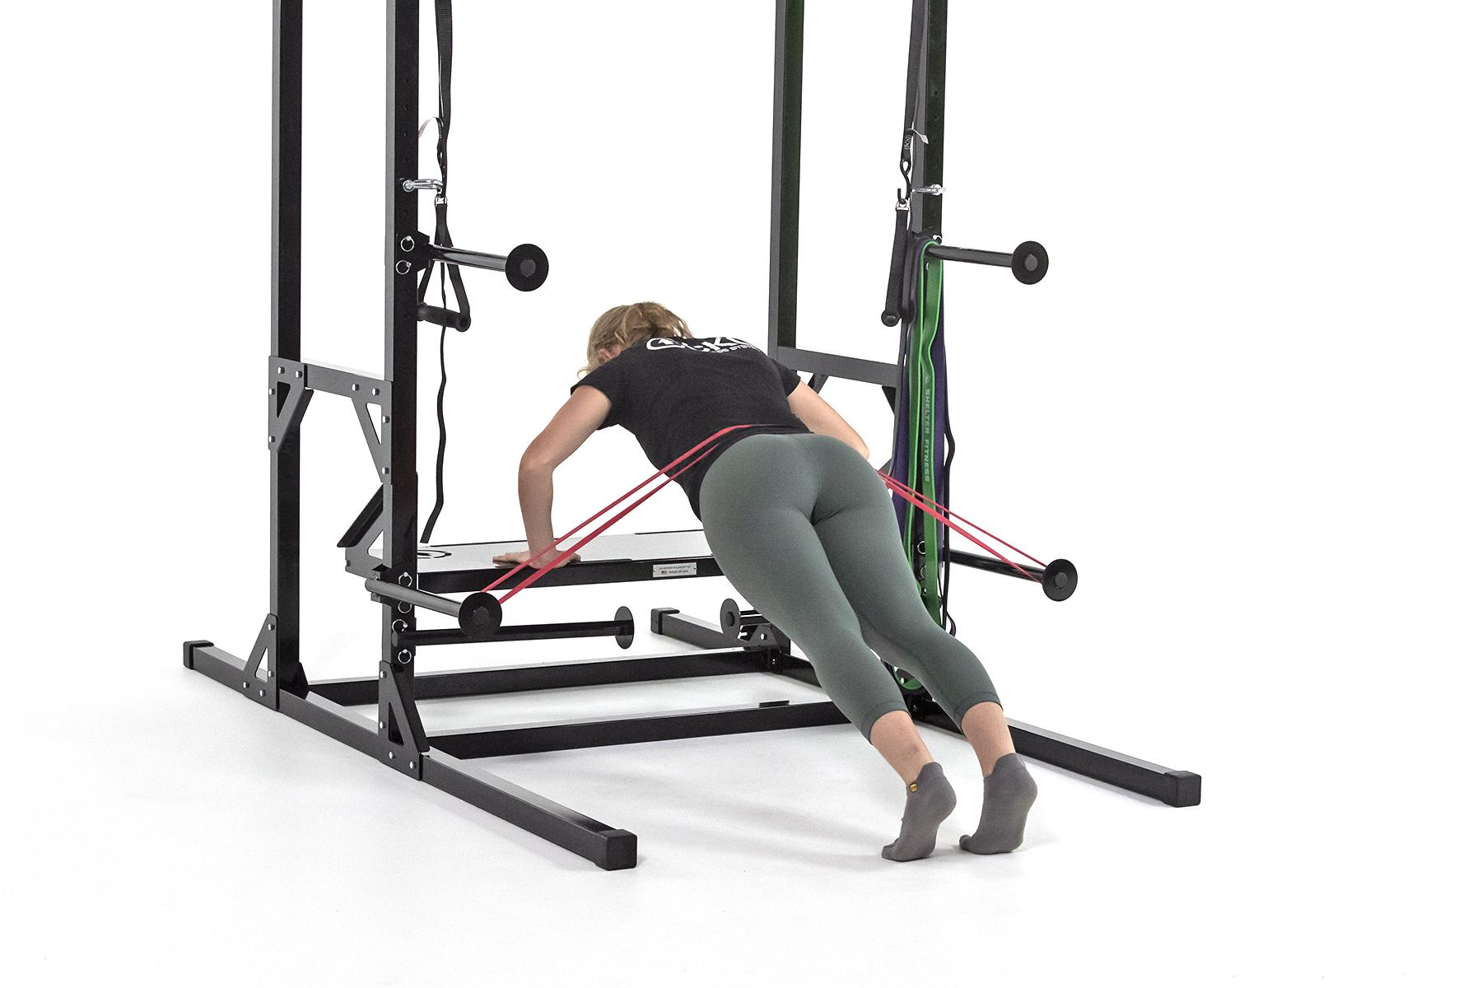
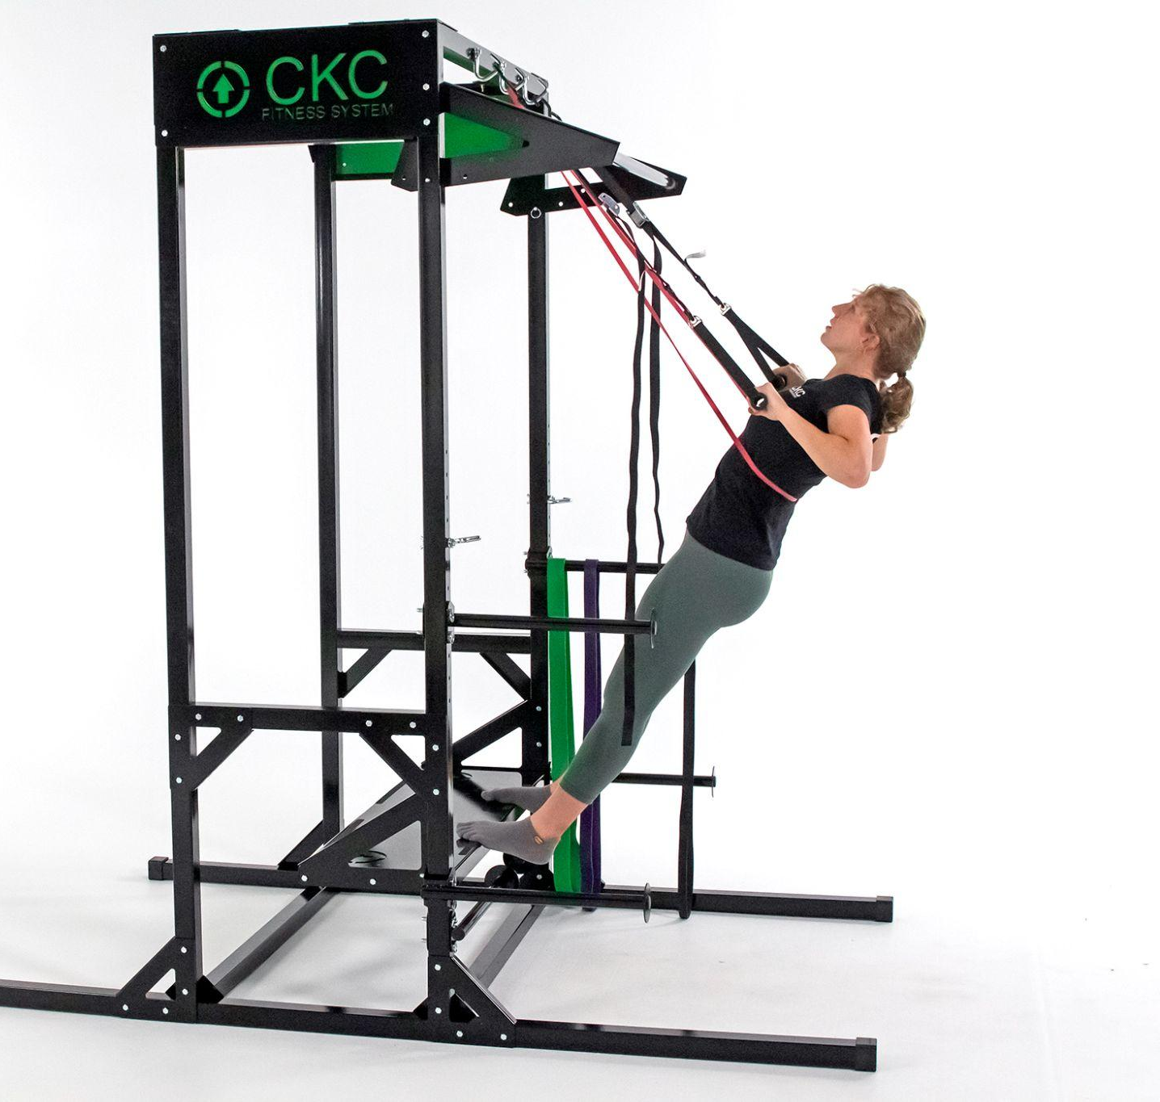
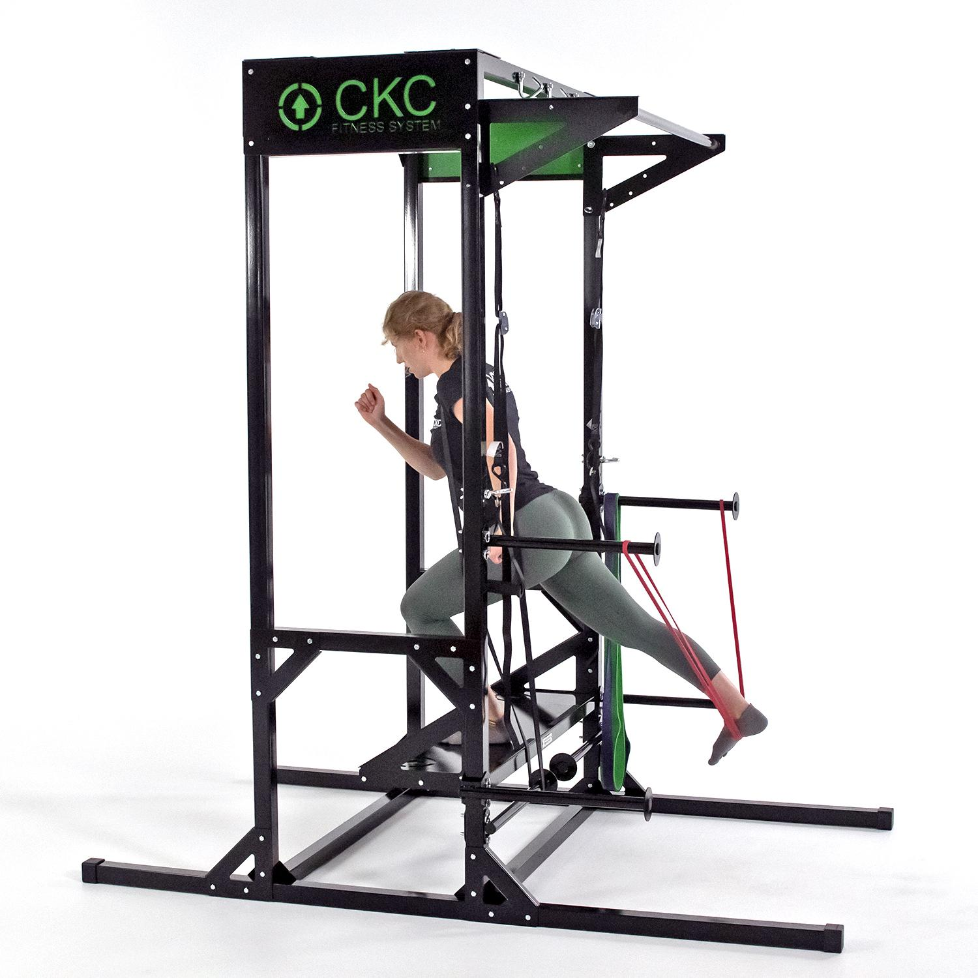
Circuit Training
A form of workout in which resistance training and cardiovascular training effects are combined
Exercises are performed in a circuit, one after the other
Quick transition with little to no rest between exercises, promotes cardiorespiratory benefits while resistance training

Slide 27
Targeted Training
Circuit training works best when you are in a progressive resistance exercise phase that requires a high volume of repetitions with decreased rest periods.
These phases include the connective tissue adaptation and hypertrophy phases.
Circuit training is not an optimal way to improve peak cardiovascular function or maximal strength.
For those goals, more focused targeted training is needed.

Slide 28
Functional Exercise
A form of exercise that involves training the body for the activities performed in daily life.
Oftentimes, these exercises are compound in nature
Functional exercise follows the principle of specificity

Slide 29
External forces acting on our bodies
Gravity is the force of attraction between an object and the center of the Earth. It is a fundamental force of nature.
  It keeps one grounded and must be overcome with every step we take.
Ground Reaction Force is an equal and opposite force exerted by the ground on a body in contact with it.
The lower extremity musculoskeletal system is designed with large bones and muscles producing forces that enable one to overcome ground reaction forces created by gravity.
Exercises should mimic these conditions - FUNCTIONAL!

Slide 30
Muscle Function Against Gravity
Instead of one muscle flexing a joint and the other extending it, the same muscle is responsible for both actions.
The muscles work in conjunction with other muscles in the kinetic chain eccentrically to control the bending caused by gravity and concentrically to overcome it.
We will diver deeper into these concepts in the “CKC Muscle Function” course

Slide 31
Importance of
Functional Exercise

Slide 32
Function Exercise Follows the Specificity Principle
We walk, bend, squat and run under the influence of these gravitational forces.
Whether we are attempting to decrease someone's fall risk or improve their athletic performance, a functionally based training program is superior at achieving these goals.
As one ages the maintenance of this closed chain functional strength is a key to preserving quality of life.

Slide 33
Functional Exercise and the Shoulder
The shoulder joint is anatomically unstable when it functions in an open kinetic chain.
Even though humans have evolved from using the upper extremities as legs, the shoulder joint still retains design features that require closed chain forces when significant force is applied to the upper extremity.

Slide 34
Why is non functional exercise superior to functional exercise for the upper extremity?
It is theorized that the shoulder joint requires external forces to assist with joint stabilization.
The shoulder has a cuff of musculature (the rotator cuff) to assist in this stabilization.
When the compressive forces provided by gravity are utilized in closed chain exercise, there is less need for the rotator cuff musculature to stabilize the shoulder joint.

Slide 35
Why is open chain functional exercise for the upper extremity not advised?
Motion in an open chain, especially with load, places a great deal of stress on this rotator cuff musculature.
  Over time the rotator cuff wears out.
As a result of this disruption, the rotator cuff is a major cause of pain and disability in modern life.
Training the upper extremity musculature in a non-functional closed chain manner also helps to keep the joints of the upper extremity properly positioned.

Slide 36
Train functionally to...
Improve strength
Cause muscle hypertrophy
Provide superior protection from injury.
Due to the multi-joint nature of most of the exercises, training functionally has a greater metabolic cost.

Slide 37
Clinic Examples

Slide 38
Exercise Programming Templates

Slide 39
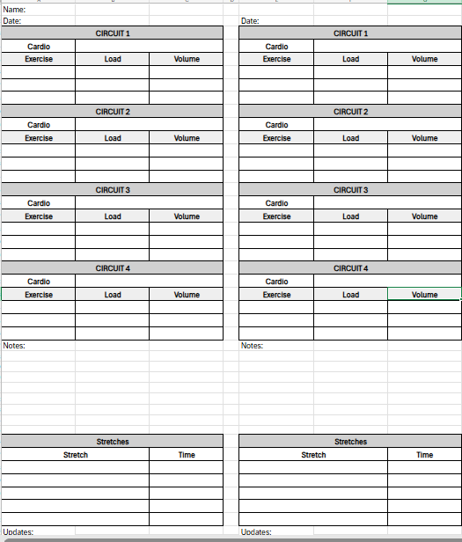
Connective Tissue + Hypertrophy Phases

Slide 40
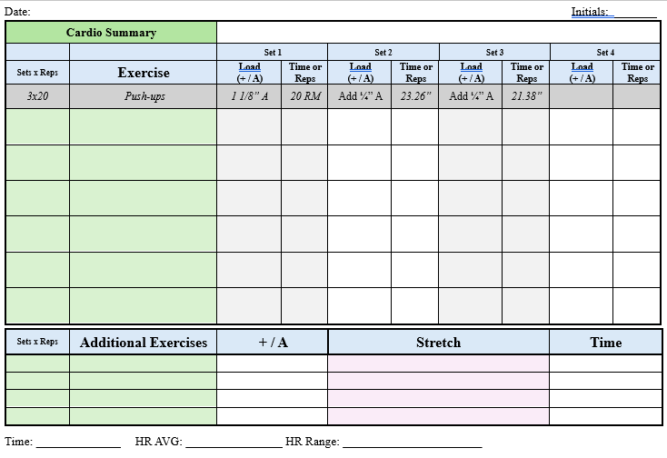
High Volume Overspeed Phase
Start at your true 20 RM and offload from there

Slide 41
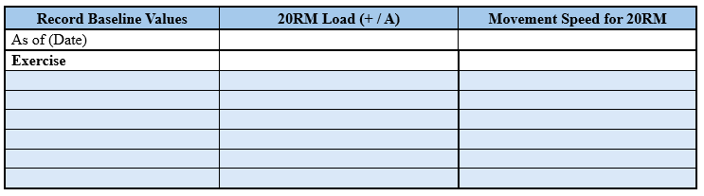
High Volume Overspeed Phase Cont.
20 RM & Max Baseline Movement Speed
Example

Slide 42
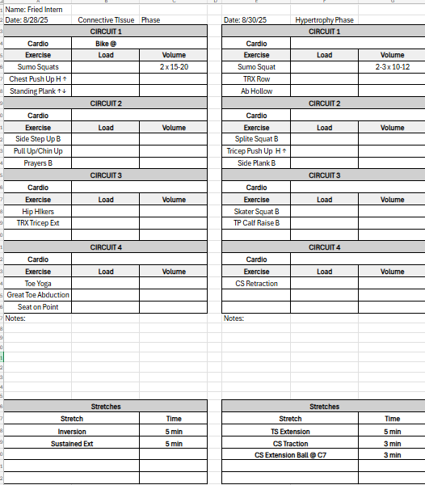
Standard Examples

Slide 43
Evaluation Templates

Slide 44
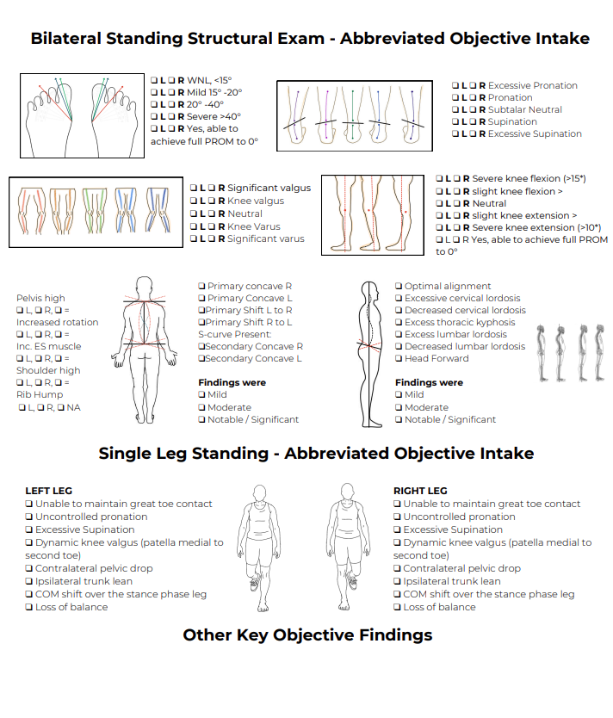
Standard Examples
Abbreviated exam form

Slide 45
Confidential and Proprietary Information
The concepts presented in this presentation are the proprietary intellectual property of CKC Systems LLC. These materials are intended solely for informational purposes and may not be reproduced, distributed, or disclosed without the express written consent of CKC Systems LLC.
For more information, visit www.ckcfitness.com
© 2025 CKC Systems LLC. All rights reserved

