Slide 1
Muscle Function
A Segmental Approach
David Luedeka PT, MS, DPT, CSCS
Keila Strick PT, DPT, CSCS

Slide 2
Introduction

Slide 3
What is the action of the hamstring?
Notes:
Raise your hand if you can tell me the action of the hamstring! Student participation here

Slide 4
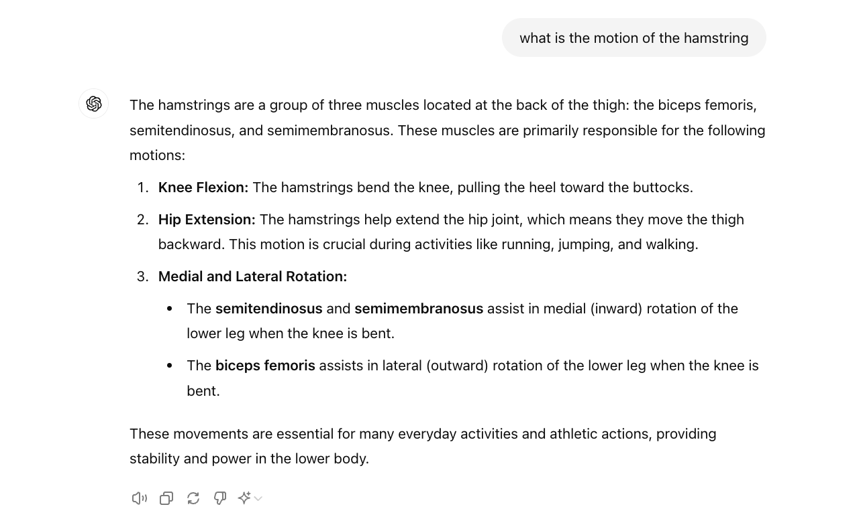
What is the action of the Hamstring?
Notes:
Squats do not target hamstrings well, but you could not develop strength of other muscles without the contribution from the hamstrings - why?

Slide 5
What is the action of the quad?
Notes:
Raise your hand if you can tell me the action of the quadriceps! Student participation here

Slide 6
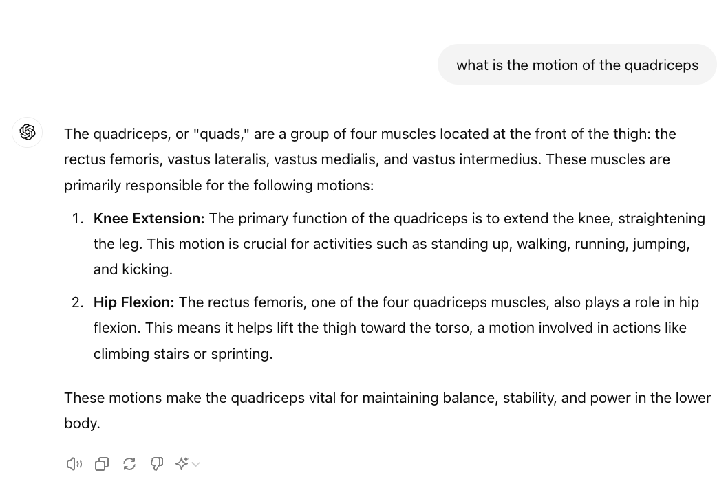

Slide 7
Introduction
Functional LE MSK motion is much more complex than the traditional joint based approach is able to explain
Notes:
We don’t walk around doing hamstring curls all day – what is the true function of the hamstring?

Slide 8
Classic Approach to MSK Anatomy

Slide 9
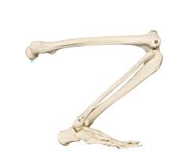
The Joint Based Approach
Musculoskeletal anatomy commonly taught in a joint based approach. A few key terms
  Bones = Segments
  Joints = Axis of Rotation and connect segments
  Muscles = Produce force and create torque
Function of a muscle is described in terms of the joint motion that occurs when a muscle contracts in isolation
  E.g. the quadriceps extend the knee joint
Bones = Segments
Muscle = Force
Joint = Hinges
Replica Human Complete Leg [Product page]. Skulls Unlimited International, Inc.
Notes:
Let’s review a simple approach to muscle function. The classic joint based approach

Slide 10
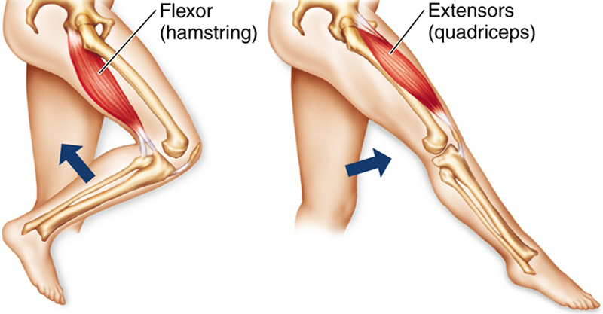
The Joint Based Approach
Commonly describes muscles function as it relates to movement at one joint
Categorizes muscles as agonist, synergists, and/or antagonist
Emphasizes open chain, isolated muscle action
Does discuss synergistic muscle actions and co-contraction, but not in depth
Personal Injury Doctor Group. (2017, August 9). Hamstring function & mechanism of injury | Sports Specialist.
Notes:
The most common way musculoskeletal anatomy is taught to is from a joint perspective.
How we are traditionally taught muscle actions: A certain muscle (the agonist) generates force on a bone which in turn creates motion at a joint. The antagonist muscle on the other side of the bone is inhibited to allow this motion to occur. This perspective is joint focused and explains how muscles generally create motion in an open kinetic chain environment. This simplistic view does not explain what is happening in the lower extremities when it functions against closed kinetic chain forces or when muscles impact motion on bones they do not have direct attachment on.
Synergist - wrist extensors are a synergist to the finger flexors - synergists can potentiate the effect of the prime movers - often use as a fixating or stabilizing force for the prime mover to work more effectively
Antagonist - further definition - antagonist either relaxes or cooperates with agonist - preventing unwanted effect and actually acting as a synergist

Slide 11
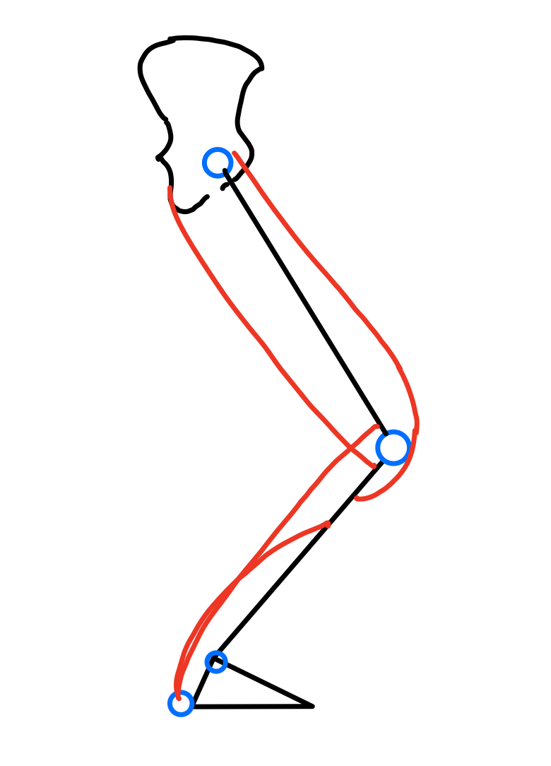
Lombard's Paradox: Complexity of LE Motion
1907 Lombard and Abbott described the co-contraction of the quadriceps and hamstrings when rising from a squat position
Hamstrings, quadriceps, and glutes all contribute to this motion
The muscles have contradicting actions, so how are we achieving this motion?
What is the true role of the muscles involved?
Notes:
In 1907 Lombard and abbott first published a paper that described the co contraction of the Quadriceps and hamstrings when rising from a squat position. This paradox went against the agonist/antagonist relationship of simply taught open chain isolated muscle action. So, for over 100 years we have realized that understanding functional lower extremity anatomy is not easy and even today is equivocal with regards to certain motions. In this class we will focus on functional musculoskeletal anatomy especially of the lower extremity. Understanding functional motion of the lower extremities requires an understanding of a segmental motion.

Slide 12
What is the Joint Based Approach lacking?
Lombard's paradox shows that we did not understand or consider all forces acting on the LE when standing up
Fails to fully describe the complex function of multiarticular muscles (muscles spanning more than one joint)
Does not fully explain the role of muscle action during functional movements

Slide 13
Biomechanics Review

Slide 14
Recall Classic Joint Based Approach
Bones = Segments
Joints = Axis of Rotation and connect segments
Muscles = Produce force and create torque
Bones = Segments
Muscle = Force
Joint = Hinges
Replica Human Complete Leg. Skulls Unlimited International, Inc
Notes:
a simple approach to muscle function. The classic joint based approach
How we are classically taught MSK anatomy

Slide 15
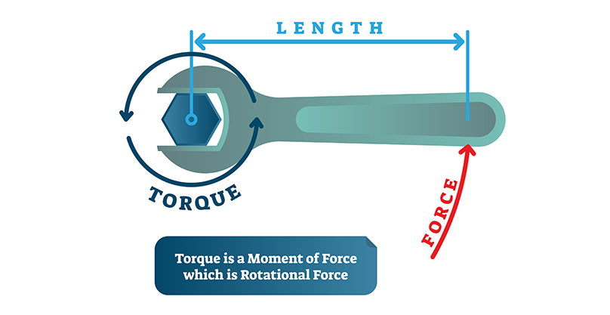
Torque
The force applied to a moment arm which is attached to a fixed axis and thus causes rotation.
Torque = Force (F) x Moment Arm (MA)
  Forces include: internal and external forces
  Moment arm: perpendicular distance from the force to the axis of rotation
Electronic Fasteners, Inc. (n.d.). Torquing loads on fasteners

Slide 16
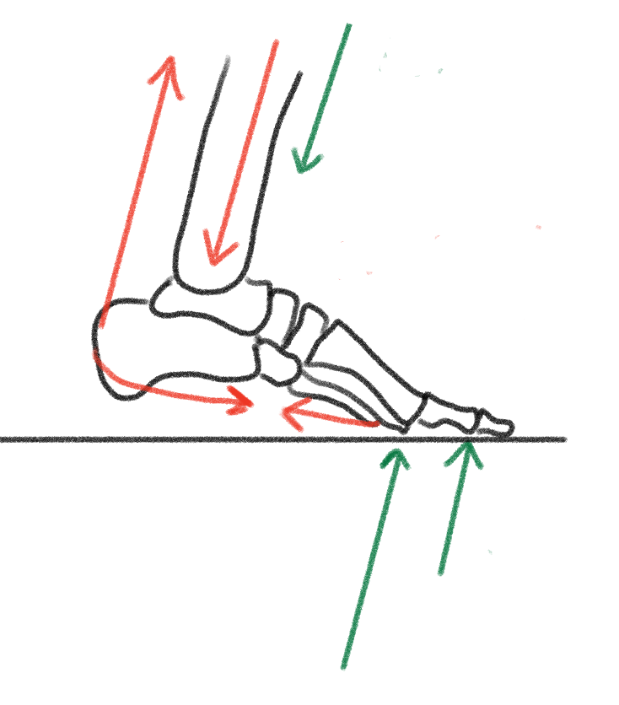
Forces that act on our MSK System: Internal and External
External Forces
Gravity, body weight, external resistance, ground reaction force
Internal Forces
Active
  Muscle/tendon
Passive
  Ligaments and fascia
Joint surface forces
  Tension
  Compression
Notes:
It is important to know the types of joints in the body because they dictate the direction of motion of the segment.
Force (mass x acceleration – typically gravity)

Slide 17
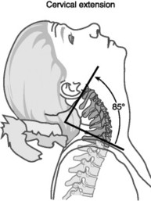
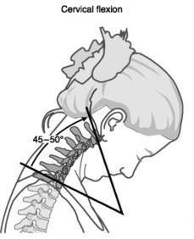
Internal Forces Cont.
Joint surface forces
  Tension/distraction: Pulls joint surfaces apart
  Compression/approximation: Squeezes joint surfaces together.
Is compression occurring anteriorly or posteriorly in the first image? How about the second?
What are those forces’ impact on the joint, bone, and soft tissue structures?
Raffaele Blasi. (2019, November 19). Il rachide cervicale e le patologie dell’era moderna. Exclusive Trainers Academy.
Notes:
Tension/distraction: Pulls joint surfaces apart, increasing space and decreasing pressure between them.
Why is this valuable clinically? In what cases might tension/distraction be indicated?
Compression/approximation: Squeezes joint surfaces together, increasing pressure and reducing space
Why is this valuable clinically? In what cases might compression be indicated?

Slide 18
What do tension and compression afford us?
Tension/Distraction
  Joint space
  Changes in pressure, inviting synovial fluid into the joint
    indicated in the case of OA, spinal nerve root compression, etc.
Compression/Approximation
  Rigid lever - combining segments, creating more efficiency in our movement patterns
  Stabilizing force (remember this for segmental anatomy)

Slide 19
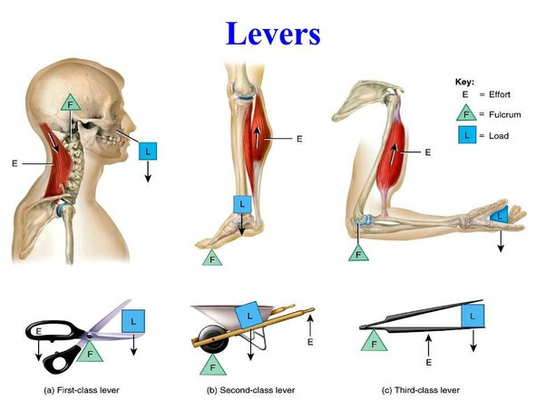
Lever Systems in the Body
Moment arm position to axis of rotation dictates type of leverage & mechanical advantage
First Class
Second Class
Third Class
Lian Sing. (2022, March 2). Simple Machines Olympics. Science Mill.
Notes:
Lever: requires moment arm and axis of rotation
Addition of force at lever arm around axis of rotation is called torque.
Torque is measured by the movement around an AOR when a force is applied to a moment arm. Therefore, in order to produce torque, there must be 3 components: AOR, force, and moment arm. Depending on where each component is relative to one another, defines which type of lever system.
In the human body, most of our muscle lever systems are at a mechanical disadvantage. This is due to the effort (internal) moment arm being shorter than the resistance (external) moment arm. This defines a third class lever. With a few exceptions, the majority of segment rotation in the body happens via third class leverage.
The different types of lever systems are demonstrated in the illustrations above. Second class and first lever – only one of each in the body (and only when stabilizing forces are applied).

Slide 20
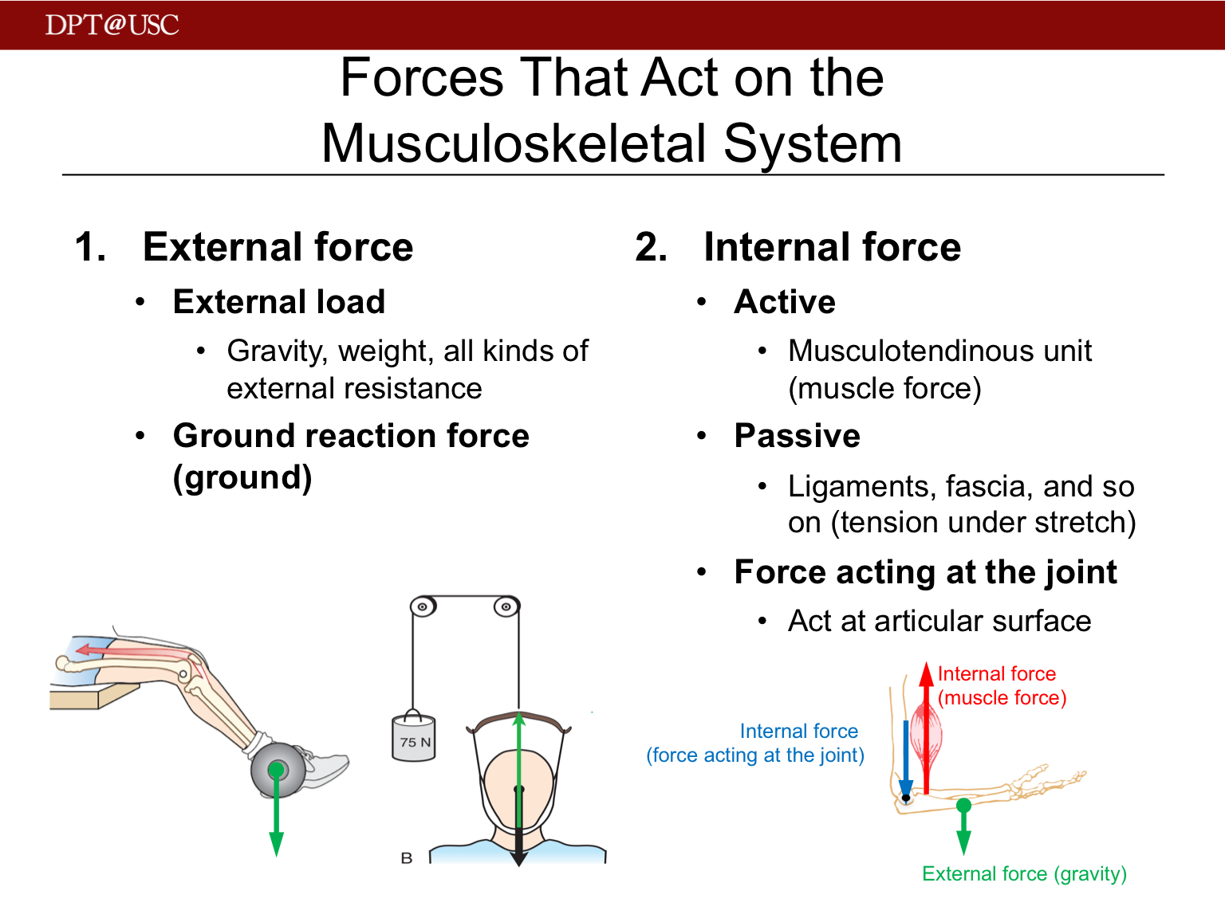
Torque & Muscle Contractions
Isometric contraction
  External MA x external force = internal/effort MA x internal force
  External torque = internal torque
Concentric contraction
  Internal torque > external torque
Eccentric contraction
  External torque > internal torque
  Internal muscle effort is controlling this elongation phase
Notes:
To progress or regress exercise we can manipulate external MA and/or external force; minimal change in internal MA (perpendicular distance from line of pull of muscle to joint axis)

Slide 21
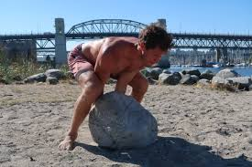
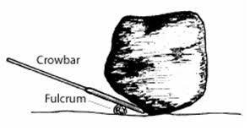
Understanding Mechanical Advantage through changing the Moment Arm / Leverage
First class lever
Adrian Faccioni. (2020, May 5). Eastern European Training Methodologies – How to develop powerful athletes
TeachEngineering. (2021, January 12). Levers That Lift [Lesson]
Notes:
In this example, we can more easily move the heavy boulder by increasing the length of the moment arm in which the force to move the boulder is applied. The first picture, very hard to move the boulder. Assuming all else is equal the longer the moment arm, the great the torque production. As we are evaluating segmental motion, longer moment arms will have a greater impact on movement about the joint.

Slide 22
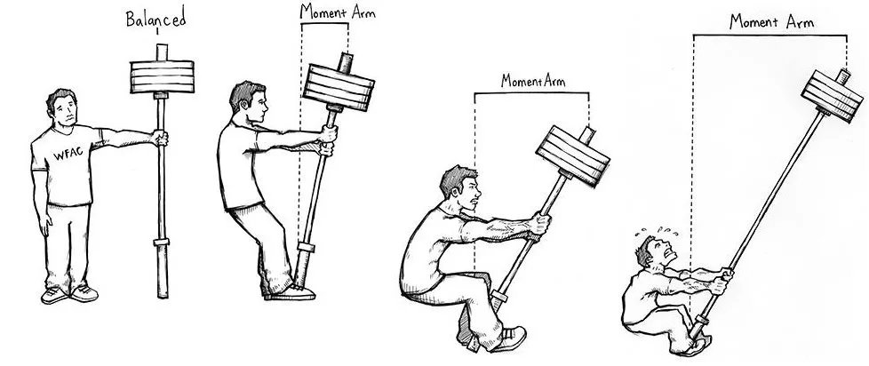
Changing moment arms alters mechanical leverage
The force related to external moment arms exist outside the human body and are therefore, easy to manipulate
PowerliftingToWin. (2014, February 7). Powerlifting technique and leverages
Notes:
Our entire body is comprised of similar mechanisms. Our bones are the levers. The muscle attachment to the bone creates the internal force. The joints are the pivot points or the axis of rotation (AOR). The perpendicular distance from the AOR to the line of force created by muscular contraction is the internal moment arm (IMA). The distance from the external load to the axis of rotation is the external or load moment arm (EMA).
Increasing the external moment arm (EMA) length requires an exponential increase in muscle force production to maintain equilibrium as the IMA is relatively unchanged.
Let’s use the upper extremity as an example. What is harder? Holding a weight close to your body, or further away from your body? It is hard to support the load when it is further from your body because the external moment arm is elongated and therefore, the internal muscle effort to support the weight must increase as the internal moment arm is relatively constant in an isometric contraction.
While you cannot manipulate internal moment arms in the same way you can manipulate external moment arms, they are not constant. As seen in the slide, the internal moment arm of the tibialis anterior decrease as the muscular attachment point gets closer to the axis of rotation.
Image source: https://unbreakablestrengthco.com/2019/03/20/what-the-fk-is-a-moment-arm-and-what-does-it-have-to-do-with-my-training/

Slide 23
Internal moment arms and mechanical leverage
Internal moment arms are relatively fixed and only change slightly based on joint position
  examples of lever systems in the body that are mechanically disadvantageous?
  examples of lever systems in the body that are mechanically advantageous?
Notes:
Disadvantageous - all for the most part because 3rd class levers. But clinically, more concerned with the lack of internal leverage compared to external in SL stance –
*glute med as an example
*what is at more of disadvantage – shorter or longer limb? Why?
*Second class lever – calf
*Patella elongates the IMA of the quads

Slide 24
Segmental Approach to MSK Anatomy

Slide 25
Why do we care?
Understand the true function of the muscles in a closed chain (specifically as it relates to multiarticular muscles)
Provides a complete picture of what is happening in the lower extremity
Consider some of the more complex architecture of the MSK system
Train under principle of specificity for strength and conditioning and injury rehab
Holistic muscle function–how one movement fault leads to another

Slide 26
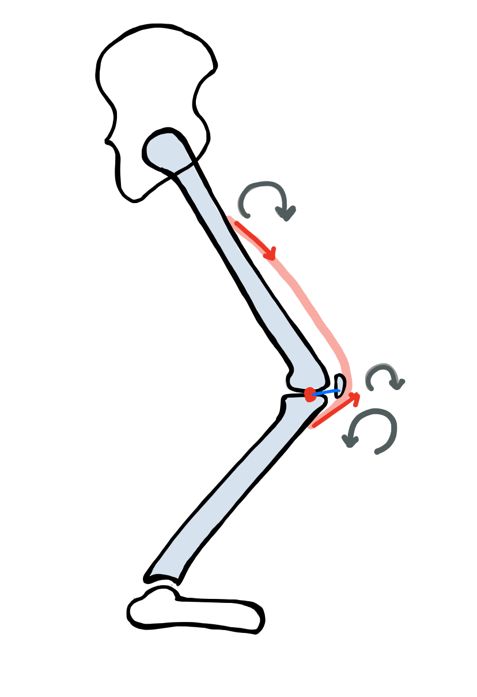
A relatively new approach: Segment Based
Terms are similar with addition of segmental rotation
Segment = Bones
Joint = Axis of Rotation
Muscle = Creates Force (Torque)
Internal Moment arm = Muscle line of pull to the joint axis of rotation via a perpendicular line
Segment Rotation = clockwise/anterior or counterclockwise/posterior
Focus shifts to what the segment is doing at each joint
Notes:
Focusing on the motion of the moment arms ( Bones) is the definition of a segment based approach and is key to understanding functional motion especially in the LE. Joints are the connection of segments (Bones), and oftentimes segments at a joint are not doing the same thing. The complexity of a segmental approach to musculoskeletal function lies in the fact that the proximal segment of a joint may be doing one thing and the distal segment another. It is not as simple as saying that the hamstrings are a hip joint extensor. How do they extend the hip if there main attachments are to the lower leg bones?
First introduced in the literature in 1993. What Is a Joint Torque for Joints Spanned by Multiarticular Muscles?. J Appl Biomech. 1993;9(4):333-336. doi:10.1123/jab.9.4.333

Slide 27
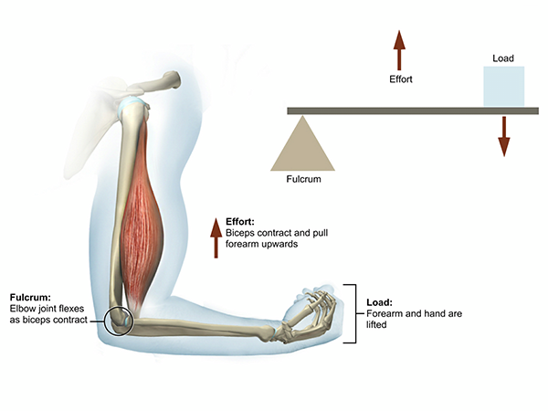
Review: Torque (rotational force)
Forces applied to moment arms in the body can be internal (effort) or external (resistance)
  Examples of external forces: bodyweight, added load, gravity, GRF
  Examples of internal forces: muscles (active), ligaments/fascia (passive), and joint reaction forces
Moment arms are defined by the forces’ (internal and external) perpendicular distance to the joint axis
Desiree Parent. (2020, July 29). Biomechanics: Lever systems in the body
Notes:
Forces applied to moment arms in the body can be internal (effort MA) or external (resistance MA)
External forces - bodyweight / or added load, gravity and ground reaction are examples of external forces.
Internal forces - muscles (active), ligaments/fascia (passive), and joint reaction forces are examples of internal forces.

Slide 28
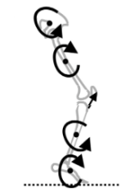
How do muscles impact segments they have no direct attachment on?
Through Joint Contact Forces (JCF)
Generally, the torque applied to one segment is transferred to an attached segment through JCFs
JCFs tend to be equal to the segmental torque created by the moment arms
JCFs are like the gears between segments and therefore, indirectly create motion on other segments
Daniel J. Cleather, Dominic F. L. Southgate, & Anthony M. J. Bull. (2015). The role of the biarticular hamstrings and gastrocnemius muscles in closed chain lower limb extension. Journal of Theoretical Biology, 365, 217–225
Notes:
Generally the torque applied to one segment is transferred to an attached segment ( via a joint) by joint contact forces.
Joint contact forces tend to be equal to the segmental torque created by the moment arms.
Joint contact forces are like the gears between segments and create motion as well

Slide 29
Segmental Motion Through Joint Contact Forces
Energy and force produced by a muscle is passed through the kinetic chain via joints
If one segment moves clockwise (anterior), force is passed through the joint, and the connected segment moves counterclockwise (posterior)
Joint structure dictates the plane of motion
Daniel J. Cleather, Dominic F. L. Southgate, & Anthony M. J. Bull.(2015). The role of the biarticular hamstrings and gastrocnemiusmuscles in closed chain lower limb extension. Journal of TheoreticalBiology, 365, 217–225
Notes:
In this graphic, we can see that the torque applied to the pelvis by the contraction of the proximal hamstrings pulling on the ischial tuberosity, creates a counterclockwise rotation and through joint contact forces, a clockwise rotation at the proximal femur.
In this example, the gastroc is also contracting and causes a clockwise rotation at the foot segment, and through joint reaction forces, the distal tibia rotates counterclockwise.

Slide 30
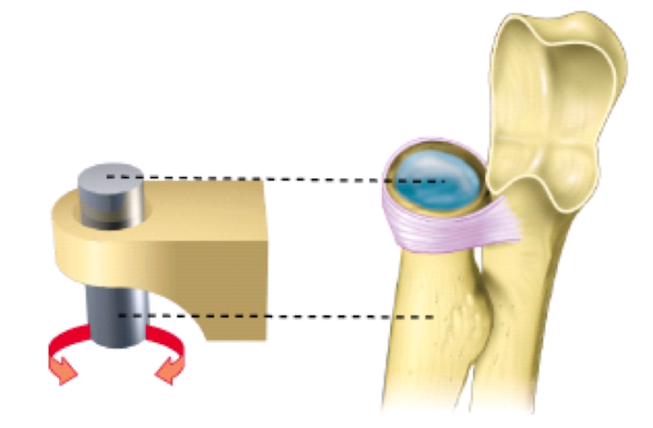
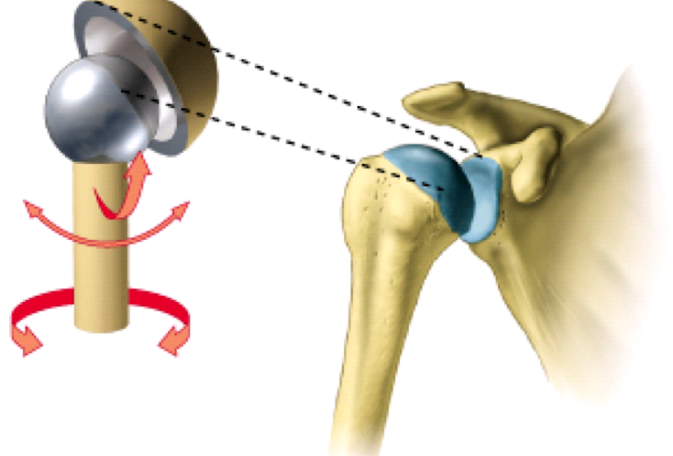
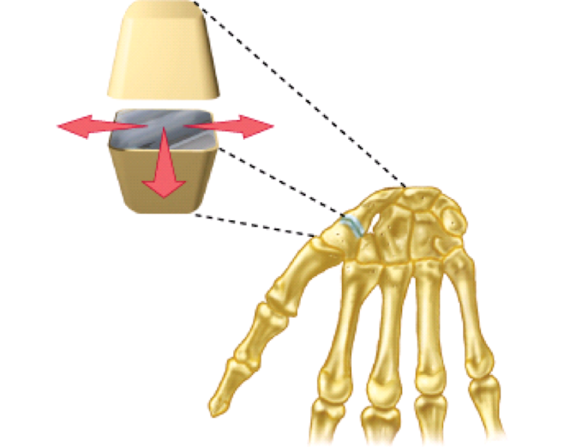
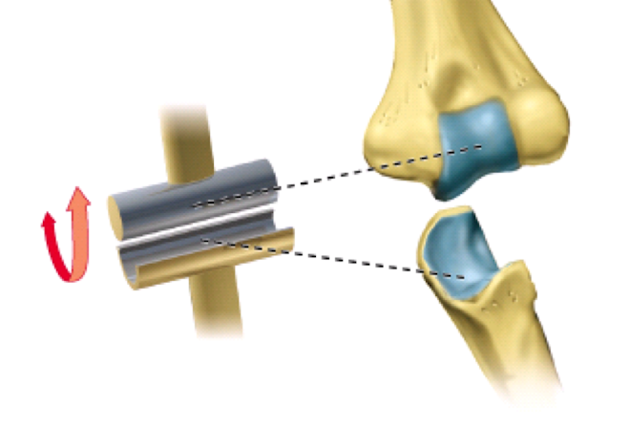
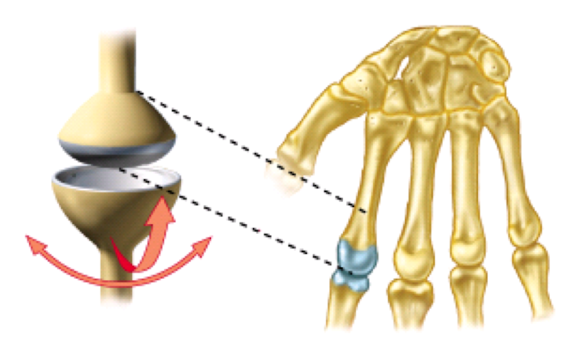
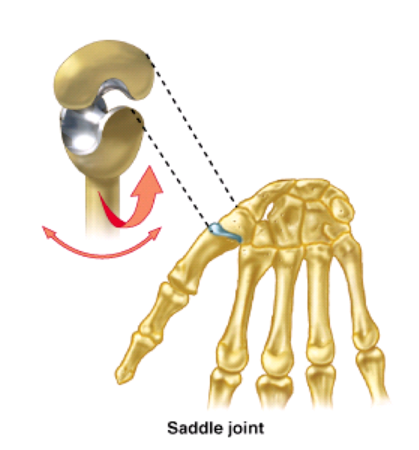
Joint Types (Diarthrodial)
Plane
Pivot
Ball and Socket
Saddle
Hinge
Ellipsoid / Condyloid
RNDr. Michaela Račanská, Ph.D. (2017). Lecture 7 – General arthrology [PDF lecture]. Department of Dentistry, Masaryk University
Notes:
There are 6 types of diarthrodial joints, they determine the motion of a segment
Hinge: Allows motion in one direction. Flexion and extension in the sagittal plane
Pivot: Allows motion in one direction. Rotation along the long axis of a bone. Radius on the ulna.
Ball and socket: Allows motion in all planes. The hip and the shoulder.
Ellipsoid: Similar to ball and socket but one joint surface is oval instead of round. Does not allow rotation due to structure and ligaments.
Saddle Joint: Concave convex articulations in frontal and sagittal plane.
Plane Joint: Allows some gliding/translation and rotation between bone surfaces. Held together by ligaments.
The motion of a segment, produced by the counter force, is determined by the type of joint connecting the segments.

Slide 31
Segmental Based Approach
The function of muscles that span multiple joints is more complex than classically taught
With a biarticular/multiarticular muscle contraction, the magnitude of force created at each joint is the same.
Recall → torque = force X moment arm
  If force is the same across multiple joints, at what joint will rotational motion occur?
Internal moment arm dictates motion!

Slide 32
So now, what is the action of the hamstring? How about the quad?
…
Let’s discuss!

Slide 33
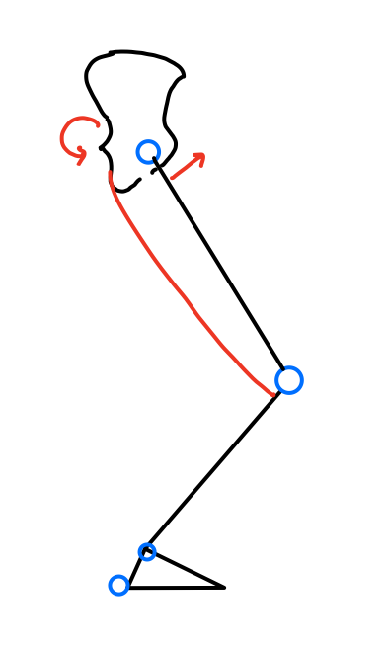
Moment arm dictates motion in multiarticular muscles!
The hamstrings span the hip joint and knee joint with primary attachments to the tibia and the pelvis (note: not the femur)
Does the hamstring have a greater internal moment arm at the hip or knee joint?
Consider: When contracted, the magnitude of force exerted by the hamstring is the same at both joints
Where is there stabilization occurring and where is there motion occurring?
Hip IMA
Knee IMA
Notes:
Multiarticular muscles are exactly what they sound like – muscles that span more than one joint. When describing the function of these muscles, it can get fairly complicated. The alteration of muscle length-tension relationship and internal moment arms depending on body position, varying joint angles, and co-contraction of other muscles in functional movement, makes it very difficult to simplify the functional role of any given muscle.
Since multiarticular muscles cross multiple joints and impart the same force at each joint it crosses when activated, its greatest impact will occur at the joint in which its internal moment arm is the greatest.
For this example, evaluate the internal moment arm at each joint the hamstring muscle crosses: the knee and the hip.
The joint with the larger internal moment arm will dictate the motion of the segment. (The muscle contraction will have the greatest impact on joint reaction forces). Therefore, we can conclude that in this position, the hamstring will have a more powerful influence at the hip joint compared to the knee joint. And the hamstrings would therefore have more of a stabilizing effect at about the knee joint.

Slide 34
Segment Based Approach
How can we best explain the way the hamstrings facilitate knee extension with sit to stand motion?
Distal hamstrings create a counter joint stabilizing force to the quads which are acting to pull the tibia anteriorly.
Proximal hamstring is posteriorly rotating the pelvis and through joint reaction forces, causing anterior rotation (extension) at the proximal femur
Notes:
How do the Hamstrings contribute to knee extension? They are rotating the proximal femur forward and creating a stable axis at the knee for the powerful quadriceps

Slide 35
Functional Motion Characteristics
Closed chain motion.
Co-contractions and synergistic muscle activity (e.g. quads and hamstrings fire at once in sit-to-stand)
Co-contractions offer a stabilization force and movement force
  Again, dictated by internal moment arm!

Slide 36
Why do we have Multiarticular Muscles?
Effective at controlling segmental motion and impacts timing of joint movement necessary for functional tasks (as opposed to all or nothing with monoarticular muscle contraction)
Provide a co-contraction force that stabilizes the joint axis of motion
Maintain optimal length-tension relationship during motion

Slide 37

Stabilizing Force vs Counter Force
Person pushing door = Moving Force
Door hinge = Stabilizing Force
In functional movement, both forces will occur simultaneously.
The stabilizing muscles will have an internal moment arm that is less than the counter muscle group.
Notes:
We need the stabilizing force? Think about a door. Without the brackets stabilizing the door to the hinge, when force was applied to the door, the entire door would be displaced.

Slide 38
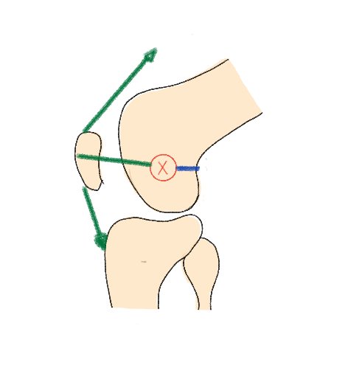
At the knee during sit-to-stand…
Quad = Moving Force
Hamstring = Stabilizing Force
Notes:
Assess IMA – which muscle group has mechanical advantage? Hamstrings create the stability/compression (the hinge) to allow quads to create rotational force at the knee joint!
This works sit<>stand because the patella will always allow quads a mechanical advantage at the knee by increasing IMA

Slide 39
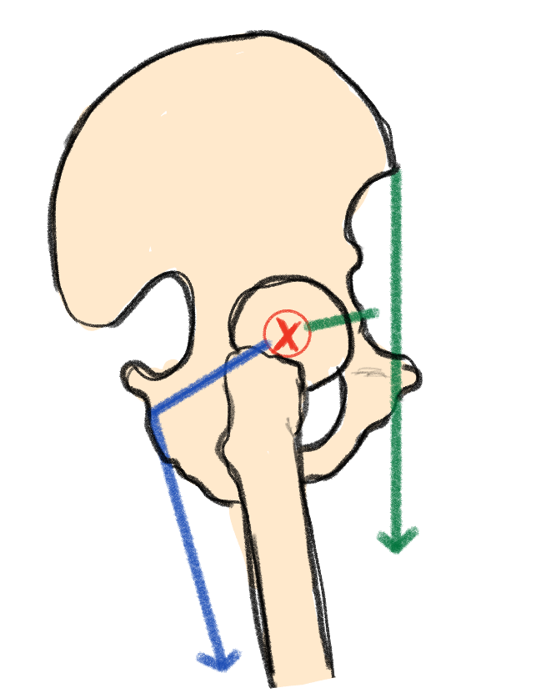
At the hip during sit-to-stand…
Hamstring = Moving Force
Quad = Stabilizing Force
Notes:
Conversely, look at the IMA of the hamstrings versus the rectus femoris at the pelvis. Which muscle group has the mechanical advantage? The shorter IMA of the quads creates the role of stability at the femoroacetabular (hip) joint, approximating joint surfaces. The longer IMA of the hamstrings allows hip extension action, even though there is not a direct connection to the proximal femur

Slide 40
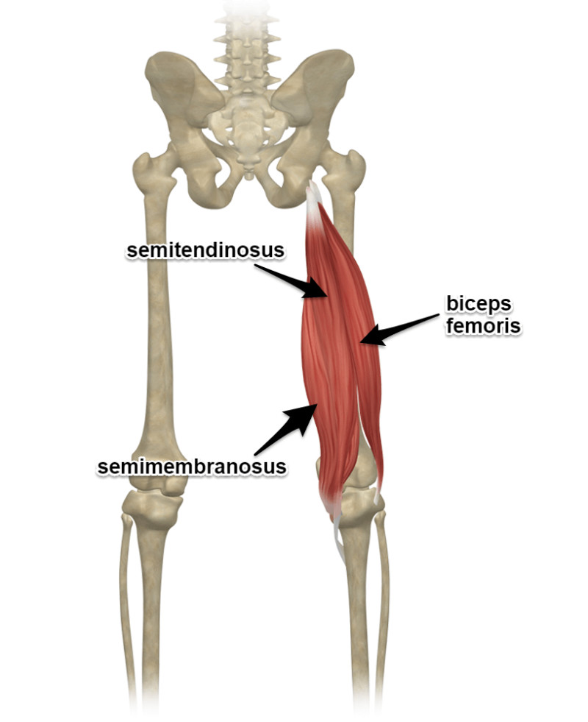
Comparison: Joint Based vs Segmental Approach
Joint based approach of the hamstring:
  Extends the hip joint
  Flexes the knee joint
  Function at the pelvis?
Segment based approach of hamstring:
  Pelvis pulled into posterior rotation JCF cause proximal femur to rotate in the opposite direction (clockwise/anterior)
  Proximal tibia pulled clockwise to stabilize the quads more powerful counter clockwise rotation of the tibia
  We get information about the pelvis and the segment that the hamstring has limited attachment on, the Femur.
YogaAnatomy. (2014, September 21). The hamstrings: Attachments & actions
Notes:
We are not saying the joint based approach is inaccurate–it does adequately describe isolated muscle action in an open chain. This approach, however, fails to consider how humans actually function in everyday life. Functional movement is not comprised of single joint, isolated muscle actions – it is compound, multisegmental, and complex movement patterns.
The hip joint is comprised of the pelvis and the femur, but the bulk of the hamstrings do not attach directly onto the femur. How then, does it cause femoral motion in the direction of hip extension? The segmental based approach helps to explain this phenomenon. As the hamstring shortens, proximally it pulls the pelvis into counterclockwise rotation. Through joint reaction forces, the proximal femur which articulates directly onto the pelvis, rotates clockwise.
The knee joint is comprised of the femur and tibia, but again, the hamstrings do not have a strong direct attachment at the femur. As the distal hamstring contracts, the proximal tibia is pulled clockwise, and through joint reaction forces, the distal femur rotates counterclockwise.

Slide 41
Why do we care?
Understand the true function of the muscles in a closed chain (specifically as it relates to biarticular muscles)
Provides a complete picture of what is happening in the lower extremity
Consider some of the more complex architecture of the MSK system
Train under principle of specificity for strength and conditioning and injury rehab
Holistic muscle function–how one movement fault leads to another

Slide 42
Why do we care?
Understanding the complex function of muscles during human motion provides avenues of optimal care
  Specificity
  Minimize injury during exercise
  Exercise selection for pre/rehab
  Evenly distributed joint loading
  Optimal length-tension muscle relationship

